Slide 1
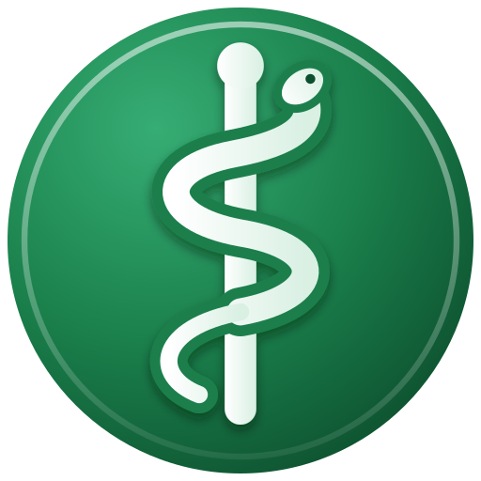
Medicus
A secure workstation for healthcare staff – from start-up to shutdown
Notes:
Medicus is a Linux-based operating system for Norwegian healthcare. Every picture in this presentation is a screenshot of the system as it runs, with synthetic test patients and simulated health-worker ID cards. The system itself is in Norwegian.

Slide 2




What is Medicus
Card login
Ready for the health network
Hardened security
Follows the workplace
Health-worker ID card and PIN. No passwords. Emergency access when lives are at stake.
One interface to Helsenorge, the Summary Care Record and e-prescriptions – today against a simulator.
Firewall, USB lock, virus scanning, VPN, and no running programs from the home folder.
The PC knows which hospital it is in. Your position comes with it.
Linux-based, only for machines owned by health trusts, municipalities and the public sector. Its own design, nothing copied from Windows.

Slide 3
Start-up
01
From pressing the power button to the login screen

Slide 4
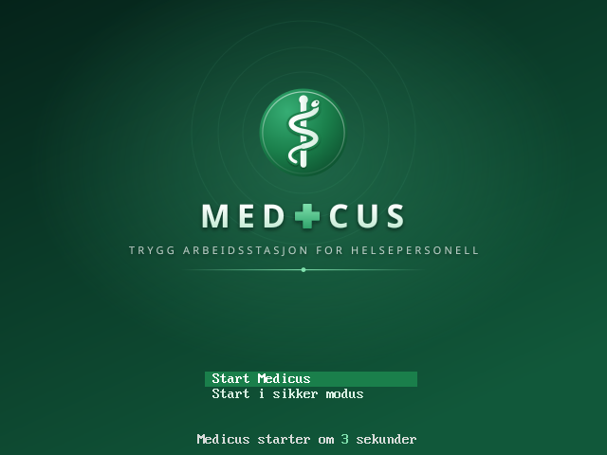
The boot menu
Starts by itself after 5 seconds.
Safe mode for troubleshooting.
Locked: nobody can change the start-up command. That closes a common way around the login.

Slide 5
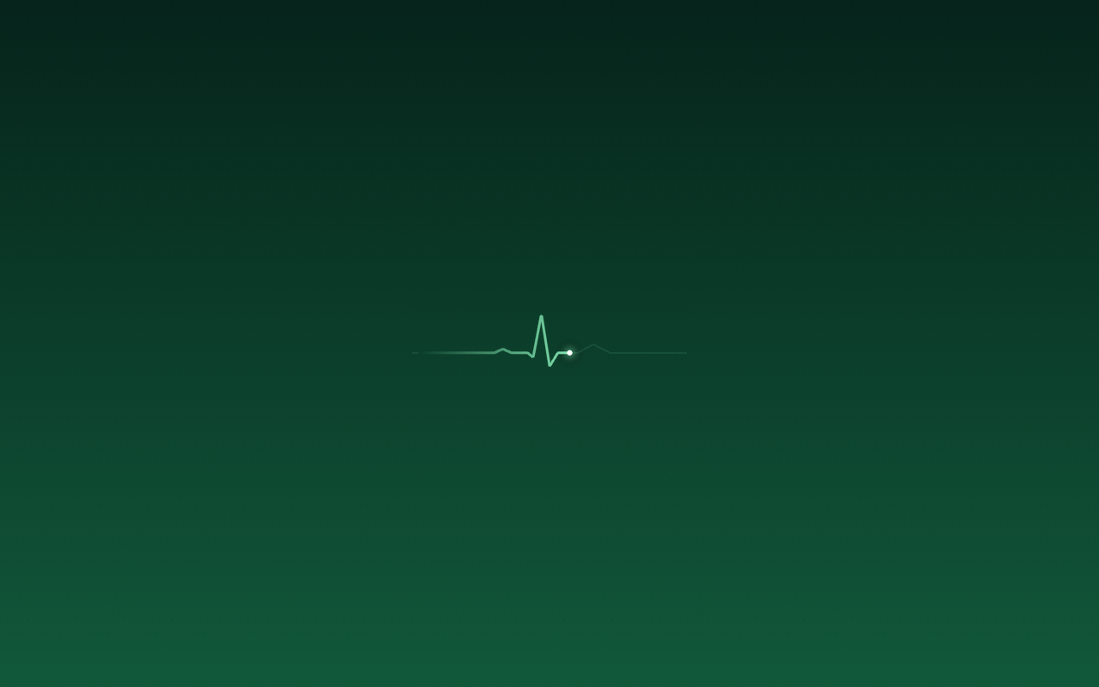
The heartbeat shows something is happening
One loading animation: an ECG line with a pulse.
The same everywhere: at start-up, at login and in the apps.
No text: the pulse alone says the machine is working.

Slide 6
Login
02
Health-worker ID card and PIN – or emergency access

Slide 7
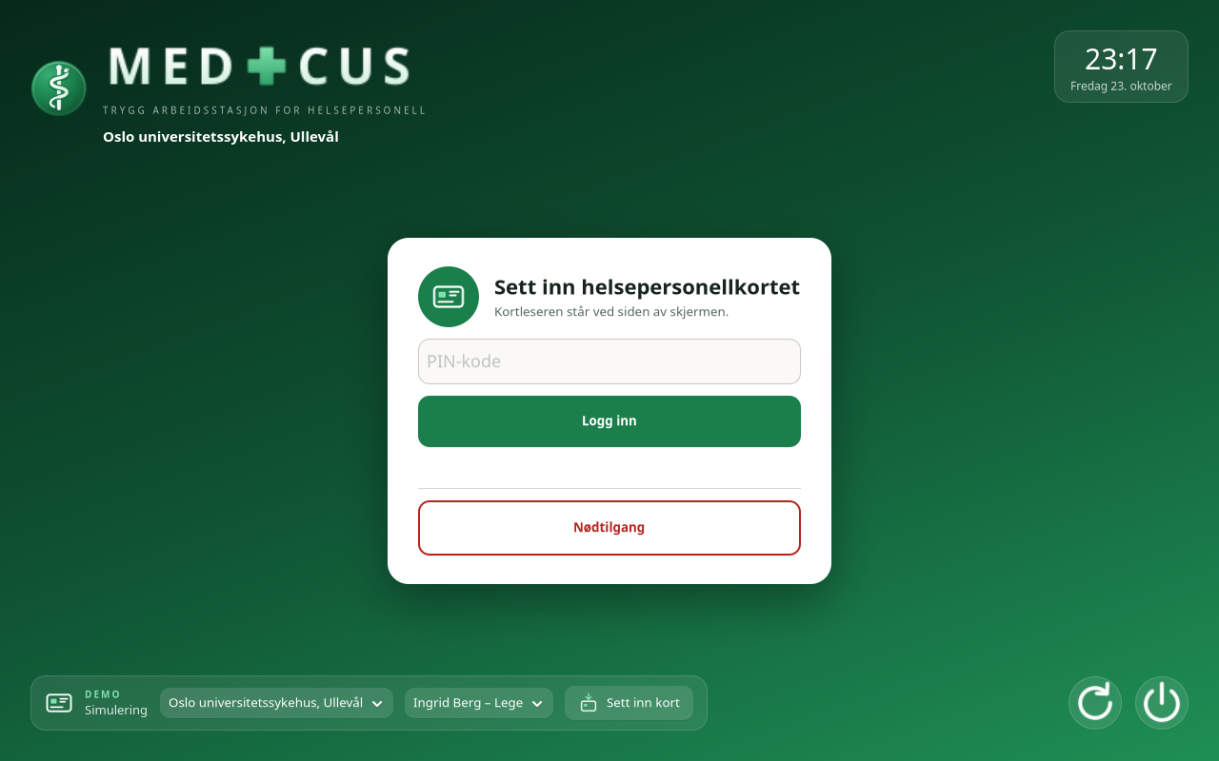
The login screen
Insert the card, type the PIN.
Three wrong PINs block the card – the screen clearly says IT must unlock it.
The workplace under the logo is the PC's fixed location.
The demo panel at the bottom simulates the card reader and the workplace.

Slide 8
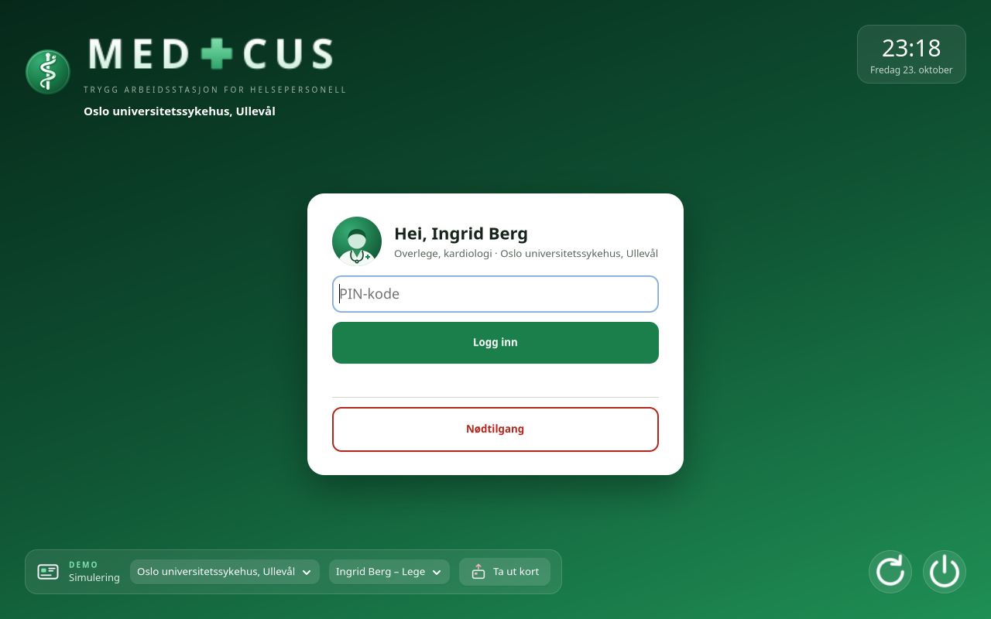
The card is inserted
Name, position and workplace are shown at once.
One button to insert and remove the card.
Remove the card: you are logged out at once.

Slide 9
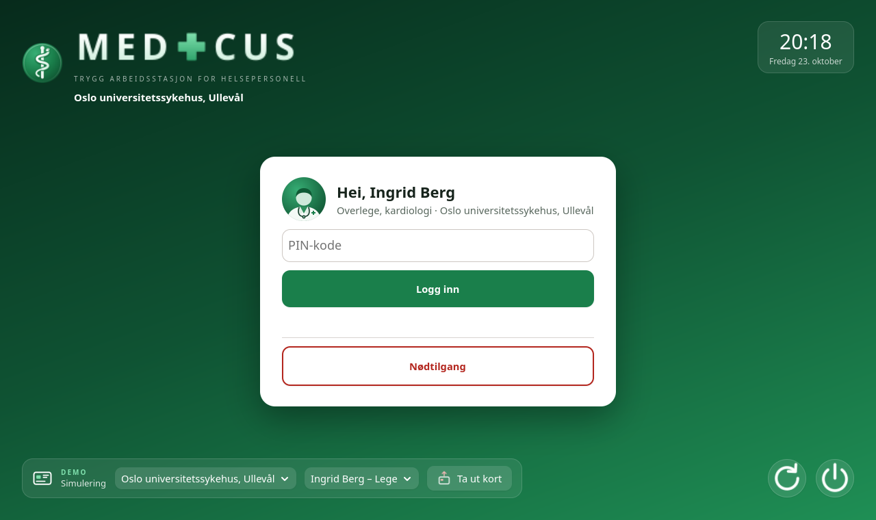
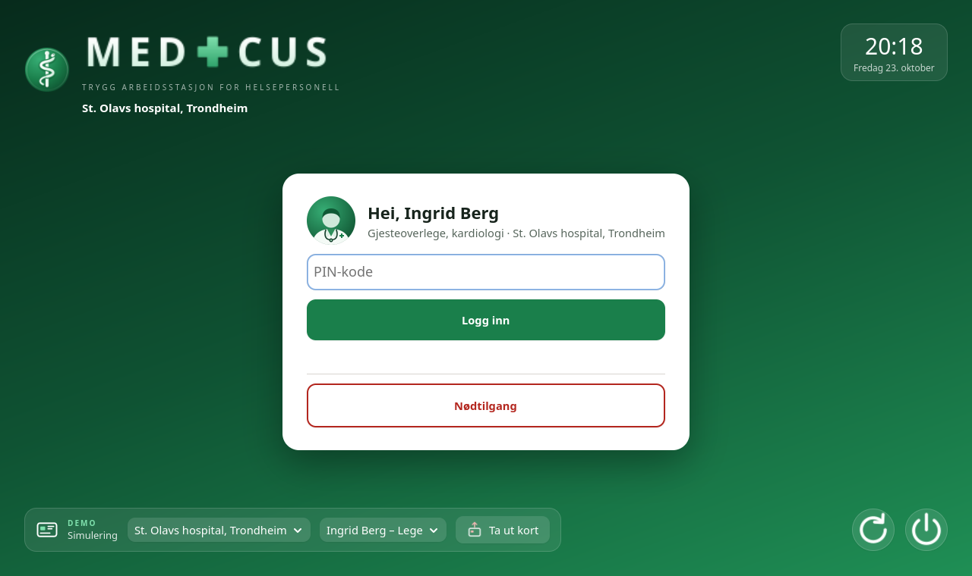
The workplace follows the PC
Ullevål: Senior consultant, cardiology
St. Olavs: Visiting consultant, cardiology
The card says who you are. The PC says where you are. Your position is taken from that workplace.

Slide 10
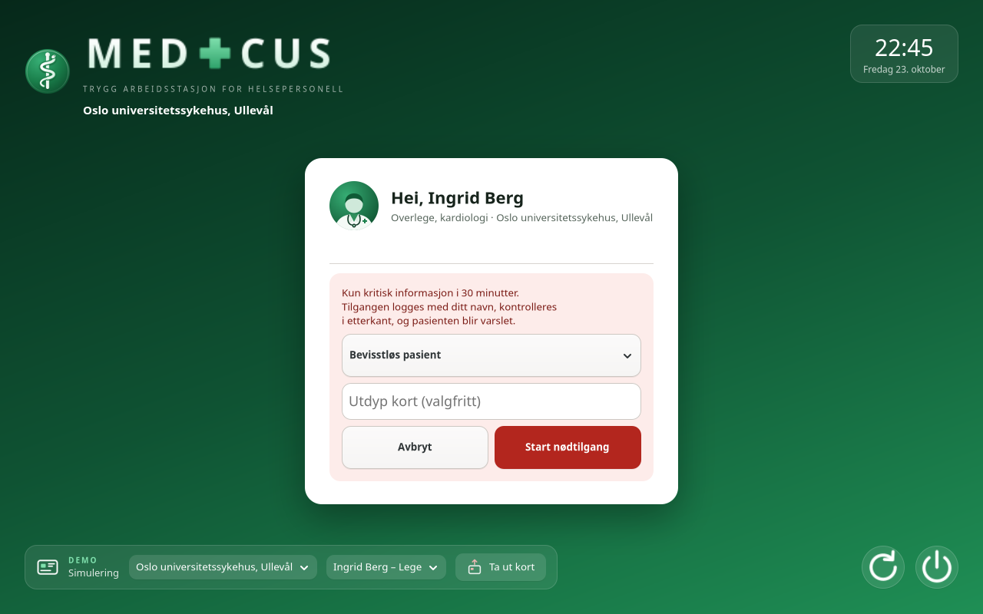
Emergency access
Card + reason, no PIN – to save time.
Only critical information for 30 minutes.
Logged by name, reviewed afterwards, and the patient is notified.

Slide 11
The desktop
03
Start menu, shortcuts and standard programs

Slide 12
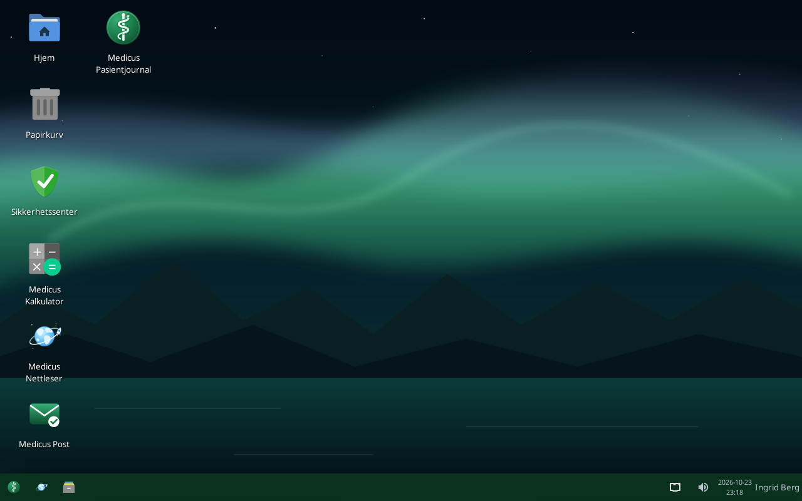
The desktop
Own wallpapers: Northern Lights, Fjord, Forest and Mountains.
Shortcuts to the Medicus apps, Home and Trash.
The taskbar: Start button, shortcuts to the browser and Files, open windows, network, sound, clock and name.

Slide 13
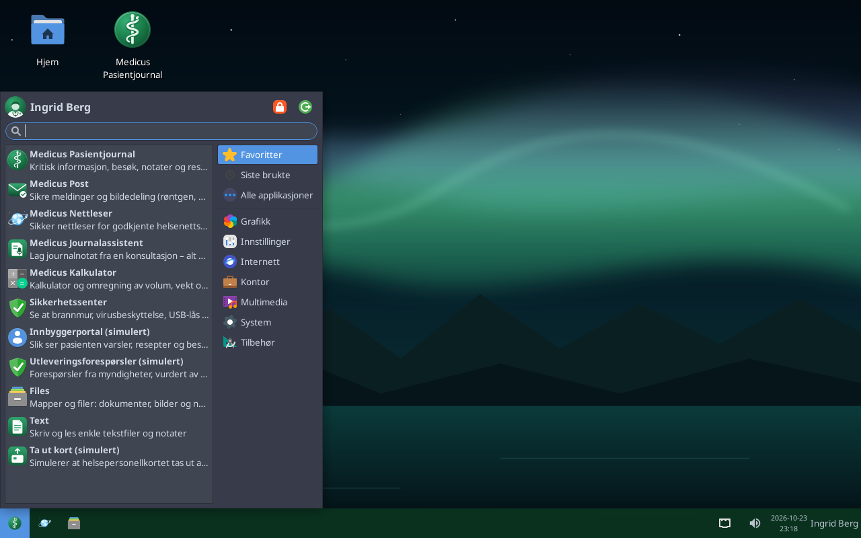
The Start menu
Favourites: all the Medicus apps first.
Profile picture: a neutral health-worker figure.
No terminal and no "run command".

Slide 14
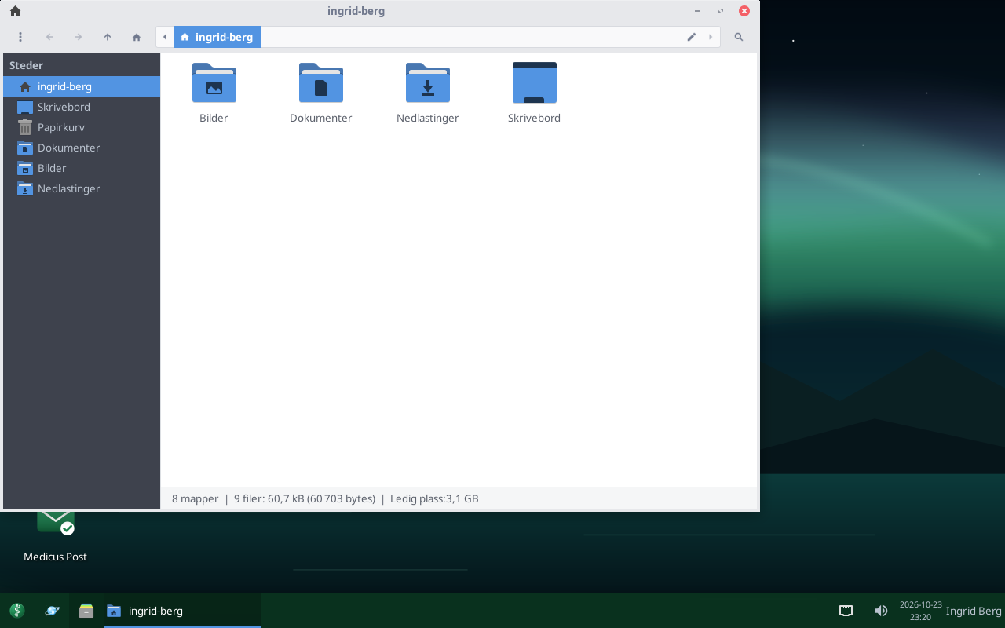
Files – the file manager
A tidy sidebar: Home, Desktop, Documents, Pictures, Downloads and Trash.
Large icons, folders first, no menu bar.
One click from the shortcut on the taskbar.
Plain names: Files, Pictures, Text and Mouse. Text is Medicus' own text editor.

Slide 15
Apps and features
04
Patient record, Post, browser, security and tools

Slide 16
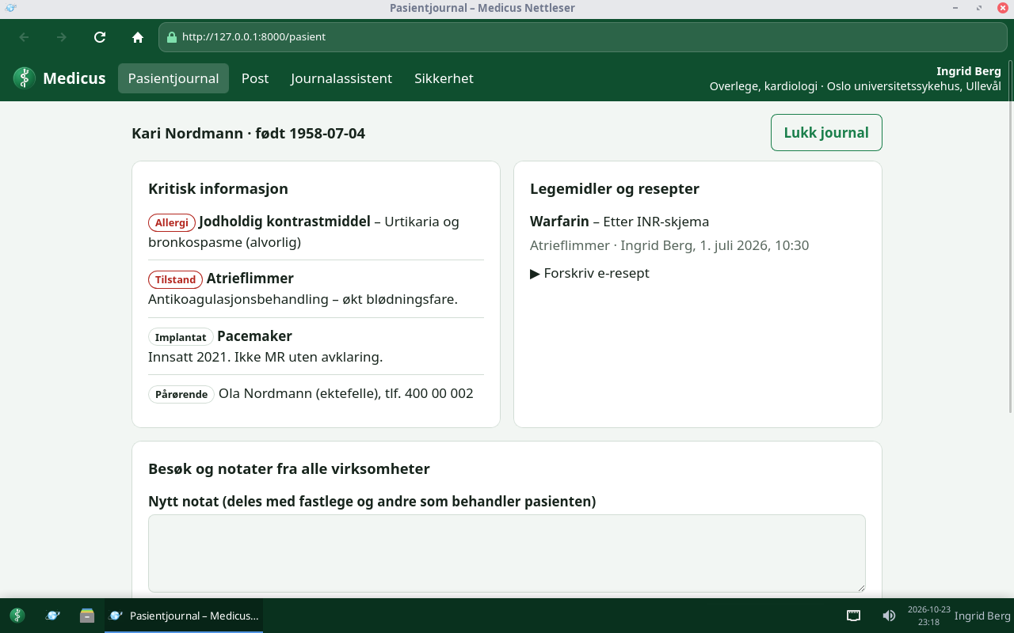
Patient record
Critical information at the top: allergies, conditions, implants.
Visits and notes from every provider in one place.
E-prescriptions for doctors.
Every opening is logged and shown to the patient.

Slide 17
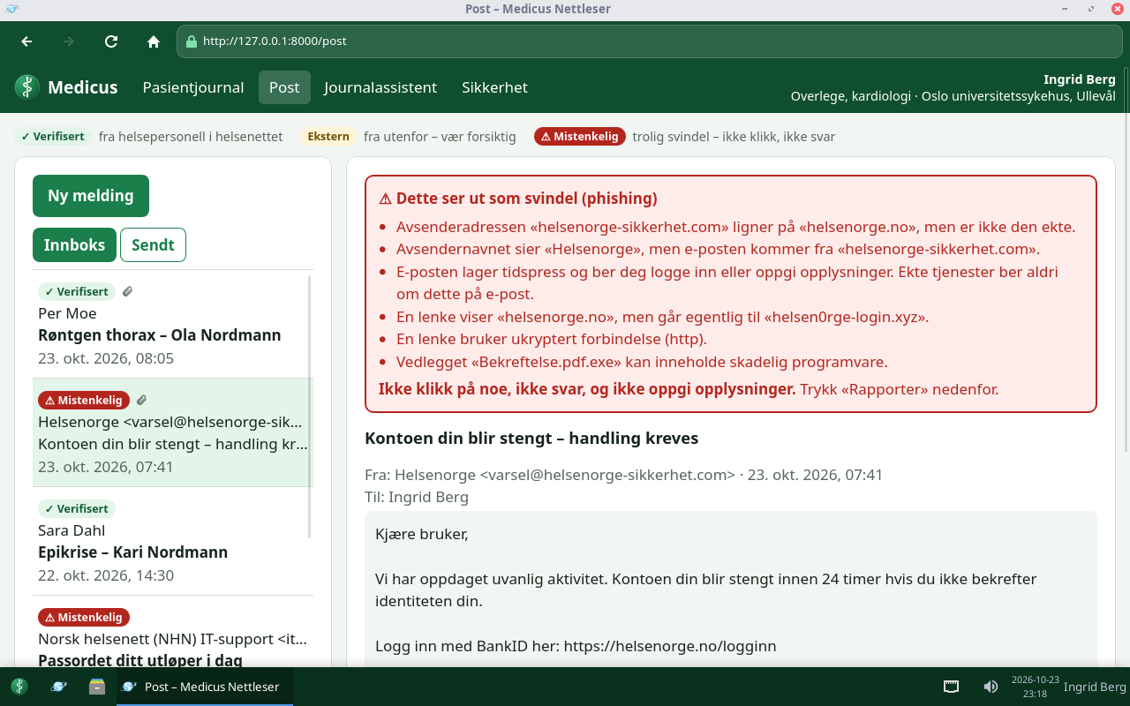
Medicus Post – phishing warning
Green: verified health worker in the health network.
Red: suspicious e-mail, with an explanation in plain language.
Links and attachments from outside are blocked.

Slide 18
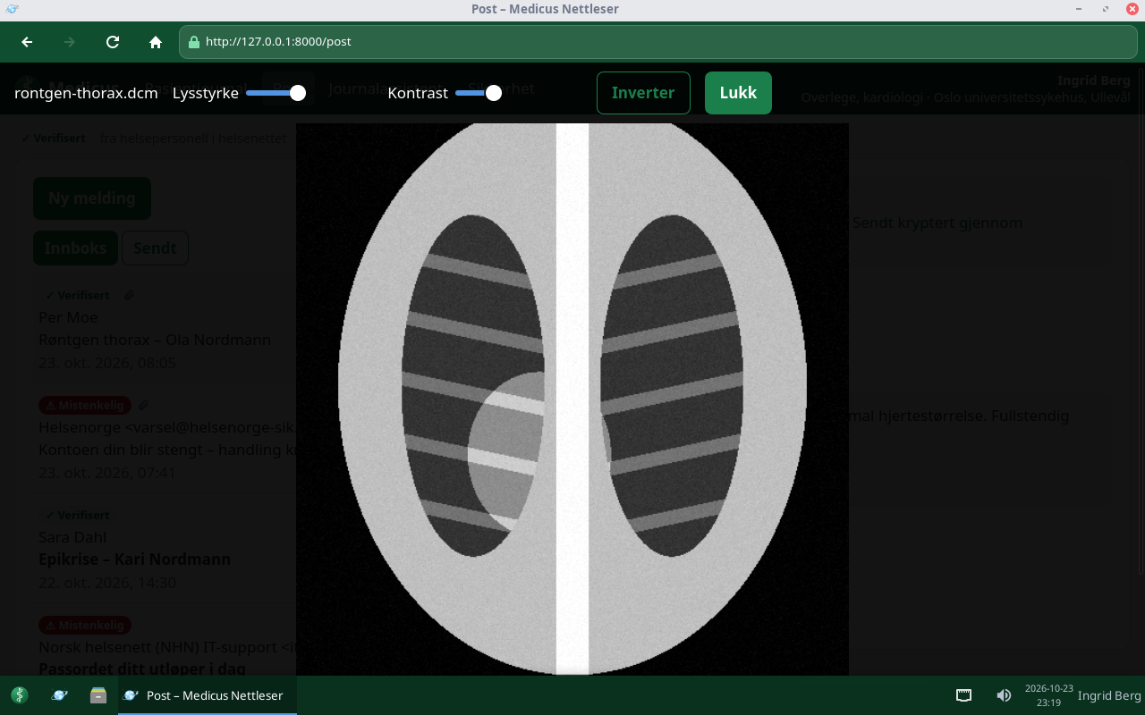
Image sharing: X-ray and MRI
DICOM images are shown right in the message.
Brightness, contrast and invert.
Virus-scanned before they are let in.

Slide 19
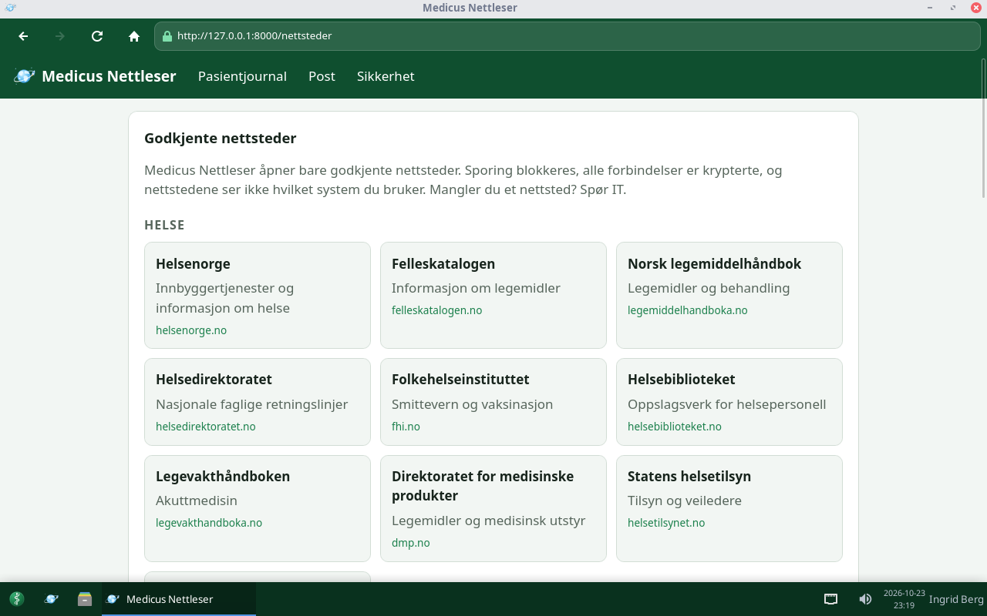
Medicus Nettleser (the browser)
Its own browser with its own icon: a light-blue Earth with a rocket in orbit.
Approved websites only: health, public services and Norwegian news.
No ads or tracking, nothing is stored, no other brands.

Slide 20
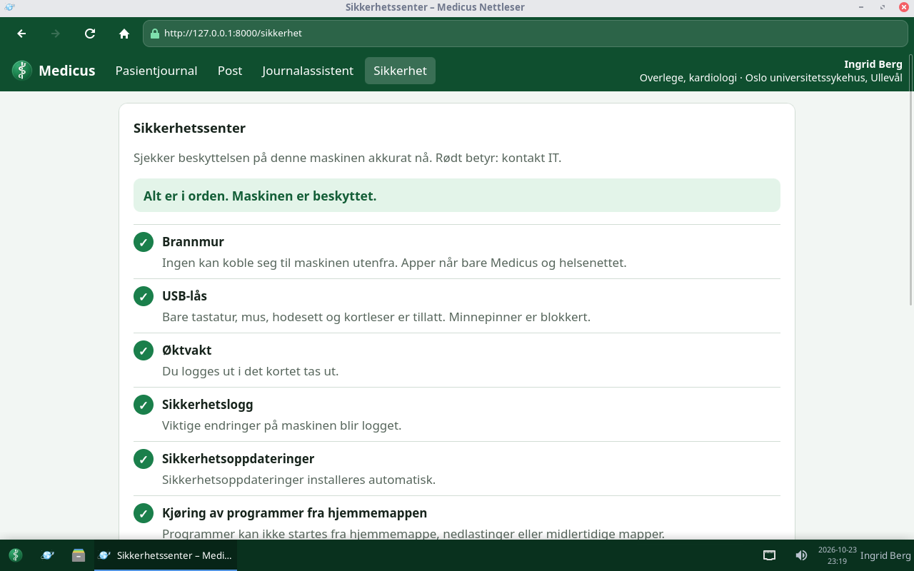
Security Center
Checks live that the protection works.
Green: all is well. Red: contact IT.
Firewall, USB, virus, security log, updates, VPN.

Slide 21
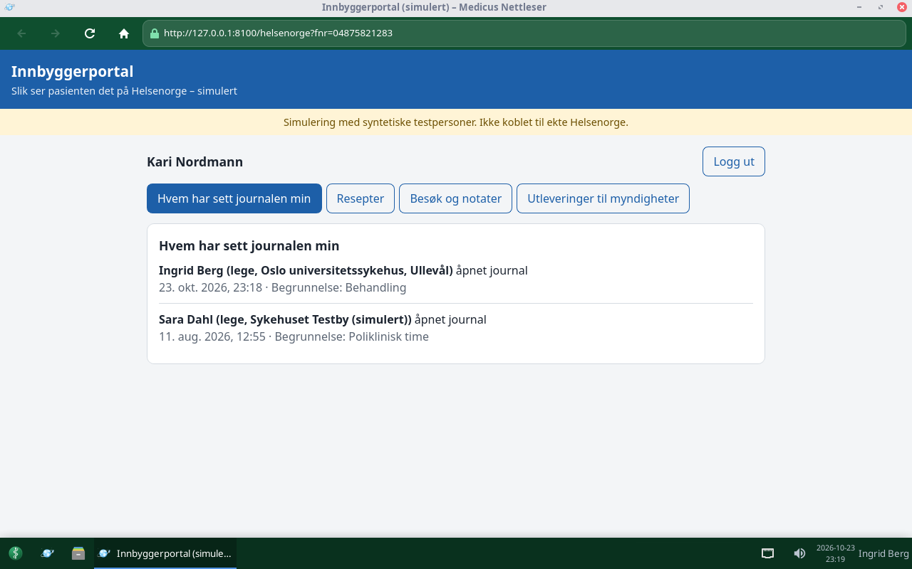
Patients see who has opened their record
The citizen portal (simulated Helsenorge).
Name, role, place and reason for every opening.
Emergency access is clearly marked.

Slide 22
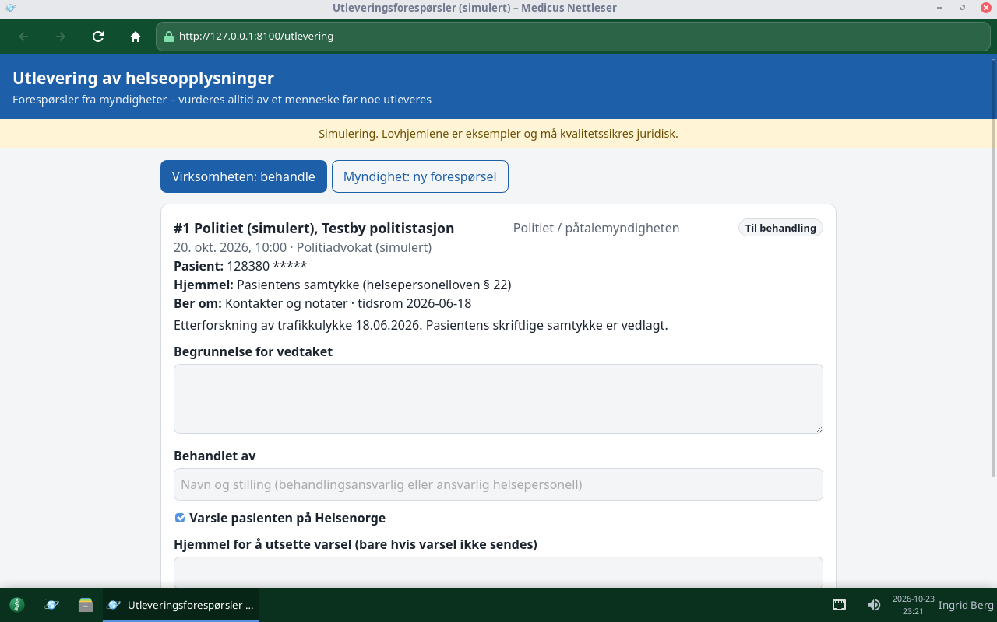
Requests from authorities
Only with a legal basis that applies to that exact authority.
Police, child welfare, NAV, supervisory bodies: each has its own legal bases. Others need consent.
A person decides, as little as possible is disclosed, and the patient is notified.

Slide 23
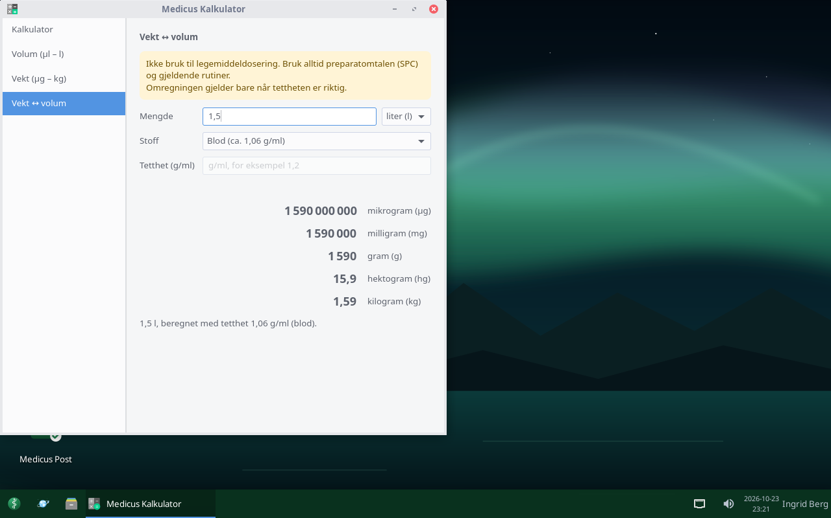
Medicus Calculator
Calculator with decimal comma.
All units: µg–kg, µl–litre, teaspoon and tablespoon.
Weight ↔ volume: e.g. litres → kg, with densities for blood, saline and more.
Warning: not for medicine dosing.

Slide 24
Security
05
Layer upon layer – no single fault opens everything

Slide 25








Protection in layers
Firewall
USB lock
Virus scanning
VPN with kill switch
Nobody can connect from outside. Apps reach only the health network.
Memory sticks blocked. Only keyboard, mouse, headset and card reader.
Every attachment is scanned before it is let in.
All traffic encrypted to the health network, no other way out.
No running programs
Session guard
Security log
Updates
Not from the home folder, downloads or temp folders.
Card out – the session ends immediately.
Changes to logins, the firewall and settings are logged.
Security updates are installed automatically.

Slide 26
Shutdown
06
Log out, lock or shut down

Slide 27
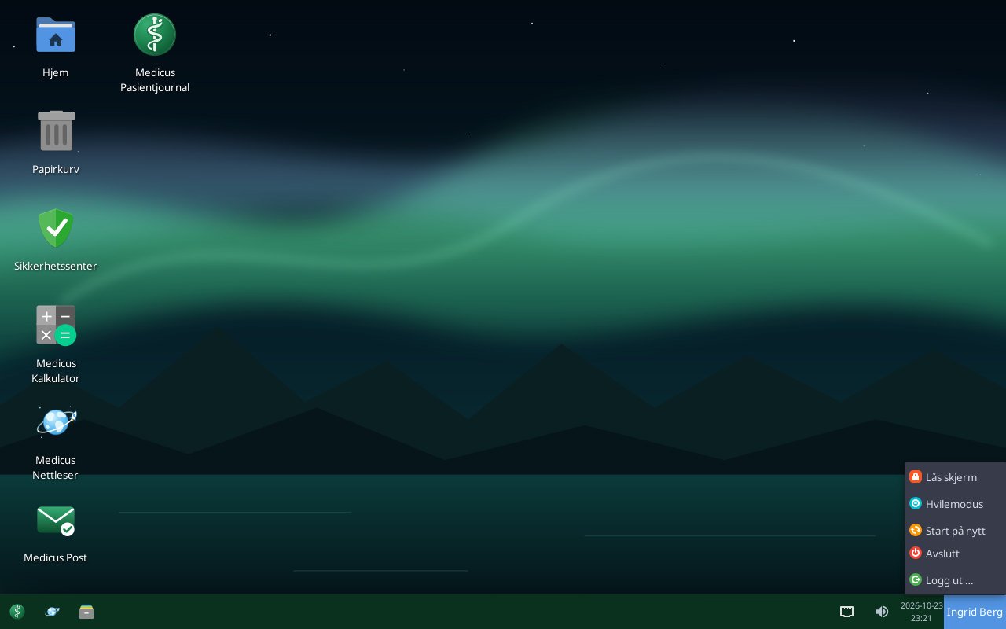
The power menu
Lock screen, sleep, restart, shut down, log out.
No hibernate: it would write patient data to disk.
No "switch user": the card decides who is logged in.

Slide 28



The road ahead
Agreement with Norsk helsenett
Real health-worker ID cards
Installation to disk
Security audit
Membership, HelseID and approval – the interface is ready.
Replace the simulated card reader with a real one (PKCS#11).
An installation mode for IT, with full disk encryption.
External penetration test, Normen, GDPR and MDR assessment.

