Slide 1
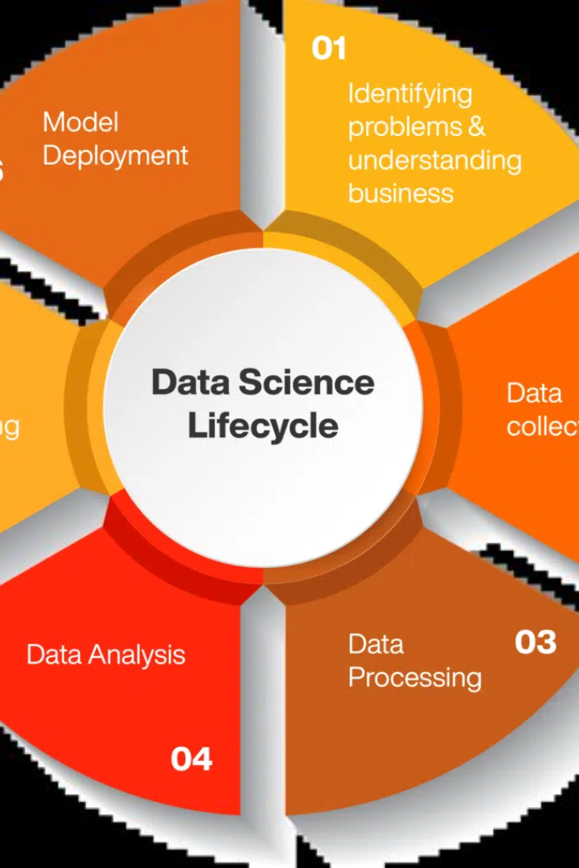
Optimization, A Pillar of Data Science
Welcome to this presentation on optimization, one of the foundational concepts of data science. In this presentation, we will explore the importance, definition, real-life applications, challenges, best practices for optimization and future trends in optimization.
--23071A6740-Musab wasiuddin

Slide 2
Contents
Definition of optimization
Importance of Optimization
Optimization algorithms and techniques
Real-life applications of optimization
Best practices for implementing optimization
Future trends in Optimization
Conclusion

Slide 3

What is Optimization in Data Science?
Definition
Importance
Optimization in data science is the process of finding the best solution to a mathematical problem from all possible solutions.
Optimization helps data scientists in decision-making, provides better insights for businesses to improve their processes, products, and services.

Slide 4
Definition and Explanation of Optimization
Objective Function
Constraints
Objective Function is a mathematical formula for evaluating how well a particular solution meets the requirements of a problem.
Constraints are restrictions on the possible values of the decision variables of an optimization problem.

Slide 5
The Importance of Optimization in Data Science
1
Maximize Performance 🚀
2
Reduce Costs 💰
3
Enhance Efficiency 👨‍💻
By reducing resources used, optimization reduces the cost associated with data science projects and algorithms.
Optimization improves the performance of machine learning algorithms and models, resulting in better accuracy and less error.
By reducing computation time, optimization improves the efficiency of data science projects and enables quicker decision-making.

Slide 6
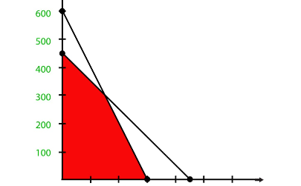
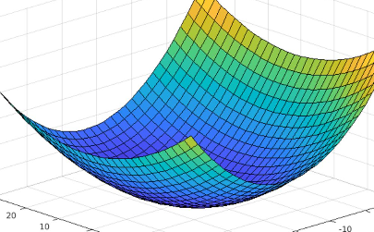
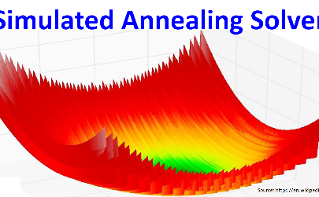
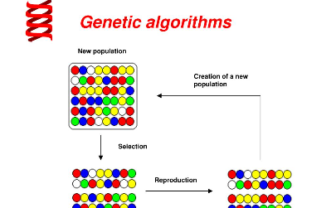
Common Optimization Algorithms and Techniques
Linear Programming
Gradient Descent
Simulated Annealing
Genetic Algorithm
A method to find an optimal solution when there are constraints and variables in a linear relationship.
A popular optimization algorithm for finding the minimum of a function by iteratively reducing the gradient.
An optimization algorithm for finding the global maximum or minimum of a function by mimicking the way metals cool and anneal.
An optimization technique that mimics the process of natural selection to find the optimal solution to a problem.

Slide 7

Real-life Applications of Optimization in Data Science
1
Marketing Analytics 📈
Optimization helps marketers to identify the most effective marketing strategies and channels to increase returns on investment.
2
Supply Chain Management ⛓
Optimization is used in logistics and operations management to route trucks, allocate resources and inventory management.
3
Healthcare 🏥
Optimization can be used to allocate medical resources, predict the spread of diseases and optimize clinical trials.

Slide 8
Applications of Optimization in Data Science
1
Recommendation Systems
Optimization is used in recommendation systems to suggest a list of relevant items for users based on their behavior and preferences.
Supply Chain Optimization
2
Optimization is used to optimize logistics and transportation routes, inventory management, and delivery schedules for maximum efficiency and profitability in supply chain management.
3
Resource Allocation
Optimization is used to allocate resources such as materials, workforce, and time efficiently to reduce costs, minimize downtime, and improve productivity.
Portfolio Optimization
4
Optimization is used in finance to create optimal asset portfolios that maximize returns and minimize risks under different scenarios and objectives.

Slide 9
Challenges and Limitations of Optimization
1
Combinatorial Explosion 🔥
2
Local Minimum/Maximum 🔄
Optimization problems with a large number of variables, constraints and solutions can take a long time to solve or might be impractical.
Optimization algorithms can get stuck in local minimum or maximum instead of finding the global min/max.
3
No Free Lunch 🎓
There is no one-size-fits-all optimization solution. Each optimization problem requires a unique approach, making it challenging to choose the right optimization technique.

Slide 10
Best Practices for Implementing Optimization in Data Science Projects
Define the problem clearly 🗺
Choose the right algorithm 🤖
Before starting any optimization project, define the problem statement clearly, including goals, constraints, and available resources.
Different optimization techniques are better suited to different problem types. Choose the right technique for your problem carefully.
Start small 🏗
Monitor and validate results 🧪
Start with a simple implementation of the optimization model, validate the results, and then build more complex models as needed.
Monitor the results of optimization continually to ensure that they are reliable, stable, and provide the expected outcome.

Slide 11
Future Trends in Optimization
Advances in Metaheuristic Algorithms
Integration of Optimization with Machine Learning
Metaheuristic algorithms like swarm intelligence, ant colony optimization, and particle swarm are emerging as promising solutions to large-scale optimization problems.
There's a growing trend towards integrating optimization and machine learning to create smarter and more efficient algorithms that can handle large and complex data sets with less human intervention.
Optimization for Big Data
Optimization for Deep Learning
Due to the exponential growth of data, optimization techniques are needed to scale data analytics and machine learning models for processing massive amounts of data.
Optimization techniques are required to fine-tune the parameters of deep learning models, to improve the accuracy of predictions, and reduce the time and resources required for training.

Slide 12

Conclusion: The Future of Optimization in Data Science
Optimization is an essential pillar of data science, and the field is poised to benefit from advancements in optimization algorithms and techniques. As data volume and complexity grow, the importance of optimization will only continue to rise. The implementation of optimization in data science is crucial for real-world problem-solving.

