Slide 1

Blockchain Introduction & Conceptualization
Time：5:00PM GMT+1
Casweeney Ojukwu (@codingcas)

Slide 2
Review of Blockchain Technology
Contextualizing Blockchain
Distributed Ledgers
Consensus Mechanisms
Public & Private Blockchains
Distributed Ledger Platforms
CONTENTS
Blockchain Primitives
Cryptographic Hash Function
Public Key Cryptography
Merkle Trees
Blockchain Structure
Smart Contracts
Nodes
Multichain Example (Bitcoin Implementation)

Slide 3
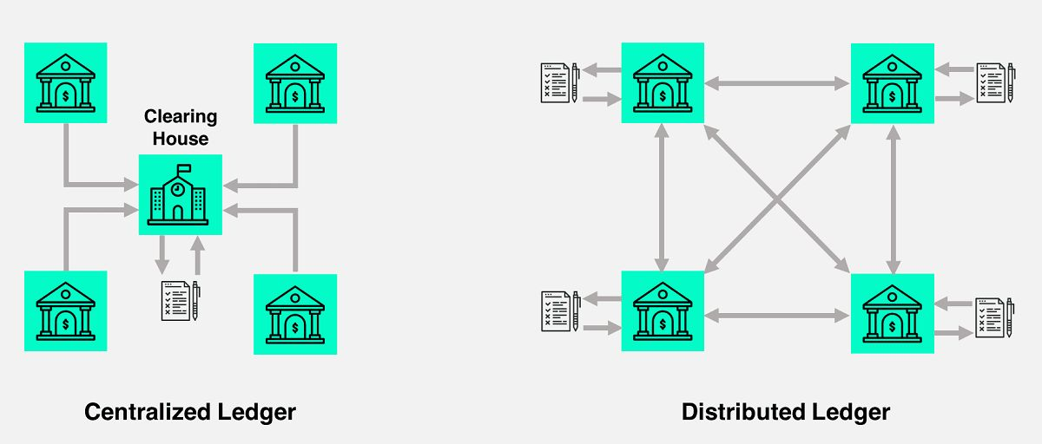
Contextualizing Blockchain
Blockchain technology is a structure that stores transactional records, (also known as the block) of the public in several databases, known as the chain in a network connected through peer-to-peer nodes.The storage is referred to as digital ledger.
Every transaction in this ledger (blockchain) is authorized by the digital signature of the owner which authenticates the transaction and safeguards it from tampering. Hence, information contained in this digital ledger is highly secured.
Distributed Ledgers
A distributed ledger is a database that is consensually shared and synchronized accross multiple sites, institutions or geographies, accessible by multiple people. It allows transactions to have public witnesses.
Participants of each node of the network can access the recordings shared accross that network and can own an identical copy of it. Any changes or additions made to the ledger are reflected and copied to all participants in a matter of seconds or minutes.
A distributed ledger stands in contrast to a centralized ledger which is mostly used by companies. A centralized ledger is more prone to cyber attacks and fraud, and it has a single point of failure.

Slide 4
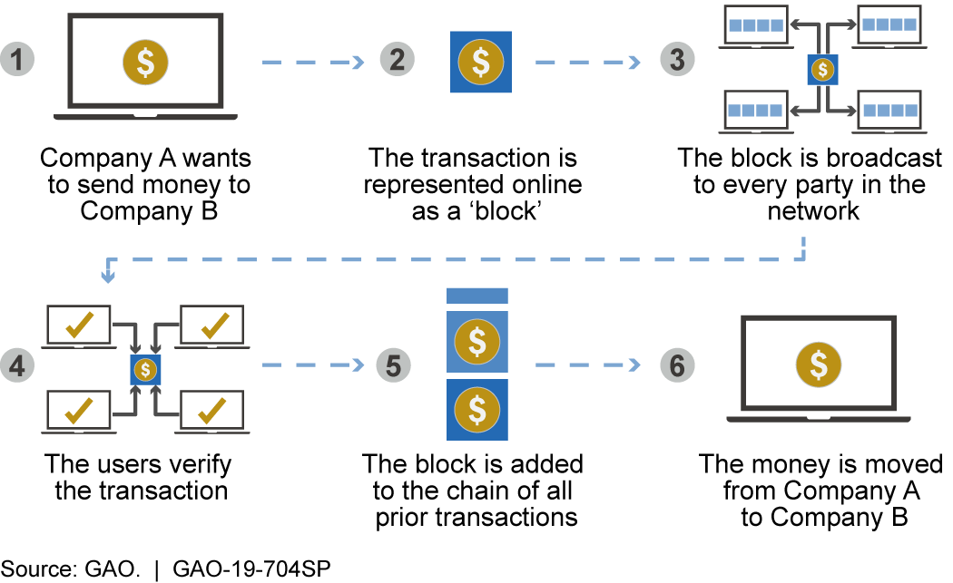
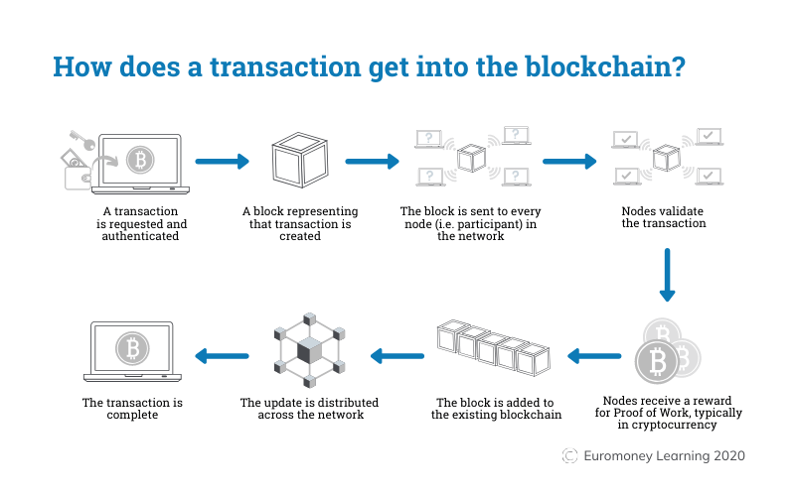
Differences between DLT and Blockchain
The most important difference to remember is that blockchain is just one type of distributed ledger.
Blockchain is a sequence of blocks, but distributed ledgers do not require such chain
Distributed ledgers do not need proof of work and theoritically offers better scaling options.
Removing the intermediary party from the equation is what makes the concept of DLT very appealing.
Distributed ledgers does not necessarily need to have data structured in blocks.
A distributed ledger is exactly how you can envision a blockchain. However, all blockchains are distributed ledgers, but not all distributed ledgers are blockchains.

Slide 5
Consensus Mechanisms
The goal of consensus mechanism is to facilitate the process of agreement among participants of a distributed data system to guarantee data consistency.
In this way, consensus algorithms achieve reliability in the blockchain network and establish trust between unknown peers in a distributed computing environment.
Essentially the consensus protocol makes sure that every new block that is added to the blockchain is the one and only version of the truth that is agreed upon by all the nodes in the blockchain. Consensus algorithms are designed to incentivize honest participants in the network.
Proof of Work
Proof of Stake
Proof of work is the god father of blockchain consensus algorithms which was first implemented on the bitcoin network.
Participants will only accept a valid block when the block hash is less than a target number known as the block difficulty
Proof os stake involves currency holders staking some currency for the chance to validated a block. It works by selecting validators in proportion to their quantity of holdings in the associated cryptocurrency. This is done to avoid the computational cost of proof-of-work schemes.
Practical Byzantine Fault Tolerance
Do Research on others
Byzantine Fault Tolerance(BFT) is the feature of a distributed network to reach consensus(agreement on the same value) even when some of the nodes in the network fail to respond or respond with incorrect information. The objective of a BFT mechanism is to safeguard against the system failures by employing collective decision making(both – correct and faulty nodes) which aims to reduce to influence of the faulty nodes. BFT is derived from Byzantine Generals’ Problem.
Research on othe consensus mechanisms: Proof of Authority, Proof of Capacity, Proof of Importance, Proof of Activity, Delegated Proof of Stake

Slide 6
Public, Consortium and Fully Private Blockchain
Public Blockchain:
A public blockchain is a blockchain that anyone in the world can read, anyone in the world can send transactions to and expect to see them included if they are valid and anyone in the world can participate in the consensus process.
Public blockchains are secured by crypto-economics: the combination of economic incentives and cryptographic verification using mechanisms such as proof of work or proof of stake.
Consortium Blockchain:
A consortium is a blockchain where the consensus process is controlled by a pre-selected set of nodes.
Fully Private Blockchain:
A fully private blockchain is blockchain where write permission are kept centralized to one organization. Read permissions may be public or restricted to an arbitrary extent.

Slide 7
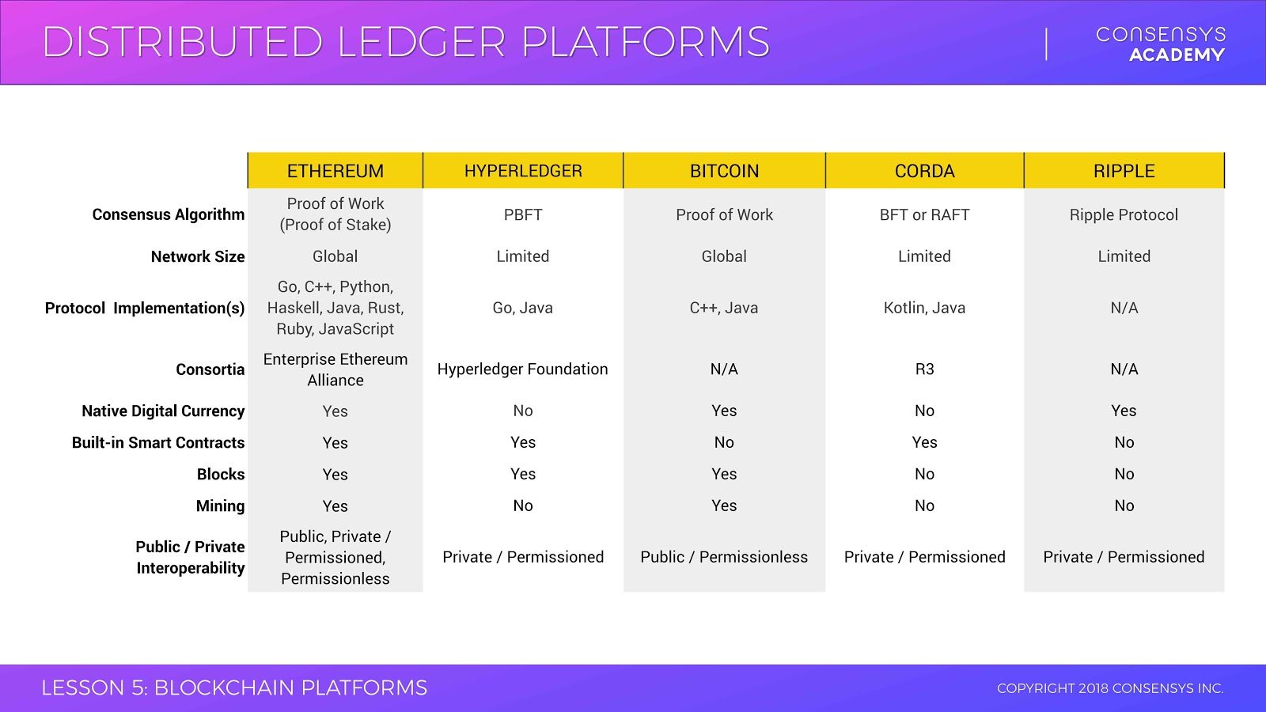
Distributed Ledger Platforms
Since the emergence of bitcoin which uses the Proof of Work Consensus Algorithm, there have been different DLT based platforms springing up to solve scalability and decentralization issues. A comparison is given below

Slide 8
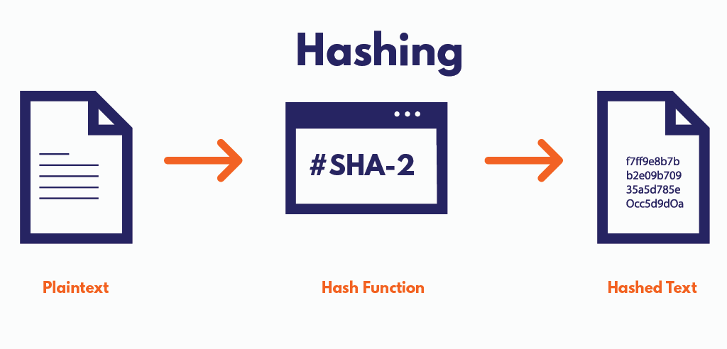
Cryptographic Hash Function
A hash function is a mathematical function that converts a numerical input value into another compressed numerical value. The input to the hash function is of arbitrary length but output is always of fixed length.
Properties of Cryptographic Hash Functions
Non-reversibility: also know as one-way function. A good hash should make it very hard to reconstruct the original password from the output or hash.
Diffusion, or avalanche effect​: A change in just one bit of the original password should result in change to half the bits of its hash. In other words, when a password is changed slightly, the output of enciphered text should change significantly and unpredictably.
Determinism​: A given password must always generate the same hash value or enciphered text.
Collision resistance​: It should be hard to find two different passwords that hash to the same enciphered text.
Non-predictable: ​The hash value should not be predictable from the password.

Slide 9
Examples of Cryptographic Hash Functions
Cryptographic hash functions are widely used in cryptocurrencies to pass transaction information anonymously. For example, bitcoin​, the original and largest cryptocurrency, uses the SHA-256 cryptographic hash function in its algorithm. Similarly, IOTA, a platform for the ​Internet of Things​, has its own cryptographic hash function, called Curl.
However, hashes have other applications in the real world. These are some of the most common cryptographic applications:
Password Verification: Storing passwords in a regular text file is dangerous, so nearly all sites store passwords inputs their password, it is hashed and the result is compared to the list of hashed values stored on the company's servers.
Signature Generation and Verification: Verifying signatures is a mathematical process used to verify the authenticity of digital documents or messages. A valid digital signature, where the prerequisites are satisfied, gives its receiver strong proof that the message was created by a known sender and that the message was not altered in transit. A digital signature scheme typically consists of three algorithms:
a key generation algorithm;
a signing algorithm: given a message and a private key, produces a signature; and
a signature verifying algorithm.
Merkle Trees​, a technology used in cryptocurrencies, is a kind of digital signature.
Verifying File and Message Integrity: Hashes can be used to make sure messages and files transmitted from sender to receiver are not tampered with during transit. The practice builds a "chain of trust." For example, a user might publish a hashed version of their data and the key so that recipients can compare the hash value they compute to the published value to make sure they align.

Slide 10
Public Key Cryptography
Public-key cryptography, or asymmetric cryptography, is an encryption scheme that uses two mathematically related, but not identical, keys - a public key and a private key. Unlike symmetric key algorithms that rely on one key to both encrypt and decrypt, eachkey performs a unique function. The public key is used to encrypt and the private key is used to decrypt.
In Ethereum we use public key cryptography to create the public-private key pair. Pair because public key is derived from private key and together they represent an Ethereum account by providing a publicly accessible account handle called an address
It is computationally infeasible to compute the private key based on the public key. Because of this, public keys can be freely shared, allowing users an easy and convenient method for encrypting content and verifying digital signatures, and private keys can be
kept secret, ensuring only the owners of the private keys can decrypt content and create digital signatures.
Public key cryptography is used to control ownership of funds in the form of private keys and addresses
Private keys are at the heart of all user interaction with Ethereum, infact account addresses are derived directly from the private keys.
The main business applications for public-key cryptography are:
Digital signatures - content is digitally signed with an individual’s private key and is verified by the individual’s public key
Encryption - content is encrypted using an individual’s public key and can only be decrypted with the individual’s private key
Security Benefits of Digital Signatures
Assuming the private key has remained secret and the individual it was issued to is the only person with access to it, digitally signing documents and emails offers the following benefits:
Authentication – since the individual’s unique private key was used to apply the signature, recipients can be confident that the individual was the one to actually apply the signature
Non-repudiation – since the individual is the only one with access to the private key used to apply the signature, he/she cannot later claim that it wasn’t him/her who applied the signature
Integrity - when the signature is verified, it checks that the contents of the document or message match what was in there when the signature was applied. Even the slightest change to the original document would cause this check to fail.

Slide 11
Security Benefits of Digital Signatures
Assuming the individual’s private key has not been compromised, encrypting data and messages offers the following security benefits:
Confidentiality - because the content is encrypted with an individual’s public key, it can only be decrypted with the individual’s private key, ensuring only the intended recipient can decrypt and view the contents
Integrity - part of the decryption process involves verifying that the contents of the original encrypted message and the new decrypted match, so even the slightest change to the original content would cause the decryption process to fail.
ECDSA (Elliptic Curve Digital Signature Algorithm).
Elliptic Curve Cryptography (ECC) and ECDSA are a specific flavor of asymmetric or public key cryptography based on the discrete logarithm problem as expressed by addition and multiplication on the points of an elliptic curve. They are widely used in blockchain technology because of three reasons:
Their computational performance is economical compared to a lot of other algorithms
The keys that are generated are relatively short
Bitcoin started it, so most new blockchain projects have copied it
Given a private key, a public key can be derived/calculated using the elliptic curve multiplication: K = k * G
where:
K = private key
k = resulting public key
G = constant point called generator point
* = is the special curve multiplication operator
Note: It is easier to a public key from private key, but you cannot calculate the private key from public key.
The last 20bytes of the keccak256 hash of the public key with an 0x prefix = Your account address (EOA)

Slide 12
Merkle Trees
Merkle trees are a fundamental part of what makes blockchains tick. Although it is definitely theoretically possible to make a blockchain without Merkle trees, simply by creating giant block headers that directly contain every transaction, doing so poses large scalability challenges that arguably puts the ability to trustlessly use blockchains out of the reach of all but the most powerful computers in the long term.
It is a special kind of binary tree used to encode large chunk of data.
The cool thing about merkle tree is that they build up from bottom-up and alow you verify if some value is present in the tree or not without having to loop over every element of the tree
Merkle tree is a type of hash tree in which each leaf node is labelled with a cryptographic hash of a data block, and each non-leaf node is labelled with the cryptographic hash of its child nodes labels:
Every leaf in a tree is a cryptographic hash of an item in a dataset
Every node is a hash of its two child elements
By creating a data structure that is built of cryptographic hashes, the entire tree is cryptograhically authenticated because:
Changing one piece of data will change the root of the tree
We can use the root to efficiently verify every item at the leaves of the tree.
Only a subset of data is required for a merkle proof

Slide 13
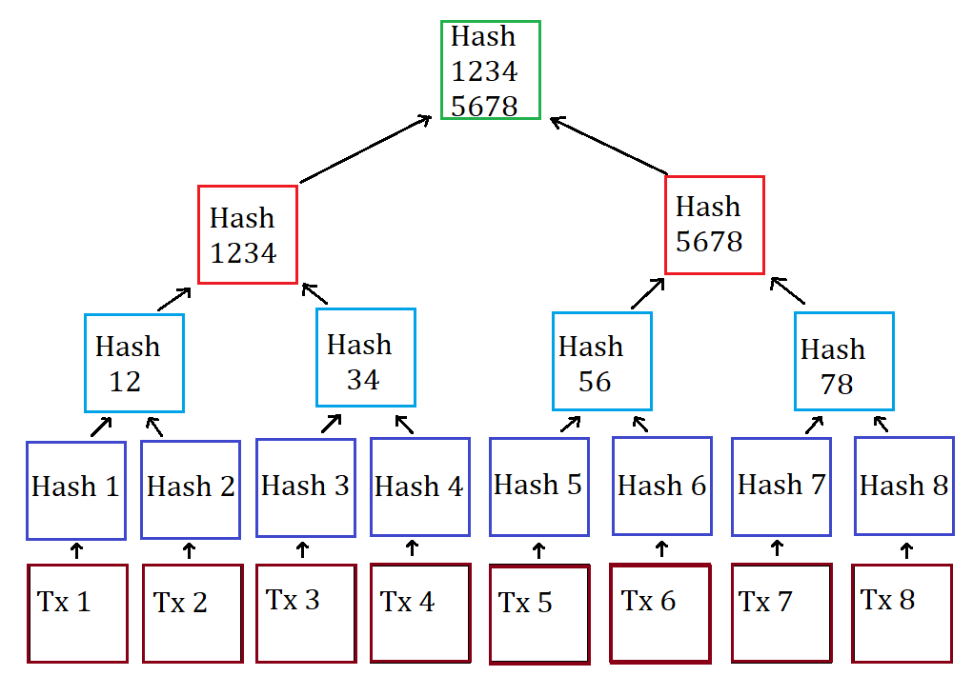
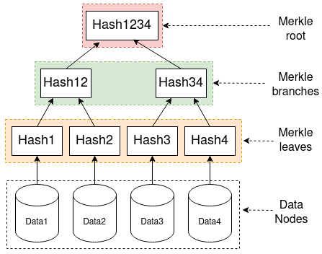

Slide 14
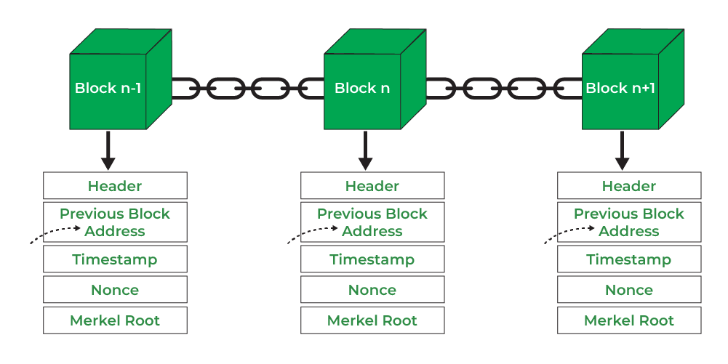
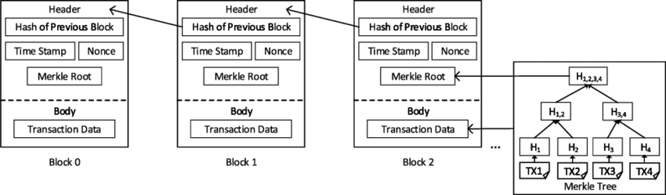
Blockchain Structure
A blockchain is a globally shared transactional database. This means everyone can read entries in the database ust by participating in the network.
The main element of the blockchain is the BLOCK which contains:
Block Header (A block header is used to identify a particular block on an entire blockchain and is hashed repeatedly to create proof of work for mining rewards.)
A list of transactions (A merkle tree based on the list)
Hash of previous block
Nonce:
Used for proof of work
Modified to get valid block hash
Timestamp and
Tx Root
A chain of blocks leads to the propagation of blockchain.
Transactions in a block are arranged using a data structure called Merkle Tree

Slide 15
Smart Contracts
Smart Contract is a term used to describe computer code that automatically executes all or part of an aggreement and is stored on a blockchain based platform.
Smart Contracts work on an If - Then principle
Properties of smart contracts
Trustless: It eradicates the need for a third party intermediary or facilitator
Trackable
Irreversible
Self-executing: it executes certain commands based on how it was written to respond to external interaction.
Nodes
A node is a computer that runs the ethereum client
Clients
Clients are softwares that gives miners access to the blockchain. The client is what is connected in a peer-to-peer network with other clientson a network.

Slide 16
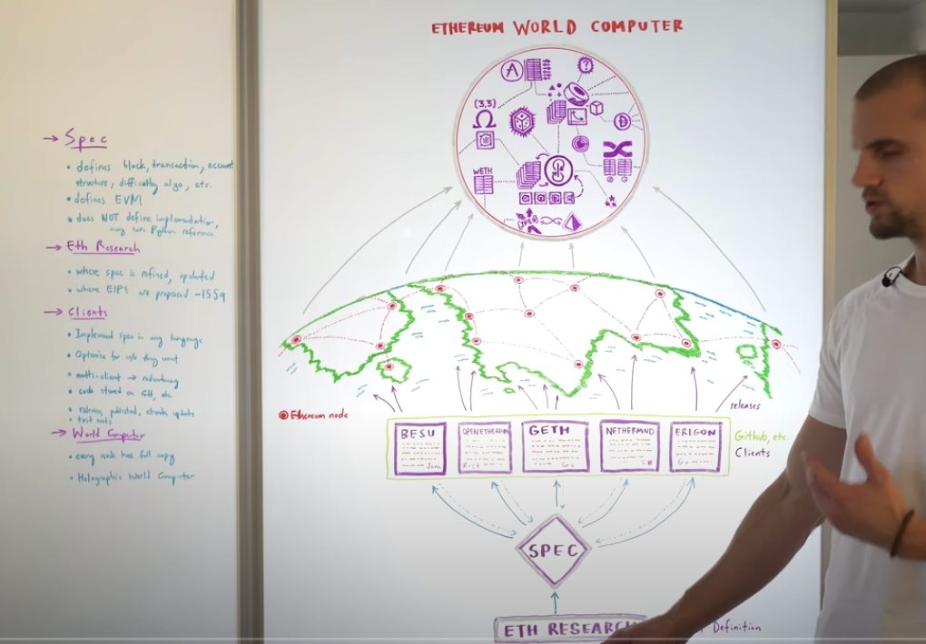
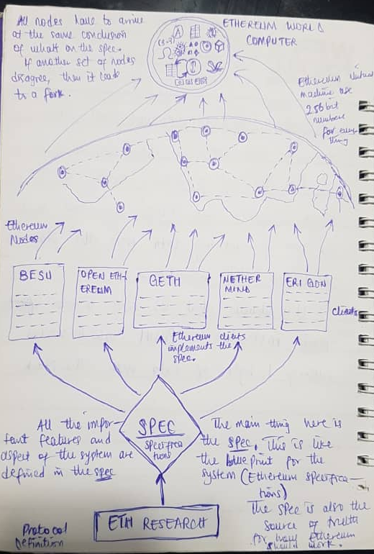

Slide 17
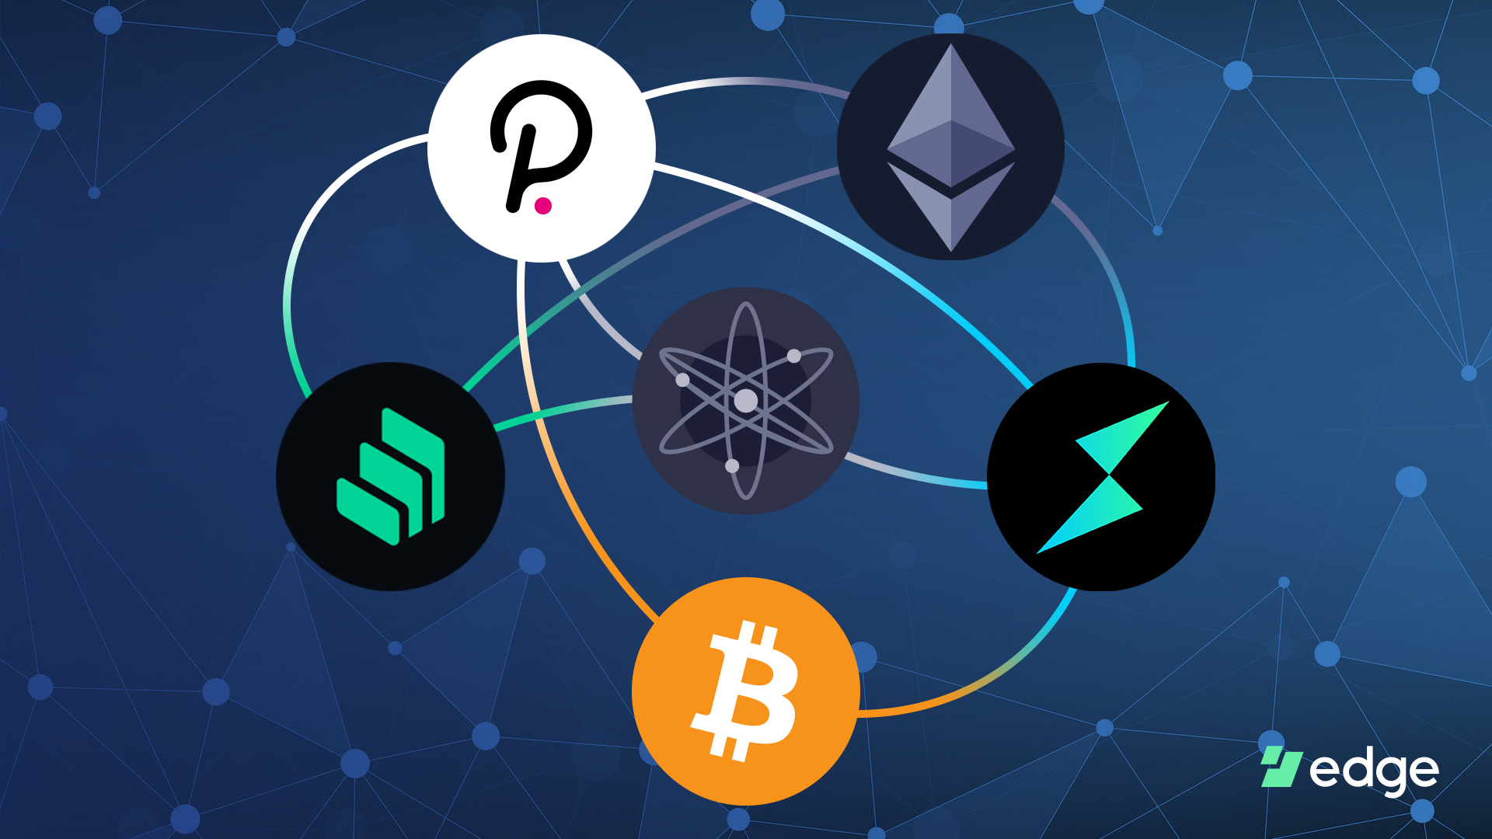
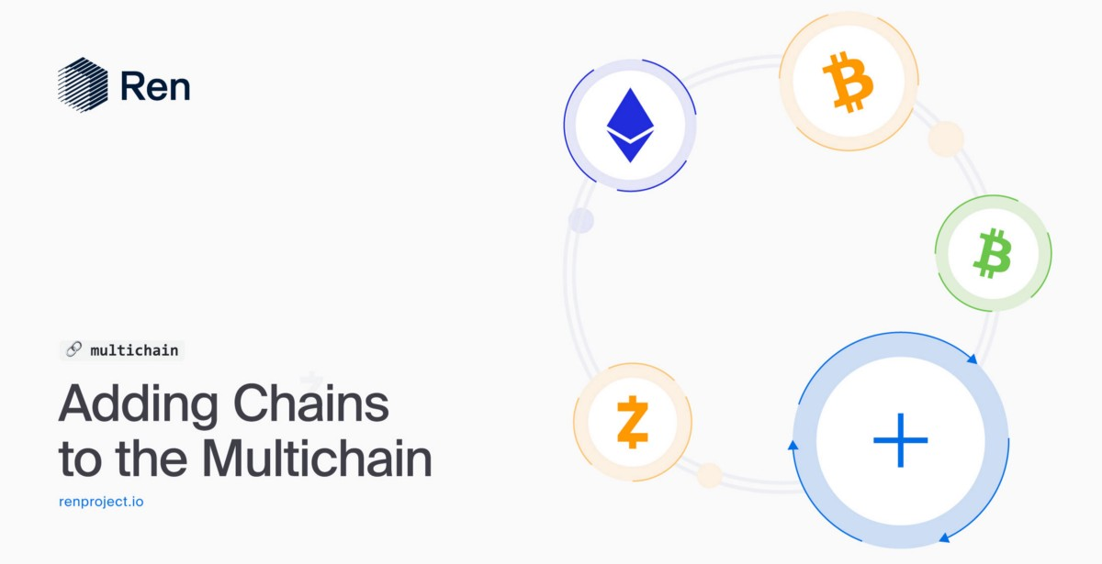
Multichains
A multichain is a network of bridges and parachains that link current blockchains to improve services and circumvent the constraints of earlier technologies like Bitcoin (BTC) and Ethereum (ETH). Such alternatives include blockchains such as Solana (SOL), Near (NEAR), and Cosmos (ATOM).
How does a multichain work? Their objective is not to delegitimize the presence of older blockchains, but rather to enable users to take advantage of Ethereum’s and Bitcoin’s strengths while routing traffic to these newer ecosystems that enhance ancient technology.
This has been more significant over the last few years since Ethereum has become the environment of choice for decentralized finance (DeFi) initiatives. Due to its poor throughput, hefty gas prices, and complex infrastructure, Ethereum has been unable to tackle all the hurdles posed by the increasing popularity of these applications.
Multichains are intended to build communication channels across various blockchains, enabling developers and companies to thrive in one environment while making use of the solutions offered by another ecosystem.

Slide 18
Thank you for listening
Ask Questions
Research & Study

