Slide 1

Group Project overview Team 5 SWE-312 UI design

Slide 2
Table of content
Problem Statement
pothole tracking and repair system (PHTRS) overview
Work Progression(phases)
Development of use case model, identification of user-groups and associated tasks
Development of a paper prototype
Development of an initial software prototype and usability evaluation
Improvement of software prototype

Slide 3

Problem Statement
Develop a user interface for “Online pothole tracking and repair system”(PHTRS).

Slide 4

PHTRS Overview
Ingleburn is a medium sized city in Australia, its public works department are looking to develop an online pothole tracking and repair system (PHTRS).

Slide 5
Phase1: Development of use case model, identification of user-groups and associated tasks
In Phase 1 we performed that:
user analysis
task analysis
Use case diagram
Use case document

Slide 6
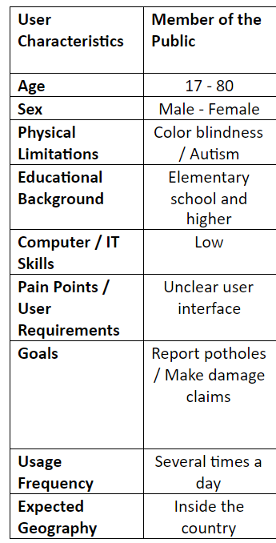
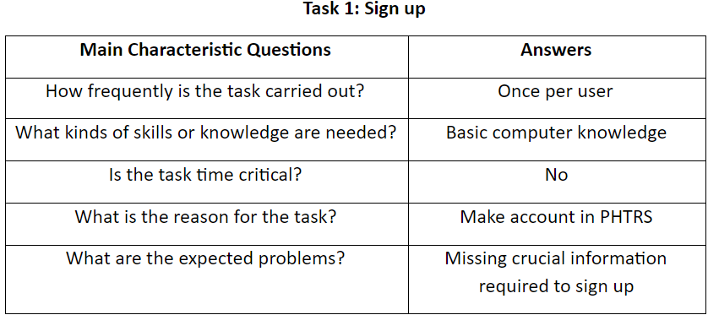
Phase1 examples
User Analysis
Task Analysis

Slide 7
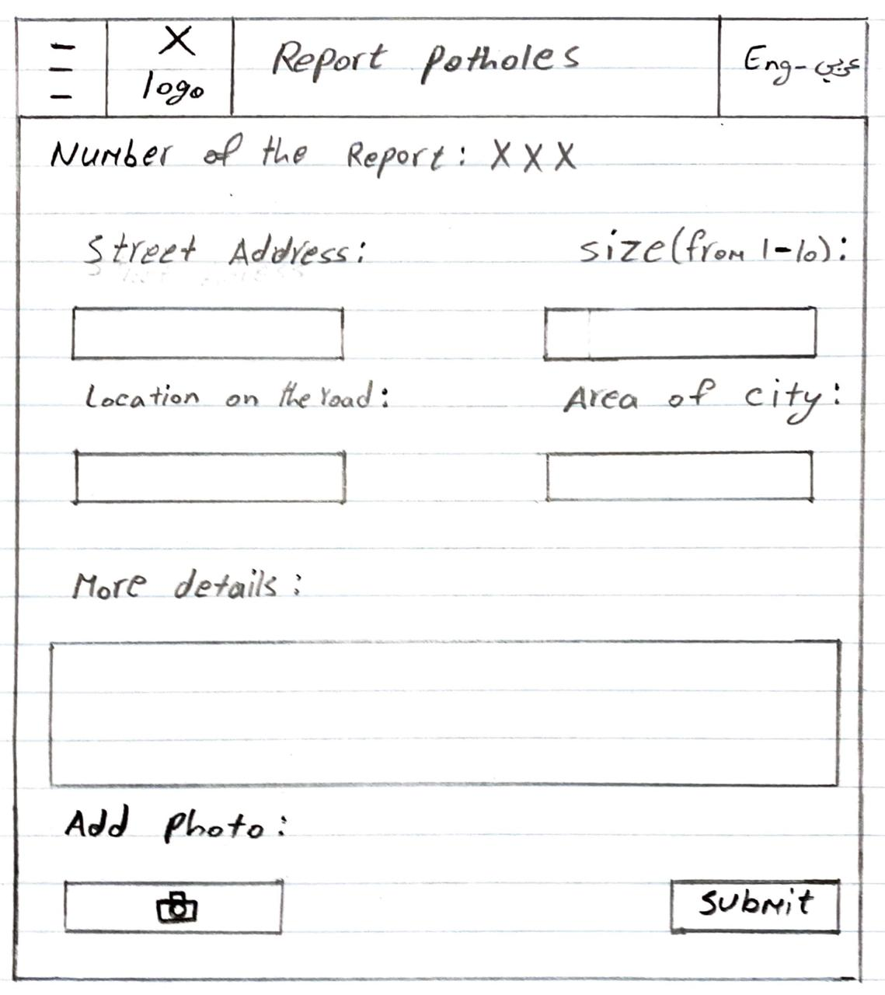
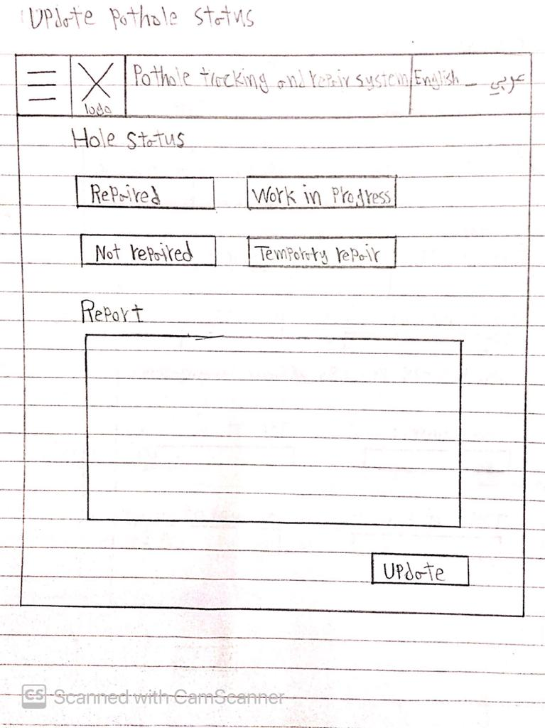
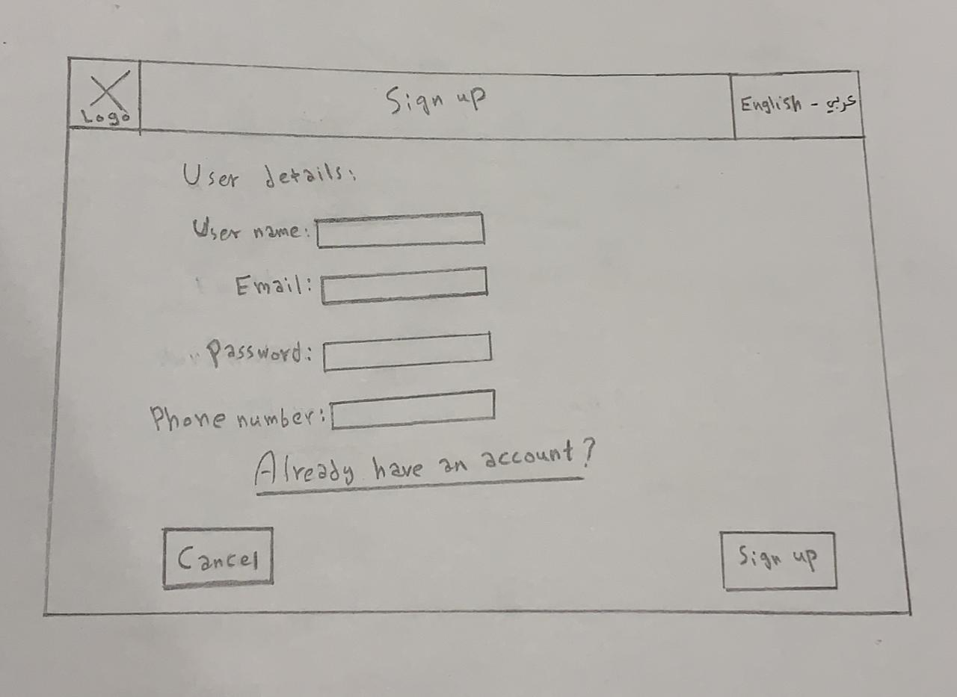
Phase2:Development of a paper prototype
In Phase 2 we performed that:
Sketch UI design for PHTRS on paper

Slide 8

Phase 3: Development of an initial software prototype and usability evaluation
In Phase 3 we performed that:
Developed UI design prototype for Phtrs using figma
Made usability evaluation for UI design prototype

Slide 9
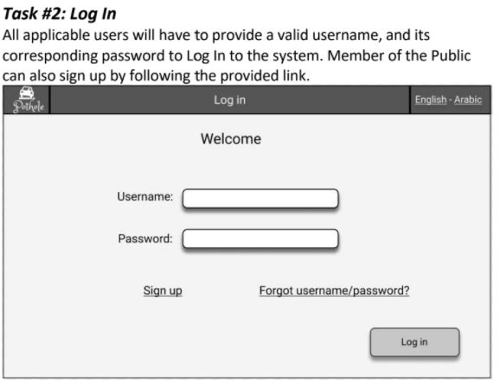
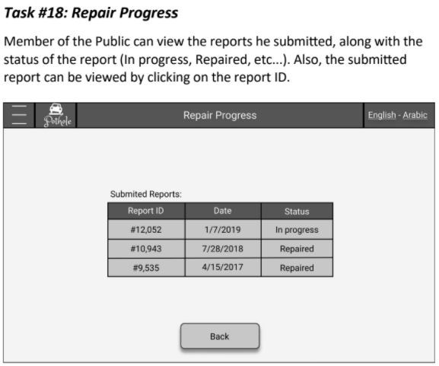
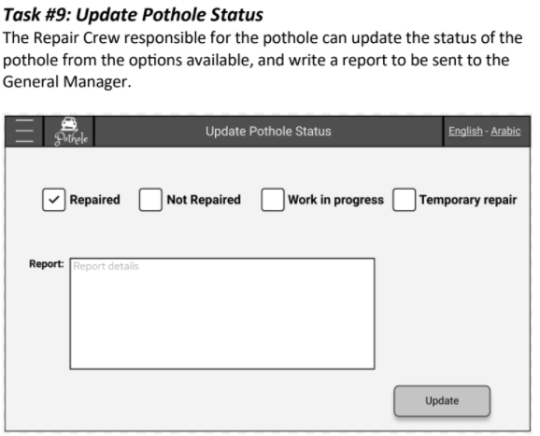
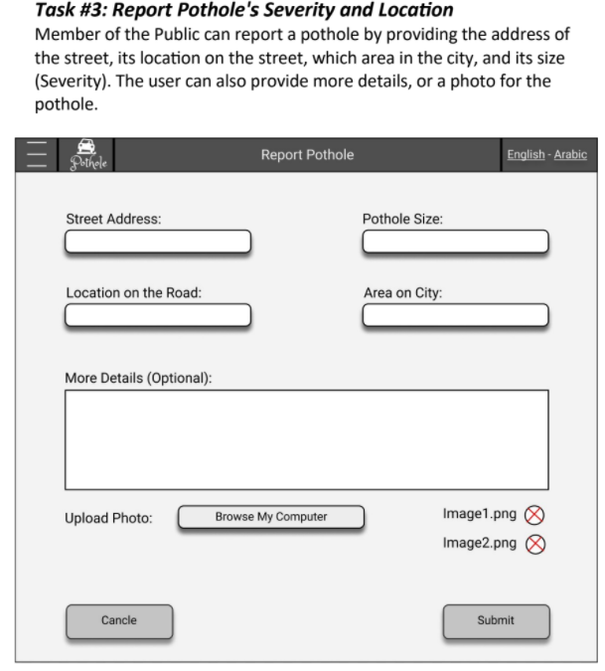
Phase 2 examples

Slide 10

Phase 4:Improvement of software prototype
In Phase 4 we performed that:
Improve the software prototype by taking into consideration the usability evaluation results of Team 4.

Slide 11
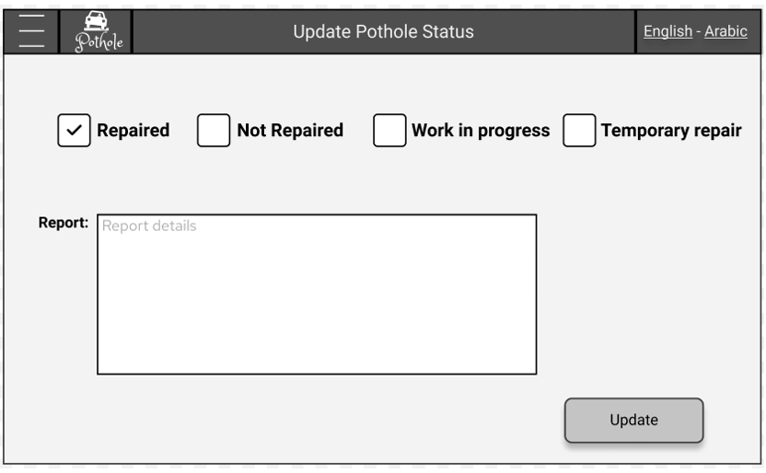
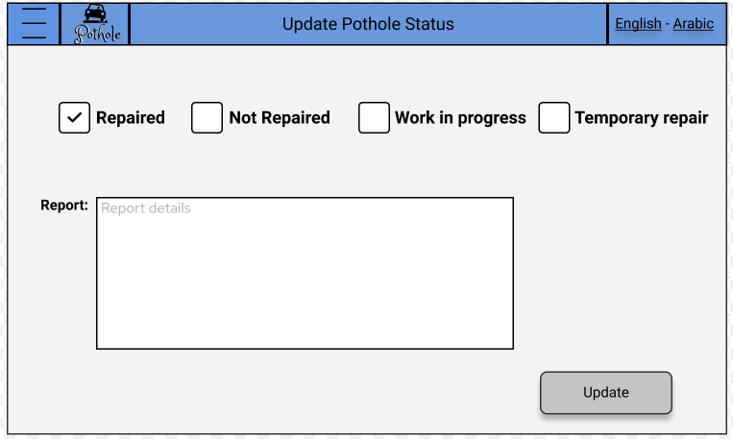
Improvements
According to team 4 evaluation we change the color of header from black to blue to be more appealing

Slide 12
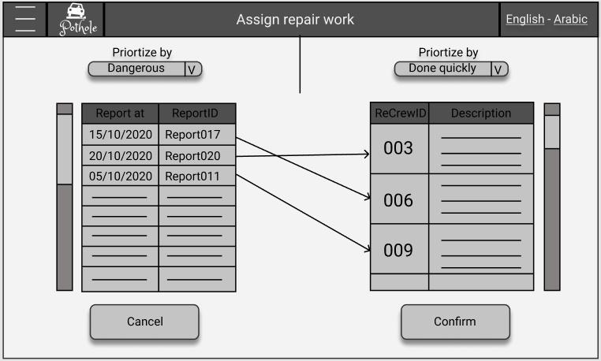
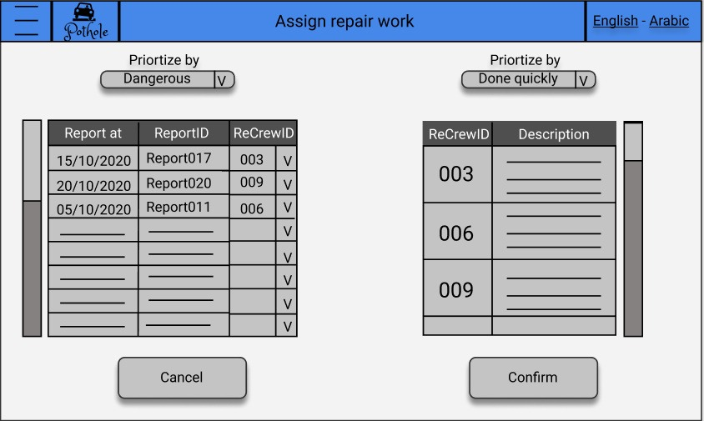
Improvements
According to team 4 evaluation we change the structure of assign repair work UI to be more organized.

Slide 13

Thanks!
Team 5 members
Nazeer Al-Filfil (Leader)
Jawad AlYousef
Rayan Al Shahrani
Rayan AlBilihi
Mosab Alqarni

