Slide 1
BREAST CANCER
Written by.:
PROF Dr. WASEEM ABDELAZIZ,MD
ASSISTANT PROF.OF GENERAL SURGERY AND SURGICAL ONCOLOGY

Slide 2
Breast Neoplasm
I-Benign:
A-Duct papilloma
B-Fibroadenoma
C-Benign phylloides
II-Malignant:
A-Carcinoma
B-Sarcoma
C-Lymphoma

Slide 3
Breast Carcinoma
A-Non-Invasive :
1-Ductal Carcinoma In-situ (DCIS)
2-Paget’s disease
B-Invasive :
1-Invasive ductal carcinoma
2-Invasive Lobular carcinoma

Slide 4
Lobular Carcinoma In-Situ
Lobular carcinoma in situ(LCIS)
•Diagnosed by biopsy
•Increased the risk of bilateral breast cancers
•Some considered it as risk factor NOT a precancerous lesion

Slide 5
Non-Invasive BREAST CARCINOMA
A-Carcinoma in situ:
1-Duct carcinoma in situ(DCIS):
Density or microcalcifications in mammography
20—30% of newly diagnosed cancer
Will turn into invasive breast cancer

Slide 6
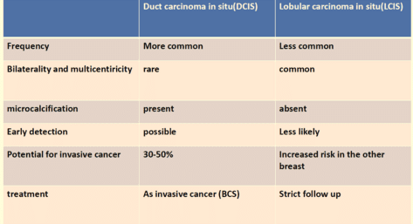

Slide 7
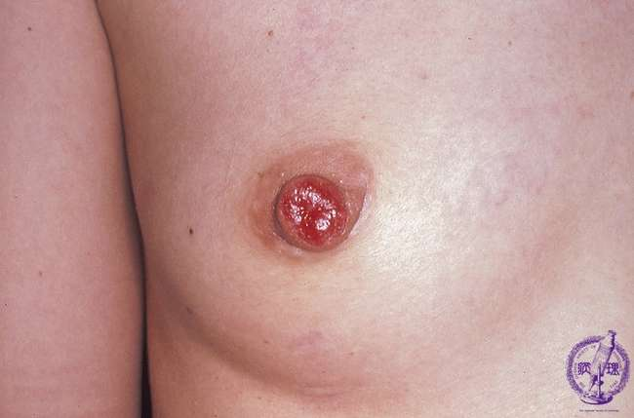
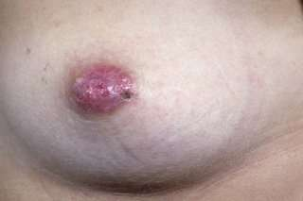
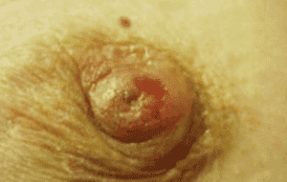
2-Paget’s disease of the nipple

Slide 8
Intraductal carcinoma, begins in the epithelium of main milk duct and spreads within the epithelium up to skin of the nipple and down to breast substance
•An eczema-like lesion and nipple is eroded
•Affects old females
•Unilateral
•May be accompanied with underlying breast mass

Slide 9
THREE HISTOLOGICAL FEATURES:
1-hyperplasia of all layers of the epidermis
2-round cell infiltration of the dermis
3-paget`s cells—clear vacuolated cells with small dark –staining nuclei
the cells are alone or in clusters
in the deeper layer of the epidermis

Slide 10
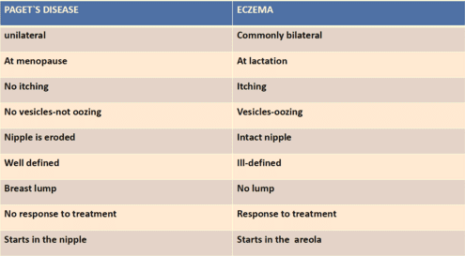

Slide 11
B-INVASIVE BREAST CANCER
1-Invasive duct carcinoma( Non Specific Type NST)
75% previous name (schirrouscarcinoma )
hard,cutsurface is concave,rough,gritty and pale grey with prominent yellow and white flecks
rapid lymphatic spread
with multiple satellite masses within the breast
2-INVASIVE LOBULAR CARCINOMA:
5-10% ,bilateral ,multicentricity in (20%)

Slide 12
3-Medullary carcinoma –5-7%
Well-circumscribed border
Intense infiltration by lymphocytes and plasma cells
Prognosis is favorable
4-Mucinous carcinoma---3%
Abundant accumulation of extracellular mucin
5-Tubular carcinoma—2%
Tubular formation –prognosis is good
6-Inflammatory carcinoma:
Rare-highly malignant
Grows rapidly
Invades the dermal plexus of lymphatics

Slide 13
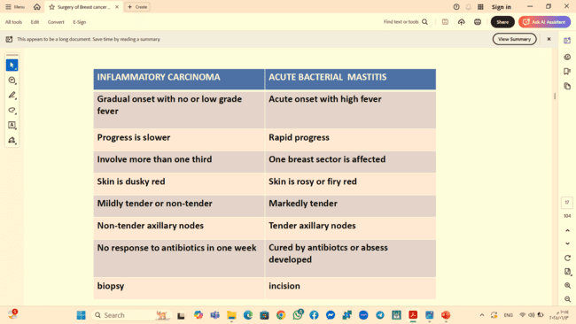

Slide 14
Carcinoma of the breast
Worldwide ; 1 of 8 women will develop breast cancer throughout her life
•Most cases developed after the age of 50
•National cancer institute in Cairo reported breast cancer to represent about 35% of all female cancers
Sporadic breast cancer :
65%--75%
Familial breast cancer :
20%--30%
Hereditary breast cancer :
5%--10%

Slide 15
RISK FACTORS
I-MAJOR FACTORS:
1-gender: female
2-previous breast cancer
3-age: -rare below age of 20 years.
-mean age is 60 years.
4-family history
1st degree relative increases risk 2.3 folds
Mother and sister increases risk 13 folds

Slide 16
5-PRECANCEROUS LESION
Duct papilloma (especially if multiple) ) the risk 1.5 -2 times.
Ductal carcinoma in situ
N.B.: lobular carcinoma in situ increases the risk by 5 -10 times.
6-GENETIC:
-5-10% of breast cancer
-Autosomal inheritance of a mutant gene
Genes :
BRCA 1 (on chromosome 17)
BRCA2 (on chromosome 13)
P53 (lifrauminisyndrome)

Slide 17
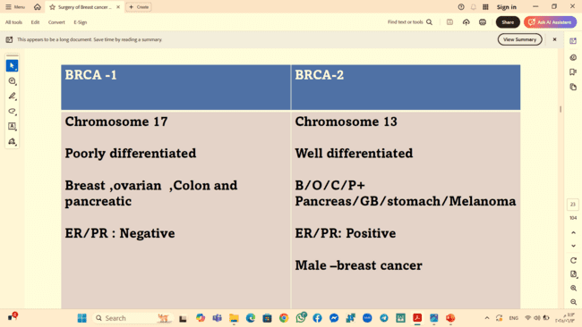

Slide 18
II-INTERMEDIATE FACTORS
Alcohol and diet
Endocrine factors
Early menarche
Late menopause
Hormone replacement therapy(HRT)
Nulliparity and elderly primipara
Irradiation
Benign proliferative breast disease( multiple papillomatosis)

Slide 19
Clinical presentations
I-SYMPTOMS:
1-BREAST MASS:
Discovered accidentally (or during routine screening) and progressive course.
2-NIPPLE DISCHARGE: watery(mostly) ,blood-stained nipple discharge or pasty material.
3-NIPPLE RETRACTION
4-pain:
-Advanced cases
-Inflammatory carcinoma
-Paget’s disease of the nipple.

Slide 20
II-SIGNS:
1-breast asymmetry
2-tethering
3-dimpling
4-puckering
5-peud’orange
6-nodule
7-ulcer
8-axillary lymph node
9-arm edema
10-manifestations of distant metastasis

Slide 21
Investigations
I-For diagnosis
II-For Staging

Slide 22
I-INVESTIGATIONS FOR DAIGNOSIS:
TRIPLE ASSESSMENT
confident diagnosis 99.9% of cases
1-CLINICAL EVALUATION :
-History and examination
2-RADIOLOGICAL EVALUATION
-U/S and mammography
3-PATHOLOGICAL EVALUATION
-Biopsy

Slide 23
BREAST IMAGING
1-ULTRASONOGRAPHY:
can differentiate solid and cystic lesion
a speculated hypoechoic mass more tallthan wide suggests malignancy
with color codded duplex sonography:
-malignant lesion receives blood from all around with turbulent speed
-benign lesions receive blood flow from one side at a low speed
useful in young women
u/s guided tru-cut needle biopsy can be done

Slide 24
MALIGNANT APPEARING MASSES
1-irregular margins
2-hypoechoic
3-posterior acoustic shadow
4-vertical growth appearance ( taller than wide )

Slide 25
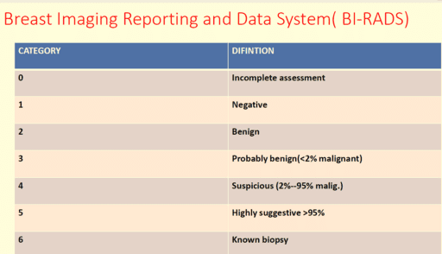

Slide 26
2-SOFT TISSUE MAMMOGRAPHY
95% accurate in diagnosis of breast cancer
It can be combined with tru-cut biopsy
Useful for detecting multifocal lesions
The cancer :
-a dense opacity with indefinite borders and irregular spicules
-clustered microcalcifications
less diagnostic in young women due to density of the normal tissue however , contrast enhanced digital mammography and tomosynthesis may help in this cases

Slide 27
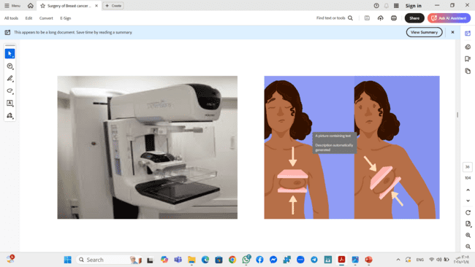

Slide 28
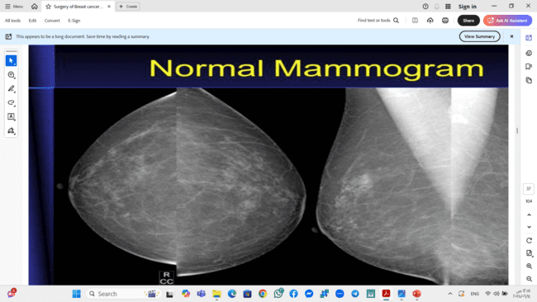

Slide 29
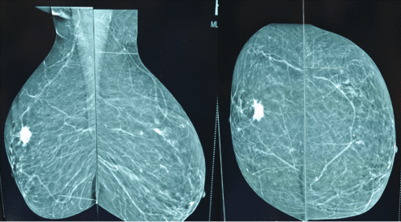

Slide 30
3-MAGNETIC RESONANCE IMAGING (MRI)
postoperative scarring to differentiate between fibrosis and local recurrence of malignancy
before and after neoadjuvant therapy to monitor response
in the presence of breast implants.

Slide 31
Pathological evaluation(biopsy)
1-Fine needle aspiration cytology (FNAC)
Out patientclinic using a 10-20 ml syringe and a 21 –gauge needle
The mass is fixed by one hand and the needle is passed in it several times while keeping suction by the other hand ,the suction is then released on a slide and stained for examination of the cytology
Large pleomorphic nuclei,ill-defined cytoplasm and abnormal nuclear chromatin ratio indicate malignancy
False negative up to 10% of cases

Slide 32
FNAC DISADVANTAGES
1-false negative rate high
2—inadequate specimen
3-requires skilled cytopatholgist
4-cannot differentiate in situ vs invasive lesions

Slide 33
2-TRU-cut biopsy

Slide 34
Done under local anaesthesia
•With a special needle that cuts a core of tissue
•The specimen allows for histological examination and for assessment of the receptors
•Under U/S guide
ADVANTAGES:
1-lower false negative rates
2-doesn`t need specially trained cytopathologist
3-adequate samples are obtained
4—can differentiate in situ vs invasive lesions
5-can confirm er\pr\her2 -neu status

Slide 35
3-EXCISION BIOPSY:
the whole mass is excised
paraffin sections are stained and examined within two days
the most reliable and provide a big enough specimen to allow for hormone receptor estimation as well
4-FROZEN SECTION BIOPSY:
the tumor is either excised or incised
the specimen is frozen and the diagnosis is obtained within 20 minutes

Slide 36
investigations of non-palpable lump
1-stereotactic core biopsy: mammography guided
used for non palpable lesions
biopsy from a microcalcifications
2-excisional biopsy from impalpable breast masses:
the radiologist can place a wire inside the lesion under mammography or u/s and the mass is removed with the wire for histological assessment

Slide 37
3-SENTINALNODE BIOPSY:
Lympho zuranblue dye
TC99 Sulphur colloid
accuracy 99%
use portable gamma camera
INDICATIONS:
high –risk in situ cancer
T1 or T2 carcinoma and especially good prognostic tumors ( mucinous ,papillary, and adenoid cystic)
negative axillary lymph node metastasis (clinically and/or radiologically)

Slide 40
SENTINEL LYMPH NODE
If the node is positive : axillary clearance
If the node is negative: no further excision
The value of the SLN biopsy is to avoid axillary dissection in node negative patient
Reducing the incidence of lymphoedema

Slide 41
SENTINEL NODE BIOPSY
CONTRAINDICATIONS:
Altered drainage of breast ( augmentation surgery)
Recent mammoplasty and pregnancy
Allergy to the dye or radiocolloid
ABSOLUTE CONTRAINDICATIONS:
Inflammatory carcinoma
Axillary mets.

Slide 42
II-Staging investigations
METASTATIC WORK UP
To decide whether the case is MO or M1
IN EARLY BREAST CANCER
Chest –x ray
U/S of the abdomen
IN LOCALLY ADVANCED BREAST CANCER
CT scan of chest
CT scan of the abdomen
Bone scan
Pet scan

Slide 43
Investigations for detection of Molecular types of breast cancer
Hormonal Receptors
estrogen receptors (ER)
-60% are +ve
-the tumor will regress if deprived of oestrogen or the hormone receptor is blocked by an anti-oestrogen
Progesterone receptors (PR)
HER2/neu
KI67

Slide 44
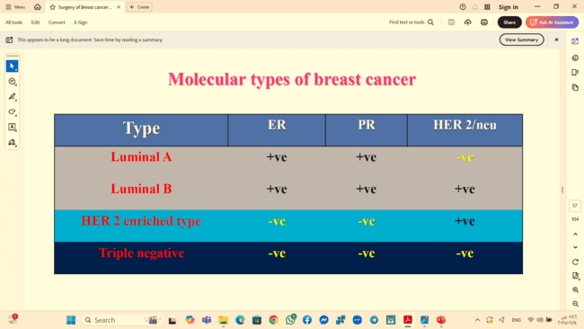

Slide 45
BREAST CANCER STAGING
INTERNATIONAL TNM STAGING
T=tumour
Tis: carcinoma in situ ,Paget's disease with no palpable mass
To: no evidence of primary tumour
T1 mass of 2cm or less
T2 mass of 2-5 cm
T3 mass larger than 5 cm
T4 any size with direct extension to chest wall or to skin or inflammatory carcinoma

Slide 46
N=nodes:
No=no palpable axillary nodes
N1=mobile palpable homo lateral axillary nodes
N2=fixed homo lateral axillary nodes
N3=palpable homolateral supraclavicular nodes
M=metastases
Mo=no evidence of distant metastases
M1=distant metastases

Slide 47
SPREAD
LOCAL SPREAD:
-Occur through the breast substance ,skin , pectoralis major ,serratus anterior muscle and the chest wall
LYMPHATIC SPREAD:
-by embolism or permeation
-mostly to axillary nodes
-internal mammary chain
-supraclavicular nodes in advanced cases

Slide 48
-lymph node affection is an important prognostic factor
obstruction of the dermal lymphatics:
-breast skin oedema –marked in dependent part( the lower half of the breast)
-The edematous skin is pitted at the site of hair follicles, sebaceous glands, and sweat glands---giving appearance of an orange peel “peaud`orange”

Slide 49
BLOOD SPREAD
Metastases to the lungs, bones, brain and the liver.
The bones-lumbar vertebrae, ribs, femur , humorous and skull.
Mets. to the spine through the communications between posterior intercostal veins and the paravertebral veins (Batson's plexus)
Blood metastases may occur very early to produce distant mets. or pathological fractures.

Slide 50
EARLY DETECTION OF BREAST CANCER
TWO MAIN METHODS:
1-breast self-examination (BSE):
All women over age of 20 should examine their breasts monthly
One week after menstruation
Presence of lump or dimpling
Recent retraction of nipple

Slide 51
2-clinical examination
indications:
women>50,strong family history,
Annual mammograms and semiannual physical examinations should begin10 years earlier than the age at diagnosis of the youngest affected relative and no later than the age of 40.
30% of detected lesions are ductal carcinoma in situ

Slide 52
LINES OF TREATMENT
A-SURGERY:
1-curative
2-palliative
B-RADIOTHERAPY
1-chest wall
2-axilla
3-supraclavicular
C-CHEMOTHERAPY
D-HORMONAL THERAPY
E-Targeted therapy

Slide 53
STAGING OF TREATMENT
EARLY BREAST CANCER “EBC” :
STAGE I
STAGE II
LOCALY ADVANCED BREAST CANCER “LABC” :
Stage III
ADVANCED BREAST CANCER/Inoperable Breast Cancer :
STAGE IV

Slide 54
1-treatment of early breast cancer
STAGE I AND II
local eradication of the disease by surgery followed by radiotherapy (breast conservative therapy)
in combination of some forms of adjuvant therapy

Slide 55
Treatment of early breast cancer A-Breast Conservative Therapy (BCS)
Wide local excision of the tumor witha1–cm safety margin.
If close to the skin part of it may be excised to ensure the adequate safety margin.
BREAST CONSERVATIVE SURGERIES :
1-wide local excision
2-lumpectomy
3-quadrentectomy
4-segmentectomy
5-oncoplastic breast conservative surgery

Slide 56
INDICATIONS:
small tumor < 4cm
large lesion 5cm in large breast
the lesion is solitary or multifocal in one quadrant
not central not medial
young patient
CONTRAINDICATIONS:
pregnancy as radiotherapy is contraindicated
extensive microcalcification
Multicentric ( masses in more than one quadrant by mammography or MRI)
small breasts.

Slide 57
MANAGEMENT OF THE AXILLA
THE SENTINEL LYMPH NODE:
-The first lymph node in the axilla to be affected by metastases
-Injection of patent blue, methylene blue 1% or radioactive Sulphur colloid near the tumor or retro areolar will allow identification , excision and pathological examination of the SLN
It is indicated in patients (clinically and radiologically negative LNS)

Slide 58
Treatment of early breast cancer B-MODIFIED RADICAL MASTECTOMY
MRM or Patey operation for–large , multicentric ,central tumors or
Local recurrence after CBS
An ellipse around the tumor with at least 5cm safety margin including the areola and the nipple removal of the whole breast and all axillary LNS.
Nerve to serratus anterior and nerve to latissimus dorsi are spared
Post operative radiotherapy to the internal mammary LNS and supraclavicular LNS

Slide 59
TYPES OF MASTECTOMY :
1-modified radical mastectomy
2-simple mastectomy
3-skin sparing mastectomy
4-nipple sparing mastectomy

Slide 60
2-MANAGEMENT OF LABC
CLASSIFICATION OF LABC :
A-LABC—Operable at presentation
T3N1Mo
B-LABC –Inoperable at presentation
T4 any N Mo
Any T N2or N3, Mo
C-INFLAMMATORY CARCINOMA OF BREAST
T4d ,No,Mo

Slide 61
Treatment OF Operable LABC
OPTIONS OF TREATMENT :
a-modified radical mastectomy
b-neoadjuvant CT –to attempt to down-staging surgery :
Before surgery lead to reduction of the tumor in size and allow CBS in stead of mastectomy
The same drugs used in adjuvant protocol are used in neo-adjuvant
Patients who receive neoadjuvant will start radiotherapy after surgery
No postoperative chemotherapy
-if tumor responding : BCT
-non-responding—MRM—CT with RT (radiotherapy)+/ HT(hormonal therapy)

Slide 62
TREATMENT OF (Inoperable Locally Advanced BC.)
NEO-ADJUVANT CHEMOTHERAPY :
Aim of the treatment : -to make the disease operable and achieve loco-regional control, hence improve patients quality of life. neo -adjuvant CT then MRM
ADVANTAGES OF NEOADJUVANT CT.(conservative therapy)
-to make the tumor operable
-to assess tumor response to CT
ADJUVANT TREATMENT OF BREAST CANCER
1-chemotherapy
2-radiotherapy
3-hormonaltherapy
4-targettherapy

Slide 63
Treatment of Advanced Disease (Stage IV) “ Metastatic breast cancer”
the aim is palliation and improving the quality of life
MODALITIES OF TREATMENT :
1-surgery:
a-simple mastectomy to remove an unpleasant malodorous fungating tumor
b-internal fixation of the pathological fractures
c-urgent decompression and stabilization of the spine in case of spinal cord compression

Slide 64
2-radiotherapy:
a-for locoregional for palliation of pain and ulceration
b-systemically for brain and spinal mets and for bone secondaries
c-superior vena cava obstruction
indications of radiotherapy in breast cancer:
1->4 positive axillary nodes
2-tumour size > 5 cm
3-positive surgical margins
4-as a part of LABC protocol
.

Slide 66
3-hormonal therapy:
a-to hormone positive only with 60% response
b-more effective in post menopause
c-not effective in node negative or visceral mets or below 35 yrs
4-target therapy:
trastuzumab or herceptin
=monoclonal antibodies that targets the her-2 neu oncogene
her-2 neu codes for a growth factors that is overexpressed in 25% to 38% of breast cancer
her-2 neu over expression indicates aggressive nature of malignancy
trastuzumab may be used for her2-neu positive tumor in adjuvant or neo adjuvant setting

Slide 67
PROGNOSTIC FACTORS OF BREAST CANCER
1-axillary nodal status(mos timportant)
2-tumor size
3-er\pr—both positive–good prognosis
4-histological grade of tumor
5-her2neu over expression---aggressive malignancy—poor prognosis

Slide 68
FOLLOW UP
Monthly self examination of the breast
Regular physical examination following mastectomy is necessary :
=every 4 months for years 1 and 2
=every 6 months for years 3 ---5
--every 12 months thereafter
Contralateral mammogram yearly
Routine bone scan ,skeletal survey
CT abdomen and brain not necessary –yield is low

Slide 69
MANAGENENTOF SPECIFIC PROBLEMS
Hypercalcemia: Correction of dehydration by I.V. fluids ,frusemide, prednisolone and bisphosphonate
Pathological fractures—internal fixation and radiotherapy
Cerebral metastases: corticosteroids and radiotherapy
Spinal cord compression: urgent surgical decompression followed by radiotherapy
pleural effusion—chest tube drainage and cytotoxic bleomycin
liver METs.--chemotherapy

Slide 70
Reconstructive procedures after mastectomy
1-A synthetic implant –inserted behind the pectoralis major
2-Tram=transverse rectus abdominis myocutaneous flap
3-Latissmus dorsi flap

Slide 71
DISEASE OF THE MALE BREAST
A-GYNAECOMASTIA:
-enlargement of the male breast
-unilateral or bilateral
AETIOLOGY:
Imbalance between estrogen and androgens
TYPES :
1-physiological:
2-infantile=due to circulating maternal hormones ,resolves within 6months
3-pubertal=in 70% of pubertal boys ,asymptomatic and resolves within 2 years
4-senile=due to reduction of testosterone

Slide 72
CLINICAL FEATURES:
•Breast enlargement ,unilateral or bilateral
•No tenderness
•Subareolar mass( a disc of tissue)
•Soft and mobile
•Any eccentricity ,induration or fixation should raise the suspicion of malignancy
•Examination of the abdomen and testes

Slide 73
GRADES
GRADE I—mild breast enlargement without skin redundancy
GRADE IIA:---moderate breast enlargement without skin redundancy
GRADE IIB:--moderate breast enlargement with skin redundancy
-GRADE III—marked breast enlargement with skin redundancy and ptosis

Slide 74
pathophysiologic mechanism
I-ESTROGEN EXCESS STATES:
A-GONADAL ORIGIN
1-true hermaphroditism
2-gonadal stromal (non germinal) neoplasms of the testis
a-leydigcell (interstitial)
b-sertolicell
c-granulosa –theca –cell
3-germ-cell tumors :
a-choriocarcinoma
b-seminoma ,teratoma
c-embryonal carcinoma

Slide 75
B-NON TISTICULAR TUMORS
1-Adrenal cortical neoplasm
2-lung carcinoma
3-HCC.
C-ENDOCRINE DISORDERS
D-Diseases of the liver –non alcoholic and alcoholic cirrhosis
Nutrional alteration states.

Slide 76
II-ANDROGENIC DEFICIENCY STATES:
a-senescence
b-hypoandrogenic states( hypogonadism) :
1-primary testicular failure
a-klinefelter`s syndrome
b-reifenstein`s syndrome
c-rosewater-gwinup-hamwifamilial gynaec.
d-kallmann syndrome
e-kennedy`s disease with gyanec.
f-eunuchoidal state(cong.anorchia)
g-hereditary defects of androgen
h-adrenocorticotrophic hormone deficiency

Slide 77
2-Secondary testicular atrophy
a-trauma
b-orchitis
c-cryptorchidism
d-irradiation
e-renal failure
III-PHARMACOLOGICAL CAUSES:
Drugs with estrogenic activity(digitalis, estrogens, anabolic steroids ,marijuana)
HCG
Drugs inhibit the action or synthesis of testosterone( cimetidine ,ketoconazole, phenytoin, spironolactone ,antineoplastic agents ,diazpam,)
Through idiopathic (reserpine, theophylline, verapamil, tricyclicantide pressants and furosmide)

Slide 78
INVESTIGATIONS:
not required for neonate or adolescent
1-liver function tests and hormonal assays
2-biopsy in suspected cases of malignancy
TREATMENT:
most cases require no treatment
reassurance in physiological cases
in secondary cases-TTT of the underlying causes or withdrawal of the drugs
persistent cases with embarrassment–surgery or liposuction

Slide 79
Carcinoma of the male breast
male cancer is rare
rapidly attached to the skin and chest wall
ulceration is common
D.D. from gynaecomastia
staging and treatment similar to carcinoma of female breast
MRM,chemotherapy and tamoxifen
prognosis is worse

Slide 80
THANK YOU

