Slide 1
Short notes on radiotherapy

Slide 2
Contents
Definitions
Types of radiations
Interactions of ionizing radiations with the matter
Radiotherapy machines
Cellular effects of radiations
Types of radiotherapy
Radiotherapy procedure
Fractionations
Side effects of radiotherapy

Slide 3
Radiation
The propagation of energy from a radiative source to another medium is termed radiation. This transmission of energy can take the form of particulate radiation or electromagnetic radiation.
Photon: If the smallest unit of an element is considered to be its atom, the photon is the smallest unit of electromagnetic radiation
Electromagnetic radiation is subdivided into ionizing and nonionizing radiations according to wavelength and energy.

Slide 4
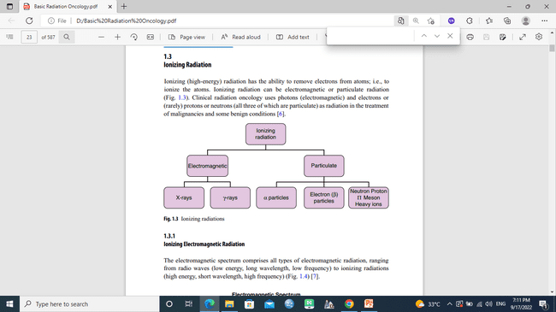
Types of nonionizing electromagnetic radiation: • Radio waves • Microwaves • Infrared light • Visible light • Ultraviolet light
Ionizing (high-energy) radiation has the ability to remove electrons from atoms (to ionize the atoms).

Slide 5
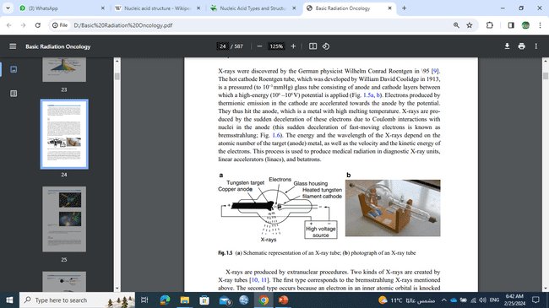
The hot cathode Roentgen tube, which was developed by William David Coolidge in 1913, is a pressured (to 10−3mmHg) glass tube consisting of anode and cathode layers between which a high-energy (10(6) –10(8)V) potential is applied, Electrons produced by thermionic emission in the cathode are accelerated towards the anode by the potential. They thus hit the anode, which is a metal with high melting temperature. X-rays are produced by the sudden deceleration of these electrons due to Coulomb interactions with nuclei in the anode , The energy and the wavelength of the X-rays depend on the atomic number of the target (anode) metal, as well as the velocity and the kinetic energy of the electrons. This process is used to produce medical radiation in diagnostic X-ray units, linear accelerators (linacs)

Slide 6
Two types of x-rays are produced
1-the bremsstrahlung X-rays (Compton interactions)
2- Characteristic X-rays: occurs because an electron in an inner atomic orbital is knocked out by an incoming electron, and the resulting space in the orbital is filled by another electron that moves from an outer atomic orbital, This electron must shed energy to move in this manner, and the energy released is radiated as characteristic X-rays

Slide 7
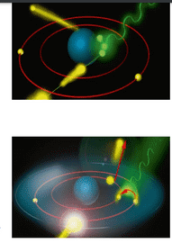
the bremsstrahlung X-rays
Characteristic X-rays

Slide 8
Interaction of ionizing radiation with the matter
Radiation is scattered and absorbed when it passes through tissue; the intensity of radiation constantly decreases as it propagates within tissues. This decrease depends on the type of tissue and its thickness
Three types of interactions are important
Photoelectric effect
Compton effect
Pair production

Slide 9
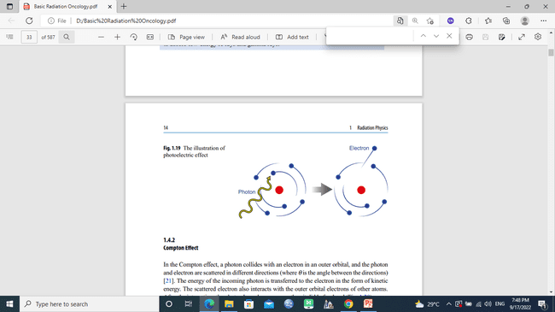
Photoelectric effect: when any electromagnetic radiation reaches a surface, it transfers its energy to the electrons of that surface, which are then scattered, the knocked electrons are of inner shells. This is the basic interaction in diagnostic radiology. It is dominant at energies of less than 35 kV, and in atoms with high atomic numbers (Z)

Slide 10
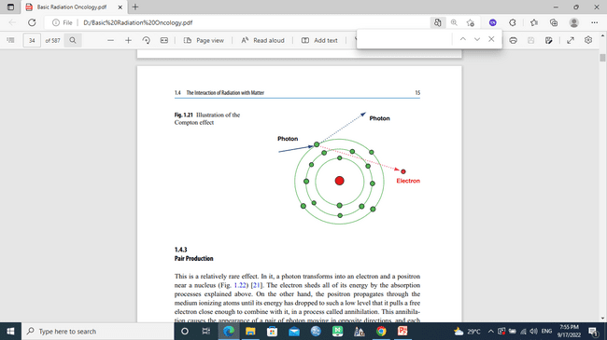
Compton effect: a photon collides with an electron in an outer orbital, and the photon and electron are scattered in different directions. This is the main mechanism for the absorption of ionizing radiation in radiotherapy. It is the dominant effect across a wide spectrum of energies, from 35 kV–50 MV, The absorption of incoming radiation is the same for bone and soft tissues. (depends on electron density of material)

Slide 11
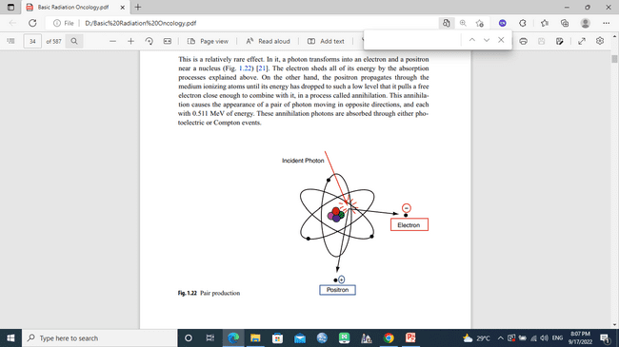
Pair production: a photon transforms into an electron and a positron near a nucleus. The electron sheds all of its energy by the absorption processes explained above, the positron propagates through the medium ionizing atoms until its energy
has dropped to such
a low level that it pulls
a free electron close
enough to combine with it

Slide 12
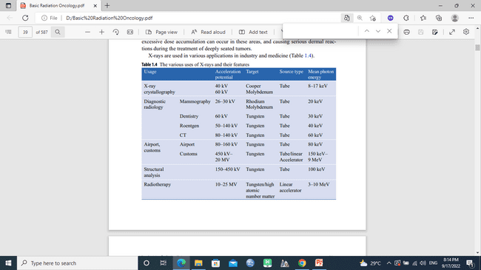
Uses of x-rays

Slide 13
Absorbed dose:
the amount of energy absorbed from a radiation beam per unit mass of absorbent material. It is measured in grays (Gy), although an older unit, the rad, is also still used
Rad: This is the amount of radiation that causes one erg (of energy) to be absorbed per gram of irradiated material (rad=radiation absorbed dose).
1 rad=100 erg/g.
Gray (Gy): This is the amount of radiation that causes one joule to be absorbed per kilogram of irradiated material.
1 Gy=1 J/kg.
1 Gy=100 cGy=100 Rad

Slide 14
Radiotherapy machines
Kilovoltage machines (<1000 kV)
Contact therapy machines: 40–50 kV
Superficial therapy machines: 50-150 kV
Orthovoltage therapy machines: 150-500 kV
Supervoltage therapy machines: 500-1000 kV
Megavoltage machines (>1 MV)
Cobalt 60 teletherapy: the half-life of Co-60 is 5.27 years, Dose rate >150 cGy/min, Two gamma rays with energies of 1.17 and 1.33 MV

Slide 15
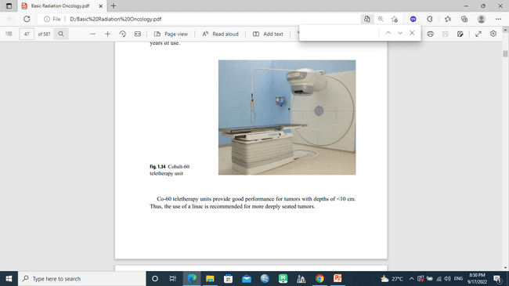
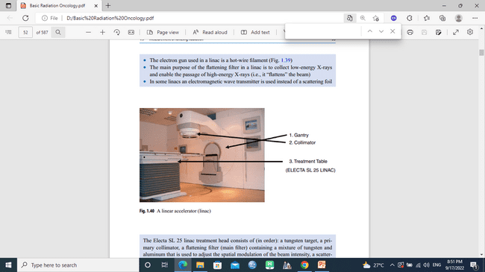
Linear accelerator (linac) Produces several photon and electron energies
Others like microtron, betatron, cyclotron

Slide 16
Electrons, protons, alpha particles, neutrons, and heavy ions are all forms of ionizing particulate radiation. Electrons are normally bound to a (positively charged) nucleus. The number of electrons is equal to the number of protons in a neutral atom. However, an atom can contain more or less electrons than protons, in which case it is known as a negatively or positively charged ion
Neutrons are the neutrally charged particles that enable the formation of stable large atomic nuclei by decreasing the repulsion between the protons in the nucleus. However, neutrons, like protons, actually consist of particles called quarks.

Slide 17
Cellular Effects of Radiation
Ionizing radiation injects energy into a material as it passes through it, like a microscopic bullet, until the radiation is stopped by the material due to absorption In addition, radiation breaks the molecular bonds of the material in its path and changes the structure of the material.
Ionizing radiation can cause breaking, sticking, clamping and curling in chromosomes. Broken chromosomes can reorganize, remain the same, or combine with other chromosomes. All of these events result in mutations or in eventual cell death

Slide 18
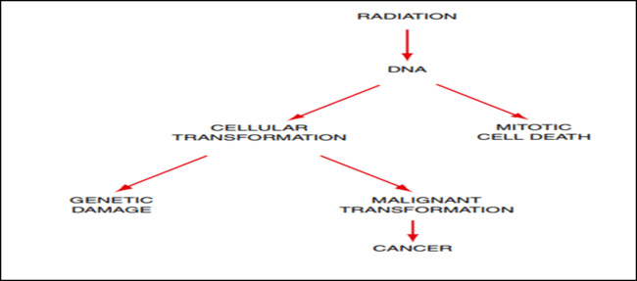
Direct effect: The direct ionization of atoms in DNA molecules is the result of energy absorption via the photoelectric effect and Compton interactions. If this absorbed energy is sufficient to remove electrons from the molecule, bonds are broken, which can break one DNA strand or both, While the direct effect of low linear energy transfer (LET) radiation is largely insignificant, the direct effect dominates for high-LET radiation.
LET → loss of energy per unit tract length

Slide 19
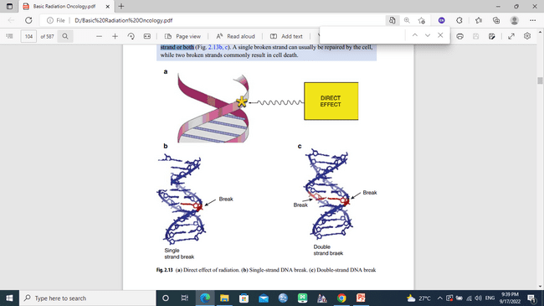

Slide 20
A quarter to a third of the damage produced in cellular macromolecules by radiation is due to its direct effect. This means that most of the damage is caused by the indirect effect of the radiation.
Indirect Effect of Radiation at the Molecular Level: The indirect effect of radiation on molecules includes the formation of free radicals by energy transfer from radiation, and the resulting molecular damage caused by the interactions of these free radicals with DNA, this phenomenon is most probably due to the interaction of radiation with water molecules, since the human body is approximately 70% water.

Slide 21
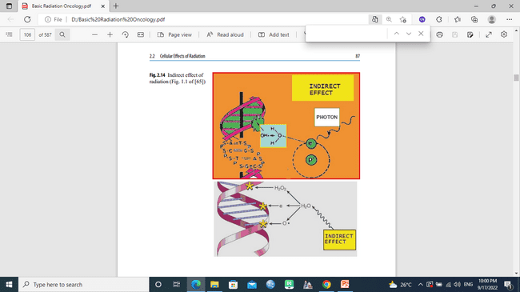

Slide 22
Types of Cellular Damage Due to Radiation
1. Lethal damage. This is irreversible, irreparable damage, resulting in cell death.
• This usually results from the direct effect of radiation.
• Double strand breakage in DNA (+).
• Particularly observed in high-LET radiation.
2. Sublethal damage . SLD can be repaired within hours under normal conditions, unless an additional radiation dose is given (inducing further SLD).
• This generally occurs due to the indirect effect of radiation.
• Single strand breakage in DNA (+).
• Observed in low-LET radiation.

Slide 23
3. Potentially lethal damage: This is repairable damage, the ability of cells to recover from DNA damage depending on the post-irradiation environment. Under normal conditions, this type of damage is lethal to cells undergoing mitosis
However, such damage can be repaired in suboptimal environmental conditions after exposure to radiation because the cell gets the signal of that suboptimal conditions that are not suitable for mitosis are present. The cell then prefers to repair this potential damage rather than initiate mitosis.

Slide 24
Approximately 50–60% of all cases of cancer require radiotherapy at some stage during their treatment.
Radiotherapy Types According to Aim
Curative radiotherapy. This is the application of radiotherapy alone to cure. Used in cases of early-stage Hodgkin’s lymphoma, nasopharyngeal cancer, some skin cancers, and early glottic cancers
Palliative radiotherapy. This is the alleviation of cancer symptoms by applying palliative doses of radiation. Used in cases of brain and bone metastases and superior vena cava syndrome for example.
Prophylactic (preventive) radiotherapy. This is the prevention of possible metastases or recurrences through the application of radiotherapy. An example is whole-brain radiotherapy for acute lymphoblastic leukemia and small cell lung cancer.
Total body irradiation. This is the ablation of bone marrow by radiation in order to suppress the immune system, eradicate leukemic cells, and clear space for transplant cells during bone marrow transplantation conditioning.

Slide 25
B. Radiotherapy Types According to Timing
Adjuvant radiotherapy. Radiotherapy given in combination with another kind of treatment modality.
• If given after surgery → postoperative radiotherapy
• If given before surgery → preoperative radiotherapy (neoadjuvant)
chemo-radiotherapy. Radiotherapy given concurrently with chemotherapy

Slide 26
C. Radiotherapy Types According to Mode
External radiotherapy (teletherapy/external beam radiotherapy). Radiotherapy applied to the body externally using a treatment machine.
Brachytherapy (sealed-source radiotherapy). Radiotherapy performed by placing temporary or permanent radiation sources into body cavities
Intraoperative radiotherapy (IORT). Radiotherapy given under intraoperative conditions, usually by electron beams or low-energy X-rays. It is delivered to the tumor bed just after the resection of the primary tumor, and external radiotherapy is generally required afterwards.

Slide 27
Stereotactic radiotherapy (SRT). Radiotherapy delivered by several beams that are precisely focused on a three-dimensionally localized target. A special frame or a thermoplastic mask is used for CNS tumors, while a body frame may or may not be used for extracranial sites.
• If given in 1-5 fractions in ablative doses → stereotactic radiosurgery (SRS)
• If given in more than five fraction → stereotactic radiotherapy (SRT)

Slide 28
Three-dimensional conformal RT (3D-CRT).
A radiotherapy technique where the dose volume is made to conform closely to the target through the use of 3D anatomical data acquired from CT or MRI imaging modalities. The aim is to apply the maximum dose to the target while sparing neighboring structures as much as possible with the aid of advanced computer software and hardware.

Slide 29
Intensity-modulated radiotherapy (IMRT).
A highly developed form of 3D-CRT. IMRT provides a highly conformal dose distribution around the target through the use of non-uniform beam intensities. This is achieved through using either static or dynamic segments. The isodose distribution can then be matched closely to the target by modulating the intensity of each subsegment.
Cyberknife (robotic radiosurgery).
A type of SRT/radiosurgery technique. It provides frameless treatment of tumors at both cranial and extracranial sites and utilizes a 6 MV linac mounted on a robotic arm as well as a robotic tabletop. Cyberknife has the ability to perform all sorts of advanced radiotherapy techniques, including IMRT, IGRT, breathing-synchronized radiotherapy, tumor-tracking radiotherapy, and SRS/ radiotherapy.

Slide 30
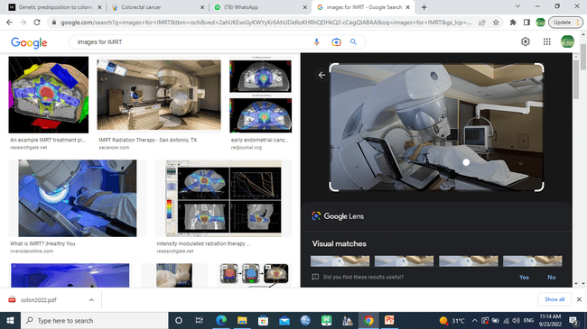
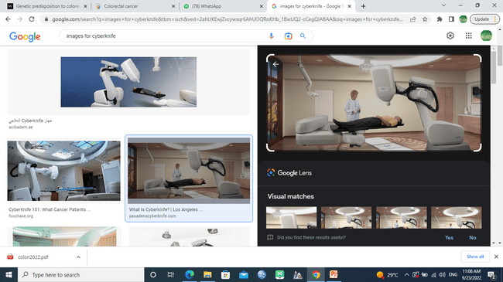
IMRT and Cyberknife

Slide 31
Image-guided radiotherapy (IGRT).
The integration of various radiological and functional imaging techniques in order to perform high-precision radiotherapy. The main aims are to reduce setup and internal margins, and to account for target volume changes during radiation therapy, such as a tumor volume decrease or weight loss (adaptive radiotherapy). This is not an IMRT technique; it enables various radiotherapy techniques, including IMRT, to be delivered more accurately

Slide 32
Tomotherapy. There are two sorts of tomotherapy: serial and helical tomotherapy. Serial tomotherapy utilizes a special collimator system called a MiMIC that is mounted on a classic linac gantry. The table also has a special device called a crane that allows it to be moved with high precision. IMRT is then performed in several arcs. Helical tomotherapy, on the other hand, uses a dedicated tomotherapy machine. It consists of a 6 MV linac mounted on a CT, and it delivers IMRT with spiral movements like those in the CT procedure. Simulations and IMRT are performed within the same machine.

Slide 33
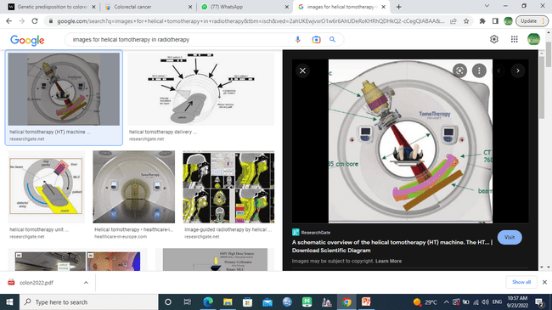
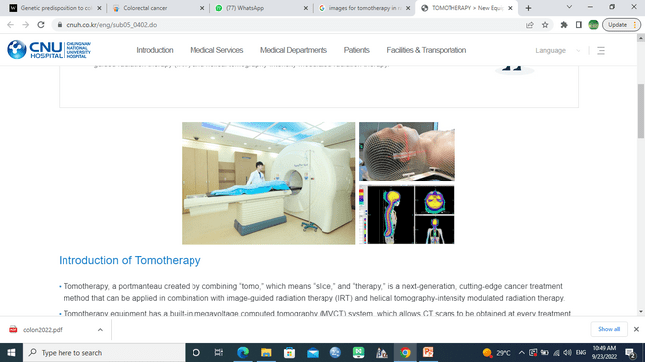
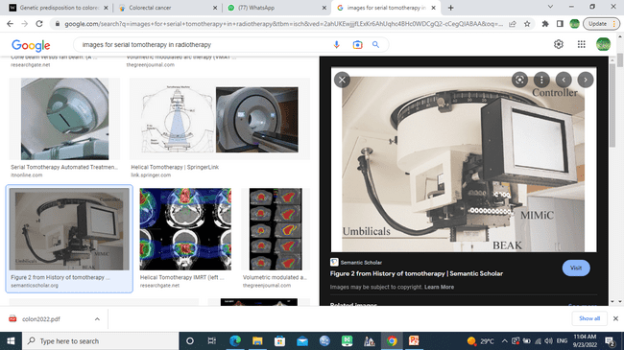

Slide 34
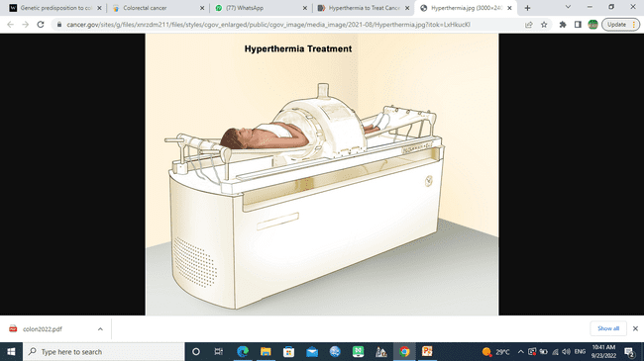
Hyperthermia. Hyperthermia is a type of treatment in which body tissue is heated to as high as 43◦ to help damage and kill cancer cells with little or no harm to normal tissue. Hyperthermia to treat cancer is also called thermal therapy or thermotherapy. This type is used with other forms of treatments (RT, CTR)

Slide 35
Radiotherapy procedure
Radiotherapy is performed by a group of team members, including radiation oncologist, radiation physicist, radiotherapist, dosimetrist, nurse, psychologist and/or social workers. The treatment success in radiotherapy is highly dependent on adequate technical equipment.
Short summary of patient’s age, prominent physical sign, pathology report, stage, and consent of radiotherapy especially if the fields of RT involve important sites (testes, ovaries, eyes)

Slide 36
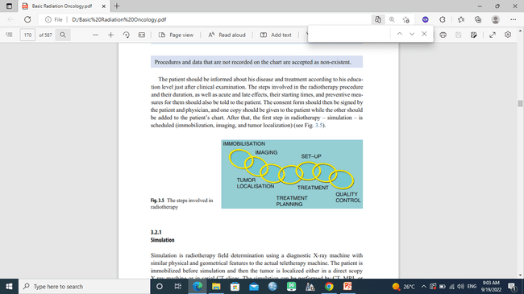
Furthermore, The steps involved in the radiotherapy procedure and their duration, as well as acute and late effects, their starting times, and preventive measures for them should also be told to the patient.

Slide 37
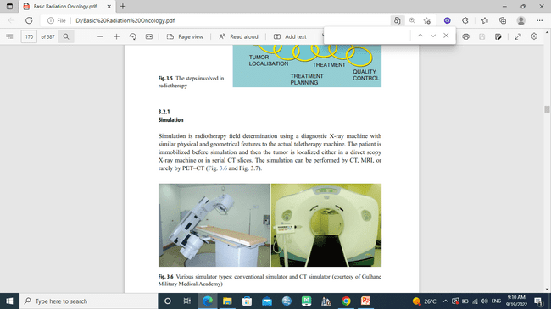
Simulation (simulator)
Simulation is radiotherapy field determination using a diagnostic X-ray machine with similar physical and geometrical features to the actual teletherapy machine. The simulation can be performed by CT, MRI, or rarely by PET–CT

Slide 38
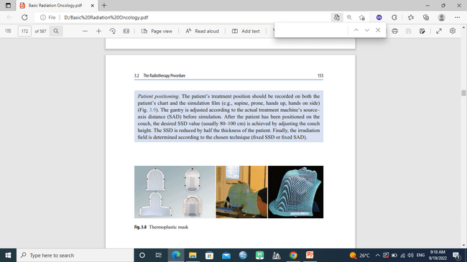
Immobilization: The patient should be positioned in the most comfortable, easily reproducible way that is suitable for the irradiated region of interest, The most frequently used apparatus for immobilization is the thermoplastic mask, baseplate, breast board, etc.

Slide 39
Patient positioning: the patient’s treatment position should be recorded on both the patient’s chart and the simulation film (e.g., supine, prone, hands up, hands on side).
Imaging and tumor localization: the patient is placed on the simulator couch in the required position. The mask, base plate, T-arm, breast board, knee support or any other similar immobilization device is positioned accurately. Oral or IV contrast material can be used if required, also radio-opaque rectal and vaginal applicators. The lasers are turned on and they are positioned at the midline according to the region of interest. Reference points are determined by radio-opaque markers located at the cross-sections of the lasers

Slide 40
Fields determination: The region of interest (that for which serial CT slices are to be taken) is determined by the radiation oncologist, These slices are sent online to the treatment planning room via the network. Delineation by the multileaf collimator (MLC) or the blocks is performed, and critical structures are spared.
Data on the energy, fraction number and dose, and the treatment machine are entered into the planning computer, the doses for the target and the organs at risk are evaluated with the DVH, and the isodoses are carefully checked in each slice.

Slide 41
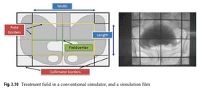
The final verified treatment plan is sent online to the treatment machine via the network, treatment parameters are recorded on the patient’s chart, and isodose curves and DVH printouts are also attached to the chart

Slide 42
Fractionation
Basis of fractionation is repair and repopulation that occurred in normal cells, and sensitization of tumor cells by reoxygenation and redistribution
Types of fractionation
Conventional: 1.8-2 Gy/f, once daily, 5/week, total: 25-35 fractions (most common)
Hyperfractionation: 1.1-1.2Gy, ≥2/day, ≥10/week, total 60-70 fractions
Accelerated: 1.1-2Gy, >1/day, >5/w, 25-35fr.
Hypofractionation: >2Gy/f, ≤5/w, ≤25 f

Slide 43
Aim of fractionation is to
increase local control
increase total dose
decrease normal tissue toxicity
palliate symptoms as in hypofractionation

Slide 44
Side effects of radiation on tissues and organs can be classified into three groups: acute, subacute and chronic.
Acute effects: changes that occur in the first 6 months. If the radiation dose is high enough, the organ’s parenchymal tolerance is exceeded, and organ death occurs. If the dose is low, the organ continues to function fully or partially, even in the presence of parenchymal damage.
Subacute effects: changes that occur between 6 and 12 months. Secondary parenchymal degeneration resulting in decreased resistance to radiation is observed.
Chronic effects: changes that occur after 12 months. Carcinogenesis, genetic mutations and chromosomal aberrations occur.

Slide 45
Examples of acute effects
Dry mouth (xerostomia)
Mouth ulcers
Sore throat
Reduced sense of taste (dysgeusia)
Loss of appetite
Discomfort and swelling
Nausea and vomiting
Diarrhea
Dysuria, urinary irritations
Headache, blurred vision
Temporary hair loss
Mucositis, stomatitis
Infection

Slide 46
Examples of subacute effects
Muscle and joint stiffness
Permanent alopecia
Lung & skin fibrosis
Erectile dysfunction, vaginal dryness
Bowel obstruction secondary to enterocolitis
Fistula formation, bowel perforation, stricture
Skin atrophy, disturbed pigmentation, telangiectasia
Anosmia
Liver atrophy, fat necrosis
Bone fractures
Infertility

Slide 47
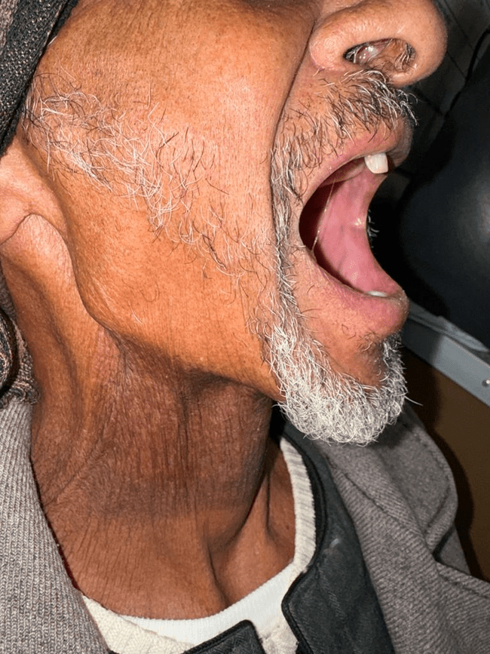
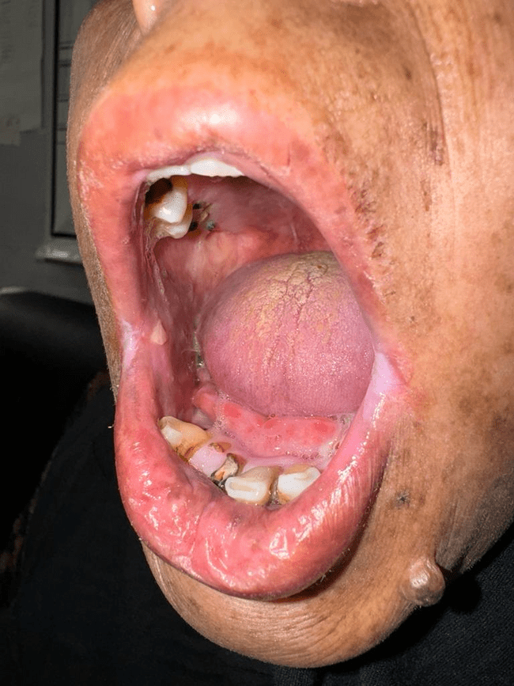

Slide 48
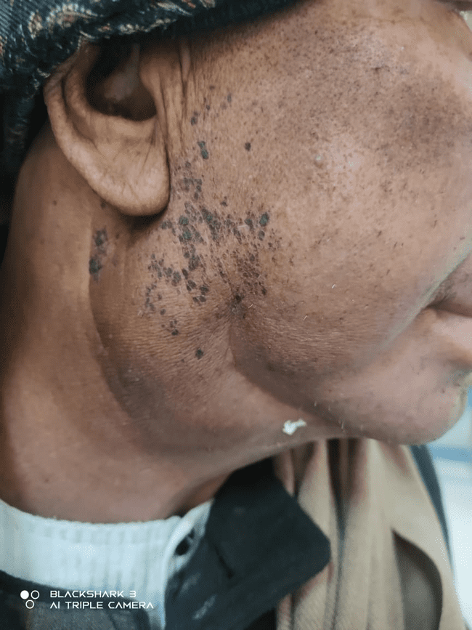
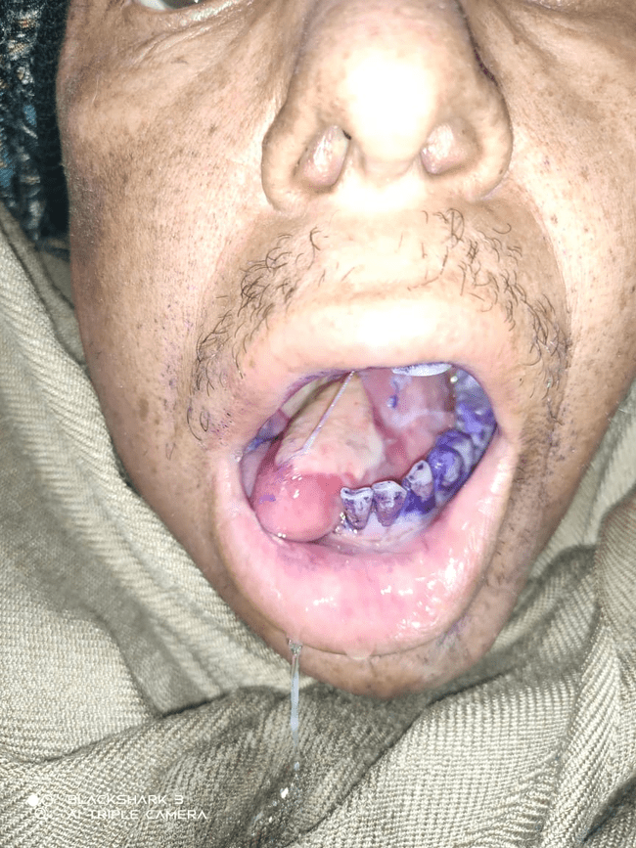

Slide 49
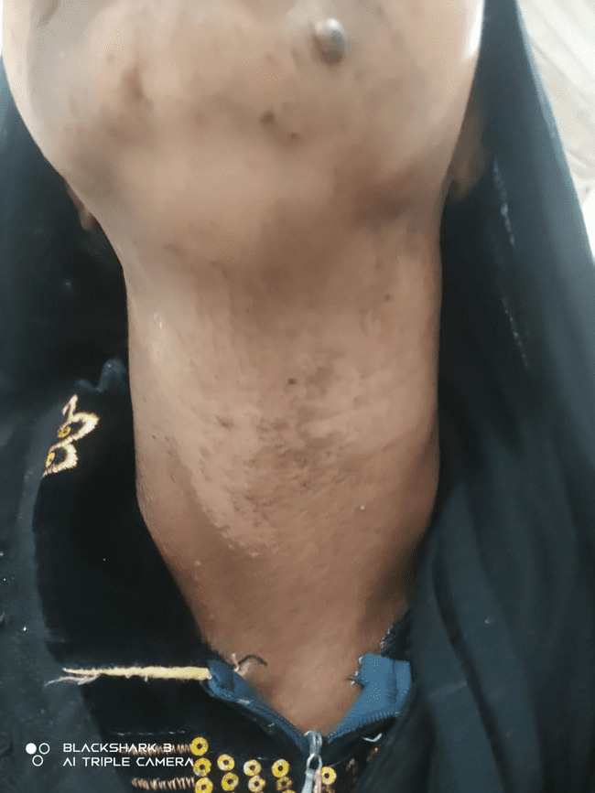

Slide 50
Thank you
Questions???

