Slide 1
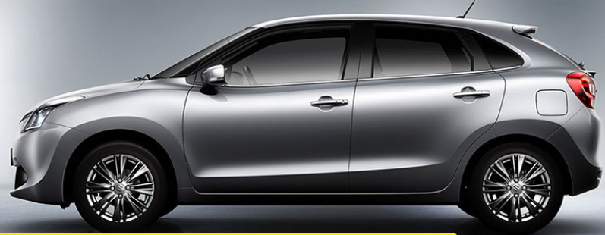

Capstone Project

Slide 2
Why solve this problem?
Problem Statement-1 : Identifying the ownership pattern of cars throughout the
country. This also captures the problem wherein information regarding the
spending patterns can be identified
Problem Statement-2: Identify the type of order each state receives and present it
as an interactive visualization.
Problem Statement : Customer Lifetime value prediction - Based on Customer
segments, predict the revenue that can be extracted from each segment over a
life of the car -Regression/Time Series.

Slide 3
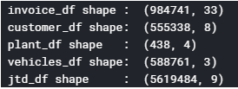
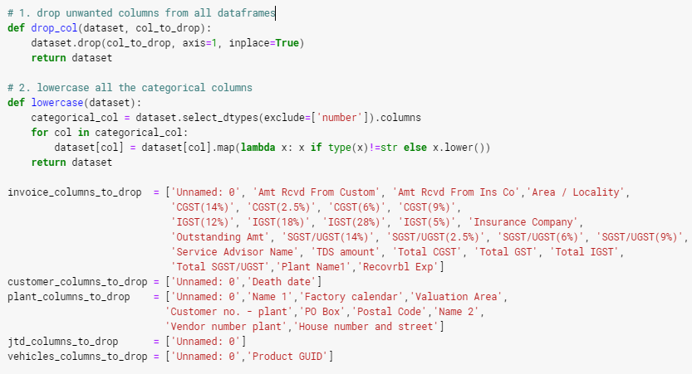
Data Insights

Slide 4
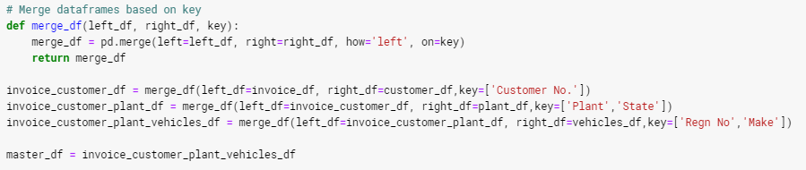




Data Preprocessing: Merge dataframes

Slide 5
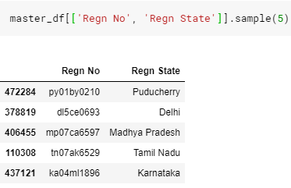
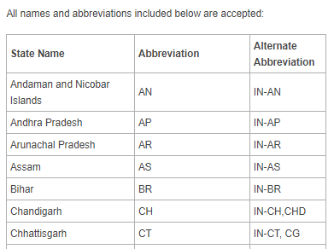
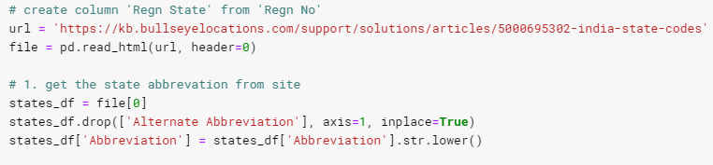
Data Preprocessing

Slide 6
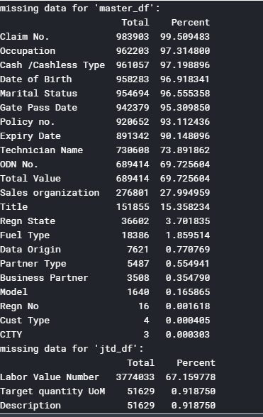
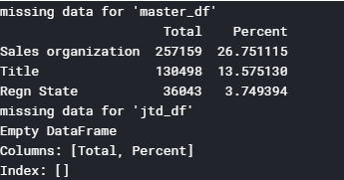
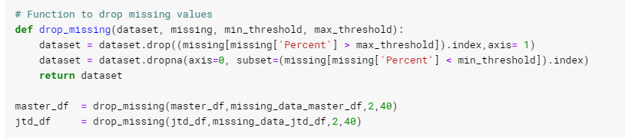
Data preprocessing: Missing Values

Slide 7
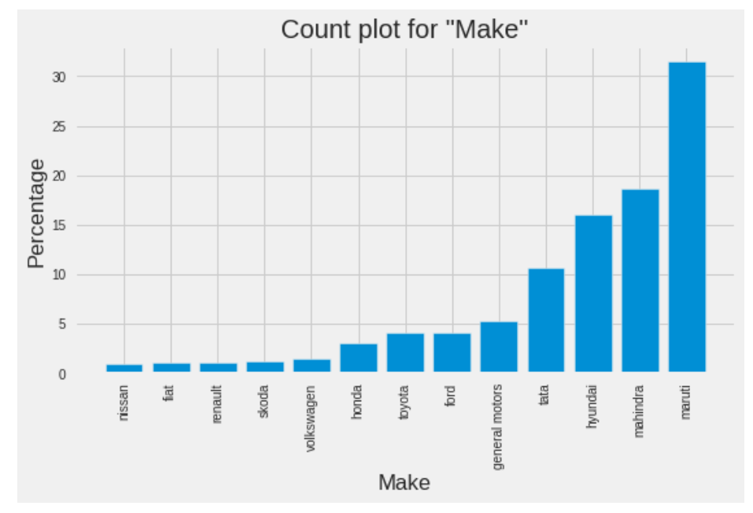
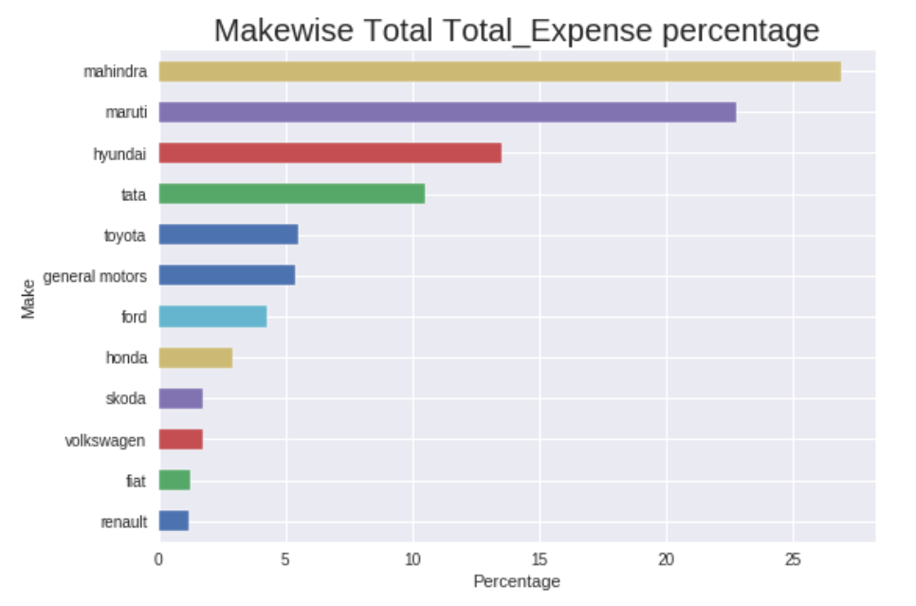
Data Analysis
Observation:
Revenue from ‘Mahindra’ is more though the number of repairs for Maruti is largest

Slide 8
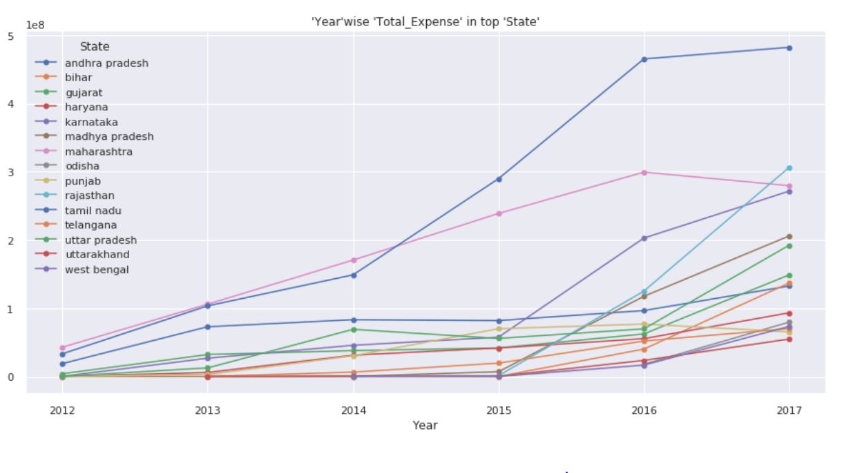
Data Analysis
Observation:
Uttarakhand has the lowest ‘Total_Expense’ but the ‘Tamilnadu’ has increase a lot in the 2014 to 2016

Slide 9
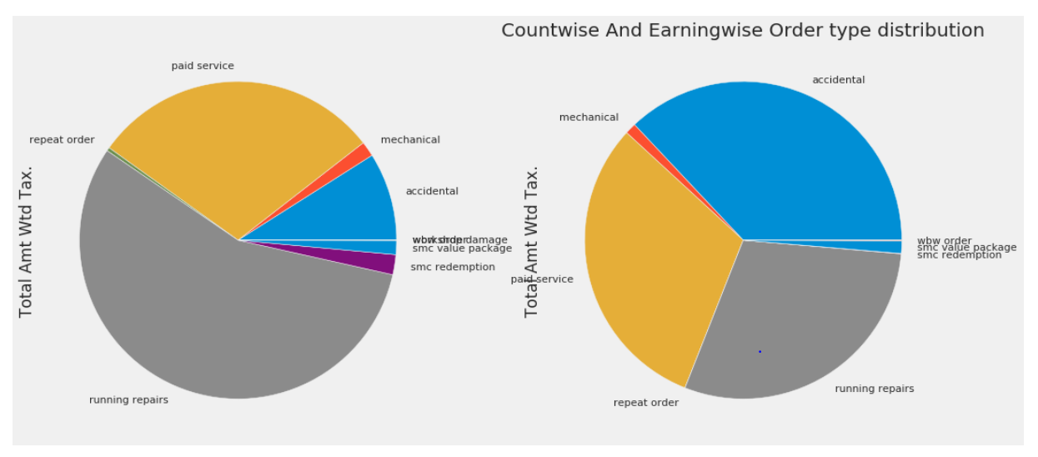
Data Analysis
Observation:
Revenue from accidental is more compare to running repairs though the countwise distribution for running repair is largest

Slide 10
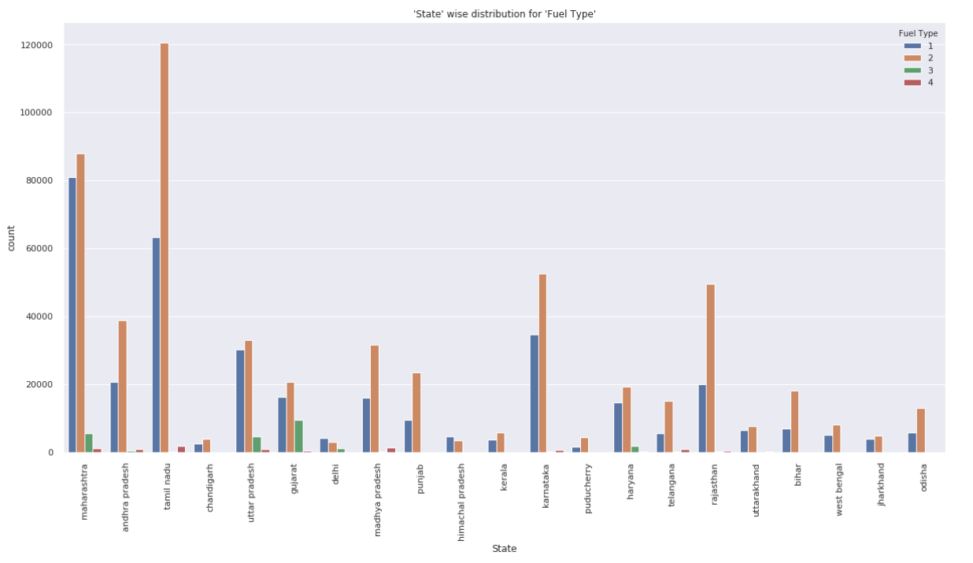
Data Analysis

Slide 11
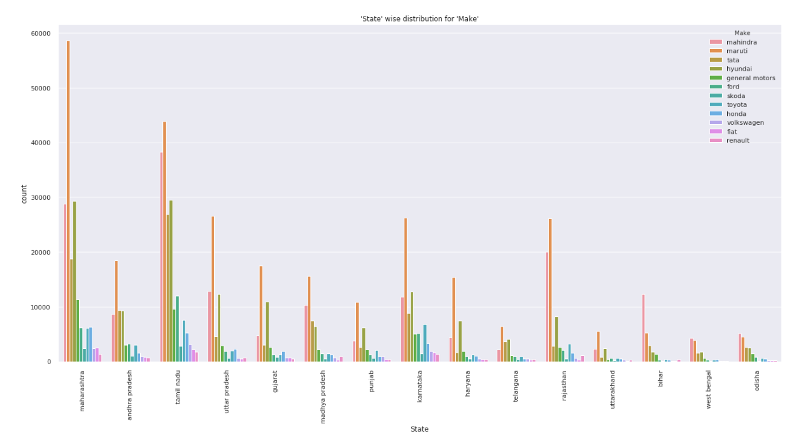
Data Analysis

Slide 12
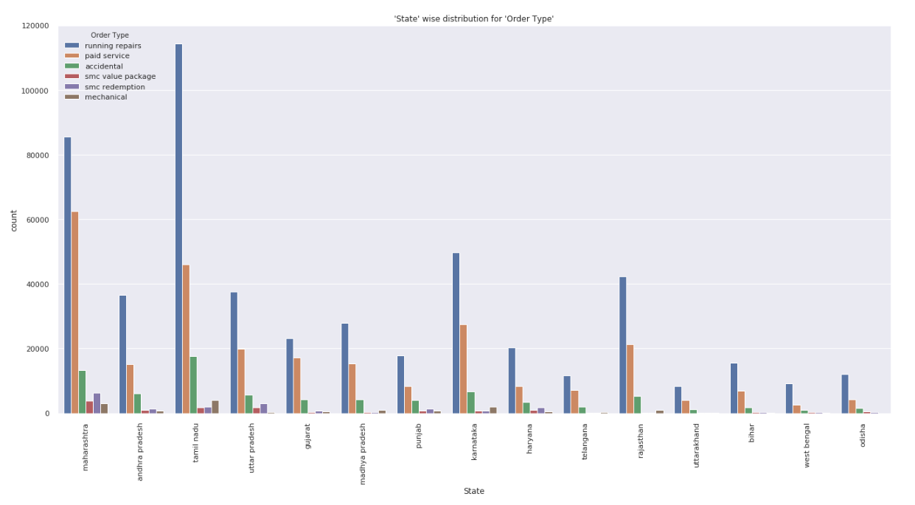
Data Analysis

Slide 13
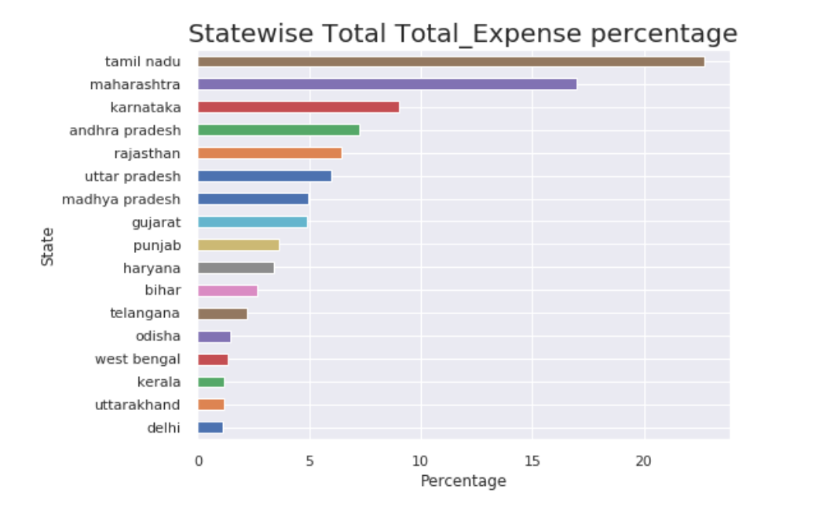
Data Analysis

Slide 14
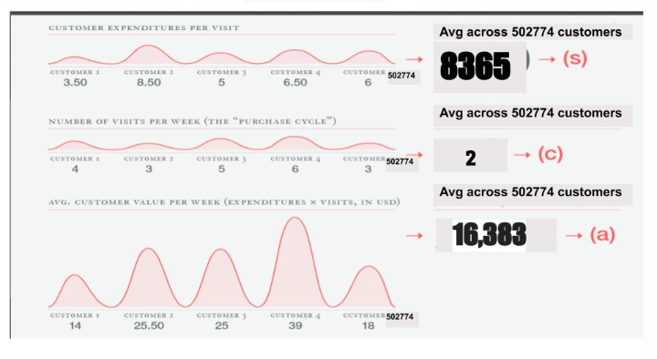
Customer Lifetime Value
Simple Lifetime Value = Months *a * t = 60,3297 (Rs)
t = Average customer lifespan = 3 (Months)

Slide 15
Summary
Using our estimate for Customer Lifetime value, MFC must spend less than Rs. 60,3297 to acquire new customer
If MFC spends more than Rs 60,3297 per acquisition over the course of an average customer lifespan (3 months), there’s a chance that they could be losing money

Slide 16
Thank You

