Slide 1

Networking of a Coffee Brand Syed Musab Pirzada – 25125

Slide 2
Devices
Routers
Switches
Email Server
Web server
DNS Server
DHCP server
Wireless Device
PCs
Laptops
Smartphones
Tablets
Printers

Slide 3

INTRODUCTION
The coffee industry is a highly competitive market, with many well-established brands and new entrants vying for market share
In order to stay ahead of the competition, it is crucial for coffee brands to have efficient and reliable computer network systems in place
The purpose of this report is to examine the computer network systems of leading coffee brands and the impact they have on the overall efficiency and productivity of these businesses

Slide 4
REQUIREMENTS & ANALYSIS
Cisco Packet Tracer
Windows

Slide 5

IP Addressing & Structure

Slide 6
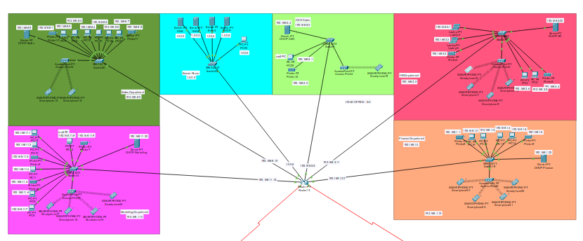
Head office

Slide 7
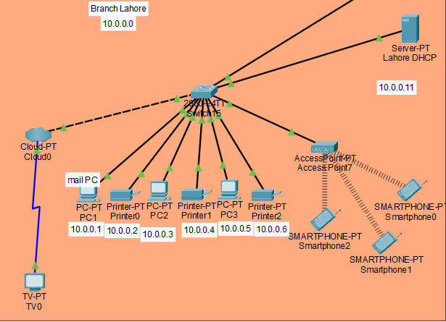
Branch Lahore

Slide 8
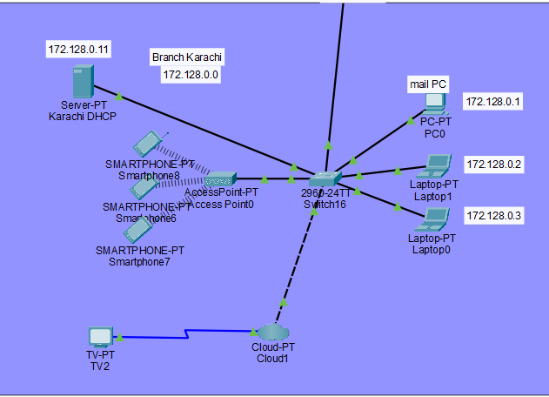
Branch Karachi

Slide 9
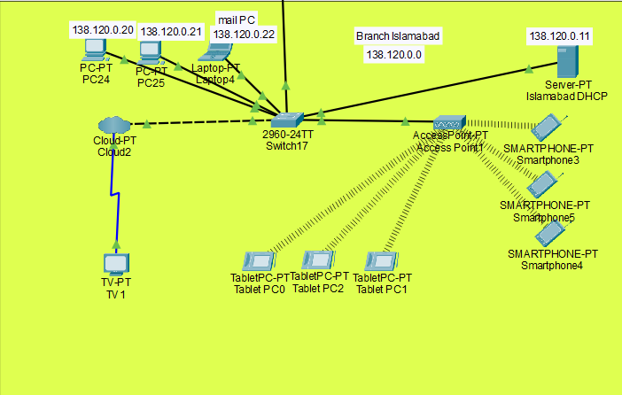
Branch Islamabad

Slide 10
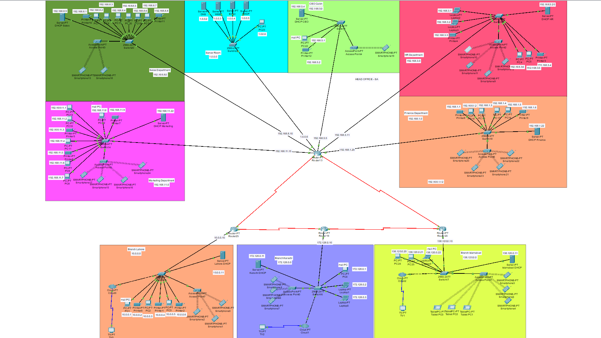
Complete Design

Slide 11
ARCHITECTURE & DESIGN
The Use of RIP routing on Routers
Use of Firewall in DHCP server in Branch Islamabad

Slide 12

EXPERIMENTAL RESULTS
After Checking all the PCs, Laptops, Smartphones they are pinging with each other.
Web browser is getting data from web server.
DNS server allocating domain name to IP address.
DHCP is providing IP addresses.

Slide 13
CONCLUSION
It is clear that computer network systems play a critical role in the coffee industry, and that it is crucial for coffee brands to have efficient and reliable systems in place to stay competitive in the market
In summary, coffee brands that invest in advanced computer network systems and keep them up to date, will be well-positioned to manage their operations more efficiently, enhance customer experience and increase their chances of success in the industry
This report provides valuable insights for coffee industry professionals and those looking to improve their network systems

