Slide 1
REAL-FAKE JOB PREDICTION MODEL
PROJECT TITLE

Slide 2
> The Problem statement is to develop a robust machine learning model capable of accurately distinguishing between real and fake job postings in online job listings. > The dataset available for training and evaluation exhibits a significant class imbalance, with a disproportionately small number of fraudulent job postings compared to legitimate ones.
PROBLEM STATEMENT

Slide 3
UNIQUENESS
Human Impact: Unlike many other fraud detection tasks that primarily concern financial losses. By accurately identifying fraudulent job listings, this project has the potential to protect job seekers from scams, ensuring their safety and well-being in the digital job market.
Complexity of Data:
The imbalanced nature of the dataset adds an additional layer of complexity to the project. Dealing with skewed class distributions requires specialized techniques and careful model evaluation to achieve reliable results.

Slide 4
DATASET
Size: The dataset comprises approximately 17880 rows. Attributes: It contains 17 different columns/features, capturing various aspects of job postings such as job title, description, company information, salary, location, and more. Class Imbalance: The dataset exhibits significant class imbalance, with only approximately 5% of the entries labeled as fraudulent (class 1), while the vast majority, around 95%, are labeled as non-fraudulent (class 0). Source: Dataset Link [Kaggle]

Slide 5

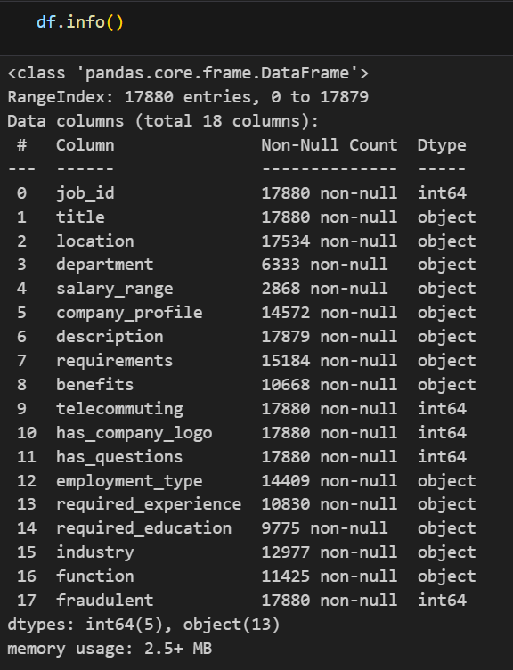
df.head()
df.info()

Slide 6
Table of Contents :
Exploratory Data Analysis (EDA)
Data Pre-Processing
Modeling
Sampling Techniques
Results & Conclusions

Slide 7
EXPLORATORY DATA ANALYSIS
01

Slide 8
1. Missing Values: The EDA begins by visualizing the missing value status of the dataset using a heatmap. 2. Class Distribution: The distribution of the target variable ('fraudulent') is visualized using a pie chart to understand the imbalance between fraudulent and non-fraudulent job postings. 3. Feature Distribution: The distribution of categorical features such as employment type, required experience, required education, job functions, telecommuting, and company logo presence are visualized using count plots. 4. Pairwise Scatter Plot Matrix: A pairwise scatter plot matrix is generated to visualize the relationships between pairs of numerical variables in the dataset.

Slide 9
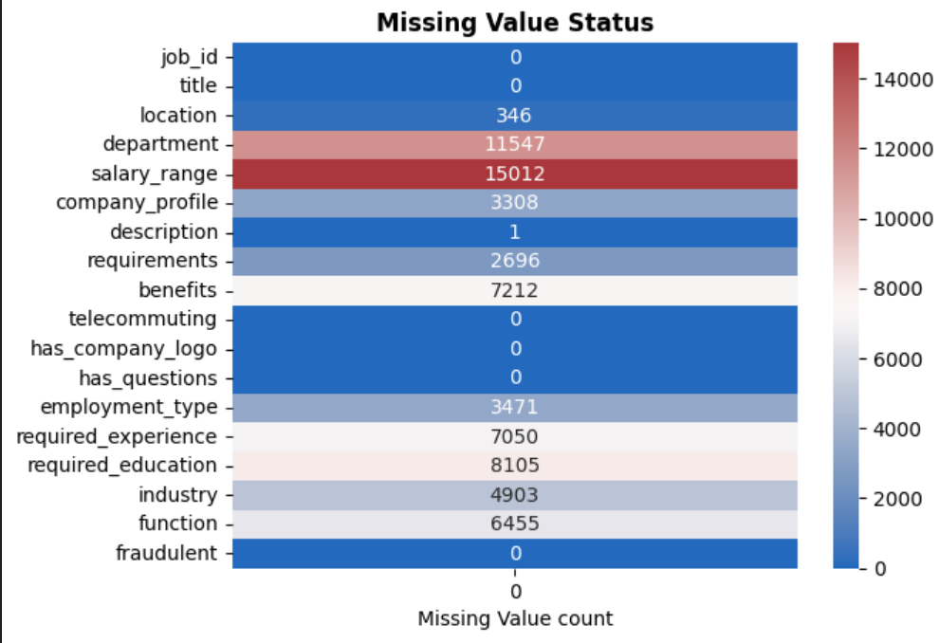
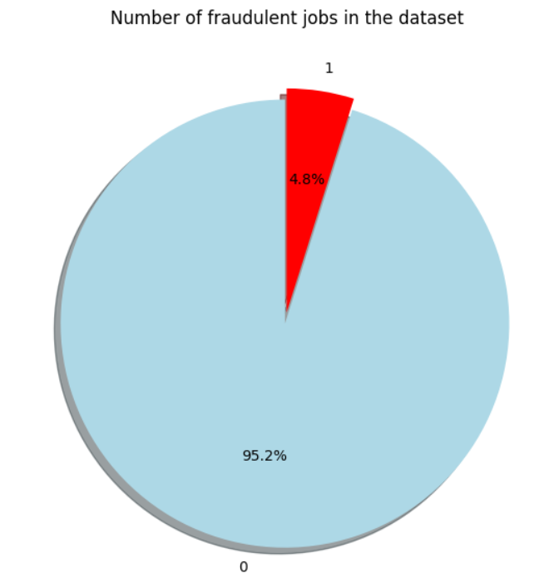

Slide 10
DATA PROCESSING
02

Slide 11
1. Handling Missing Values: Missing values in the dataset are addressed by filling them with appropriate strategies. For categorical columns missing values are filled with the mode (most frequent value). Text-based columns are filled with 'Not provided’. 2. We’re dropping the column department as it has 70% of NULL values. 3. Label Encoding: Categorical variables are encoded using Label Encoding to convert them into numerical format, which is suitable for machine learning algorithms. 4. Splitting Data: The dataset is split into features (X) and the target variable (y). Additionally, the data is split into training and testing sets using the train_test_split function

Slide 12
Imbalance SAMPLING TECHNIQUES Employed
03

Slide 13
SMOTE (Synthetic Minority Over-sampling Technique): SMOTE is applied to generate synthetic instances for the minority class, thereby balancing the dataset. After applying SMOTE, the dataset’s class distribution is visualized, and the performance of machine learning models trained on the balanced dataset is evaluated using metrics such as accuracy, precision, recall, and F1-score.

Slide 14
Oversampling: Random oversampling is employed to increase the number of minority class instances, achieving a more balanced dataset. Similar to SMOTE, the performance of models trained on the oversampled dataset is evaluated and compared to models trained on the original imbalanced dataset. Undersampling: Random undersampling is used to reduce the number of majority class instances, creating a more balanced dataset. Models trained on the undersampled dataset are evaluated to assess their performance in classifying fraudulent and non-fraudulent job postings.

Slide 15
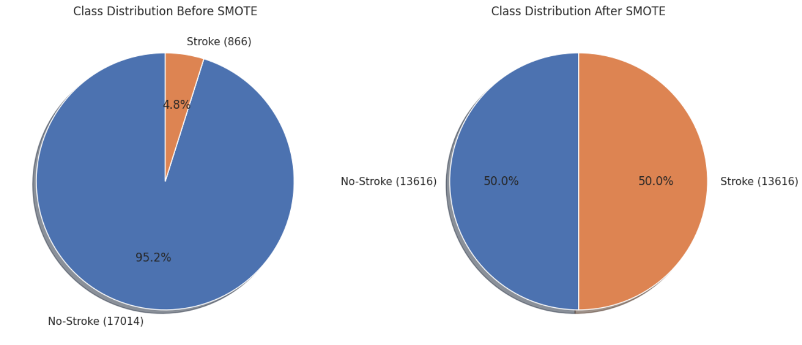

Slide 16
MODELING
04

Slide 17
Model Selection : 1. Logistic Regression 2. Decision Tree Classifier 3. Random Forest 4. XGBoost 5. SVM (Support Vector Machine)

Slide 18
Training and Evaluation: Each model is trained on the training dataset after pre processing the data and evaluated using various performance metrics such as accuracy, precision, recall, and F1-score. Confusion Matrix and ROC Curve: For each model, a confusion matrix is plotted to visualize the model's performance in terms of true positives, true negatives, false positives, and false negatives. Additionally, the ROC (Receiver Operating Characteristic) curve is plotted along with the AUC (Area Under the Curve) score to evaluate the model's ability to distinguish between classes.

Slide 19
RESULTS & CONCLUSION
05

Slide 20
SMOTE Results: The performance metrics of models trained on datasets generated using SMOTE are provided. The results highlight the impact of SMOTE in balancing the dataset and improving model performance in classifying fraudulent and non-fraudulent job postings. Logistic Regression: Accuracy = 78.92%, Precision = 77.74%, Recall = 82.21%, F1 Score = 79.91% Decision Tree Classifier: Accuracy = 97.26%, Precision = 96.79%, Recall = 97.87%, F1 Score = 97.33% Random Forest Classifier: Accuracy = 99.15%, Precision = 99.20%, Recall = 99.13%, F1 Score = 99.17% XGBoost: Accuracy = 99.11%, Precision = 98.75%, Recall = 99.53%, F1 Score = 99.13% SVM: Accuracy = 75.53%, Precision = 78.01%, Recall = 72.03%, F1 Score = 74.90%

Slide 21
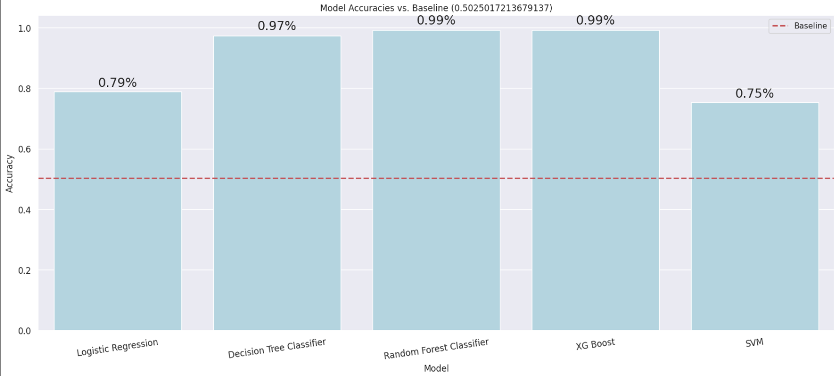
Model Accuracy vs Baseline

Slide 22
Undersampling Results: The performance metrics (accuracy, precision, recall, and F1-score) of ML models trained on datasets generated using undersampling techniques are presented. The results show how well the models classify fraudulent and non-fraudulent job postings after balancing the dataset through undersampling. Logistic Regression: Accuracy = 77.90%, Precision = 81.63%, Recall = 77.92%, F1 Score = 79.73% Decision Tree Classifier: Accuracy = 85.87%, Precision = 89.66%, Recall = 84.42%, F1 Score = 86.96% Random Forest Classifier: Accuracy = 92.75%, Precision = 94.67%, Recall = 92.21%, F1 Score = 93.42% XGBoost: Accuracy = 93.48%, Precision = 95.95%, Recall = 92.21%, F1 Score = 94.03% SVM: Accuracy = 59.06%, Precision = 72.53%, Recall = 42.86%, F1 Score = 53.79%

Slide 23
Oversampling Results: Similarly, the performance metrics of models trained on datasets generated using oversampling techniques are presented. These results demonstrate the effectiveness of oversampling in improving model performance and addressing class imbalance. Logistic Regression: Accuracy = 77.42%, Precision = 78.48%, Recall = 76.78%, F1 Score = 77.62% Decision Tree Classifier: Accuracy = 99.28%, Precision = 98.61%, Recall = 100.0%, F1 Score = 99.30% Random Forest Classifier: Accuracy = 99.94%, Precision = 99.89%, Recall = 100.0%, F1 Score = 99.94% XGBoost: Accuracy = 99.72%, Precision = 99.46%, Recall = 100.0%, F1 Score = 99.73% SVM: Accuracy = 74.11%, Precision = 77.27%, Recall = 69.76%, F1 Score = 73.32%

Slide 24
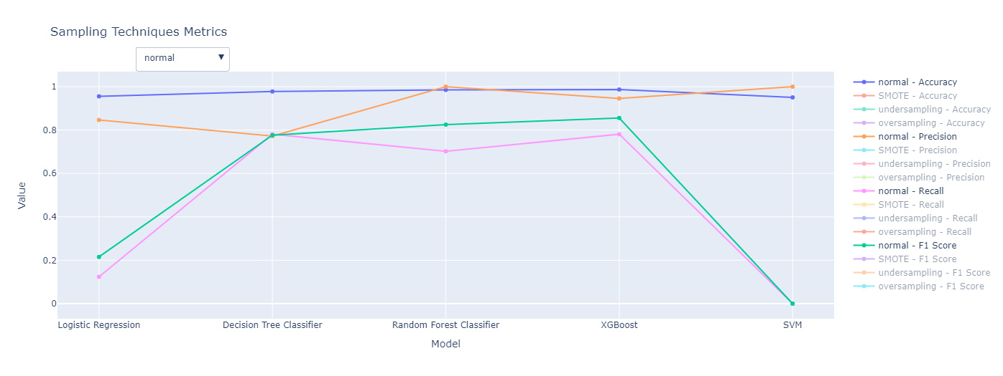
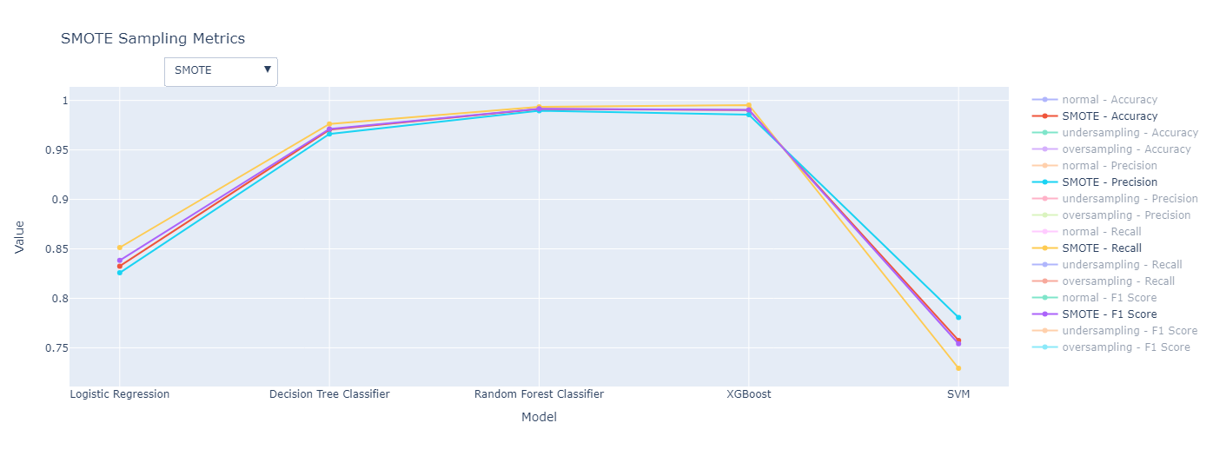
Visualisation

Slide 25
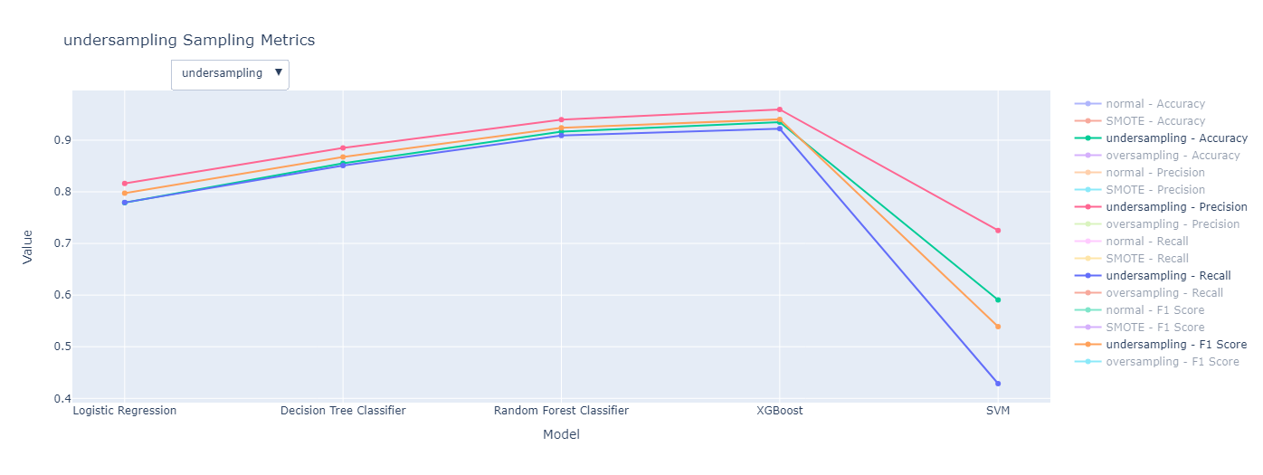
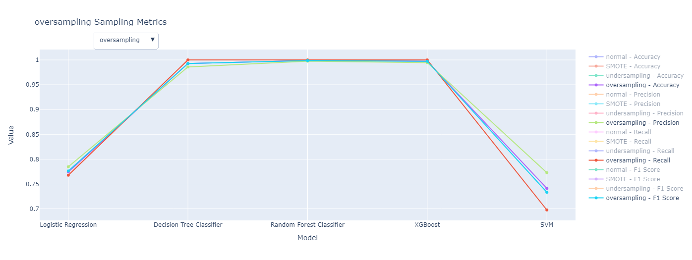

Slide 26
Conclusions [ Top learning’s in this project ]: SMOTE : appears to perform the best across most models, showing high accuracy and balanced performance in terms of precision, recall, and F1-score. Oversampling techniques also yield competitive results, particularly with Decision Tree, Random Forest, and XGBoost models, achieving very high accuracy and balanced metrics. Undersampling shows comparatively lower accuracy and mixed performance in terms of precision, recall, and F1-score, especially with Logistic Regression and SVM models. So, if you prioritize balanced performance across different metrics, SMOTE appears to be the best sampling technique in this scenario.

Slide 27
Thank you!!

