Slide 1

UE22AM342BA2 – Deep Learning on Graph
Course Project
Project Title : MULTI MODAL MEME VIRALITY PREDICTION USING HYPERGRAPH NEURAL NETWORKS
Name: K Bhavish Raju SRN: PES1UG22AM078
Name: K Musadiq Pasha SRN: PES1UG22AM079
Name: M Govindarajan SRN: PES1UG22AM089

Slide 2
Topic
PROBLEM STATEMENT
Social media content, especially memes spreads at unprecedented speed, often going viral within hours. However, the factors that govern virality are complex and multi-modal, involving text, images, timing, engagement, and platform dynamics. Understanding these factors is crucial for creators looking for reach, marketing, analyzing current public trends, etc.
The project addresses the challenge of predicting meme virality on social media platforms, specifically whether a meme will achieve high or low engagement based on multimodal features. The classification task involves determining if a meme will surpass a viral threshold score, effectively dividing memes into two classes: viral (high engagement) and non-viral (low engagement).

Slide 3
Uniqueness
This project stands out in several ways:
Multimodal Integration: Unlike traditional content analysis that focuses on a single data type, this approach integrates three distinct modalities: image features, text features, and categorical metadata
Hypergraph Neural Network Application: The application of hypergraph neural networks (HGNNs) to meme virality prediction represents an innovative approach that can capture more complex relationships between data points.
Time-Contextual Analysis: The model incorporates temporal features by extracting time-of-day patterns from posting timestamps, acknowledging that posting timing influences content performance.
This is an interesting topic as it can be a very impactful application and a good use of Hypergraphs.

Slide 4
Dataset
Dataset used was a Reddit based meme dataset.
Initially we used the reddit api to collect all the memes images from different subreddits.
We then performed OCR on the images to extract text from the same.
The dataset consisted of timestamp, subreddit information, extracted text content, images, which were of great importance.
The dataset consisted of 5601 samples.
There was a metadata csv which consisted of the above mention meta data of the images.
And then there was an image folder consisting of images. These were matched with the image name in the csv file.
Dataset Link: https://www.kaggle.com/datasets/musadiqpashak/meme-dataset

Slide 5
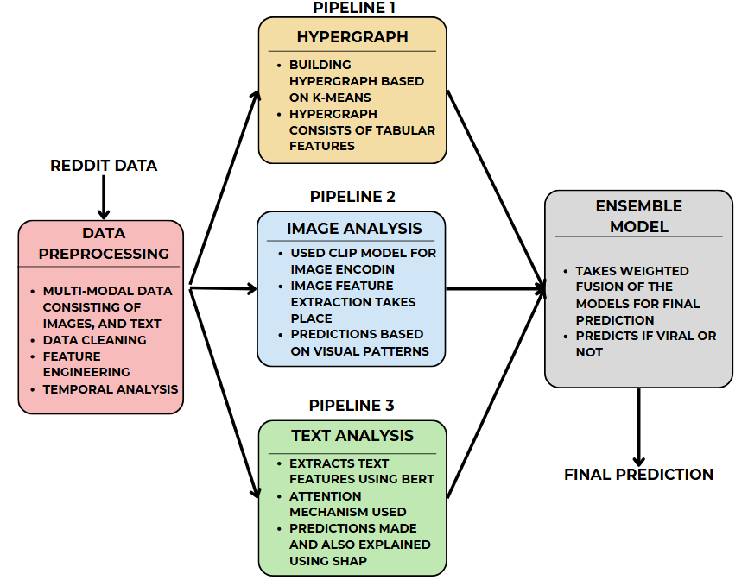
Overall design or approach in a free hand diagram
APPROACH 1

Slide 6
Overall design or approach in a free hand diagram
APPROACH 1
In this approach we use 3 different pipelines or models.
HYPERGRAPH APPROACH: Created hyperedges by clustering samples based on tabular features (time of day, section encoding).
Image Analysis with CLIP: Used OpenAI's CLIP (Contrastive Language-Image Pre-training) to generate embeddings for meme images. Built a custom classifier on top of CLIP embeddings with a 2-layer neural network.
Text Analysis with BERT: Applied BERT tokenizer to meme text. Interpreted model decisions using attention weights. Used SHAP values to explain predictions based on text input.
Finally the models were fused into an ensemble model for final predictions.

Slide 7
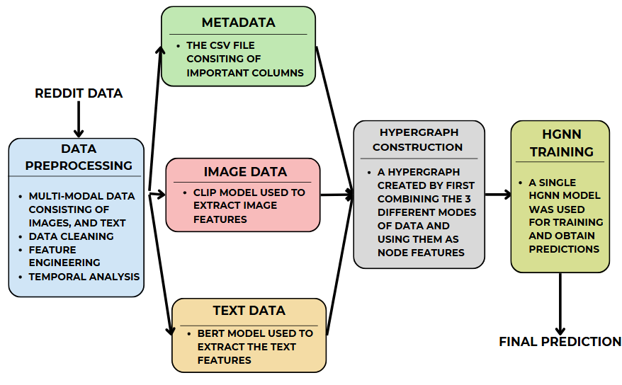
Overall design or approach in a free hand diagram
APPROACH 2

Slide 8
Overall design or approach in a free hand diagram
APPROACH 2
In this approach we use a single HYPERGRAPH Training method.
First data extraction is done. Tabular data already available form the csv file was preprocessed.
Then the image data and the text data was given to the CLIP and BERT model respectively for images and text feature extraction. These features were then combined.
This combined data was then used to build hypergraphs with the node features being this data for each meme.
Next the hypergraph was trained using HGNN.
Final predictions were then made

Slide 9
Final results so far
IN APPROACH 1:
We are evaluating all four of our models (tabular metadata, text, image and ensemble) using the same comprehensive set of metrics
Class-wise metrics - Precision, Recall, F1-score and Support
Overall metrics - Accuracy, Macro avg, Weighted avg
The results can be seen in the next slides:

Slide 10
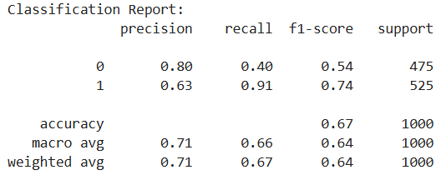
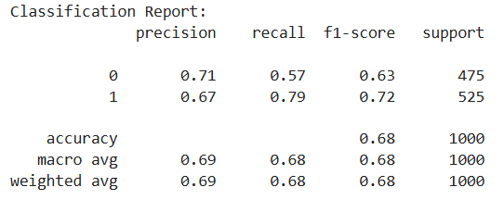
Final results
Hyper Graph Model
Achieves the highest precision for class 0 (0.80) but lowest recall (0.40), indicating it's very selective but misses many class 0 instances
Shows excellent recall for class 1 (0.91), suggesting it captures most class 1 instances
Overall accuracy is 0.67, with consistent macro and weighted averages (0.71 for precision, ~0.65 for recall)
Image Model
More balanced performance across both classes compared to the hyper graph
Class 1 has better overall metrics than class 0
Slightly higher overall accuracy (0.68) than the hyper graph model
Very consistent macro and weighted averages (0.69 for precision, 0.68 for recall and F1)
Hyper graph
Image model

Slide 11
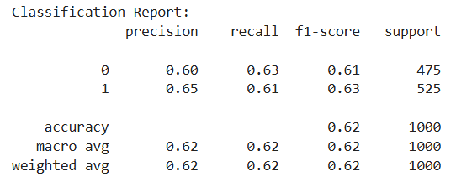
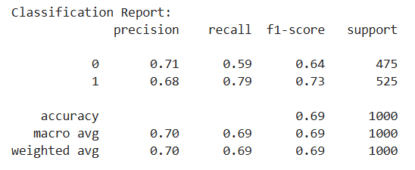
Final results
Text Model
Lowest overall performance of the four models (0.62 accuracy)
More balanced between classes but with generally lower scores
Perfectly consistent macro and weighted averages (0.62 across precision, recall, and F1)
Shows similar recall for both classes (0.63 and 0.61)
Ensemble Model
Highest overall accuracy (0.69) of all four models
Strong recall for class 1 (0.79) while maintaining decent recall for class 0 (0.59)
Most balanced F1-scores between classes (0.64 and 0.73)
Shows good precision-recall trade-off for both classes
Text model
Ensemble model

Slide 12
Final results so far
IN APPROACH 2:
The Hyper GNN model gives a result of about 65 to 66% accuracy.
This shows that though hypergraphs help analyze complex relationships, the different perceptions on virality and the unpredictable nature of what goes viral is still a hard problem to solve.
Also the measure for virality is also a tough one and hence our results are not the best one could expect.
The unpredictable nature of virality makes this a tough problem to solve but hypergraphs have done a decent job in the same.

Slide 13
Final results so far
Overall on comparing the 2 approaches, both of them perform equally well.
The ensemble model takes a small edge over the single hypergraph model.
The not so high accuracies are partially due to low dataset and as well as the unpredictable nature of the virality trends. Virality is something hard to analyse and the hypergraphs have done a decent job if not the best.
Main CHALLENGES are deciding what is viral and also complex patterns of virality trends in today's world

Slide 14
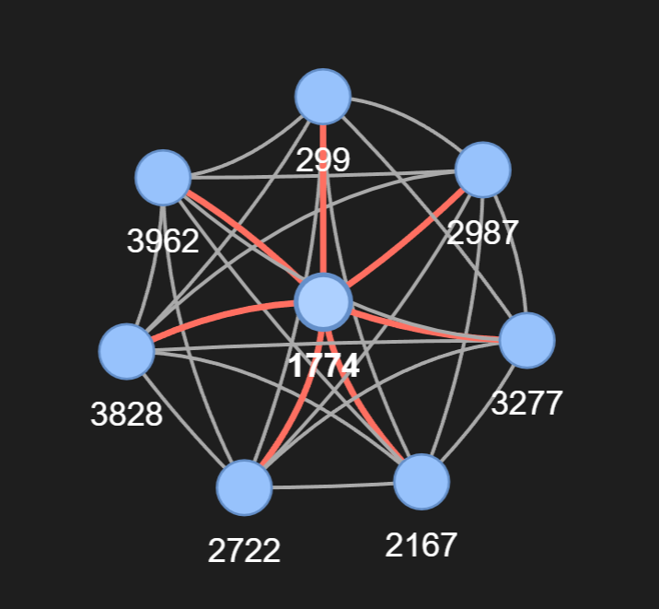
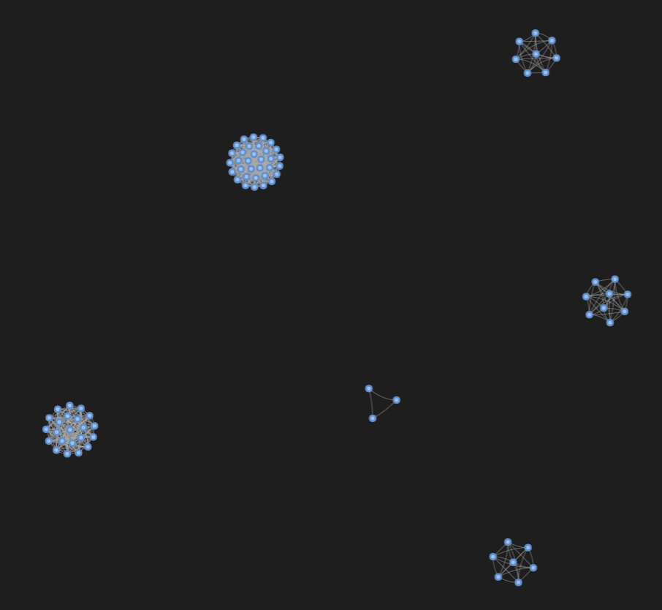
Final results so far
HyperGraph Visualization

Slide 15
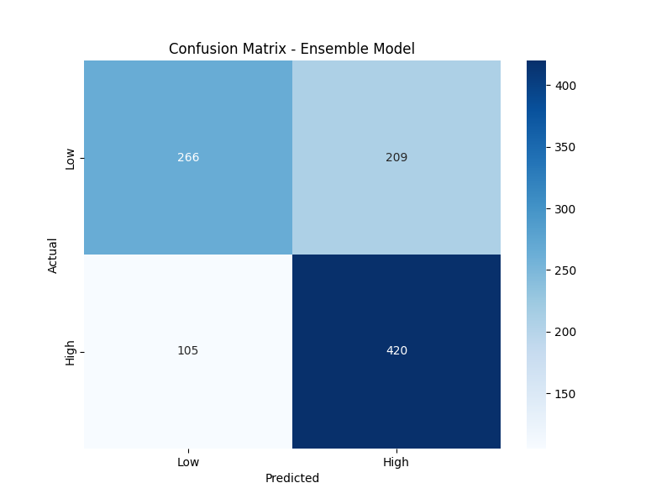
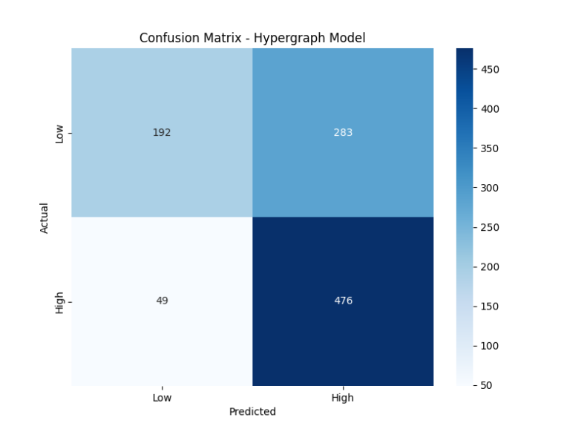
Final results so far
Confusion Matrix

Slide 16
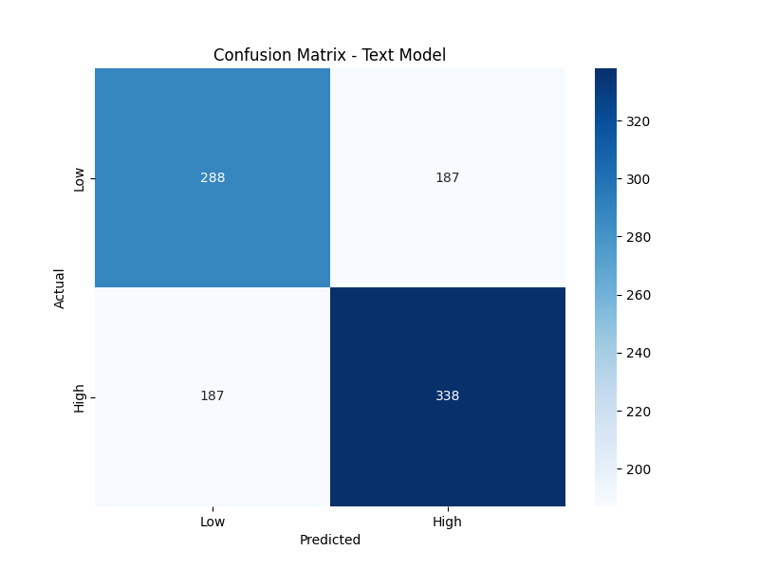

Final results so far

Slide 17
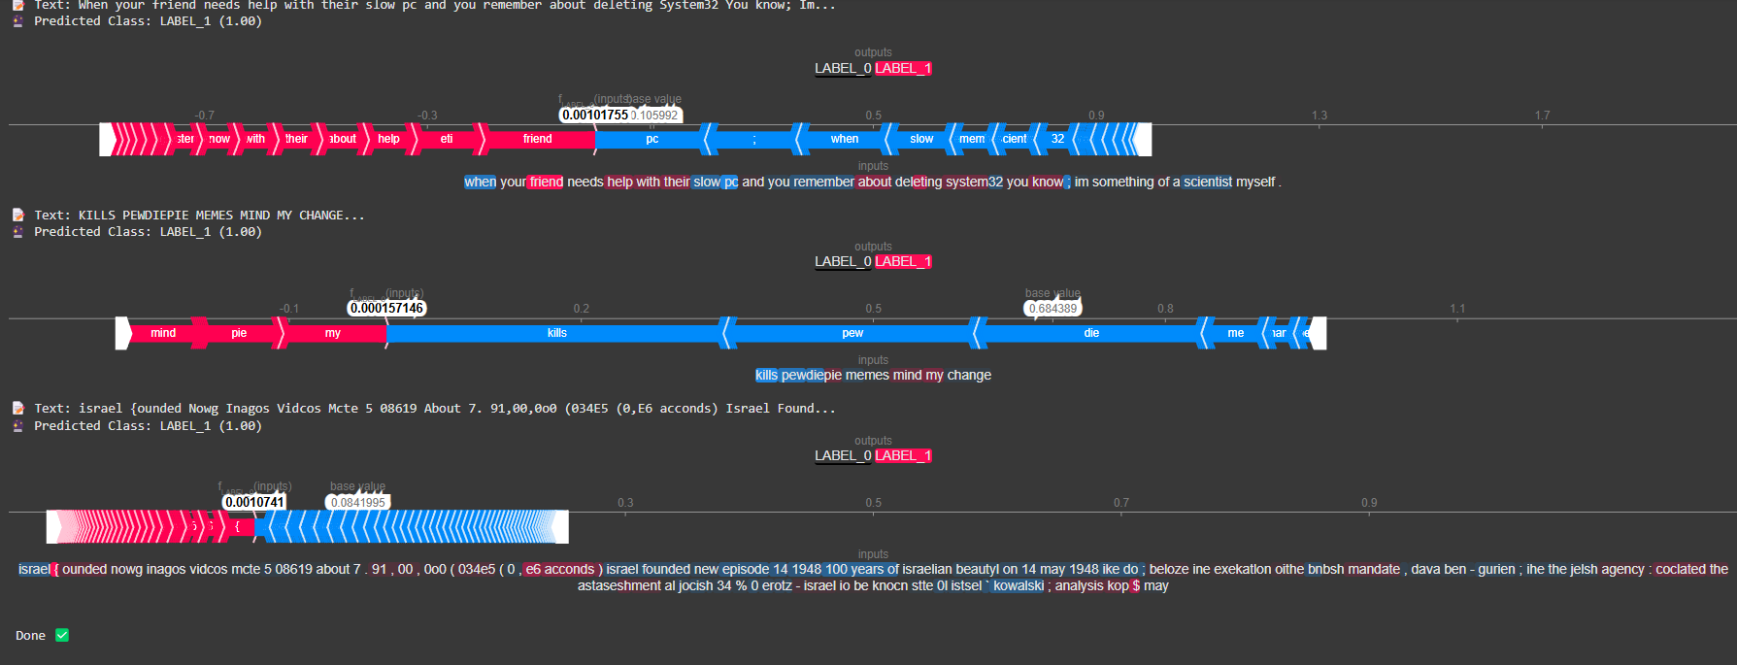
Final results so far
Shap Visualization

Slide 18
Done vs Remaining to be done ?
No | Description | Done or To be done
1 | Data loading and preprocessing | Done
2 | Hypergraph-based model implementation and training | Done
3 | Image model (CLIP) implementation and training | Done
4 | Text model (BERT) implementation and training | Done
5 | Ensemble model combining all three pipelines | Done
6 | Model evaluation and performance comparison | Done
7 | Implementation of inference functions for all models | Done

Slide 19
Quantity and quality of work
no | Code functionality | % Complete | Runs without problem (Y/N) | If there are minor issues, indicate
1 | Data preprocessing and visualization | 100% | Y | None
2 | Hypergraph model implementation | 100% | Y | None
3 | Image classification with CLIP | 100% | Y | None
4 | Text classification with BERT | 100% | Y | None
5 | Ensemble model integration | 100% | Y | None
6 | Inference functions for all models | 100% | Y | None
7 | Visualization and explainability features | 90% | Y | Some visualizations might not display in certain environments

Slide 20
Top few learning
Serial No | Top learning in this project
1 | Hypergraph neural networks can effectively capture complex relationships in tabular data for predicting meme virality
2 | Ensemble models combining tabular, image, and text features outperform individual models in virality prediction
3 | CLIP model provides strong image feature extraction capabilities for meme classification
4 | Attention visualization and SHAP values help explain model decisions for better interpretability

Slide 21
Top unresolved challenges
Serial No | Brief description of unresolved challenges | Type of challenge (scope/data/design/implementation / others)
1 | Model explainability for ensemble predictions could be improved | Design
2 | Limited external validation of model predictions on new memes | Data
3 | Real-time inference pipeline for immediate virality prediction on new content | Implementation
4 | Results could be improved. But unpredictable nature of viral content makes it a very challenging to understand the patterns. | Result

Slide 22
Reference papers, if any
No | Paper Title | Authors | Publication Year
1 | Decoding Reddit Memes Virality | Tanmay Sah and Kayden Jordan | 2024
2 | Dissecting the Meme Magic: Understanding Indicators of Virality in Image Memes | Chen Ling, Ihab AbuHilal, Jeremy Blackburn, Emiliano De Cristofaro, Savvas Zannettou, Gianluca Stringhini | 2021
3 | Dank or not? Analyzing and predicting the popularity of memes on Reddit | Kate Barnes, Tiernon Riesenmy, Minh Duc Trinh, Eli Lleshi, Nóra Balogh, and Roland Molontay | 2021

