Slide 1
Customer Segmentation and EDA for Wolt Users
Submitted by
Musarat Hussain

Slide 2
Content
Demographic based Segmentation
Amount Spend on Purchases by each Country
Registration on each day of September
Revenue generated in Each Day of the week
Segmentation based on Preferred Restaurant Type
Segmentation based on Preferred device Type
Day wise Registration
Segmentation based on amount use for purchase
Segmentation based on frequency of Purchasing
Segmentation based on Distance
Segmentation based on Type of Purchased

Slide 3
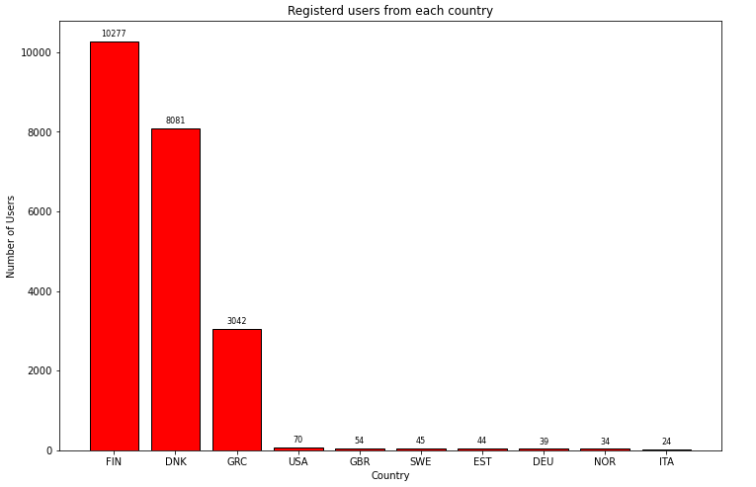
Demographic Segmentation
Help us to know which country has more number of users
Important for wolt to know and improve service accordingly.
Helps wolt to use their employees and collaboration accordinly

Slide 4
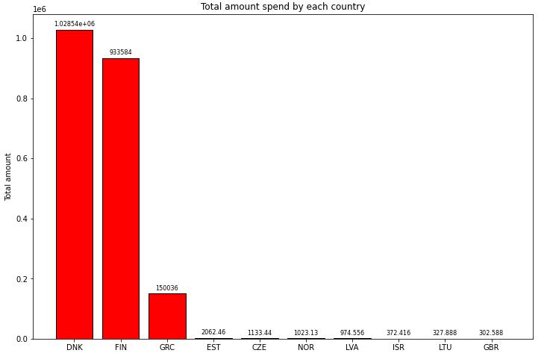
Amount Spend on Purchases by each Country
Helps to know which country is spending more on purchases
Better to establish or smoother the services in other countries as well
Study DNK and try to establish the system in other countries as well

Slide 5
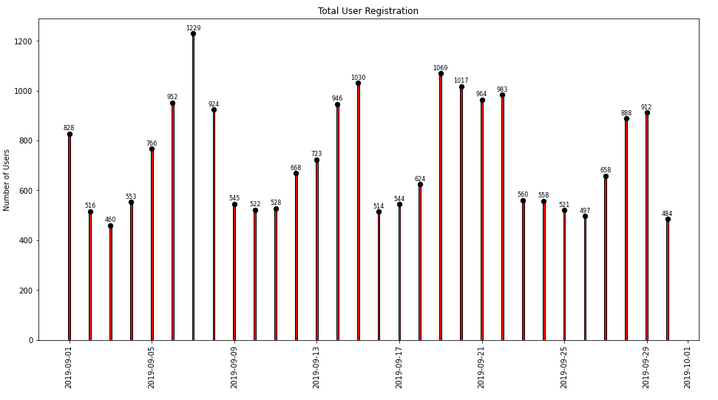
Registration on each day of September
Shows the trend of registration in September.

Slide 6
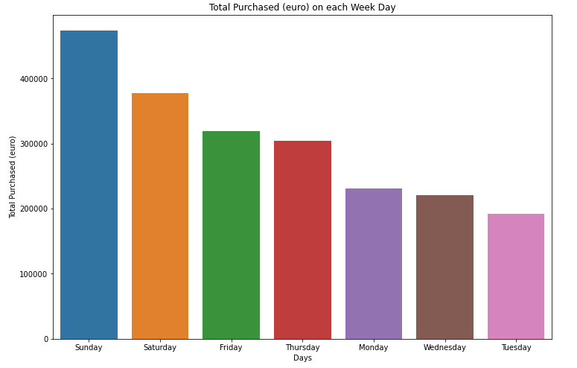
Revenue generated in Each Day of the week
It will help us to know which Day
of the week is generating more
Revenue.

Slide 7
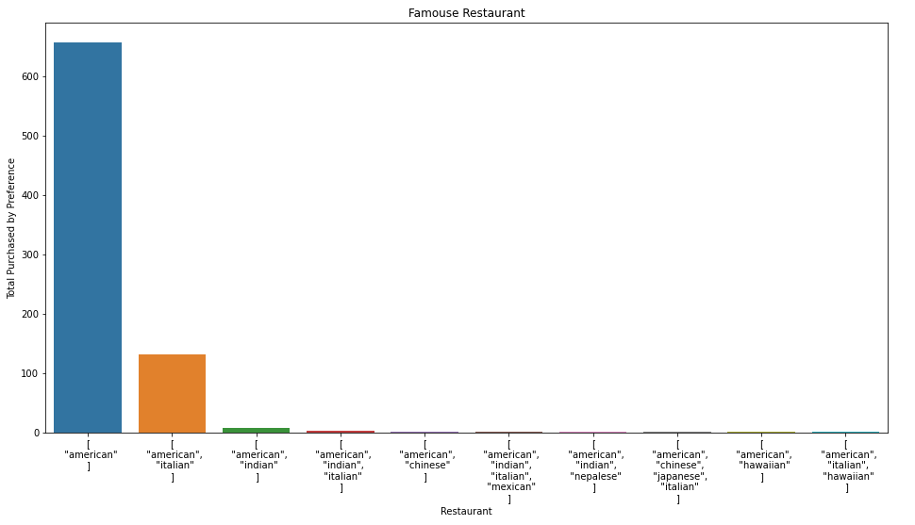
Segmentation based Preferred Restaurant Type
More User prefer to purchase form American so it will help Wolt to smoother their services and collaboration with this restaurant
More collaboration with American restaurant needs to be made

Slide 8
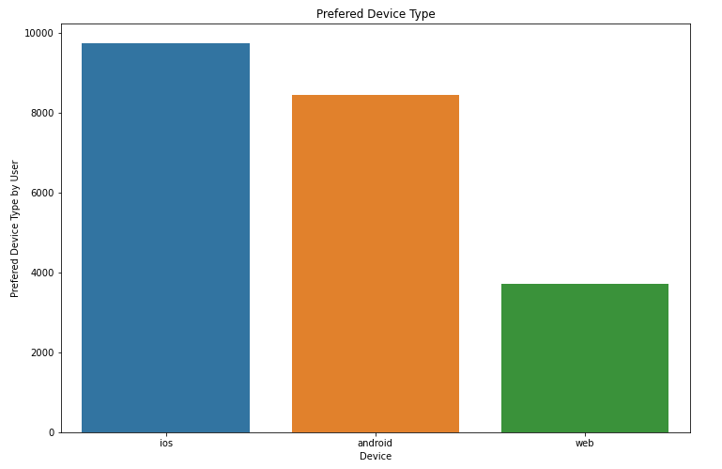
Segmentation based on Preferred device Type
This device help wolt to improve or make their device type more user friendly. Most user use ios while web users are very less.
Wolt need to make web more user friendly to make it one of the most preferred way for using wolt.

Slide 9
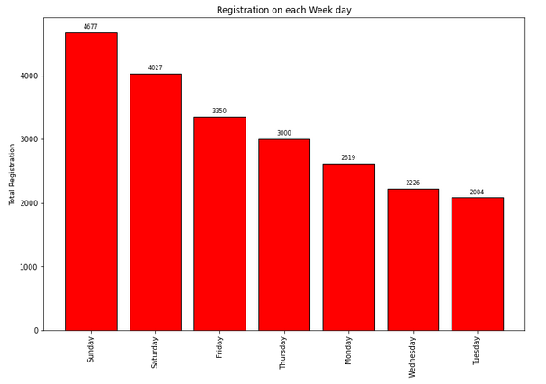
Day wise Registration
Sunday is most popular in term
Of User registration to wolt
Wolt needs to arrange some extra
People for delivery on Sunday
to make the flow as fast as
possible. It will also help wolt
a better and more fast services.

Slide 10
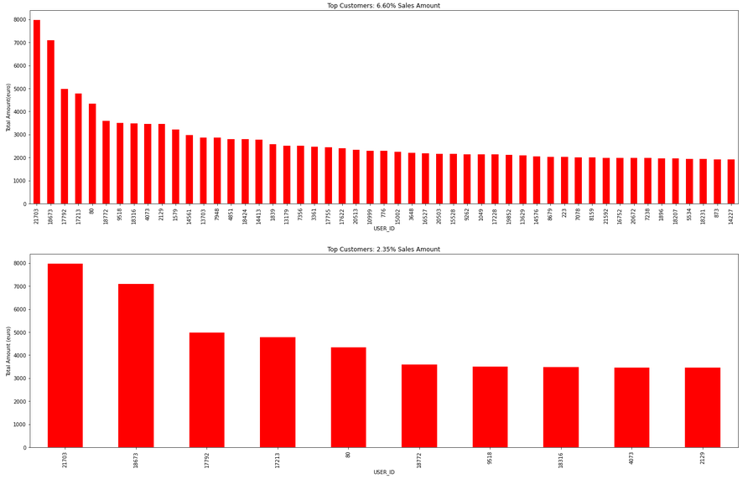
Segmentation based on amount use for purchase
Lk

Slide 11
Segmentation based on amount use for purchase (cont…)
It is one the best approach to know about the frequent
It will also help wolt to prioritize them, get feedback from them and analyse it carefully for further improvement.

Slide 12
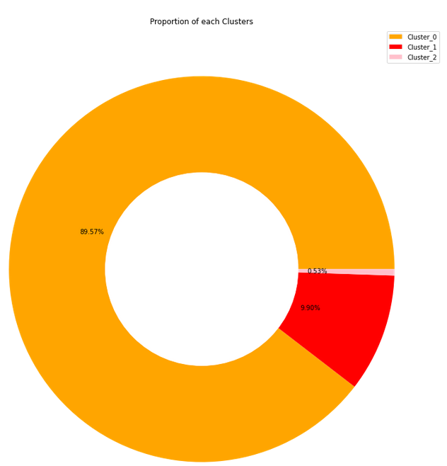
Segmentation based on frequency of Purchasing
1. Only 0.53% of the buyers
are of high frequency user
In wolt.
2. Most users just registerd
and then never ordered
anything
This approach will help wolt under-
stand that it need to focus on
Less frequency users to make them
More frequency by arranging or coll-
Borating with other restaurant.

Slide 13
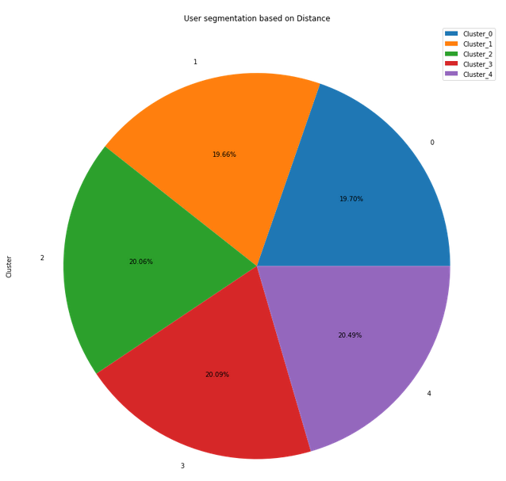
Segmentation based on Distance
Equal Distribution of user in term of distance
This segmentation helps wolt to arrange
vehicles and chose people having correct
vehicles.

Slide 14
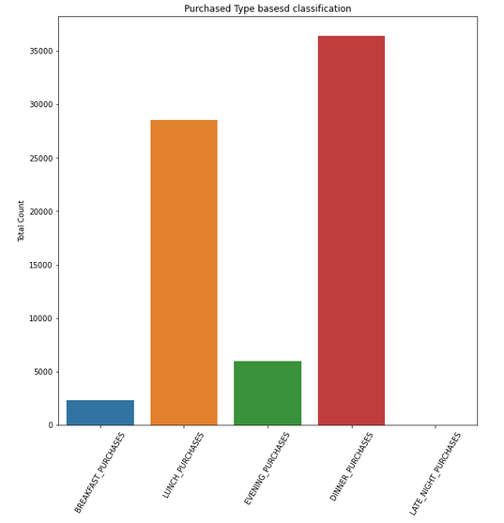
Segmentation based on Type of Purchased
Most User prefer to purchase
Dinner and lunch is second highest
User are not purchasing anything
Latenight.
This approach is adopted as it will let
wolt know about their peak duty
time

