Slide 1
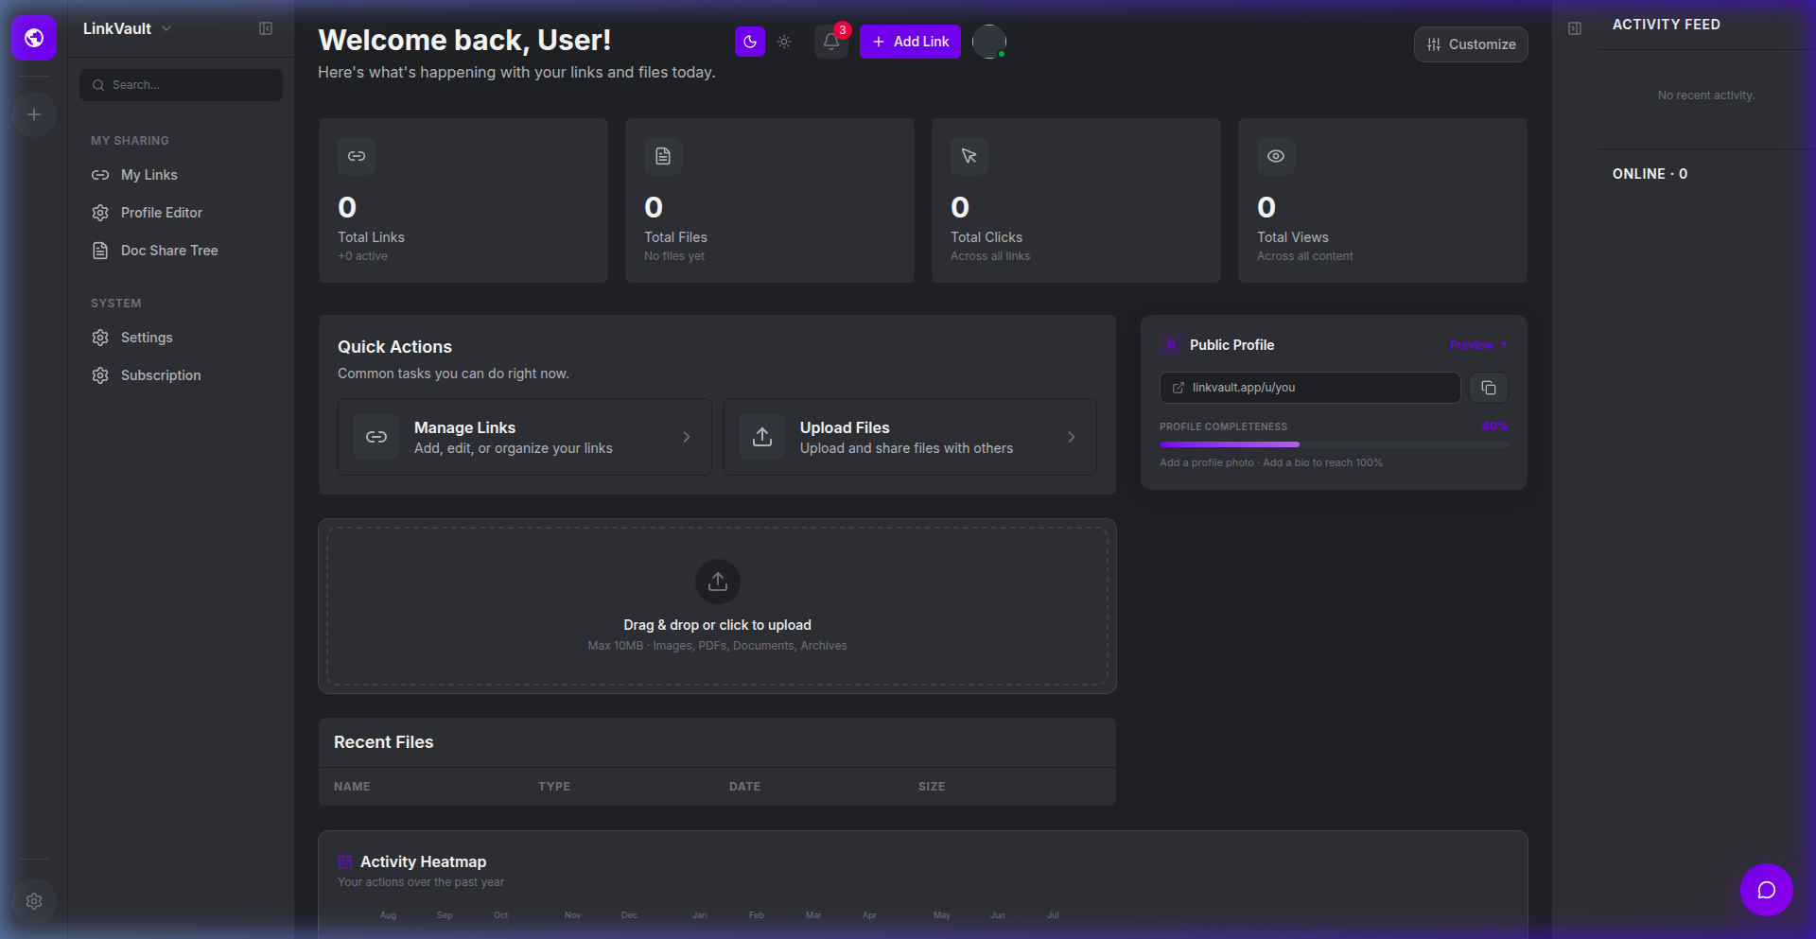
LINKVAULT
Foundational SaaS Architecture & Product Concept Blueprint
An MVP-stage codebase consolidating cloud storage, public bio link profiles, secure file transfers, and hierarchical directories.
Architectural Overview & Concept Pitch Deck — Ready for Team Refinement

Slide 2
MARKET NEED
The Opportunity: Consolidating $20B+ Markets
THE FRAGMENTATION PROBLEM
• Workspace Fragmentation: Teams jump between Notion for docs, Linktree for bios, Dropbox for files, and WeTransfer for sharing.
• Subscription Fatigue: Businesses and creators pay 4+ different subscription bills, adding friction and cost.
• Security Concerns: Transferring files and links across multiple unaligned platforms leaves audit trails scattered.
THE LINKVAULT SOLUTION
• All-in-One Command Center: LinkVault consolidates file storage, nested directories, bio links, and quick transfers in one app.
• One Dashboard, One Subscription: Save 70% of software costs by replacing disjointed single-purpose tools with one beautiful interface.
• Unified Governance: Bank-level security, centralized audit logs, team RBAC, and real-time synchronization out of the box.

Slide 3
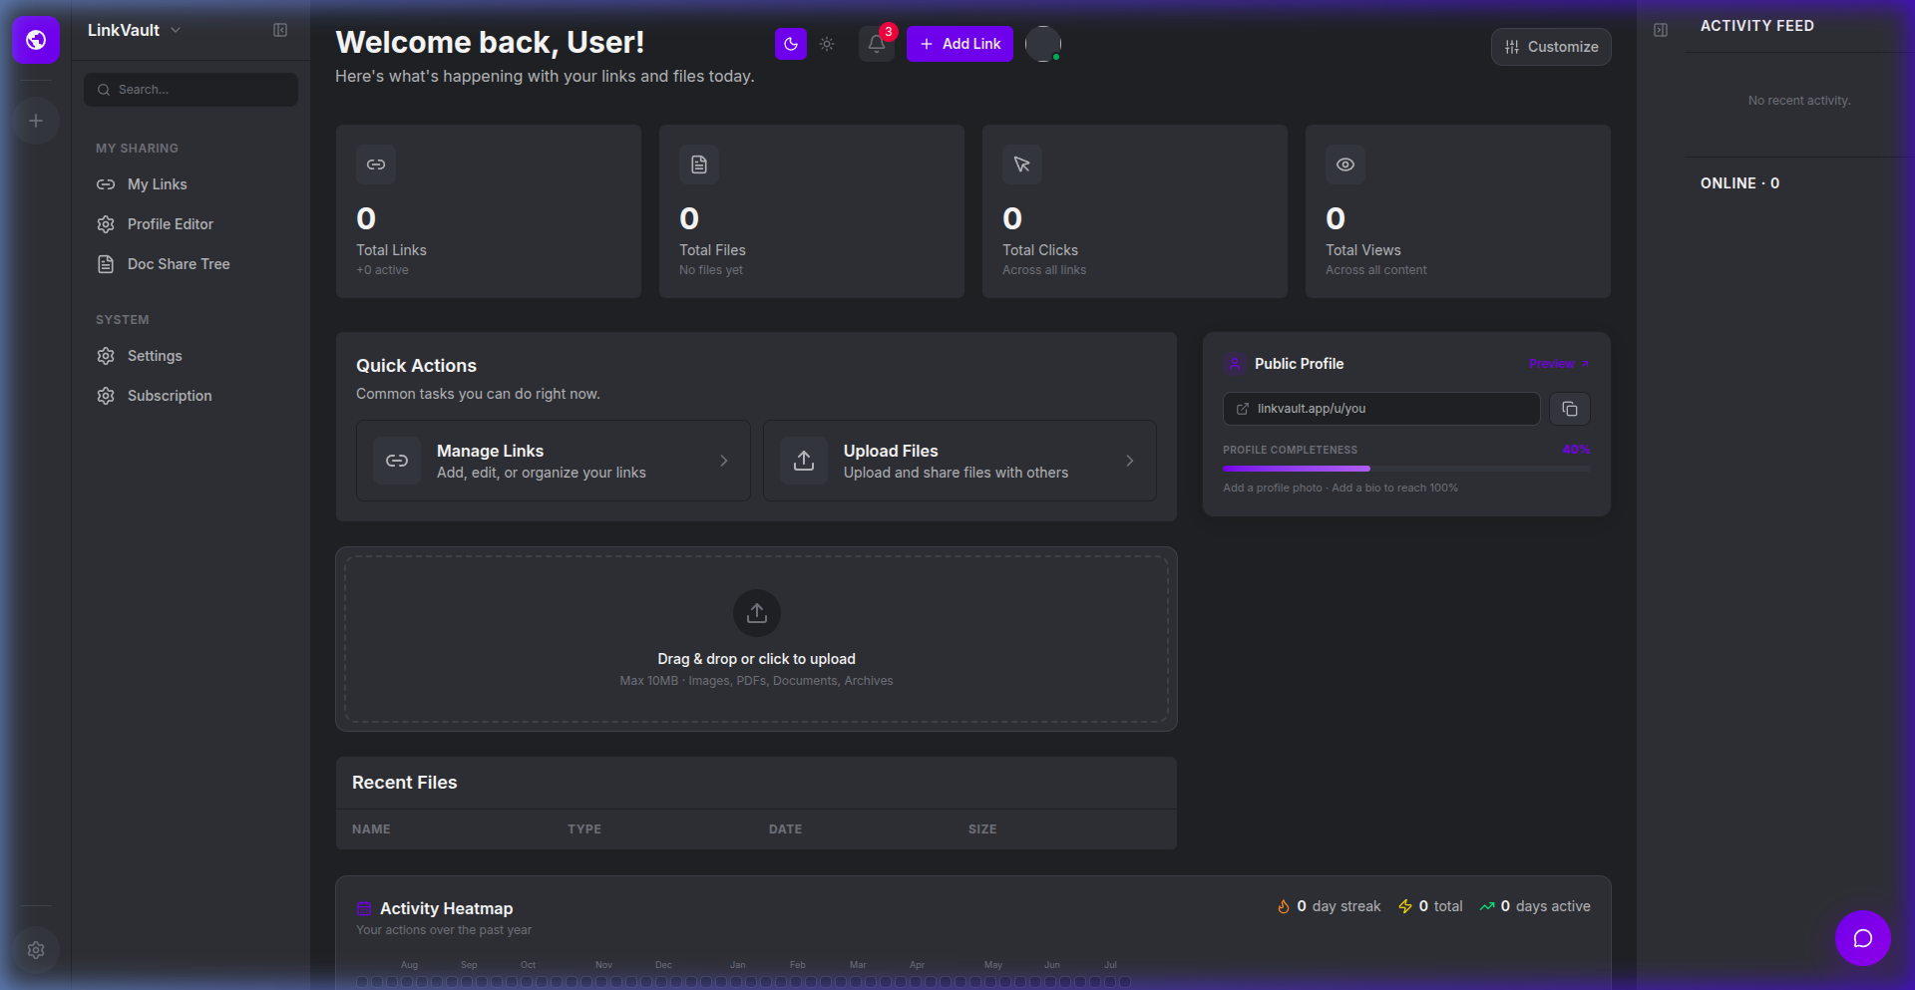
PRODUCT WALKTHROUGH
Core Walkthrough: The Unified Command Center
DASHBOARD HOME
• Centralized Dashboard: Displays high-level analytics, active links count, stored files count, and activity feeds at a glance.
• SSO Access Skeletons: Formulated authentication handlers mapped to Google, GitHub, and LinkedIn OAuth.
• Live Activity Stream: Integrated SignalR framework designed to broadcast team workspace updates and file events in real-time.

Slide 4
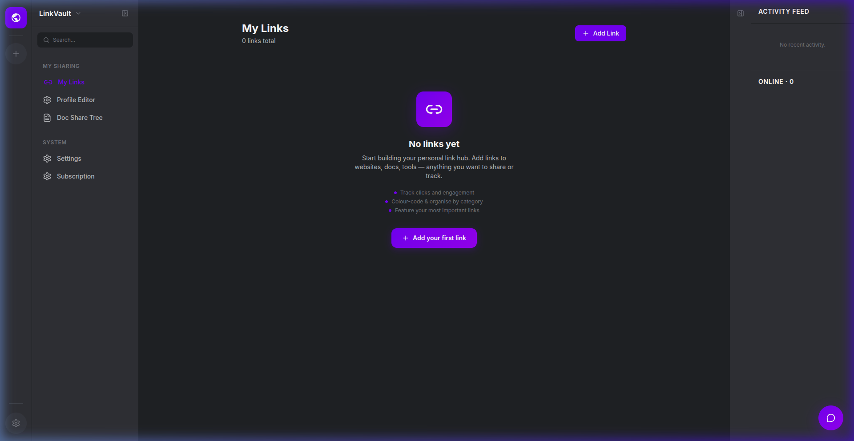
PRODUCT WALKTHROUGH
Core Walkthrough: Bio Link Profiles
BIO LINK BUILDER
• Linktree-style profiles: Drag-and-drop link configuration for customizable user bios.
• Public Profile pages: Instantly accessible via vanity URLs (e.g., /u/username).
• Social Integrations: Responsive layouts that dynamically align content, redirect links, and collect click logs.

Slide 5
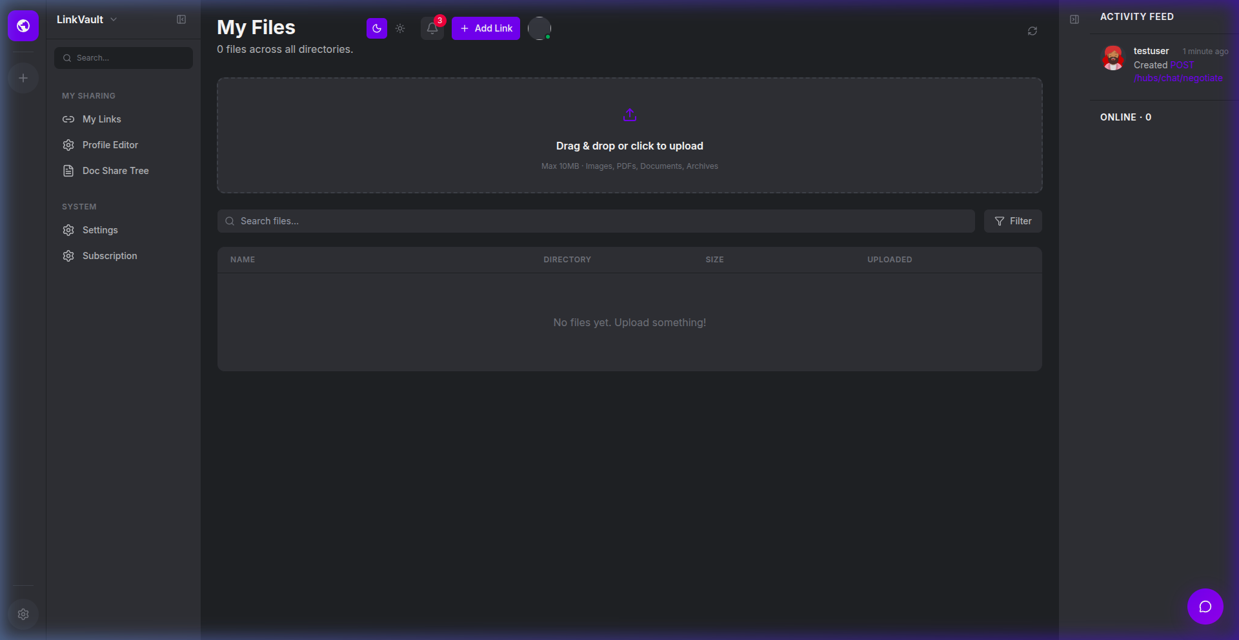
PRODUCT WALKTHROUGH
Core Walkthrough: Cloud Files & Directories
FILE MANAGEMENT
• Dropbox-grade Secure Storage: Upload, inspect, download, and organize files in real-time.
• Hierarchical Directories: Nest files in customizable directory structures with breadcrumb navigation.
• Granular Controls: Configured roles for team members (Admin, Manager, Member, Viewer) to govern uploads and shares.

Slide 6
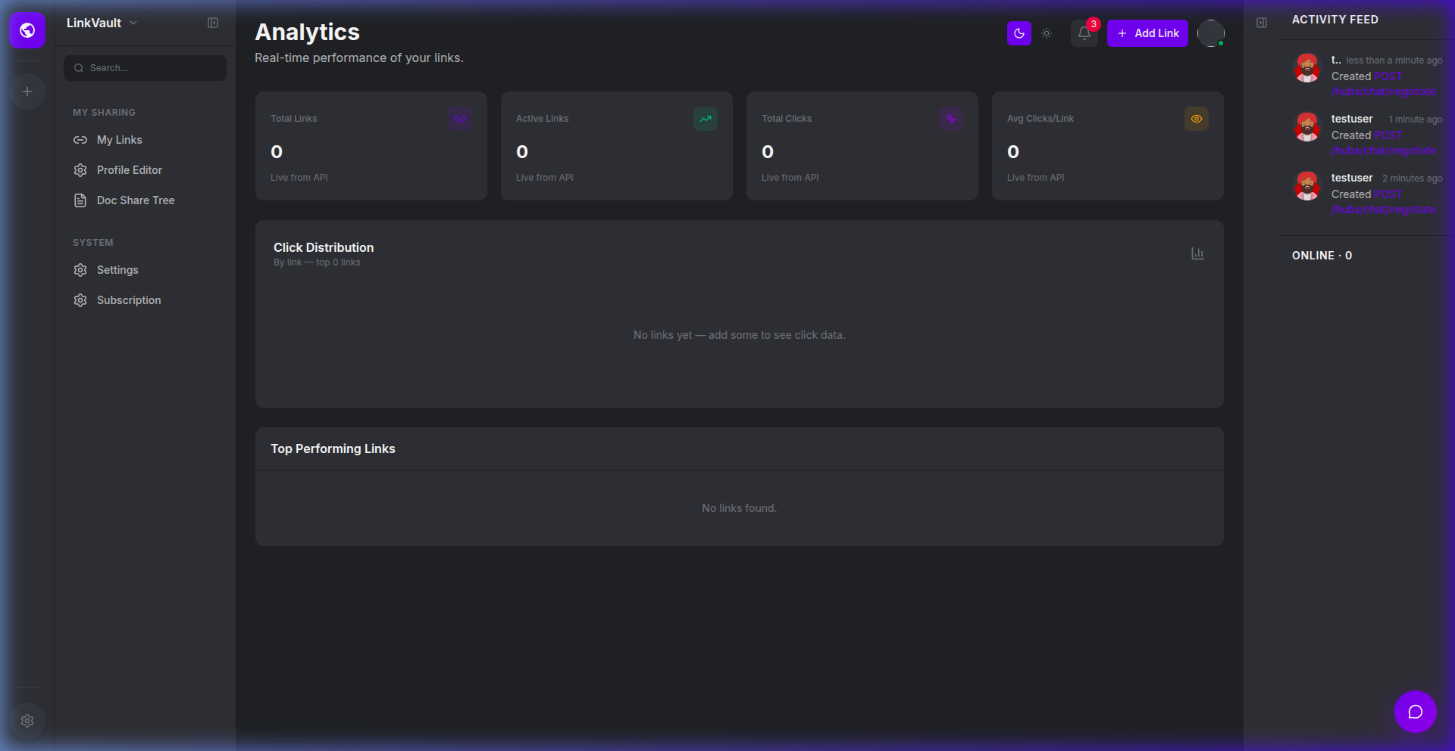
PRODUCT WALKTHROUGH
Core Walkthrough: Visual Analytics
DASHBOARD ANALYTICS
• Visitor & Click Tracking: Log links clicked, files downloaded, and geographic visitor sources.
• Interactive Charts: Configured Recharts graphs showing daily link visits and storage size distributions.
• Referral Insights: Capture click reference headers to identify what traffic channels generate the most engagement.

Slide 7
TECHNICAL STACK
Enterprise-Grade Architecture & Security
MODERN TECH STACK
• Backend: ASP.NET Core 8 Web API (C#) — robust, high-throughput, and clean controller/service abstraction.
• Frontend: React 18 with TypeScript & Vite — ultra-fast compilation, modern single-page-app routing, and state managed by Zustand.
• Database: PostgreSQL with Entity Framework Core — robust database migrations and schemas.
• Real-Time Sync: ASP.NET Core SignalR Web Sockets — pushes real-time activity feeds and team collaboration updates instantly.
GOVERNANCE & SECURITY
• Bank-Level Auditing: Detailed, read-only audit log page tracking all document reads, updates, and permission changes.
• Frictionless SSO: Pre-configured OAuth login with Google, GitHub, and LinkedIn, keeping user acquisition friction to zero.
• Two-Factor Auth (2FA): Advanced account protection built natively into the security model.
• Docker Containerization: Includes Docker Compose configuration for immediate, single-command deployment.

Slide 8
COMMERCIAL POTENTIAL
Why This is the Ultimate Digital Product to Sell
ARCHITECTURAL FOUNDATION
• Robust MVP-stage codebase serving as a structural starting point.
• Provides core models, controllers, and interactive pages.
• Saves months of developer bootstrapping and scaffolding time.
TEAM REQUIRED FOR LAUNCH
• Not yet fully production-ready or ready for public deployment.
• Requires a dedicated development team to review, polish, and QA.
• Clean architectural framework ready to be customized and expanded.
PRICED FOR IDEA & IP
• Asking price is primarily for the core SaaS concept and structure.
• Includes design assets, UI layouts, and frontend-backend wiring.
• High-value blueprint for creators, startups, or agencies.

