Slide 1
Analysis on 10 Brands over 5 years.
AIR FRYER MARKET INTELLIGENCE
Demand Estimation · Brand Positioning · Profitability Analysis

Slide 2
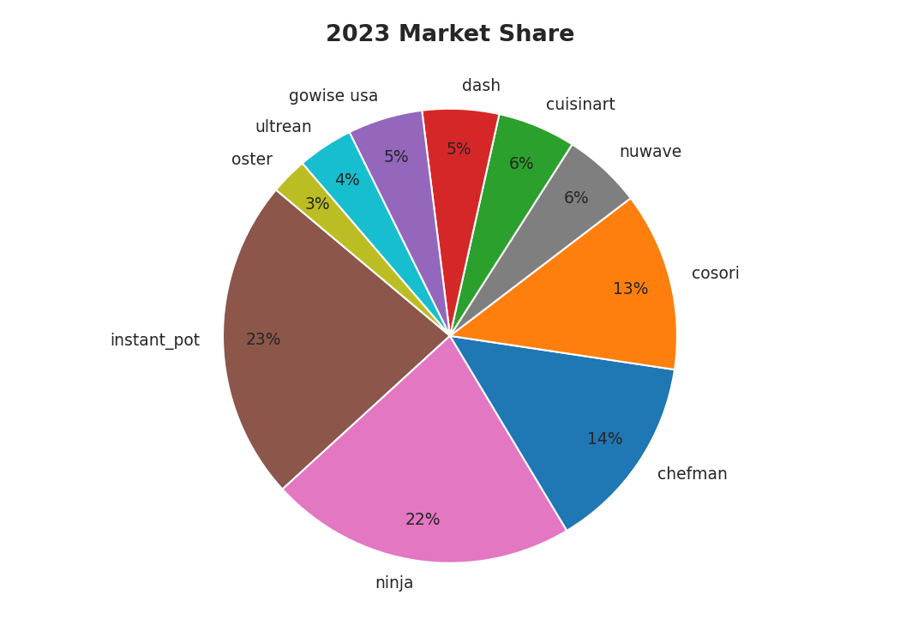
Ninja dominates in 2023 with 29% share, up from 17% in 2019.
Cuisinart ($224 avg) and Oster ($189 avg) hold the premium tier.
Dash leads the budget segment at $57 average price.
Cosori grew rapidly from near-zero in 2019 to ~8% by 2021.
All brands rate between 4.2–4.7, broadly satisfied consumers.
Compact form factor is 98% of all products across the market.
MARKET OVERVIEW

Slide 3
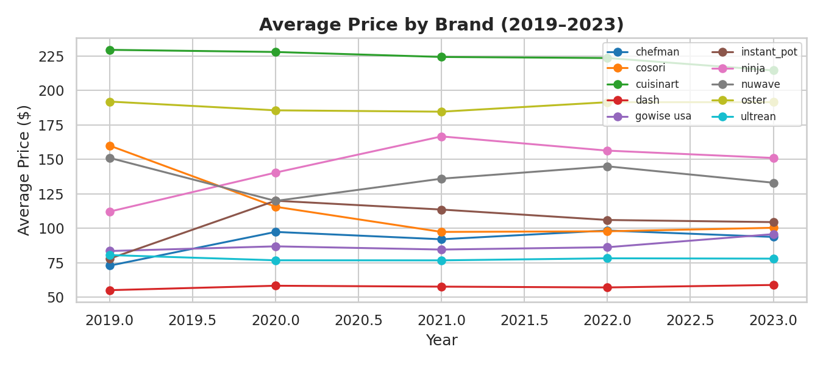
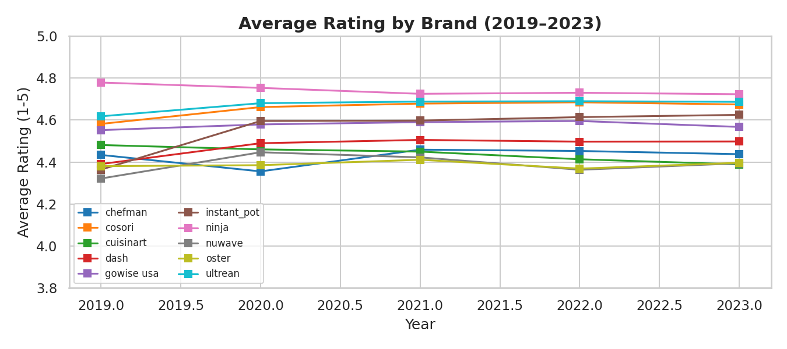
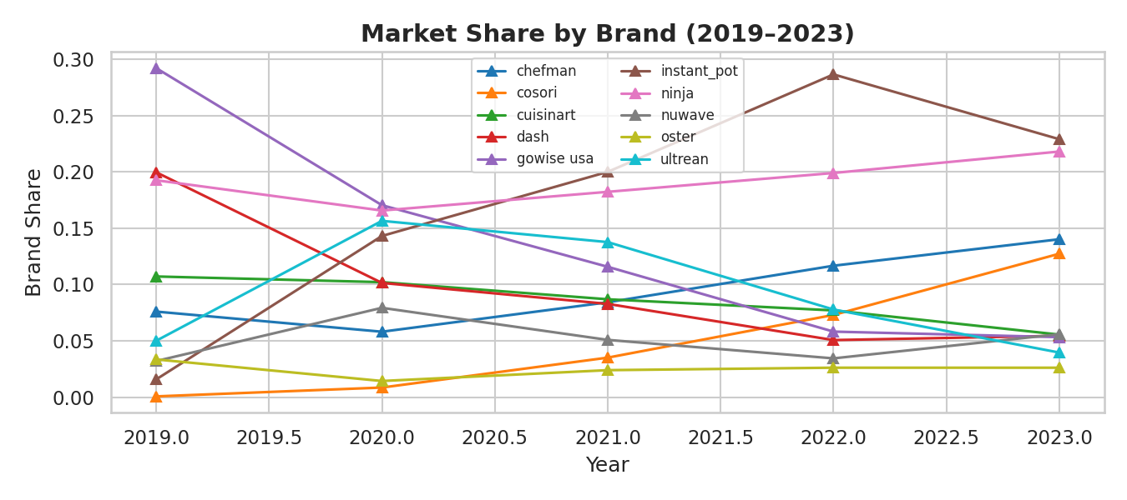
Prices, Ratings & Shares Over Time
Key Observations: Ninja has been the standout story of this market, growing its share from 17% in 2019 to 29% by 2023 and showing no signs of slowing down. Cuisinart held its high-price position stable throughout. What is perhaps most striking is how little ratings have moved for any brand which everyone stays between 4.2 and 4.7, suggesting consumers have started treating air fryers as a commodity appliance. GoWise USA and NuWave both lost meaningful ground over the period.

Slide 4
The Demand Model
log(s_bt) = α₀ + α_t + γ_b + β_price · p_bt + β_rating · r_bt + Σ β_ℓ · x_btℓ + ε_bt
log(s) = intercept + year effects + brand effects + β_price × price + β_rating × rating + product characteristics + error
01
Estimation Method
02
Price Coefficient
OLS regression on log market share. Year dummies absorb the logit denominator. Brand dummies capture persistent unobserved quality and reputation differences across brands.
β_price = −0.0377 (p = 0.002). The negative sign is required for economic validity — it confirms demand falls when prices rise, which makes cost and markup calculations meaningful.
03
Model Fit
04
Top Demand Drivers
R² = 0.763. The model explains 76% of variation in log market share which a strong fit given only 50 observations across 10 brands and 5 years.
Compact design (β = +9.8, p = 0.01) is the strongest positive demand driver. Cuisinart, Ninja, and Instant Pot have the largest brand fixed effects, meaning consumers prefer them beyond what price and features alone explain.

Slide 5
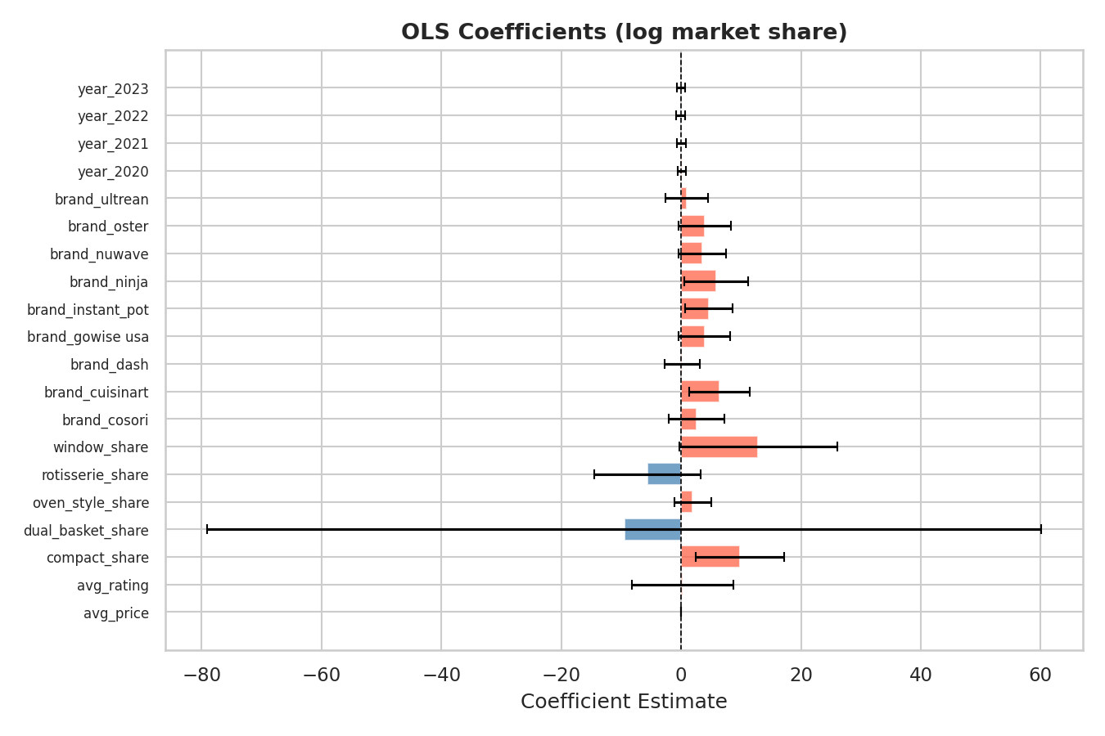
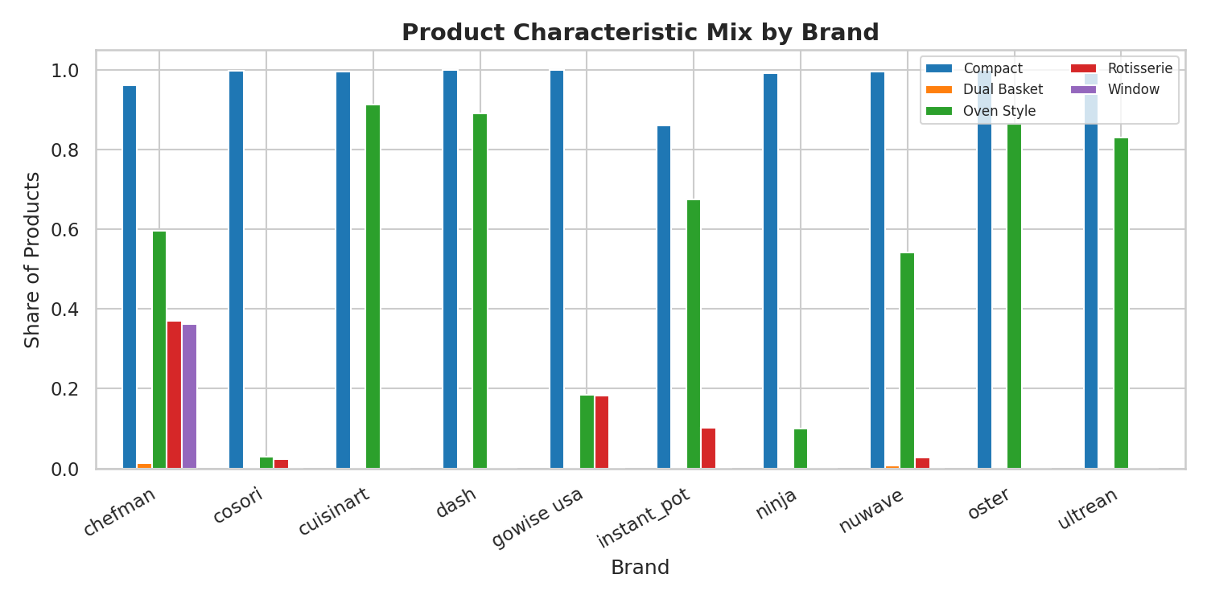
Product Features & Estimated Coefficients
Blue = negative demand impact · Red = positive · Dashed line = zero

Slide 6
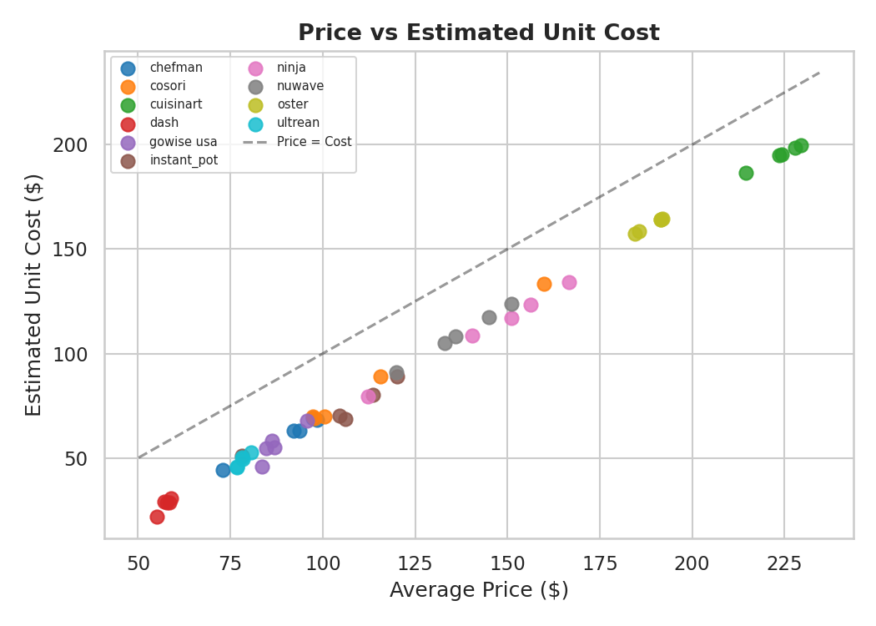
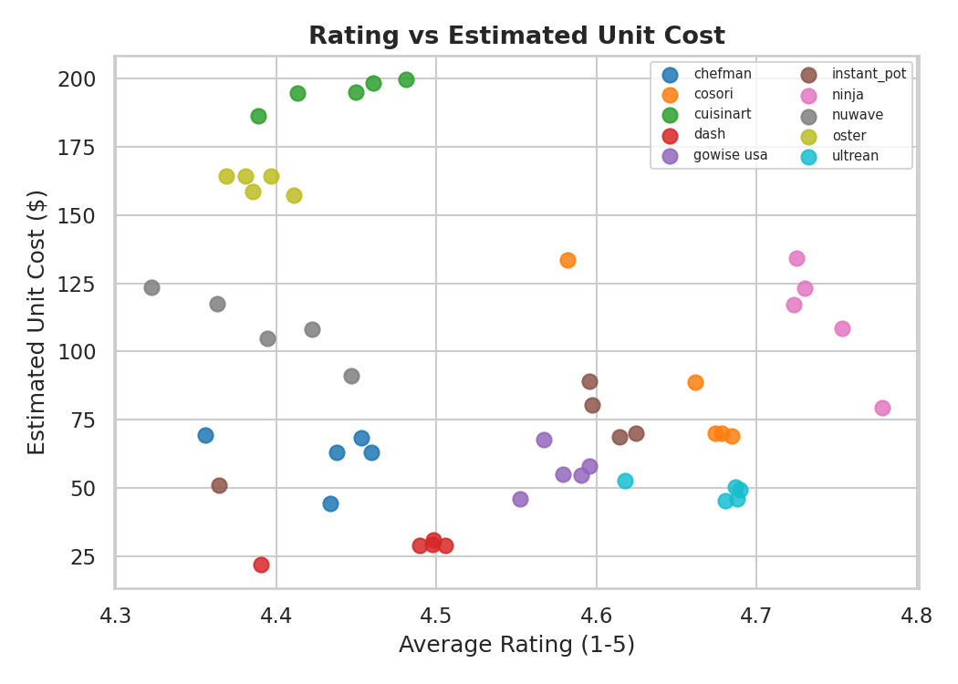
Estimated Unit Costs & Markups
Brand | Avg Price | Unit Cost | Markup
Ninja | $145 | $112 | $33
Cuisinart | $224 | $195 | $29
Instant Pot | $104 | $72 | $33
Oster | $189 | $162 | $27
Dash | $57 | $28 | $30

Slide 7
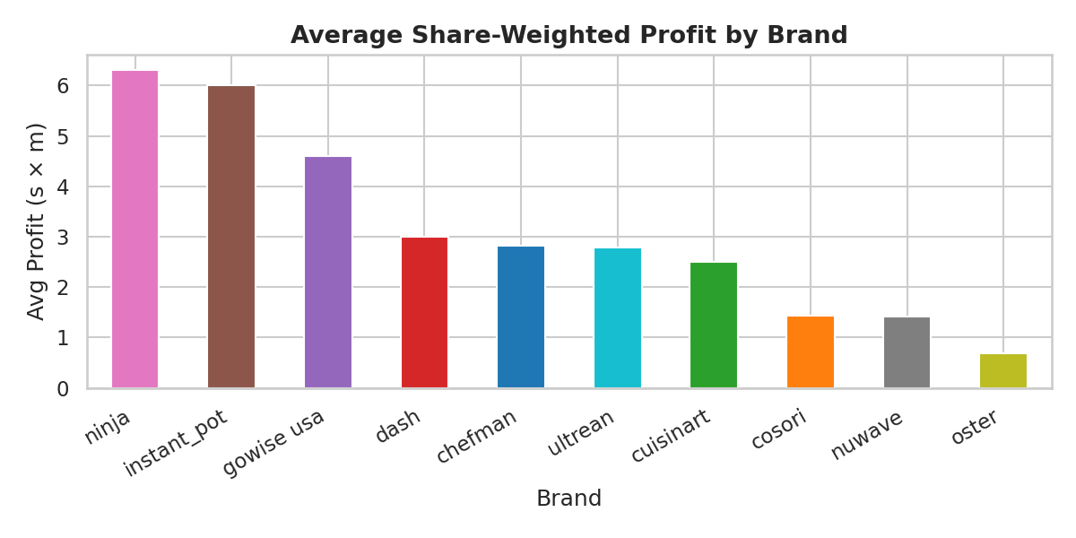
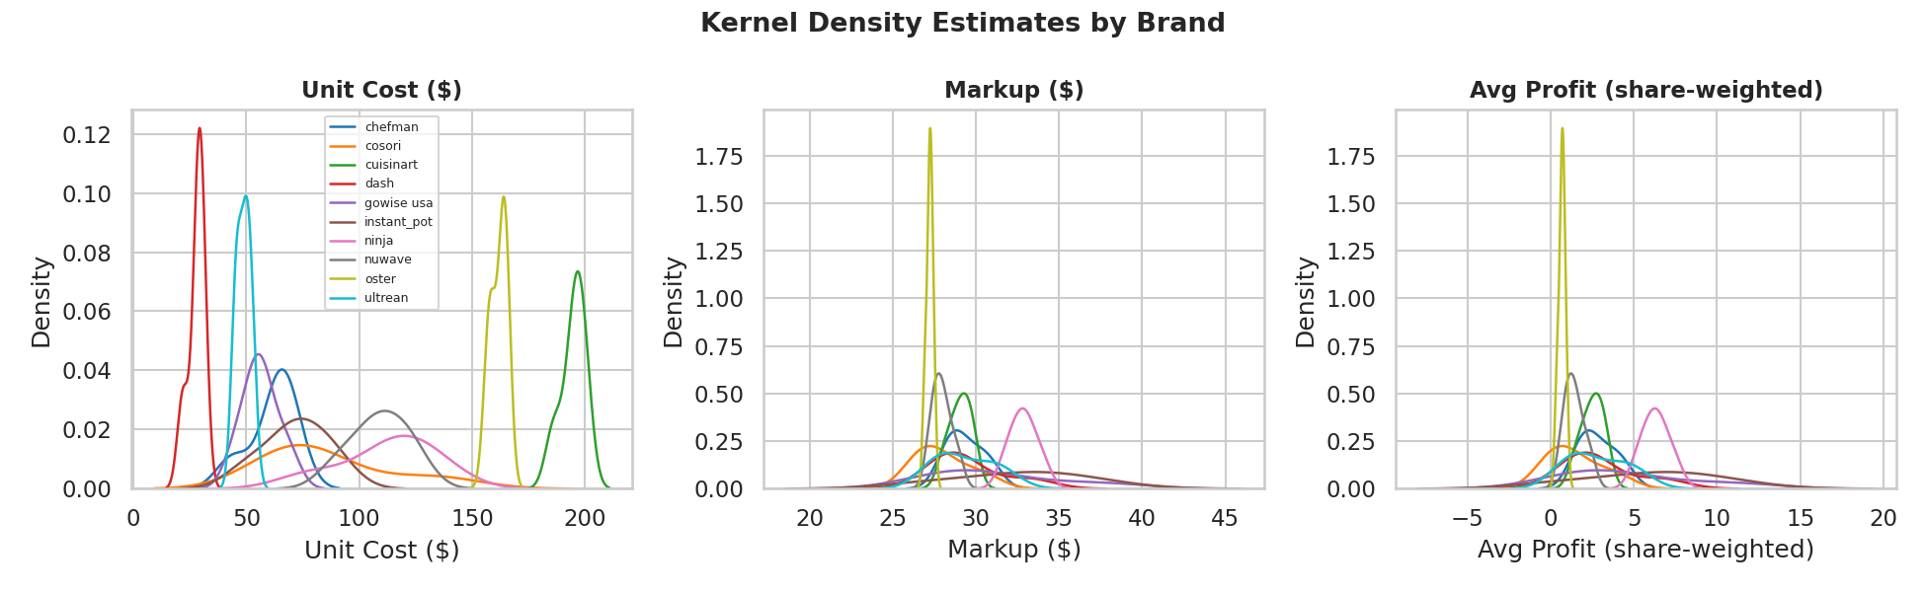
Share-Weighted Profitability
Key Insight: Dollar markups are remarkably similar across all brands ($27–$33). Profitability is driven by market share, not margins. Ninja and Instant Pot win through volume. Oster and NuWave carry high costs or low share which puts both strategically vulnerable positions.

Slide 8
CONCLUSIONS & STRATEGIC TAKEAWAYS
01
Ninja is the market winner
02
Price sensitivity is real
Largest and growing share, strong brand fixed effect, markups of $32.85/unit justified by volume-driven profitability.
β_price = −0.038 (p < 0.01). A $10 price increase reduces log share by 0.38 — meaningful in a competitive market.
03
Compact is the winning format
04
Margins are compressed
98% of products across all brands are compact. Brands without a strong compact presence risk losing demand share.
All brands earn $27–$33/unit regardless of price. Winners compete on cost structure, not pricing power.
05
Oster is overexposed
06
Entry opportunity exists
Highest unit costs ($162), lowest share-weighted profit (0.68). Premium price without the share to justify it.
The budget segment has low costs but Dash's declining share signals room for a better-positioned entrant.

