Slide 1

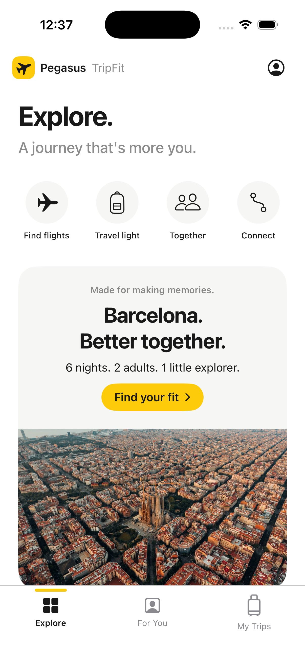
TripFit
PEGASUS
HACKATHON
Native iPhone app + airline insights
01
TripFit
for Pegasus
A more personal way to plan,
choose and book a trip.
09 OCT 2026
Notes:
[0:00–0:20] Pegasus believes everyone has the right to fly. We built TripFit to make the next step easier: deciding which journey is right for you. It is a native iPhone booking assistant, connected to an airline insights dashboard.
Sources and evidence
README.md
https://www.flypgs.com/en/help-center
Screenshot: docs/screenshots/ios-home.png

Slide 2
TripFit
PEGASUS
HACKATHON
The Pegasus promise
02
What makes Pegasus,
Pegasus?
“Everyone has the right to fly”
Affordable access
Freedom to choose
Digital convenience
Help passengers find
a workable journey.
Recommend extras
that fit their needs.
Reduce repeated effort
without taking control.
09 OCT 2026
Pegasus states the promise. TripFit translates it into a product hypothesis for planning and booking.
Notes:
[0:20–0:50] What makes Pegasus, Pegasus? Affordable access, a travel experience people can customise, and digital convenience. Our idea follows those principles. Better assistance should help someone find a workable trip, understand the extras they need and avoid repeating the same decisions. It should never hide the price or take the decision away from them.
Sources and evidence
https://www.flypgs.com/en/help-center
https://www.flypgs.com/en/about-pegasus/why-pegasus
https://www.flypgs.com/en/sustainability/about-pegasus-airlines-and-our-sustainability-framework

Slide 3
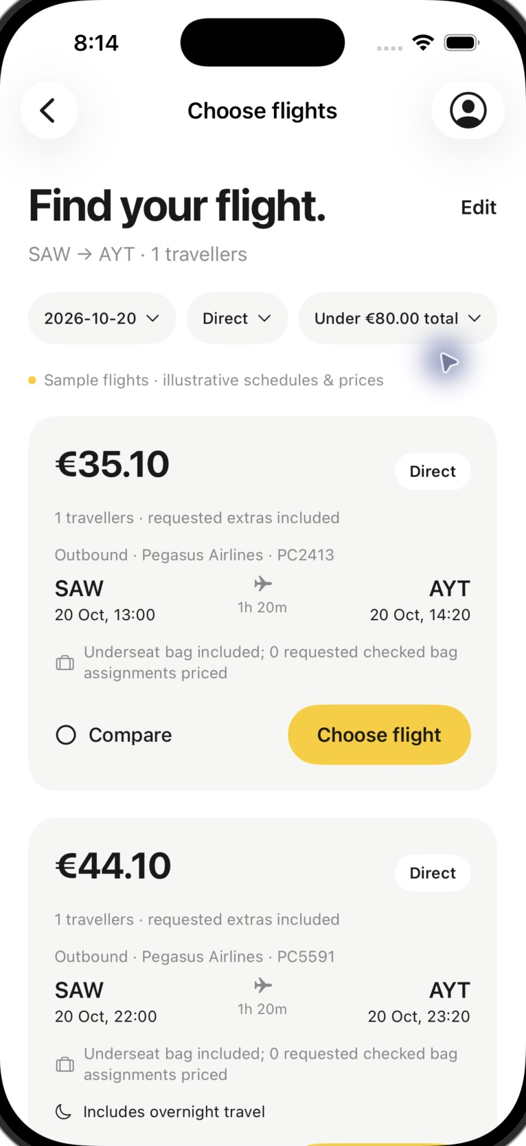
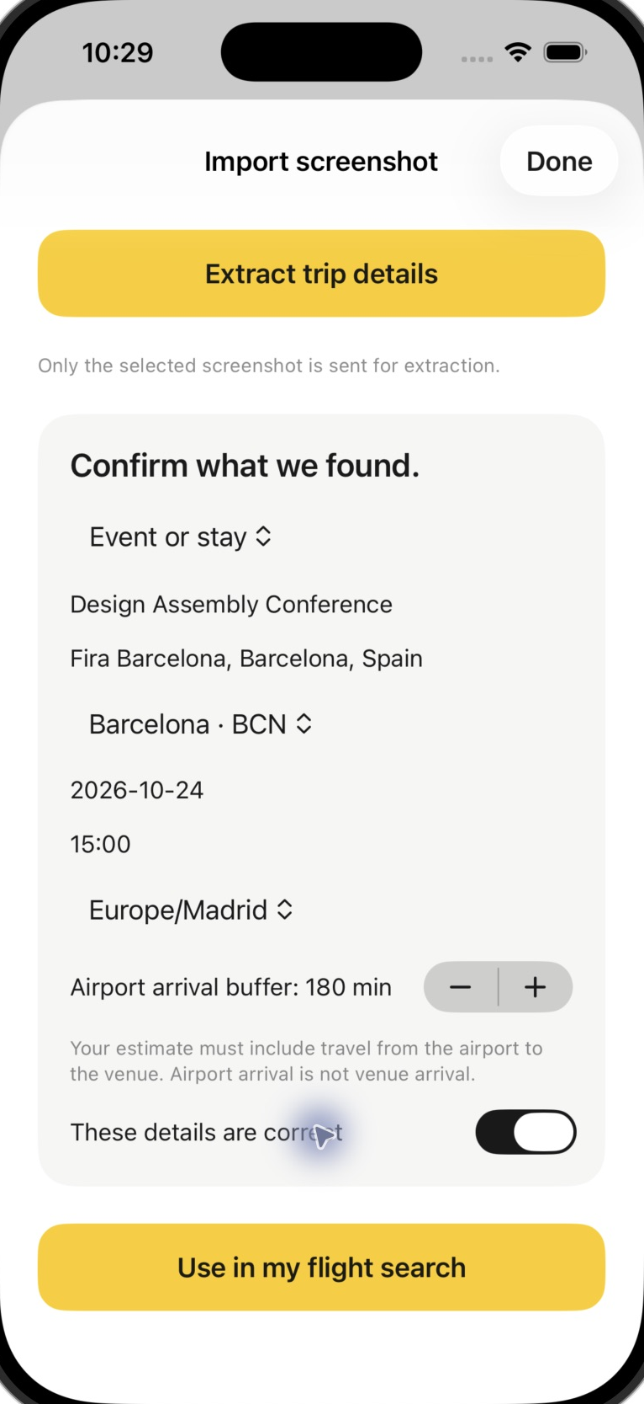
TripFit
PEGASUS
HACKATHON
01 / AI trip planner
03
A trip plan becomes
a flight search
Describe the trip.
Or import an invitation,
event or flight screenshot.
Review editable requirements.
Set an arrival or connection buffer.
Keep important constraints locked.
09 OCT 2026
Real text/image extraction. Incoming flights stay separate from onward pricing. Timing buffers do not guarantee a transfer.
Notes:
[0:50–1:25] The planner starts with how people actually think: get me to Barcelona before this event, within this budget. Type the request or import an invitation or an incoming-flight screenshot. AI extracts the context. The traveller checks the destination, date, time zone and arrival buffer, and locks what matters. Those confirmed details drive search. If nothing matches, the app can explain genuine alternatives without silently changing a locked requirement.
Sources and evidence
backend/evidence/live-trip-import-results.json
backend/evidence/live-import-search-results.json
docs/PROVIDERS.md
Screenshot: docs/screenshots/ios-v2-antalya.png
Screenshot: docs/screenshots/ios-event-confirmation.png

Slide 4
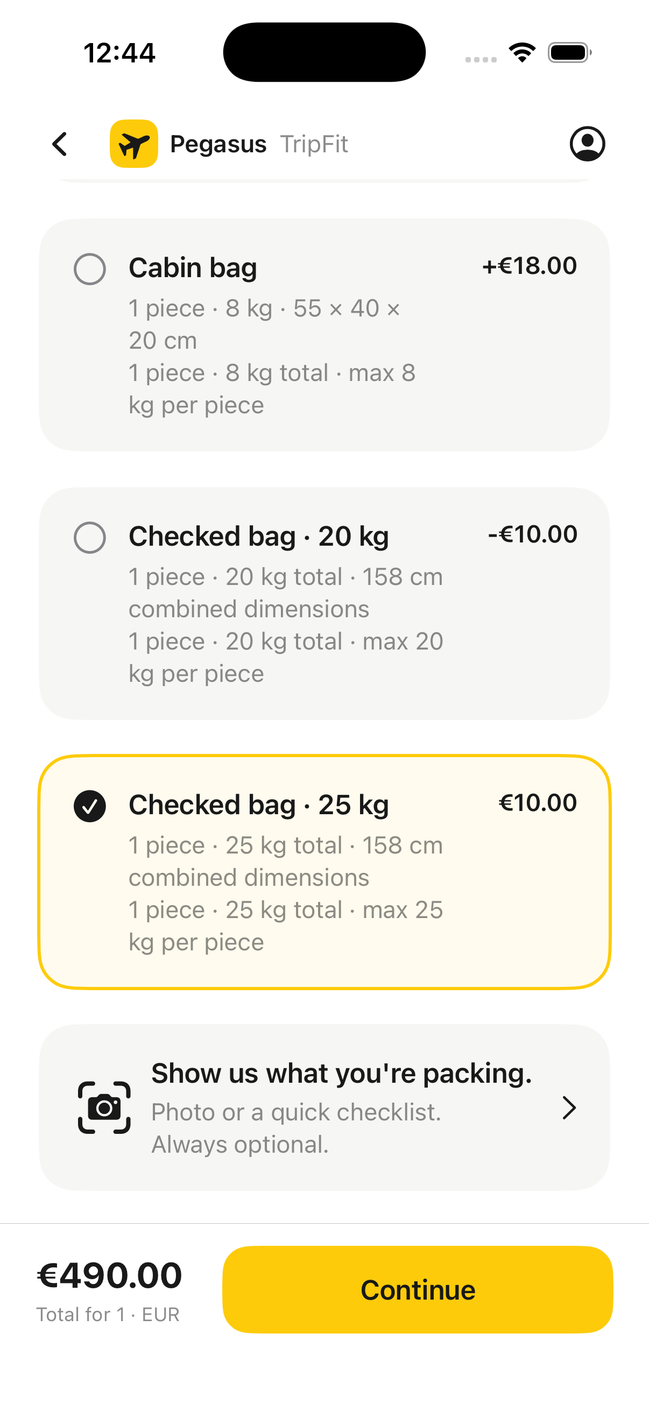
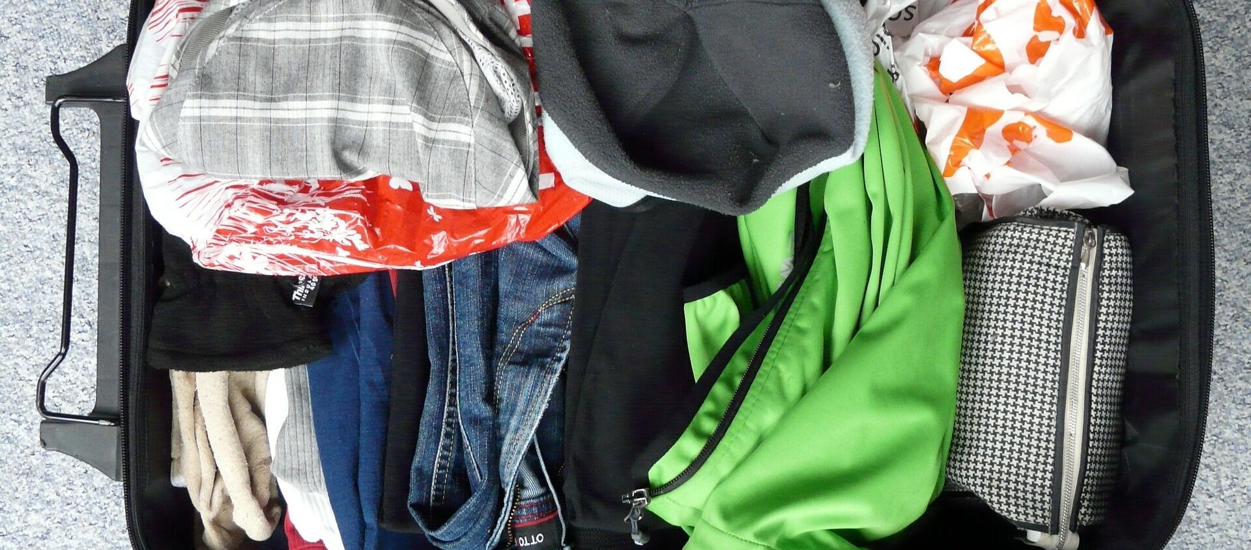
TripFit
PEGASUS
HACKATHON
02 / Photo packing assistant
04
A photo helps choose
the right bag
Vision identifies visible items.
You confirm the weight and size.
Catalogue rules calculate fit and price.
Keep your allowance,
add a bag or compare
an eligible bundle.
09 OCT 2026
Actual photo test and native baggage UI. In-app bag prices use demo inventory. Weight cannot be measured from a photo.
Notes:
[1:25–1:55] Packing is often the next difficult choice. Take a photo or use a checklist. In real vision tests, different photos produced different item lists. The passenger can correct that list and confirm the measurements. Code then checks the catalogue. The answer can be an added bag, a suitable bundle or no extra at all. That supports the Pegasus model: the passenger pays for what fits their trip. The priced in-app flow currently uses labelled demo inventory.
Sources and evidence
backend/evidence/live-packing-results.json
docs/booking-v2-model-verification.json
docs/VERIFICATION.md
Screenshot: docs/screenshots/ios-baggage.png

Slide 5
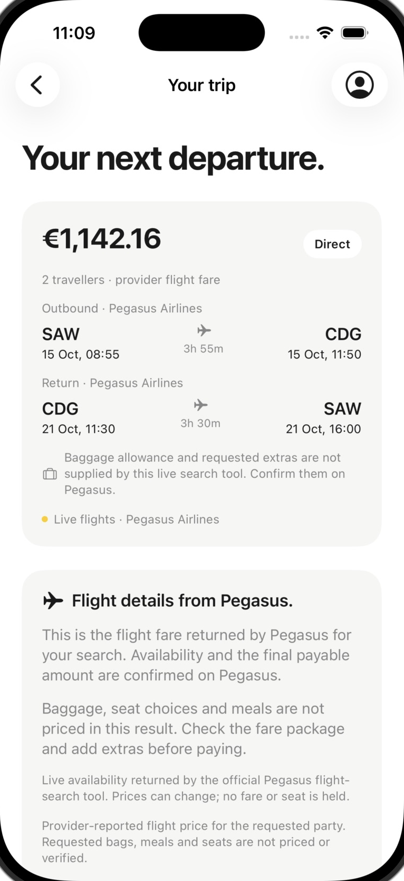
TripFit
PEGASUS
HACKATHON
03 / Search, compare and continue
05
Real flights.
Clear choices.
Live Pegasus availability and fares.
Compare candidates against the trip.
Review explicit nearby alternatives.
The native demo also covers bags, seats,
meals, bundles, review and saved trips.
09 OCT 2026
Live selection continues on Pegasus to book and pay. In-app checkout is demo only: no charge and no ticket issued.
Notes:
[1:55–2:20] We connected real Pegasus flight availability. AI explains candidate trade-offs, while provider data and code own schedules and prices. The app never invents a flight to make a search succeed. Public Pegasus access supports search, so a live choice continues on Pegasus. We separately built the native extras, review and confirmation journey using clearly labelled demo inventory.
Sources and evidence
docs/PROVIDERS.md
docs/INTEGRATIONS.md
docs/VERIFICATION.md
Screenshot: docs/screenshots/ios-live-pegasus-details.png

Slide 6
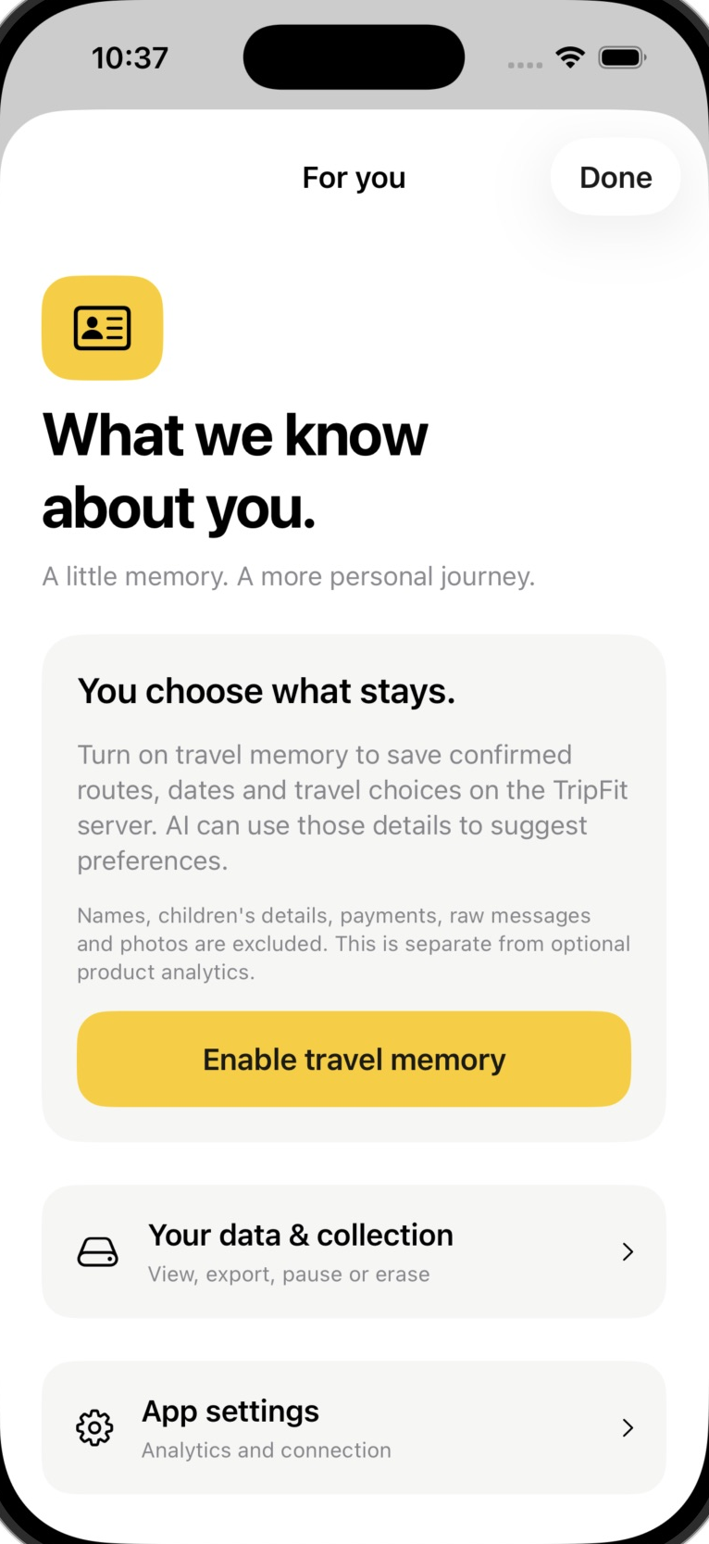
TripFit
PEGASUS
HACKATHON
04 / Customer learning
06
What we know
about you
Aisle seat. Cabin bag. Direct flights.
Learn from confirmed trips and requests.
Show where each preference came from.
Let the traveller correct, lock or forget it.
Reuse a preference only with the customer’s control.
09 OCT 2026
Separate opt-in. Example preferences came from fictional test activity. Searches show interest, not a completed visit.
Notes:
[2:20–2:50] With permission, TripFit builds a small travel memory from confirmed activity. In our test, three fictional activities supported preferences for aisle seats, cabin baggage and direct flights. What we know about you makes that memory inspectable. AI suggestions link to the underlying activity, and direct corrections belong to the customer. They can change, lock or forget a preference, then explicitly reuse requirements in search.
Sources and evidence
docs/PERSONALIZATION.md
backend/evidence/live-personalization-results.json
docs/travel-profile-model-verification.json
Screenshot: docs/screenshots/ios-travel-memory-consent.png

Slide 7
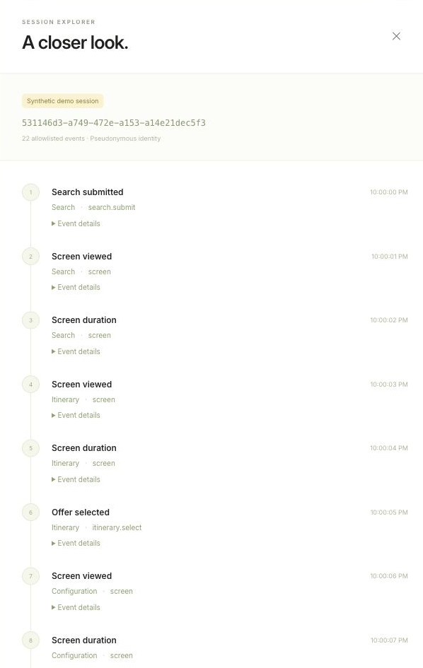
TripFit
PEGASUS
HACKATHON
05 / Data collection and control
07
Personalisation
needs permission
Personal travel memory
Confirmed routes, dates and choices.
Pause, inspect, export or erase the profile.
Separate airline analytics
Pseudonymous events, active time and errors.
09 OCT 2026
Stored memory/analytics exclude raw text, photos, names and payments. Requested AI analysis sends selected inputs for processing.
Notes:
[2:50–3:20] There are two distinct permissions. Personal memory helps the individual traveller. Product analytics helps Pegasus understand the journey through pseudonymous events and aggregate measures. Stored memory and analytics exclude names, payment details, raw messages and photos. Requested AI analysis still sends the chosen input for processing. Customers can pause memory, inspect their activity, export it or erase it. Deleting personal memory does not automatically delete already uploaded aggregate analytics.
Sources and evidence
docs/PERSONALIZATION.md
docs/ANALYTICS.md
ios/App/TravelProfileStore.swift
Screenshot: docs/screenshots/dashboard-v2-session.png

Slide 8
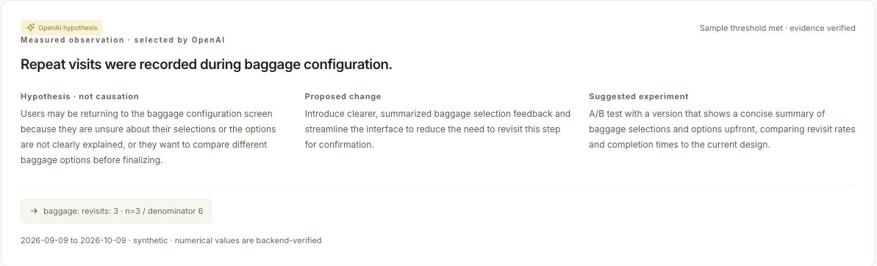
TripFit
PEGASUS
HACKATHON
06 / Airline improvement loop
08
Where the booking
journey gets harder
09 OCT 2026
Actual dashboard and real AI output from synthetic rehearsal events. Hypotheses require a controlled experiment.
Notes:
[3:20–3:50] The airline gets a useful learning loop. We record the ordered journey and measure active time, revisits and recommendation outcomes. Code calculates the metrics. AI proposes an explanation and a test tied to those metrics. This actual dashboard example uses synthetic rehearsal data: repeated baggage visits suggest testing a clearer allowance summary. It does not prove confusion, and it does not prove the proposed change will work.
Sources and evidence
docs/ANALYTICS.md
backend/evidence/final-insight-verification.json
Screenshot: docs/screenshots/dashboard-v2-ai-live.png

Slide 9
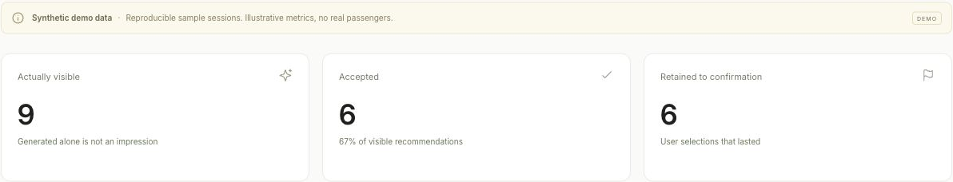
TripFit
PEGASUS
HACKATHON
Value and technical proof
09
Built for the Pegasus model
Easier booking
Relevant extras
Customer trust
Completion and repeated input
Fit, acceptance and corrections
Control, opt-outs and errors
09 OCT 2026
80 backend tests / 58 booking checks / 26 profile checks. Screenshot metrics are synthetic; business gains remain pilot hypotheses.
Notes:
[3:50–4:20] We would test value in the terms that matter for Pegasus: more completed journeys and better-fitting ancillary choices, while protecting correctness and customer control. We are not claiming conversion or revenue gains from rehearsal data. The prototype has a successful Xcode build, 80 backend tests, 58 native booking checks and 26 profile checks. Real Pegasus and OpenAI calls have succeeded. Full device, accessibility and photo-journey acceptance testing remains a pilot prerequisite.
Sources and evidence
docs/VERIFICATION.md
docs/booking-v2-model-verification.json
docs/travel-profile-model-verification.json
Screenshot: docs/screenshots/dashboard-v2-recommendations.png

Slide 10
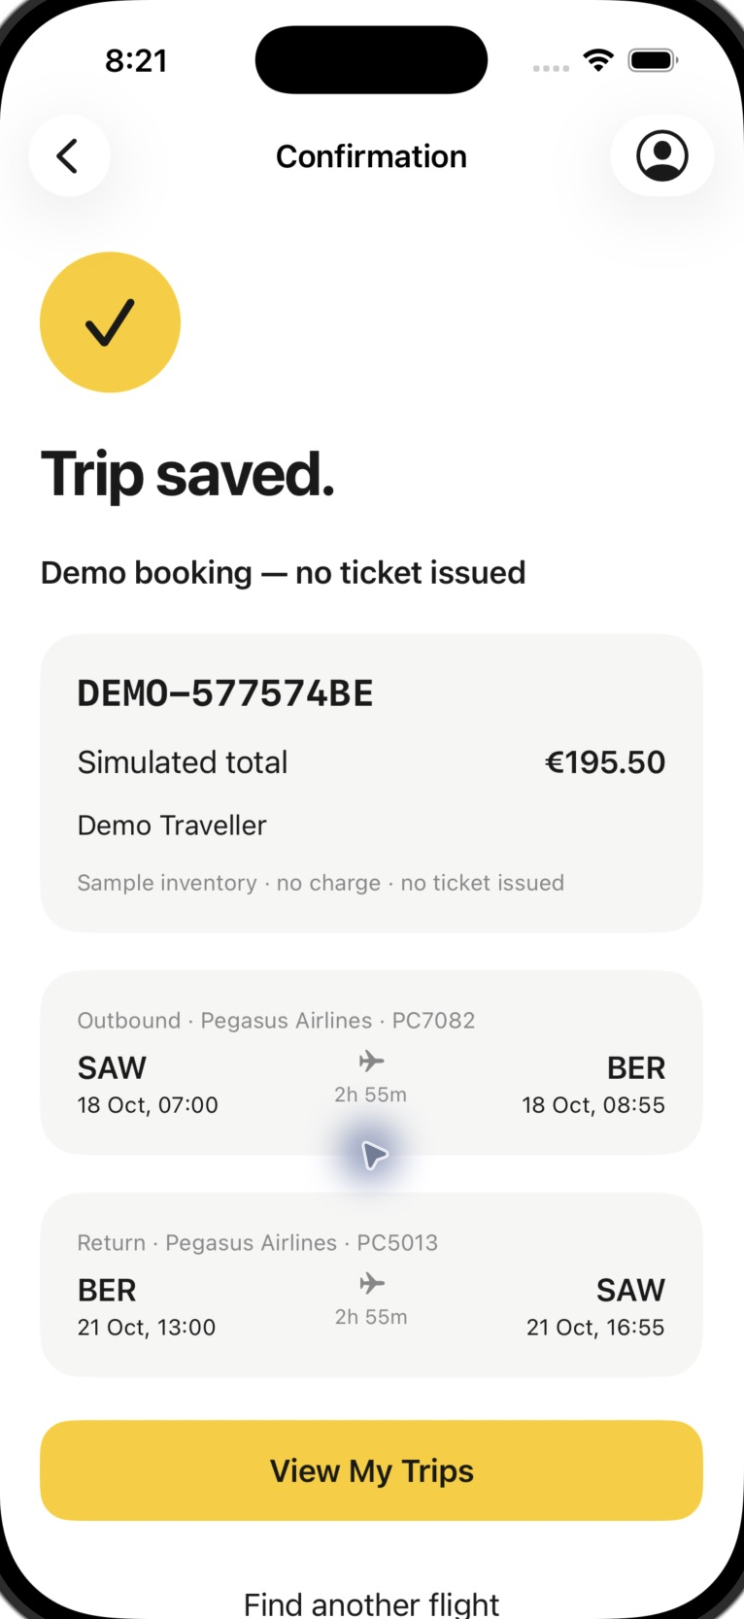
TripFit
PEGASUS
HACKATHON
The next step
10
A more personal
Pegasus journey
A controlled pilot
Start with one route cohort.
Connect authorised booking services.
Measure completion and relevant choices.
Code, README and submission deck
github.com/MusayevAli/Pegasus
09 OCT 2026
Hackathon prototype. Demo confirmation shown. Authorised extras, payment and ticketing integration remains required.
Notes:
[4:20–4:45] Our ask is a Pegasus product and engineering sponsor for a controlled pilot. Start with one route cohort, connect the authorised booking services and measure whether these improvements help people complete the right journey. The code, runnable Xcode project, backend, dashboard and evidence are in the GitHub repository. TripFit takes the Pegasus promise and makes the choices around flying more personal. Thank you.
Sources and evidence
https://github.com/MusayevAli/Pegasus
docs/PROVIDERS.md
Screenshot: docs/screenshots/ios-v2-confirmation.png

