Slide 1
Java3D
Kamran Musayev

Slide 2
Course Contents
  Java-3D Overview
  Benefit of 3D
  Java3D classes and methods
  Instruments
  Models
  Visualization
  Export to Scad

Slide 3
Benefit of 3D
Speed
Precision and control
Scenario visualization
Reduced lead times
You will avoid costly mistakes.
17.06.2016

Slide 4
Classes and Methods
Model
Node
Bar
Commands
17.06.2016

Slide 5
Instruments
Java SE
Swing
Java Fx
Maven
Git
17.06.2016

Slide 6
User Interface
Create Interface
Create Buttons
Create Camera
Create Axis
Create Model
17.06.2016

Slide 7
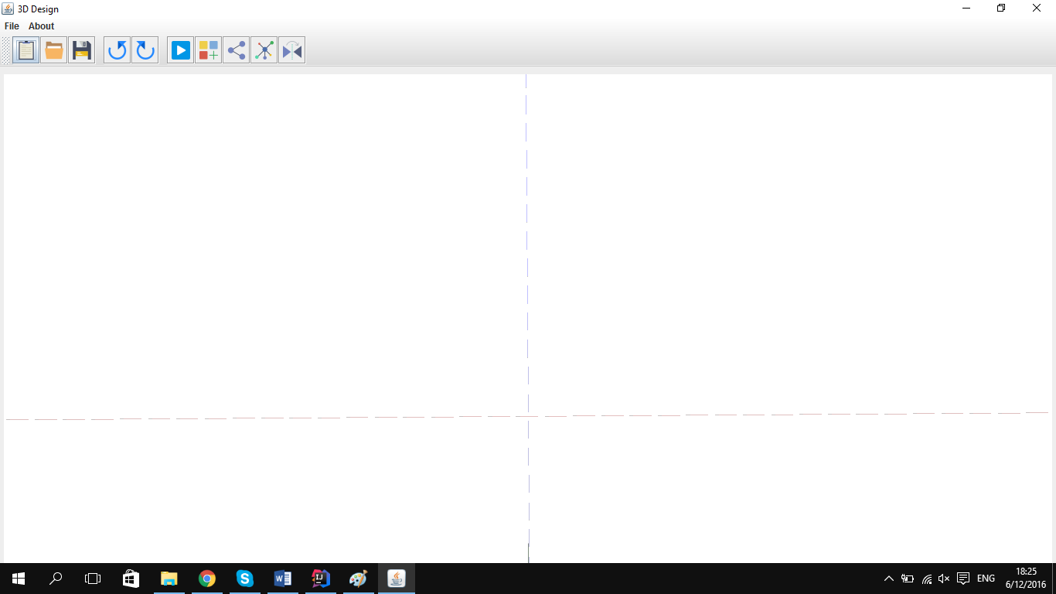
User Interface
17.06.2016

Slide 8
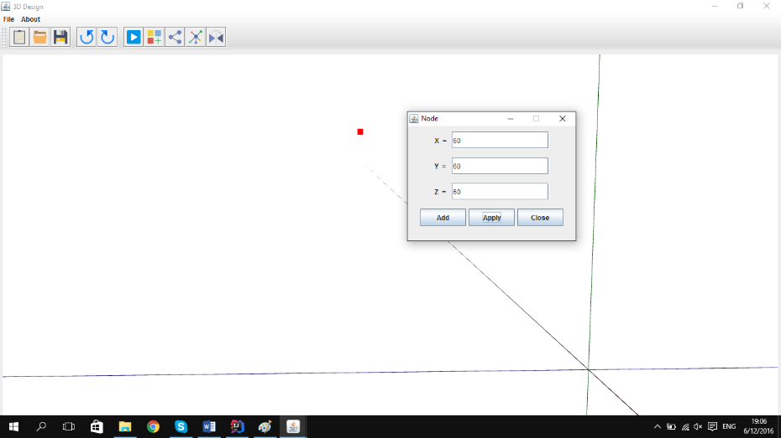
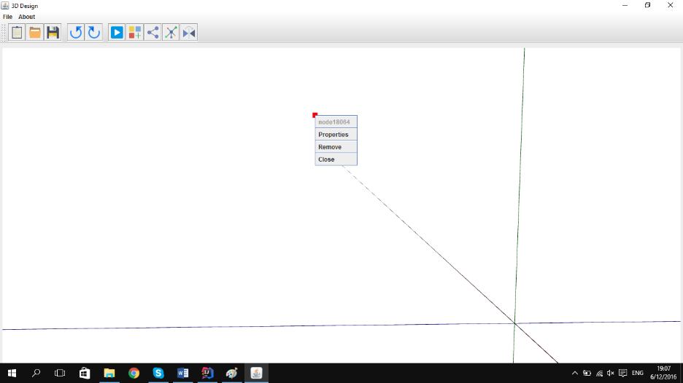
Create Node
Create Node Window
Node Properties Window
17.06.2016

Slide 9
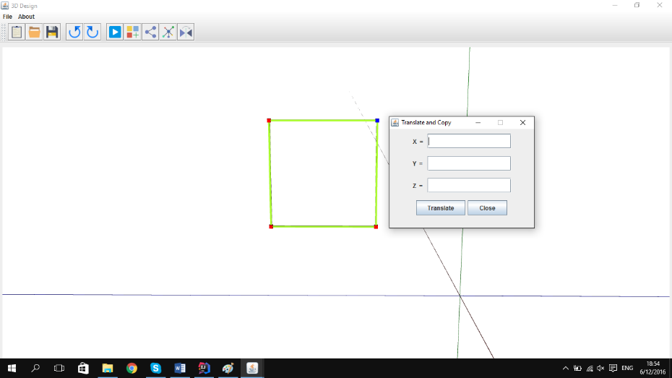
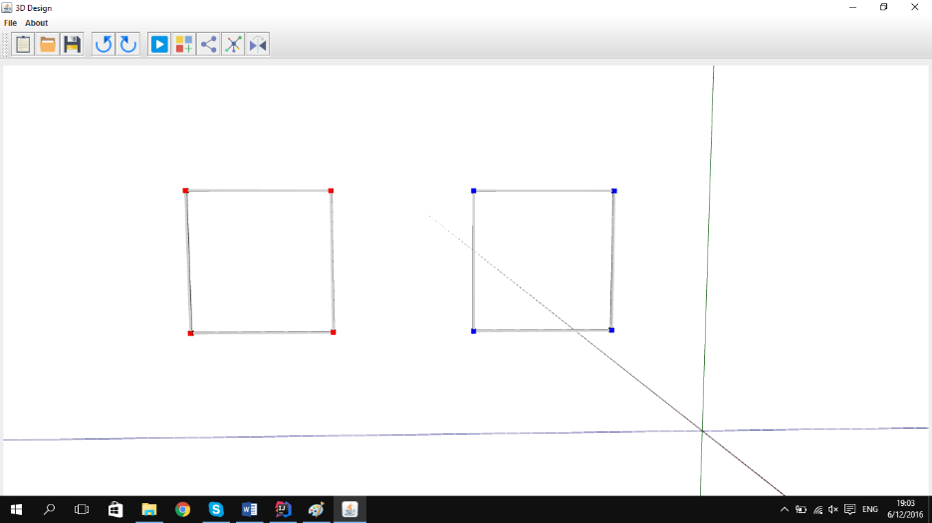
Select and Translate Node and bar
Select Node and Bar
Translate Node and Bar

Slide 10
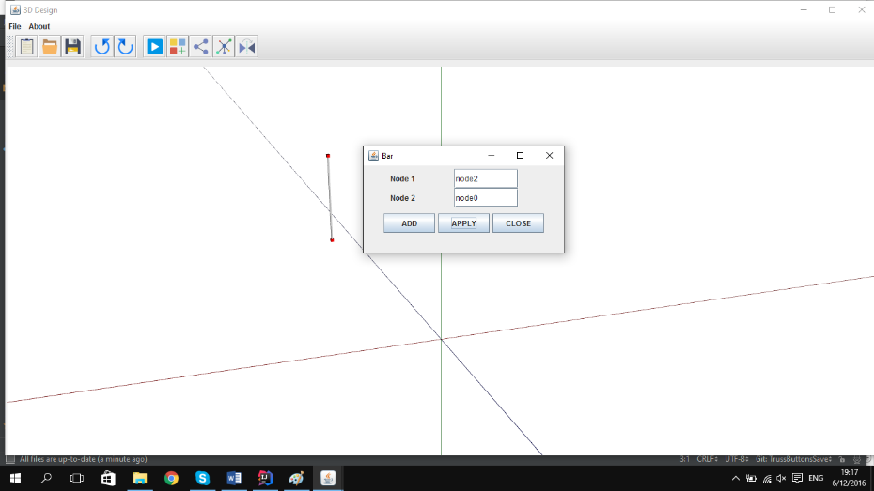
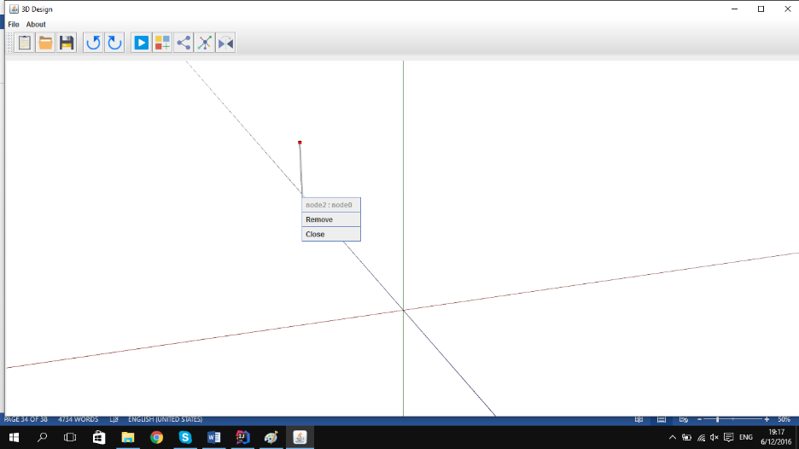
Create Bar
Create Bar Window
Bar Properties Window

Slide 11
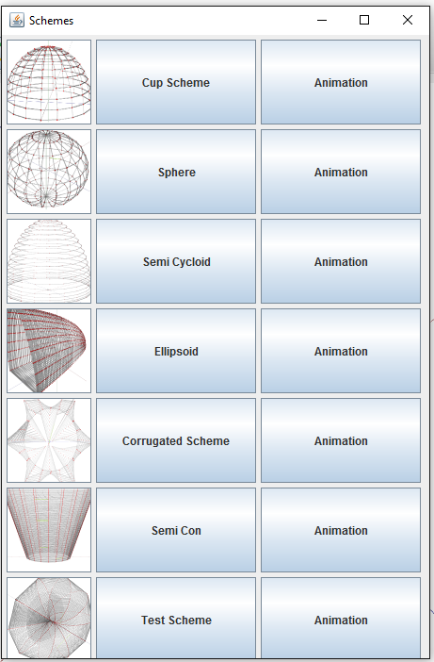
Create Schemes
17.06.2016

Slide 12
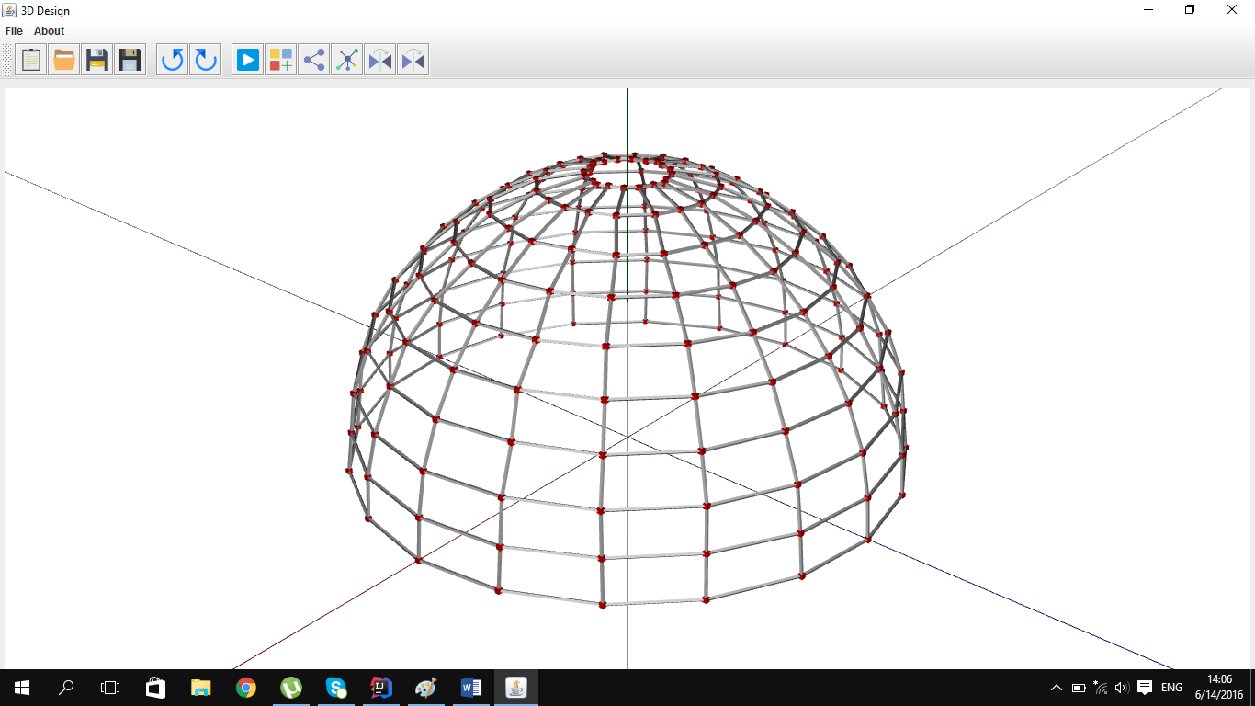

Slide 13
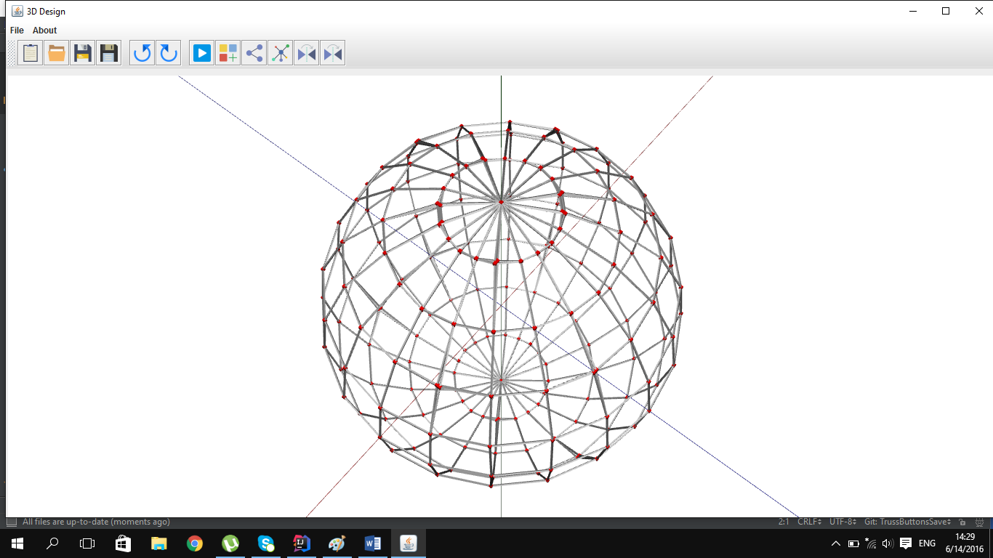

Slide 14
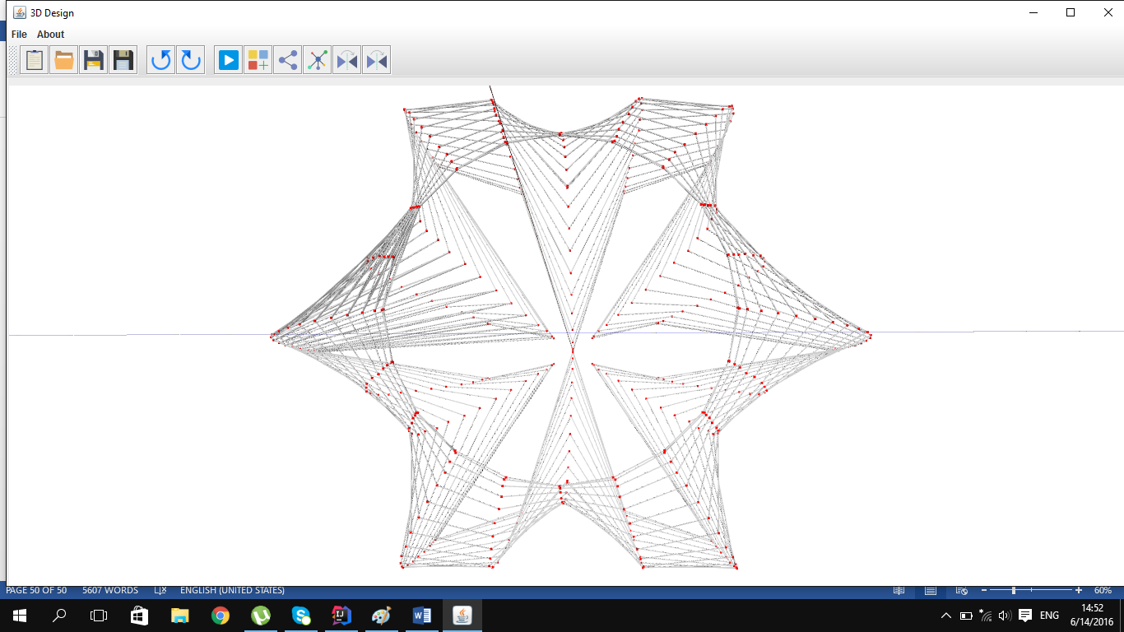

Slide 15
Export To Scad
17.06.2016

Slide 16
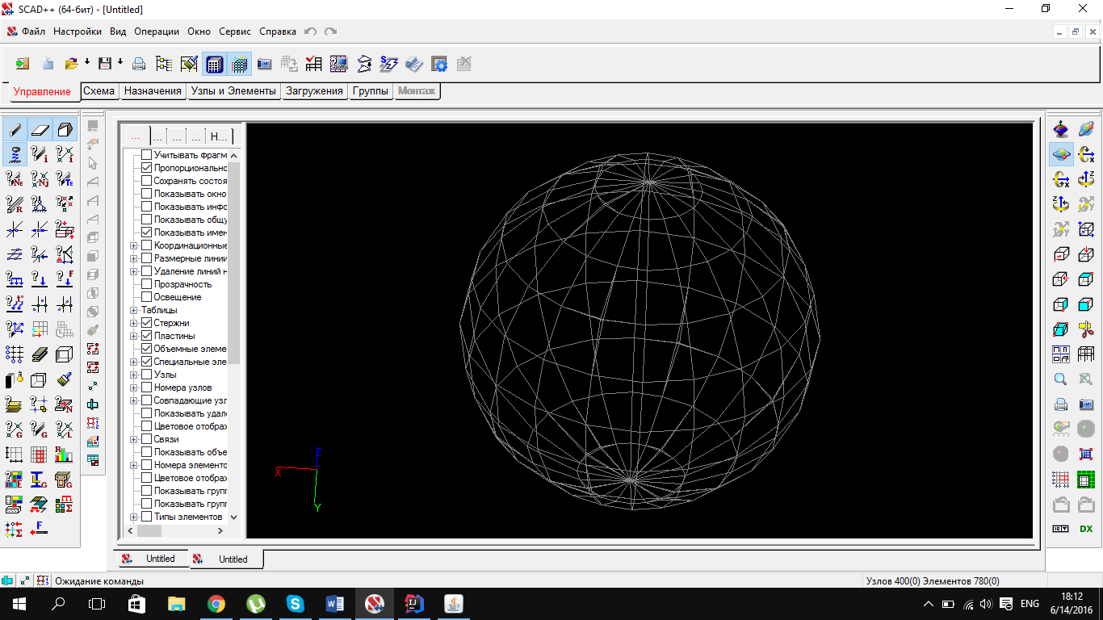
Export to Scad
17.06.2016

Slide 17
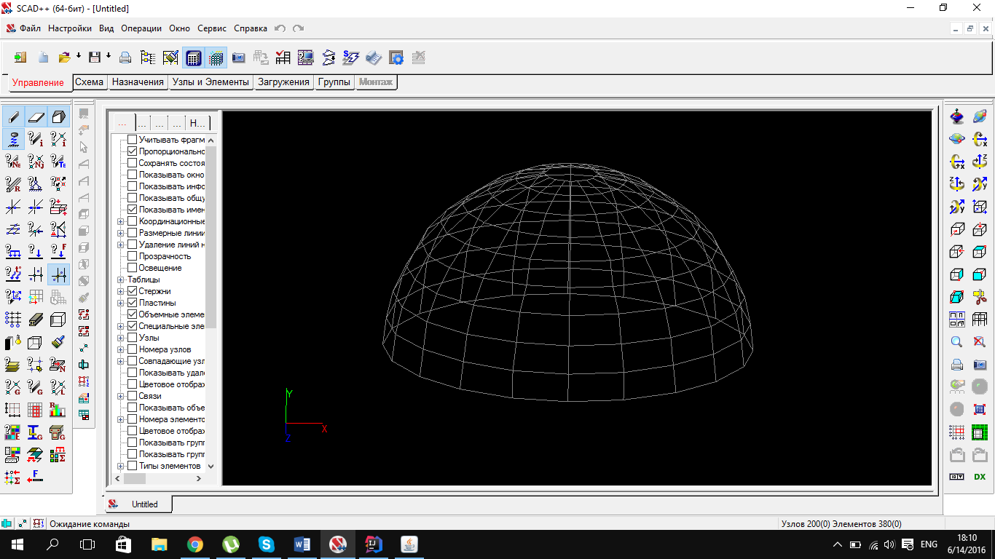
Export to Scad
17.06.2016

Slide 18
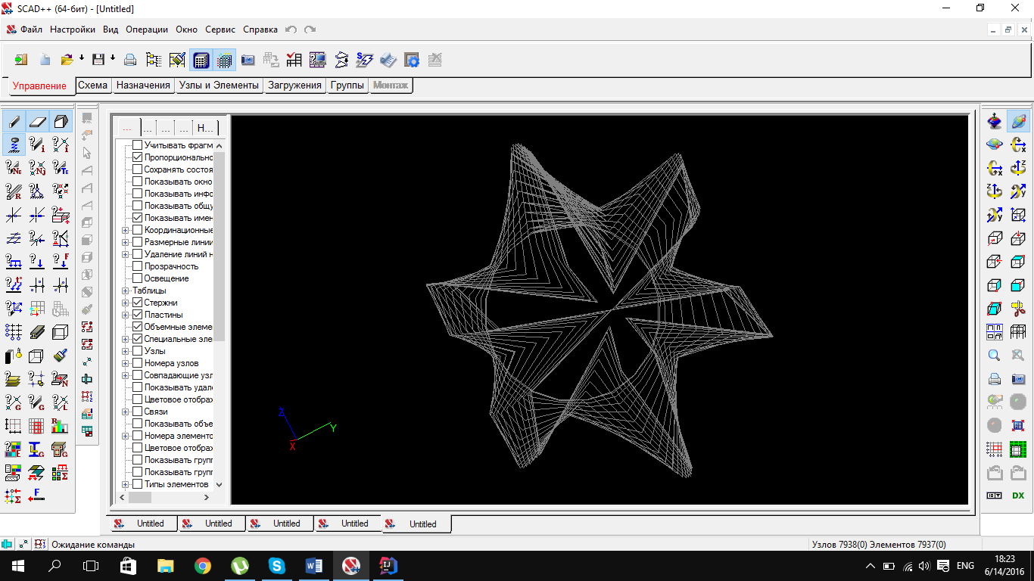
Export to Scad
17.06.2016

Slide 19
Thanks

