Slide 1
COEN807 TERM PROJECT
Predicting At-Risk Student Academic Performance Using Machine Learning
Submitted by
Musbahu Tijjani
P25EGCP8009
Course: COEN807
A comparative supervised classification project using the UCI Student Performance dataset
GitHub: https://github.com/MusbahuTijjani/COEN807_Student_Performance_ML
June 2026

Slide 2
COEN807 MACHINE LEARNING TERM PROJECT
Problem Overview and Objectives
Problem
Objective
Decision Use
Identify students likely to fail final course performance so support can be offered before final outcomes.
Build and compare supervised ML models that predict At_Risk status from student, family, school, and behavioural data.
Use predictions for academic support, tutoring, and early intervention, not punishment or exclusion.
COEN807 | Machine Learning | Musbahu Tijjani
https://github.com/MusbahuTijjani/COEN807_Student_Performance_ML
2

Slide 3
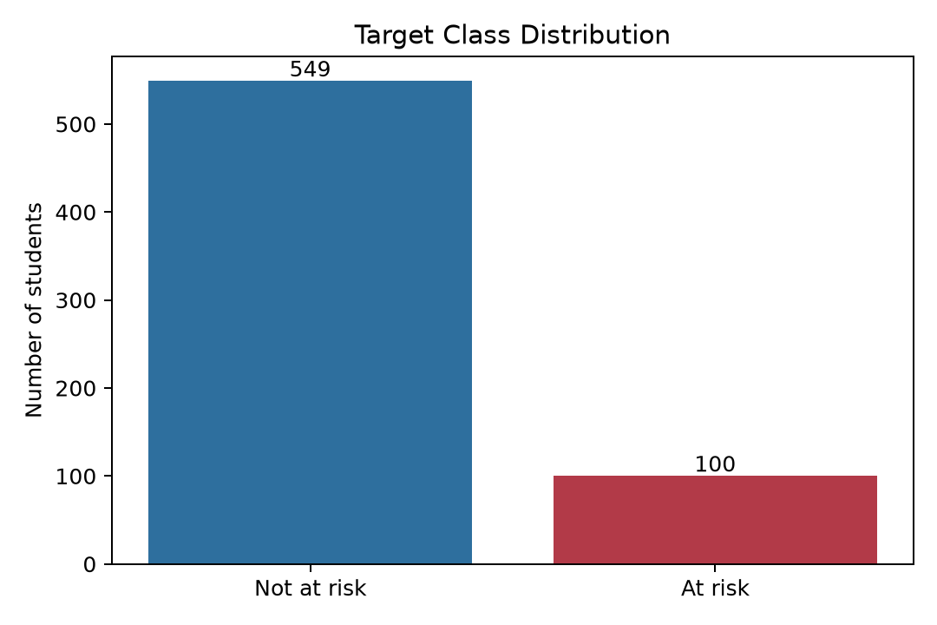
COEN807 MACHINE LEARNING TERM PROJECT
Dataset and Target Definition
Source: UCI Machine Learning Repository, Student Performance dataset.
Selected file: Portuguese language course subset, student-por.csv.
Records: 649 students with demographic, school, family, behavioural, and grade variables.
Target: At_Risk = 1 when final grade G3 is below 10 out of 20.
Class distribution: 100 at-risk and 549 not-at-risk students.
COEN807 | Machine Learning | Musbahu Tijjani
https://github.com/MusbahuTijjani/COEN807_Student_Performance_ML
3

Slide 4
COEN807 MACHINE LEARNING TERM PROJECT
End-to-End Methodology Workflow
1
2
3
4
5
>
>
>
>
Acquire public dataset
Engineer At_Risk target
Preprocess features
Train and tune models
Evaluate and interpret
Implementation used scikit-learn pipelines so preprocessing and model fitting remain reproducible.
COEN807 | Machine Learning | Musbahu Tijjani
https://github.com/MusbahuTijjani/COEN807_Student_Performance_ML
4

Slide 5
COEN807 MACHINE LEARNING TERM PROJECT
Preprocessing and Feature Engineering
Target Engineering
Feature Processing
Two Experiments
At_Risk = 1 if G3 < 10.
At_Risk = 0 otherwise.
This turns final grade prediction into a support-focused classification task.
Categorical variables: one-hot encoding.
Numeric variables: median imputation and standardisation.
Train-test split: stratified 80/20.
Early-warning: excludes G1 and G2.
Performance-aware: includes G1 and G2.
This separates early usefulness from predictive strength.
COEN807 | Machine Learning | Musbahu Tijjani
https://github.com/MusbahuTijjani/COEN807_Student_Performance_ML
5

Slide 6
COEN807 MACHINE LEARNING TERM PROJECT
Models Compared and Tuning Design
Dummy Majority baseline checks whether accuracy is misleading.
Logistic Regression gives an interpretable linear baseline.
Decision Tree gives rule-based nonlinear structure.
Random Forest and Gradient Boosting test ensemble tree performance.
Support Vector Machine tests a margin-based classifier.
GridSearchCV with five-fold stratified cross-validation tuned model hyperparameters.
6
5
20%
F1
Models
CV folds
Test split
Primary metric
COEN807 | Machine Learning | Musbahu Tijjani
https://github.com/MusbahuTijjani/COEN807_Student_Performance_ML
6

Slide 7
COEN807 MACHINE LEARNING TERM PROJECT
Experimental Setup and Metrics
Why Not Accuracy Alone?
Primary Metrics
Operational View
The majority class is not-at-risk. A model can look accurate while detecting no at-risk students.
At-risk recall: catches students needing support.
At-risk F1: balances recall and precision.
Balanced accuracy and ROC-AUC support comparison.
False negatives mean unsupported students.
False positives may still receive harmless academic support.
COEN807 | Machine Learning | Musbahu Tijjani
https://github.com/MusbahuTijjani/COEN807_Student_Performance_ML
7

Slide 8
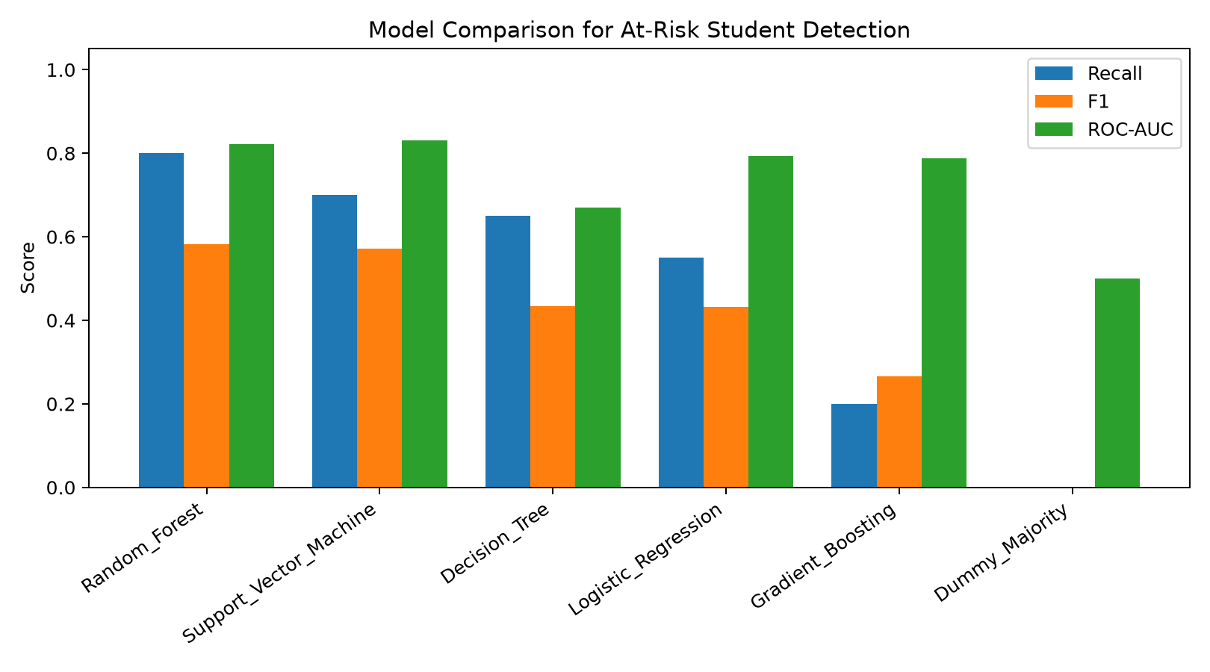
COEN807 MACHINE LEARNING TERM PROJECT
Early-Warning Results: Without G1 and G2
RF
0.800
Best model
Recall
0.582
0.822
F1-score
ROC-AUC
Interpretation: Random Forest detected 16 of 20 at-risk students in the test set, but it also produced 19 false positives.
COEN807 | Machine Learning | Musbahu Tijjani
https://github.com/MusbahuTijjani/COEN807_Student_Performance_ML
8

Slide 9
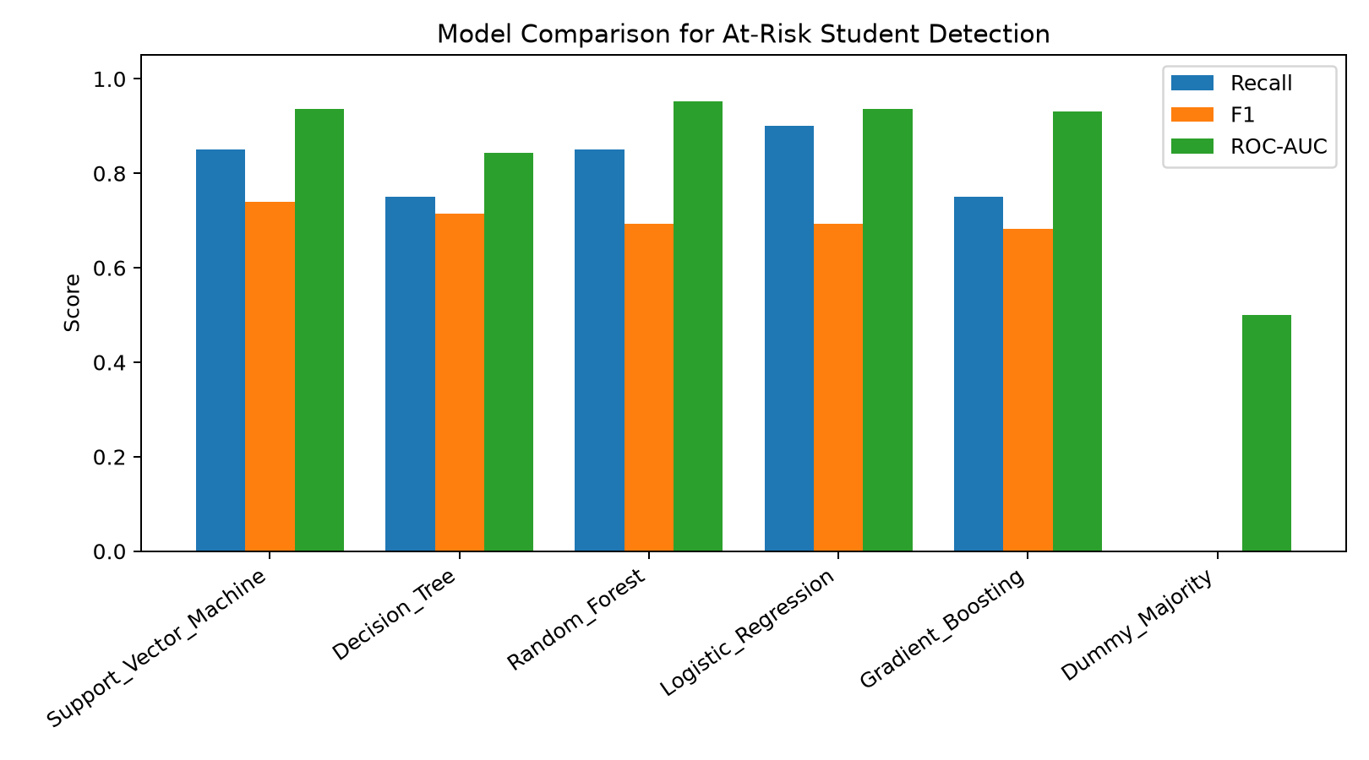
COEN807 MACHINE LEARNING TERM PROJECT
Performance-Aware Results: With G1 and G2
SVM
0.908
Best model
Accuracy
0.850
0.739
Recall
F1-score
Interpretation: adding prior grades improves prediction; the SVM detected 17 of 20 at-risk students and reduced false positives to 9.
COEN807 | Machine Learning | Musbahu Tijjani
https://github.com/MusbahuTijjani/COEN807_Student_Performance_ML
9

Slide 10
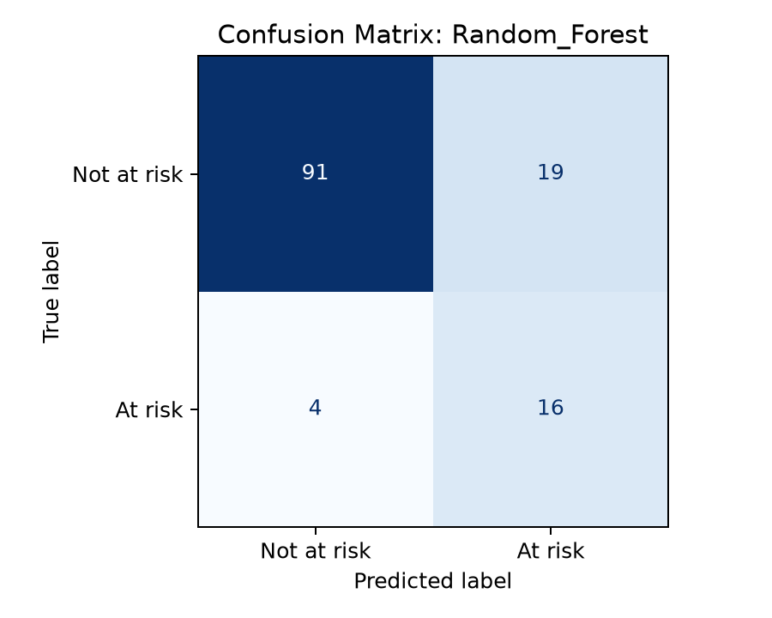
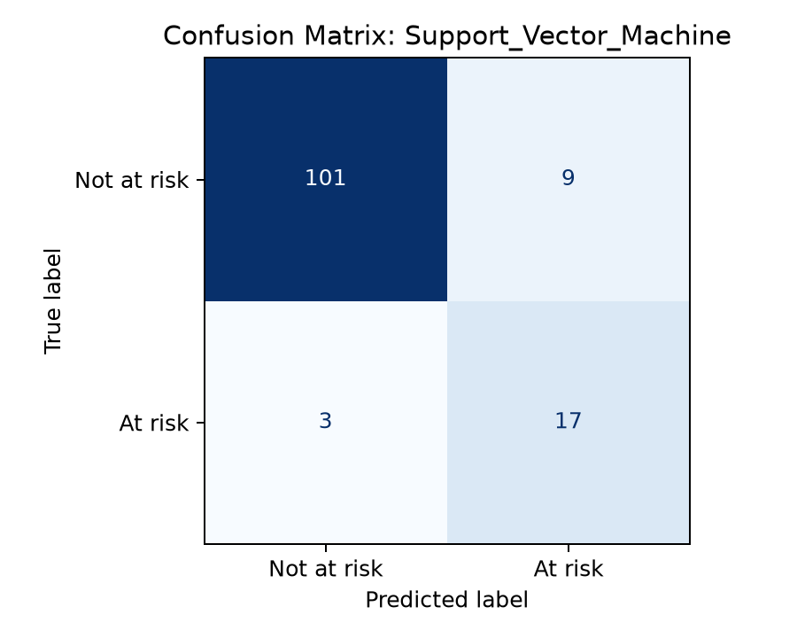
COEN807 MACHINE LEARNING TERM PROJECT
Comparative Findings and Interpretation
Main Finding
G1 and G2 strongly improve performance, but the early-warning model is more useful when interventions must begin before later grades are available.
Accuracy baseline warning: Dummy Majority scored 0.846 accuracy but detected 0 at-risk students.
COEN807 | Machine Learning | Musbahu Tijjani
https://github.com/MusbahuTijjani/COEN807_Student_Performance_ML
10

Slide 11
COEN807 MACHINE LEARNING TERM PROJECT
Limitations, Bias, Ethics & Safeguards
Limitations
Bias Risks
Safeguards
Portuguese secondary school data may not generalise to Nigerian education contexts.
Dataset size is moderate and not all real-world factors are measured.
Address, internet access, parental education and family support may encode socioeconomic inequality.
Use for academic support only.
Validate locally.
Audit subgroups.
Keep human review and appeal procedures.
COEN807 | Machine Learning | Musbahu Tijjani
https://github.com/MusbahuTijjani/COEN807_Student_Performance_ML
11

Slide 12
COEN807 MACHINE LEARNING TERM PROJECT
Reproducibility and Submission Checklist
Report PDF and this PowerPoint deck include the GitHub repository link.
Repository contains source code, dataset/access instructions, outputs, figures, trained models and README.
Run workflow: pip install -r requirements.txt, then python src/train_models.py.
Google Drive folder must be set to: Anyone with the link can view.
Final GitHub repository link is shown below for direct access.
https://github.com/MusbahuTijjani/COEN807_Student_Performance_ML
COEN807 | Machine Learning | Musbahu Tijjani
https://github.com/MusbahuTijjani/COEN807_Student_Performance_ML
12

