Slide 1


DEPARTMENT OF COMPUTER ENGINEERING
AHMADU BELLO UNIVERSITY, ZARIA
COEN 807 - MACHINE LEARNING
PREDICTING AT-RISK STUDENT ACADEMIC PERFORMANCE
2025/2026 FIRST SEMESTER
PROJECT-BASED EXAMINATION
BY:
MUSBAHU TIJJANI
P25EGCP8009
JUNE, 2026
JUNE, 2026
Department of Computer Engineering
1

Slide 2
PROBLEM OVERVIEW
The Project Meets the Lecturer's Requirements
Problem
Objective
Decision Use
Predict students who may be at risk of failing so academic support can begin before final outcomes.
Build and compare supervised ML models using student, school, family, and behavioural data.
Use predictions for tutoring, advising, and support rather than punishment or exclusion.
Evidence included: report, slides, GitHub code, dataset files, results, models, and figures.
Department of Computer Engineering
2

Slide 3
DATASET DESCRIPTION
The Dataset Is Public, Relevant, and Suitable
Source
Target
Quality
Class Balance
UCI Machine Learning Repository
Student Performance dataset
At_Risk = 1 if G3 < 10
otherwise 0
649 records
33 original variables
0 missing values
100 at-risk students
549 not-at-risk students
Accuracy alone is misleading
Selected file: data/raw/student/student-por.csv
Department of Computer Engineering
3

Slide 4
METHODOLOGY
A Reproducible End-to-End Workflow
1
Acquire public dataset
>
2
Engineer At_Risk target
>
3
Preprocess features
>
4
Train and tune models
>
5
Evaluate and interpret
Scikit-learn pipelines keep preprocessing, training, and evaluation reproducible.
Department of Computer Engineering
4

Slide 5
PREPROCESSING
Feature Engineering Prepares the Student Data
Target Engineering
Feature Processing
Two Experiments
At_Risk = 1 if final grade G3 is below 10.
This turns final performance into a support-focused classification task.
Categorical variables use one-hot encoding.
Numerical variables use median imputation and standardisation.
Early-warning excludes G1 and G2.
Performance-aware includes G1 and G2 to examine grade-history impact.
Train-test split: stratified 80/20 with fixed random seed.
Department of Computer Engineering
5

Slide 6
EXPERIMENTAL SETUP
Six Classifiers Use the Same Tuning Protocol
Models Compared
Tuning
Reason
Dummy Majority
Logistic Regression
Decision Tree
Random Forest
Gradient Boosting
Support Vector Machine
Five-fold stratified cross-validation.
Grid search over model hyperparameters.
Primary tuning score: At_Risk F1.
The baseline checks imbalance.
Linear, tree, ensemble, and margin-based models give a fair comparison.
5
20%
F1
CV folds
Test split
Primary metric
Department of Computer Engineering
6

Slide 7
EXPERIMENTAL SETUP
Evaluation Goes Beyond Accuracy
Why Not Accuracy Alone?
Primary Metrics
Operational View
The majority class is much larger. A model can look accurate while detecting no at-risk students.
At-risk recall identifies students needing support.
At-risk F1 balances recall and precision.
Confusion matrices show false negatives and false positives clearly for support planning.
Also reported: balanced accuracy, precision, ROC-AUC, and confusion matrix counts.
Department of Computer Engineering
7

Slide 8
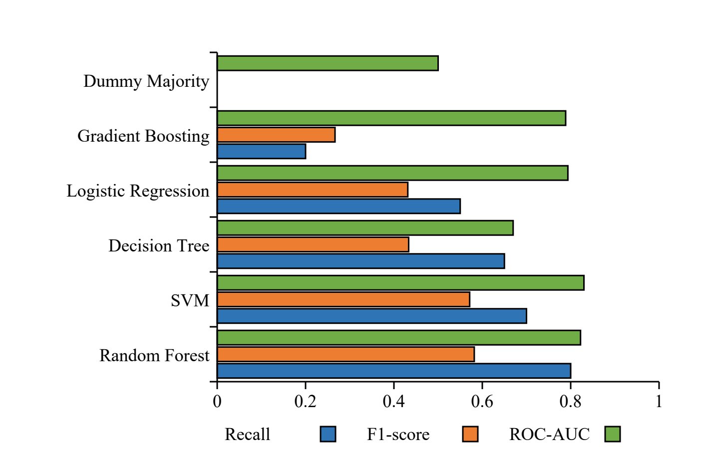
RESULTS
Random Forest Leads Without G1 and G2
RF
0.800
Best model
Recall
0.582
0.822
F1-score
ROC-AUC
Interpretation
Detected 16 of 20 at-risk students, with 19 false positives.
Department of Computer Engineering
8

Slide 9
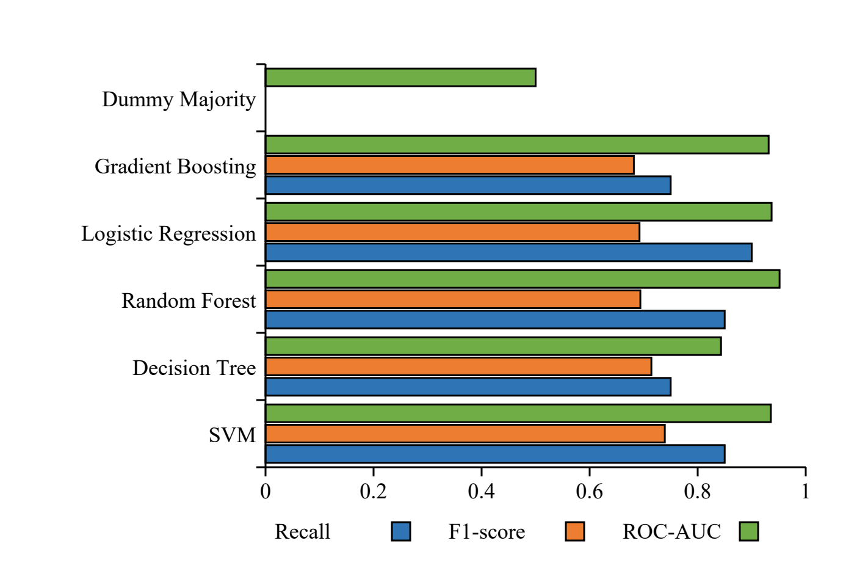
RESULTS
G1 and G2 Improve Predictive Performance
SVM
0.908
Best model
Accuracy
0.850
0.739
Recall
F1-score
Interpretation
Detected 17 of 20 at-risk students and reduced false positives to 9.
Department of Computer Engineering
9

Slide 10
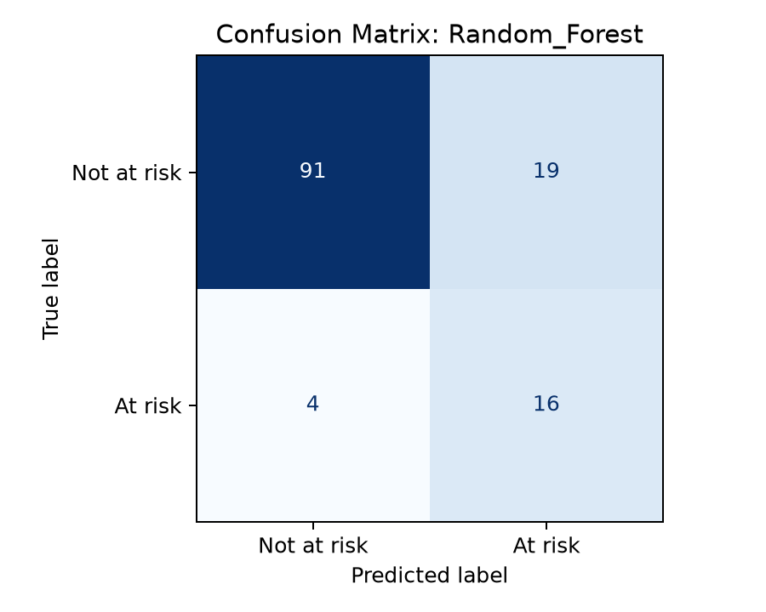
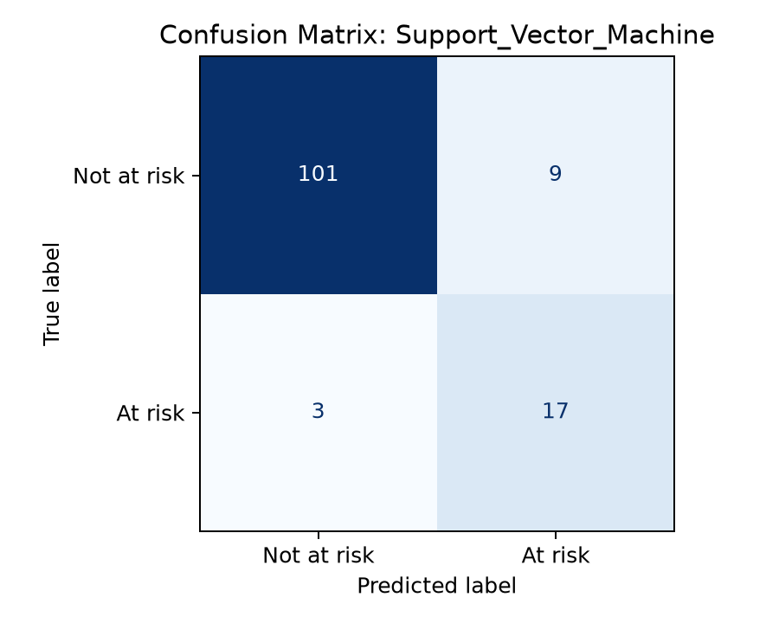
COMPARATIVE ANALYSIS
Model Choice Depends on Intervention Timing
Main Finding
G1 and G2 strongly improve performance, but the early-warning model is more useful before later grades are available.
Accuracy warning: Dummy Majority scored 0.846 but detected no at-risk students.
Department of Computer Engineering
10

Slide 11
KEY FINDINGS
Timing, Metrics, and Responsible Use Matter
Finding 1
Finding 2
Finding 3
Prior grades G1 and G2 are strong predictors of final academic risk.
Early-warning prediction is less accurate but more useful before later grades are available.
Accuracy alone is misleading because the majority-class baseline detects no at-risk students.
Best early-warning model: Random Forest. Best performance-aware model: SVM.
Department of Computer Engineering
11

Slide 12
CHALLENGES AND LESSONS LEARNED
Challenges, Lessons, and Responsible Use
Challenge
Lesson
Responsible Use
The class distribution is imbalanced, so the model can appear accurate while missing at-risk students.
Recall, F1-score, ROC-AUC, and confusion matrices are more informative than accuracy alone.
Predictions should guide support, tutoring, and counselling. They should not be used for punishment or exclusion.
External validation should use independent Nigerian data and report confidence intervals.
Department of Computer Engineering
12

Slide 13
SUBMISSION EVIDENCE
The Package Contains Reproducibility Evidence
Report
Source Code
Artifacts
COEN807_Technical_Report.pdf
Chapter One to Chapter Five format with results and discussion.
src/train_models.py
src/build_report.py
requirements.txt
run_project.bat
Dataset/access files
Generated result CSV/JSON
Figures
Trained models
PowerPoint deck
GitHub repository: https://github.com/MusbahuTijjani/COEN807_Student_Performance_ML
Department of Computer Engineering
13

Slide 14
CONCLUSION AND FUTURE WORK
Machine learning can support early academic intervention when results are evaluated responsibly.
Early Warning
Conclusion
Future Work
Random Forest detected 80% of at-risk students without G1 and G2.
Performance-aware SVM performs better when prior grades are available.
Test external validation, nested CV, calibration, threshold optimization, and SHAP/fairness metrics.
https://github.com/MusbahuTijjani/COEN807_Student_Performance_ML
Department of Computer Engineering
14

