Slide 1



Market Place
MyFarm Dev
Hackathon Project
An online marketplace connecting local Gambian traders and buyers
Visit Demo Site: market-tracker-onzf.onrender.com

Slide 2
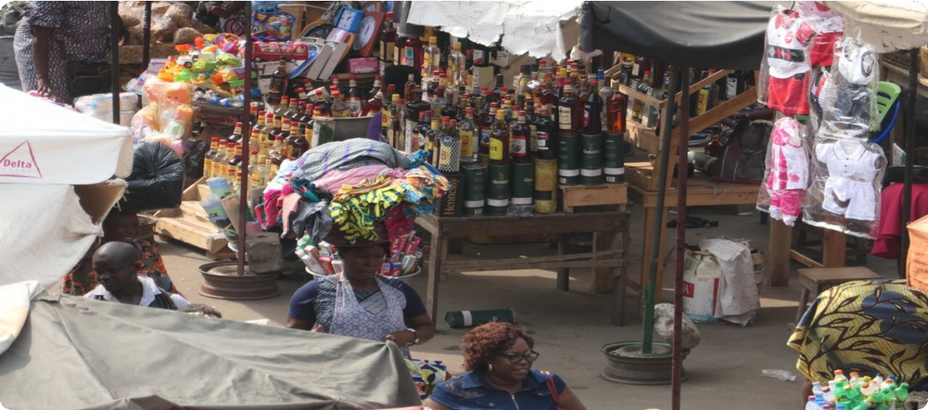



The Problem
Hard to compare prices
Buyers must visit multiple locations to find the best deals
Difficult to find sellers
No centralized information about who sells what products
Time wasted
Manually searching for goods is inefficient and frustrating
Market Place aims to solve these challenges through technology

Slide 3
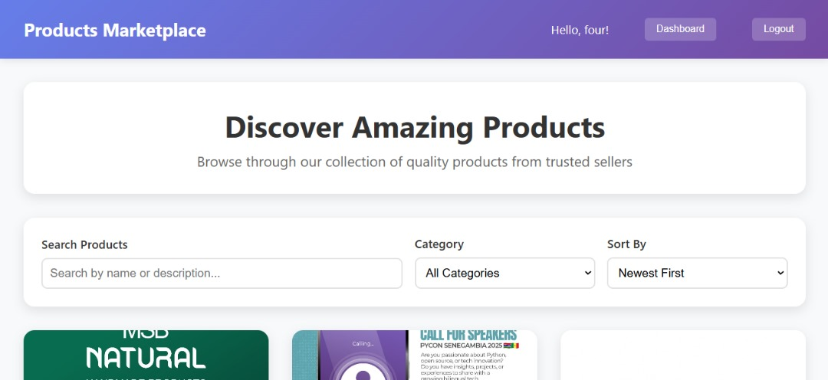

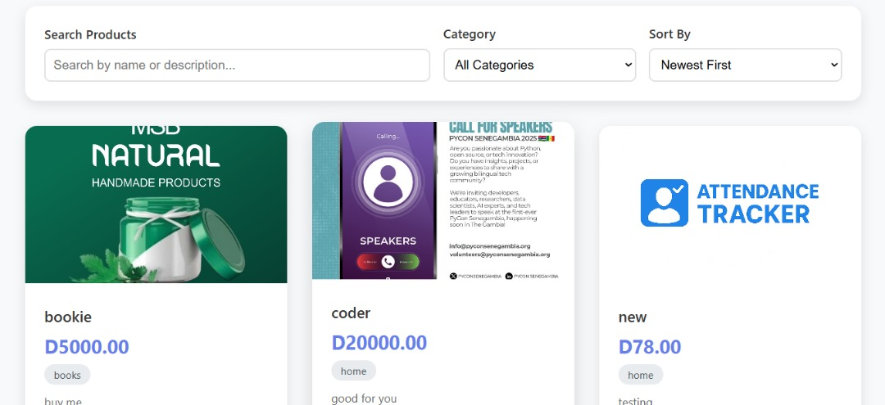


Our Solution
Impact
Real World Benefits
Real time Price Tracking
Transparent market information for all Gambian traders and buyers
Empowered Communities
Connecting traders and buyers directly, fostering economic growth
Improved Market Access
Digital platform bridges gaps between rural and urban markets
Digital Platform
Connecting buyers and sellers across The Gambia in one convenient location
Browse Products
Easily find and compare prices across multiple sellers
Sell Products
Sellers can post their products and reach more customers

Slide 4
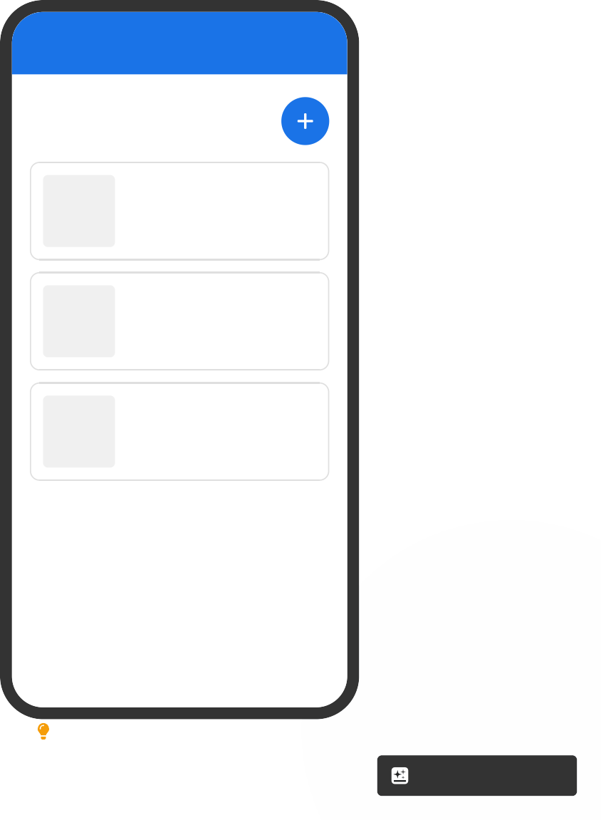


Key Features
Market Place
Offline Marketplace
Browse and post products in a centralized platform for Gambian sellers and buyers
Products
Browse local products
Fresh Tomatoes D25 per kg Serrekunda Market
Multi-role Access
Different permissions and features for buyers, sellers, and administrators
Cassava D30 per kg Brikama Market
Mobile-friendly UI
Responsive design that works well on all devices for maximum accessibility
Local Rice D45 per kg Bakau Market
Payment Processing
In-person payment only. In current version

Slide 5





Tech Stack
Full Stack
Architecture
Backend
Django framework providing robust Python-based infrastructure for secure data handling and business logic
Frontend
HTML, CSS, JavaScript with Bootstrap for responsive and accessible user interfaces
Djafigo
HTML5
CSS3
JavaScript
Database
SQLite database engine providing lightweight, efficient data storage and retrieval
Bootstrap
SQLite
Refider
Hosting
Render platform for reliable cloud deployment with continuous integration

Slide 6
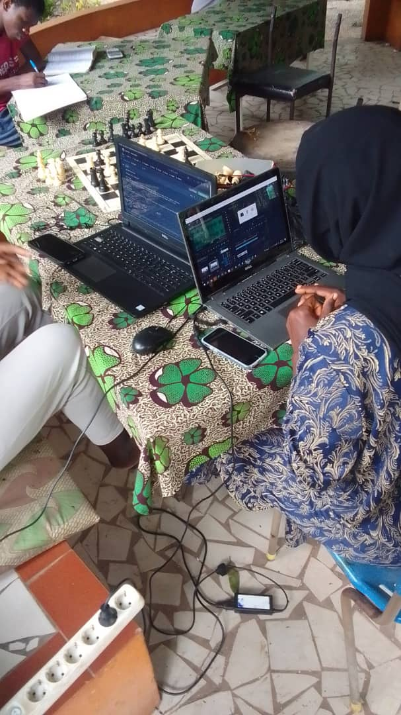

Thank You!
MyFarm Dev Team
Market Place — Hackathon Project
Our Team
Musa Jawo
Oumie Loum
Alieu Sarr
Alhusainou Mi Bah

