Slide 1
Rancidity
By Jovan Fernandes

Slide 2
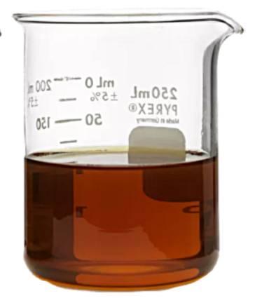
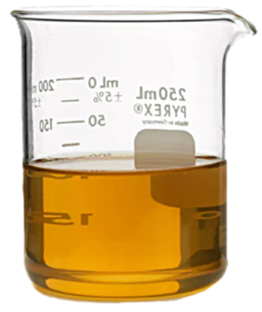
What Is
Rancidity
Rancidity is the process of chemical spoilage in fats and oils, caused by exposure to oxygen, light, moisture, or bacteria, resulting in unpleasant odors, tastes, and lowered nutritional value
When fats and oils are oxidized, they become rancid and their smell and taste change. Rancidity is the chemical decomposition of fats, oils, and other lipids.
Oil turns rancid after kept in air for too long

Slide 3
2
1
3
Types Of Rancidity
Hydrolytic rancidity
It occurs when water splits fatty acid chains away from the glycerol backbone in glycerides.
Oxidative rancidity
It occurs when the double bonds of an unsaturated fatty acid react chemically with oxygen.
Microbial rancidity
It is a process in which microorganisms such as bacteria use their enzymes, including lipases, to break down chemical structures in the fat.

Slide 4
Types Of Rancidity
1
2
3
Hydrolytic rancidity
Oxidative rancidity
Microbial rancidity
It occurs when water splits fatty acid chains away from the glycerol backbone in glycerides.
It occurs when the double bonds of an unsaturated fatty acid react chemically with oxygen.
It is a process in which microorganisms such as bacteria use their enzymes, including lipases, to break down chemical structures in the fat.

Slide 5
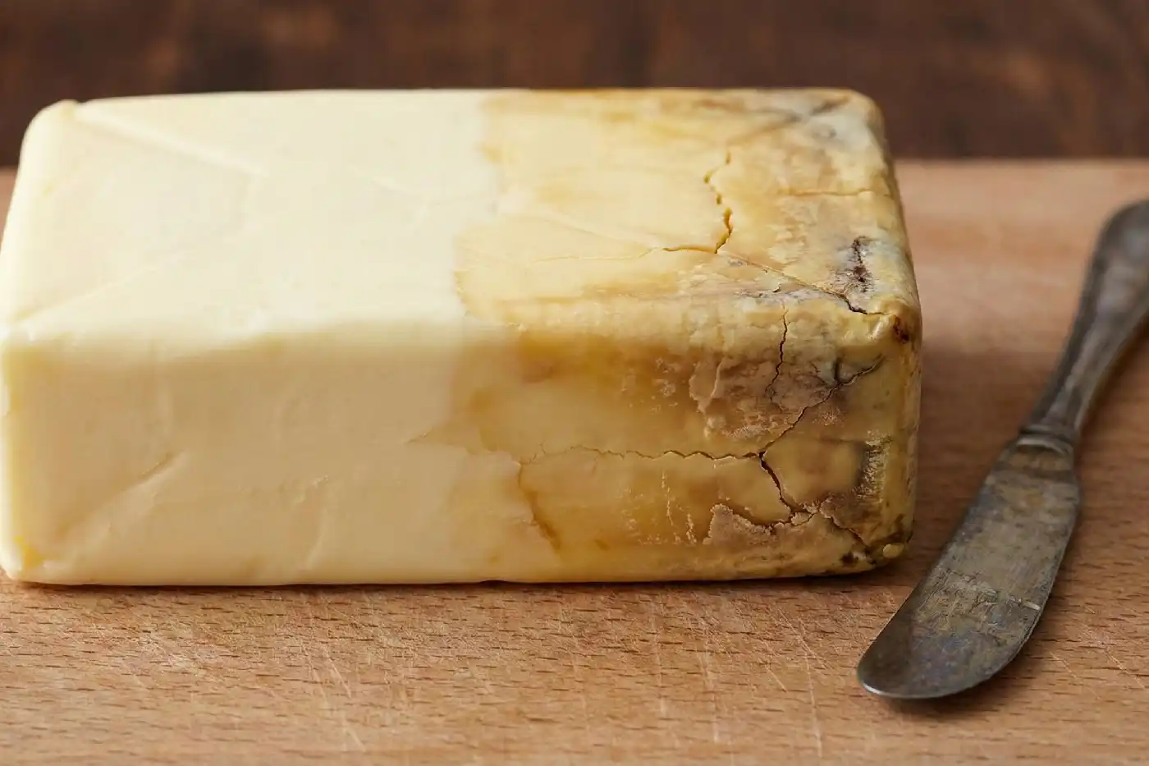
3
Microbial rancidity
2
Oxidative rancidity
1
Hydrolytic rancidity
Hydrolytic rancidity is the breakdown of fats (triglycerides) in the presence of water, resulting in the release of free fatty acids and glycerol. This reaction creates a soapy, bitter, or foul-smelling off-flavor. It commonly affects dairy, unrefined oils, and foods with high moisture content
Butter turns rancid primarily when its fat molecules break down through oxidation or hydrolysis. This chemical process releases free fatty acids—notably butyric acid—which causes the distinct sour, paint-like, or unpleasant smell

Slide 6
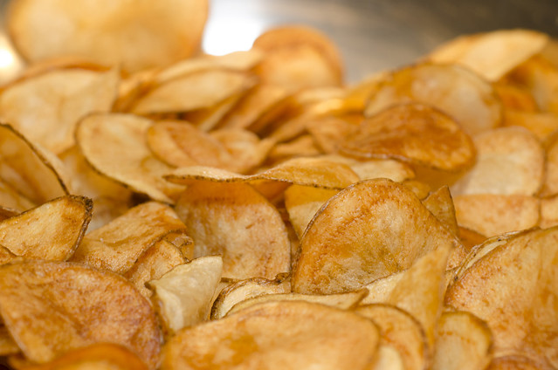
3
Microbial rancidity
2
Oxidative rancidity
Oxidative rancidity is the process where fats and oils in food react with oxygen in the atmospheric air. This oxidation breaks down unsaturated fatty acids, producing volatile compounds like aldehydes and ketones. This gives the food an unpleasant, foul smell and a bad taste, making it inedible
Potato chips left in the air turns rancid due to oxidation

Slide 7
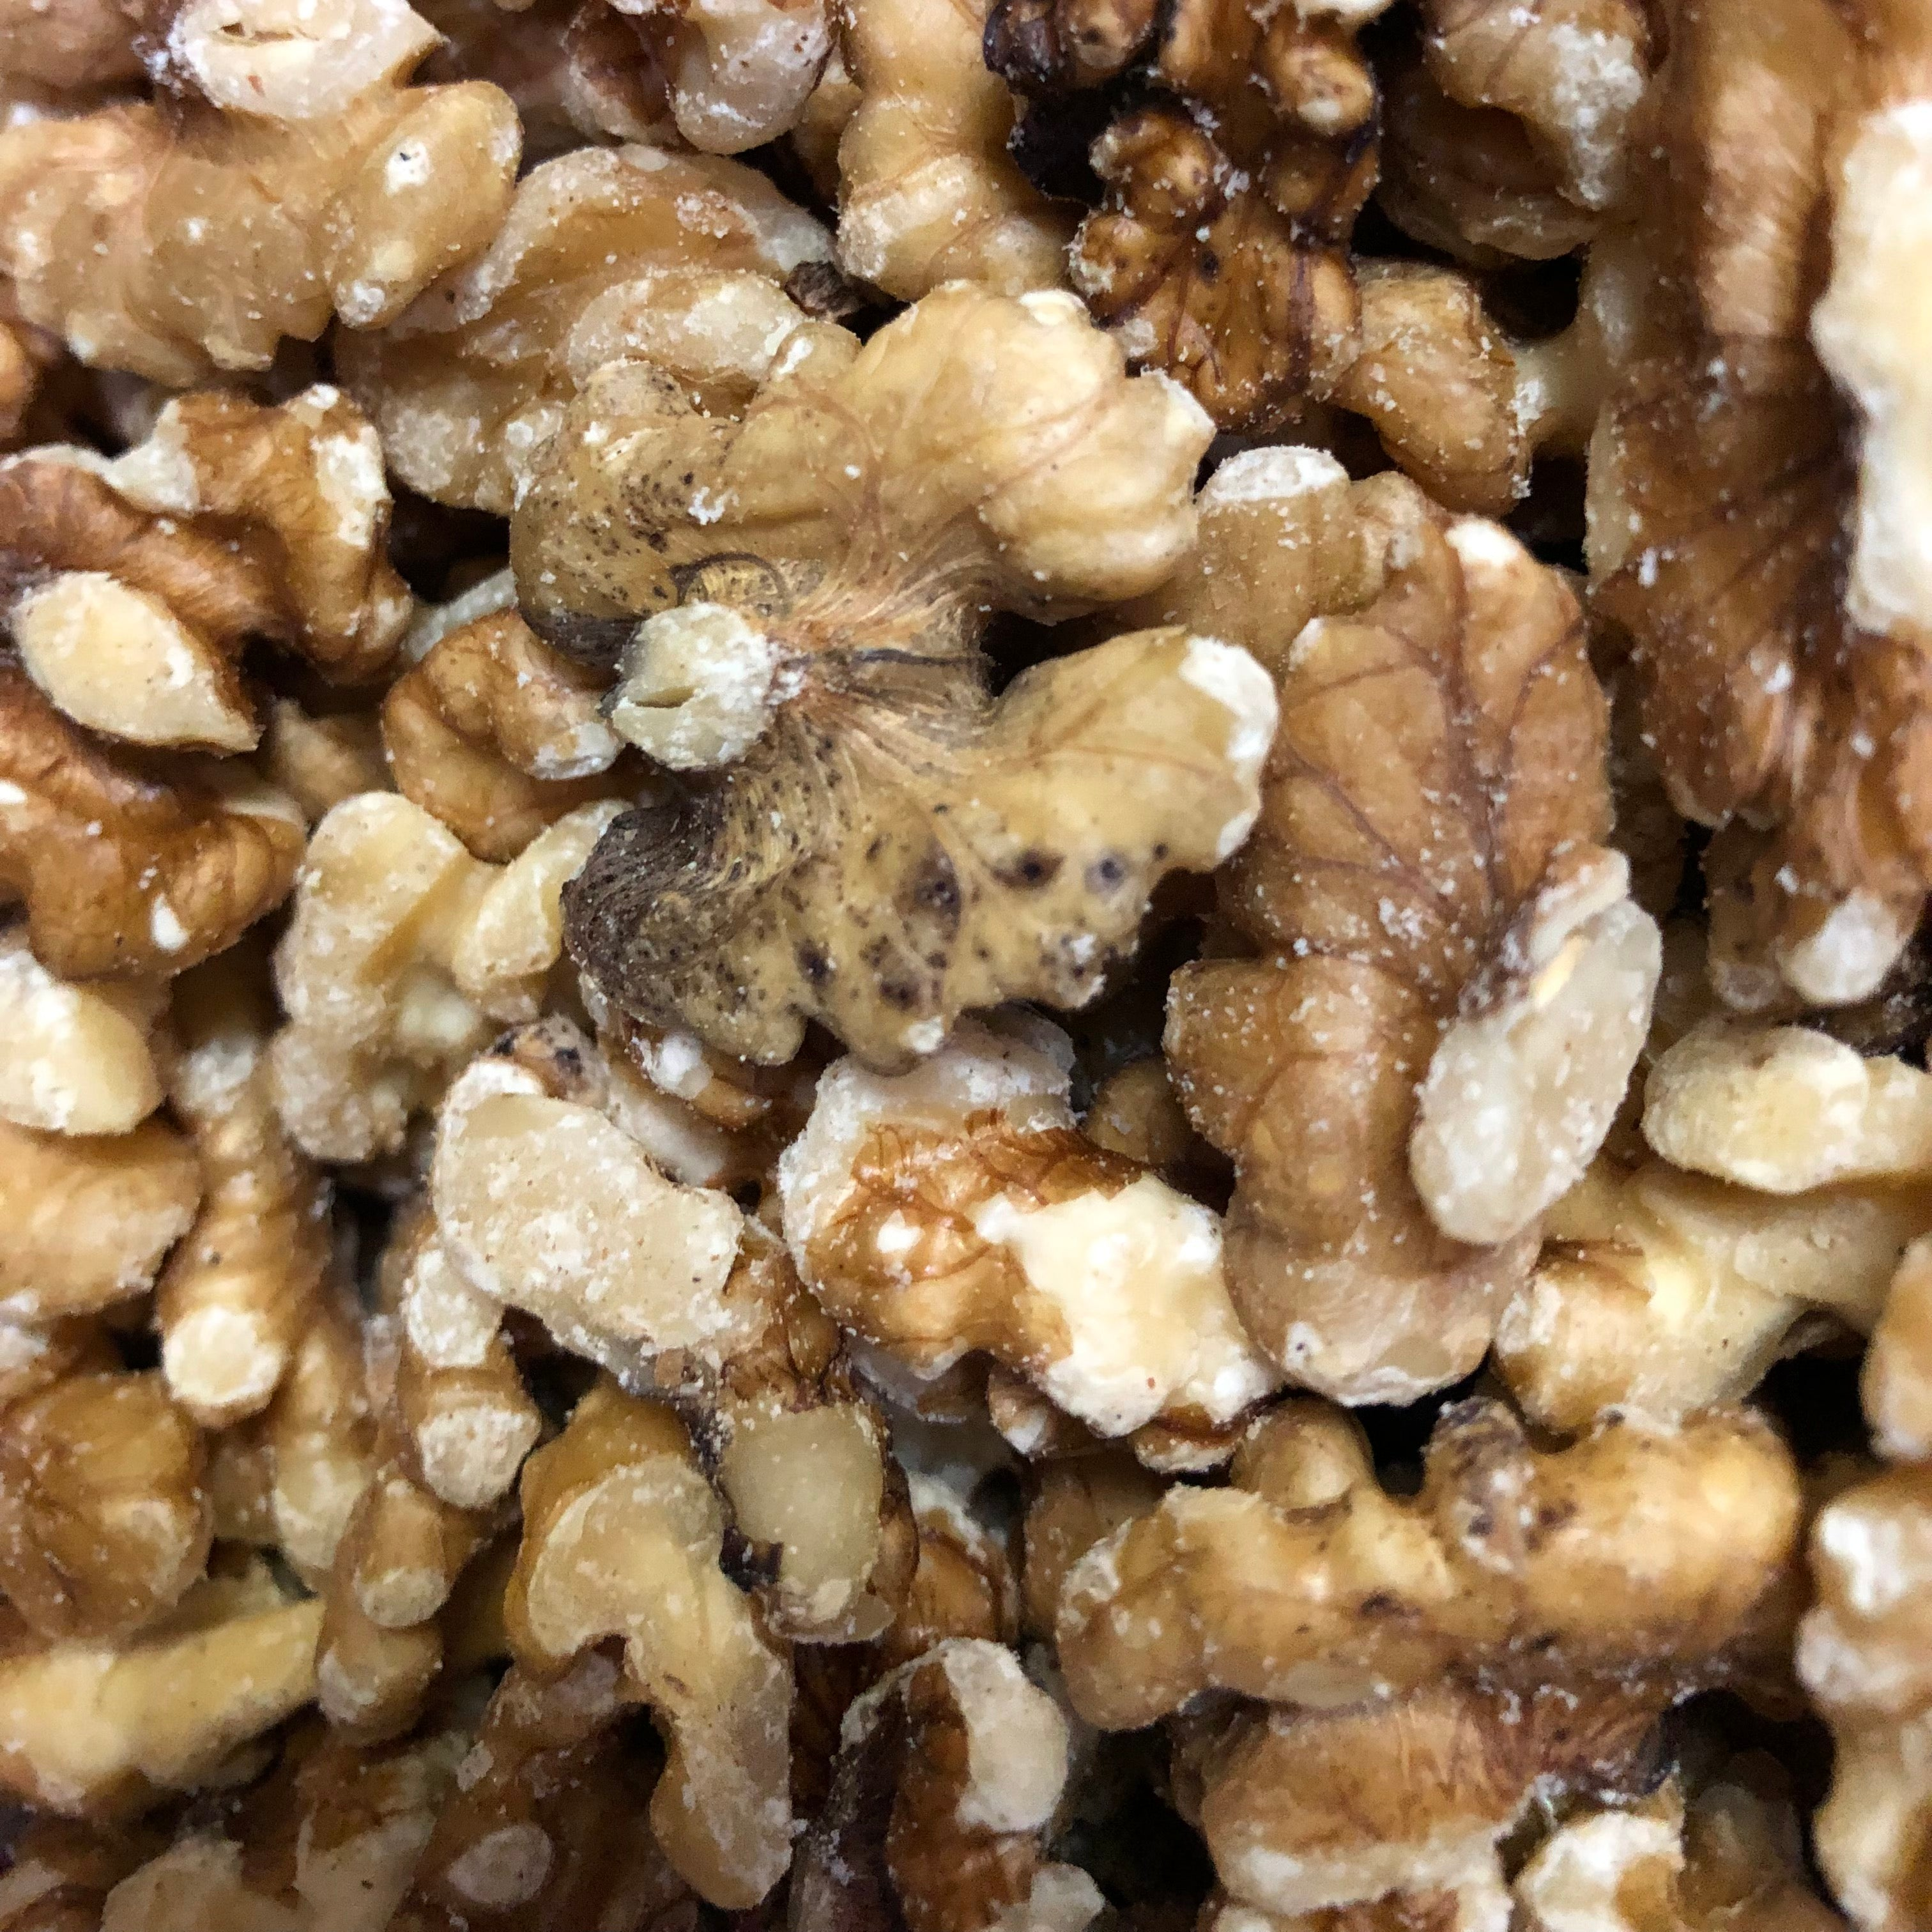
3
Microbial rancidity
Microbial rancidity is a type of food spoilage where microorganisms (like bacteria, molds, and yeast) contaminate fats and oils. They release enzymes—primarily lipases
Walnuts turned rancid after kept in a humid environment

Slide 8
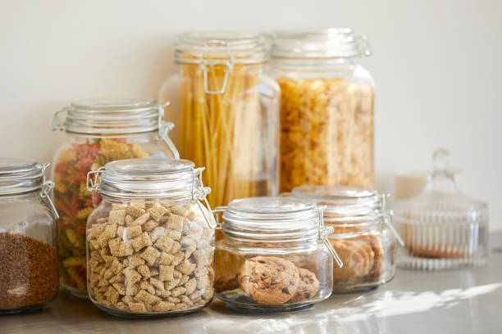
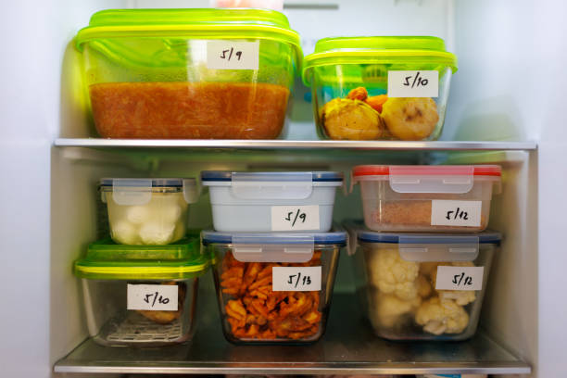
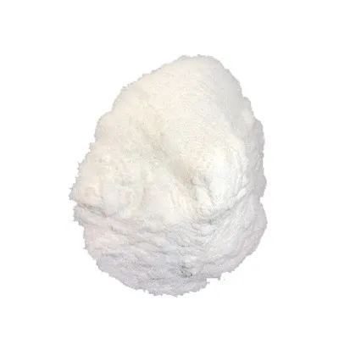
Preventive Measures
Airtight Containers: Limiting the exposure of oils and fats to ambient air drastically slows down the rancidification process
Low-Temperature Storage: Storing perishable foods in a refrigerator or freezer slows down the chemical and enzymatic reactions responsible for spoilage
Antioxidant Additives: You can add natural or synthetic antioxidants (such as Vitamin C, Vitamin E, BHA, or BHT). These compounds safely scavenge free radicals to halt the oxidation of lipids
Inert Gas Flushing: Food manufacturers (like potato chip brands) replace oxygen in packages with nitrogen or helium. This creates an oxygen-free environment, stopping oxidation Inert Gas Flushing:

