Slide 1
NINJA OF CSEDU
Presented By:
1. Md. Musfiqur Rahman, Roll: 05
2. Fairuz Nawer Meem, Roll: 17

Slide 2
OUTLINES

Slide 3
OUTLINES
Introduction
Objectives
Resources
Features
How to play
Working Process

Slide 4
INTRODUCTION

Slide 5
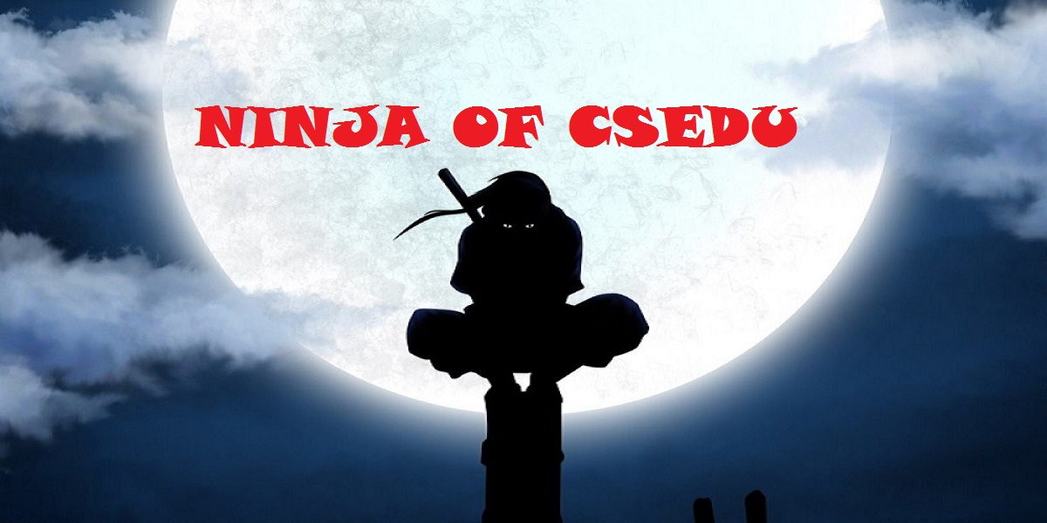
INTRODUCTION
a two dimensional single player game consisting of two levels

Slide 6
OBJECTIVES

Slide 7
OBJECTIVES
Implementation of C++ Programming Language
To work with basic level graphics
To gain ideas about game development

Slide 8
RESOURCES

Slide 9
RESOURCES
Used Microsoft Visual Studio 2013
Used Simple and Fast Multimedia Library (SFML) 2.3.2 version
Used images for making co-relational interface with users
C++ and SFML learning sources

Slide 10
FEATURES

Slide 11
FEATURES
Two dimensional game
Resolution 1200 * 600
Visualized from “SIDE VIEW”
A ninja running game having multiple obstacles related to CSE
Played through two different levels having unique SUPERPOWERS

Slide 12
INTERESTING FEATURES

Slide 13

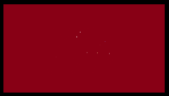
INTERESTING FEATURES (1/5)
Coins to be collected to increase points
Blocks used as obstacles

Slide 14




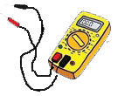
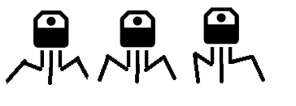

INTERESTING FEATURES (2/5)
CSE related topics used as other obstacles
C Language C++ Language Java
Multimeter Transistors Linked List

Slide 15
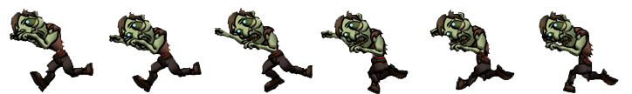
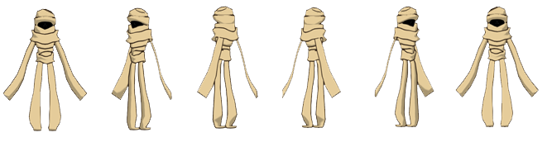
INTERESTING FEATURES (3/5)
Zombie and mummy used as enemies

Slide 16


INTERESTING FEATURES (4/5)
Ninja stars, ninja knives and fireballs used as weapons
Ninja Star Ninja Knife
Fireball

Slide 17
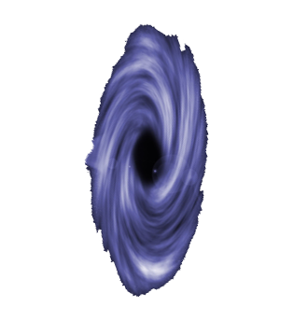
INTERESTING FEATURES (5/5)
Teleportation

Slide 18
HOW TO PLAY

Slide 19
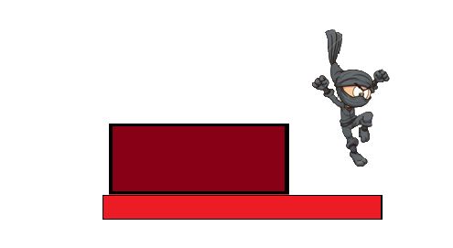
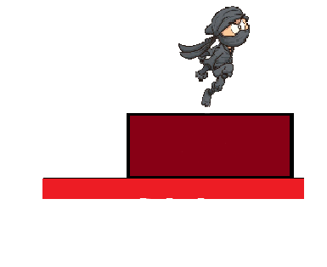

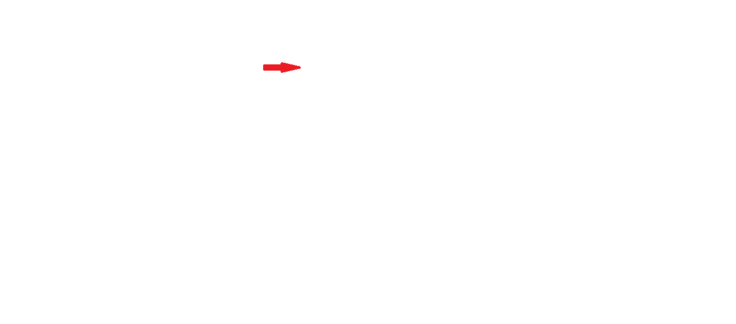

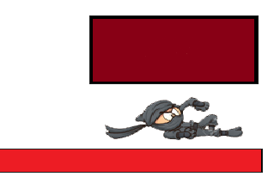
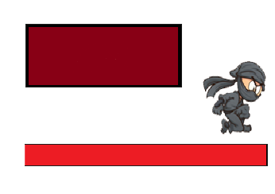

Press up arrow key to jump
Press down arrow key to slide

Slide 20
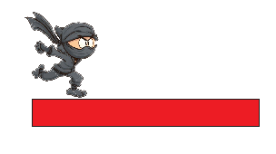
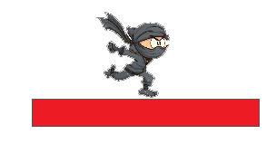

Press left arrow key to move forward (in level 2)
Press right arrow key to move backward (in level 2)

Slide 21

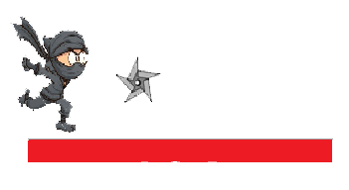


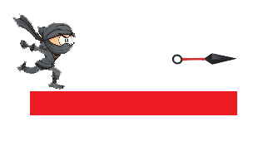
Press spacebar –
(a) to throw a star
(b) to throw a knife

Slide 22




Press S key to use gained superpowers

Slide 23
Working Process

Slide 24
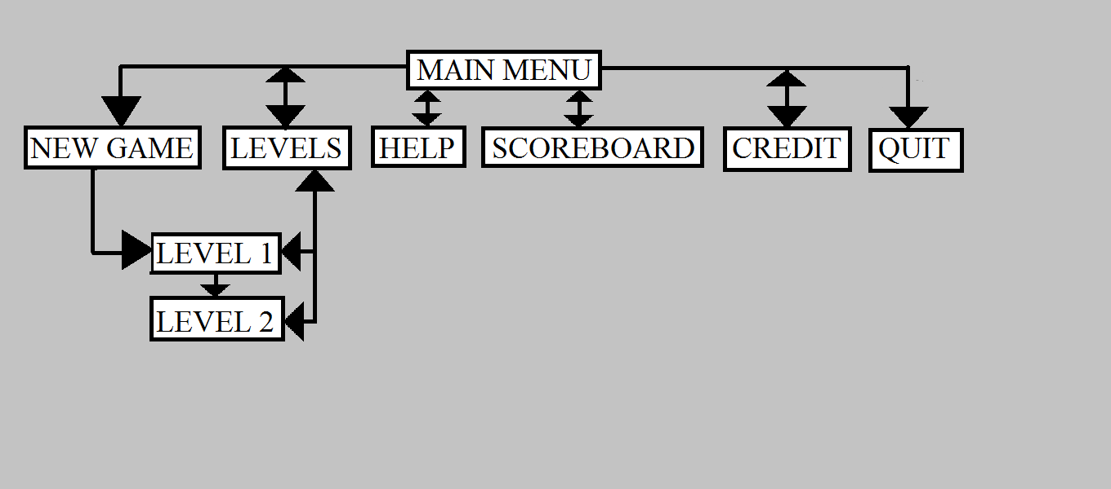
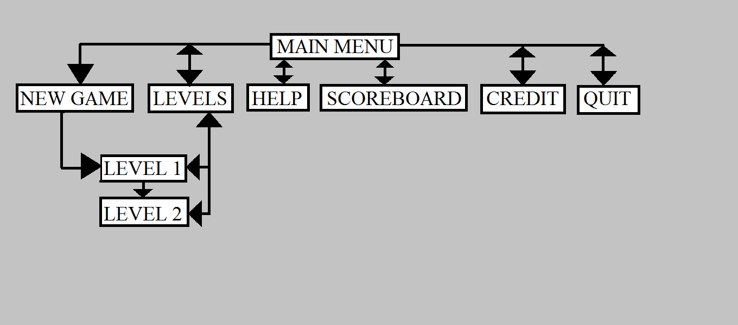
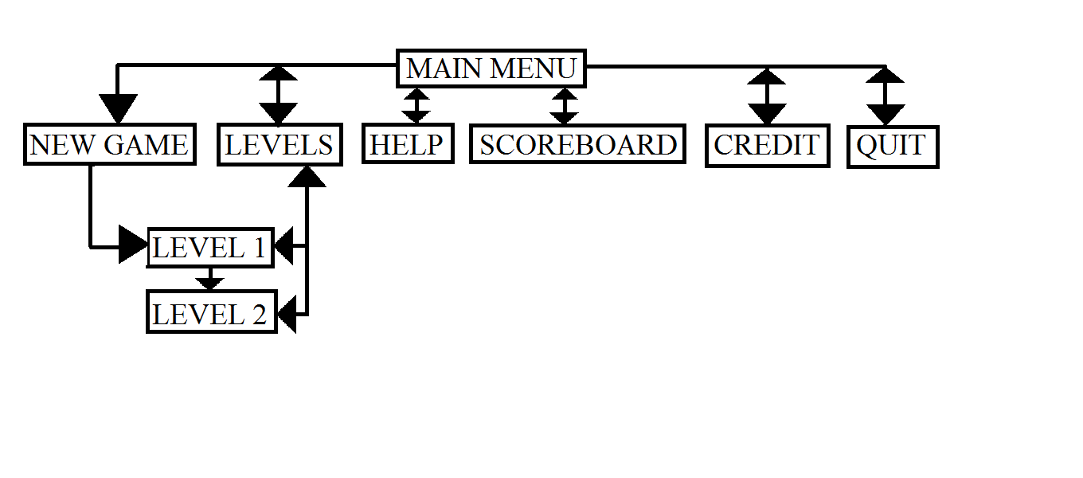
Flowchart

Slide 25
THANK YOU

