Slide 1
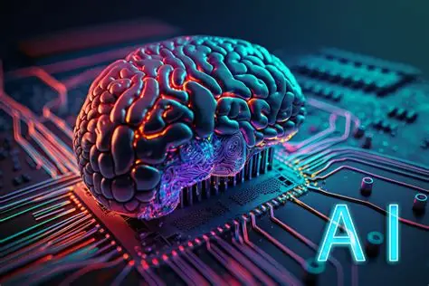
E-Commerce & Marketplace AI Adoption Report
Analysis of AI usage in e-commerce platforms
Trends, gaps, and AI adoption roadmap

Slide 2
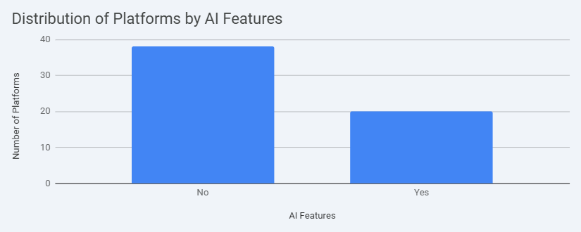
Current AI Adoption – Overview
Out of 58 platforms:
- 38 have no AI features
- 20 use some form of AI

Slide 3
Current AI Adoption – Key Findings
Recommendation Systems: 19 have them, 38 do not
NLP: 14 use it, 44 do not
Personalization: 56 have no visible personalization
Visual Search: 57 do not have it
Fraud Detection: 57 lack it
Inventory Prediction: 56 do not have it
3D Try-out: None
Computer Vision: 56 do not use it
Chatbots: 26 rule-based, 18 AI-powered, 13 none

Slide 4
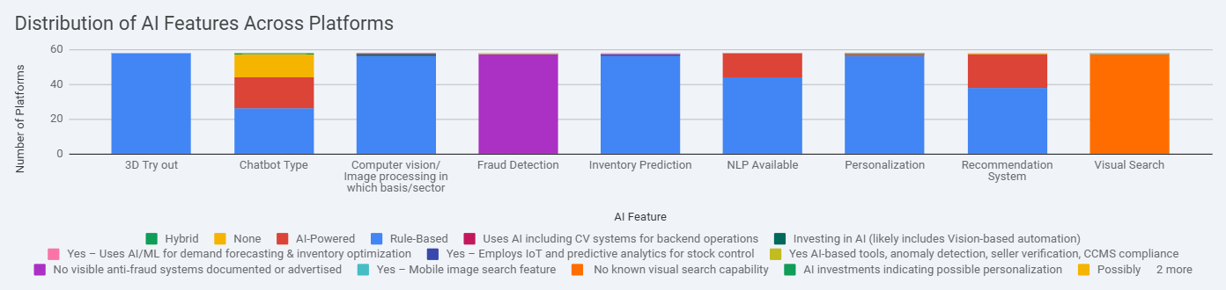
Distribution of AI Features Across Platforms

Slide 5
MVP 1 – Core AI Features (Quick Wins)
Recommendation System – suggest products based on browsing & purchase history
AI Chatbot with Basic NLP – handle common customer questions
Basic Personalization – show recently viewed items or tailored product categories

Slide 6
MVP 1 – Core AI Features (Quick Wins)
Slide 1: Recommendation System
Implement a basic recommendation engine to suggest products based on user browsing history, purchase patterns, and popular items. This can significantly improve user engagement and sales.
Slide 2: AI-Powered Chatbot with Basic NLP
Introduce an AI-powered chatbot for customer support, capable of understanding common queries and providing automated responses. This can reduce support load and improve response times.
Slide 3: Basic Personalization
Begin with simple personalization features, such as displaying recently viewed items or personalized product categories on the homepage.

Slide 7
MVP 2 – Better Experience & Efficiency
Advanced NLP – handle complex queries, sentiment analysis, CRM integration
Visual Search – upload images to find similar products
Basic Fraud Detection – flag suspicious transactions
Basic Inventory Prediction – forecast demand to manage stock

Slide 8
MVP 3 – Advanced AI for Competitive Advantage
3D Try-out – virtual try-on for clothes or furniture
Full Fraud Detection – high-accuracy prevention using multiple data points
Advanced Inventory Optimization – real-time stock management
Computer Vision – auto-categorize products and check image quality

Slide 9
Conclusion
Start small, build gradually
Adopt AI features step-by-step
Gain competitive advantage in the market

