Slide 1
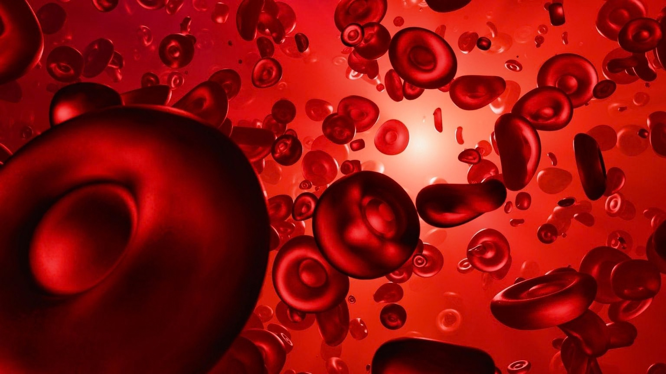

An Efficient Deep Learning Approach for Detecting Sickle Cell Diseases from Blood Cell Images
Group ID - T2530925
Musfique Us Salehin - 22301477
Sadnan Islam - 22201278
Shehraj Nayeem Khan - 24241111
Pratyasha Roy - 24241115
Mohd Samir Hassan - 24141265
SUPERVISED BY
CO-SUPERVISED BY
Dr. Md. Ashraful Alam
Dewan Ziaul Karim
Professor
Department of Computer Science and Engineering
Brac University
Senior Lecturer
Department of Computer Science and Engineering
Brac University
Notes:
1

Slide 2
Abstract & Keywords
  Clinical Context: Sickle cell disease (SCD) and carrier trait (SCT) screening remains inaccessible in low-resource settings due to heavy reliance on costly High-Performance Liquid Chromatography (HPLC) equipment and central lab infrastructure.
  Proposed Framework: An efficient, edge-deployable deep learning framework evaluating paired Differential Phase Contrast (DPC) blood cell images captured before (t0) and two hours after (t02hrs) chemical deoxygenation with 2% sodium metabisulfite (Na2S2O5).
  Architecture: Red blood cells are represented as bags of 64x64 masked crops (4,000 cells per donor per time point). A single-channel MobileNetV3-Small encoder (0.93M parameters) extracts cell embeddings, fed into Temporal-Difference Multiple Instance Learning (TD-MIL) with gated attention pooling.
  Primary Outcomes: Evaluated on 37 held-out test donors across Nepal and Canada using donor-level 5-fold cross-validation. Achieved 97.3% donor accuracy (36/37 correct), 0.990 Macro-AUC, 100% healthy recall (13/13), 100% disease recall (13/13), and 90.9% carrier recall (10/11).
  Footprint & Deployment: Total model size is ~1.4M parameters with a 1-hour training time, making local deployment beside low-cost microscopes (<$3000) feasible.
Keywords: Sickle Cell Disease, Multiple Instance Learning (MIL), Attention Pooling, MobileNetV3, Temporal Difference Fusion, Edge Deployment, Differential Phase Contrast Microscopy, Low-Cost Screening.

Slide 3
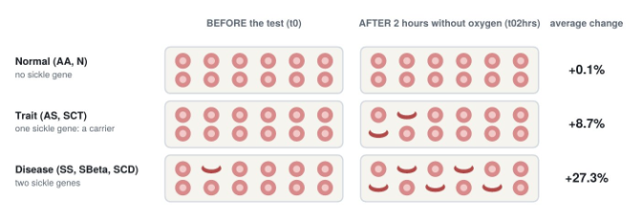

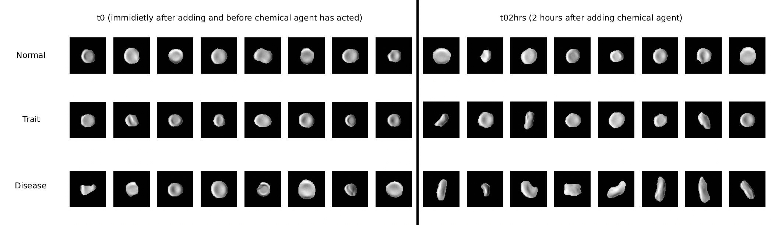


Clinical Background
Sickle Cell Disease (HbSS)
Sickle Cell Trait (HbAS)
RBCs deform under low oxygen, occluding vessels and causing organ damage.
Carriers appear normal at but deform after chemical deoxygenation invisible without paired testing.
Diagnostic Bottleneck
HPLC is expensive and scarce where SCD is most prevalent. Our solution: sub- $3,000 Octopi DPC microscope + deoxygenation at and .
Notes:
2

Slide 4
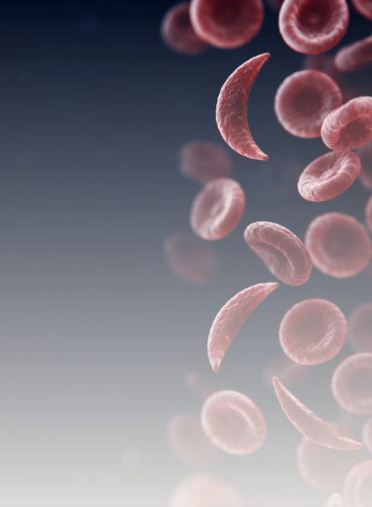
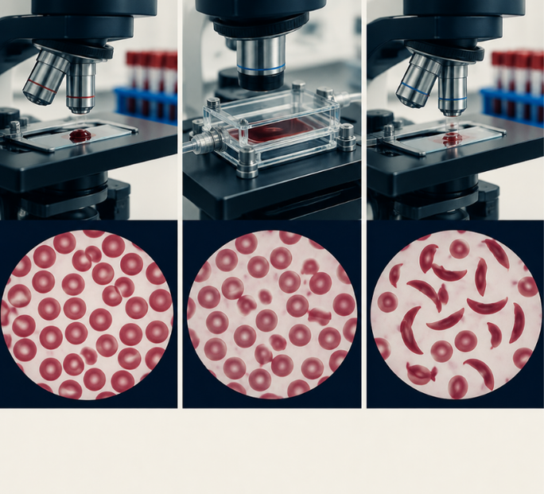
Problem Statement & Research Objectives
Problem Statement
Research Objectives
1. Misaligned Unit of Analysis: Existing AI literature focuses on classifying single cells or single photographs rather than issuing one clinical decision per patient.
2. Neglected Carrier Class: Sickle Cell Trait (SCT) carriers appear morphologically normal under ordinary smears; without a chemical deoxygenation test, carriers remain invisible to AI models.
3. Severe Data Leakage: Randomly splitting single cells across splits places cells from the same patient in both training and test sets, artificially inflating accuracy by 5-30 percentage points.
4. Motivation from Earlier Failure: Our prior cell-level classifier reached only 49% accuracy on held-out patients, proving that single-cell formulations are fundamentally flawed
  Donor-Level Reformulation: Formulate donor classification as a bags-of-cells problem (TD-MIL) to output exactly one diagnostic call per donor.
  Temporal State Integration: Explicitly capture the dynamic deoxygenation response delta between t0 and t02hrs states.
  Rigorous Evaluation Protocol: Implement donor-stratified 5-fold cross-validation with programmatic leakage guards and bootstrap confidence intervals.
  Edge-Deployable Architecture: Maintain an ultra-lightweight footprint (~1.4M parameters) suitable for local point-of-care embedded deployment

Slide 5
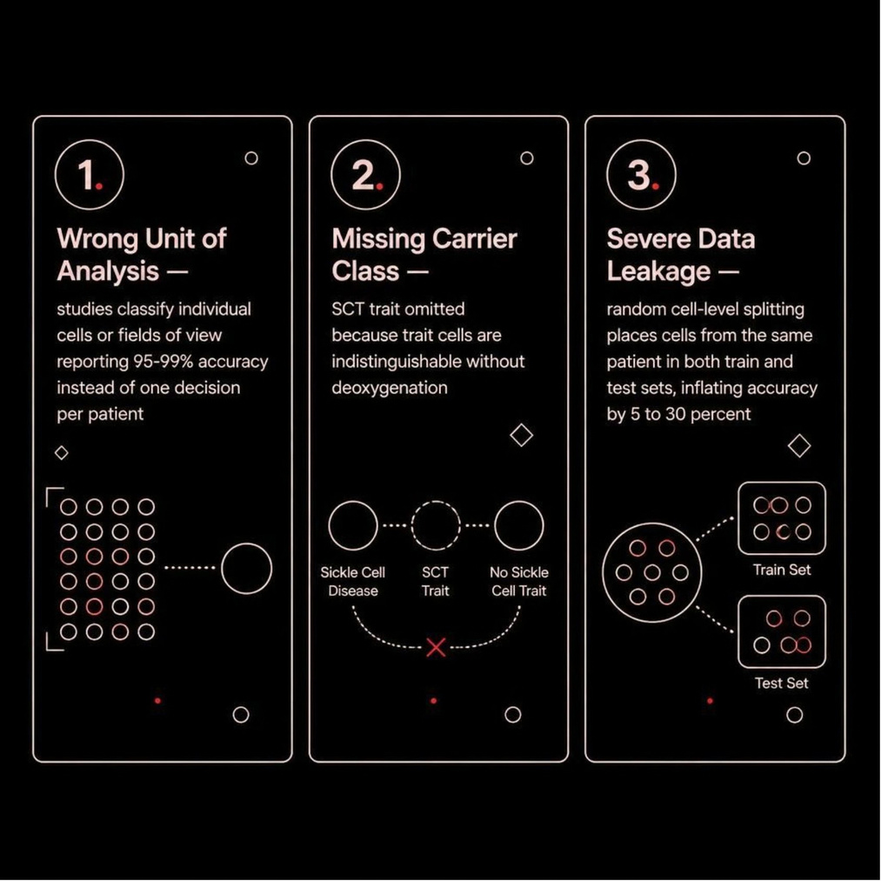
Literature Review & Gap Analysis
Three Critical Flaws in Existing Research
  Cell & Image-Level Classifiers (Xu et al. 2017, Alzubaidi et al. 2020, Tasji et al. 2026): Achieved high headline accuracies (93%-99%) on cell crops, but omitted the Trait class and frequently allowed patient overlap across data splits.
  Patient-Level Diagnostics (de Haan et al. 2020, D'Costa et al. 2024): Used smartphone microscopes or microfluidic chips for binary disease vs healthy classification; lacked temporal deep feature fusion across paired time points.
  Multiple Instance Learning in Haematology (Kazeminia et al. 2022, Hehr et al. 2023): Applied attention MIL primarily to white blood cells or rare anemia panels without paired temporal bags.
  Original erythroSight Study (Shrestha et al. 2024/2026): Used Cellpose segmentation to extract 19 shape parameters into 30-bin histograms, evaluated via Quadratic SVM (AUC 0.940-0.962).
Identified Research Gap: No published work combines two time-point cell bags using gated
attention and explicit temporal difference vectors [h0, h2, h2 - h0] for three-class phenotype screening under strict leakage-guarded cross-validation
Core Research Question
How can we build an end-to-end, donor-level model that classifies Normal, Trait, and Disease using paired timepoint images while guaranteeing zero data leakage?

Slide 6



ARCHITECTURE
Proposed System Architecture 5-Stage Pipeline
Acquisition
Extraction
Cell Encoder
TD-MIL Head
c
Donor Decision
Notes:
6

Slide 7
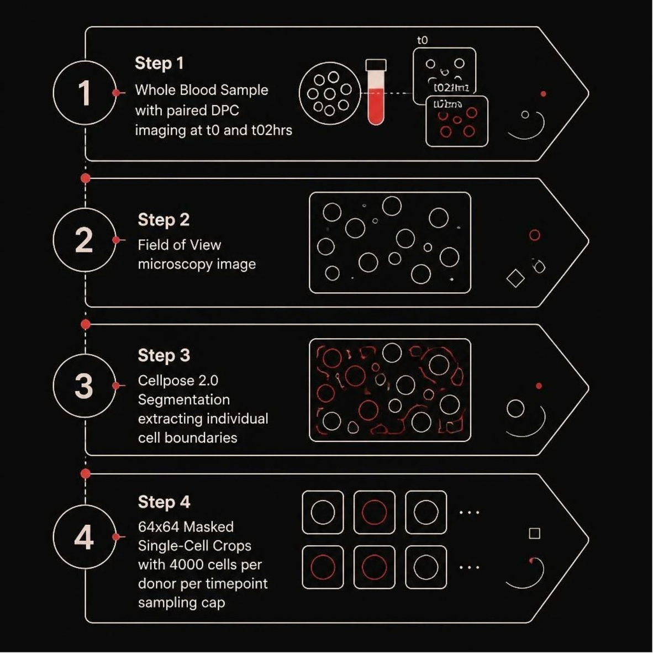
Dataset & Preprocessing Pipeline
  Dataset Provenance: Public erythroSight release (DOI: 10.20383/103.0916, CC BY 4.0), captured using Octopi microscopes across sites in Nepalgunj (Nepal) and Vancouver (Canada). Genotypes confirmed via HPLC.
  Cohort Composition: 37 primary test donors (13 Normal, 11 Trait, 13 Disease); expanded to 46 training donors. 3 ABeta donors (beta-thalassemia trait) held out as negative control.
  Total Corpus Volume: 1,470 fields of view; 8,077,631 segmented individual cells across all time points.
  64x64 Cell Cropping: Centered on bounding box center with background zeroed. Truncation affects only 0.060% of sickled cells (208 cells out of 6.52 million).
  Donor Sampling: Uniformly sampled 4,000 cells per donor per time point (392,000 crops total; 1.31 GB) to ensure equal donor weighting.
Notes:
5

Slide 8
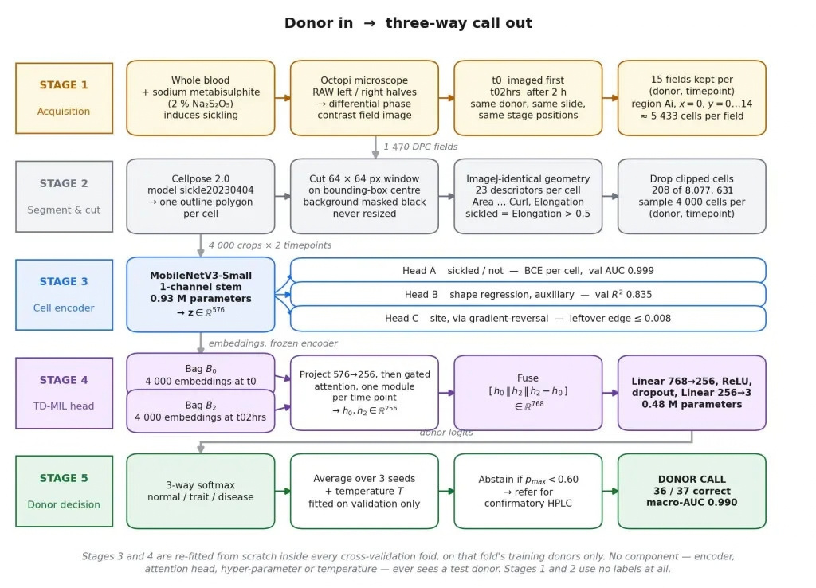
THE PROPOSED FRAMEWORK OPERATES IN 5 SEQUENTIAL STAGES FROM BLOOD ACQUISITION TO FINAL DECISION

Slide 9
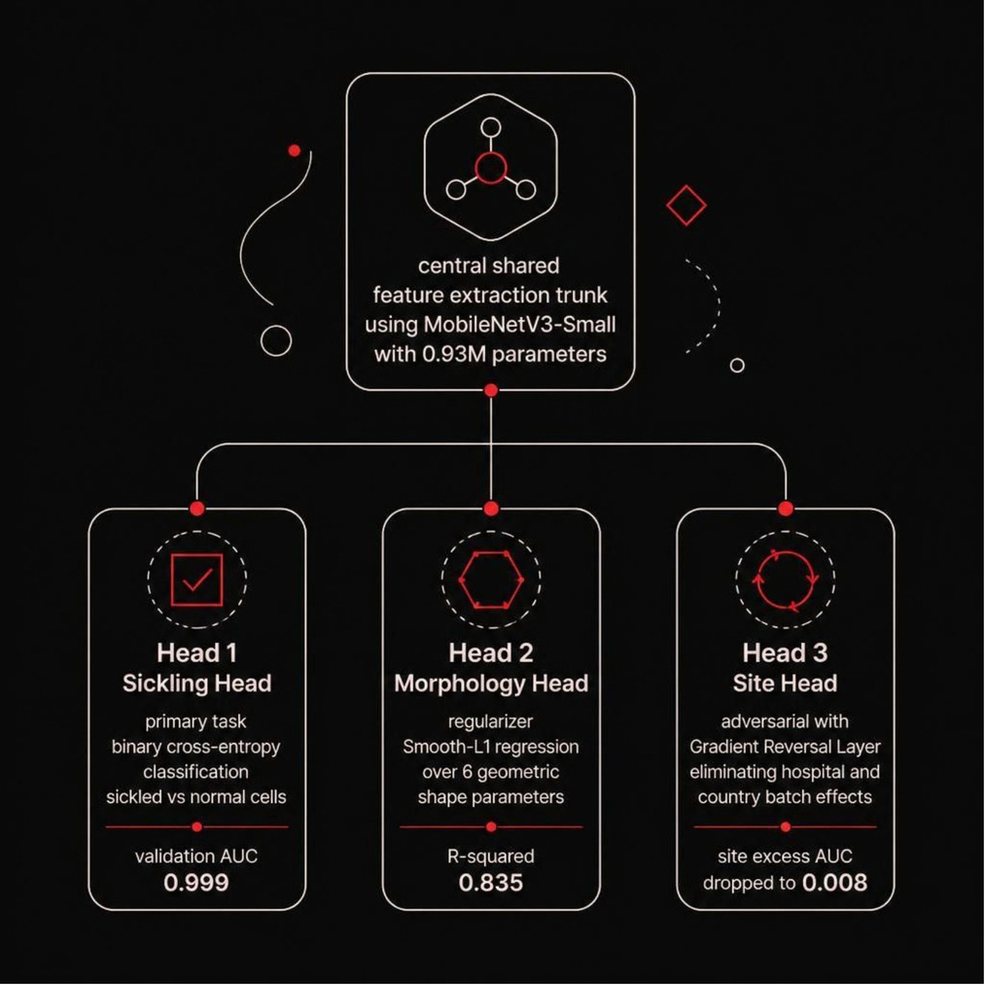
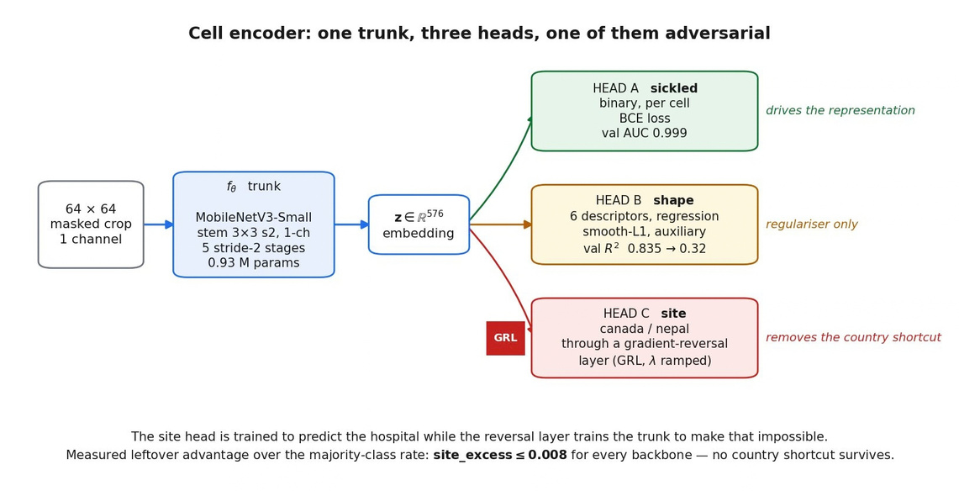
Model Architectures (Cell Encoder & TD-MIL Head)
STAGE 3
MobileNetV3-Small Cell Encoder
Single-Channel MobileNetV3-Small 0.93M Parameters
Sickling Head (Primary)
Binary cross-entropy on sickled vs. normal cells. Val AUC: 0.999
Morphology Head (Regularizer)
Smooth-L1 regression over 6 geometric shape parameters.
Site Head (Adversarial GRL)
Gradient Reversal Layer eliminates hospital/country batch effects. Site excess AUC: 0.008
Notes:
7

Slide 10
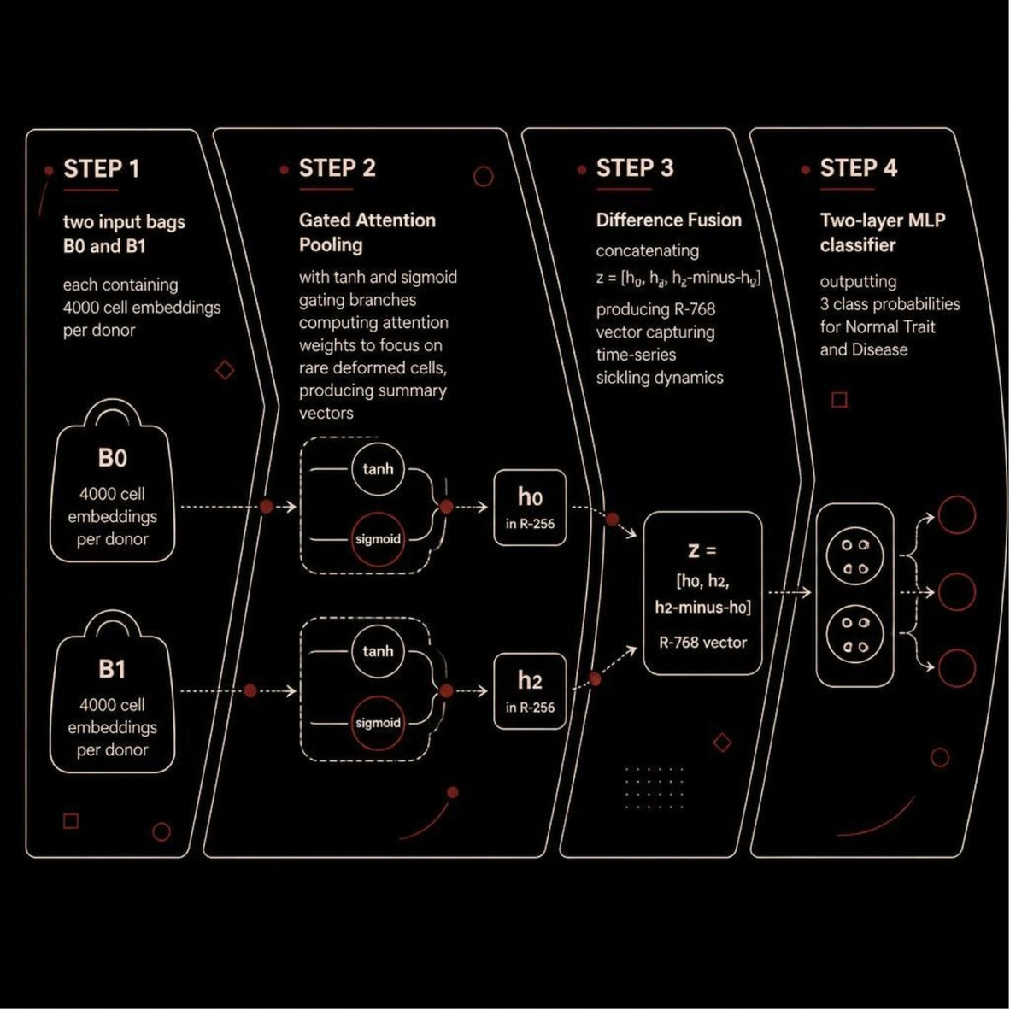
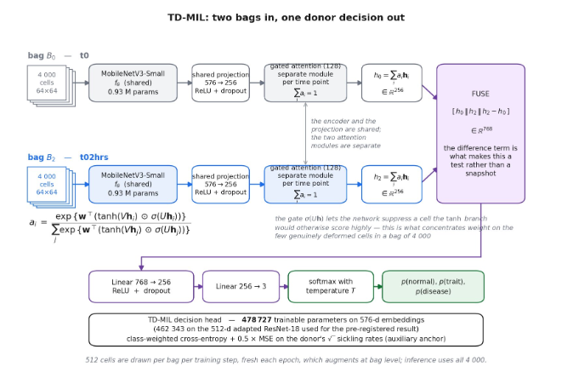
STAGE 4
Temporal-Difference MIL (TD-MIL)
  Shared Projection: Maps cell embeddings 576 -> 256 dimensions.
  Gated Attention Pooling: Summarizes Bag B0 into h0 (256-d) and Bag B1 into h2 (256-d).
  Fusion Vector: z = [h0, h2, h2 - h0] in R^768.
  Classifier: Linear(768 -> 256) -> ReLU -> Dropout -> Linear(256 -> 3 logits). Total head parameters: 0.48M.
Notes:
8

Slide 11
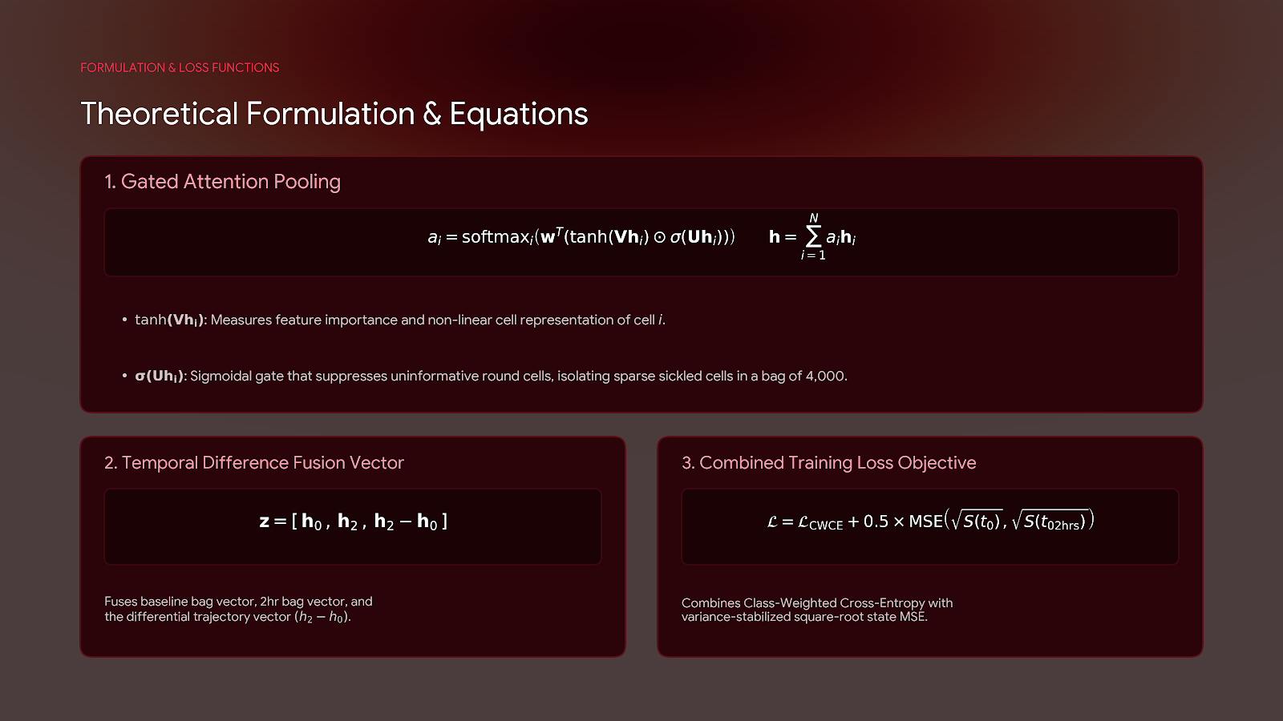

Slide 12

EVALUATION
Implementation Details & Experimental Safeguards
Donor-Level Stratified 5-Fold CV
Folds stratified by genotype class and acquisition country (32-34 train, 6 val, 7-8 test donors per fold).
Programmatic Leakage Guards:
Automated scripts assert before every epoch that no test donor cell is present in training, feature scaling, or tuning pipelines. Fired 15/15 times with zero violations.
Label Permutation Control:
Shuffled training labels while keeping test labels intact. Model collapsed to chance performance (Macro-AUC 0.521, Balanced Acc 0.386), proving zero pipeline leakage.
Classical Baselines
Compared against 4 sickling-rate baselines ( , RULE) on identical folds.
Notes:
9

Slide 13
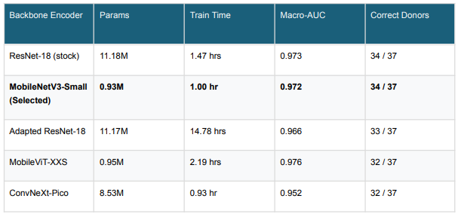
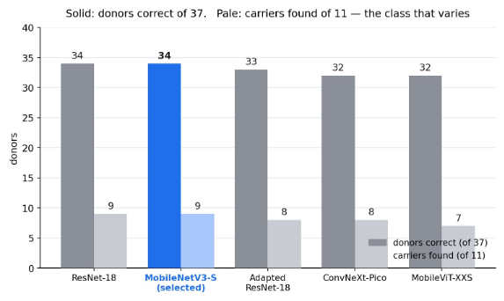
Encoder Backbone Comparison of 5 Encoders
Key Finding: All 5 backbones yielded saturated cell-level sickling AUCs (0.999) and overlapping paired CIs containing zero. MobileNetV3-Small was selected purely on compute cost (15x faster than adapted ResNet-18).

Slide 14
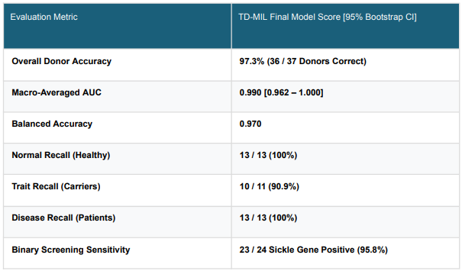
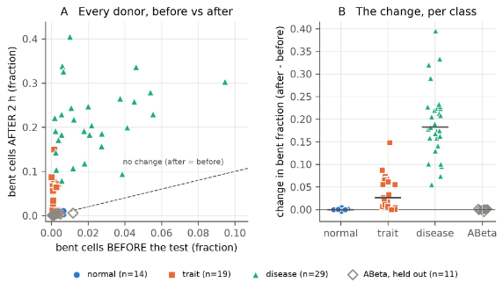
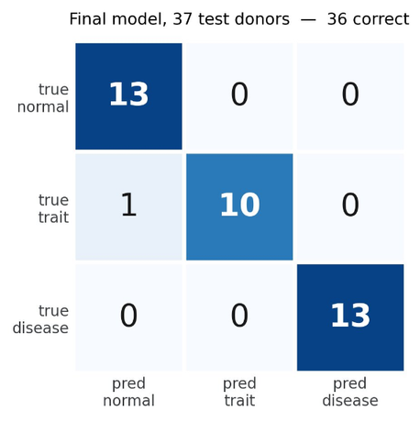
Experimental Results & Classification Performance
  97.3% Overall Donor Accuracy: Correctly classified 36 out of 37 test donors in out-of-fold evaluation with a Macro-AUC of 0.990.
  Zero Normal-vs-Disease Confusion: No healthy donor was misclassified as a patient, and no patient was misclassified as healthy.
  95.8% Binary Screening Sensitivity: Successfully identified 23 out of 24 sickle gene-positive donors (carriers and patients combined).
  Clinically Safe Calibration: An Expected Calibration Error (ECE) of 0.045 indicates slight under-confidence, providing a safe threshold for clinical screening.
  Confusion matrix of the final model on the 37 test donors, out-of-fold.
  One error remains: SCT-002, a carrier whose cells did not sickle. Every healthy donor and every patient is correct.

Slide 15
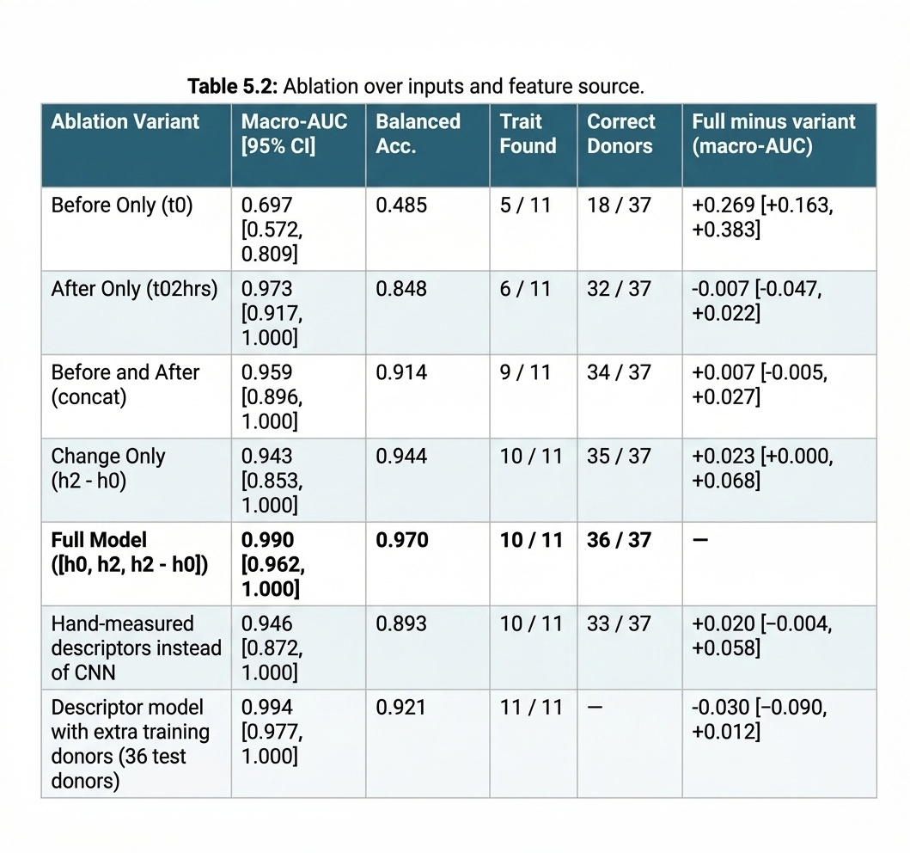
Ablation Studies
Ablation Over Inputs and Feature Source :
  Before only: Pre-test photo alone is near-useless (0.697 AUC, 5/11) signal is in the reaction.
  After only: Post-test photo alone is already strong (0.973 AUC, 6/11).
  Before + after: Both photos, no difference term 0.959 AUC, best balanced acc. yet (0.914).
  Change only: Just the difference best balanced acc. (0.944) and carrier recall (10/11) of any single input.
  Full model: All three combined the reference design, 0.990 AUC, 36/37 donors.
  Descriptors: 14 hand-measured numbers nearly match the CNN (0.946 AUC, 10/11) learned features add little.
  Descriptors + more donors: Best score in the table (0.994 AUC, 11/11) different 36-donor split, not significant.

Slide 16
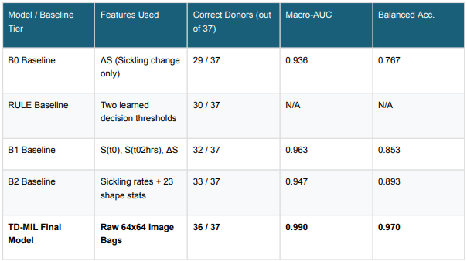
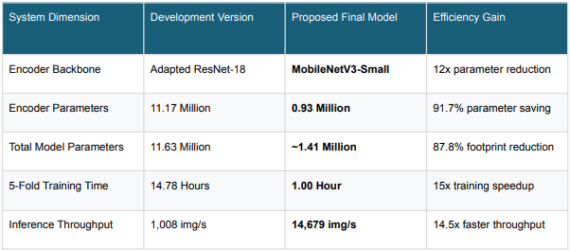
Comparison with Classical Baselines
Computational Efficiency & Edge
Clinical Edge over Baselines: B2 raised 3 false alarms on healthy donors; TD-MIL raised zero false alarms and correctly detected weakly sickling carriers that rate-based models missed.
Edge Deployment Value: Total size (~5.6 MB) enables local execution directly on low-cost microcontrollers or district clinic laptops attached to Octopi microscopes, without requiring internet connectivity.

Slide 17
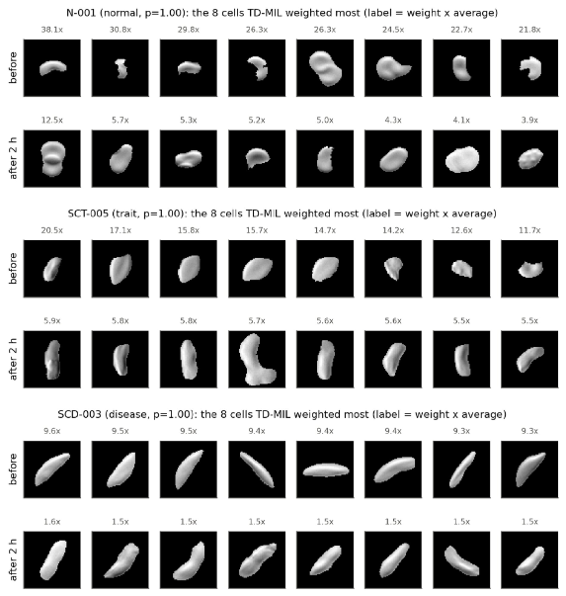
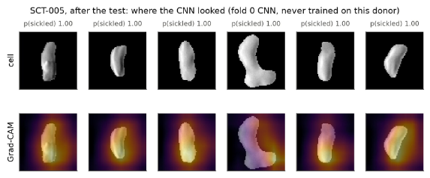
Explainable AI (XAI) & Model Interpretability
  Attention Weight Interpretability:
    Disease Donors: High attention focused on irreversibly sickled cells at t0 (9.6x bag average) and sickled crescents at t02hrs.
    Carrier Donors (Trait): Attention concentrates on mildly elongated cells appearing exclusively post-deoxygenation (5.9x bag average).
    Healthy Donors: Attention weights remain uniformly flat across odd debris/fragments, accurately reporting the absence of sickling signals.
  Grad-CAM Saliency Maps: Confirms the cell encoder attends specifically to the inner body contours and concave curved edges of red blood cells, rather than background padding or mask boundaries.

Slide 18
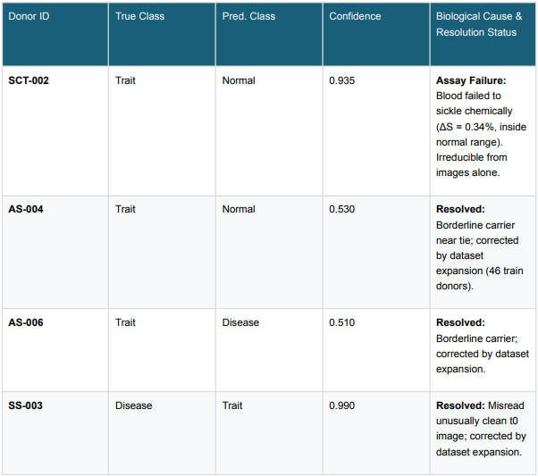
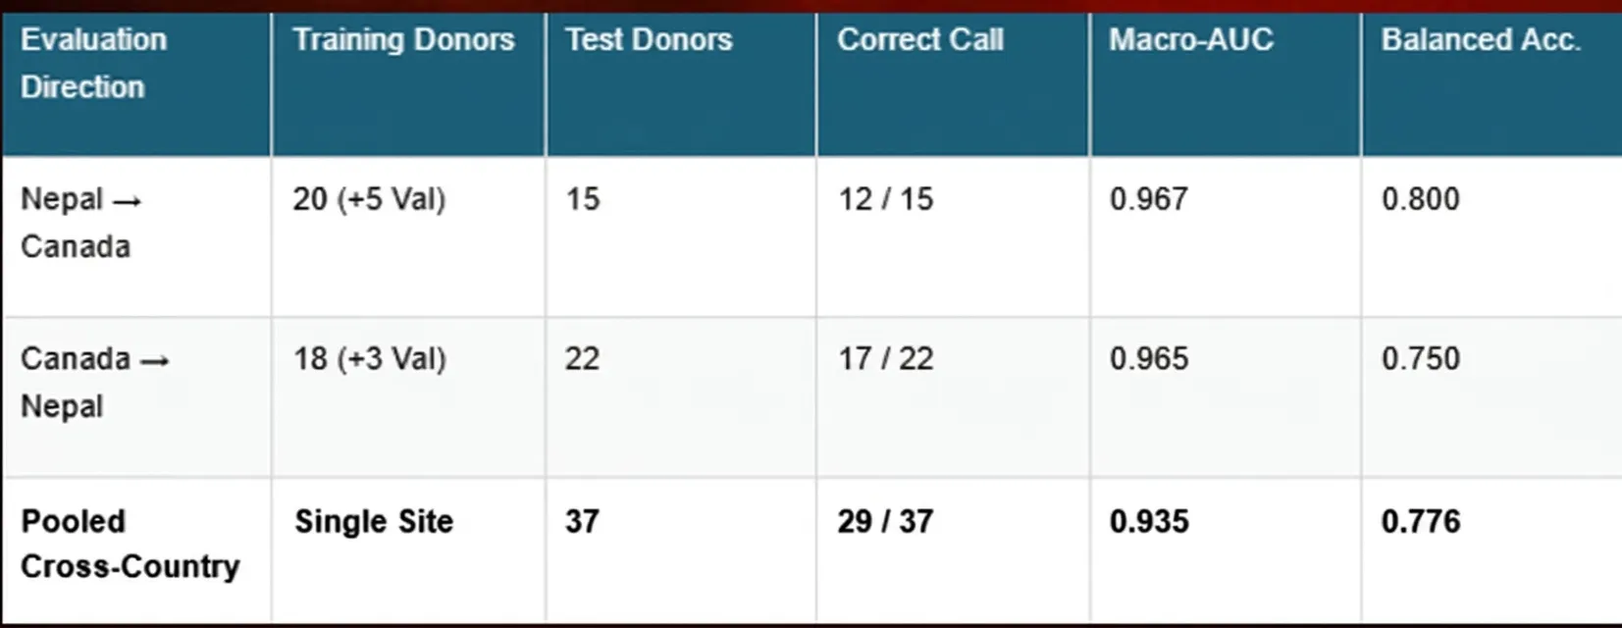
Detailed Error Analysis & Clinical Safety
Cross-Country Generalization Analysis
Site Differences: Canadian carriers exhibit strong sickling (8-17% change), whereas Nepali carriers exhibit subtle sickling (0.3-3% change).
Site-Adversarial Verification: GRL head maintained country predictability below majority baseline (+0.00), demonstrating true domain invariance.
Clinical Safety Thresholding: Setting a predicted probability abstention threshold at 0.60 automatically flags low-confidence cases for confirmatory HPLC testing, avoiding clinical misdiagnosis.

Slide 19
Summary of Contributions
  First MIL Formulation for Sickling Test: Reformulated donor classification as cell bags, enabling carrier (SCT) detection impossible with cell-level models.
  Temporal State Vector Fusion: Fused pre- and post-deoxygenation bags ([h0, h2, h2 - h0]) to capture dynamic chemical sickling response.
  Backbone Saturation Finding: Proved 5 CNN/ViT backbones perform equivalently, proving problem bottleneck resides in formulation and data, not network depth.
  Edge-Deployable System: Delivered a 1.4M parameter pipeline achieving 97.3% donor accuracy, 0.990 Macro-AUC, and zero healthy false alarms.
  Edge-deployable sizing: ~1.4M params total (0.93M encoder + 0.48M head) sized for the phone/embedded hardware the low-cost microscope already runs on, not a server.
  Honest comparison, not a win: Statistically equivalent to classical donor-level sickling-rate baselines (paired macro-AUC diff ≈ 0, CI includes zero) but zero false alarms on healthy donors vs. 3 for the strongest baseline.
NOVELTY
CONTRIBUTION

Slide 20

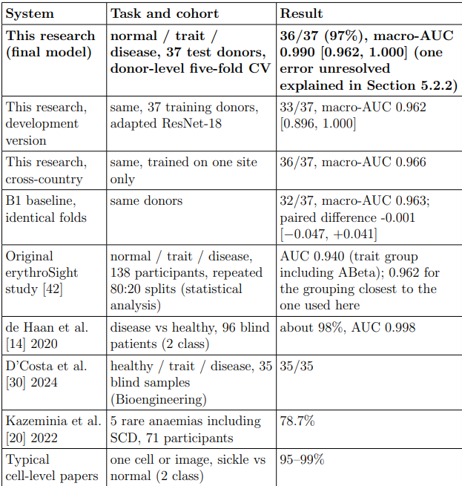
Against the literature

Slide 21
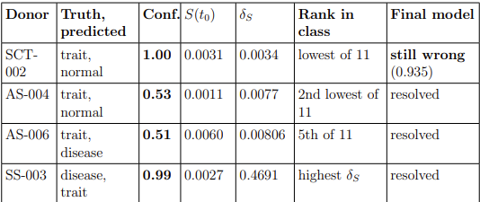
Challenges & System Limitations
Future Work
  Small Cohort Statistical Power: With N=37 test donors, 1 donor equals 2.7% accuracy. Confidence intervals remain wide despite 36/37 accuracy.
  Assay False Negative Bound: Blood samples that fail to react chemically (e.g., SCT-002 with 0.34% change) cannot be identified from image features alone.
  Auxiliary Head Bottleneck: Shape R^2 dropped on expanded training sets due to linear single-layer capacity limits across diverse imaging regions
  Scope Restriction: Evaluated specifically on DPC images from Octopi microscopes; brightfield smears or smartphone adapters require retraining.
  Reagent Dependency: The protocol still requires manual preparation of the chemical deoxygenation agent (Na₂S₂O₅).
  Borderline Carrier Sensitivity: 1 anomalous sickle-cell trait (SCT) donor exhibited negligible sickling, revealing physical limits of chemical hypoxia.
  Multi-Center Clinical Validation: Expanding the dataset to include diverse clinical sites across sub-Saharan Africa and South Asia.
  Microfluidic Integration: Automating the deoxygenation process within an integrated lab-on-a-chip to remove manual chemical mixing.
  Mobile Phone Adaptation: Compressing the MobileNetV3 encoder further to process images captured directly via smartphone-mounted lenses.
  Pre-Registered Abstention Bands: Validate automated p < 0.60 referral protocols for laboratory HPLC verification.
  Enlarge the test cohort before any further model comparison
  Expantion of field of view: Including every field of view for train, test, validation by using valid more valid samples.
  Adding transformer attention: To help ask the model how should different cells pay attention to each other
  Timepoints usage expantion

Slide 22
Key References
  Shrestha et al. (2024/2026), ErythroSight open-access image dataset & automated microscopy. npj Digital Public Health.
  Ilse et al. (2018), Attention-based deep multiple instance learning. ICML.
  Howard et al. (2019), Searching for MobileNetV3. IEEE/CVF ICCV.
  Ganin et al. (2016), Domain-adversarial training of neural networks. JMLR.
  de Haan et al. (2020), Automated screening of sickle cells using smartphone microscopy. npj Digital Medicine.

Slide 23
"Behind every red blood cell is a human life; behind efficient AI is the promise that no patient or carrier goes unseen."
QUESTIONS & DISCUSSION
Thank you for your time and attention
Notes:
1

