Slide 1
automated Bangla image captioning system
Group Members:
Md. Musfiqur Rahman (ID: 1620277042)
Milon Hossain (ID: 1610497042)
Kh Sadik (ID: 1621536042)
Fahad Ahmed Pranto (ID: 1612607042)

Slide 2
Project background
Not many deep learning AI applications in Bangla language
Even less in computer vision
So we decided to create an image captioning program in Bangla
Make something to help the less fortunate people

Slide 3

Overview
Our project is an automated image captioning program in Bangla
It is designed to help disabled people get a sense of their surroundings
It is going to be implemented as a web app and a mobile app (In future)
It uses deep neural network to correctly predict the contents of a picture and provide an accurate caption

Slide 4

workflow
Collect
Collect a huge set of images (at least 10,000) and Caption each image in 3 different ways
Preprocess
Preprocess the image and text to fit the neural network model
Train
Develop and train the model
Evaluate
Evaluate the result
Application
Develop the web app and mobile app

Slide 5
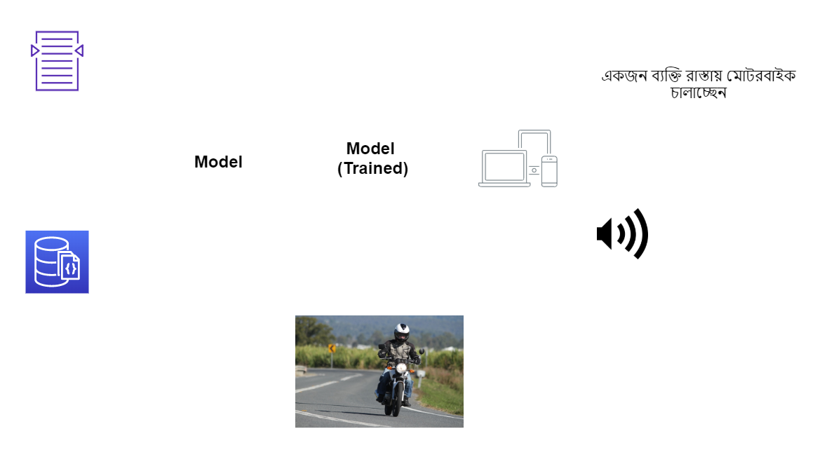
Workflow Diagram

Slide 6
Dataset
Collect more than 10,000 images from various sources
Caption each of the collected images in 3 different ways
Use the captions for word embedding

Slide 7
Works DONE SO FAR
Oboyob: A sequential-semantic Bengali image captioning engine (2019)
Chittron: An Automatic Bangla Image Captioning System (2018)

Slide 8
Deep learning models
Sequence to Sequence (Show and Tell)
Attention on Attention
Neural Baby Talk

Slide 9
Show and tell
Uses a multilayered Long Short-Term Memory (LSTM)
One LSTM is used to read the input sequence to obtain large fixed-dimensional vector
Another LSTM is used to extract the output sequence from that vector
It can learn data with a long-range temporal dependencies
The model stops making predictions after it reaches the end of sentence token

Slide 10
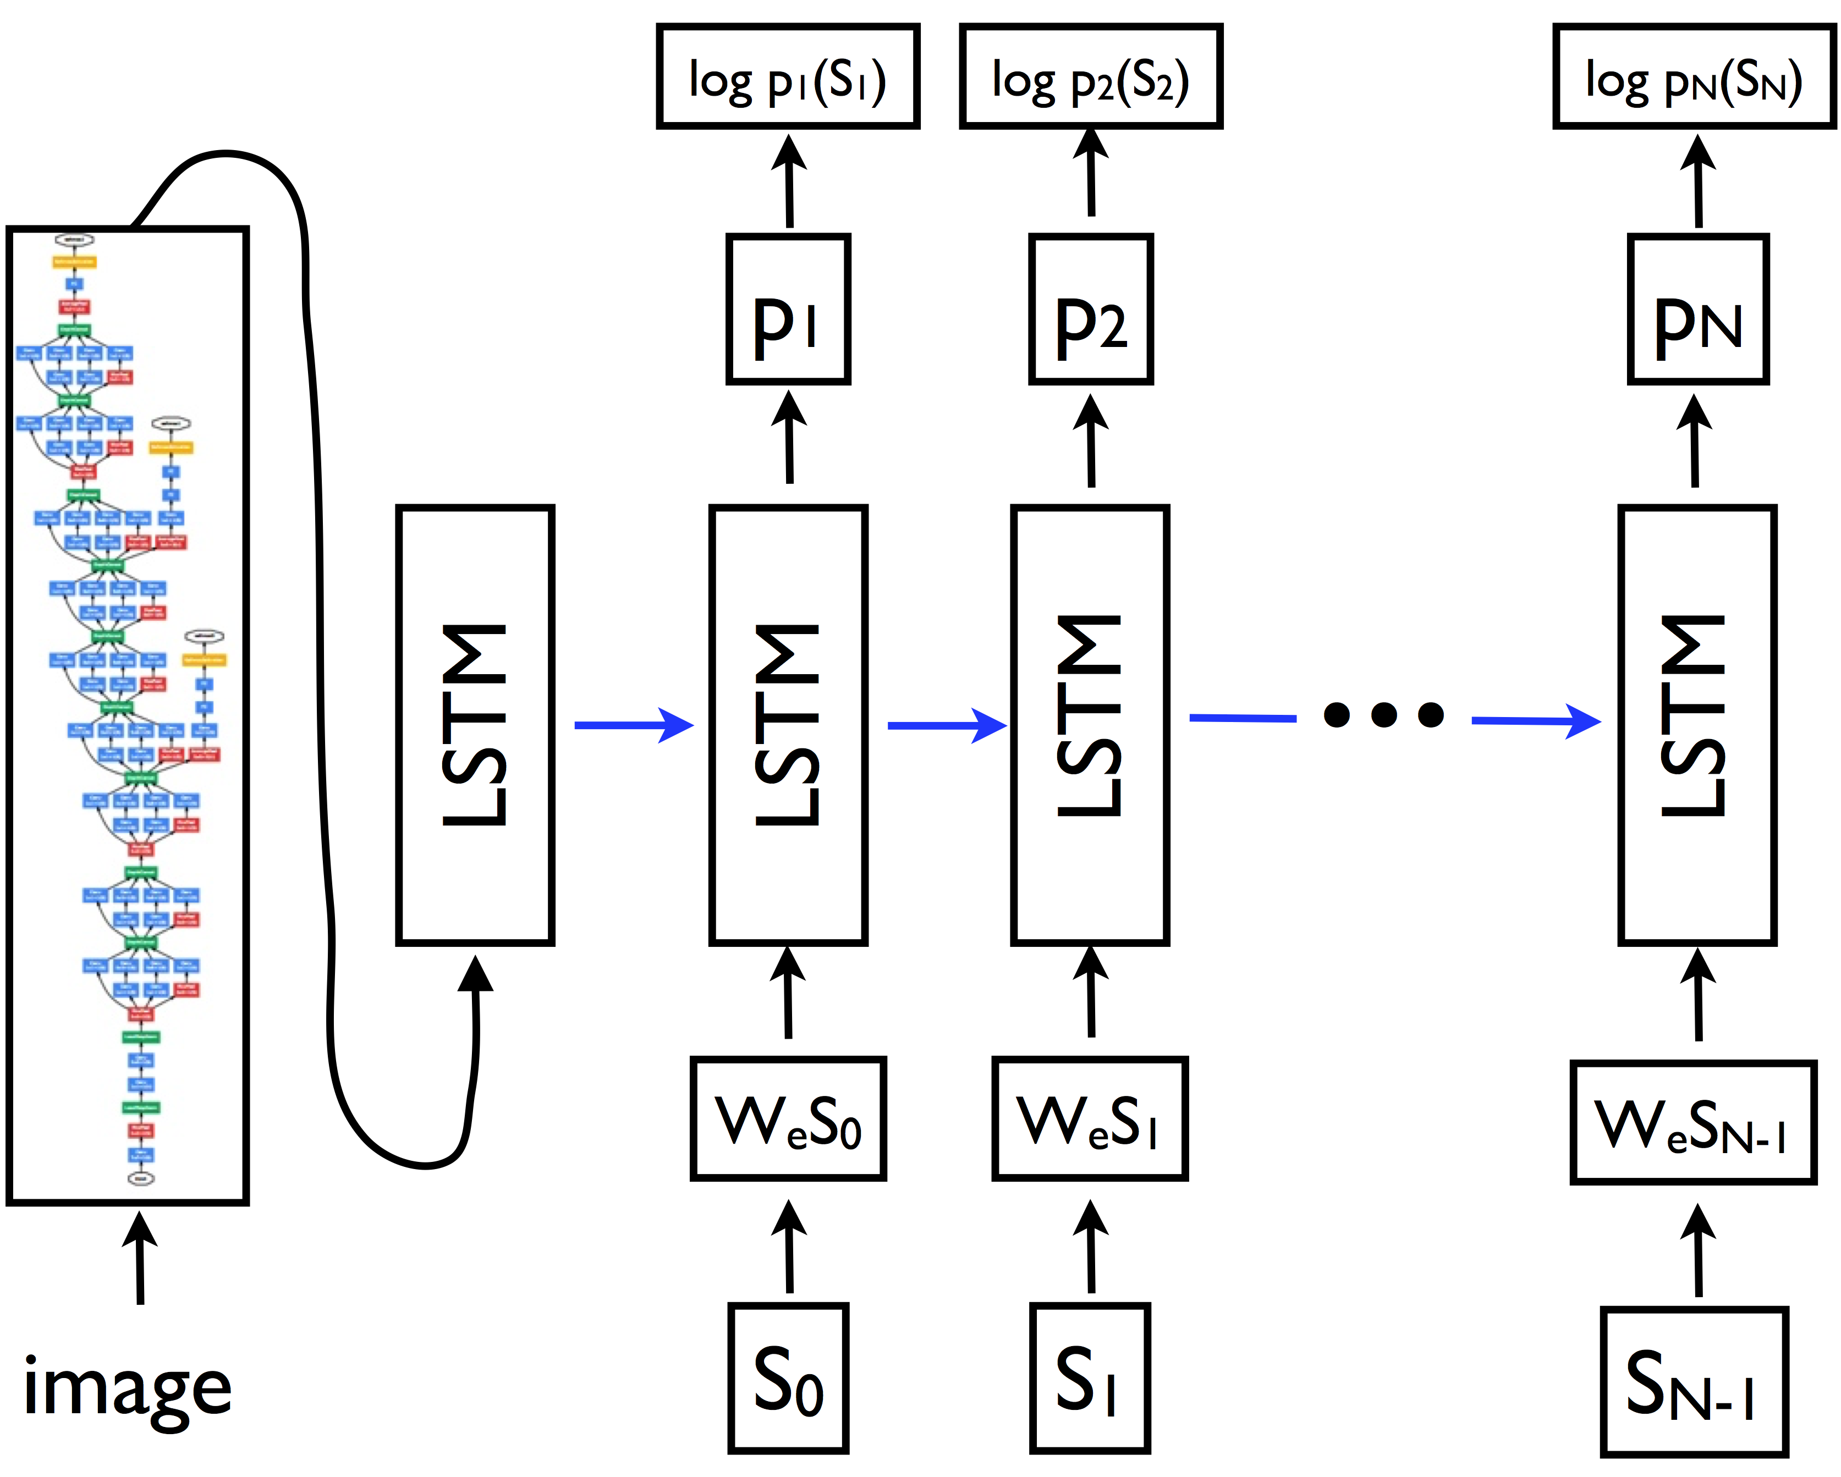
Show and tell Model [Architecture]
Input image: 224px224px
VGG16 (CNN) Encoder
LSTM (RNN) Decoder
Output: Image Caption

Slide 11
Show and tell (Limitations)
A very basic encoder decoder architecture
Relatively old model (2015)
Doesn’t make use of bounding box annotation
Uses simple dataset

Slide 12
Attention on Attention (AoA)
Also an encoder-decoder based model
Image is first encoded via a CNN-based network to a set of feature vectors
Decoded to words via an RNN-based network
Expands the traditional frameworks of attention to assess the connection between the effects of attention and the queries

Slide 13


Attention on Attention (Architecture)
Encoder
Decoder
CNN based network
Receive the pre-processed images
Extracts feature vectors of objects in the image
Applies AoA to determine how the objects are related to each other
An RNN-based network
Takes the output from the encoder
Uses AoA to filter out the irrelevant results and keep only the useful information
Produce the caption

Slide 14

Neural baby talk
NBT first generates a sentence ‘template’ with slot locations explicitly tied to specific image regions
It explicitly localizes objects in the image while generating free-form natural language descriptions for image captioning.
The object detector will detect the region and CNN will analyze the region features
Based on that RNN will generate image caption.
So the slots get filled with proper text based on the image

Slide 15
Neural baby talk (Advantages)
It allow for the integration of various object detectors
01
Variety of captions can be produced for the same image using different detection backends
02
It has the ability to generate captions for novel objects
03

Slide 16

Thank You

