Slide 1

Transaction

Slide 2
Transaction Concept
A transaction is a unit of program execution that accesses
and possibly updates various data items
A transaction is the DBMS’s abstract view of a user program: a sequence of reads and writes
A transaction must see a consistent database
During transaction execution the database may be
temporarily inconsistent
A sequence of many actions which are considered to be one atomic unit of work
When the transaction completes successfully (is committed), the database must be consistent
After a transaction commits, the changes it has made to the database persist, even if there are system failures
Multiple transactions can execute in parallel
Two main issues to deal with:
Failures of various kinds, such as hardware failures and system crashes
Concurrent execution of multiple transactions

Slide 3
ACID Properties
To preserve the integrity of data the database system transaction mechanism must ensure:
Atomicity. Either all operations of the transaction are properly
reflected in the database or none are
Consistency. Execution of a transaction in isolation preserves the consistency of the database
Isolation. Although multiple transactions may execute concurrently, each transaction must be unaware of other concurrently executing transactions. Intermediate transaction results must be hidden from other concurrently executed transactions
 That is, for every pair of transactions T_{i} and T_{j}, it appears to T_{i} that either T_{j}, finished execution before T_{i} started, or T_{j} started execution after T_{i} finished
Durability. After a transaction completes successfully, the changes it has made to the database persist, even if there are system failures

Slide 4
Example of Fund Transfer
Transaction to transfer $50 from account A to account B:
read(A)
2. A := A – 50
write(A)
read(B)
5. B := B + 50
6. write(B)
Atomicity requirement – if the transaction fails after step 3 and before step 6, the system should ensure that its updates are not reflected in the database, else an inconsistency will result.
Consistency requirement – the sum of A and B is unchanged by the execution of the transaction.
Isolation requirement – if between steps 3 and 6, another transaction is allowed to access the partially updated database, it will see an inconsistent database (the sum A + B will be less than it should be)
 Isolation can be ensured trivially by running transactions serially, that is one after the other.
 However, executing multiple transactions concurrently has significant
benefits in DBMS throughput
Durability requirement – once the user has been notified that the transaction has completed (i.e., the transfer of the $50 has taken place), the updates to the database by the transaction must persist despite failures.

Slide 5
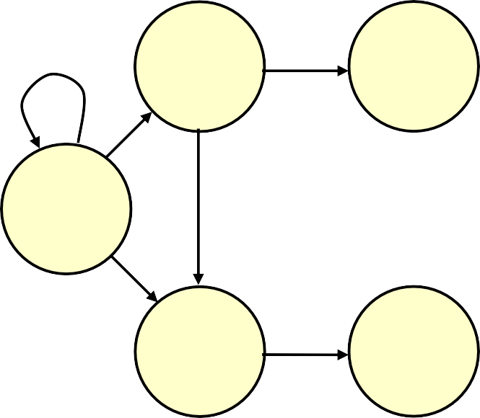
Transaction States
Active
the initial state; the transaction stays in this state while it is executing
Partially committed
after the final statement has been executed
Failed
after the discovery that normal execution can no longer proceed
Aborted
after the transaction has been rolled back and the database restored to its state prior to the start of the transaction
Two options after it has been aborted:
Partially committed
Committed
Active
after successful completion
Failed
Aborted

Slide 6
Concurrent Executions
Multiple transactions are allowed to run concurrently in the system. Advantages are:
increased processor and disk utilization, leading to better transaction throughput: one transaction can be using the CPU while another is reading from or writing to the disk
reduced average response time for transactions: short transactions need not wait behind long ones.
Concurrency control schemes – mechanisms to achieve isolation; that is, to control the interaction among the concurrent transactions in order to prevent them from destroying the consistency of the database

Slide 7
Concurrency Control
Concurrency control (CC) is a process to ensure that data is updated correctly and appropriately when multiple transactions are concurrently executed in DBMS
Obviously some form of concurrency control mechanism is necessary to enable transactions to run concurrently as far as possible; but controlled in such a way that the effect is the same as if they had been run serially.

Slide 8
What Happen in a Transaction
Retrieve : ‘read’ (R)
Update : ‘write’ (W).
interleaving two transactions => 3 PBS: RR – no problem
WW – lost update
WR – uncommitted dependency
RW – inconsistent analysis

Slide 9
Three classic problems
Although transactions execute correctly, results may interleave in diff ways =>
3 classic problems.
Lost Update
Uncommitted Dependency/ Dirty Read Problem
Inconsistent Analysis

Slide 10
LOST UPDATE
Occurs when two transactions that accesses the same items have their operations interleaved in a way that makes the value of database incorrect.

Slide 11
Lost Update problem
Time | User 1 (Trans A) | User2 (Trans B)
1 | Retrieve t= 40
2 |  | Retrieve t= 40
3 | Update t t=40+10 =50
4 |  | Update t t= 40-10 = 30
5
6
t is a tuple in a table retrieved by both users in the course of both transactions. Transaction A loses an update at time 4. The update at t3 by transaction A is lost (overwritten) at t4 by B.

Slide 12
UNCOMMITTED DEPENDENCY
Occurs when one transaction updates a database & transaction fails but its update is read by some other transaction.

Slide 13
Uncommitted Dependency
Time | User 1 (Trans A) | User 2 (Trans B)
1 |  | Retrieve t = 40 Update t = 50
2 Retrieve t = 50
3 |  | Rollback t= 40
4
5 Update t= 50+10 = 60
6
One trans is allowed to retrieve/update) a tuple updated by another, but not yet committed.
Trans A is dependent at time t2 on an uncommitted change made by Trans B, which is lost on Rollback.

Slide 14
Inconsistent Analysis
Initially: Acc 1 = 40; Acc2 = 50;
Acc3 = 30;
Time | User 1 (Trans A) | User 2 (Trans B)
1 | Retrieve Acc 1: Sum = 40
2 | Retrieve Acc 2: Sum = 90
3 |  | Retrieve Acc3 :
4 |  | Update Acc3: 30 → 20
5 |  | Retrieve Acc1:
6 |  | Update Acc1: 40 → 50
7 |  | commit
8 | Retrieve Acc3: Sum = 110 (not 120)
Trans A sees inconsistent DB state after B updated Accumulator
=> performs inconsistent analysis.

Slide 15
Solution of Transaction Problems
Problem of Serialization :
1.Serialization
Slow Response Time
Long CPU idle time

