Slide 1
A Normalisation Example

Slide 2

Take the following table.
StudentID is the primary key.
Is it 1NF?

Slide 3
No. There are repeating groups (subject, subjectcost, grade)
How can you make it 1NF?

Slide 4

Create new rows so each cell contains only one value
But now look – is the studentID primary key still valid?

Slide 5
No – the studentID no longer uniquely identifies each row
You now need to declare studentID and subject together to uniquely identify each row.
So the new key is StudentID and Subject.

Slide 6
So. We now have 1NF.
Is it 2NF?

Slide 7
Studentname and address are dependent on studentID (which is part of the key)
This is good.
But they are not dependent on Subject (the other part of the key)

Slide 8
And 2NF requires…
All non-key fields are dependent on the ENTIRE key (studentID + subject)

Slide 9
So it’s not 2NF
How can we fix it?

Slide 10
Make new tables
Make a new table for each primary key field
Give each new table its own primary key
Move columns from the original table to the new table that matches their primary key…

Slide 11
Step 1
STUDENT TABLE (key = StudentID)

Slide 12

Step 2
STUDENT TABLE (key = StudentID)
SUBJECTS TABLE (key = Subject)

Slide 13



Step 3
STUDENT TABLE (key = StudentID)
SUBJECTS TABLE (key = Subject)
RESULTS TABLE (key = StudentID+Subject)

Slide 14
Step 3
STUDENT TABLE (key = StudentID)
SUBJECTS TABLE (key = Subject)
RESULTS TABLE (key = StudentID+Subject)

Slide 15
Step 4 - relationships
STUDENT TABLE (key = StudentID)
SUBJECTS TABLE (key = Subject)
RESULTS TABLE (key = StudentID+Subject)

Slide 16
Step 4 - cardinality
STUDENT TABLE (key = StudentID)
1
Each student can only appear ONCE in the student table
SUBJECTS TABLE (key = Subject)
RESULTS TABLE (key = StudentID+Subject)

Slide 17
Step 4 - cardinality
STUDENT TABLE (key = StudentID)
1
SUBJECTS TABLE (key = Subject)
1
Each subject can only appear ONCE in the subjects table
RESULTS TABLE (key = StudentID+Subject)

Slide 18
Step 4 - cardinality
STUDENT TABLE (key = StudentID)
1
SUBJECTS TABLE (key = Subject)
1
A subject can be listed MANY times in the results table (for different students)
8
RESULTS TABLE (key = StudentID+Subject)

Slide 19
Step 4 - cardinality
STUDENT TABLE (key = StudentID)
1
SUBJECTS TABLE (key = Subject)
1
A student can be listed MANY times in the results table (for different subjects)
8
8
RESULTS TABLE (key = StudentID+Subject)

Slide 20
A 2NF check
STUDENT TABLE (key = StudentID)
1
SUBJECTS TABLE (key = Subject)
1
SubjectCost is only dependent on the primary key,
Subject
8
8
RESULTS TABLE (key = StudentID+Subject)

Slide 21
A 2NF check
STUDENT TABLE (key = StudentID)
1
SUBJECTS TABLE (key = Subject)
1
8
8
Grade is only dependent on the primary key (studentID + subject)
RESULTS TABLE (key = StudentID+Subject)

Slide 22
A 2NF check
STUDENT TABLE (key = StudentID)
1
Name, Address are only dependent on the primary key
(StudentID)
SUBJECTS TABLE (key = Subject)
1
8
8
RESULTS TABLE (key = StudentID+Subject)

Slide 23
But is it 3NF?
STUDENT TABLE (key = StudentID)
1
So it is 2NF!
SUBJECTS TABLE (key = Subject)
1
8
8
RESULTS TABLE (key = StudentID+Subject)

Slide 24
A 3NF check
STUDENT TABLE (key = StudentID)
1
Oh oh…
What?
SUBJECTS TABLE (key = Subject)
1
8
8
RESULTS TABLE (key = StudentID+Subject)

Slide 25
A 3NF check
STUDENT TABLE (key = StudentID)
1
HouseName is dependent on both StudentID + HouseColour
SUBJECTS TABLE (key = Subject)
1
8
8
RESULTS TABLE (key = StudentID+Subject)

Slide 26
A 3NF check
STUDENT TABLE (key = StudentID)
1
Or HouseColour is dependent on both StudentID + HouseName
SUBJECTS TABLE (key = Subject)
1
8
8
RESULTS TABLE (key = StudentID+Subject)

Slide 27
A 3NF check
STUDENT TABLE (key = StudentID)
1
But either way,
non-key fields are dependent on MORE THAN THE PRIMARY KEY (studentID)
SUBJECTS TABLE (key = Subject)
1
8
8
RESULTS TABLE (key = StudentID+Subject)

Slide 28
A 3NF check
STUDENT TABLE (key = StudentID)
1
And 3NF says that non-key fields must depend on nothing but the key
SUBJECTS TABLE (key = Subject)
1
8
8
RESULTS TABLE (key = StudentID+Subject)

Slide 29
A 3NF check
STUDENT TABLE (key = StudentID)
1
WHAT DO WE DO?
SUBJECTS TABLE (key = Subject)
1
8
8
RESULTS TABLE (key = StudentID+Subject)

Slide 30

Again, carve off the offending fields
1
SUBJECTS TABLE (key = Subject)
8
8
1
RESULTS TABLE (key = StudentID+Subject)

Slide 31

A 3NF fix
1
SUBJECTS TABLE (key = Subject)
8
8
1
RESULTS TABLE (key = StudentID+Subject)

Slide 32
A 3NF fix
8
1
1
SUBJECTS TABLE (key = Subject)
8
8
1
RESULTS TABLE (key = StudentID+Subject)

Slide 33
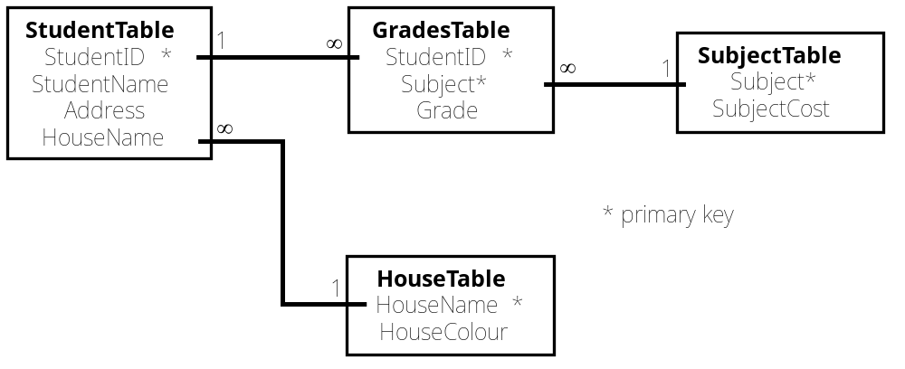
A 3NF win!
8
1
1
8
8
1
SUBJECTS TABLE (key = Subject)
RESULTS TABLE (key = StudentID+Subject)
Or…

Slide 34
The Reveal
Before…
After…
1
8
1
1
8
8
SUBJECTS TABLE (key = Subject)
RESULTS TABLE (key = StudentID+Subject)

