Slide 1
CSE - 313 Computer Architecture
Faculty: Shoib Ahmed Shourav
United International University

Slide 2
Memory Organization

Slide 3
Components
Processor
Processor
Input
Input
Control
Control
Memory
Datapath
Datapath
Output
Output

Slide 4
Reality!
Memory is the required for storing
Program
Data
Programmers want unlimited amounts of memory with low latency
Different memory types
Static RAMs
Dynamic RAMs
Magnetic disk
How to make memory Bigger, Faster, and Cheaper?

Slide 5
Principle of Locality
Programs access a small proportion of their address space at any time
Temporal locality
Items accessed recently are likely to be accessed again soon
e.g., instructions in a loop, induction variables(Fixed inc/dec)
Spatial locality
Items near those accessed recently are likely to be accessed soon
E.g., sequential instruction access, array data

Slide 6
How does hardware exploit principle of locality?
Organize memory system into a hierarchy
Multiple levels of memory with different speeds and sizes
Entire addressable memory space available in largest, slowest memory
Incrementally smaller and faster memories, each containing a subset of the memory below it, proceed in steps up toward the processor

Slide 7
How does hardware exploit principle of locality
Store everything on disk
Copy recently accessed (and nearby) items from disk to smaller DRAM memory
Main memory
Copy more recently accessed (and nearby) items from DRAM to smaller SRAM memory
Cache memory

Slide 8
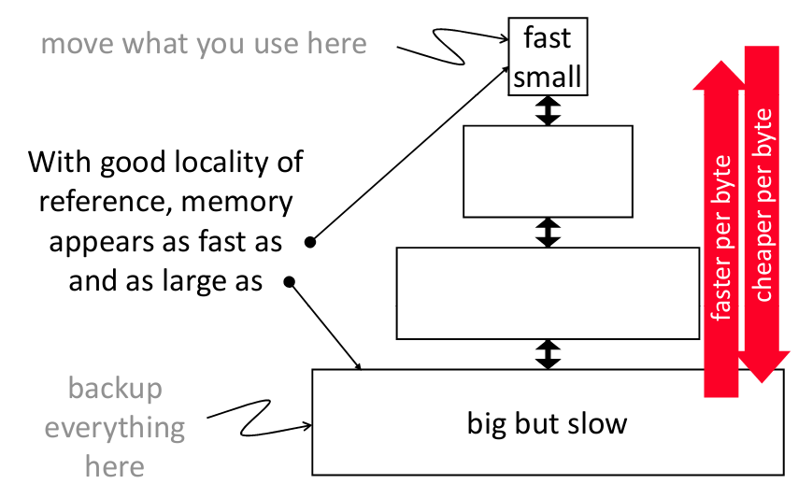
Memory Hierarchy

Slide 9
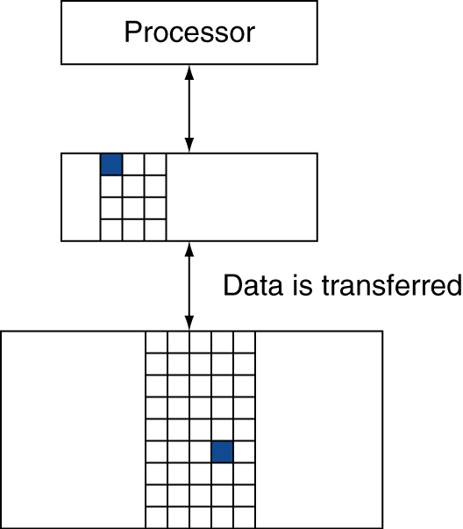
Memory Hierarchy: Terminology
Block (or line)
The minimum unit of information that can be either present or not present in the memory
If accessed data is present in upper level
Hit: access satisfied by upper level
If accessed data is absent in upper level
Miss: block copied from lower level

Slide 10
Memory Hierarchy: Terminology
Hit: data appears in some block in the upper level
Hit Rate/Hit Ratio: hits/accesses, i.e., the fraction of memory access found in the upper level
Hit Time: Time to access the upper level which consists of
Access time + Time to determine hit/miss
Miss: data needs to retrieve from a block in the lower level
Miss Rate/ Miss Ratio = misses/accesses = 1 - (Hit Rate)
Miss Penalty: Time to replace a block in the upper level + Time to deliver the block to the processor
Hit Time << Miss Penalty

Slide 11
Cache
Cache memory
The level of the memory hierarchy closest to the CPU based on SRAM
Memorize the most frequently accessed DRAM memory locations to avoid repeatedly paying for the DRAM access latency
Address
Address
Processor
Cache
Main
Memory
Data
Data

Slide 12
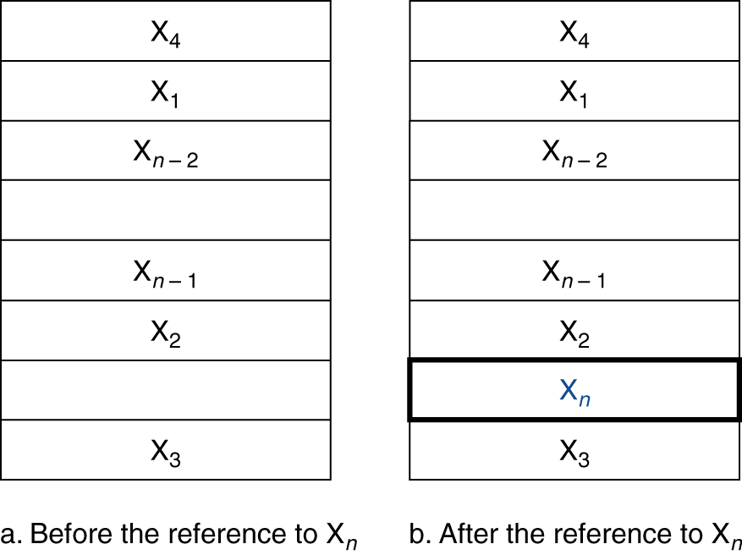
Cache
Which information goes into the cache?
Access to word X_{n}
Create a miss
Load X_{n} into the cache

Slide 13
Cache
How do we know if the data is present?
Where do we look?
Simple approach: Direct mapping
Every memory location can be mapped only to exactly one cache position
Mapping:
(Block address) modulo (number of cache blocks in the cache)

Slide 14
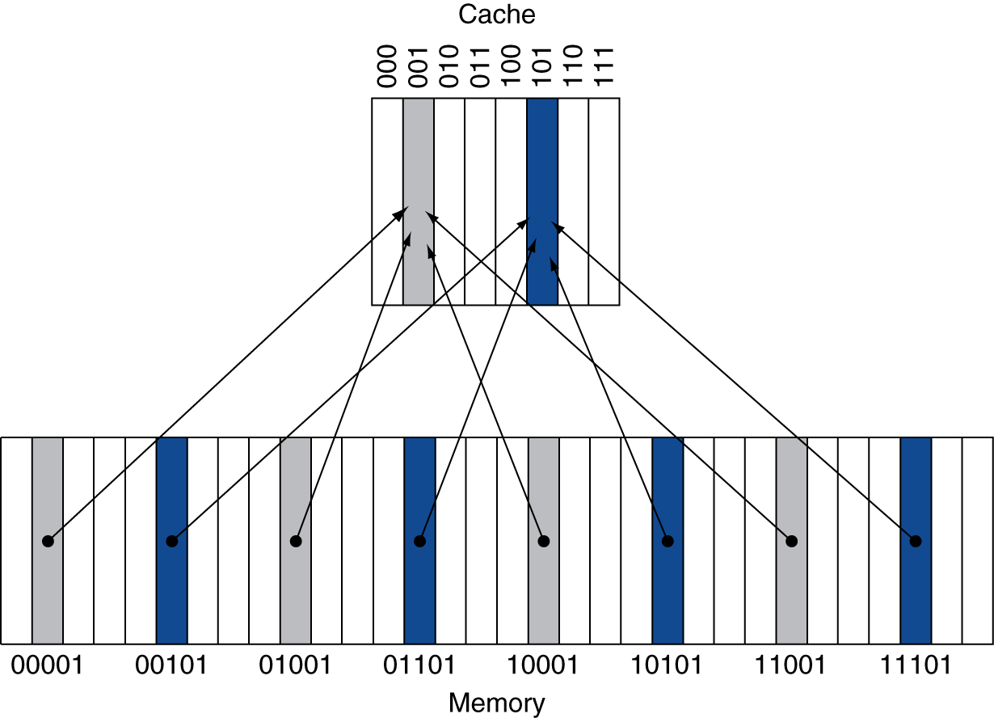
Direct Mapped Cache
Location determined by address
Direct mapped: only one choice
(Block address) modulo (#Blocks in cache)

Slide 15
Tags and Valid Bits
How do we know which particular block is stored in a cache location?
Store block address as well as the data
Actually, only need the high-order bits
Called the tag
What if there is no data in a location?
Valid bit: 1 = present, 0 = not present
Initially 0
Difference?

Slide 16
Direct Mapped Cache Example
One word blocks, cache size = 1K words (or 4KB)
Block offset
31 30 . . . 13 12 11 . . . 2 1 0
Hit
Tag
20
10
Data
Valid bit ensures something useful in cache for this index
Index
Read data from cache instead of memory if a Hit
Index
Valid
Tag
Data
0
1
2
.
.
.
1021
1022
1023
Compare Tag with upper part of Address to see if a Hit
20
32
Comparator

Slide 17
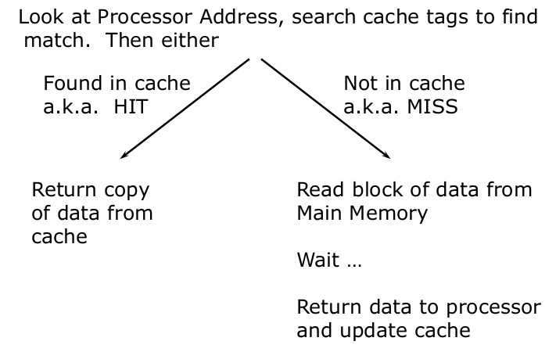
Cache: Read Algorithm

Slide 18
Cache Example
Cache 8-blocks,Ram 32-Blocks, 1 word/block, direct mapped
Initial state
Index | V | Tag | Data
000 | N
001 | N
010 | N
011 | N
100 | N
101 | N
110 | N
111 | N

Slide 19
Cache Example
Word addr | Binary addr | Hit/miss | Cache block
22 | 10 110 | Miss | 110
Index | V | Tag | Data
000 | N
001 | N
010 | N
011 | N
100 | N
101 | N
110 | Y | 10 | Mem[10110]
111 | N

Slide 20
Cache Example
Word addr | Binary addr | Hit/miss | Cache block
26 | 11 010 | Miss | 010
Index | V | Tag | Data
000 | N
001 | N
010 | Y | 11 | Mem[11010]
011 | N
100 | N
101 | N
110 | Y | 10 | Mem[10110]
111 | N

Slide 21
Cache Example
Word addr | Binary addr | Hit/miss | Cache block
22 | 10 110 | Hit | 110
26 | 11 010 | Hit | 010
Index | V | Tag | Data
000 | N
001 | N
010 | Y | 11 | Mem[11010]
011 | N
100 | N
101 | N
110 | Y | 10 | Mem[10110]
111 | N

Slide 22
Cache Example
Word addr | Binary addr | Hit/miss | Cache block
16 | 10 000 | Miss | 000
3 | 00 011 | Miss | 011
16 | 10 000 | Hit | 000
Index | V | Tag | Data
000 | Y | 10 | Mem[10000]
001 | N
010 | Y | 11 | Mem[11010]
011 | Y | 00 | Mem[00011]
100 | N
101 | N
110 | Y | 10 | Mem[10110]
111 | N

Slide 23
Cache Example
Word addr | Binary addr | Hit/miss | Cache block
18 | 10 010 | ? | 010
Index | V | Tag | Data
000 | Y | 10 | Mem[10000]
001 | N
010 | Y | 11 | Mem[11010]
011 | Y | 00 | Mem[00011]
100 | N
101 | N
110 | Y | 10 | Mem[10110]
111 | N

Slide 24
Cache Example
Word addr | Binary addr | Hit/miss | Cache block
18 | 10 010 | Miss | 010
Index | V | Tag | Data
000 | Y | 10 | Mem[10000]
001 | N
010 | Y | 10 | Mem[10010]
011 | Y | 00 | Mem[00011]
100 | N
101 | N
110 | Y | 10 | Mem[10110]
111 | N

Slide 25
Multiword Block Direct Mapped Cache
Four words/block, cache size = 1K words
Byte offset
Hit
31 30 . . . 13 12 11 . . . 4 3 2 1 0
Data
Tag
20
8
Block offset
Index
Index
Valid
Tag
Data
0
1
2
.
.
.
253
254
255
20
32
Notes:
to take advantage for spatial

Slide 26
Block Size Considerations
Larger blocks should reduce miss rate
Due to spatial locality
But in a fixed-sized cache
Larger blocks ⇒ fewer of them
More competition ⇒ increased miss rate
Larger miss penalty
Can override benefit of reduced miss rate

Slide 27
Cache Size
32-bit byte address
A direct-mapped cache
The cache size is 2^{n} blocks
The block size is 2^{m} words (2^{m+2} bytes)
What is the size of the tag field?
32-(n+m+2)
n select cache block
m select words within block
2 select byte within word

Slide 28
Cache Size
32-bit byte address
A direct-mapped cache
The cache size is 2^{n} blocks
The block size is 2^{m} words (2^{m+2} bytes)
What is the size of the cache (unit: no. of bit)?
2^{n} X (2^{m} X 32 + 32-(n+m+2) +1)

Slide 29
Mapping an Address to a Multiword Cache Block
64 blocks, 16 bytes/block
To what block number does address 1200 map?
Block address = ⎣1200/16⎦ = 75
Block number = 75 modulo 64 = 11
31
10
9
4
3
0
Tag
Index
Offset
22 bits
6 bits
4 bits

Slide 30
Cache Example
32-bit byte address
A direct-mapped cache
What is the cache line size (in words)?
4
How many entries does the cache have?
64
Tag | Index | Offset
31-10 | 9-4 | 3-0

Slide 31
Problem-1
Suppose you are required to design a 512 KB cache with 4 words data per block. Each word contains 4 bytes of data. There are 32 bits the memory address.
(a) Calculate the number of blocks in the cache
(b) Find out the number of index bits and tag bits
(c) Calculate the actual size of the cache
512 KB / 4 Words
(2^9 * 2^10)/ (2^2 * 2^2)=2^19/ 2^4 = 2^15=2^n
m = 2 & n(index)=15
Tag= 32-(n+m+2) = 32- (15+2+2)= 32-19= 13
1KB=1024B

Slide 32
a)
(512*2^10)/4*4=B) 2^15
Index(n)=15
Offset=(word)2+(byte)2=4
Tag= 32-(15+4)=13
c)
2^15*(1(valid bit)+13+4*4*8)

Slide 33
Problem-2
Suppose you have designed a 256 KB cache with 2 words data per block.
(a) Calculate the miss rate for the following memory address accesses. Memory is byte ad-dressable.
12, 42, 7, 15, 40, 39
(b) Suppose you have changed the cache design to 4 words data per block. Calculate the miss rate in this case for the scenario in part (a).
(c) Explain the principle of locality that caused the change in miss rate in (b)

Slide 34
# of blocks = (2^8*2^10)/(2*2^2)=2^15
12 :
Block address= Floor(12/8)=1 [Type of hashing]
Block number = Block address % # of blocks = 1% 2^15 =1
[note : 8-15 complete address copied]
Result : Miss
42:
Block address= Floor(42/8)=5
Block number = Block address % # of blocks = 5% 2^15 =5
[note : 40-47 complete address copied]
Result : Miss

Slide 35
7 : miss [0-7]
15 : hit
40 : hit
39 : miss [32-39]
Miss rate : 4/6 = (4/6)*100 %

Slide 36
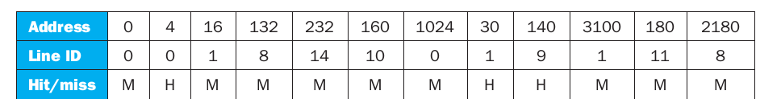
Cache Example
32-bit byte address
A direct-mapped cache
What is the hit ratio?
0.25

Slide 37
Handling Cache Misses
Read misses
Stall execution, fetch the block from the next level in the memory hierarchy, install it in the cache, send requested word to processor, and then let execution resume
Write misses
Write allocate: Stall execution, fetch the block from next level in the memory hierarchy, install it in cache, write the word from processor to cache, also update memory, then let execution resume
or
No-write allocate: skip the cache write and just write the word to memory

Slide 38
Cache-Memory Consistency? (1/2)
Need to make sure cache and memory have same values on writes: 2 policies
1) Write-Through Policy: write cache and write through the cache to memory
Every write eventually gets to memory
Too slow, so include Write Buffer to allow processor to continue once data in Buffer, Buffer updates memory in parallel to processor

Slide 39
Cache-Memory Consistency? (2/2)
Need to make sure cache and memory have same values on writes: 2 policies
2) Write-Back Policy: write only to cache and then write cache block back to memory when evict block from cache
Writes collected in cache, only single write to memory per block
Include bit to see if wrote to block or not, and then only write back if bit is set
Called “Dirty” bit (writing makes it “dirty”)

Slide 40
Write Through vs. Write Back
Advantages
Write through
Misses are simpler and cheaper because they never require a block to be written back in the lower level
Easier to implement
Write Back
Individual words can be written by the processor at the rate that the cache, rather than the memory, can accept them
Multiple writes within a block require only one write to the lower level in the hierarchy
When blocks are written back, the system can make effective use of a high bandwidth transfer, since the entire block is written

Slide 41
Measuring Cache Performance
Components of CPU time
Program execution cycles
Includes cache hit time
Memory stall cycles
Mainly from cache misses
CPU time = (CPU execution clock cycles + Memory-stall clock cycles) X Clock cycle time
Memory-stall cycles = memory accesses/program × miss rate × miss penalty

Slide 42
Cache Performance Example
Given
I-cache miss rate = 2%
D-cache miss rate = 4%
Miss penalty = 100 cycles
Base CPI (ideal cache) = 2
Load & stores are 36% of instructions
Miss cycles per instruction = Miss rate * Miss penalty
I-cache: 0.02 × 100 = 2
D-cache: 0.36 × 0.04 × 100 = 1.44
Actual CPI = 2 + 2 + 1.44 = 5.44
Ideal CPU is 5.44/2 =2.72 times faster!

Slide 43
Average Access Time
Hit time is also important for performance
Average memory access time (AMAT)
AMAT = Hit time + Miss rate × Miss penalty
Example
CPU with 1ns clock, hit time = 1 cycle, miss penalty = 20 cycles, I-cache miss rate = 5%
AMAT = 1 + 0.05 × 20 = 2ns
2 cycles per instruction

Slide 44
Any Question?
?

