Slide 1
CSE - 313 Computer Architecture
Faculty: Shoib Ahmed Shourav
United International University

Slide 2
Preview of the last class

Slide 3
Microprocessor
without
Interlocked
Pipeline
Stages (MIPS)

Slide 4
Assembler
A program that translates a symbolic version of instructions into the binary version.
Assembly Language
A symbolic representation of machine instructions.

Slide 5
Five classic components
Input
output
Memory
Data-path
Control
Processor

Slide 6
Memory
Primary Memory (RAM)
Faster
Volatile
Expensive
Secondary Memory (Storage)
Slower
Non-volatile
Less expensive

Slide 7
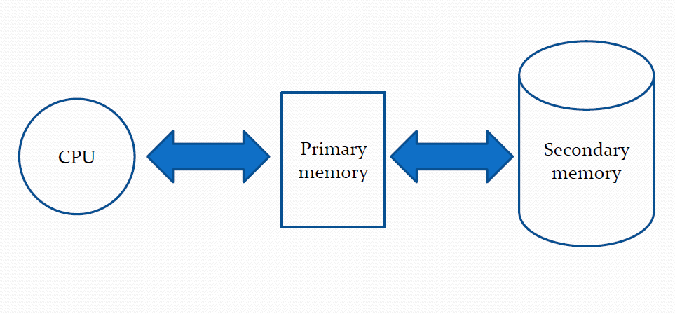

Slide 8
Primary Memory
RAM (Random Access Memory)
DRAM (Dynamic) –DDR4 RAM
SRAM (Static) –Cache memory
SRAM is static while DRAM is dynamic
SRAM is faster compared to DRAM
SRAM consumes less power than DRAM
SRAM uses more transistors per bit of memory compared to DRAM
SRAM is more expensive than DRAM
Cheaper DRAM is used in main memory while SRAM is commonly used in cache memory

Slide 9
Secondary Memory
ROM (Read Only Memory)
EPROM (erasable programmable read only memory)
CD-ROM
CD-R/W
Flash Memory (pen drive)
Floppy disk
Magnetic Tape
Hard disk

Slide 10
Instruction set
Instruction set (IS):
The vocabulary of commands understood by a given architecture.
The set of instructions / primitive operations that a CPU may execute is a major component of ISA (IS Architecture)
Assembly language is a textual version of these instructions.

Slide 11
Instruction set
We will study the MIPS architecture in some detail in this class
MIPS –semiconductor company that built one of the first commercial RISC (Reduced IS Computer) architectures
Why MIPS?
MIPS is simple, elegant and similar to other architectures developed since the 1980's
MIPS widely used in embedded apps
Almost 100 million MIPS processors manufactured in 2002
Used by NEC, Nintendo, Cisco, Silicon Graphics, Sony, …

Slide 12
MIPS Assembly Language
All instructions have 3 operands
One destination, two source operands
Operand order is fixed (destination first)
Example: C code: a = b + c
MIPS code: add a, b, c
C code: a = b + c + d;
MIPS code: add a, b, c
add a, a, d
Design principle: Hardware implementation is simplified via regularity
Operands must be registers in MIPS
Register set of a machine is a limited number of special locations built directly into the hardware.

Slide 13
MIPS Assembly Language
32 registers in MIPS
Registers are numbered from 0 to 31
Each register can be referred to by number or name
Number references: $0, $1, … $30, $31
By convention, each register also has a name to make it easier to code
$t0 -$t7 for temporary variables ($8-$15)
$ra for return address
Each MIPS register is 32 bits wide
Groups of 32 bits called a word in MIPS

Slide 14
MIPS Assembly Language
C code:
f = (g + h) –(i + j);

Slide 15
MIPS Assembly Language

Slide 16
MIPS Assembly Language
Arithmetic:
add, addi, sub
Why not subi?[Hints 2’s complement]
Logical:
and, or, nor, andi, ori, sll, srl
Why not “not” instruction?
Why not “nori” instruction?

Slide 17
Any Question?
?

