Slide 1
CSE - 313 Computer Architecture
Faculty: Shoib Ahmed Shourav
United International University

Slide 2
Performance

Slide 3
Defining Performance
Which airplane has the best performance?

Slide 4
Response Time and Throughput
Response time
How long it takes to do a task
Throughput
Total work done per unit time
e.g., tasks/transactions/… per hour
How are response time and throughput affected by
Replacing the processor with a faster version?
Adding more processors?
We’ll focus on response time for now…

Slide 5
Relative Performance
Define Performance = 1/Execution Time
“X is n time faster than Y”
Example: time taken to run a program
15s on A, 10s on B
Pb/Pa= Ea/Eb
Execution Time_{A} / Execution Time_{B} = 15s / 10s = 1.5
So B is 1.5 times faster than A

Slide 6
Measuring Execution Time
Elapsed time
Total response time, including all aspects
Processing, I/O, OS overhead, idle time
Determines system performance
CPU time
Time spent processing a given job
Discounts I/O time, other jobs’ shares
Comprises user CPU time and system CPU time
Different programs are affected differently by CPU and system performance

Slide 7
CPU Clocking
Operation of digital hardware governed by a constant-rate clock
Clock period
Clock (cycles)
Data transfer and computation
Update state
Clock period: duration of a clock cycle
e.g., 250ps = 0.25ns = 250×10^{–12}s
Clock frequency (rate): cycles per second
e.g., 4.0GHz = 4000MHz = 4.0×10⁹Hz

Slide 8
CPU Time
Performance improved by
Reducing number of clock cycles
Increasing clock rate
Hardware designer must often trade off clock rate against cycle count

Slide 9
CPU Time Example
Computer A: 2GHz clock, 10s CPU time
Designing Computer B
Aim for 6s CPU time
Can do faster clock, but causes 1.2 × clock cycles A
How fast must Computer B clock be?

Slide 10
Instruction Count and CPI
Instruction Count for a program
Determined by program, ISA and compiler
Average cycles per instruction
Determined by CPU hardware
If different instructions have different CPI
Average CPI affected by instruction mix

Slide 11
CPI Example
Computer A: Cycle Time = 250ps, CPI = 2.0
Computer B: Cycle Time = 500ps, CPI = 1.2
Same ISA
Which is faster, and by how much?
A is faster…
…by this much

Slide 12
CPI in More Detail
If different instruction classes take different numbers of cycles
Weighted average CPI
Relative frequency

Slide 13
CPI Example
Alternative compiled code sequences using instructions in classes A, B, C
Instruction | add | sub | beq
CPI for instruction | 1 | 2 | 3
IC in sequence 1 | 2 | 1 | 2
IC in sequence 2 | 4 | 1 | 1
Sequence 1: IC = 5
Clock Cycles = 2×1 + 1×2 + 2×3 = 10
Avg. CPI = 10/5 = 2.0
Sequence 2: IC = 6
Clock Cycles = 4×1 + 1×2 + 1×3 = 9
Avg. CPI = 9/6 = 1.5

Slide 14
Performance Summary
Performance depends on
Algorithm: affects IC, possibly CPI
Programming language: affects IC, CPI
Compiler: affects IC, CPI
Instruction set architecture: affects IC, CPI, T_{c}

Slide 15
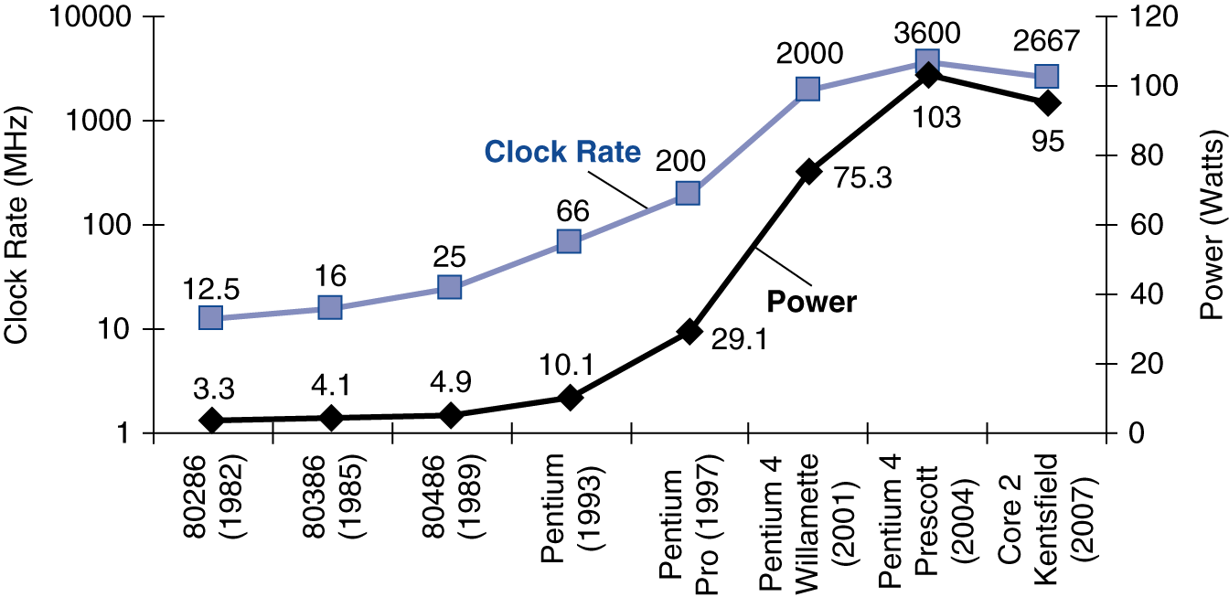
Power Trends
§1.5 The Power Wall
In CMOS IC technology
×30
5V → 1V
×1000

Slide 16
Reducing Power
Suppose a new CPU has
85% of capacitive load of old CPU
15% voltage and 15% frequency reduction
The power wall
We can’t reduce voltage further
We can’t remove more heat
How else can we improve performance?

Slide 17
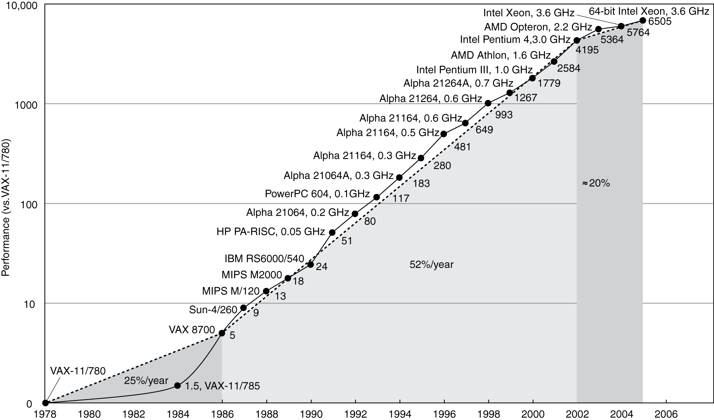
Uniprocessor Performance
§1.6 The Sea Change: The Switch to Multiprocessors
Constrained by power, instruction-level parallelism, memory latency

Slide 18
Multiprocessors
Multicore microprocessors
More than one processor per chip
Requires explicitly parallel programming
Compare with instruction level parallelism
Hardware executes multiple instructions at once
Hidden from the programmer
Hard to do
Programming for performance
Load balancing
Optimizing communication and synchronization

Slide 19
Pitfall: Amdahl’s Law
Improving an aspect of a computer and expecting a proportional improvement in overall performance
§1.8 Fallacies and Pitfalls
Example: multiply accounts for 80s/100s
How much improvement in multiply performance to get 5× overall?
Can’t be done!
Corollary: make the common case fast

Slide 20
Fallacy: Low Power at Idle
Look back at X4 power benchmark
At 100% load: 295W
At 50% load: 246W (83%)
At 10% load: 180W (61%)
Google data center
Mostly operates at 10% – 50% load
At 100% load less than 1% of the time
Consider designing processors to make power proportional to load

Slide 21
Pitfall: MIPS as a Performance Metric
MIPS: Millions of Instructions Per Second
Doesn’t account for
Differences in ISAs between computers
Differences in complexity between instructions
CPI varies between programs on a given CPU

Slide 22
Concluding Remarks
§1.9 Concluding Remarks
Cost/performance is improving
Due to underlying technology development
Hierarchical layers of abstraction
In both hardware and software
Instruction set architecture
The hardware/software interface
Execution time: the best performance measure
Power is a limiting factor
Use parallelism to improve performance

Slide 23
Any Question?
?

