Slide 1
CSE - 313 Computer Architecture
Faculty: Shoib Ahmed Shourav
United International University

Slide 2
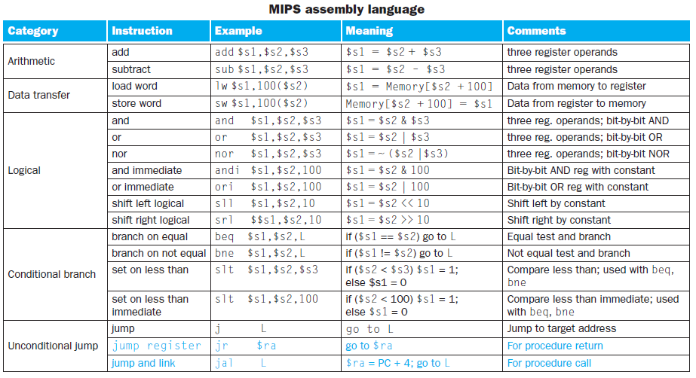

Slide 3
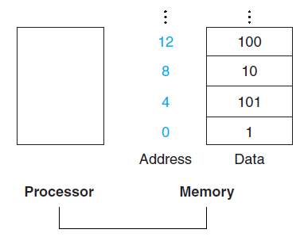
MIPS Assembly Language
MIPS memory
Programming languages have simple variables that contain single data elements as in these examples, but they also have more complex data structures—arrays.
Word by word
Data transfer instructions
lw(load word)
sw(store word)
Size of the MIPS memory?

Slide 4
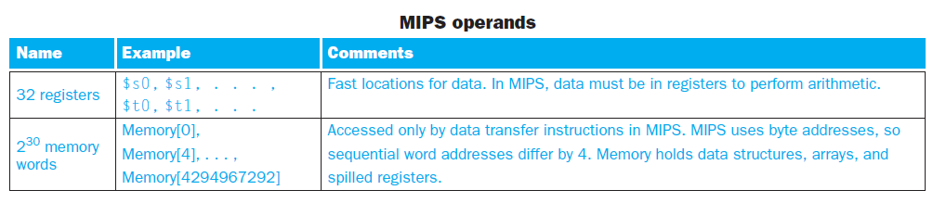
MIPS Assembly Language
What is spilling registers?
The process of putting less commonly used variables (or those needed later) into memory is called spilling registers.

Slide 5


MIPS Assembly Language
Array:
Assume variable h is associated with register $s2 and the base address of the array A is in $s3. What is the MIPS assembly code for the C assignment statement below?

Slide 6
MIPS Assembly Language
Try following C codes:
h = 230;
A[10] = h + B[i];
Suppose, Compiler will assign A (base address) into $s0, B(base address) into $s1, h into $s2 and i into $s3.
addi $s2,$zero, 230

Slide 7
MIPS Assembly Language
Instructions for making Decisions:
beq $x, $y, Label(Memory address)
If $x == $y then jump to the specified Label or address
Otherwise go next
bne $x, $y, Label(Memory address)
If $x != $y then jump to the specified Label or address
Otherwise go next
slt $t, $x, $y
If $x < $y then set 1 at $t, otherwise 0
slti $t, $x, constant

Slide 8
MIPS Assembly Language
beq, bne are conditional jump
There are some other instructions that are unconditional jump
j memory_address/Label
jal memory_address/Label
jr $ra

Slide 9
MIPS Assembly Language
Example:
if (i == j) f = g + h;
else f = g –h;
Let, compiler will assign f at $s0, g at $s1, h at $s2, i at $s3 and j at $s4
Solution:
PC→1000: beq $s3, $s4, IF // PC→1000→binary(32bits)
1004: sub $s0, $s1, $s2 // PC= PC+4 ; PC= New JA
1008: j EXIT
1012: IF: add $s0, $s1, $s2
1016: EXIT:

Slide 10
MIPS Assembly Language
Example:
if (i < j) f = g + h;
else f = g –h;
Let, compiler will assign f at $s0, g at $s1, h at $s2, i at $s3 and j at $s4
Solution:
slt $t0, $s3, $s4
beq $to, $zero, Else
add $s0, $s1, $s2
j Exit
Else: sub $s0, $s1, $s2
Exit:

Slide 11
MIPS Assembly Language
Example:
if (i <= j) f = g + h;
else f = g –h;
Let, compiler will assign f at $s0, g at $s1, h at $s2, i at $s3 and j at $s4
Solution:
slt $t0, $s3, $s4
beq $to, $zero, IF
L1: add $s0, $s1, $s2
j Exit
IF: beq $s3, $s4, L1
sub $s0, $s1, $s2
Exit:

Slide 12
MIPS Assembly Language
Try this one:
if (i < j && i != k) f = g + h;
else f = g –h;
Let, compiler will assign f at $s0,g at $s1,h at $s2,i at $s3,j at $s4 and k at $s5

Slide 13
MIPS Assembly Language
Loop:
Example:
while(save[5] == k) i++;
Let, compiler will assign I at $s0,k at $s1 and save at $s2
Solution:
Loop:
lw $t0, 20($s2)
bne $t0, $s1, Exit
addi $s0, $s0, 1
j Loop
Exit:

Slide 14
Any Question ?

