Slide 1
CSE - 313 Computer Architecture
Faculty: Shoib Ahmed Shourav
United International University

Slide 2
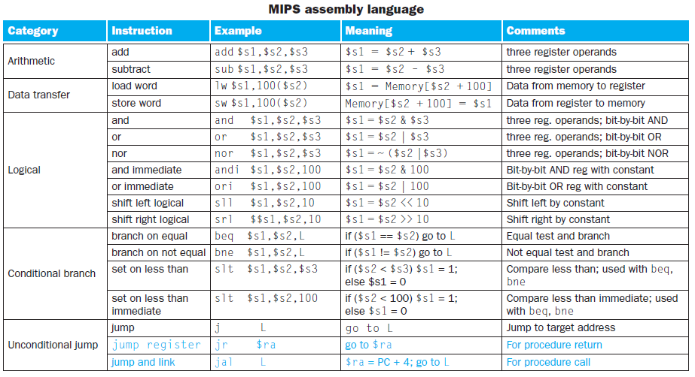

Slide 3
MIPS Assembly Language
Function:
Useful registers:
Argument registers: $a0, $a1, $a2, $a3
Return value registers: $v0, $v1
Return address: $ra
Stack pointer: $sp
Useful instructions:
jal function_address
jr $ra

Slide 4
MIPS Assembly Language
jr: (Jump register)
Unconditional jump to the address specified in a register($ra)
jal: (Jump and link)
Jump: jump to the function_address
Link: saves PC(prog. counter) + 4 in register $ra
the calling program, or caller, puts the parameter values in $a0–$a3 and uses jal X to jump to procedure X (sometimes named the callee). The callee then performs the calculations, places the results in $v0–$v1, and returns control to the caller using jr $ra.

Slide 5
MIPS Assembly Language
We must cover our tracks after our mission is complete, any registers needed by the caller must be restored to the values that they contained before the procedure was invoked. This situation is an example in which we need to spill registers to memory.
Stack: The ideal data structure for spilling registers is a stack.
MIPS allocates another register just for the stack: the stack pointer ($sp), used to save the registers needed by the callee.

Slide 6
MIPS Assembly Language

Slide 7
MIPS Assembly Language
Example:
int function(int g, int h, int i, int j,int k)
{
int f, a, b = 20, c = 30;
a = b + c;
f = ( g + h ) - (i + j);
f = a + f;
return f;
}
Arguments will be found at $a0-$a3 Let, compiler will assign f at $s0, a at $s1, b at $s2, c at $s3

Slide 8
MIPS Assembly Language
Solution (Partial):
addi $s2, $zero, 20
addi $s3, $zero, 30
add $s1, $s2, $s3
add $t0, $a0, $a1
add $t1, $a2, $a3
sub $s0, $t0, $t1
add $s0, $s1, $s0
add $v0, $s0, $zero //return f // $v0=f

Slide 9
MIPS Assembly Language
$t0–$t9: 10 temporary registers that are not preserved by the callee (called procedure) on a procedure call.
$s0–$s7: 8 saved registers that must be preserved on a procedure call (if used, the callee saves and restores them)

Slide 10
MIPS Assembly Language
Solution (Before):
addi $sp, $sp, -16
sw $s0, 12($sp)
sw $s1, 8($sp)
sw $s2, 4($sp) Spilling registers
sw $s3, 0($sp)

Slide 11
MIPS Assembly Language
Solution (After):
lw $s3, 0($sp)
lw $s2, 4($sp)
lw $s1, 8($sp) Spilling registers
lw $s0, 12($sp)
addi $sp, $sp, 16
jr $ra

Slide 12
Any Question?
?

