Slide 1
CSE - 313 Computer Architecture
Faculty: Shoib Ahmed Shourav
United International University

Slide 2
C code:
int fact (int n) { if (n < 1) return 1; else return n * fact(n - 1); }
Argument n in $a0
Result in $v0

Slide 3
MIPS code:
fact: addi $sp, $sp, -8 # adjust stack for 2 items sw $ra, 4($sp) # save return address sw $a0, 0($sp) # save argument slti $t0, $a0, 1 # test for n < 1 beq $t0, $zero, L1 addi $v0, $zero, 1 # if so, result is 1 addi $sp, $sp, 8 # pop 2 items from stack jr $ra # and return
L1: addi $a0, $a0, -1 # else decrement n jal fact # recursive call lw $a0, 0($sp) # restore original n lw $ra, 4($sp) # and return address addi $sp, $sp, 8 # pop 2 items from stack mul $v0, $a0, $v0 # multiply to get result jr $ra # and return

Slide 4
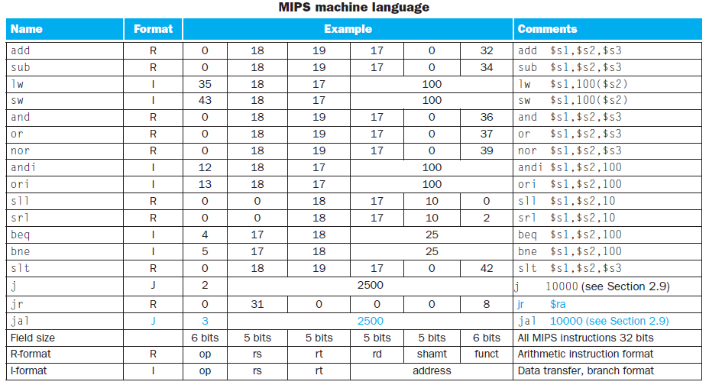
MIPS Machine Language

Slide 5
MIPS Machine Language
MIPS Fields:
3 types
R-Type (add, sub, and, or, nor, sll, srl, slt, jr)
I-Type (lw, sw, andi, ori, addi, beq, bne)
J-Type (j, jal)

Slide 6
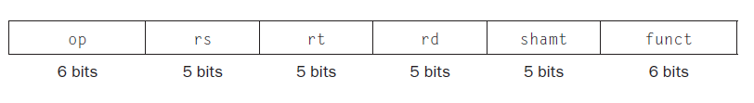
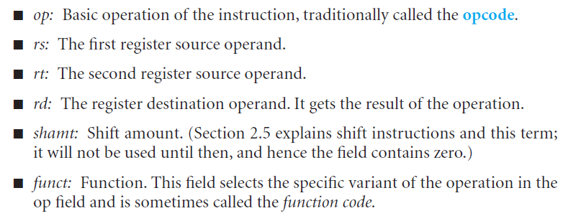
MIPS Machine Language
R-Type:

Slide 7
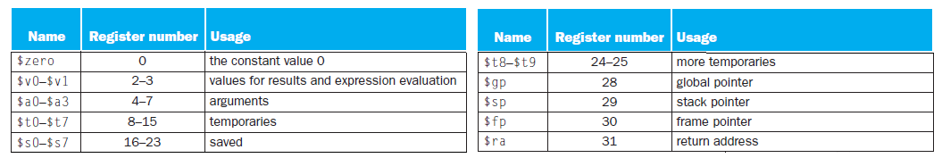
MIPS Machine Language
Register Numbering:

Slide 8
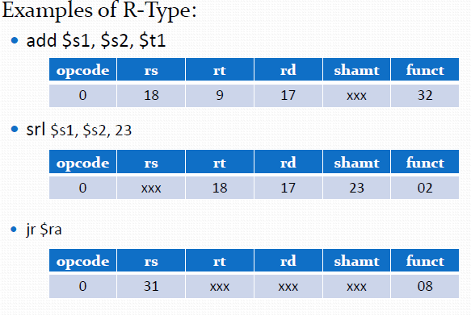
MIPS Machine Language

Slide 9
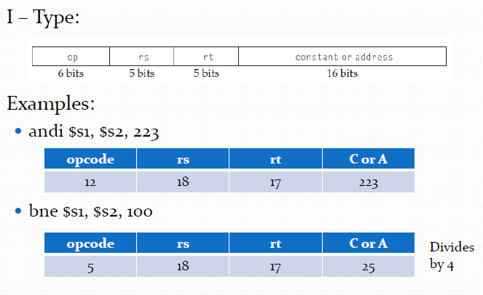
MIPS Machine Language

Slide 10
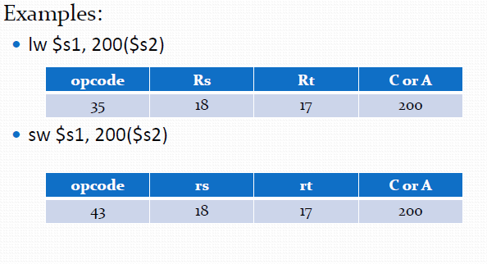
MIPS Machine Language

Slide 11
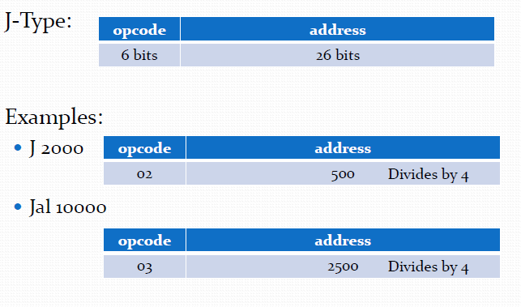
MIPS Machine Language

Slide 12
Any Question?
?

