Slide 1
CSE - 313 Computer Architecture
Faculty: Shoib Ahmed Shourav
United International University

Slide 2
MIPS Processor Implementation
3 ways:
Single cycle (Good)
Multi cycle (Better)
Pipelining (Best)

Slide 3
Single Cycle Implementation
Name: ID:

Slide 4
Components

Slide 5
Components

Slide 6
’add’ instruction
ALUsrc = 0
ALUOp = add
RegDst = 1
Memto Reg = 0
RegWrite = 1
Branch = 0

Slide 7
Single cycle implementation (For Practice)
and
or
nor
sub

Slide 8
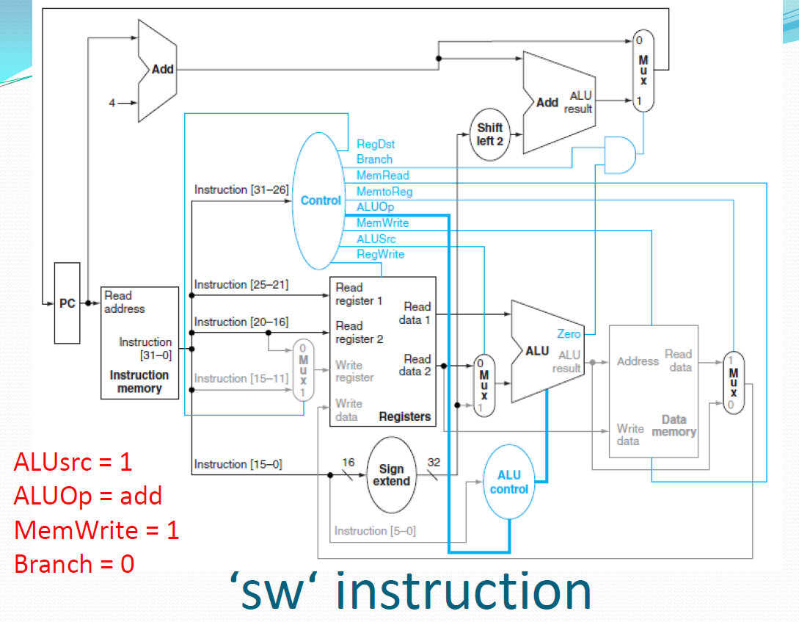

Slide 9
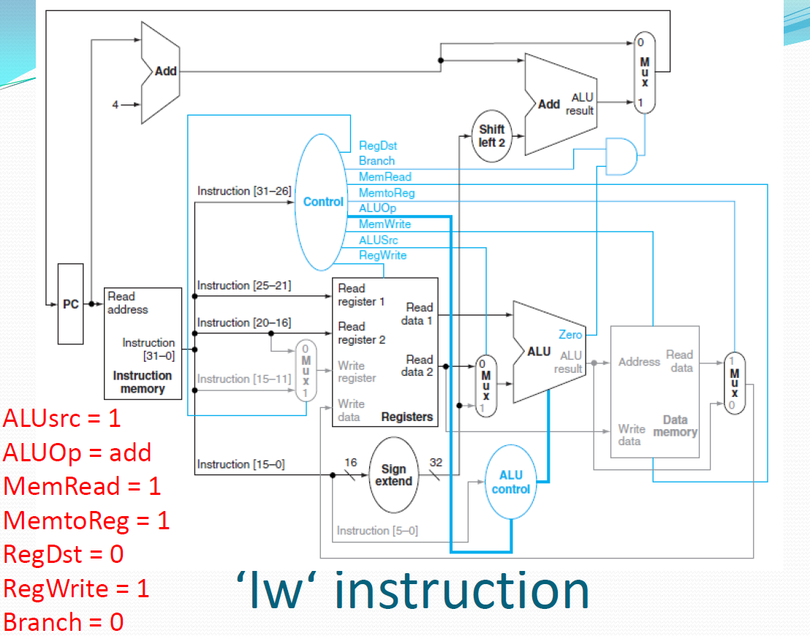
add

Slide 10
Single cycle implementation (For Practice)
andi
ori
addi

Slide 11
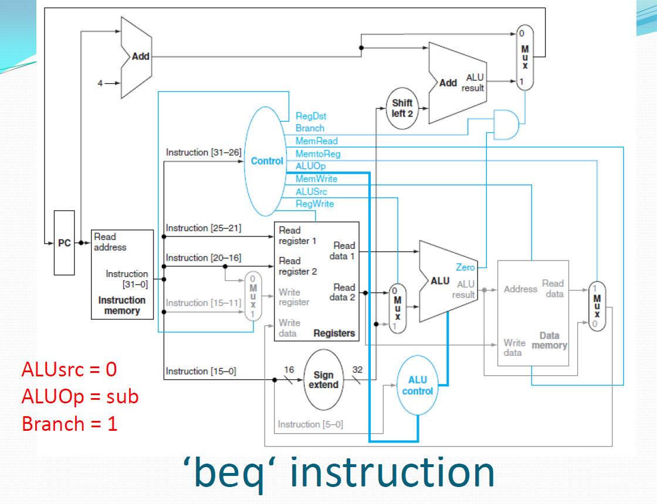

Slide 12
Any Question?
?

