Slide 1
CSE - 313 Computer Architecture
Faculty: Shoib Ahmed Shourav
United International University

Slide 2
ALU Control
ALU used for
Load/Store: F = add
Branch: F = subtract
R-type: F depends on funct field
§4.4 A Simple Implementation Scheme
ALU control | Function
0000 | AND
0001 | OR
0010 | add
0110 | subtract
0111 | set-on-less-than
1100 | NOR

Slide 3
ALU Control
Assume 2-bit ALUOp derived from opcode
Combinational logic derives ALU control
opcode | ALUOp | Operation | funct | ALU function | ALU control
lw | 00 | load word | XXXXXX | add | 0010
sw | 00 | store word | XXXXXX | add | 0010
beq | 01 | branch equal | XXXXXX | subtract | 0110
R-type | 10 | add | 100000 | add | 0010
 |  | subtract | 100010 | subtract | 0110
 |  | AND | 100100 | AND | 0000
 |  | OR | 100101 | OR | 0001
 |  | set-on-less-than | 101010 | set-on-less-than | 0111

Slide 4
The Main Control Unit
Control signals derived from instruction
R-type
0
rs
rt
rd
shamt
funct
31:26
25:21
20:16
15:11
10:6
5:0
Load/ Store
35 or 43
rs
rt
address
31:26
25:21
20:16
15:0
Branch
4
rs
rt
address
31:26
25:21
20:16
15:0
opcode
always read
read, except for load
write for R-type and load
sign-extend and add

Slide 5
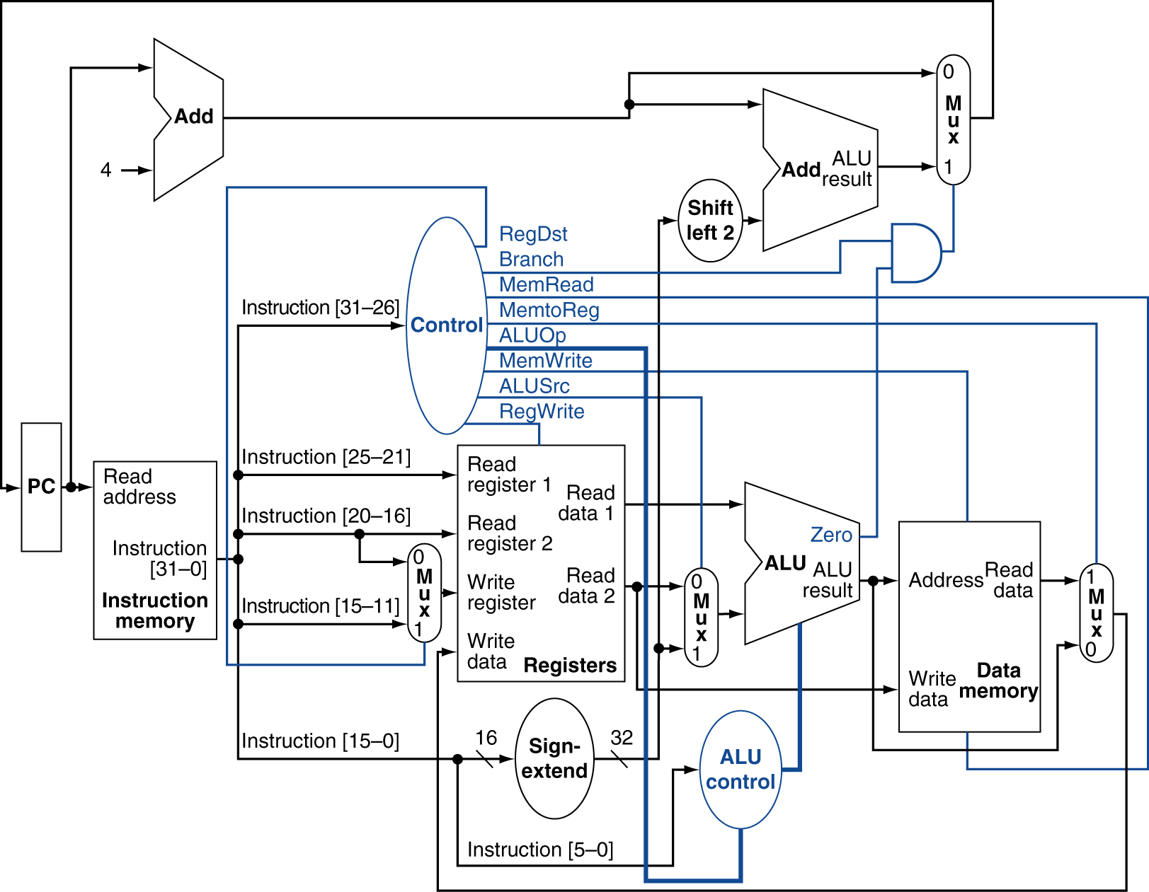
Datapath With Control

Slide 6
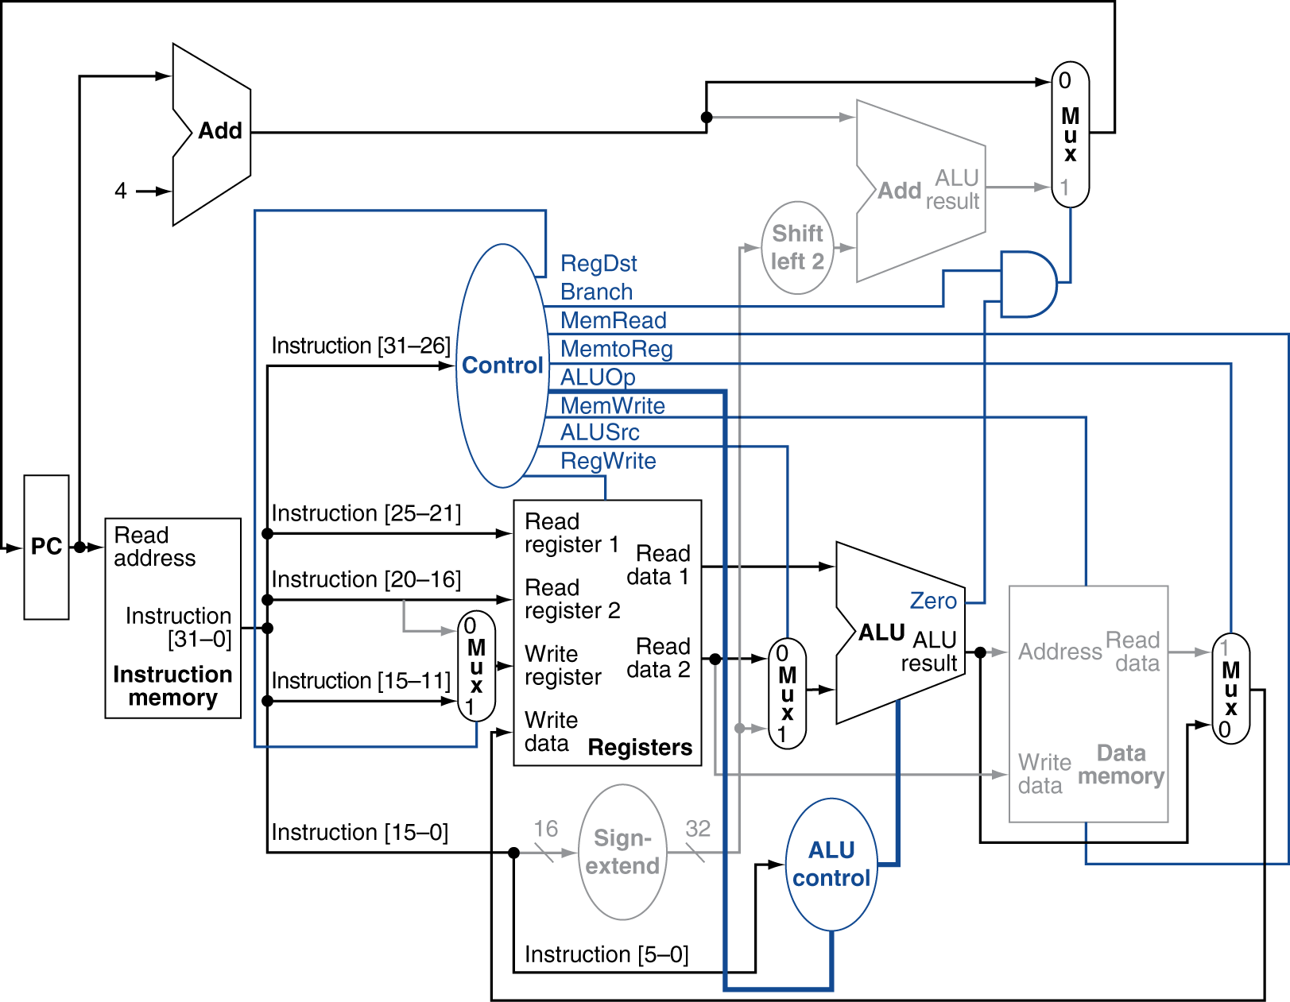
R-Type Instruction

Slide 7
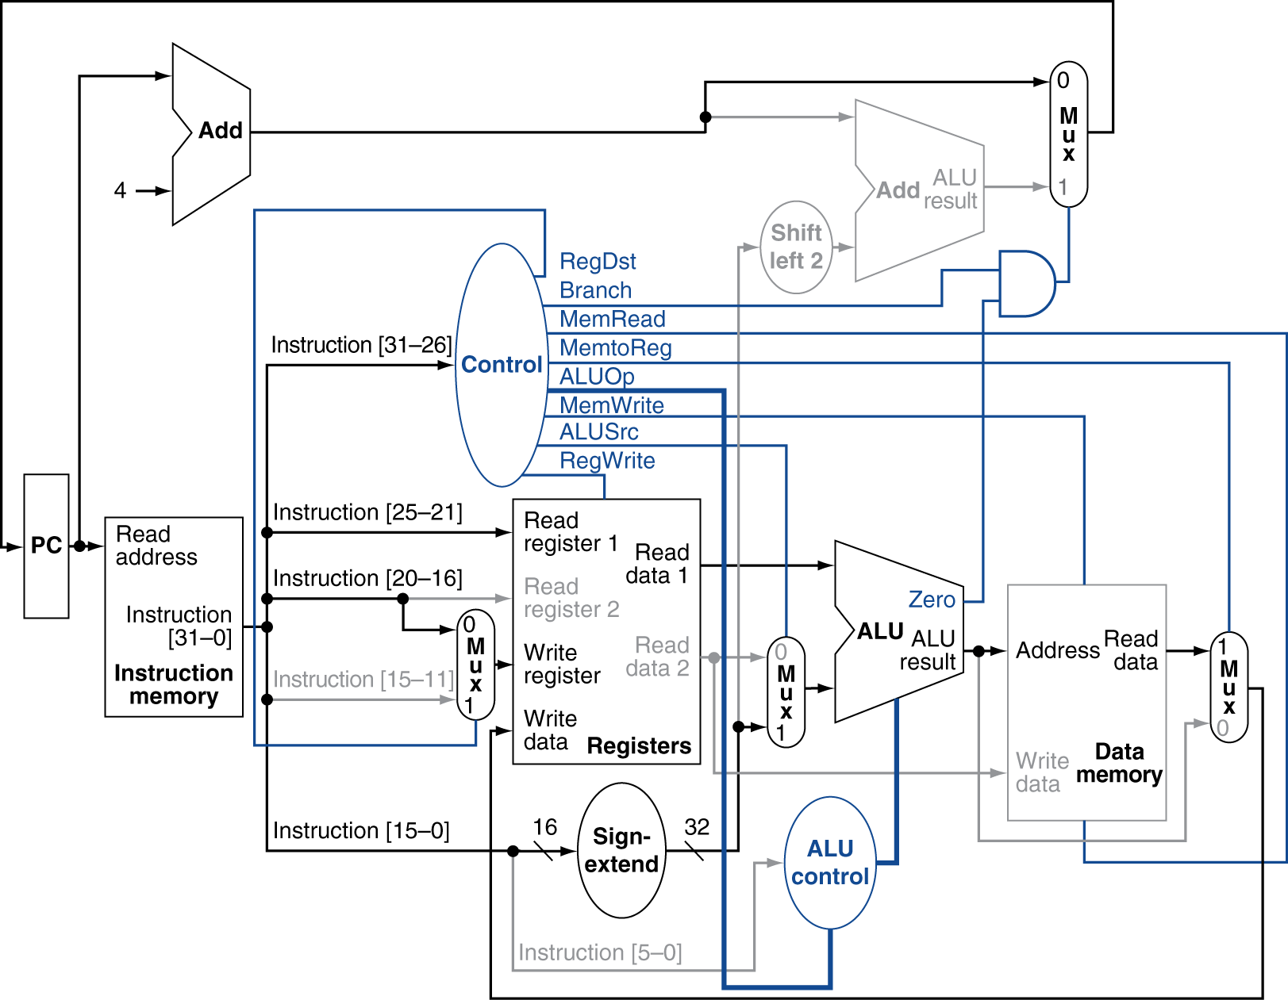
Load Instruction

Slide 8
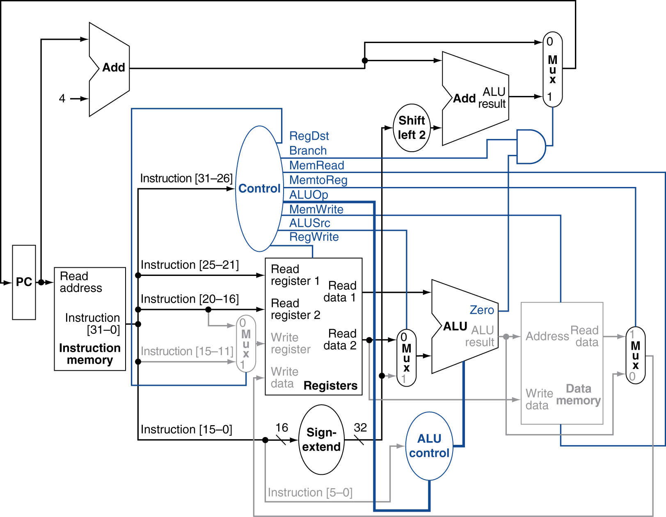
Branch-on-Equal Instruction

Slide 9
Implementing Jumps
Jump
2
address
31:26
25:0
Jump uses word address
Update PC with concatenation of
Top 4 bits of old PC
26-bit jump address
00
Need an extra control signal decoded from opcode

Slide 10
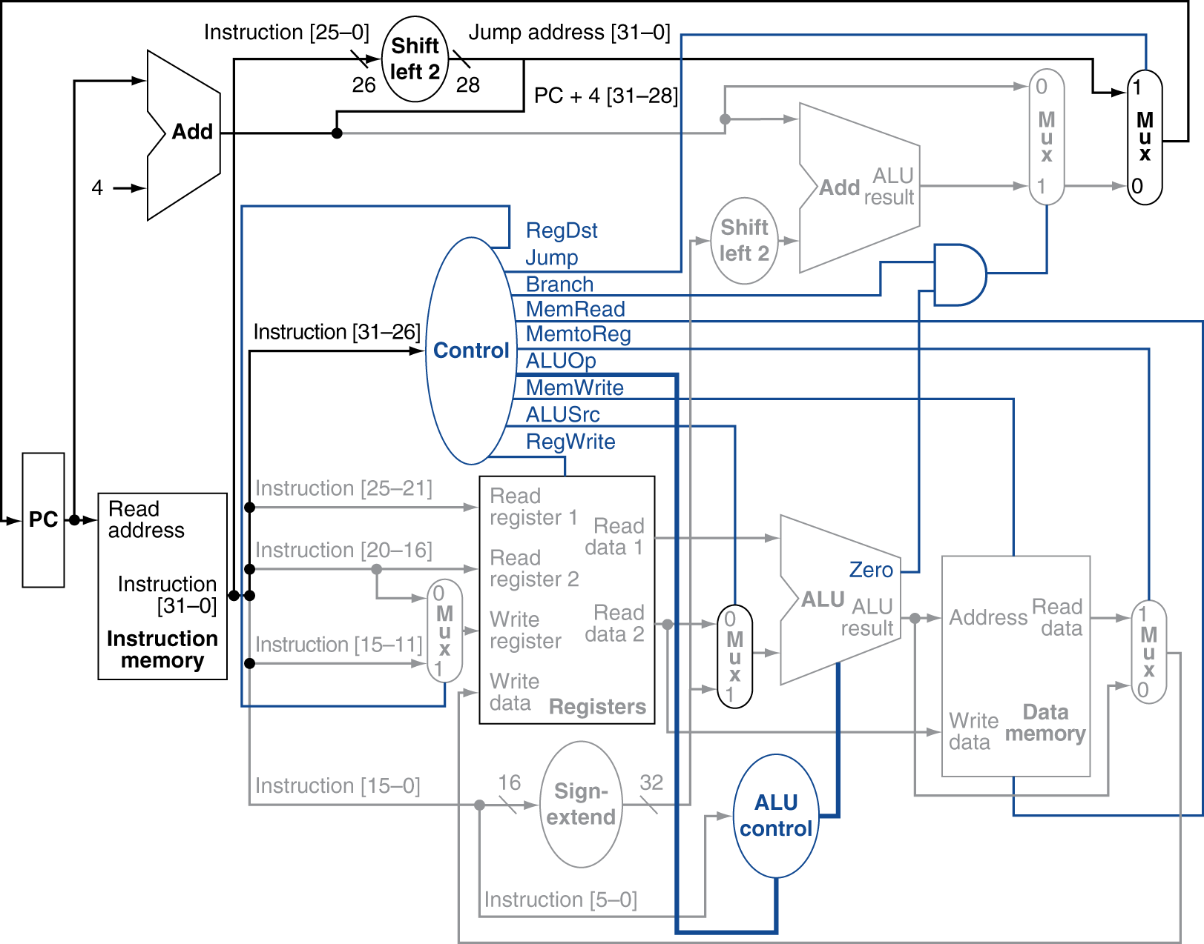
Datapath With Jumps Added
Jump =1

Slide 11
Performance Issues
Longest delay determines clock period
Critical path: load instruction
Instruction memory → register file → ALU → data memory → register file
Not feasible to vary period for different instructions
Violates design principle
Making the common case fast
We will improve performance by pipelining

Slide 12
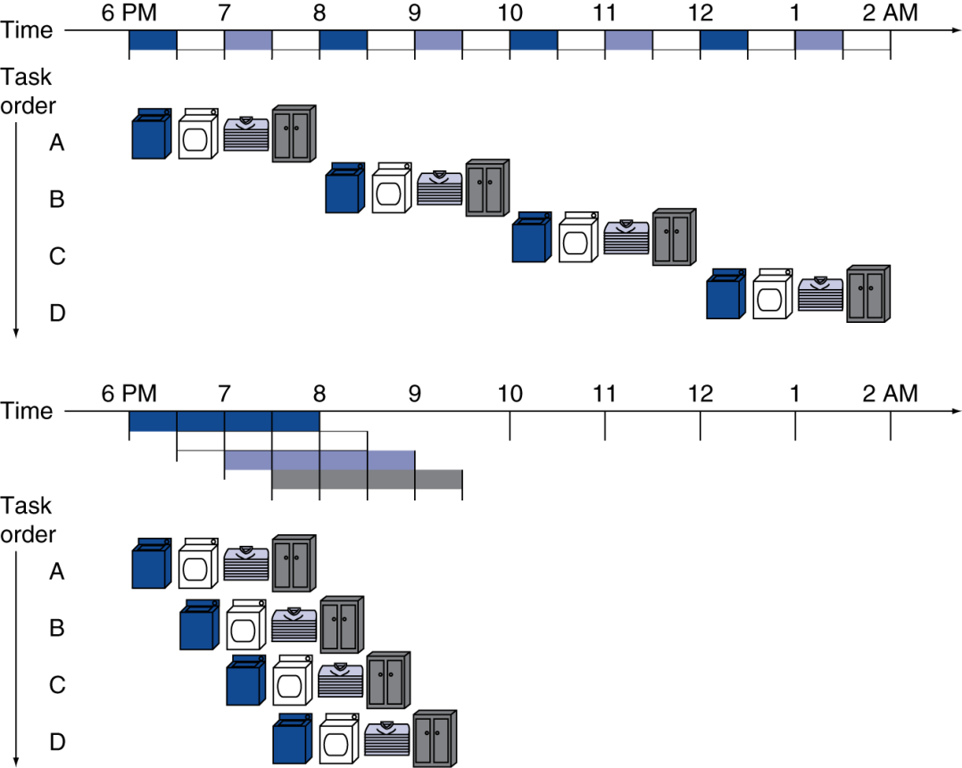
Pipelining Analogy
Pipelined laundry: overlapping execution
Parallelism improves performance
§4.5 An Overview of Pipelining
Four loads:
Speedup = 8/3.5 = 2.3
Non-stop:
Speedup = 2n/0.5n + 1.5 ≈ 4 = number of stages

Slide 13
MIPS Pipeline
Five stages, one step per stage
IF: Instruction fetch from memory
ID: Instruction decode & register read
EX: Execute operation or calculate address
MEM: Access memory operand
WB: Write result back to register

Slide 14
Pipeline Performance
Assume time for stages is
100ps for register read or write
200ps for other stages
Compare pipelined datapath with single-cycle datapath
Instr | Instr fetch | Register read | ALU op | Memory access | Register write | Total time
lw | 200ps | 100 ps | 200ps | 200ps | 100 ps | 800ps
sw | 200ps | 100 ps | 200ps | 200ps |  | 700ps
R-format | 200ps | 100 ps | 200ps |  | 100 ps | 600ps
beq | 200ps | 100 ps | 200ps |  |  | 500ps

Slide 15
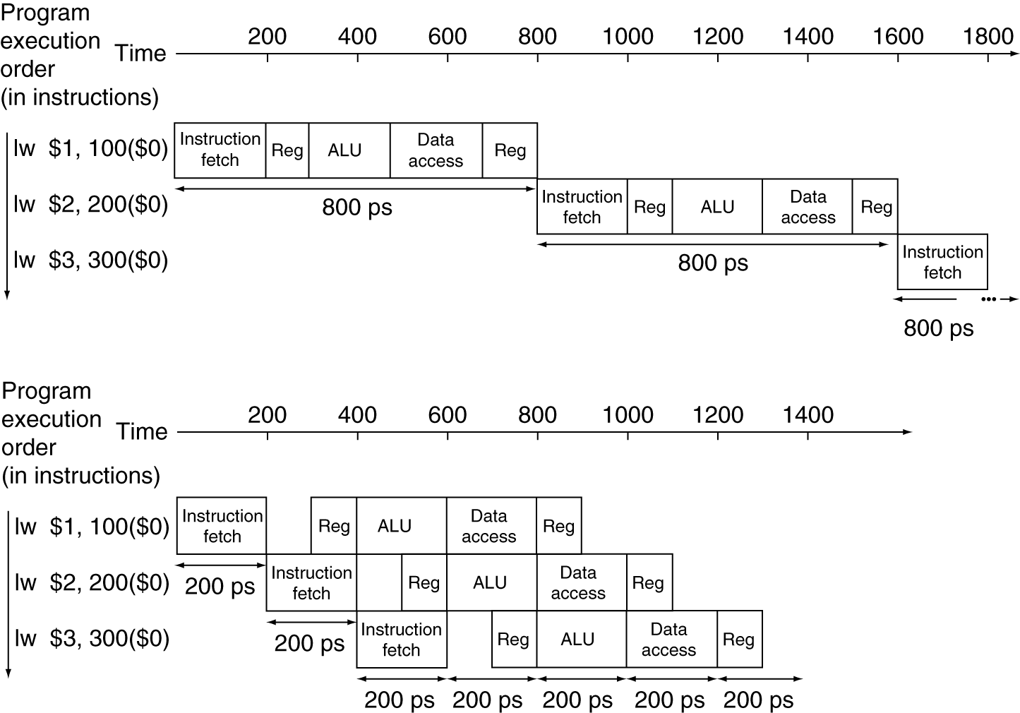
Pipeline Performance
Single-cycle (T_{c}= 800ps)
Pipelined (T_{c}= 200ps)

Slide 16
Pipeline Speedup
If all stages are balanced
i.e., all take the same time
Time between instructions_{pipelined} = Time between instructions_{nonpipelined} Number of stages
If not balanced, speedup is less
Speedup due to increased throughput
Latency (time for each instruction) does not decrease

Slide 17
Pipelining and ISA Design
MIPS ISA designed for pipelining
All instructions are 32-bits
Easier to fetch and decode in one cycle
c.f. x86: 1- to 17-byte instructions
Few and regular instruction formats
Can decode and read registers in one step
Load/store addressing
Can calculate address in 3rd stage, access memory in 4th stage
Alignment of memory operands
Memory access takes only one cycle

Slide 18
Pipelining Hazards
Situations that prevent starting the next instruction in the next cycle
Structure hazards
A required resource is busy
Data hazard
Need to wait for previous instruction to complete its data read/write
Control hazard
Deciding on control action depends on previous instruction

Slide 19
Structure Hazards
Conflict for use of a resource
In MIPS pipeline with a single memory
Load/store requires data access
Instruction fetch would have to stall for that cycle
Would cause a pipeline “bubble”
Hence, pipelined datapaths require separate instruction/data memories
Or separate instruction/data caches

Slide 20
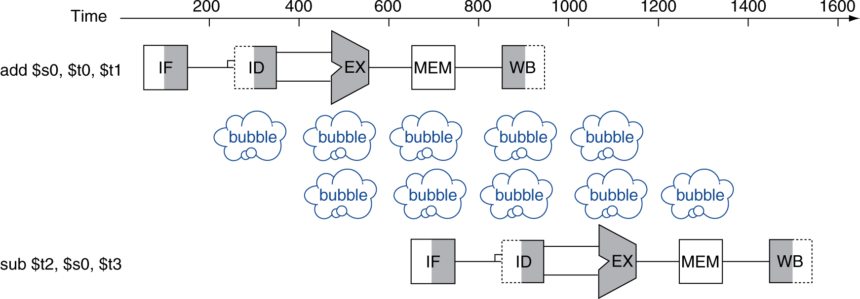
Data Hazards
An instruction depends on completion of data access by a previous instruction
add $s0, $t0, $t1 sub $t2, $s0, $t3

Slide 21
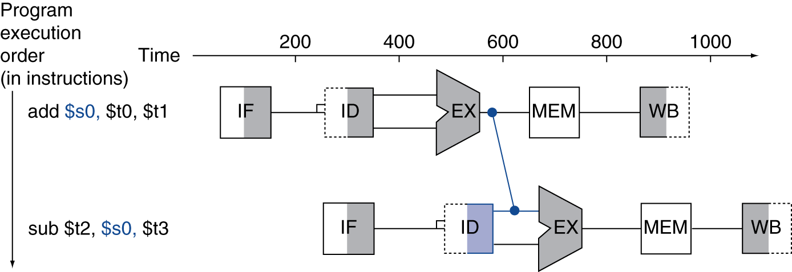
Forwarding (aka Bypassing)
Use result when it is computed
Don’t wait for it to be stored in a destination register
Requires extra connections in the datapath

Slide 22
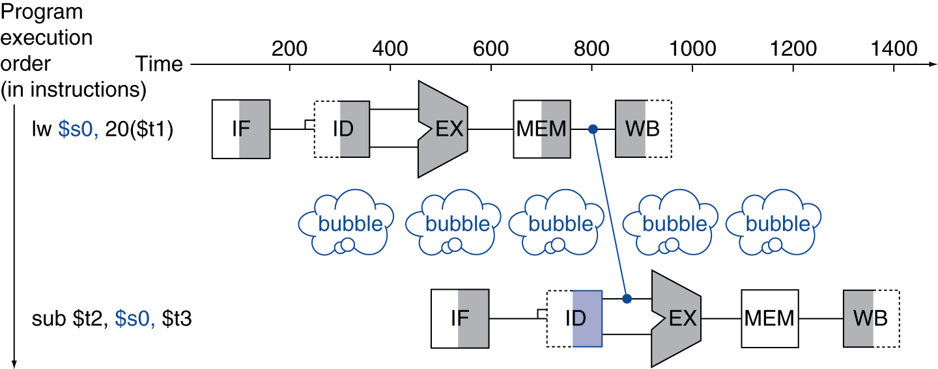
Load-Use Data Hazard
Can’t always avoid stalls by forwarding
If value not computed when needed
Can’t forward backward in time!

Slide 23
Code Scheduling to Avoid Stalls
Reorder code to avoid use of load result in the next instruction
C code for A = B + E; C = B + F;
lw $t1, 0($t0)
lw $t2, 4($t0)
add $t7, $t1, $t2
sw $t3, 12($t0)
lw $t4, 8($t0)
add $t5, $t1, $t4
sw $t6, 16($t0)
lw $t1, 0($t0)
lw $t2, 4($t0)
lw $t4, 8($t0)
add $t7, $t1, $t2
sw $t3, 12($t0)
add $t5, $t1, $t4
sw $t6, 16($t0)
stall
stall
13 cycles
11 cycles

Slide 24
Control Hazards
Branch determines flow of control
Fetching next instruction depends on branch outcome
Pipeline can’t always fetch correct instruction
Still working on ID stage of branch
In MIPS pipeline
Need to compare registers and compute target early in the pipeline
Add hardware to do it in ID stage

Slide 25
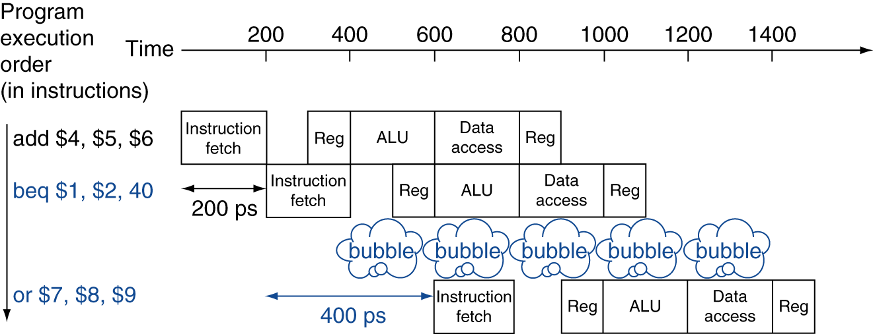
Stall on Branch
Wait until branch outcome determined before fetching next instruction

Slide 26
Any Question?
?

