Slide 1

Product and Sales Data Analytics Using Azure and Power BI
Scalable, Secure and Insightful

Slide 2
Introduction
Purpose of the Project:
To develop a streamlined pipeline for ingesting, transforming, and visualizing sales data.
Deliver actionable insights through an interactive Power BI dashboard.
Ensure scalability, security, and efficiency using Azure Data Lake Storage Gen2.
Overview of Tools Used:
Azure Data Lake Storage Gen2: Scalable and secure storage for raw and processed data.
Azure Data Factory: Data ingestion, cleaning, and transformation.
Power BI: Visualization and analytics.
Python with Azure Blob SDK: For data upload and management.

Slide 3
High-Level Solution Design
Solution Overview:
A scalable and interactive analytics platform integrating Azure and Power BI.
Ensures data quality, meaningful transformations, and impactful visualizations.
Components and Workflow:
Data Ingestion: Securely upload raw sales data to Azure Data Lake.
Data Transformation: Clean, enrich, and aggregate data using Azure Data Factory.
Data Visualization: Connect Power BI for insightful dashboards and reports.

Slide 4
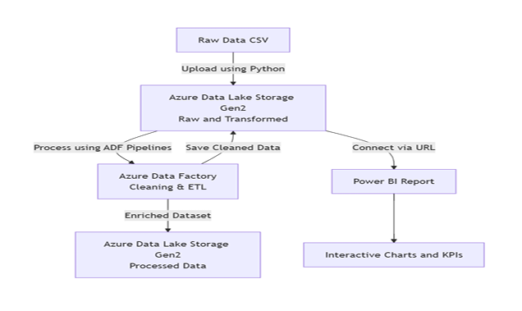
Architectural Diagram
Data Flow Pipeline:
Step 1: Upload raw sales data to Azure Data Lake Storage.
Step 2: Data ingestion pipeline cleans and validates the data.
Step 3: Transformation pipeline generates insights and aggregates data.
Step 4: Power BI connects to transformed data for visualization. Visualize with an actual pipeline diagram.

Slide 5
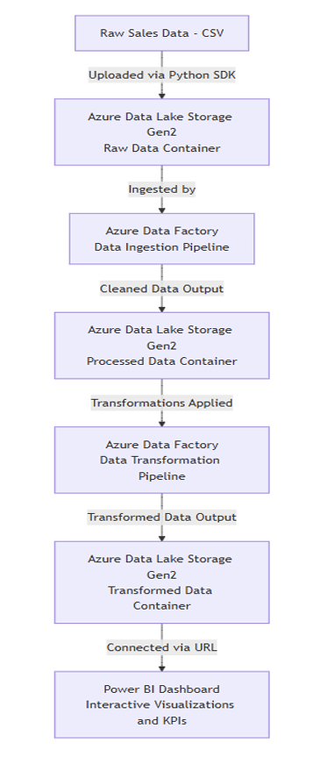

Slide 6
Choice of Data Storage
Justification for Azure Data Lake Storage:
Scalability: Supports large datasets and integrates with Azure tools.
Cost-Effective: Pay-as-you-go pricing model.
Security: Robust role-based access control (RBAC).
Advantages of Azure Data Lake Storage Gen2:
Hierarchical namespace for easy organization.
Tiered storage for optimized cost.
Fine-grained access control and integration with big data tools.

Slide 7
Data Pipeline Process
Data Ingestion Pipeline:
Upload raw sales data to Azure Data Lake Storage using Python scripts.
Perform initial cleaning and schema validation.
Cleaning Pipeline:
Handle missing values, correct data types, and mask sensitive data.
Save cleaned data to a processed data container.
Transformation Pipeline:
Add calculated fields, such as TotalSales and ProfitMargin.
Aggregate sales by location and customer.
Save transformed data to the final container.

Slide 8
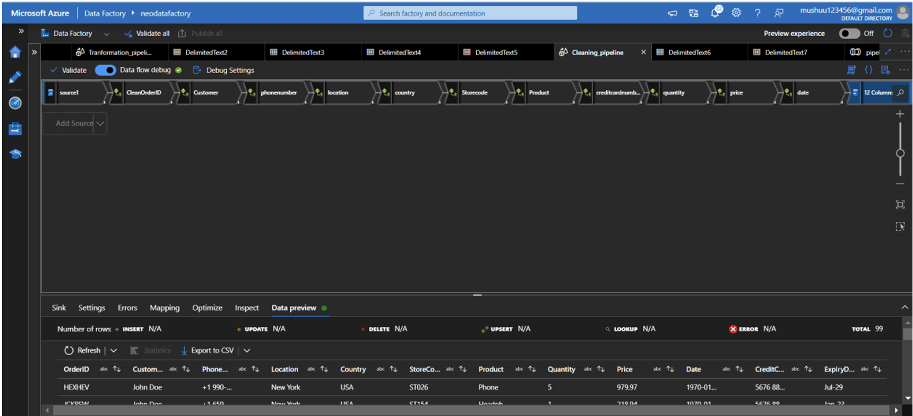
CLEANING PIPELINE DATAFLOW

Slide 9
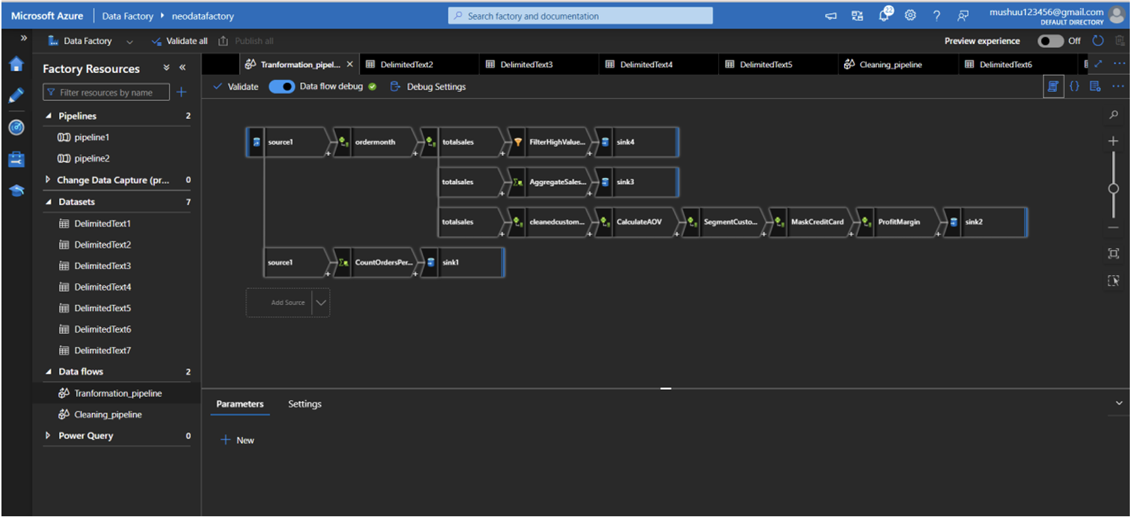
DATAFLOW TRANSFORMATION PIPELINE

Slide 10
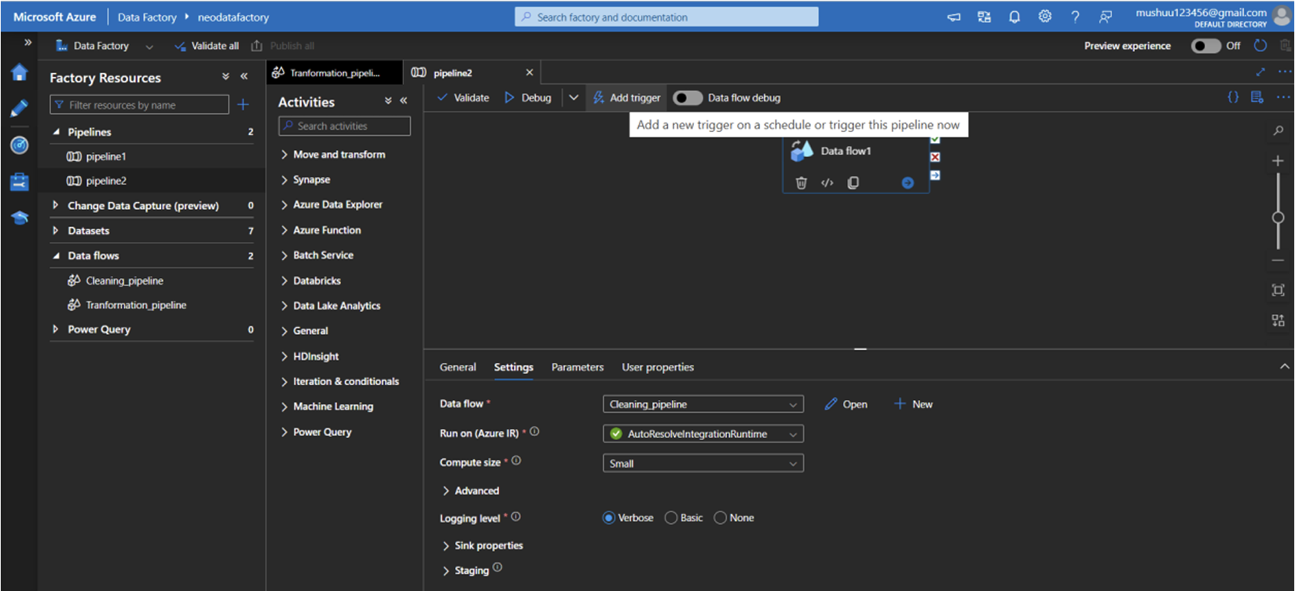
Triggering cleaned_pipeline

Slide 11
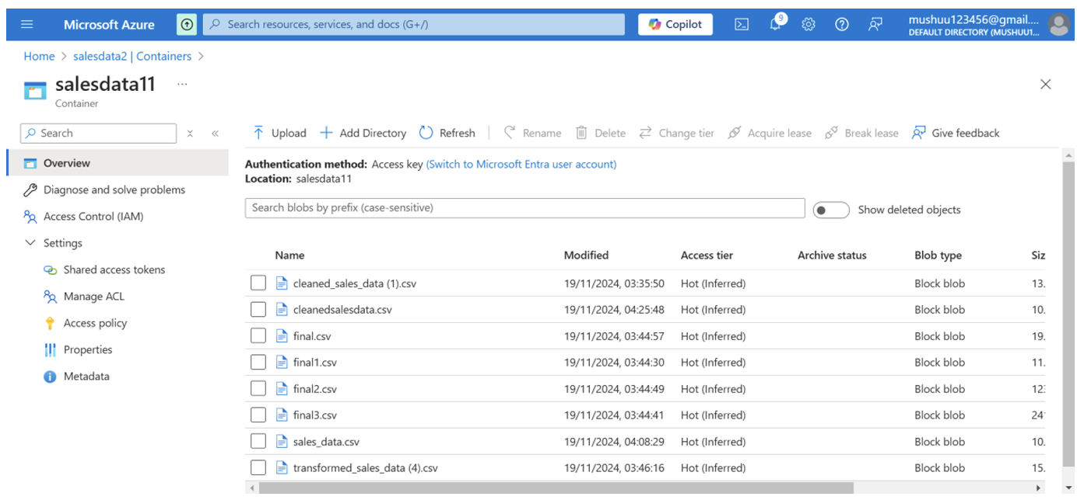
The saved files are in azure data lake storage:

Slide 12
Key Scripts/Steps
Sample Code Highlights:
Python script to upload raw data to Azure Data Lake Storage.
ADF pipeline steps for cleaning and transformation logic.
Core Transformation Logic:
Add derived columns (TotalSales, CustomerSegment).
Mask sensitive fields (e.g., Credit Card Number).
Aggregate sales for location-based insights.

Slide 13
Power BI Dashboard
Key Metrics:
Total Sales, Product Performance, and Customer Segmentation.
Sample Visuals:
KPI Chart: Total Sales.
Line Chart: Monthly Sales Trends.
Donut Chart: Customer Segment Distribution.
Treemap: Sales by Location.
Interactive Filters:
Filter by Date, Product, and Location to explore trends.

Slide 14
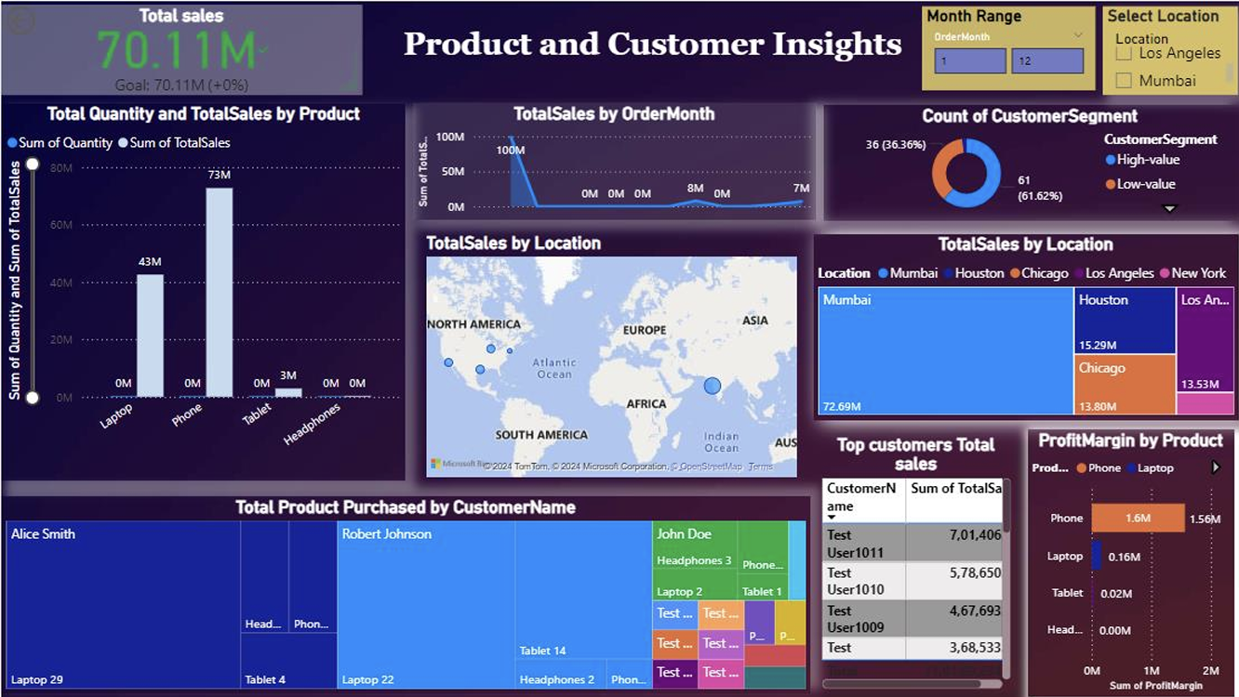
Power BI dashboard

Slide 15

.TOTAL SALES
Total Sales Achieved: The organization successfully achieved its sales target of 70.11M, reflecting strong performance.
Goal Comparison: The exact match of target and achievement highlights precise planning and execution.
Positive Indicator: The green checkmark confirms the target was met with no shortfall.
Stability in Performance: Accurate projections demonstrate effective forecasting and operational consistency.
Future Focus: Set higher sales goals to drive growth and challenge the team for better performance.

Slide 16
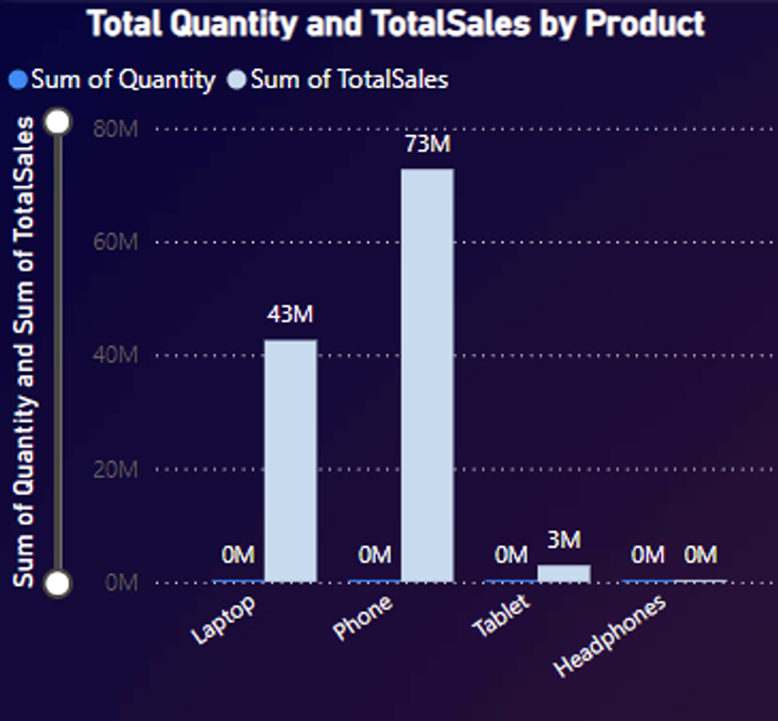
Product Sales Performance
Phones Lead in Revenue: Despite a moderate quantity sold (834 units), phones generate the highest revenue at 72.71M, indicating a high price point and strong demand.
Laptops Drive Volume: Laptops sold the most in quantity (2674 units) and contributed significantly to revenue (42.57M), suggesting they are a consistent revenue driver.
Low Impact of Headphones: Headphones have minimal revenue (23K) and higher quantity sold (56 units), showing low pricing and limited market traction.
Tablet Underperformance: Tablets sold 680 units but generated only 2.88M, indicating potential pricing issues or a declining market share.
Focus Areas: Prioritize phones and laptops as primary revenue contributors while revisiting pricing and strategies for headphones and tablets.

Slide 17
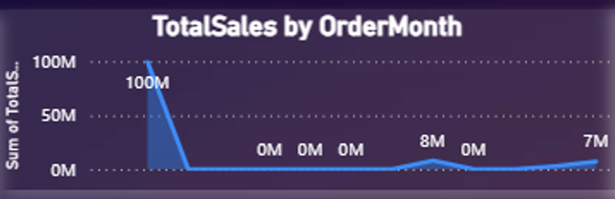
Monthly Sales Trends
Peak in January: January saw a dramatic sales spike at 100M, likely due to seasonal or promotional factors.
Sales Decline: After January, sales plummeted significantly, staying near zero for several months.
Small Recovery in Later Months: Modest sales were observed in March (7.86K) and May (7.64K), showing slight recovery.
Seasonal Dependence: The data suggests sales rely heavily on specific periods, indicating a need for consistent promotional efforts year-round.
Focus Area: Investigate what drove the January sales surge and apply similar strategies to other months to stabilize performance.

Slide 18
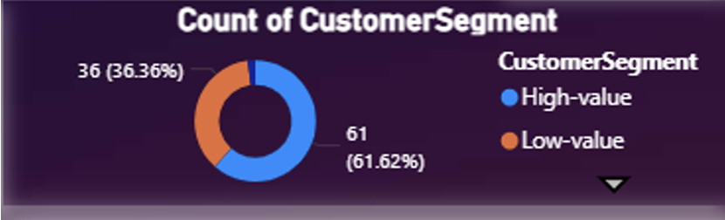
Customer segmentation to high or low based on their total purchase
High-Value Customers Dominate: The majority of customers (61.62%) belong to the high value segment, indicating a significant focus on premium buyers.
Low-Value Customers Follow: Low-value customers make up 36.36%, suggesting a smaller but notable market segment.
Negligible Medium-Value Presence: The medium-value segment is almost non-existent (2 customers), highlighting a potential gap in mid-tier offerings.
Strategic Opportunity: Strengthen engagement with high-value customers while exploring growth opportunities in the medium-value segment.

Slide 19
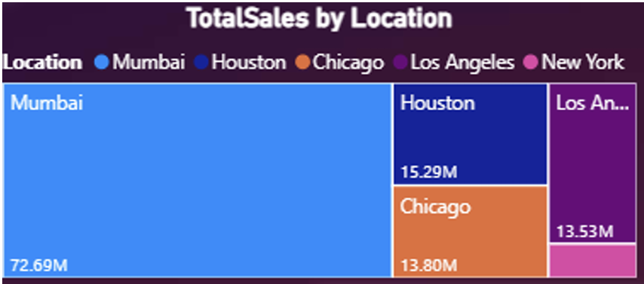
Total Sales by Location
Mumbai Leads in Sales: Mumbai dominates with 72.69M in total sales, making it the top performing location.
Houston and Chicago Perform Well: Houston (15.29M) and Chicago (13.80M) contribute significantly to overall sales.
Low Contribution from New York: New York has the lowest sales at 2.89M, highlighting an underperforming market.
Strategic Focus Needed: Prioritize Mumbai for sustained growth while exploring strategies to boost sales in New York and other regions.

Slide 20
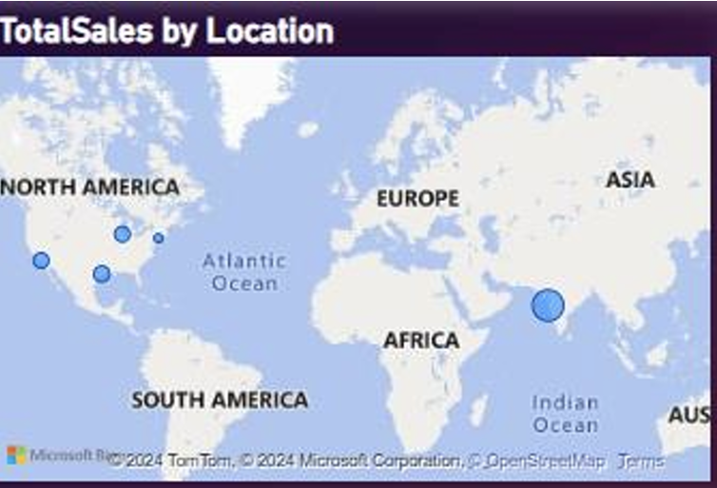
Geographic Distribution of Total Sales
Mumbai as a Sales Hub: The largest marker on the map indicates Mumbai as the leading contributor to total sales globally.
North American Presence: Moderate sales are observed in locations like Houston, Chicago, Los Angeles, and New York, showing a consistent market in the U.S.
Underrepresented Regions: Europe, Africa, and Australia lack representation, highlighting potential untapped markets.
Strategic Growth: Focus on expanding successful strategies in North America to underrepresented regions while strengthening dominance in Mumbai.

Slide 21
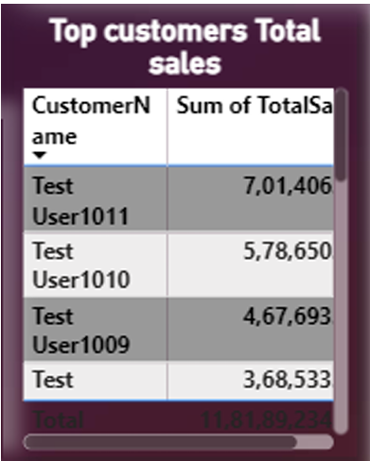
Top Customers Driving Total Sales
Major Contributor: "Test User1001" is the top customer, contributing a significant 70.11M to total sales.
Diverse Customer Base: Other notable contributors, such as "Robert Johnson" and "Alice Smith," contribute 24.48M and 20.99M, respectively.
Smaller Impact Customers: Test users like "User1011" and "User1010" contribute significantly less, reflecting their smaller purchasing capacity.
Focus Area: Retain and prioritize top customers while identifying strategies to increase sales from mid-tier contributors

Slide 22
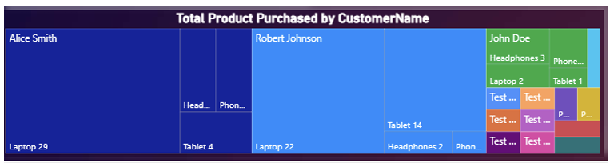
Product Purchases by Customer
Alice Smith Leads: Alice Smith is the top buyer, purchasing 29 laptops and a small number of other products, reflecting a preference for high-value items.
Diverse Buying Patterns: Robert Johnson shows a more balanced purchase pattern, buying 22 laptops and 14 tablets, indicating interest in multiple product categories.
Smaller Contributions: Customers like John Doe and test users make smaller purchases, focusing on lower quantities and varied products.
Insights for Strategy: Focus on retaining high-value customers like Alice Smith and Robert Johnson while encouraging more diverse purchasing patterns among smaller buyers.

Slide 23
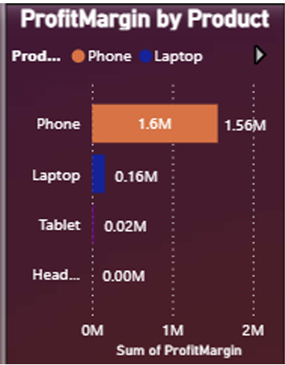
Profit Margin by Product
Phones Lead in Profitability: Phones generate the highest profit margin at 1.56M, showcasing their significant contribution to overall profitability.
Laptops as Secondary Contributors: Laptops follow with a profit margin of 0.16M, indicating steady but lower profitability compared to phones.
Minimal Profits from Tablets and Headphones: Tablets and headphones contribute negligible profit margins (23K and 790, respectively), indicating limited revenue impact.
Strategic Focus: Prioritize phones for profitability and explore opportunities to improve margins for laptops, tablets, and headphones

Slide 24
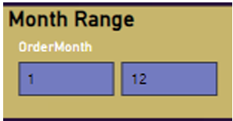
Interactive Month-Based Sales Analysis
Drill-through Feature: The chart allows users to drill through and filter sales data dynamically by selecting specific months, enabling detailed month-based insights.
Custom Month Range: The "Month Range" slicer allows users to focus on specific periods (e.g., January to December) to analyze sales trends for tailored reporting.
Enhanced Flexibility: Keeping all filters ensures consistency when navigating between reports, making it easier to compare and interpret seasonal trends.
Strategic Use: Utilize this feature to identify peak sales months and design targeted promotional strategies accordingly.

Slide 25
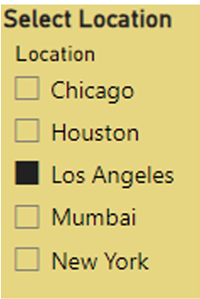
Location-Based Filtering for Sales Analysis
Interactive Location Selection: Users can filter data by selecting specific locations (e.g., Los Angeles), providing a focused view of sales performance in a chosen area.
Drill-through Enabled: The drill-through feature ensures that location-specific insights carry over across related reports, maintaining consistent filtering.
Targeted Insights: This flexibility allows businesses to analyze regional sales trends and identify underperforming or high-performing locations.
Strategic Use: Use this tool to tailor marketing efforts and resource allocation based on location-specific performance.

Slide 26
Results & Insights
Sales Trends:
Peak sales in January with seasonal dependency identified.
Customer Segmentation:
61% of customers are high-value buyers, driving significant revenue.
Product Performance:
Phones are the most profitable, while tablets underperform.

Slide 27
Security Measures
Data Storage Security:
RBAC for controlled access.
Encryption for data at rest and in transit.
Data Masking and Monitoring:
Mask sensitive fields (e.g., Credit Card Numbers).
Enable logging and alerts for pipeline activity monitoring.

Slide 28
Conclusion
Project Achievements:
Successfully built a scalable and secure data pipeline.
Delivered interactive Power BI dashboards for insightful decision-making.
Ensured compliance with data privacy regulations.
Future Enhancements:
Expand to include additional data sources.
Introduce predictive analytics and machine learning.

Slide 29

Thank You
mushuu123456@gmail.com

