Slide 1
Design and Verification of a Watchdog Timer Extension for RV32I Processor
EE-321: Computer Architecture and Organization
Presented By:
Ibraheem Hasnain (412444)
Aneeq ur Rehman (418794)
Agha Mushaf Raza (423074)

Slide 2



Motivation
To enhance RV32I processor reliability by automatically detecting software hangs and recovering the system using a hardware watchdog timer

Slide 3

Project Objectives
Hardware Watchdog Design
Software Hang Detection
Watchdog Interrupt Generation
Processor Reset Mechanism
RTL Simulation and Verification
RV32i Pipeline Integration

Slide 4
RV32I Overview & System Architecture
RV32I Overview:
  5-stage pipelined architecture: IF, ID, EX, MEM, WB
  Minimal and extensible RISC-V ISA
  Supports hardware extensions
System Architecture (before Watchdog):
  RV32I Pipeline Core
  Separate Data Path and Control Path
  Modular and extensible for future safety modules

Slide 5


Watchdog Timer Design and Operation
Independent hardware module
Internal counter increments every clock cycle
Feed signal resets counter during normal execution
Timeout triggers Watchdog Interrupt (WDT_IRQ)
Extended timeout triggers Watchdog Reset (WDT_RST)

Slide 6
Pipeline Integration & Watchdog Signal Flow
Pipeline Integration
No interference with normal pipeline instruction flow
Reset safely clears pipeline registers
Interrupt provides early fault warning to processor
Control & Signal Flow
Watchdog feed from processor during normal execution
Outputs: WDT_IRQ, WDT_RST
Reset signal integrated with pipeline and PC registers

Slide 7
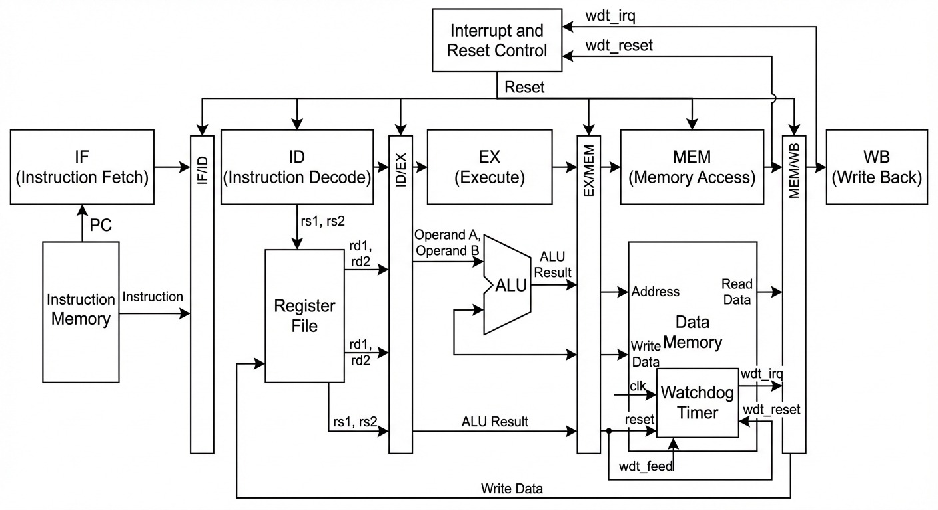
Microarchitectural diagram

Slide 8

Testbench And Verification
Custom RTL testbench for pipeline + watchdog
Cycle-by-cycle monitoring of all pipeline stages
Logs watchdog events: WDT_IRQ & WDT_RST
Detects software hangs and timeouts
Verifies correct pipeline operation under reset

Slide 9
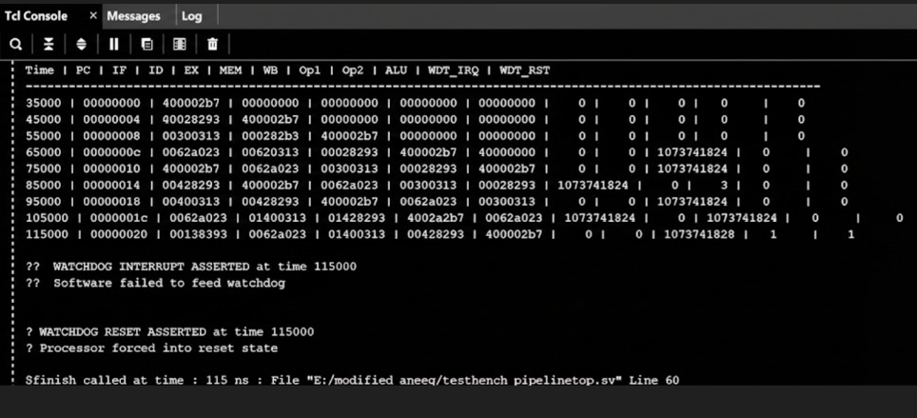
Simulation RESULTS WDT-1

Slide 10
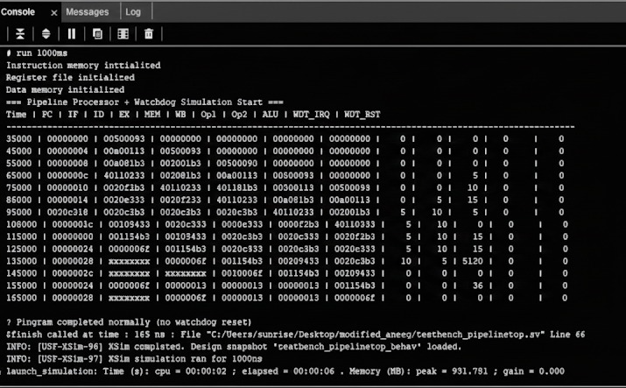
Simulation RESULTS WDT-0

Slide 11
Enhancing RV32I Reliability: Key Takeaways
  Watchdog successfully integrated with RV32I Pipeline
  Early Fault Detection Via Interrupt
  Safe Processor Recovery using Watchdog Reset
  Improve Processor Reliability and Fault Tolerance
  Verified through RTL Simulation

Slide 12
THANK YOU!

