Slide 1

PROG6212 POE Part3
Student Number: ST10443516
Presentation Topic
Contract Monthly Claim System
Digital workflow for lecturer Claim Management

Slide 2
What this Presentation covers
Key system updates from part 2 to part 3
Full walk through of the CMCS user journey
Visual demonstration of all major features
UX/UI Improvements
The system value and impact

Slide 3
Part 2
Core Features of Part2
Lecturer Functionality
  Submit monthly claims
  Upload supporting documents
  View (Track) list of submitted claims
Coordinator Functionality
  View pending claims
  Approve or reject lecturer claims
Manager Functionality
  View coordinator-approved claims
  Approve or reject them
Database & Models Built
  Claims, Documents, Users, User Roles
Basic UI & Bootstrap Layout
  Tables, forms, and buttons functioning but minimal design

Slide 4
Part 3
Core Features of Part3
Added HR who is a super user
Login & Sessions
Auto-calculation for lecturers
Secure role based access
PDF GENERATOR
Removal of manual rate entry

Slide 5
System Architecture Overview
User Roles & Workflow:
Lecturer → Coordinator → Manager → HR → PDF Reports
Functional Flow:
Lecturer submits claim + uploads evidence
Coordinator validates & approves/rejects
Manager reviews coordinator-approved claims
HR completes administrative processing + manages user accounts
System generates PDF reports for auditing
Technologies Used:
ASP.NET Core MVC
SQL / EF Core / Azure Storage
Bootstrap 5
QuestPDF for reporting

Slide 6
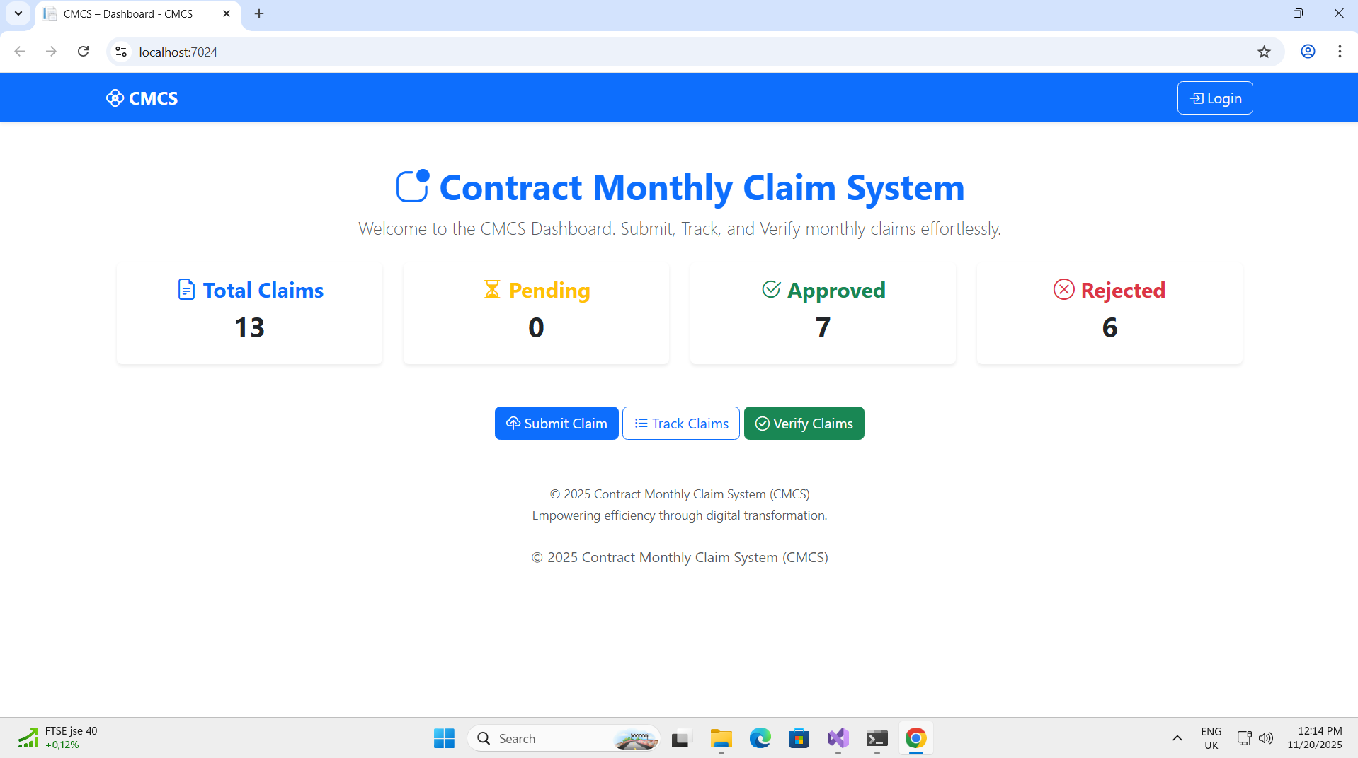
Home Dashboard.

Slide 7
Home Dashboard
Features of the Home dashboard
Instant overview of user activity
Login button
Summary cards:
  Total Claims
  Pending Claims
  Approved Claims
  Rejected Claims
Personalized greeting for logged-in user
Clean Bootstrap card styling

Slide 8
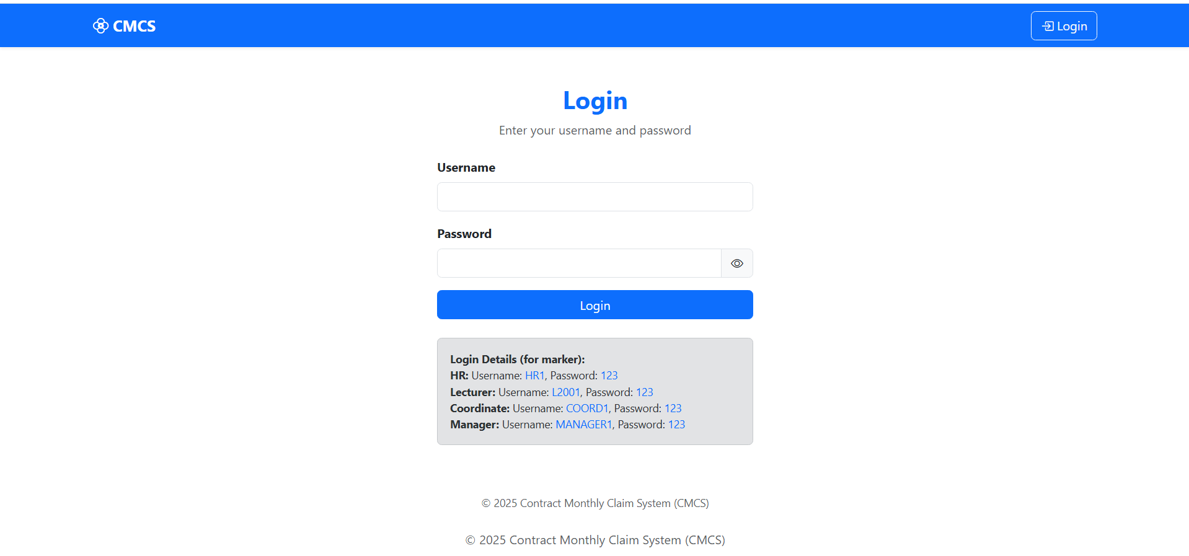
Login screen

Slide 9
Login Screen
Features of the login page
Clean, professional login layout
“Show/Hide Password” eye icon for accessibility
User role-based redirection after login
Validation messages for incorrect credentials
Secure handling of sessions

Slide 10
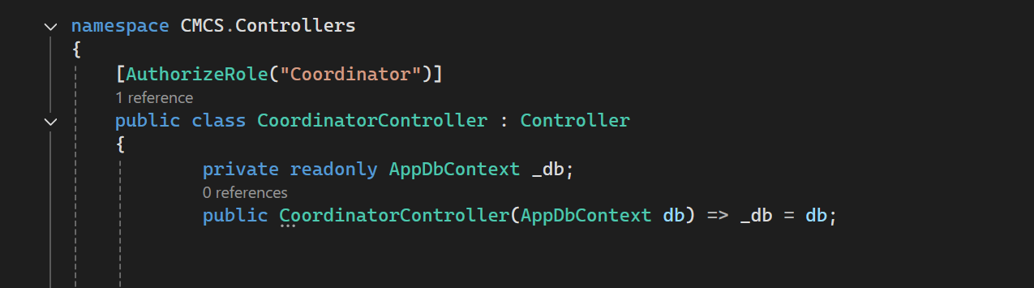
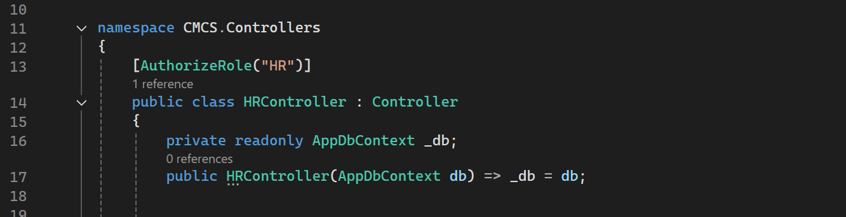
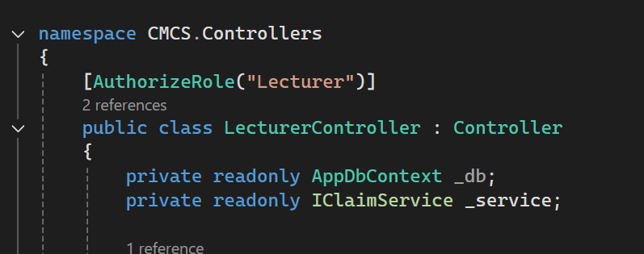
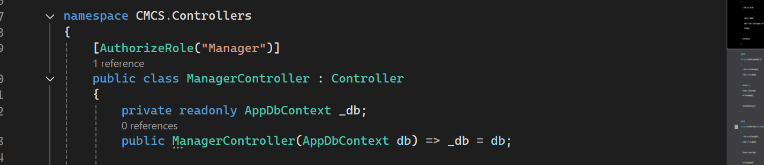
Sessions + Role-Based Access Control
Users can only access screens meant for their role.
HR → User management
Lecturer → Submit + Track
Coordinator → Verify
Manager → Approve & Pay
Explain Under Screenshot
Each controller action is restricted
If a user attempts to access another role’s page → access denied

Slide 11
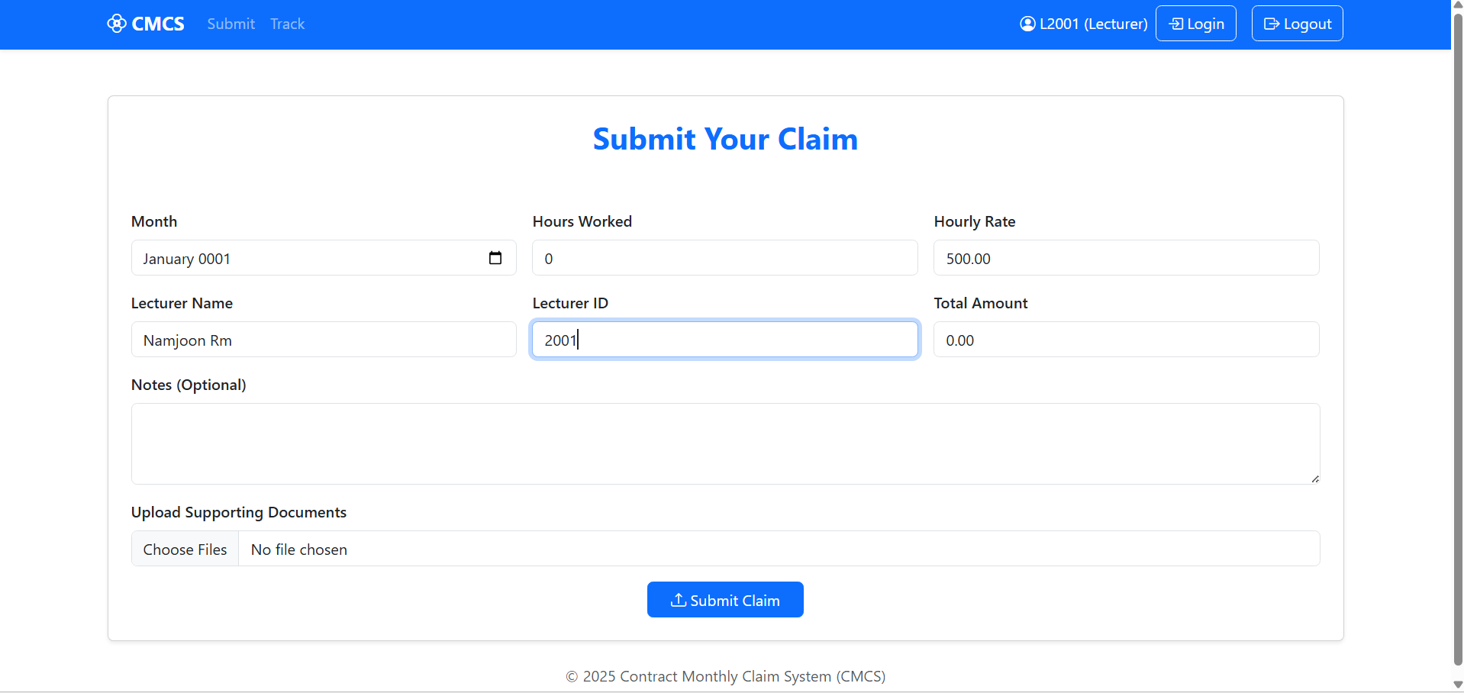
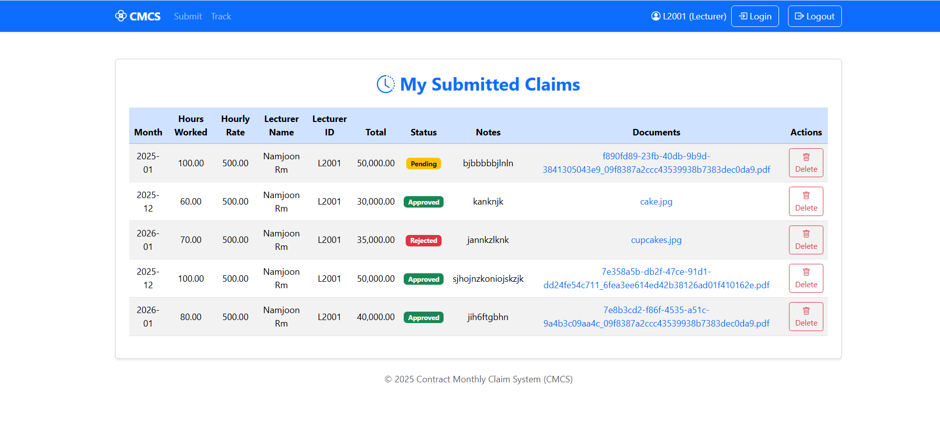
Lecturer Page
Submit Claim Page
Track Claim page

Slide 12
Lecturer Page
Submit Claim
Track Claim Page
What the Page Shows:
Input for Month, Hours Worked, Notes
File upload for evidence (JPEG/PDF/PNG)
Auto-total calculation
Rate is added on the HR page
Name is auto added from HR page
Limits only to 180 hours per month
What the Page Shows:
Interactive table with claims
Status badges (Pending, Approved, Rejected)
Downloadable evidence links
Delete option for pending claims
Accurate totals per month

Slide 13
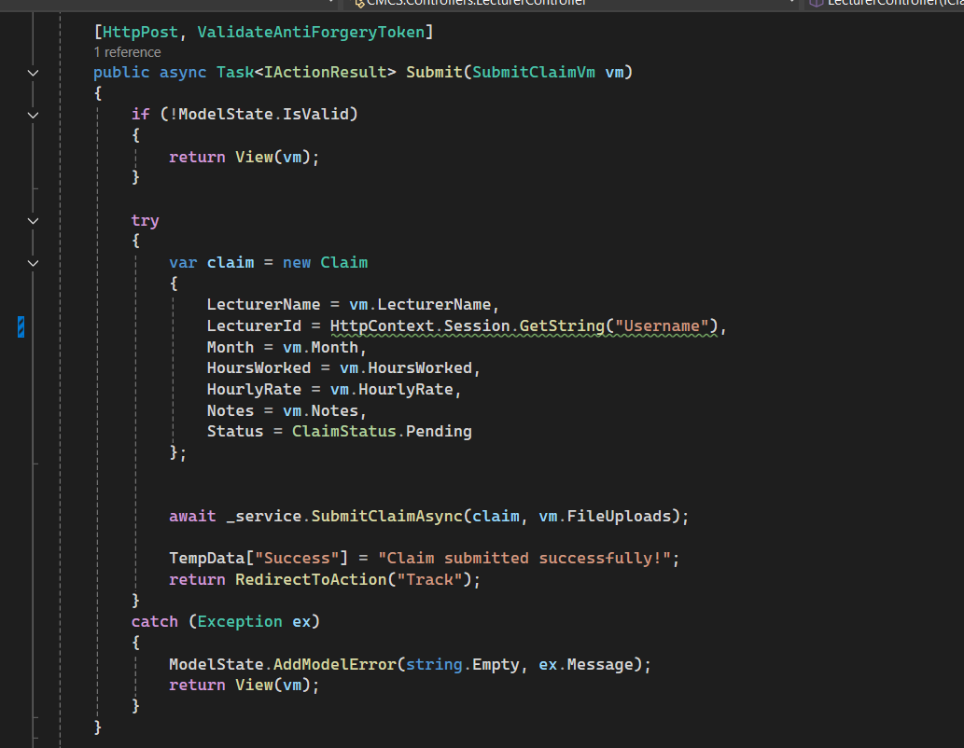
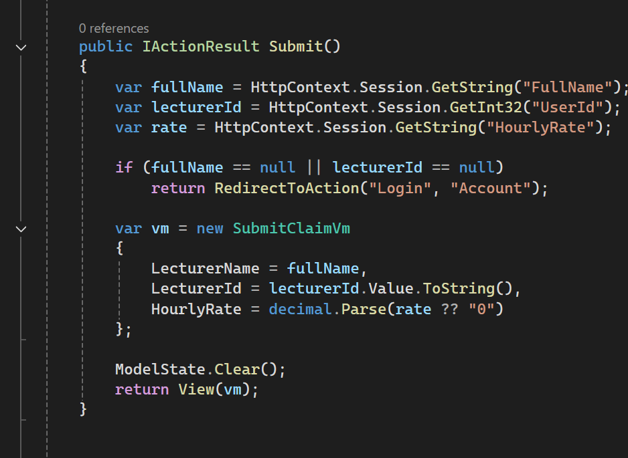
Lecturer Data Pull
LecturerController → SubmitClaim()
Explaintation of Screenshot
System fetches Lecturer HourlyRate, Name, ID from DB
Only HoursWorked + Notes are entered manually

Slide 14
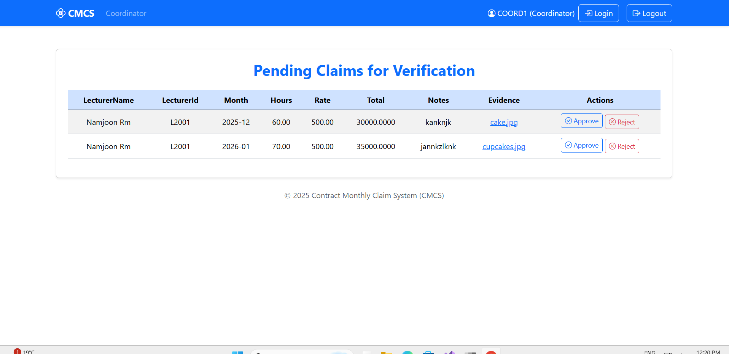
Coordinator Page
Features :
Holds the pending claims from the Lecturer
Approve or Reject
Notes & document preview
Clearly labelled tables

Slide 15
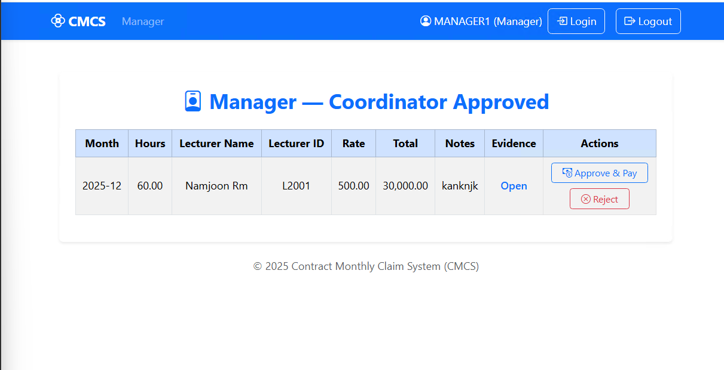
Manager:
Coordinator-Approved Claims
Features
Hold the approved claims from the coordinator
Approve & Pay
Reject with a click
Access to documents and notes

Slide 16
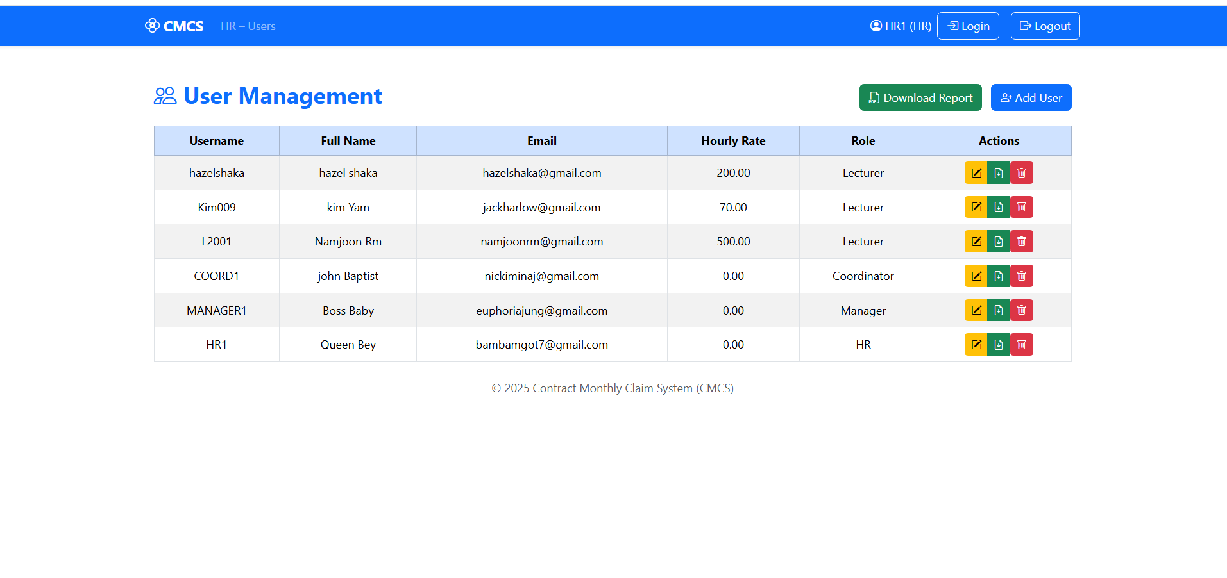
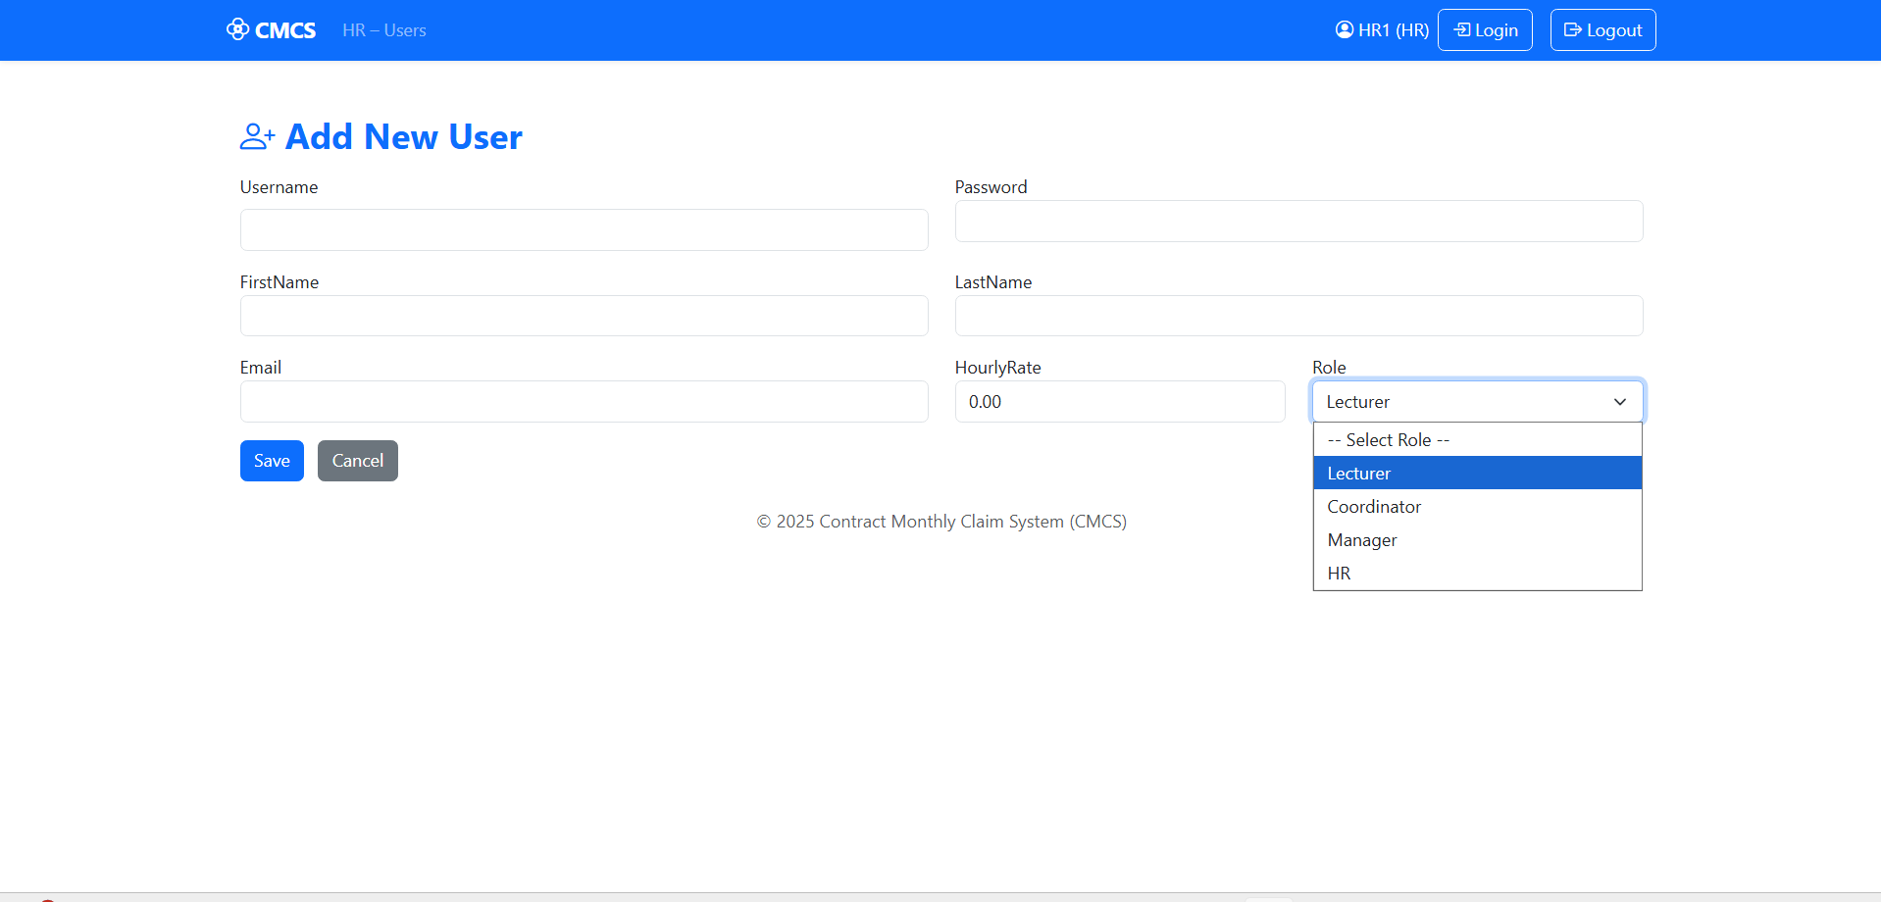
HR Page
HR Index Page
HR Create New User Page

Slide 17
HR Page
HR index page
HR Create New User
Add users
Edit users
Delete accounts
Access PDF reports
Create username
Add password
Add the users rate
The users email
Adding the role

Slide 18
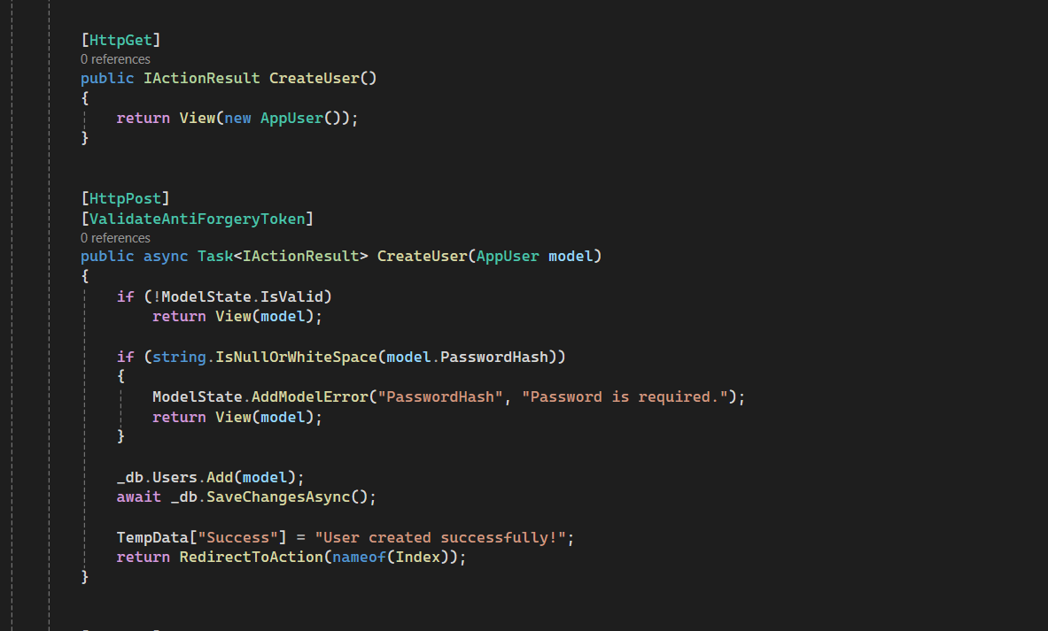
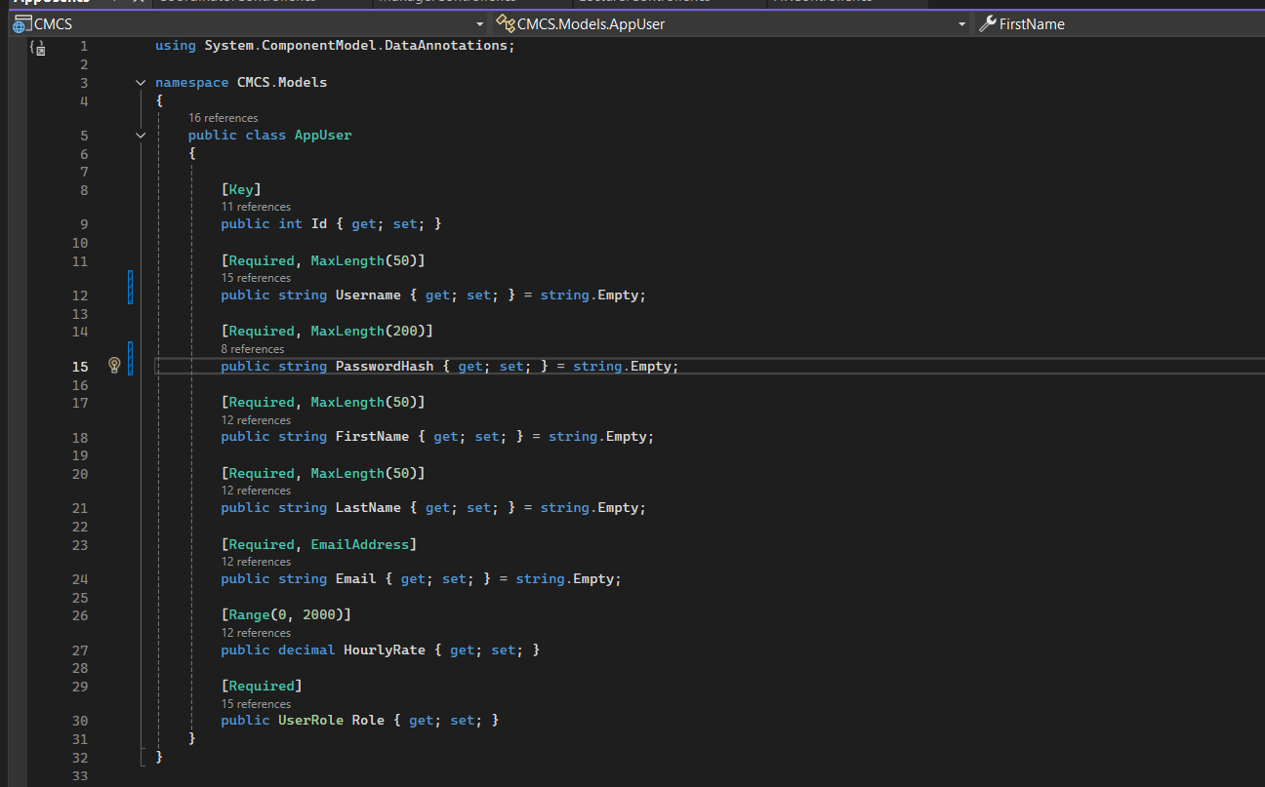
HR Creates & Manages All Users
Screenshot your HRController.cs → Create() method
Screenshot the EF Model AppUser.cs
Explaintation of Screenshot
Shows HR creating users with name, username, role, hourly rate
Password hashing or default password assignment
Role assignment logic

Slide 19
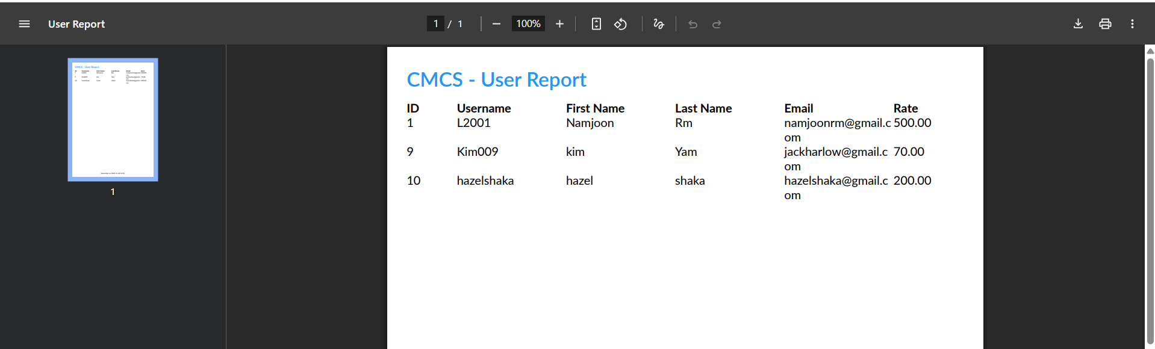
Pdf generated by HR

Slide 20
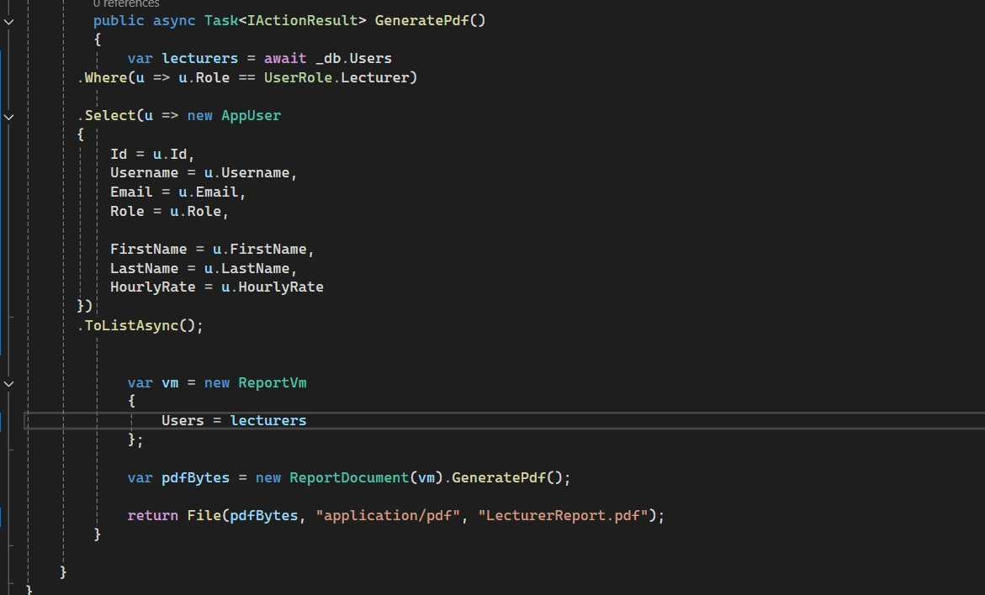
HR Generates Reports (PDF)
The GeneratePdf() method
Explaintation of Screenshot
System loads all users or claims
Renders them into a structured PDF
HR can download with one click

Slide 21
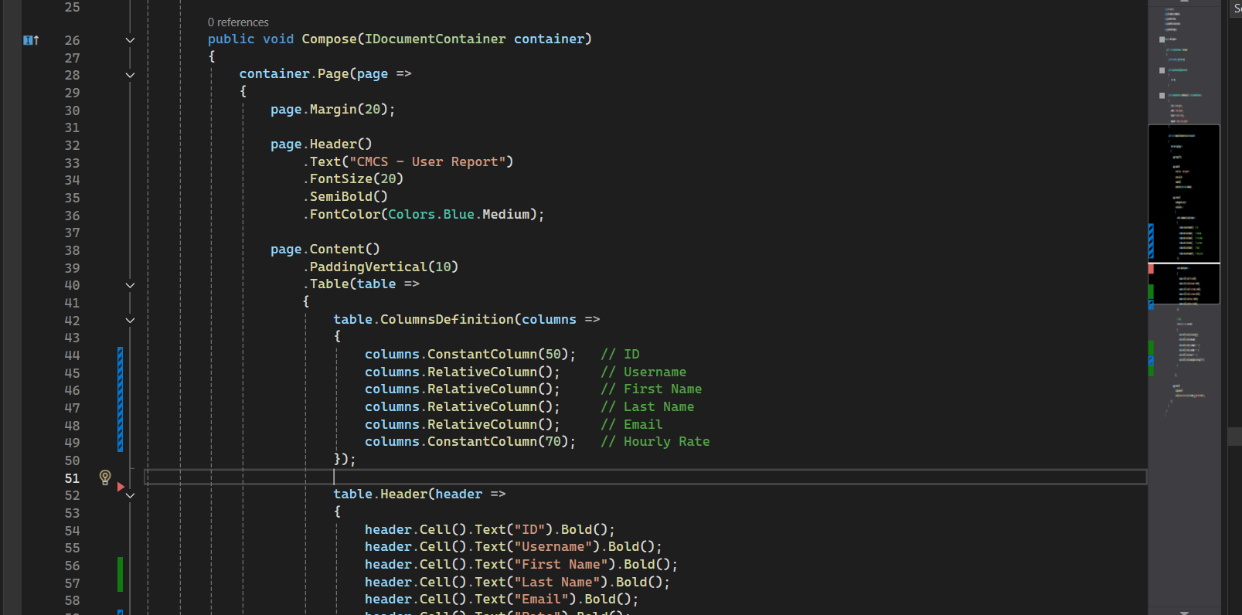
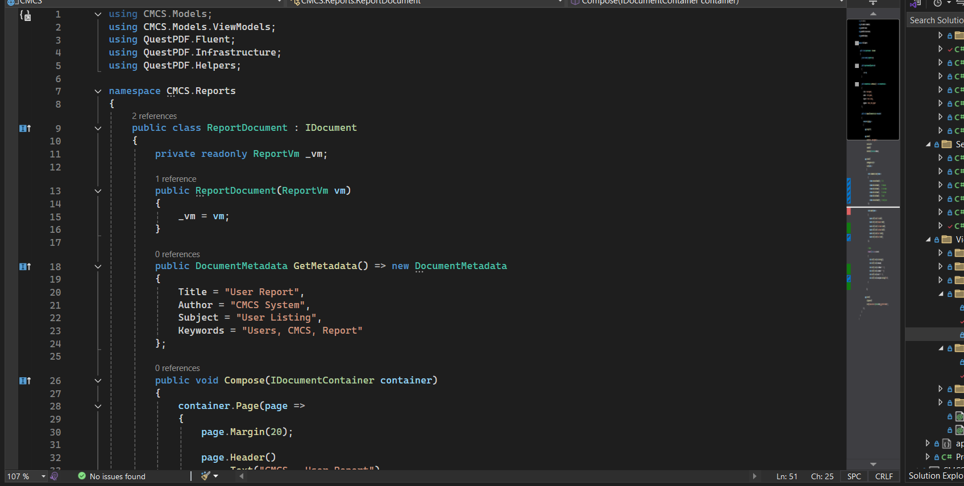
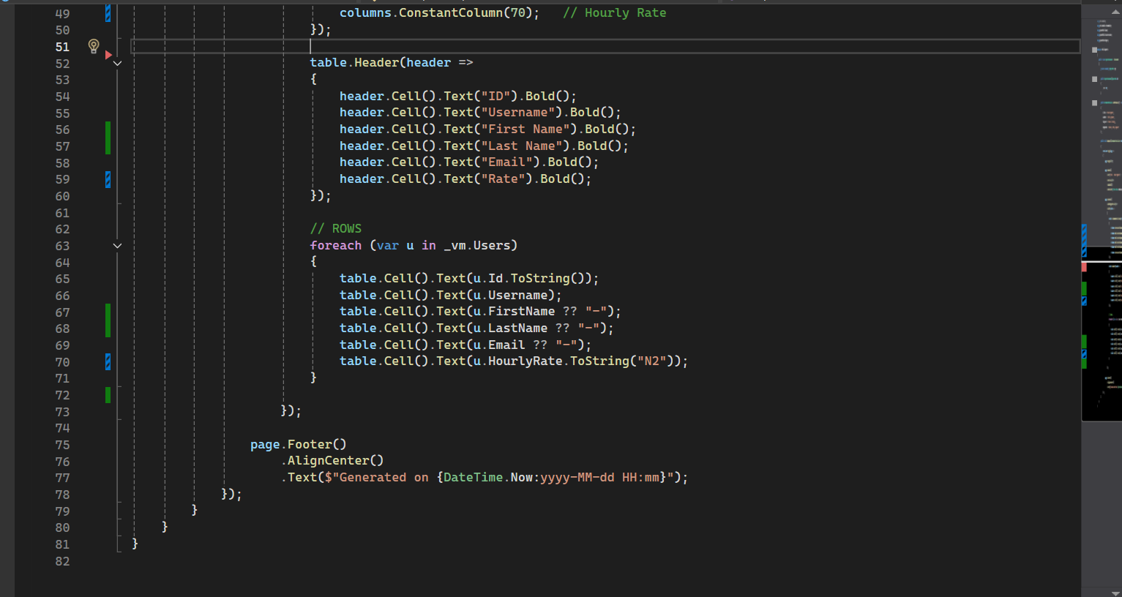
The QuestPDF document layout class
Explaintation of Screenshot
System loads all users or claims
Renders them into a structured PDF
HR can download with one click

Slide 22
Full System Demonstration Summary
The CMCS System has :
Full claim workflow from submission to payment
Multi-role approval chain
Secure authentication
Evidence management
PDF reporting
Robust search
Clean, user-friendly interface

