Slide 1
BIASLENS
MULTI-PERSPECTIVE NEWS INTELLIGENCE
See the story
behind the story.
A cross-spectrum reading desk for contested news.
15 configured outlets
TinyFish retrieval
source-linked analysis
github.com/Musharraf1128/BiasLens
Notes:
Project source: README.md and BIASLENS_BUILD_SPEC.md Part 1. This slide describes the product scope, not a live result.

Slide 2
The reading problem
One event.
Many versions.
THE SAME STORY
UNDER DIFFERENT LIGHT
SHARED FACTS
The first headline sets the frame. BiasLens widens the first read by placing coverage from different editorial positions in the same view.
What appears across the coverage set
FRAMING
What changes in emphasis, language, and context
A better first question
BiasLens keeps the distinction visible.
What do the sources agree on, and where does the framing change?
Notes:
Project source: README.md, BIASLENS_BUILD_SPEC.md Part 1, and the product language in the current Top News UI. No specific news event is presented as a verified finding here.

Slide 3
The analysis pipeline
From headline to evidence
Retrieval comes first. Structured analysis follows. Every result carries its trail.
01
02
03
04
05
TOPIC / URL
TINYFISH SEARCH
TINYFISH FETCH
STRUCTURED JSON
CONSENSUS + FRAME
A story enters the desk
Find relevant public coverage
Read and check the sources
Validate each LLM stage
Show facts and differences
Guardrails
Public pages only · excerpts capped at 25 words · invalid output becomes unavailable
Notes:
Project sources: BIASLENS_BUILD_SPEC.md Part 1; README.md; TinyFish retrieval and structured-output modules in the repository. The pipeline wording preserves the project's explicit guardrails.

Slide 4
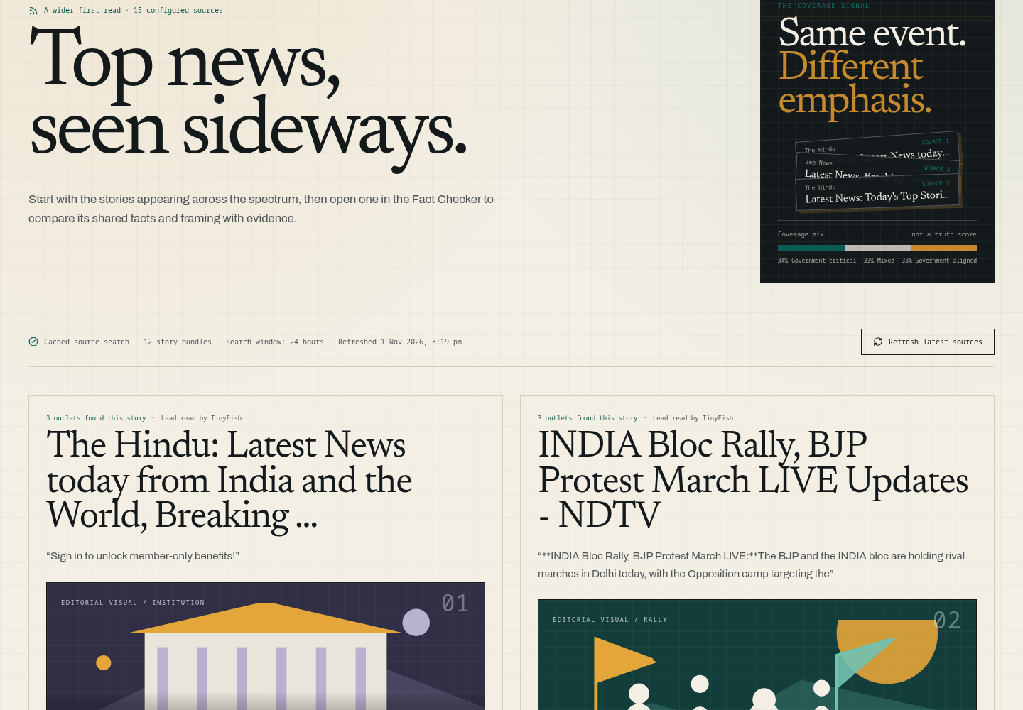
The product, in one screen
Top News turns the source list into a reading surface.
STORY BUNDLE
Multiple outlets appear together, so the reader sees the event before choosing a frame.
SOURCE TRAIL
Open the representative source, inspect the coverage mix, then move into the Fact Checker.
Current UI screenshot from the BiasLens workspace
Notes:
Visual source: /tmp/biaslens-two-column-final.png, captured from the BiasLens Top News page during local UI validation. Product claims are grounded in README.md and the current implementation.

Slide 5
Trust is part of the interface
Built for disagreement,
not false certainty.
15
configured outlets
Top News · Fact Checker · TinyFish
01
Every result stays source-linked
02
Evidence excerpts cap at 25 words
github.com/Musharraf1128/BiasLens
03
Blind spots require a verified absence check
A reading desk for contested stories
04
Unavailable means unavailable
Notes:
Project sources: README.md and BIASLENS_BUILD_SPEC.md Part 1. The final slide summarizes implemented guardrails and configured product scope; it does not claim that every source is available for every story.

