Slide 1
E-commerce Product Return Rate Analysis:
Unlocking Performance & Profitability
Insights from Your Sales Data
Musharraf Hussain Khan
Date: 30-06-2025

Slide 2
Understanding the Impact of Product Returns
Returns are an inherent part of e-commerce, but they come with significant costs:
Lost Revenue
Operational & Logistics Overhead
Potential Customer Dissatisfaction
Our Objective: To leverage data to identify:
Overall return trends and scale
Specific products, periods, or regions driving returns
Actionable insights to reduce returns and improve profitability

Slide 3
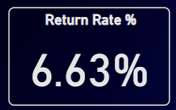
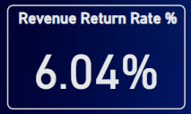
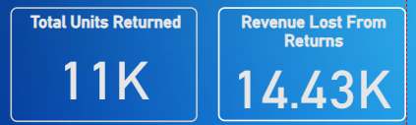
Current Return Performance: The Big Picture
Overall Unit Return Rate: 6.63%
→ Nearly 7 of every 100 units sold are returned
Overall Revenue Return Rate: 6.04%
→ Over 6% of gross sales revenue is lost due to returns
Absolute Impact:
- Total Units Returned: 11K
- Total Revenue Lost: ₹14.43K
Key Takeaway: Modest percentages, but high absolute losses = clear opportunity.

Slide 4
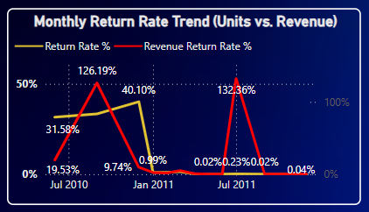
Monthly & Daily Return Rate Trends
Monthly Trend:
- Initial volatility (e.g., July 2010: 126.19%)
- Stabilized by Jan 2011 (0.02%–0.04%)
Daily Patterns:
- Spike in return rates on Thursdays (38.60%)
- Other days far lower (e.g., Tuesday: 0.17%)
Insight: Investigate Thursday-specific issues (logistics or behavior).

Slide 5
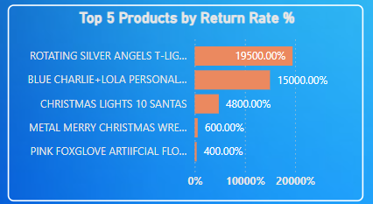
Identifying Our Top Return-Driving Products
High Volume:
- 'ROTATING SILVER ANGELS T-LIG...' → 9.4K returns
High Proportional:
- 'ROTATING SILVER ANGELS T-LIG...' → 19500%
- 'BLUE CHARLIE+LOLA PERSONAL...' → 15000%
Insight: Possible quality issues, misleading descriptions, or shipping damage.
Combo View: Helps assess return rate vs sales volume.

Slide 6
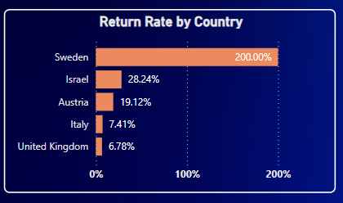
Geographical Hotspots for Returns
United Kingdom:
- Primary market, manageable rate (6.78%)
Anomalies:
- Sweden: 200.00%
- Israel: 28.24%
Insight: Indicates potential logistics, customs, or expectation mismatches.

Slide 7
Actionable Recommendations to Reduce Returns
1. Product Deep Dive:
- Focus: 'ROTATING SILVER ANGELS T-LIG...'
- Review: Quality, description, shipping
2. Optimize Thursdays:
- Review processes for spikes on this day
3. Geographical Variances:
- Investigate Sweden, Israel issues
4. Continuous Monitoring:
- Use dashboard to stay ahead of trends

Slide 8

Questions & Discussion
Thank you for your time and attention.
We can also dive deeper into specific data points or filters on the live dashboard.

