Slide 1



Xi’an Jiaotong Liverpool University
CPT204 – Advanced OOP Programming
Coursework 3 - Group Project
PRESENTED BY: Group 79
Junhao Huang: 2256792
Ruiyang WU: 2257475
May 18th, 2025

Slide 2



Part I
Overview
Introduction
& Background
Part II
Task A - Program Design of US road trip planner
Part III
Task B – Path Finding Algorithms
Part IV
Task C – City Name Sorting Algorithms Test
Part V
Task D – Project Reflection

Slide 3



Introduction & Backgrounds
Aim of the Task A & Task B
Implement algorithms that utilizes the path information from the initially provided CSV file, along with user-selected starting city, destination city, and waypoints, to ultimately calculate the best trip route with the shortest path.
Aim of the Task C
To do an independent sorting algorithm performance evaluation task that requires us to implement, test, and analyze three classic sorting algorithms

Slide 4
Introduction & Backgrounds
Task A – Program Design
GUI visualization
Plan the application framework, define the data models (City, Road, Graph), choose core data, design the GUI blueprint, and handle data input (CSV files).
Choose appropriate data structure
Design project with OOP concept
Task B – Pathfinding Algorithm
Dijkstra Algorithm
Implement core pathfinding logic, handle multiple waypoints, and ensure the shortest path is found with optimal time.
Tasks Overview
Floyd Algorithm
Task C – Sorting Tests
Insertion Sort
Implement and evaluate the performance of three sorting algorithms (insertion, quick, and merge) on different datasets and compare them with their theoretical complexity.
Quick Sort
Merge Sort
Task D – Project reflection

Slide 5
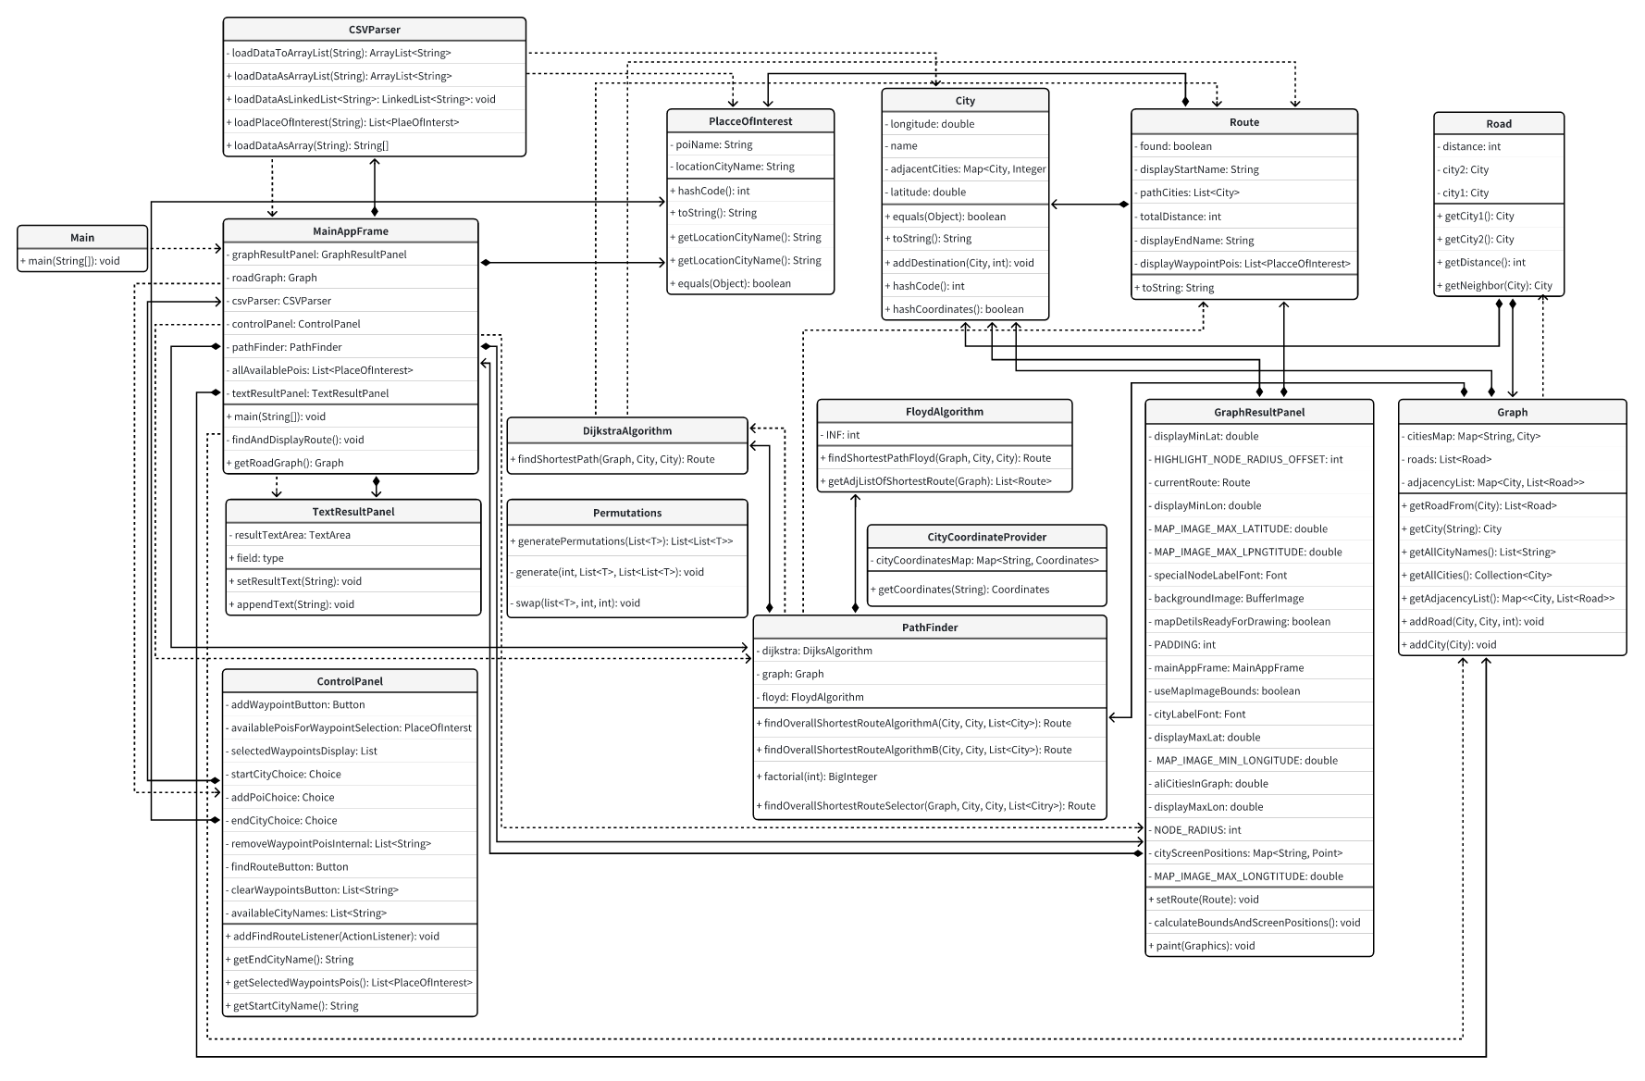
Task A – Program Design of US Road Trip Planner
Overall Program Design
The core of Task A is to design a robust and scalable program framework for our American road travel planner. We have adopted a modular layered architecture, which mainly includes the user interface layer, algorithm logic layer, data model layer, and data services and tools layer.
Task A & Task B Class Diagram
Architecture Diagram

Slide 6
Task A – Program Design of US Road Trip Planner
DijkstraAlgorithm.java
./algorithm - Implement core pathfinding logic to handle the shortest paths of single and multiple waypoints.
FloydAlgorithm.java
PathFinder.java
City.java
./model - Define core data objects related to road networks and paths.
Graph.java
PlaceOfInterest.java
Road.java
Route.java
./panel - user interaction, data input capture, multimodal display of results.
ControlPanerl.java
Architecture
GraphResultPanel.java
MainAppFrame.java
TextResultPanel.java
./parser - Read city and distance information from the provided CSV data file.
CsvParser.java
./util - Provide general city point coordinates and provide the information required for the algorithm to operate.
CityCoordinateProvider.java
Permutations.java

Slide 7
Task A – Program Design of US Road Trip Planner
Core Data Structure Selection
Map<City, List<Road>>– Adjacency list is chosen to represent sparse highway network;
Merit: Space efficient and fast neighbor traversal
Graph.java – Core of Road Network
Map<String, City> – Quickly locate City objects by city name;
Merit: O(1) Average search and ensure the uniqueness of the city
Core Data Structure
City Name; Coordination
City.java – City information and graph’s coordination
Map<City, Integer> – Stores the city and distance to which it is directly connected;
Merit: Fast retrieve speed.
List<PlaceOfInterest>– List of interests selected.
Route.java - Path result encapsulation
Start, end City

Slide 8
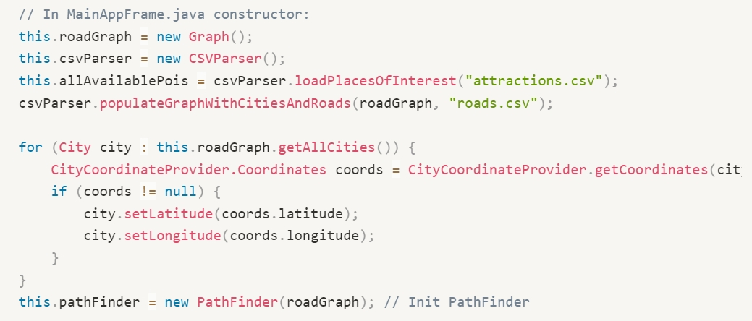
Task A – Program Design of US Road Trip Planner
Program workflow and main interactions
Startup & Data Preparation (MainAppFrame):
CSVParser → Load attractions.csv, roads.csv → Fill Graph.
CityCoordinateProvider → Set graph coordinates for City objects.

Slide 9
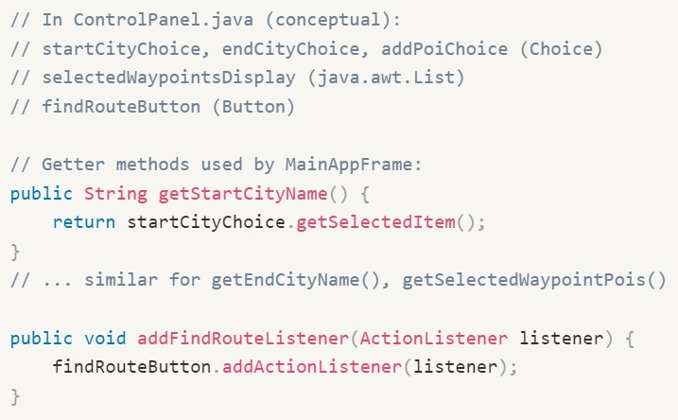
Task A – Program Design of US Road Trip Planner
Program workflow and main interactions
2. User input (ControlPanel):
Select Start Point, End Point, Route Point → Notify MainAppFrame

Slide 10
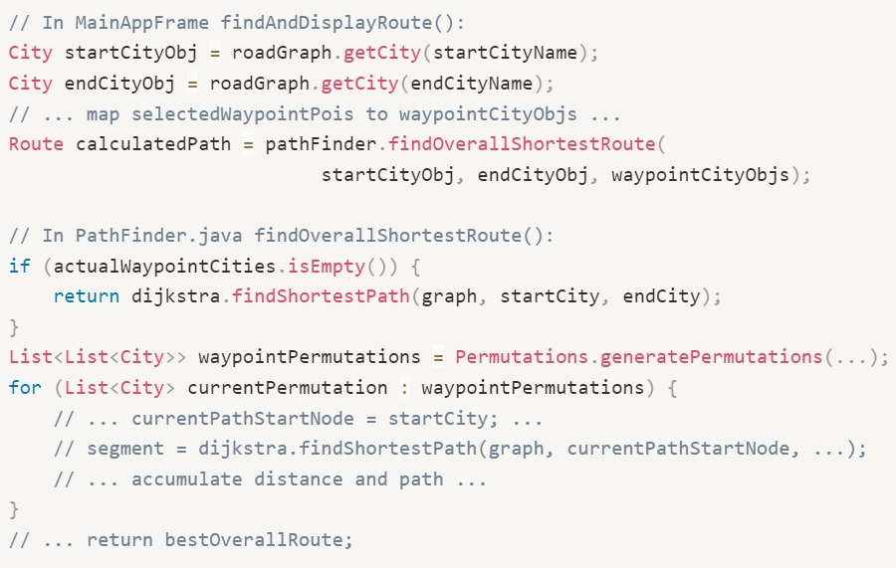
Task A – Program Design of US Road Trip Planner
Program workflow and main interactions
3. Path calculation (MainAppFrame -> PathFinder):
PathFinder → (if there are waypoints) Permutations & (loop calls) DijkstraAlgorithm → Generate Base Route

Slide 11
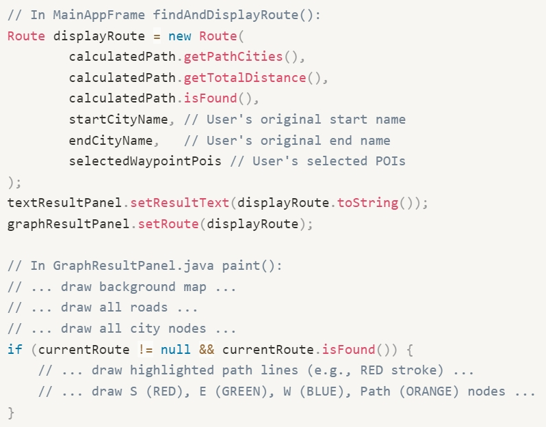
Task A – Program Design of US Road Trip Planner
Program workflow and main interactions
4. Results Processing and Display (MainAppFrame -> UI Panels):
MainAppFrame Rich Route Object (Supplements UI Context)
Route → TextResultPanel & GraphResultPanel

Slide 12
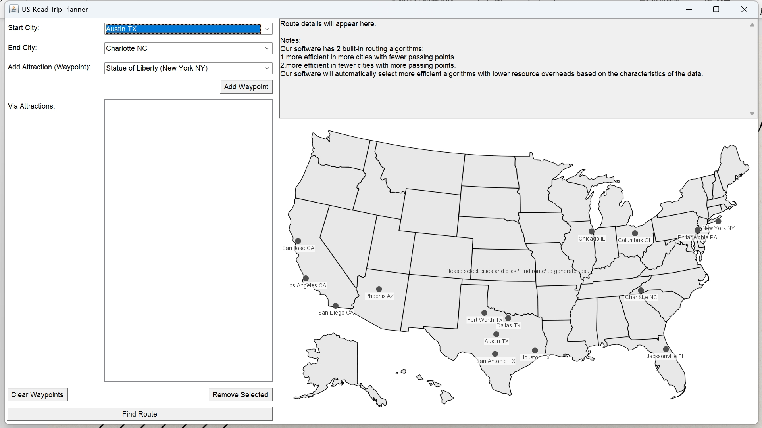
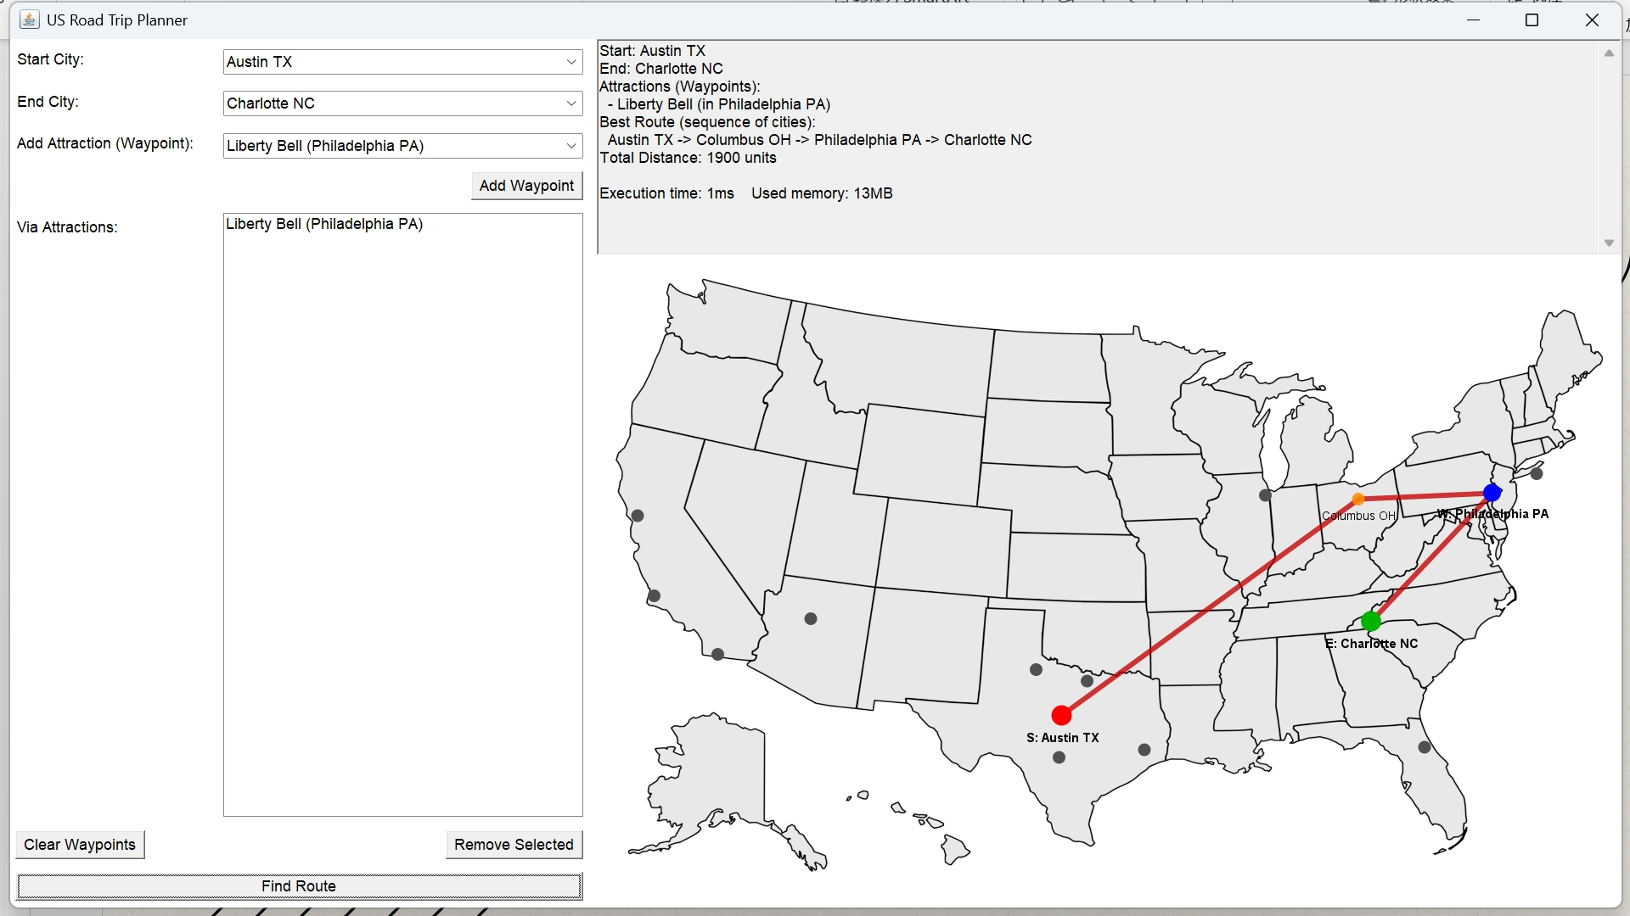
Task A – Program Design of US Road Trip Planner
GUI Panel
Here is the example of the eventual visualization panel.
Red point: Start city
Blue point: Waypoint
Orange point: Pass by city
Green point: End city
Before Selection
After Selection

Slide 13
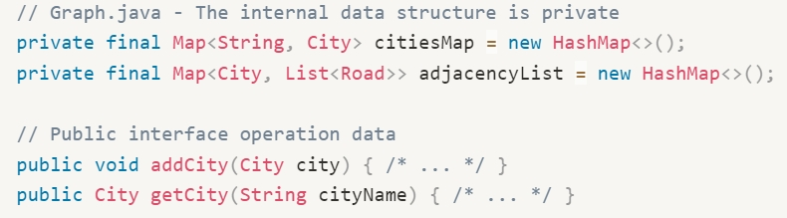
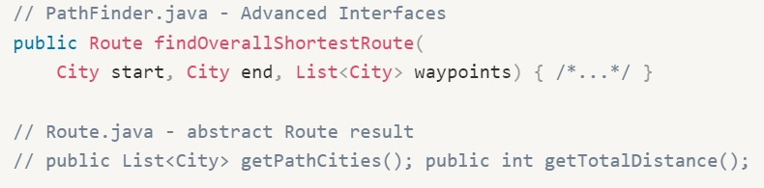
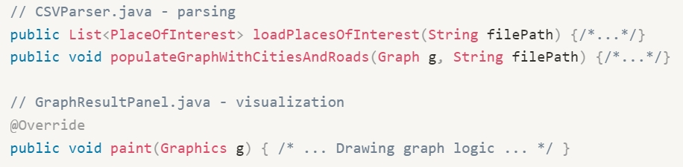
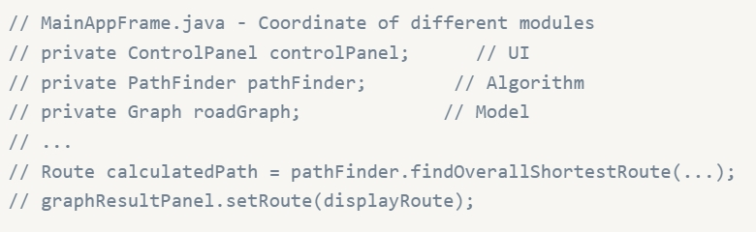
Task A – Program Design of US Road Trip Planner
1
Overall OOP Design Concept
Encapsulation: Data hiding versus interface clarity
Bundle data and methods for manipulating data, hide internal implementations, and interact through public interfaces.
Abstraction: Focus on essence, simplify complexity
Extract key features, provide simplified interfaces, and mask underlying complexity.
Single Responsibility Principle (SRP): Functional specificity and ease of maintenance
Each class should be responsible for only one specific function.
Modularity & Separation of Concerns: High Cohesion and Low Coupling
Divide the system into separate modules (packages), separating UI, logic, and data.
2
3
4

Slide 14
Task B - Design and Implementation of the Pathfinding Algorithm
3 Key Features of the Problem:
NP-Hard Properties: equivalent to finding a Hamiltonian path from the start to the end in a graph, which has been shown to be NP-complete. Computational complexity grows in a factorial order with v and cannot be solved in polynomial time.
Subproblem decomposability: its subproblem can be solved efficiently by Dijkstra or Floyd-Warshall algorithms, providing breakthrough.
Map properties: the actual road network is usually a sparse graph, and the distance between cities satisfies the triangular inequality, and the distribution of edge weights is often characterized by geographical clustering, which provides the possibility of heuristic pruning and preprocessing.
Problem Analysis and Algorithm Selection
Core: plan a shortest path from a specified starting point to the end point in a US road network, which must pass through all user-specified points of interest (POIs), and can repeatedly pass through the same path or visit the same vertex.
→From a graph-theoretic perspective: a constrained shortest path optimization problem, which is essentially a variant of the Traveler's Problem (TSP) or the search for Hamiltonian paths, and thus has the following key features:
*Due to the requirement of obtaining an optimal solution to the problem, greedy algorithms or heuristic methods are not applicable. In this case, a branch-and-bound method based on dynamic programming can be considered as a solution to the TSP problem.

Slide 15
Task B - Design and Implementation of the Pathfinding Algorithm
Algorithm B: Floyd–Warshall + Branch‑and‑Bound
Precompute All‑Pairs Shortest Paths
Run Floyd–Warshall on the n‑node graph to get distances and path info for every city pair. Time: O(n^3) Space: Θ (n^2) for the distance matrix
Build Adjacency of Shortest Legs
Transform the Floyd output into a map from each city to its list of shortest‑path “legs” to all others.
Now any two‑city shortest path query is O(1).
Initialize Branch‑and‑Bound
Define state as (current city, set of visited waypoints). Maintain a global best‑cost upper bound.
Depth‑First Search with Pruning
Recursively explore unvisited waypoints:
For each next waypoint not yet visited, fetch its precomputed leg and add its cost.
If the running cost ≥ current best bound, prune that branch.
Otherwise, mark waypoint visited and recurse.
Upon visiting all waypoints, add the leg to the end city and update the best bound if improved.
Reconstruct Optimal Path
Collect the sequence of legs that yielded the best bound and concatenate their city lists.
Complexity & Space
Worst‑case Time: still factorial (O(v!)), but heavy pruning often reduces work dramatically. Space: O(n^2) for Floyd data + O(v) recursion depth.
Algorithm A: Brute‑Force Dijkstra Approach
Generate Permutations
Enumerate all v! permutations of the v user‑specified waypoints.
Decompose into Segments
For each permutation, break the route into v+1 segments:
Start → first waypoint
Between each consecutive pair of waypoints
Last waypoint → end
Compute Shortest Paths
For each segment, run Dijkstra’s algorithm on the full graph:
Naïve array/matrix version: Θ (n^2) per run
With a min‑heap (priority queue): Θ(n log⁡ n) per run
Accumulate Distances
Sum the distances of the v+1 segments to get the total route length.
Select Best Permutation
Compare all v! total lengths and choose the smallest as the optimal path.
Complexity & Space
Time: O(v!×(v+1)×n^2) (or O(v!×(v+1)×n log ⁡n))
Space: O(n^2) for the adjacency matrix + O(n) recursion/stack overhead

Slide 16
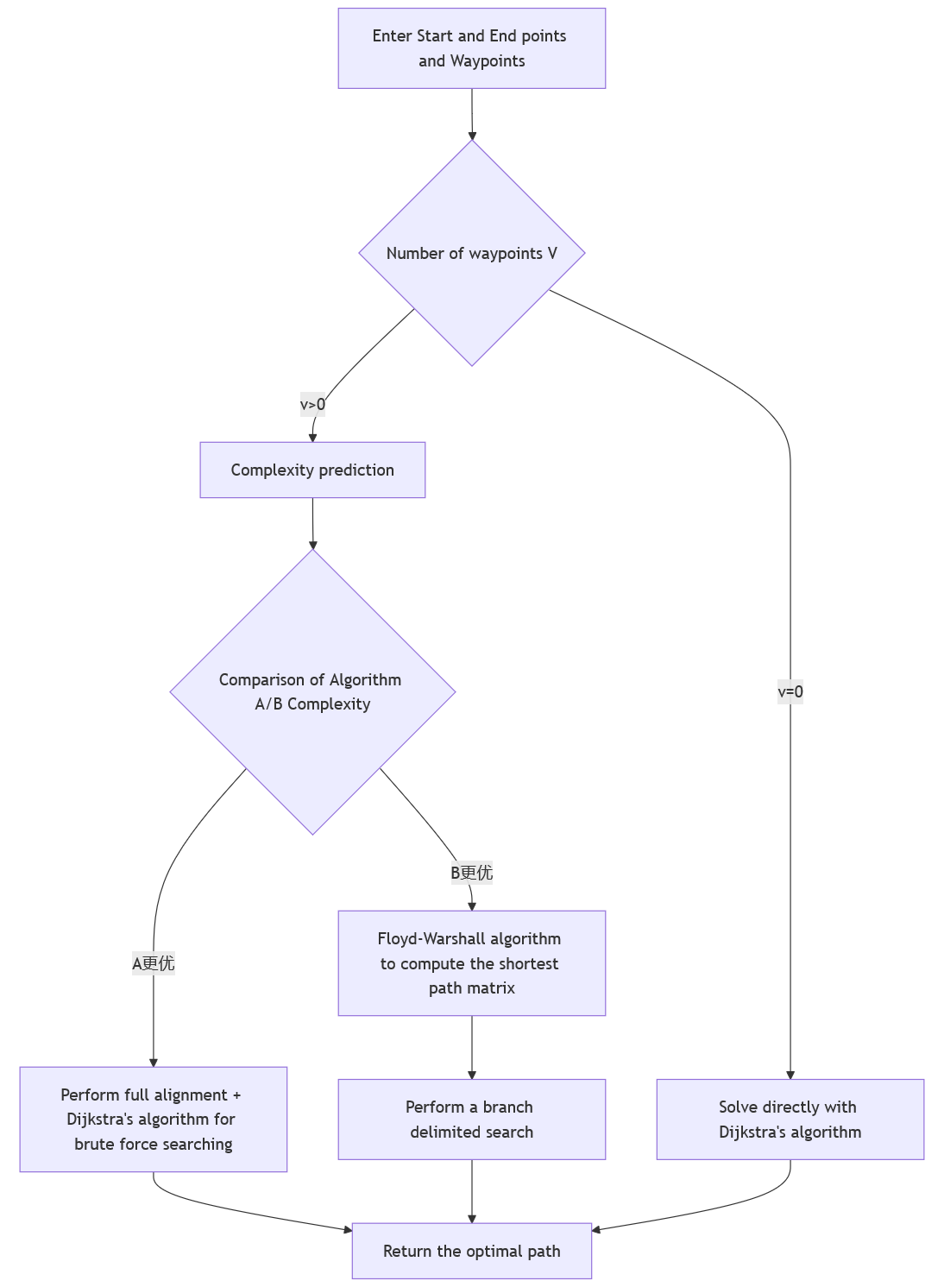
Task B - Design and Implementation of the Pathfinding Algorithm
Algorithm implementation
Input parsing: the programme reads the map data, the start point, end point and the list of waypoints.
Complexity Estimation: Calculate the theoretical complexity of the two algorithms based on n (the total number of cities) and v (the number of passing points).
Algorithm Selection: Automatically compare the order of magnitude of O(v!-(v+1)-n²) and O(n³ + pruning cost), and select the lower one.
Path computation: Algorithm A enumerates sequence by sequence and calls Dijkstra, Algorithm B starts with Floyd-Warshall and then use Branch and Bound.
Output: return the shortest path sequence and total distance, and display the list of cities along the route in the interface.

Slide 17
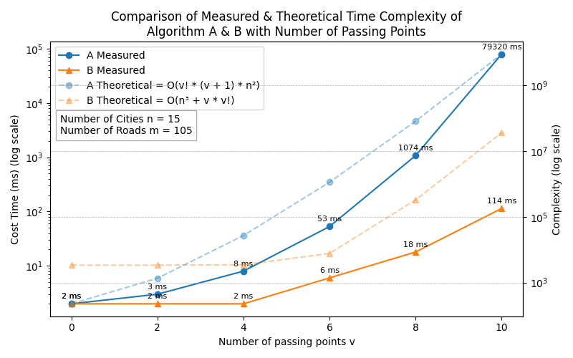
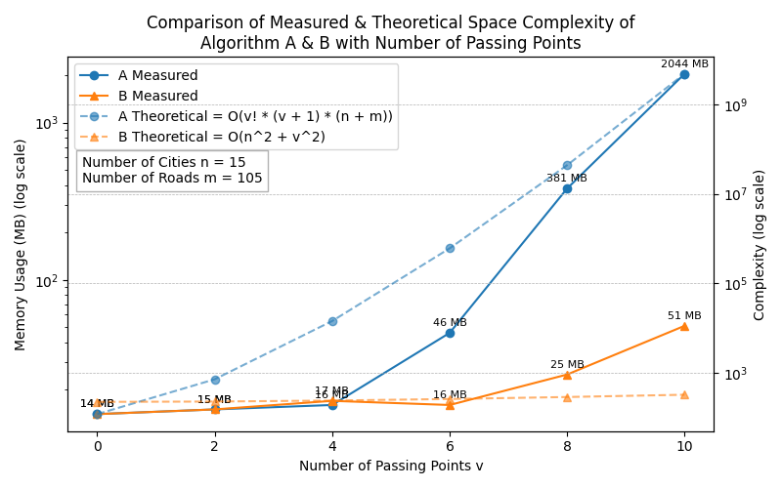
Task B - Design and Implementation of the Pathfinding Algorithm
Evaluation of two algorithms in terms of time and space complexity
Time Complexity
Space Complexity

Slide 18
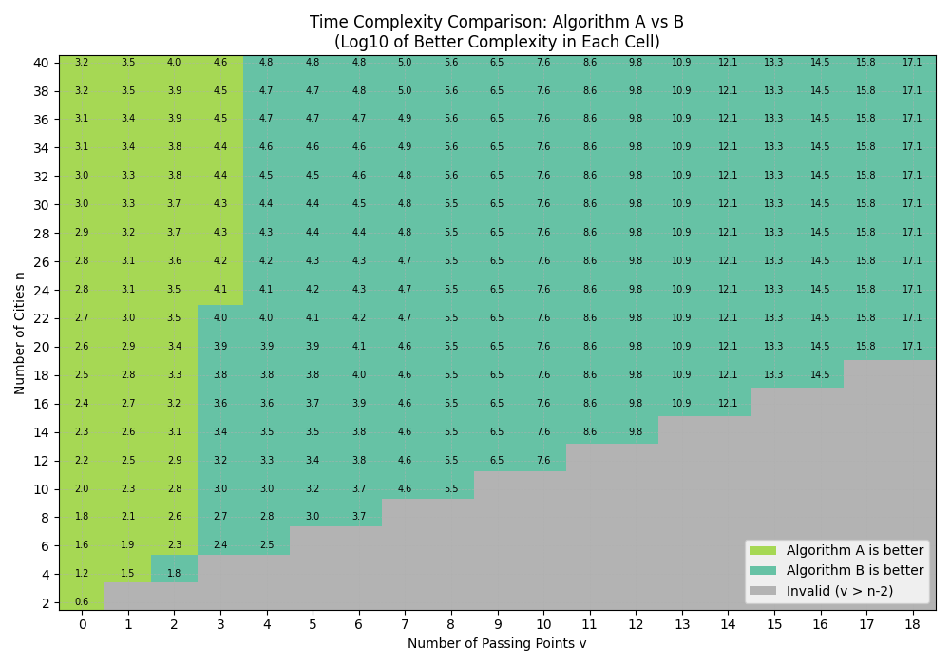
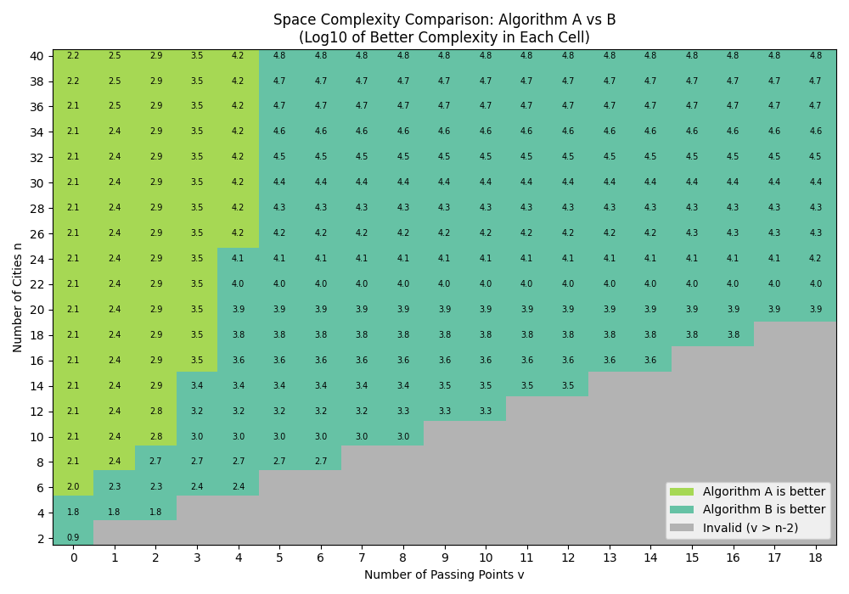
Task B - Design and Implementation of the Pathfinding Algorithm
Evaluation of two algorithms in terms of time and space complexity
Time Complexity
Space Complexity

Slide 19
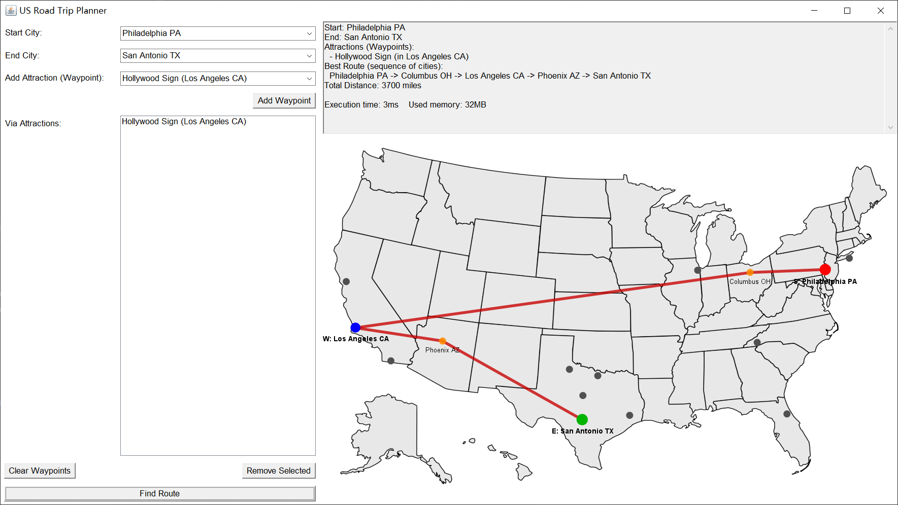
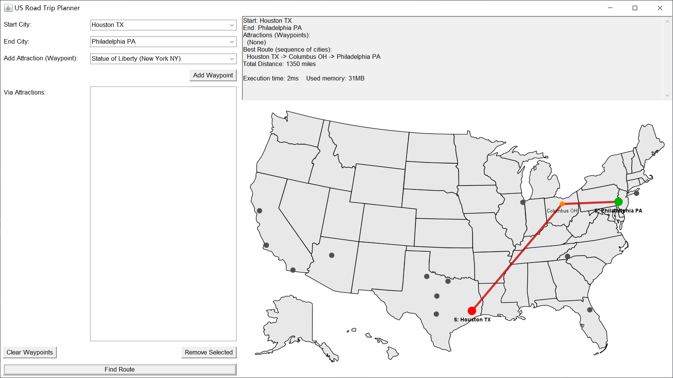
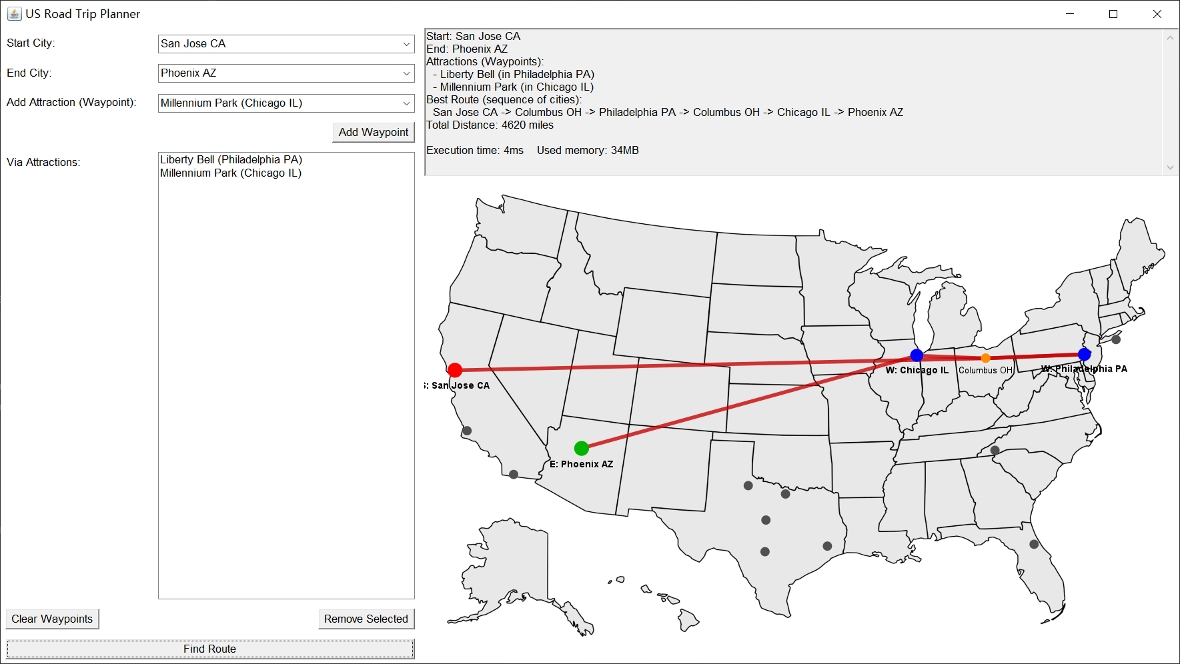
Task B - Design and Implementation of the Pathfinding Algorithm
Sample Demo
Philadelphia PA to San Antonio TX via Hollywood Sign
Houston TX to Philadelphia PA via no place of interest
San Jose CA to Phoenix AZ via Liberty Bell and Millennium Park

Slide 20
Task B - Design and Implementation of the Pathfinding Algorithm
Better alternative
Coordinate-Based Heuristics: When each city comes with additional planar coordinate information, we can use Euclidean distance as an admissible A* heuristic reduces node expansions while ensuring optimality. Local search (e.g., 2-opt, 3-opt) can further improve A* results efficiently.
Machine Learning: GNNs learn to predict edge selection probabilities, achieving near-optimal solutions on 50- and 100-node instances (0.01% and 1.39% gaps, respectively) [1]. Unsupervised and RL-based models like H-TSP scale well to large graphs [2].
Hierarchical Clustering: Partitioning large graphs into clusters allows solving intra-cluster TSPs first, then optimizing inter-cluster routes. This divide-and-conquer approach yields ~2–3% deviation from optimal with near-linear runtime [3].

Slide 21

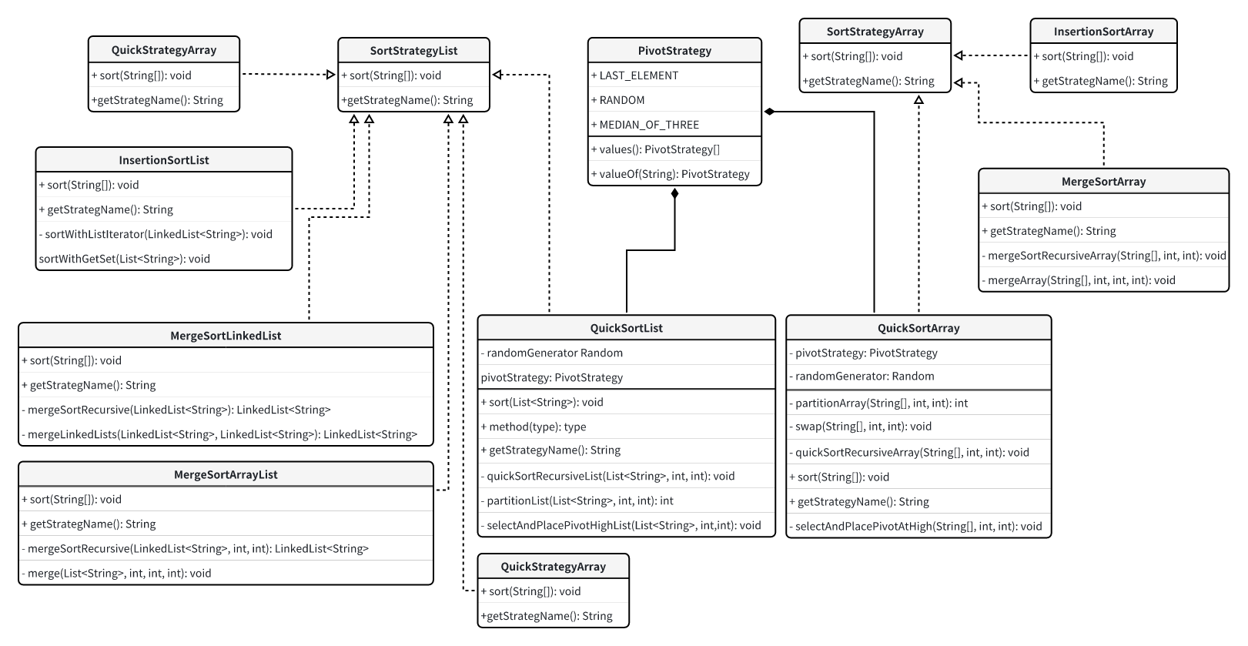
Task C – City Name Sorting Algorithm Test
Aim of the Task C
For the four datasets with different characteristics provided, three sorting tests will be performed on each file in Task C.
The basic sorting test includes:
Insertion Sort
Quick Sort
Merge Sort
More in-depth performance analysis and testing
Different Containers
String[]
ArrayList
LinkedList
Quick Sort Pivot tuning
Task C Class Diagram

Slide 22
Task C – City Name Sorting Algorithm Test
Implementation Methods and Test Design
Strategies interfaces design for different data containers:
SortStrategyArray
SortStrategyList
The sorting test implemented based on String[] will implement the SortStrategyArray interface.
The sort test based on a List<String> will implement the SortStrategyList interface.
PivotStrategy is responsible for test Quick Sort’s performance with three different pivot selection pattern.
./array
./list
./strategy
SortStrategyArray.java
SortStrategyList.java
PivotStrategy.java

Slide 23
Task C – City Name Sorting Algorithm Test
Implementation Methods and Test Design
./array and ./list: each of them contain sorting test classes implementation corresponding to the data structure.
InsertionSortArray.java
LAST_ELEMENT
./array
QuickSortArray.java
MEDIUM_OF_THREE
MergeSortArray.java
RANDOM
Strategy Design
ArrayList<String>
InsertionSortList.java
LinkedList<String>
MergeSortArrayList.java
./list
MergeSortLinkedList.java
LAST_ELEMENT
QuickSortList.java
MEDIUM_OF_THREE
QuickSortLinkedList.java
(Skip)
RANDOM

Slide 24
Task C – City Name Sorting Algorithm Test
Implementation Methods and Test Design
Key Test Methods (Keywords/Icons):
5 times preheat (eliminate JIT interference)
10 formal tests
Record the elapsed time per run (ns)
Analysis mean time and standard deviation (reflecting time span/stability)
Release JVM cache using System. gc() after different tests are completed
Test combinations: 3 sorting algorithms × 3 data container × 4 types of datasets
Data loading: CSVParser class unified processing

Slide 25
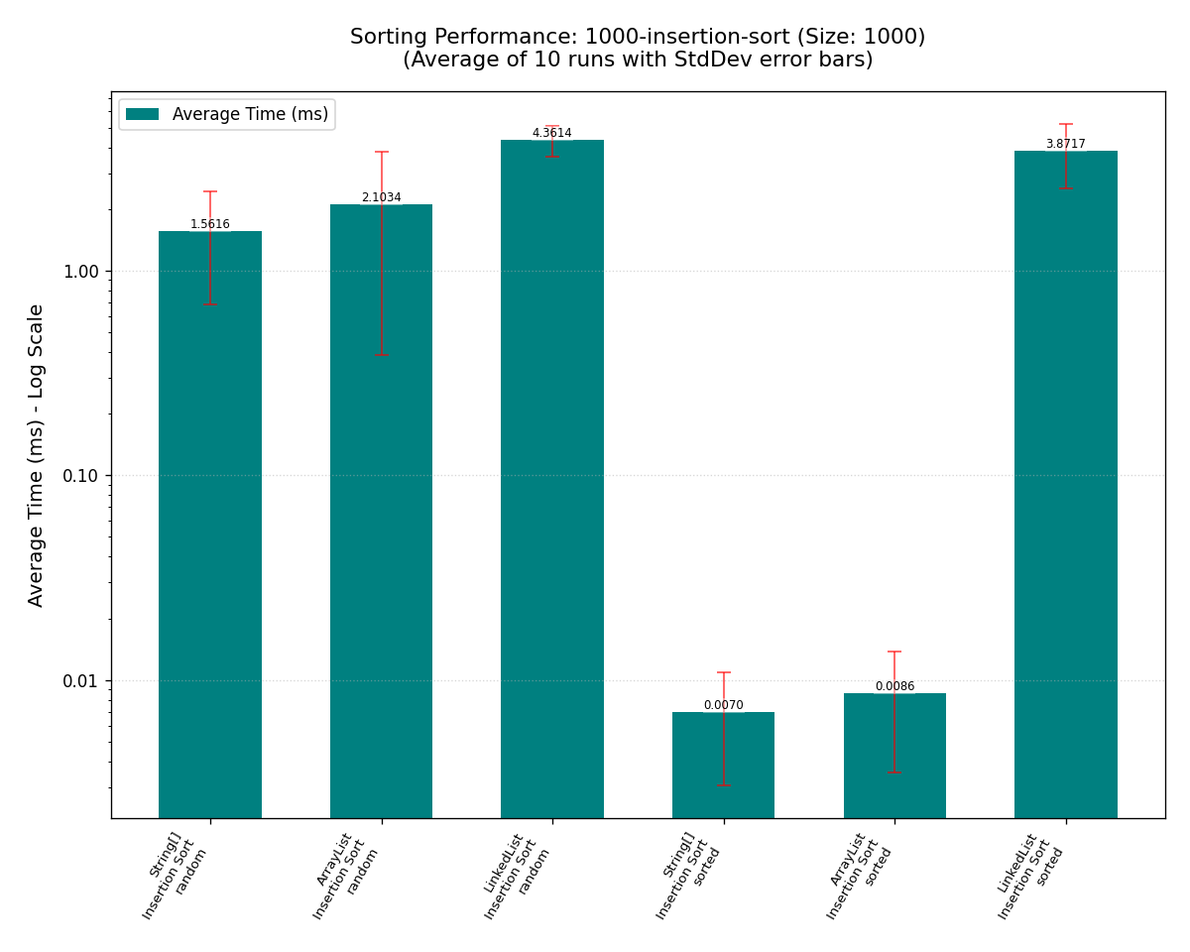
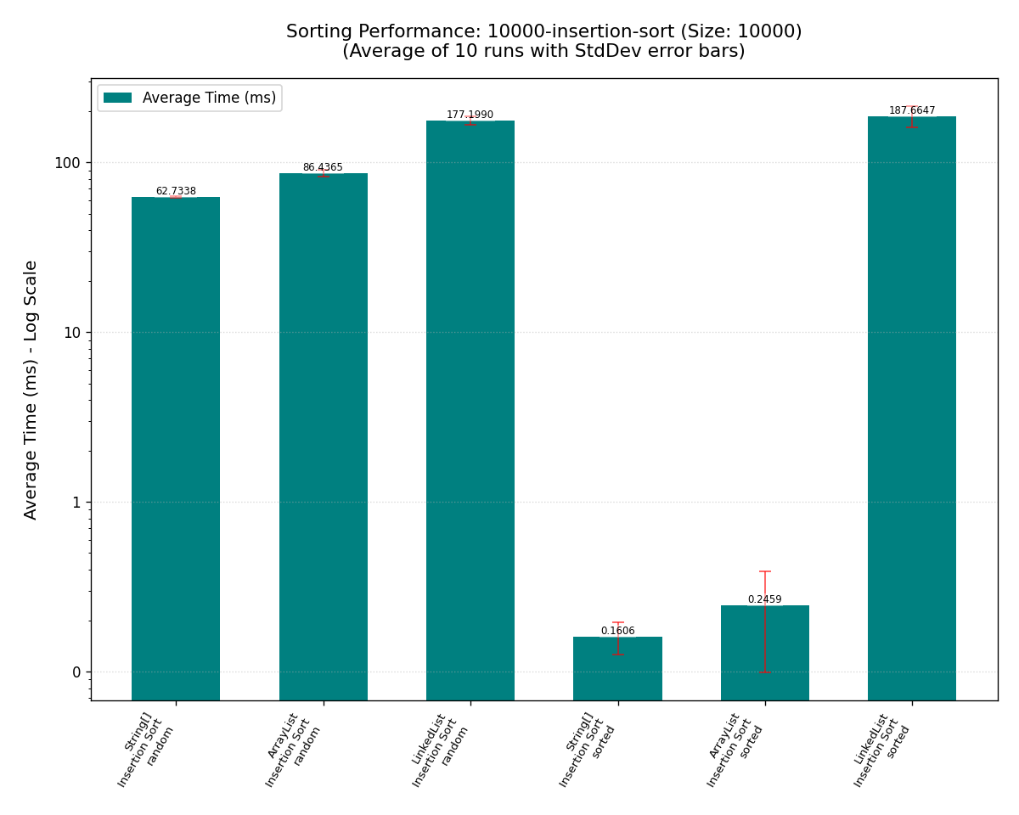
Task C – City Name Sorting Algorithm Test
Theoretic sorting time complexity
Insertion Sort
Sorted Data: Works very well, especially when based on String[] and ArrayList. Time complexity close to O(n).
Random Data: Performance will degrade, and its time complexity becomes O(n^2).
1000-insertion-sort-summary
10000-insertion-sort-summary

Slide 26
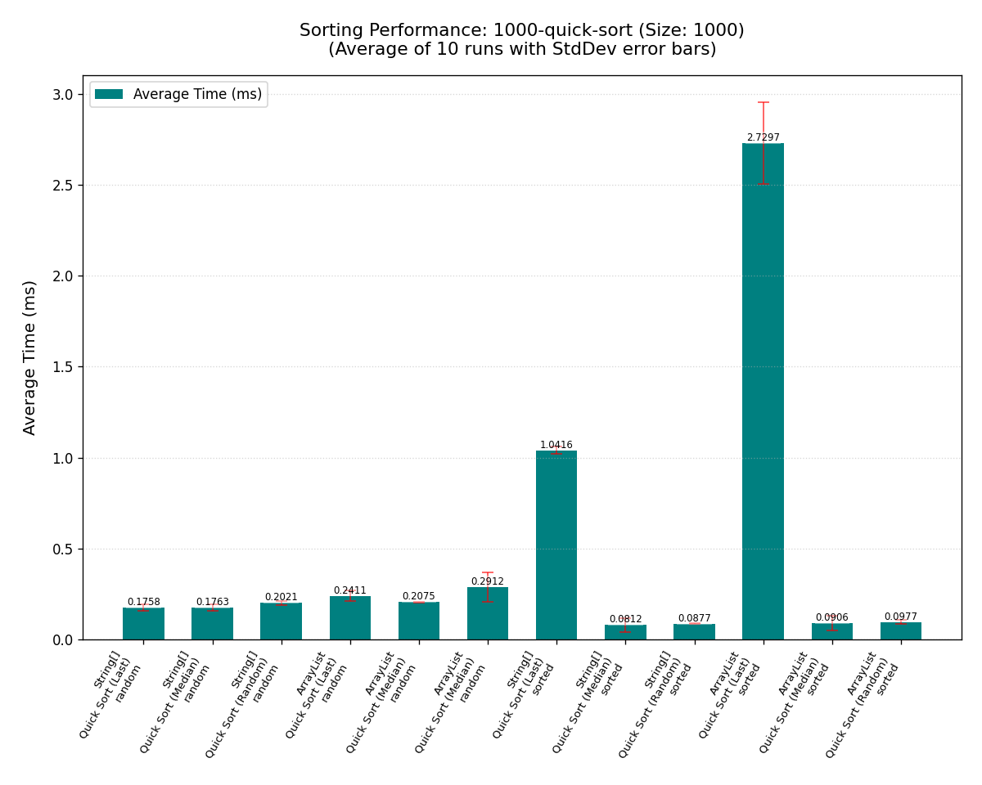
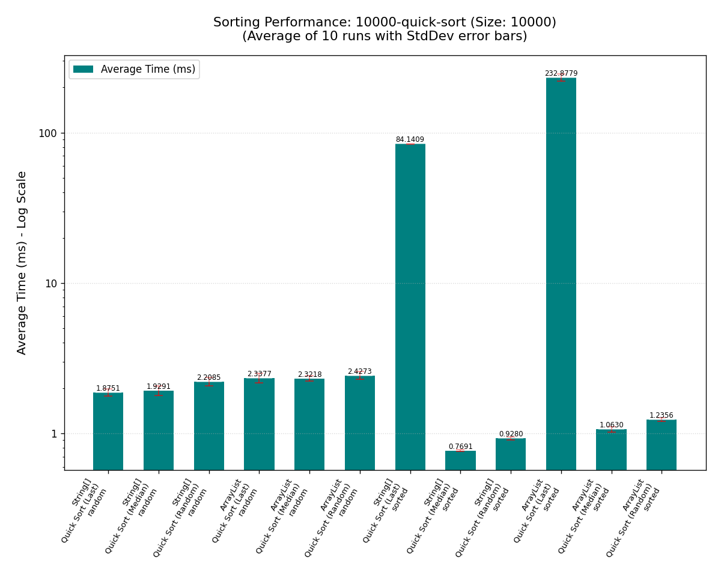
Task C – City Name Sorting Algorithm Test
Theoretic sorting time complexity
Quick Sort
Sorted Data (MEDIUM_OF_THREE & RANDOM ): effective in mitigating the worst-case behavior on sorted dataset. Time complexity close to O(n logn).
Sorted Data (LAST_ELEMENT): Very poor performance, leads to very inbalance partitions.
Random Data(All Three Pivot Strategies): The performance is around O(n logn).
1000-quick-sort-summary
10000-quick-sort-summary

Slide 27
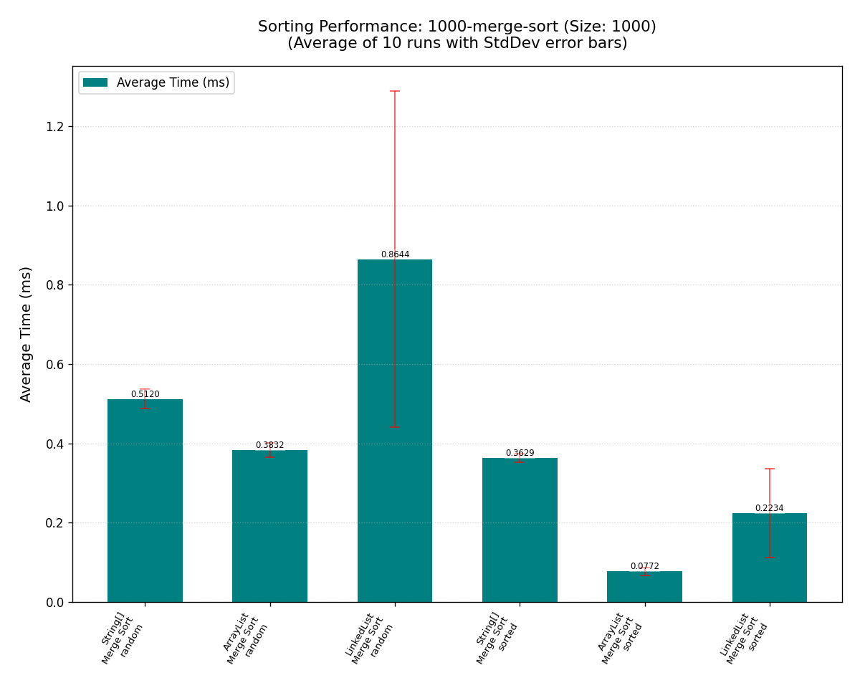
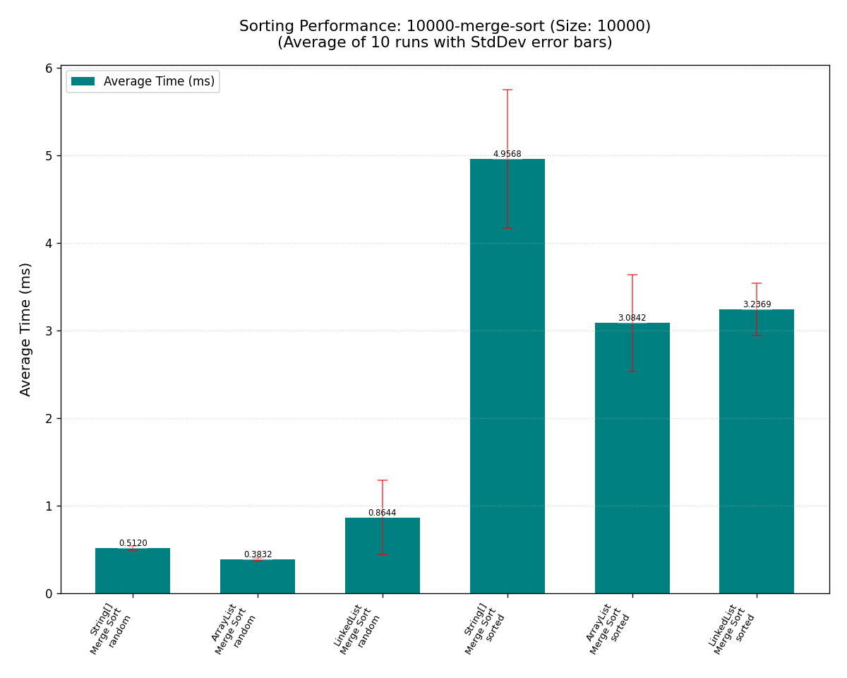
Task C – City Name Sorting Algorithm Test
Theoretic sorting time complexity
Merge Sort
This algorithm consistently exhibits O(n log n) performance across all datasets, containers, and initial data sequences, highlighting its stability.
1000-merge-sort-summary
10000-merge-sort-summary

Slide 28
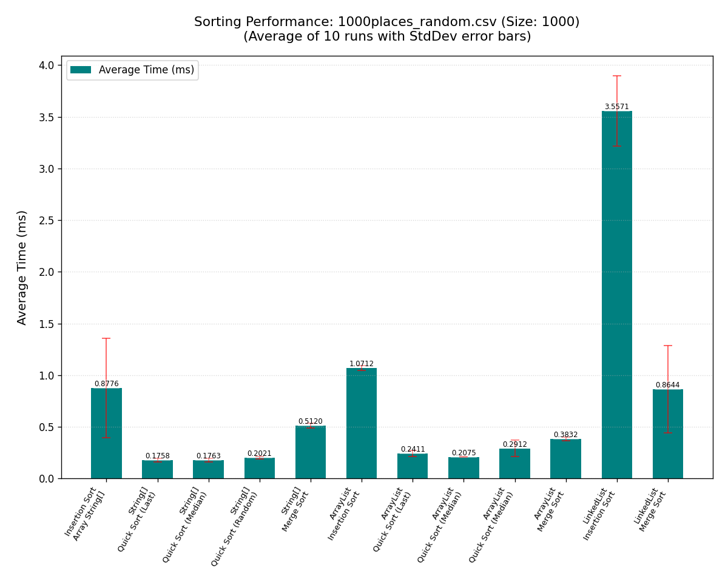
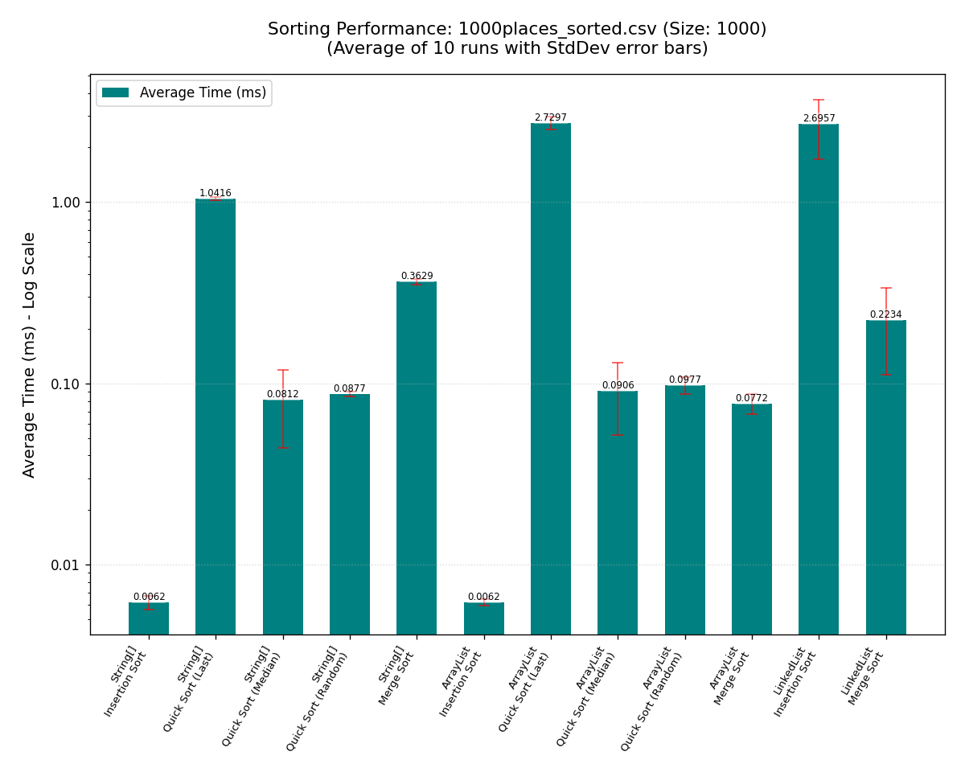
Task C – City Name Sorting Algorithm Test
Discovering - Impact of Data Containers
String[] has the best raw performance
Direct memory access with minimal overhead and cache-friendly
Suitable to those algorithms that rely on efficient random access (Insertion Sort, Quick Sort, Merge Sort).
1000-cities-random-file
1000-cities-sorted-file

Slide 29
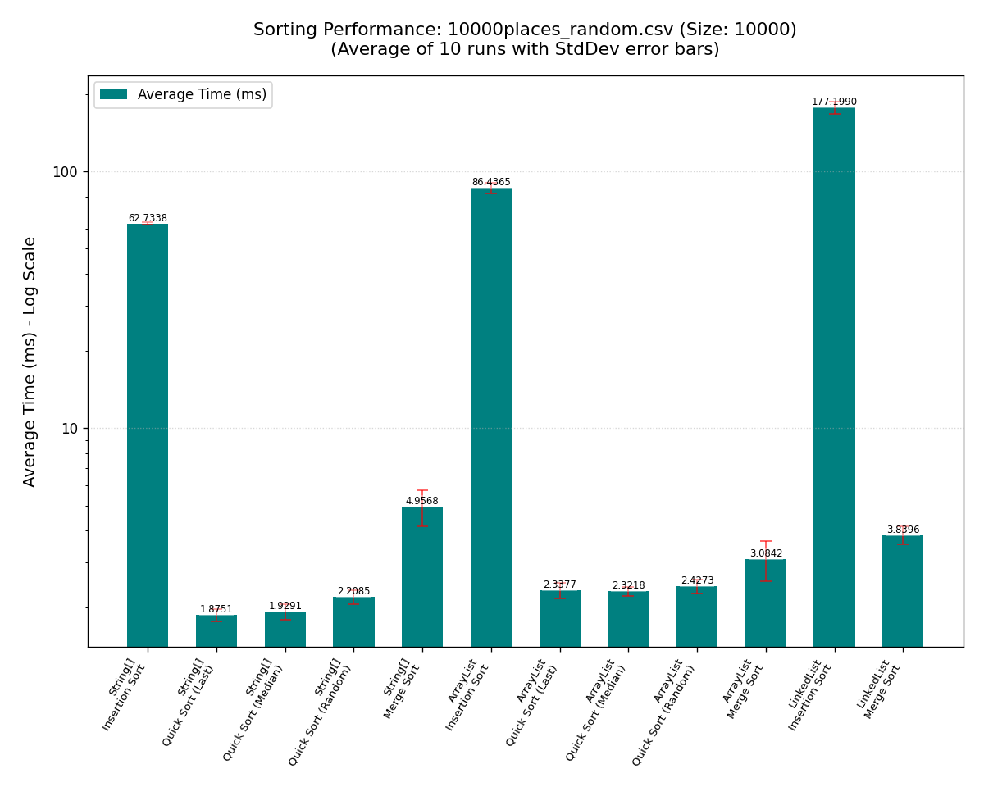
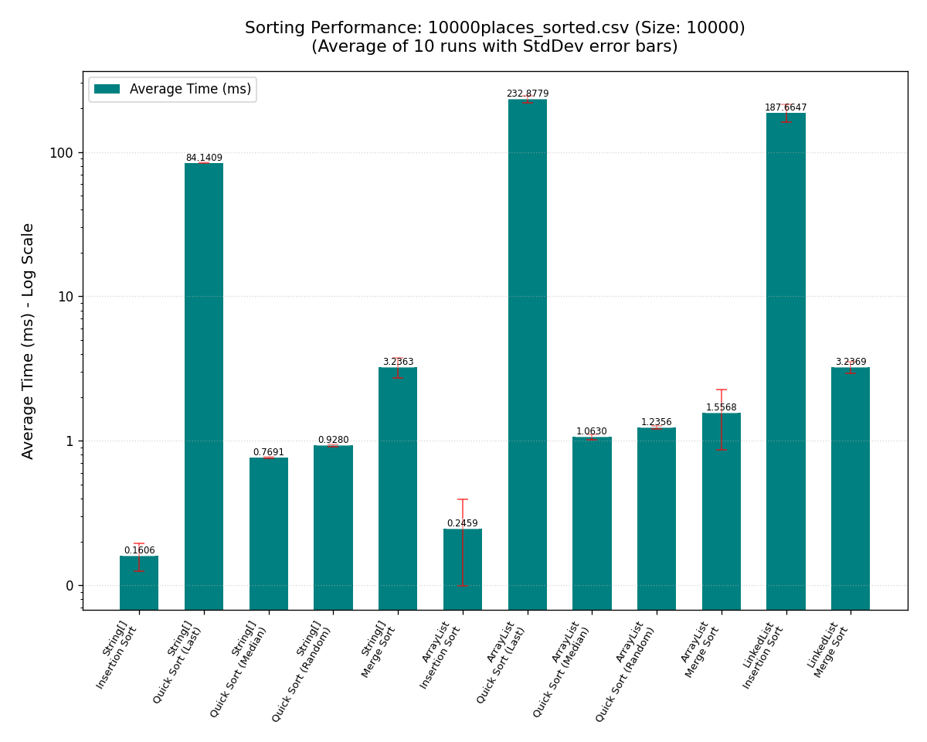
Task C – City Name Sorting Algorithm Test
Discovering - Impact of Data Containers
ArrayList<String> has nearly native performance,
The get and set method is more efficient, suitable for operations with frequent modification
Also suitable to those algorithms that rely on efficient random access (Insertion Sort, Quick Sort, Merge Sort).
10000-cities-random-file
10000-cities-sorted-file

Slide 30
Task C – City Name Sorting Algorithm Test
Discovering - Impact of Data Containers
LinkedList<String>, doesn’t perform very well on most conditions.
It only suitable for head and tail insertion, and does not perform well on situations involving a lot of selections.
Insertion Sort (implemented by ListIterator):
Although add/remove is optimized with iterators, there is still an O(n^2) bottleneck in positioning/traversal. And may stack if using get/set approache (O(n^3)).
Quick Sort:
Heavily relying on random access, direct pivot application will result in catastrophic performance (theoretical O(n^3) or worse)
Merge Sort
The only option that makes sense O(n log n). Efficient operation with linked list header and footer. (But still slower than Array&ArrayList.)

Slide 31
Task D – Project Reflection
Key Achievements
Task A – Program Design: Successfully built a modular Java app using core OOP principles (encapsulation, abstraction, single responsibility) with a clear, decoupled package structure.
Task B - Pathfinding: PathFinder implemented for optimal routes with multiple POIs, using Dijkstra for segments and strategies incorporating Floyd-Warshall for complex scenarios.
Task C – Sorting Evaluation: Implemented and evaluated Insertion, Quick, and Merge Sort on various datasets (size, order), analyzing performance and understanding data impact.

Slide 32





Task D – Project Reflection
AI Assistance & EDI Consideration
AI tools: Used AI (ChatGPT, DeepSeek) for GUI (AWT/Swing - not in curriculum) for API/layout/debug help, especially GraphResultPanel drawing. Also, for algorithm to aid design choices, not code generation. In order to clarify division of labor and communicate effectively. We use JIRA for time and task management.
EDI Current: Offered both textual and graphical path results to cater to diverse user preferences.
EDI Future: Envision Text-to-Speech (TTS) for accessibility and internationalization (i18n) for broader language support.

Slide 33


Task D – Project Reflection
Personal Growth & Takeaways
Teamwork & Project Management: Established clear task division and communication. Proficiently used Git for version control (branching, commits, merging) and Markdown for documentation, enhancing collaboration and knowledge sharing.
Technical & Self-Learning: Strengthened application of Java OOP, data structures, and algorithm design. Significantly improved self-learning by mastering AWT/Swing for GUI and enhanced problem-solving and coding standards through debugging/refactoring.

Slide 34
10/10
Thank you
CONTACT US:
ruiyang.wu22@student.xjtlu.edu.cn
Junhao.huang2202@student.xjtlu.edu.cn

Slide 35
References
[1] C. K. Joshi, T. Laurent, and X. Bresson, “An Efficient Graph Convolutional Network Technique for the Travelling Salesman Problem,” arXiv.org, 2019. https://arxiv.org/abs/1906.01227 (accessed Oct. 26, 2024).
[2] X. Pan et al., “H-TSP: Hierarchically Solving the Large-Scale Travelling Salesman Problem,” arXiv.org, 2023. https://arxiv.org/abs/2304.09395 (accessed May 18, 2025).
[3] J. Jiang, J. Gao, G. Li, C. Wu, and Z. Pei, “Hierarchical Solving Method for Large Scale TSP Problems,” Lecture Notes in Computer Science, pp. 252–261, 2014, doi: https://doi.org/10.1007/978-3-319-12436-0_28.

Slide 36
Sorting Algorithm | Specific Strategy/Implementation | Data Container | Initial Data Order | Empirical Time Complexity
Insertion Sort | InsertionSortArray | String[] | Sorted | O(n)
 | InsertionSortArray | String[] | Random | O(n^2)
 | InsertionSortList (get/set) | ArrayList<String> | Sorted | O(n)
 | InsertionSortList (get/set) | ArrayList<String> | Random | O(n^2)
 | InsertionSortList (ListIterator) | LinkedList<String> | Sorted | O(n^2)
 | InsertionSortList (ListIterator) | LinkedList<String> | Random | O(n^2)
Quick Sort | QuickSortArray (PivotStrategy.LAST_ELEMENT) | String[] | Sorted | O(n^2)
 | QuickSortArray (PivotStrategy.LAST_ELEMENT) | String[] | Random | O(n log n)
 | QuickSortArray (PivotStrategy.MEDIAN_OF_THREE) | String[] | Sorted | O(n log n)
 | QuickSortArray (PivotStrategy.MEDIAN_OF_THREE) | String[] | Random | O(n log n)
 | QuickSortArray (PivotStrategy.RANDOM) | String[] | Sorted | O(n log n)
 | QuickSortArray (PivotStrategy.RANDOM) | String[] | Random | O(n log n)
 | QuickSortList (PivotStrategy.LAST_ELEMENT) | ArrayList<String> | Sorted | O(n^2)
 | QuickSortList (PivotStrategy.LAST_ELEMENT) | ArrayList<String> | Random | O(n log n)
 | QuickSortList (PivotStrategy.MEDIAN_OF_THREE) | ArrayList<String> | Sorted | O(n log n)
 | QuickSortList (PivotStrategy.MEDIAN_OF_THREE) | ArrayList<String> | Random | O(n log n)
 | QuickSortList (PivotStrategy.RANDOM) | ArrayList<String> | Sorted | O(n log n)
 | QuickSortList (PivotStrategy.RANDOM) | ArrayList<String> | Random | O(n log n)
 | QuickSortLinkedListStub | LinkedList<String> | Any | N/A - Stub, No Sort
Merge Sort | MergeSortArray | String[] | Sorted | O(n log n)
 | MergeSortArray | String[] | Random | O(n log n)
 | MergeSortArrayList | ArrayList<String> | Sorted | O(n log n)
 | MergeSortArrayList | ArrayList<String> | Random | O(n log n)
 | MergeSortLinkedList | LinkedList<String> | Sorted | O(n log n)
 | MergeSortLinkedList | LinkedList<String> | Random | O(n log n)
Appendix

