Slide 1
Genotype data
Input
Initial guess of haplotype frequencies (P00, P01, P10, P11)
Validate
Estimate complete genotype counts from ambiguous genotype
Process
Calculate haplotype frequencies using estimated counts
No
Do haplotype frequencies converge?
Estimate genotype counts
Yes
End

Slide 2
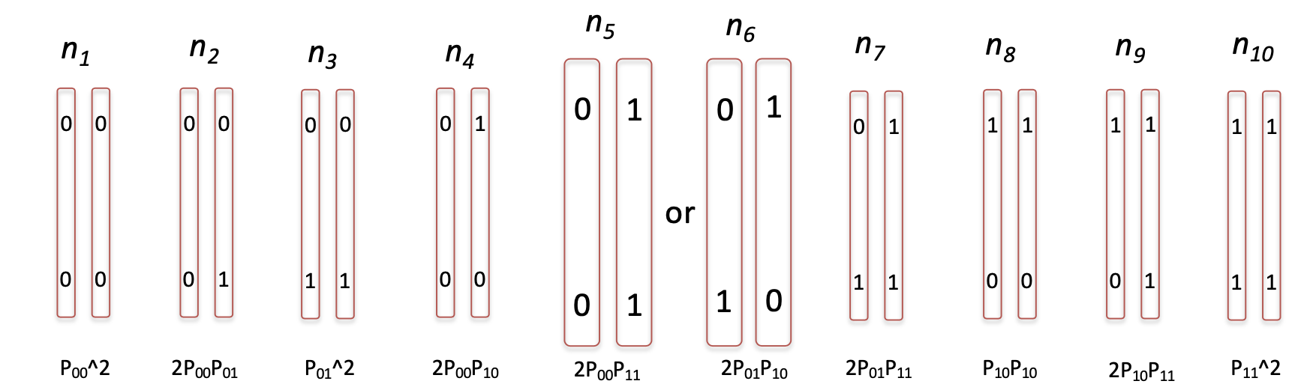
Initial guess
P₀₀ = P₀₁ = P₁₀ = P₁₁ = 1/4
n
n₅ n₆
n₅ = n * (2 * P₀₀*P₁₁)/(2P₀₀P₁₁ + 2P₀₁P₁₀)
P₀₀ = (2 * n₁ + n₂ + n₄ + n₅)
P^{i}₀₀ – P^{i-1}₀₀ ? 10^-5 or 1 million iteration

