Slide 1
Coverage
Machine Learning Pipeline Overview
Monitoring Model
At Feature Level
At Model Level
At Predictions Level
What Next?

Slide 2
Machine Learning Pipeline Overview
MLOps
Data
Training Pipeline
Data Preparation
Model Training
Model Evaluation & Validation
Trained Model
Model
Serving
Modelv2
Modelv1
Model Registry
Monitoring Performance
Predictions
Data Scientist
Musthaq

Slide 3
Monitoring Model
Machine Learning Model Monitoring can be done at two levels.
Functional Level Monitoring
Operational Level Monitoring
as a Machine Learning Engineer or Data Scientist we'll focus on Functional Level Monitoring.
Operational Level Monitoring
It deals with monitoring at system and resource level
Functional Level Monitoring
It deals with monitoring model performance, inputs (data), and outputs (predictions). As a Machine Learning Engineer/Data Scientist we’ll
Focus on functional level monitoring

Slide 4
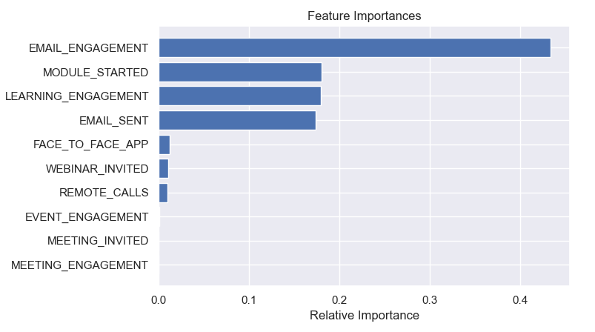
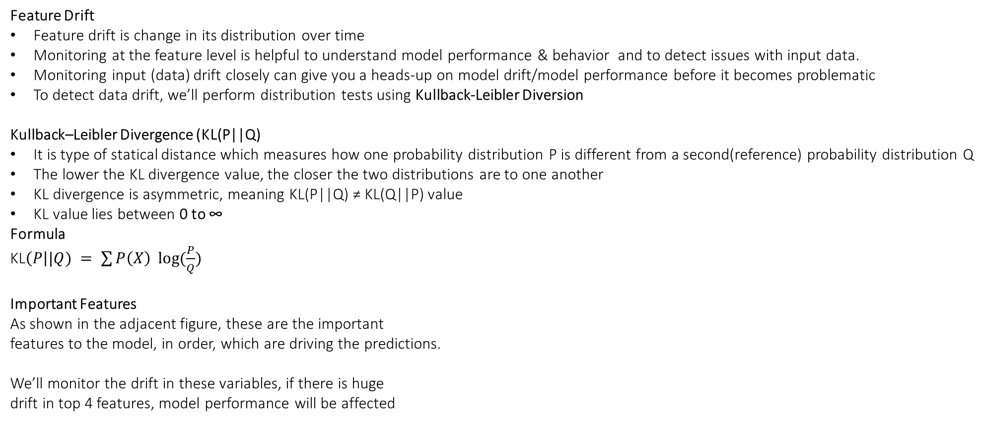
Monitoring at Feature Level
Feature Drift
Feature drift is change in its distribution over time
Monitoring at the feature level is helpful to understand model performance & behavior and to detect issues with input data.
Monitoring input (data) drift closely can give you a heads-up on model drift/model performance before it becomes problematic
To detect data drift, we’ll perform distribution tests using Kullback-Leibler Diversion
Kullback–Leibler Divergence (KL(P||Q)
It is type of statical distance which measures how one probability distribution P is different from a second(reference) probability distribution Q
The lower the KL divergence value, the closer the two distributions are to one another
KL divergence is asymmetric, meaning KL(P||Q) ≠ KL(Q||P) value
KL value lies between 0 to ∞
Formula
KL$\left(P\right||Q) = \sum{P\left(X\right) log⁡(\frac{P}{Q})}$
Important Features
As shown in the adjacent figure, these are the important
features to the model, in order, which are driving the predictions.
We’ll monitor the drift in these variables, if there is huge
drift in top 4 features, model performance will be affected
Cluster 0
319
Cluster 1
223
18
7
9

Slide 5
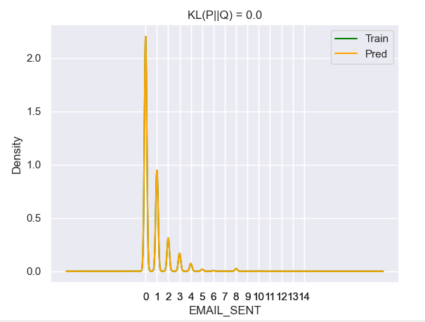
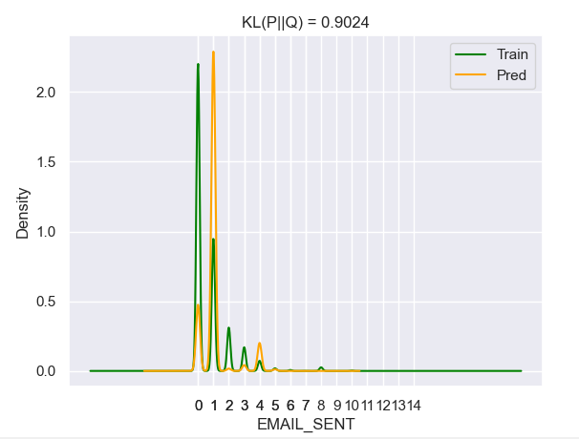
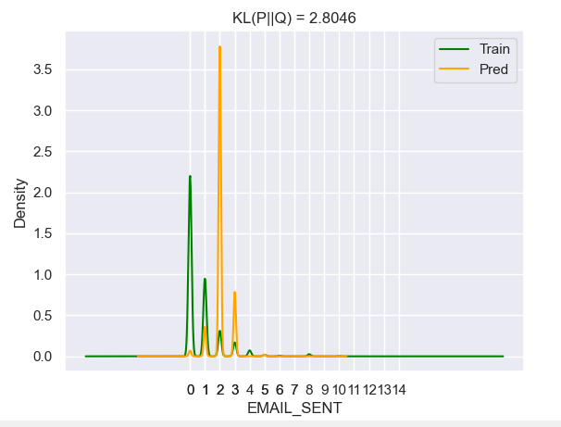
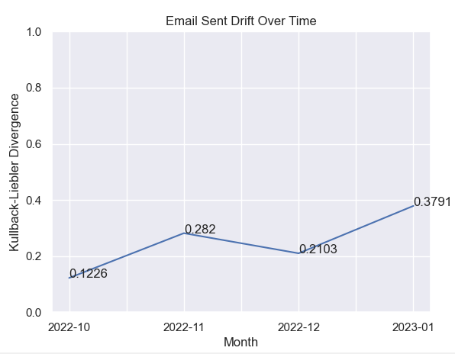
KL Divergence Example
The density plots shows the distribution of
the variable ‘EMAIL_SENT of Train & Pred
Data
Fig(a) represents the KL value as 0,
when the two distributions are same, in other
words when there is no drift
The other plots Fig(b), Fig(c) shows
the increase in the KL value as the drift is
increasing
KL value = 0 when there is no drift
KL value is close to 0 when there is
minimal drift and
KL value is high when there is huge drift
Fig(d) shows the drift of the variable
overtime
Fig (a)
Fig (b)
Fig (c)
Fig (d)

Slide 6
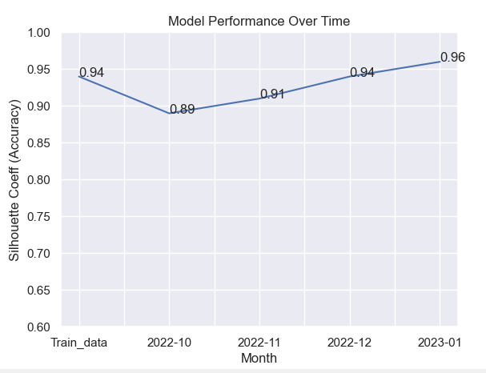
Monitoring at Model Level
Model drift, or concept drift, happens when the
relationship between features and/or labels no
longer holds because the learned relationships
or patterns have changed over time.
It’s when a model consistently returns unreliable
and less accurate results over time compared
to benchmarks
We’ll compare the accuracy of the model with
the training accuracy each time we run the model
If there is a drop in model performance for consecutive
months and predictions are not aligned with the
training results, it indicates feature drift/concept drift
Adjacent fig show the comparison of model
accuracy with training accuracy over time
Musthaq

Slide 7
Monitoring at Prediction Level
Monitoring model output in production is best indicator of model performance, it tells us if business KPIs are being met, in our case cluster characteristics
We’ll compare the predicted cluster characteristics with the training results cluster characteristics
If there is a minimum deviation of 10% in cluster characteristics, it indicates model performance is degrading or model is misclassifying the cluster data points
For example, in Digital Cluster during training we got 100% engagement with Email, if in prediction we get below or equal to 85% or 90% engagement it indicates that the model is misclassifying the datapoints which means model performance is dropped
Example
 | CLUSTER | TRAIN RESULTS | PREDICTIONS | STATUS | Model Performance
1 | NON-DIGITAL | REMOTE_CALLS=48.0%, F2F_APP=60.0%, EMAIL_ENG=0.0%, LEARNING_ENG=0.0% | REMOTE_CALLS=47.0%, F2F_APP=58.3%, EMAIL_ENG=0.0%, LEARNING_ENG=0.0% | Aligned with Training results | Dropped
2 | DIGITAL | EMAIL_ENG=100.0%, LEARNING_ENG=0.0% | EMAIL_ENG=85.0%, LEARNING_ENG=0.0% | Misclassified
3 | SELECTIVELY ENGAGED | EMAIL_SENT=2, EMAIL_ENG between 0 to 1=100.0%, LEARNING_ENG=0.0% | EMAIL_SENT=2, EMAIL_ENG between 0 to 1=100.0%, LEARNING_ENG=0.0% | Aligned with training results
4 | PRO KNOWLEDGE | LEARNING_ENG=100.0% | LEARNING_ENG=100.0% | Aligned with training results
5 | NOT ENGAGED | EMAIL_ENG=0.0%, REMOTE_CALLS=0.0%, F2F_APP=0.0% | EMAIL_ENG=0.0%, REMOTE_CALLS=0.0%, F2F_APP=0.0% | Aligned with training results

Slide 8
What Next?
Once we identified that the model performance is degrading, we can re-train our model to improve
Its performance
If retraining model doesn’t help in improving the model performance, we need to re-build the model using new data and do Shadow testing before deploying it to Production
Shadow Testing is like a creating a new model say challenger model and deploy it either offline or online and compare its performance with Champion model(Model in Prod). If the challenger model performance is better than Champion model, deploy it to the production.

Slide 9
Thank You !!!
Musthaq

