Slide 1
BT Luxury Car Rental (online booking and management system)

Slide 2
Purpose
Create website for real luxury car rental company that contains :
Car information (Price ,photo,…)
User authentification
Booking a car
Managing the business
Contact company via Contact Us form

Slide 3
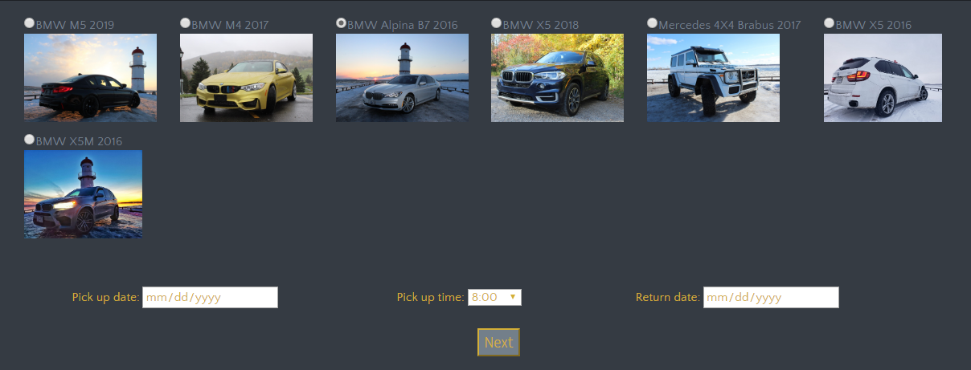
Booking system

Slide 4
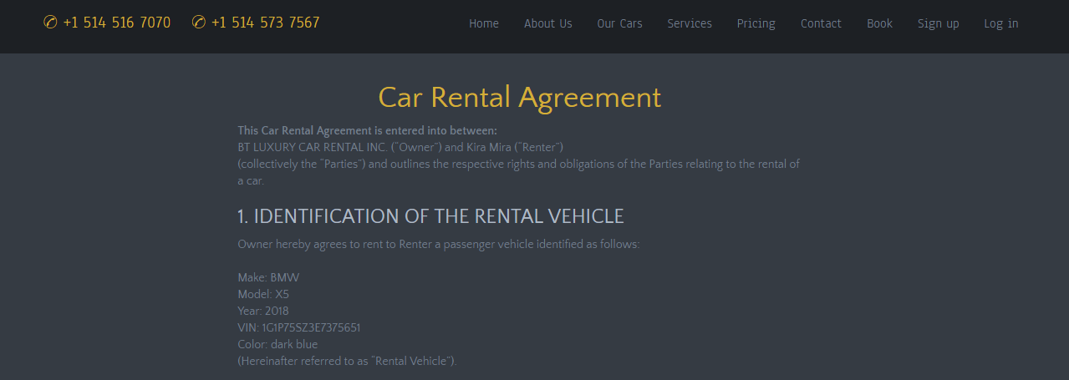
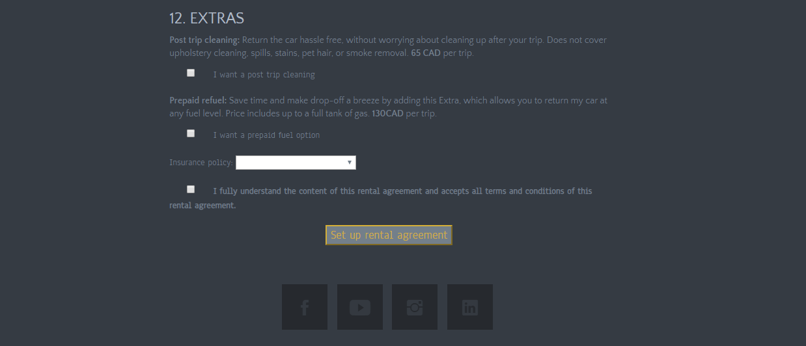
“Signing” the contract online

Slide 5
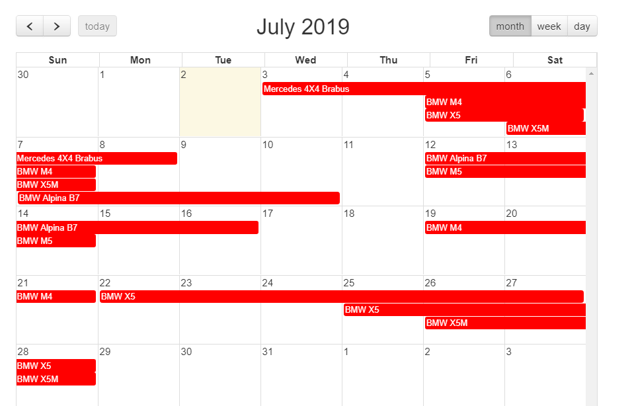
Showing car contracts via calendar

Slide 6
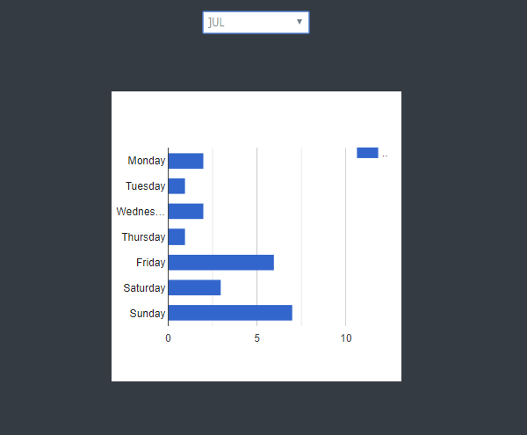
Showing busy week day via chart

Slide 7
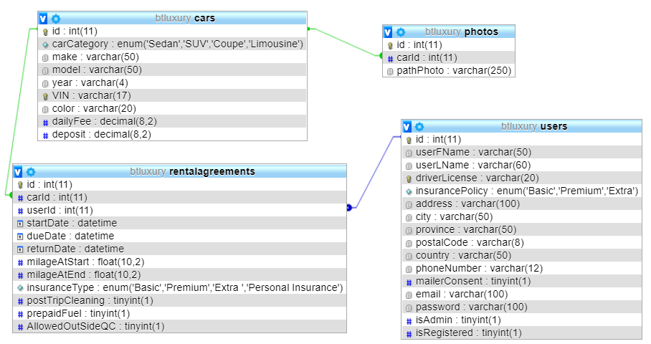
Database

Slide 8
Technologies
JavaScript fullCalendar(Using api)
khill/lavacharts (bar chart)

Slide 9
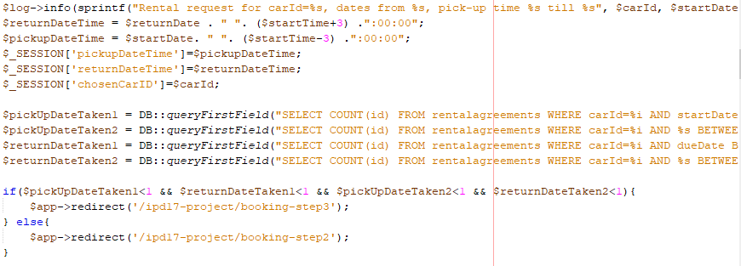
Querying database to check if the car is available during the chosen period

Slide 10
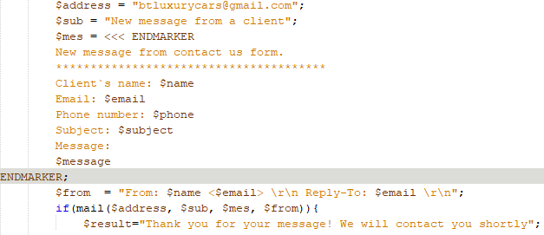
Getting messages through Contact Us

Slide 11

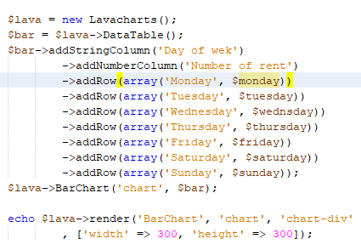
LavaChart

Slide 12
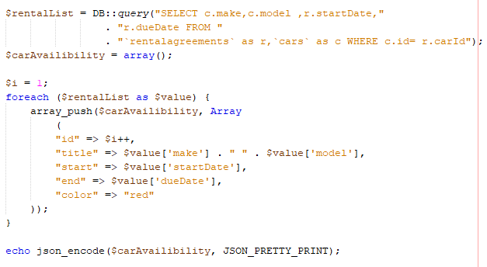
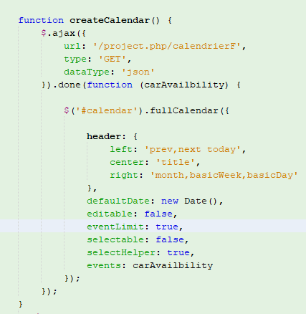
FullCalendar

Slide 13
Future work
Online payment system
More reports like which car is more rented

Slide 14
Summary
All functionality like login, sign up, register,…
Booking a car
Contacting company via Contact Us form
Business management via report

Slide 15


