Slide 1
Workshop

Slide 2
Outline
- Basic python
- Web crawling
- Data preparation
- Word2Vec
Materials: https://github.com/Music-Wandee/Workshop

Slide 3
Tool installation
Anaconda distribution
https://www.anaconda.com/distribution/#download-section
Selenium : Automatic web applications for testing purposes.
https://selenium-python.readthedocs.io/installation.html#downloading-python-bindings-for-selenium
Chrome Driver
https://sites.google.com/a/chromium.org/chromedriver/downloads
Beautiful Soup : A Python library for pulling data out of HTML and XML files.
https://www.crummy.com/software/BeautifulSoup/bs4/doc/#problems-after-installation

Slide 4
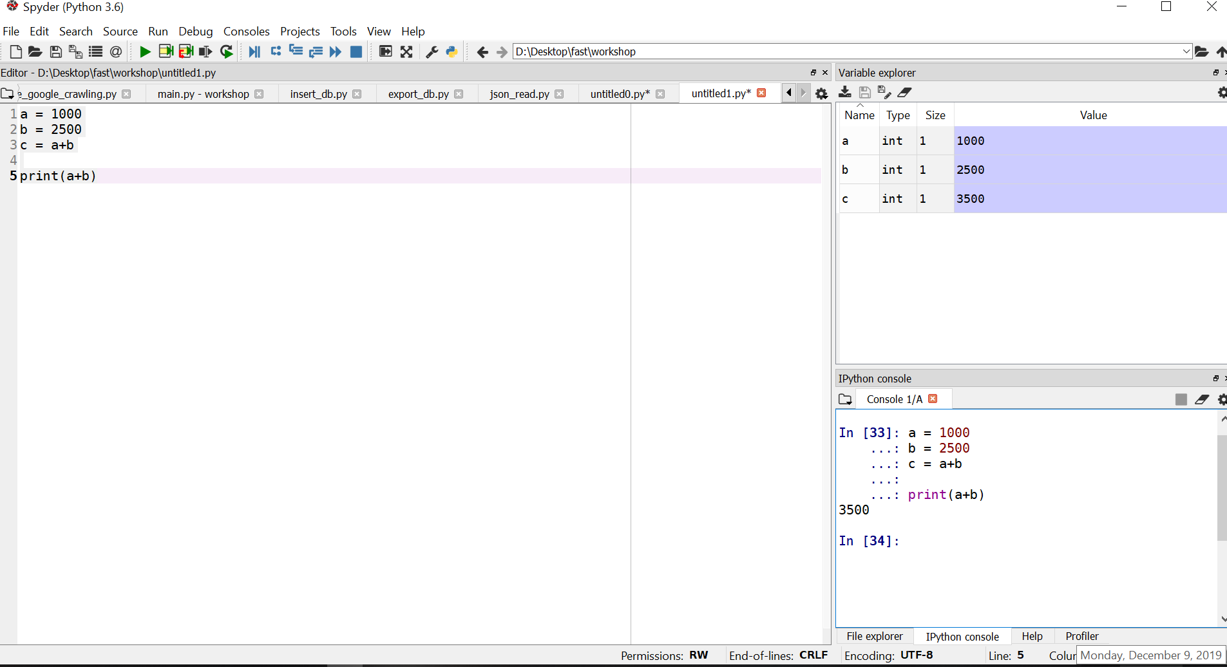
Basic python
Open Anaconda navigator
Launch spyder
Current directory
Variable explorer
Code editor
How to run code line by line.
Select/ highlight the lines
Press Ctrl + Enter
Ipython console
Python syntax: https://www.w3schools.com/python/default.asp

Slide 5
Phase I
Start
keywords
Search by using keywords/dates
Topic
{“id_”: “393974830”,
“keyword”: “เรียนพิเศษ”
“title”: “ถ้ามีลูกแล้วไม่ส่งเรียนพิเศษอะไรเลย จะเป็นอะไรไหมครับ”,
“post_number”: “0”,
“url”: “https://pantip.com/topic/39397483”,
“post”: “สงสัยว่าสมัยนี้ถ้ามีลูกแล้วเราไม่ส่งเรียนพิเศษอะไรเลย จะเป็นอะไรไหมครับ ที่ผมจะทำก็คือ….”,
“owner”: “สมาชิกหมายเลข 5516677”}
“date”: “20 มกราคม เวลา 23:28 น.”}
Crawl information
Yes
Are there any keywords left?
No
Remove duplicate data
Relevant
Label data
Irrelevant
Maybe
Insert data into a database
End

Slide 6
Phase II
Start
Relevant data
Final_data
[
{“id_”: “393974830”,
“keyword”: “เรียนพิเศษ”
“title”: “ถ้ามีลูกแล้วไม่ส่งเรียนพิเศษอะไรเลย จะเป็นอะไรไหมครับ”,
“post_number”: “0”,
“url”: “https://pantip.com/topic/39397483”,
“post”: “สงสัยว่าสมัยนี้ถ้ามีลูกแล้วเราไม่ส่งเรียนพิเศษอะไรเลย จะเป็นอะไรไหมครับ ที่ผมจะทำก็คือ….”,
“owner”: “สมาชิกหมายเลข 5516677”}
“date”: “20 มกราคม เวลา 23:28 น.”}
,
{“id_”: “393974831”,
“keyword”: “เรียนพิเศษ”
“title”: “ถ้ามีลูกแล้วไม่ส่งเรียนพิเศษอะไรเลย จะเป็นอะไรไหมครับ”,
“post_number”: “1”,
“url”: “https://pantip.com/topic/39397483”,
“post”: “ทำแบบนี้กลัวมีปัญหาเวลาต่อมหาลัยจะสอบเข้าไม่ได้มีผลต่อสายงานเวลาจบครับ...” ,
“owner”: “เม่าน้อยดอยนาน”}
“date”: “11 พฤศจิกายน เวลา 10:55 น.”}
.
.
]
Crawl information by URL
Label data
Remove duplicate data
Insert data in a database
End

Slide 7


Web crawling solution
Selenium
Beautiful soup
Call webpages
Scroll webpages
Click buttons
Send html
Extract elements
{“title”: “ผู้หญิงไม่มีสังคมมันน่าเบื่อมากมั้ยคะ”,
“post”: “ผญ.บางคนชอบทำงาน อยู่บ้านไม่มีสังคมจะเบื่อ”,
“post_number”: “1”,
“post_owner”: “สมาชิกหมายเลข 4054065”,
“url”:“https://pantip.com/topic/34270481”,
“time”: “11/08/2018 16:51:16”}

Slide 8
Workflow
Data preprocessing
Data preprocess
Pos tagging
Text classification
Tokenization
Stop word
Sentiment Analysis
Normalization
Topic model
:
:

Slide 9
Word Tokenization for Thai
Dictionary-based: algorithms in this category rely on the use of dictionaries with a mechanism to decide whether to tokenize a particular sequence of characters. Dictionary-based algorithms are typically fast but with less capable when encountering unknown words.
PyThaiNLP
Learning-based: unlike dictionary-based, algorithms in this group learn to split words based on labelled data. Learning-based approaches are usually qualitatively better and more adaptable to data from different domains, but relatively slower.
DeepCut (using Convolutional Neural Networks)
Sertis’ Bi-GRUs (using Recurrent Neural Networks)
Credit: https://pythainlp.github.io/attacut/survey.html#id1
More tokenizers: https://github.com/PyThaiNLP/docker-thai-tokenizers

Slide 10
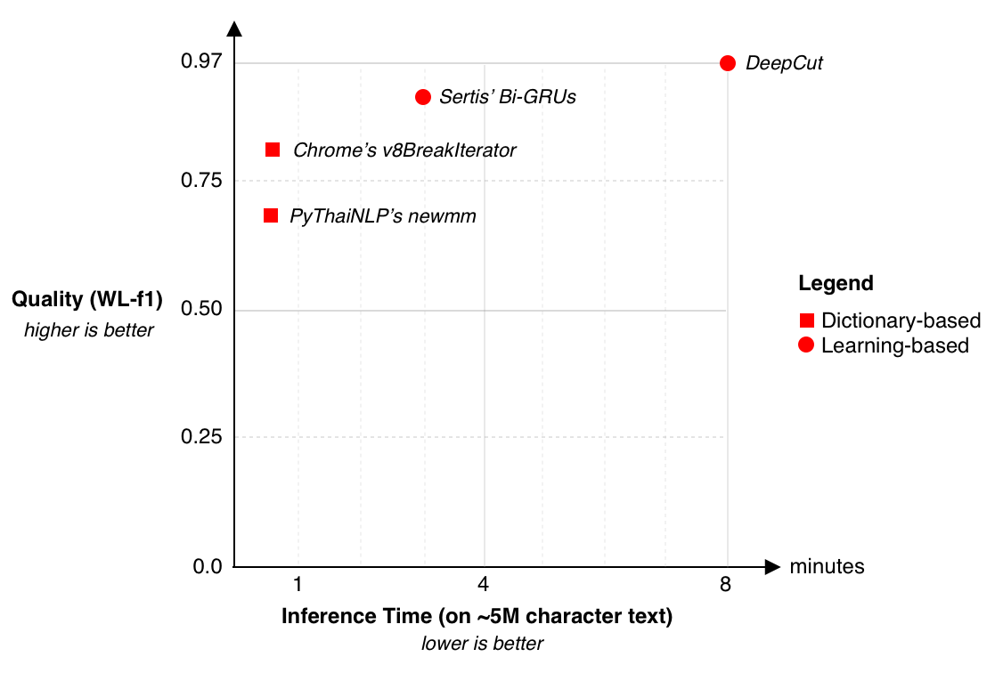
Performance
Credit: https://pythainlp.github.io/attacut/survey.html#id1

Slide 11
Word2vec
Word2vec is a model used to create word embeddings which are vector representations of a particular word.
apple
(0.2, 0.6)
banana
(0.3, 0.5)
Word similarity(apple, banana) = (0.2 X 0.3) + (0.6 X 0.5) = 0.36
Word similarity(banana, protection) = 0.23
protection
(0.8, 0.1)
More information:
https://arxiv.org/pdf/1301.3781.pdf
https://www.youtube.com/watch?v=gCRiLg-LuEs

Slide 12
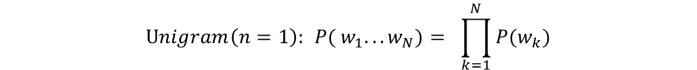
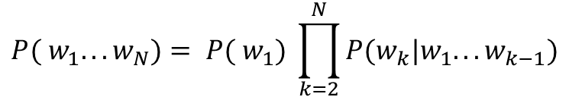
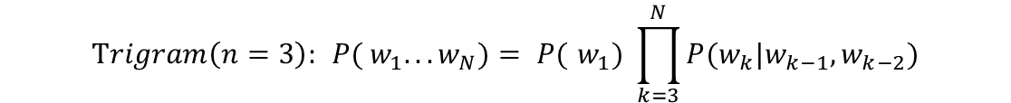
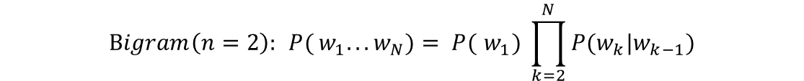
Language modeling
Statistical prediction for how strings are produced in a language
n-gam models
Prediction with p( next | full context)
Language models whose context is truncated to at most n-1 previous words
Context
next
word
Context
next
word
$$Unigram\left(n=1\right): { {P(}_{ }w_{1}. . .w_{N})= }_{ } \prod_{k=1}^{N}{{P(w}_{k})}$$
$${{P(}_{ }w_{1}. . .w_{N})= P(}_{ }w_{1}) \prod_{k=2}^{N}{{P(w}_{k}|w_{1}. . .w_{k−1})}$$
$$Bigram\left(n=2\right): { {P(}_{ }w_{1}. . .w_{N})= P(}_{ }w_{1}) \prod_{k=2}^{N}{{P(w}_{k}|w_{k−1})}$$
$$Trigram\left(n=3\right): { {P(}_{ }w_{1}. . .w_{N})= P(}_{ }w_{1}) \prod_{k=3}^{N}{{P(w}_{k}|w_{k−1},w_{k−2})}$$

Slide 13
Word2vec
Word2vec is a model used to create word embeddings which are vector representations of a particular word.
ripe
apple
(0.2, 0.6)
banana
(0.3, 0.5)
Word similarity(apple, banana) = (0.2 X 0.3) + (0.6 X 0.5) = 0.36
Word similarity(banana, protection) = 0.23
protection
(0.8, 0.1)
p(word|context)
Strong
More information:
https://arxiv.org/pdf/1301.3781.pdf
https://www.youtube.com/watch?v=gCRiLg-LuEs

