Slide 1
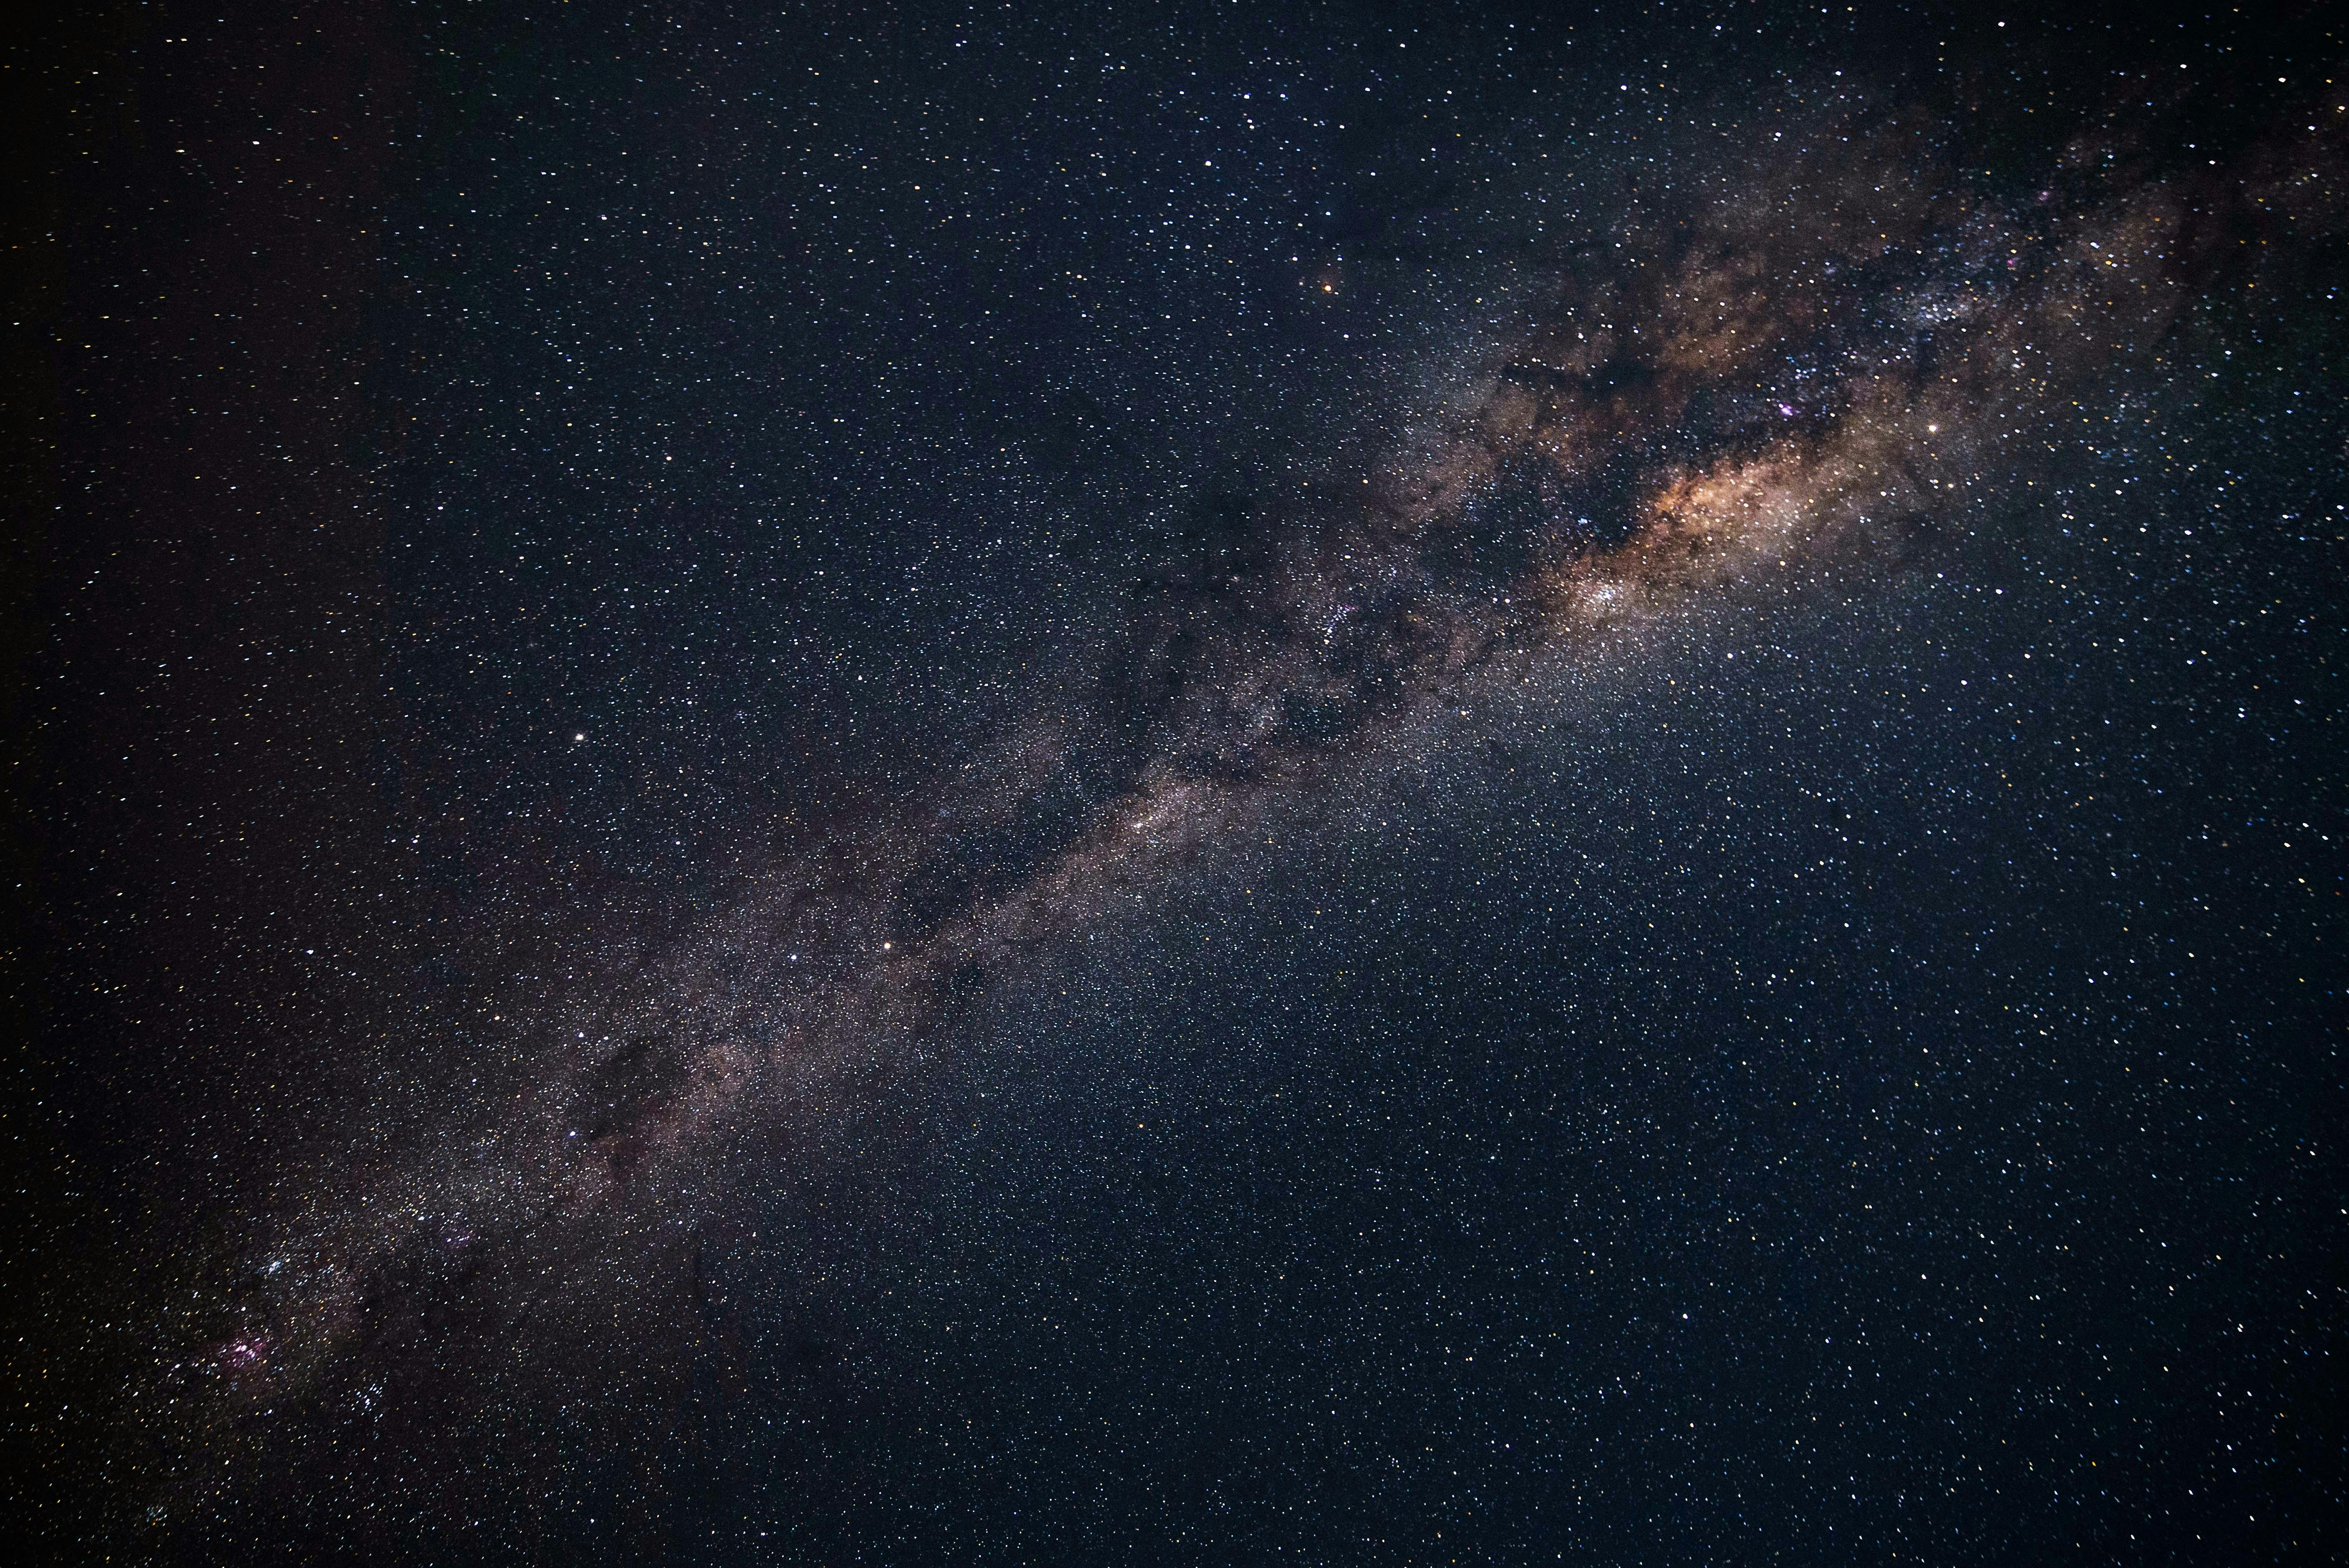



Slide 2
Team: Trotamusics
Challengue: Chronicles of Exoplanet Exploration
Project:

