Slide 1


DC-
DC+
Relay
Relay
Relay
Relay

Slide 2
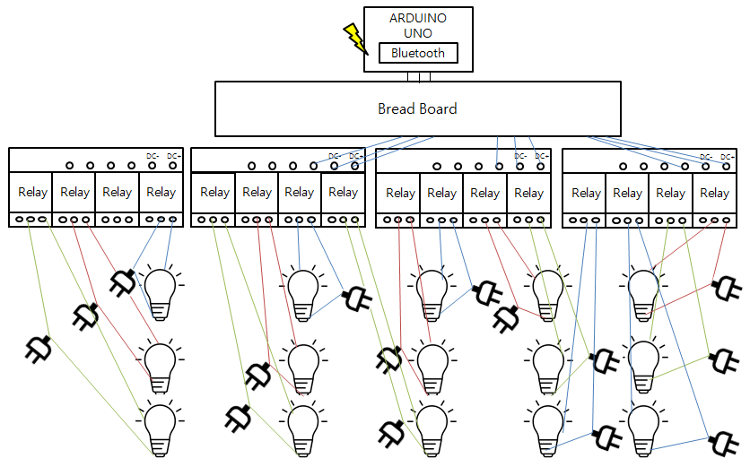

Slide 3
ARDUINO
UNO
Bluetooth
Bread Board
DC-
DC+
DC-
DC+
DC-
DC+
DC-
DC+
Relay
Relay
Relay
Relay
Relay
Relay
Relay
Relay
Relay
Relay
Relay
Relay
Relay
Relay
Relay
Relay

