Slide 2

Application Development Framework
and
Python-based Data Generation
Overview as of 2022-JUN

Slide 3
Solution Objectives
Solution Objectives
Create a technology stack that is portable and easily repurposed for different projects
Create a sensible code, directory, and document structure that can be maintained over years
Drive the application with sensible configuration files so that data can be quickly shaped to reflect many real or imagined businesses for presentations, marketing, pre-sales, or mock-ups in preparation for loading real client data.
Generate data that reflects a typical manufacturing or distribution environment
Generate data that includes features (core data fields) and labels (targets and/or outcomes)
Be able to emulate a business by continually adding more data in the same fashion that a real business adds data every new period (day, week, month) in a manner that continues initially established patterns
Be able to shape label content to drive the training of AI/ML models
Populate a database of any common type (flat-file, Oracle, SQL Server, MySQL, MariaDB) to reflect the kind of sources we are likely to encounter with clients
Create and maintain clear documents to aid both training and further development

Slide 4
Framework Elements
Framework Elements
GitHub (CVS – code versioning system)
AWS (Cloud, AI/ML components, user management)
Amplify (low-code toolset)
Flutter (“code-once; deploy-many” tool)
Cognito (user and group management)
GraphQL (easily configurable and scalable database-ish environment)
Databases (flat-file, Oracle, MariaDB, eventually others)
Snowflake (data analytics, data centralization for AI/ML engines)
AI/ML engine (e.g. AWS Sagemaker)
Python (primary coding language)
Python libraries (configparser, Faker, Pandas, etc)

Slide 5
Primary Challenges
Primary Challenges
Emulating inventory production and consumption
Determining LABEL content (better/worse outcomes used by an AI/ML model to train)
Determining what to measure
Ensuring we are creating better/worse outcomes that reflect real businesses
Feeding continually updated periods of new data to an AI/ML for re-execution (training)
Assessing AI/ML engine operation and outcomes and learning to improve our data
Generating actionable intelligence from the AI/ML outcomes (reporting, BI, dashboards)

Slide 6
SCM Data-Generation Methodology
Data & Engine Objectives
The objective is a single large table to feed to an AI/ML model
Be able to update that dataset repeatedly in a manner that aids training the AI/ML model
Apply the resultant trained model to real client data and generate measurable improvements to one or more elements of the data

Slide 7
SCM Data-Generation Methodology
Data & Engine Objectives
The objective is a single large table to feed to an AI/ML model
Be able to update that dataset repeatedly in a manner that aids training the AI/ML model
Apply the resultant trained model to real client data and generate measurable improvements to one or more elements of the data
Key Challenge
A single file with useful data can not easily be generated directly due to the complexity and dependencies inherent in real and representative SCM data (you have to fake an ERP)

Slide 8
SCM Data-Generation Methodology
Data & Engine Objectives
The objective is a single large table to feed to an AI/ML model
Be able to update that dataset repeatedly in a manner that aids training the AI/ML model
Apply the resultant trained model to real client data and generate measurable improvements to one or more elements of the data
Key Challenge
A single file with useful data can not easily be generated directly due to the complexity and dependencies inherent in real and representative SCM data (you have to fake an ERP)
Resulting Process
Determine calendar information (months or weeks, how much history, how much forecast, etc)
Populate one or more configuration files that quickly allow creation of representative client data
Using the config files, generate random but representative master data (e.g. items, locations)
Create a matrix that indicates which items have been sold/delivered to which locations
Generate random but representative per-period data for each item-to-location combination along with a number of features (actual data) and labels (targets, outcomes)
Feed that initial data to the AI/ML model
Generate new periods of data, each time feeding the updated dataset to the AI/ML model
Assess AI/ML model results, improve data generation, and repeat until useful results are gained

Slide 9

Topography
Elements
AWS
Central application and hub
AWS
Overall Application Host / Hub
User management (users, roles, security)
User Interface (web and/or mobile)
Source data (client or data-generation)
Snowflake (analytics platform)
AI/ML engines and tools (e.g. SageMaker)
Result data (e.g., BI, dashboard)
Result integration (to client systems)
GitHub.com
Development laptop
Python & Libraries
Local GitHub directory & repositories
Supporting tools
Local databases (optional)
SharePoint (documents)
Remote Oracle database
Data Generation
Configuration files
Calendar data
Master data (e.g. items, locations)
Matrix data (item-to-location combos)
Core data (per-period, features, labels)
User Mgmt
Users, roles, security
User Interface
Web
Mobile
Clear & Easy
Incoming data
From remote
Data-Gen
Windows
GitHub
Python
GitHub.com
Central hub for code
Stored in one or multiple repositories & subdirectories
Snowflake
Analytics
AI/ML engine control
Remote Oracle Database
Emulates typical client data sources
Provides source data
Will receive resultant data (improved data, analytics)
AI/ML model(s)
Evaluate
Analyze / improve
AI/ML engine control
Developer
Desktop version of GitHub
Local copy of any relevant code (repositories)
Python & libraries
Supporting tools
Local databases
Reports
B.I., Dashboards
Outgoing data
To remote
SharePoint (documents)
Design
Checklists
Training

Slide 10
Topography
Elements
Have chosen Amplify Flutter to allow a “build-once deploy-many” method for web, Android, and iOS use.
AWS
Central application and hub
AWS
Overall Application Host / Hub
User management (users, roles, security)
User Interface (web and/or mobile)
Source data (client or data-generation)
Snowflake (analytics platform)
AI/ML engines and tools (e.g. SageMaker)
Result data (e.g., BI, dashboard)
Result integration (to client systems)
GitHub.com
Development laptop
Python & Libraries
Local GitHub directory & repositories
Supporting tools
Local databases (optional)
SharePoint (documents)
Remote Oracle database
Data Generation
Configuration files
Calendar data
Master data (e.g. items, locations)
Matrix data (item-to-location combos)
Core data (per-period, features, labels)
User Mgmt
Users, roles, security
User Interface
Web
Mobile
Clear & Easy
Incoming data
From remote
Data-Gen
Windows
GitHub
Python
GitHub.com
Central hub for code
Stored in one or multiple repositories & subdirectories
Snowflake
Analytics
AI/ML engine control
Remote Oracle Database
Emulates typical client data sources
Provides source data
Will receive resultant data (improved data, analytics)
AI/ML model(s)
Evaluate
Analyze / improve
AI/ML engine control
Developer
Desktop version of GitHub
Local copy of any relevant code (repositories)
Python & libraries
Supporting tools
Local databases
Reports
B.I., Dashboards
Outgoing data
To remote
SharePoint (documents)
Design
Checklists
Training

Slide 11
Topography
Elements
Will use AWS “Cognito” to provide proven and secure user/group access.
Can also use end-client SSO.
AWS
Central application and hub
AWS
Overall Application Host / Hub
User management (users, roles, security)
User Interface (web and/or mobile)
Source data (client or data-generation)
Snowflake (analytics platform)
AI/ML engines and tools (e.g. SageMaker)
Result data (e.g., BI, dashboard)
Result integration (to client systems)
GitHub.com
Development laptop
Python & Libraries
Local GitHub directory & repositories
Supporting tools
Local databases (optional)
SharePoint (documents)
Remote Oracle database
Data Generation
Configuration files
Calendar data
Master data (e.g. items, locations)
Matrix data (item-to-location combos)
Core data (per-period, features, labels)
User Mgmt
Users, roles, security
User Interface
Web
Mobile
Clear & Easy
Incoming data
From remote
Data-Gen
Windows
GitHub
Python
GitHub.com
Central hub for code
Stored in one or multiple repositories & subdirectories
Snowflake
Analytics
AI/ML engine control
Remote Oracle Database
Emulates typical client data sources
Provides source data
Will receive resultant data (improved data, analytics)
AI/ML model(s)
Evaluate
Analyze / improve
AI/ML engine control
Developer
Desktop version of GitHub
Local copy of any relevant code (repositories)
Python & libraries
Supporting tools
Local databases
Reports
B.I., Dashboards
Outgoing data
To remote
SharePoint (documents)
Design
Checklists
Training

Slide 12
Topography
By changing the core function (application function) we can create, deploy and SELL new services based on intellectual property (I.P.) we create!
AWS
Central application and hub
Elements
AWS
Overall Application Host / Hub
User management (users, roles, security)
User Interface (web and/or mobile)
Source data (client or data-generation)
Snowflake (analytics platform)
AI/ML engines and tools (e.g. SageMaker)
Result data (e.g., BI, dashboard)
Result integration (to client systems)
GitHub.com
Development laptop
Python & Libraries
Local GitHub directory & repositories
Supporting tools
Local databases (optional)
SharePoint (documents)
Remote Oracle database
Data Generation
Configuration files
Calendar data
Master data (e.g. items, locations)
Matrix data (item-to-location combos)
Core data (per-period, features, labels)
User Mgmt
Users, roles, security
User Interface
Web
Mobile
Clear & Easy
Incoming data
From remote
Data-Gen
Windows
GitHub
Python
GitHub.com
Central hub for code
Stored in one or multiple repositories & subdirectories
Remote Oracle Database
Emulates typical client data sources
Provides source data
Will receive resultant data (improved data, analytics)
Any Application Function!
Examples include:
GL/SL reconciliation
RESTful data input/output
Survey-driven documentation
Etc…
Developer
Desktop version of GitHub
Local copy of any relevant code (repositories)
Python & libraries
Supporting tools
Local databases
Reports
B.I., Dashboards
Outgoing data
To remote
SharePoint (documents)
Design
Checklists
Training

Slide 13
Next: DataGen process overview

Slide 14
Data Generation: Initial
Calendar
ITEMs & LOCATIONS
MATRIX (items matched with locations, meta & memory)
CORE DATA (sales/inventory over many periods both past & future)

Slide 15
Data Generation: Improved
Calendar
ITEMs & LOCATIONS
MATRIX (items matched with locations, meta & memory)
CORE DATA (sales/inventory over many periods both past & future)
CORE DATA II (additional calculations that span periods)
Engine / Solution (AI/ML, Linear Algebra, Heuristics)
Actionable Intelligence (results, BI, Dashboard, deliverable)

Slide 16
Data Generation: Eventual
Calendar
ITEMs & LOCATIONS
MATRIX (items matched with locations, meta & memory)
CORE DATA (sales/inventory over many periods both past & future)
CORE DATA multi-period calculations performed directly in the cloud (e.g., database, snowflake)
Engine / Solution (AI/ML, Linear Algebra, Heuristics)
Actionable Intelligence (results, BI, Dashboard, deliverable)

Slide 17
Safety Stock
Why choose safety-stock to assess with AI/ML?
Of the many factors in a manufacturing or distribution process such as demand (orders, forecast), supply (manufacturing), distribution, lead times, cost & margin… safety stock is a singular value but interacts with several other factors.
It was simply low-hanging fruit to being our Apps Associates AI/ML journey.
Who cares?
Safety stock is not typically very dynamic, often never changing or changing annually or less.
A company that (e.g. high-volume CPG company) can be affected by safety stock. An intelligent update monthly or quarterly could improve inventory turnover and/or reduce stock-outs (improve service levels).
Challenges
A “supervised” ML model expects to be fed the “right” or “accurate” value and will attempt to calculate and equivalent right/accurate value for newly received data.
The challenge is that end-clients typically can’t provide a “right” value; they may have a acceptable value and can often tell you when it is roughly bad, roughly good, and roughly how to improve it.
Solution (for development purposes)?
We will generate an estimated safety stock using a rolling six-period average (based on future periods) and then apply simple math (e.g. 10% or 25% or 200% of orders/forecast) to arrive at an initial safety stock.
The initial safety stock will then be “corrected” using some simple IF-THEN logic in an attempt to provide a more accurate/desired value. This will then be submitted to the ML engine.

Slide 18
Safety Stock
Calculate: initial safety stock
The production capacity for a given item/location has to be randomly calculated (affected by config parameters).
The production capacity varies with the type of trend and trend-factors (e.g. amplitude).
The production capacity affects actual production, less any orders/forecast.
A safety stock is randomly chosen based on the production capacity and safety-stock factor (in config file)
Calculate: six-forward-period rolling average of net-requirements
Some combination of orders, forecast, and safety stock will product a net-requirement for production
This net-requirement can be converted to a rolling average and then used as a guide for safety-stock
For each period a starting, production, consumption, and ending inventory value is calculated.
When the ending inventory either goes negative (stock out) or gets too high (e.g. 3x the average) then the safety stock needs to be adjusted and/or a “max inventory” value set.
Calculate: perform adjustments to create a desired final safety-stock
The resulting rolling-average-safety-stock is then multiplied by an arbitrary (client-determined) factor to increase or decrease the scale.
The interim result is converted to an outcome range (LABEL): VeryLow, Low, OK, High, VeryHigh.
A corrective value is determined based on the outcome range.
The final corrected safety stock is then placed in the field SafetyStock02 for intake by the AI/ML engine.

Slide 19
Production and Inventory
Starting Inventory
All starting inventory is zero at the first period in history.
Production Capacity
In a real company production capacity is usually similar to typical demand.
If demand too high for capacity either investments would be made to increase capacity or a competitor would emerge to take the remaining demand in the market.
If demand is too low for capacity then capacity would be left (if cost effective to do so) or reduced (to free up capital) or the company would suffer losses.
So… capacity is initially set to a value related to the trend for a given ITEM (e.g. the amplitude of a seasonal trend).
At present this capacity remains fixed for the life of the item but this may be improved to alter over time.
Actual Production
A random amount of production will be calculated. Minimum and maximum capacity affect this calculation.
Ending Inventory
During the COREDATA2 file creation, each period will be assessed for starting-inventory and ending-inventory based on production and consumption (orders/forecast) each period.
If the ending-inventory is less than safety stock (or negative) then it is set to the safety-stock (a fill-or-kill scenario). No “missed volume” is currently moved forward to a future period or periods. Capacity is not.
It is the ending-inventory that is used to determine whether safety-stock is doing its job (bad, OK, good).

Slide 20
Next: Rough User-Interface Map

Slide 21
High-Level U.I.: Menu Map
Top-level Menu (multi environment)
Per-Environment Menu
Data Analytics
Apps AI/ML DEV
Apps AI/ML PRD
Client ACME DEV
Client ACME PRD
Application Development (R&D)
GL/SL Reconciliation DEV
GL/SL Reconciliation AI/ML PRD
Client Projects
Client ACME DEV
Client ACME PRD
Account Management
Users and Groups (AWS Cognito)
Permissions (AWS Cognito and/or GraphQL)
Support
Contact Apps Associates
Global Home
Return to multi-environment selection
Local Home
Return to local home screen
Administration
Users and Groups (AWS Cognito)
Permissions (AWS Cognito and/or GraphQL)
Applications
Integration: inbound data from remote systems (initiate process, review/edit data, approve for use)
Integration: DataGen: New Framework (initiate process, review/edit data, approve for use)
Integration: DataGen: New Period added to existing (initiate process, review/edit data, approve for use)
Merge: actual and generated data (initiate process, review/edit data, approve for use)
Submit: Snowflake (initiate process, review/edit data [pass control to Snowflake interface], approve for use)
Submit: Sagemaker
Execute: Sagemaker
Extract: Computed Results (may go to database, linux flat file, or to an AWS S3 directory as a flatfile)
Reporting
Process and Activity Monitoring
Local reports and dashboards
Exportable data and reports
Support
Contact Apps Associates

Slide 22
High-Level U.I.: Pending Tasks
Pending Tasks
First attempt at re-structuring the template to have a MENU and a PAGE for each of the items on the MENU MAP
Locate a python or PHP library/framework that can view/edit flatfiles
Create some buttons to “execute” a command (kick off a PHP, Python, or other program)
Represent data graphically
QuickSight (AWS)
Chartist (javascript) (https://www.creative-tim.com/tools/chartistjs)
Plotly (python) (https://plotly.com/python/)
etc.
Link to Cognito (without SSO): create user, log in, edit user, password/login reminder, etc
Enable SSO (note that Apps Associates internal network logins are connected to AWS with a form of SSO)

Slide 23
Next: Supply Chain Terms & Concepts

Slide 24
Supply Chain Terms & Concepts
Typical Manufacturing Company Terms & Concepts
Something to sell (ITEM, PRODUCT, SKU)
Some entity to sell your product to (customer, LOCATION, distributor, etc)
Awareness of where your inventory is (manufacturing site, warehouse, distribution center, in transit, at customer). These are all examples of LOCATION.
Manufacturing locations (could be owned/internal or could be CMOs [contract manufacturing organizations]).
Receiving dock for inbound raw materials
Quality check
Inbound storage
Manufacturing stages (raw processing, intermediates, finished goods, packaging)
Outbound storage
Terms
How much you are able to produce on a production line for a given ITEM is called “production capacity”
There is also “scrap” or “rework” for material that doesn’t make the grade (quality control).
Is production “constrained” or “unconstrained”
Shipping
Lead time: how long ahead of time must a customer order or for you to order materials or produce
Inventory management: how much (minimum/safety-stock or maximum) to keep where (inventory holding cost, inventory turns).
Demand Management (forecasting demand) and Supply Management (internal use of materials)
Software: ERP (Enterprise Resource Planning), Financial (orders, invoices, bulk contracts, cash management), special purpose (e.g. AI/ML, IoT, optimization, data warehouses, data lakes)
Platforms: in-cloud such as Oracle Cloud (SaaS), hybrid (IaaS), and on-premise such as Oracle EBS (old-school)

Slide 25
Next: Some representative images

Slide 26
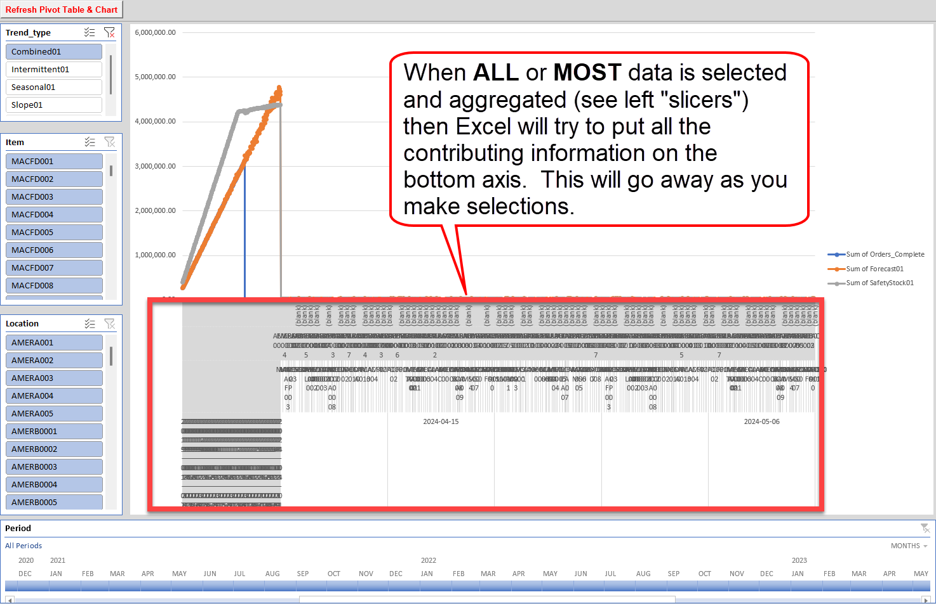
Sample
COREDATA2 from DataGen viewed in Excel: before filtering

Slide 27
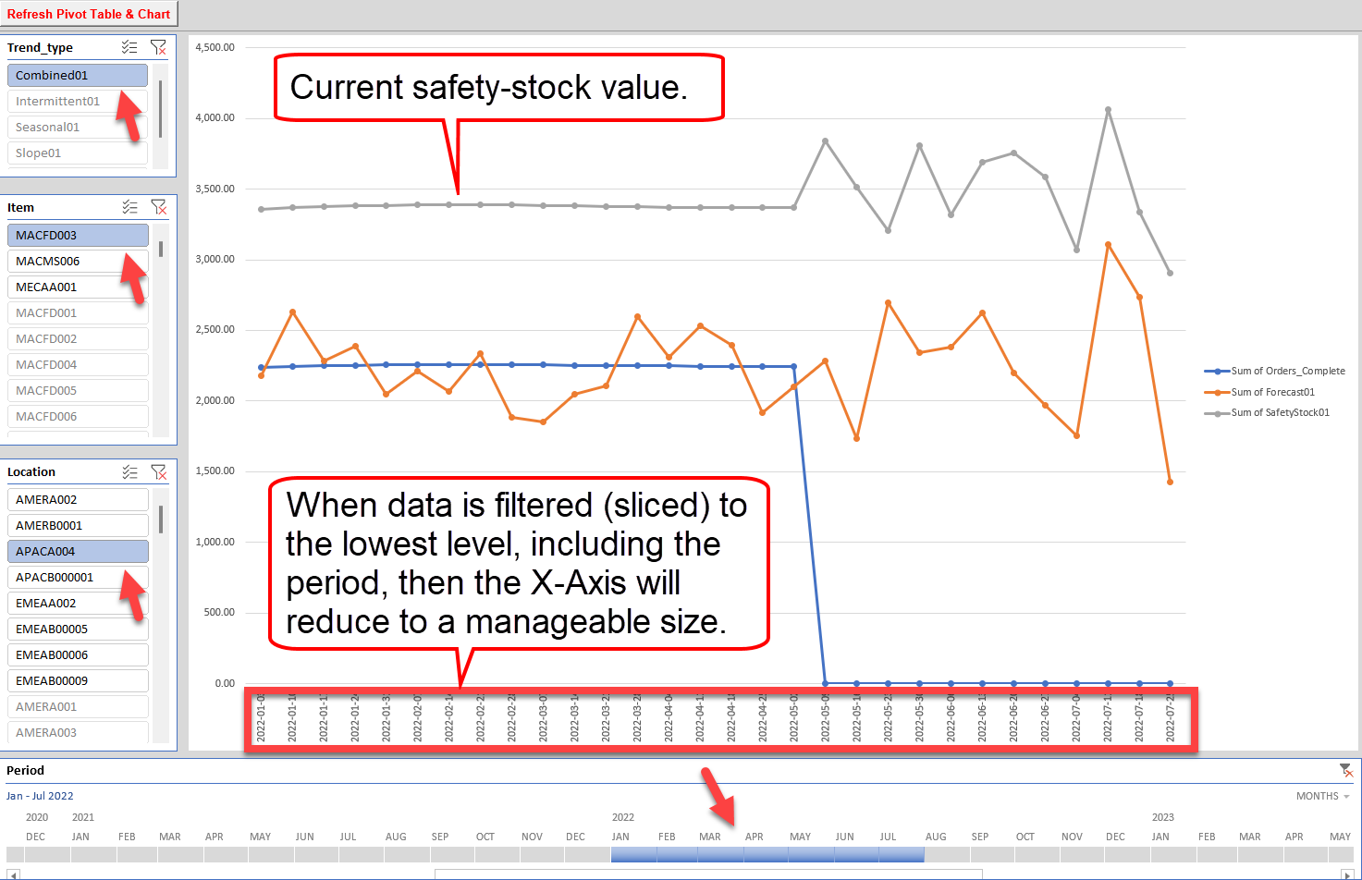
Sample
COREDATA2 from DataGen viewed in Excel: after filtering

Slide 28
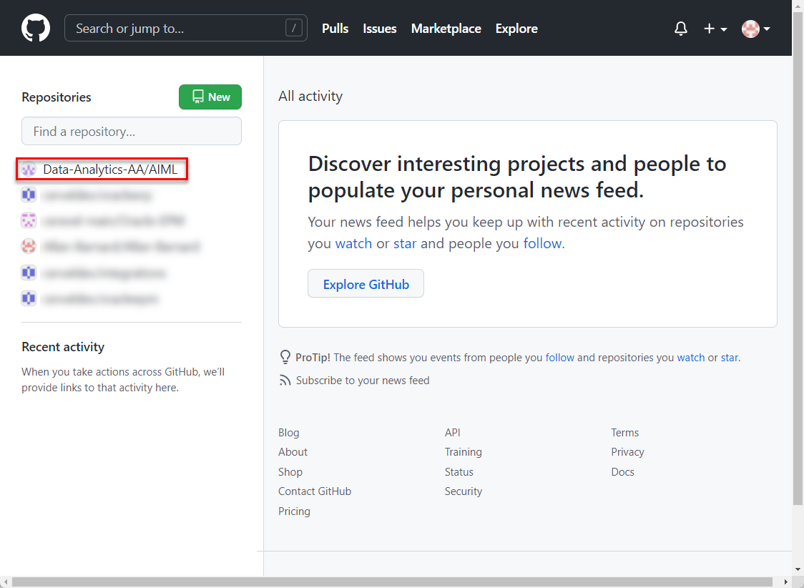
Sample
GitHub: web top-level
Create your own personal GitHub.com account
Be invited to one or more repositories (Apps Associates, Client)
Replicate on your own personal computer for day-to-day work

Slide 29
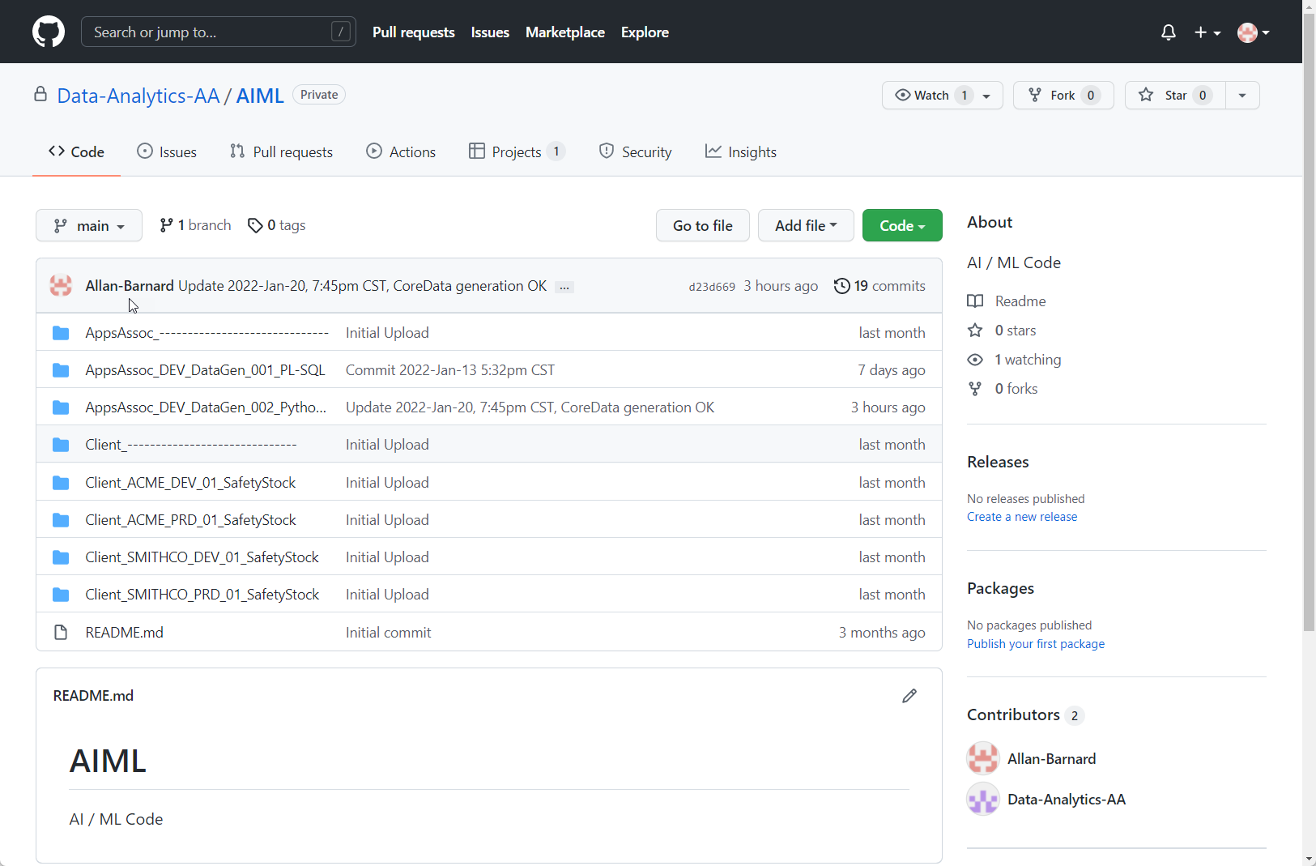
Sample
GitHub: web in-repository
Create your own personal GitHub.com account
Be invited to one or more repositories (Apps Associates, Client)
Replicate on your own personal computer for day-to-day work

Slide 30
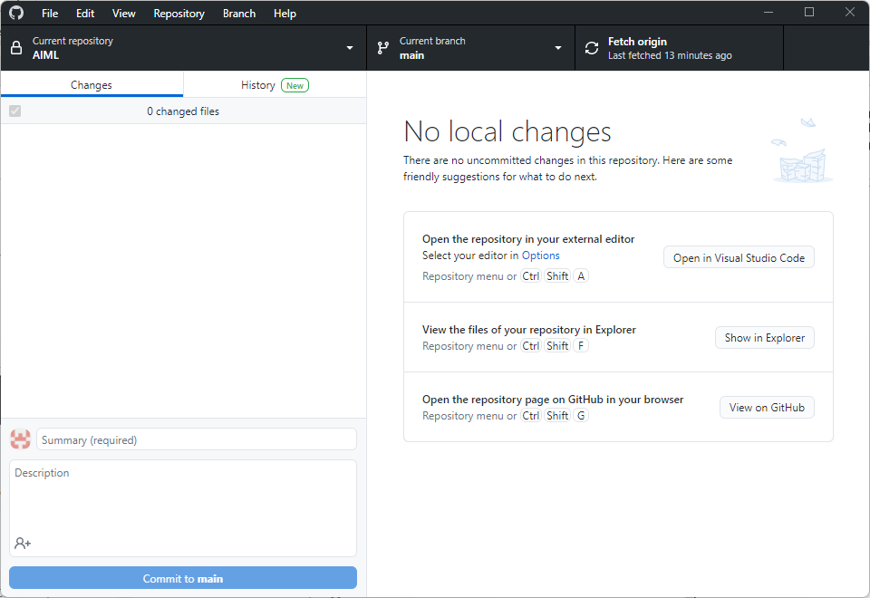
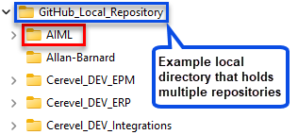
Sample
GitHub: Desktop
Synchronizes to and from the GitHub.com site
Watches for changes in your local directory (or directories)
Allows multiple team members to update the application code

Slide 31
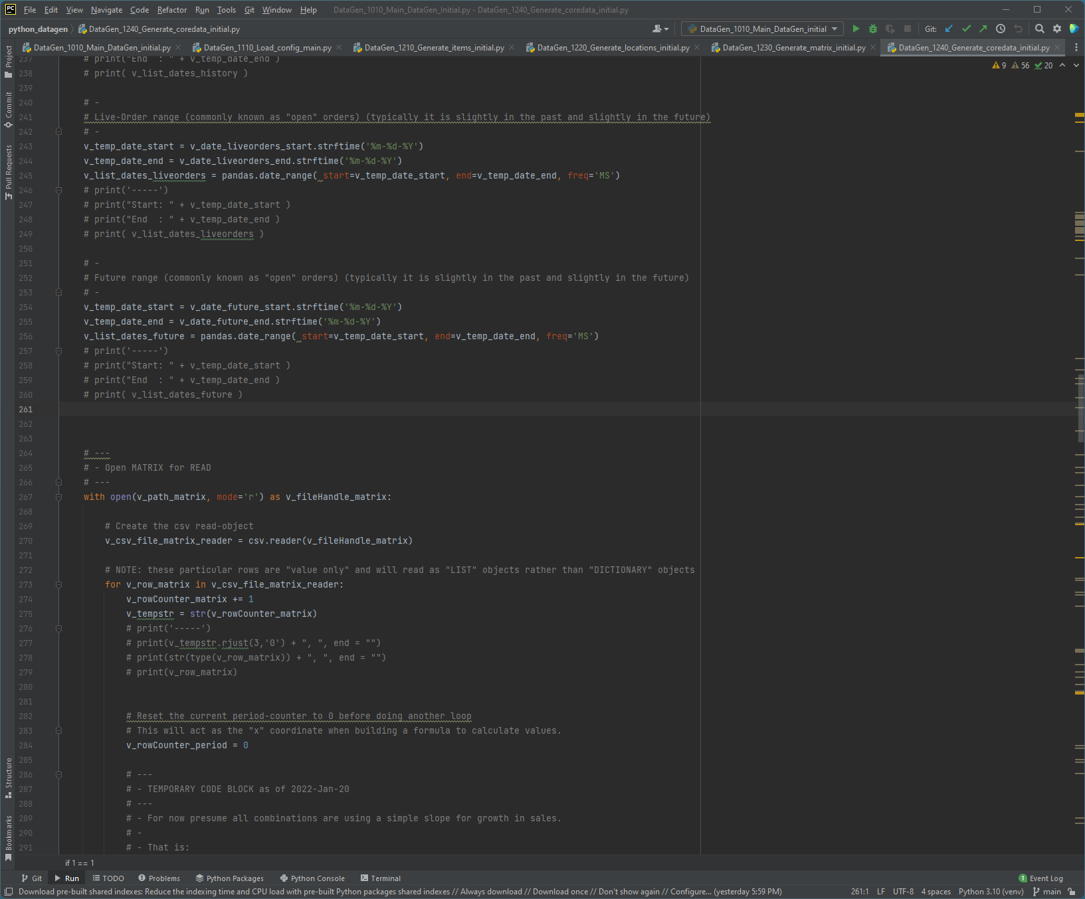
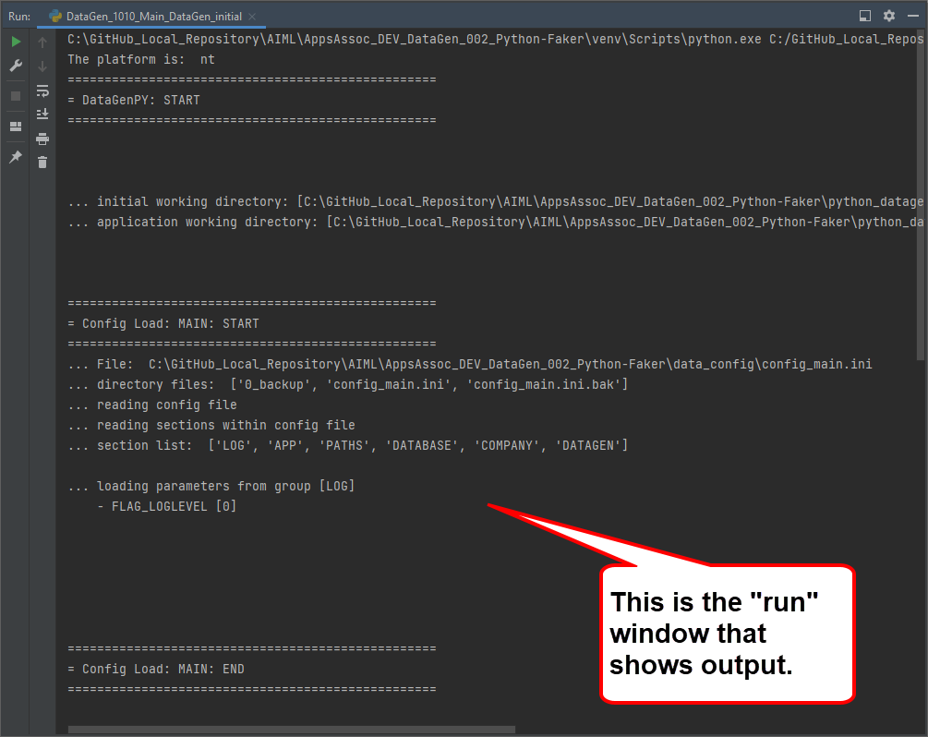
Sample
Python
Python and python libraries
PyCharm IDE (python editor)
Supporting tools like NotePad++ and MS Visual Studio Code

Slide 32
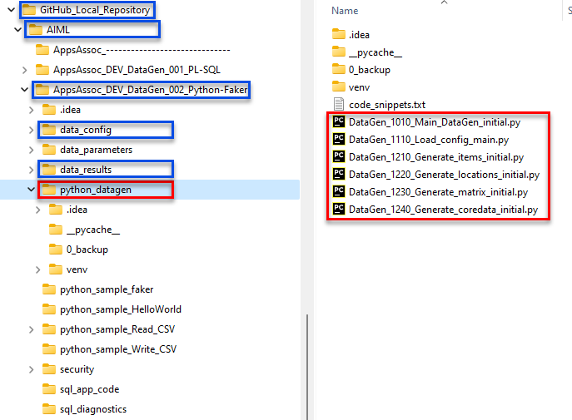
Sample
Python directories
Code
Configuration
Data

Slide 33
End

