Slide 1

第4课 Web前端-react实例
互联网应用开发技术
Web Application Development
Episode Four React Samples
陈昊鹏
chen-hp@sjtu.edu.cn

Slide 2
React
Download
https://github.com/facebook/react/
Reference
React快速上手开发
https://github.com/stoyan/reactbook
React报错 TypeError: Cannot read property 'setState' of undefined
https://blog.csdn.net/huanghanqian/article/details/80548100
JavaScript: Arrow Functions for Beginners
https://hackernoon.com/javascript-arrow-functions-for-beginners-926947fc0cdc
JavaScript初学者必看“箭头函数”
https://www.cnblogs.com/fundebug/p/6904753.html

Slide 3
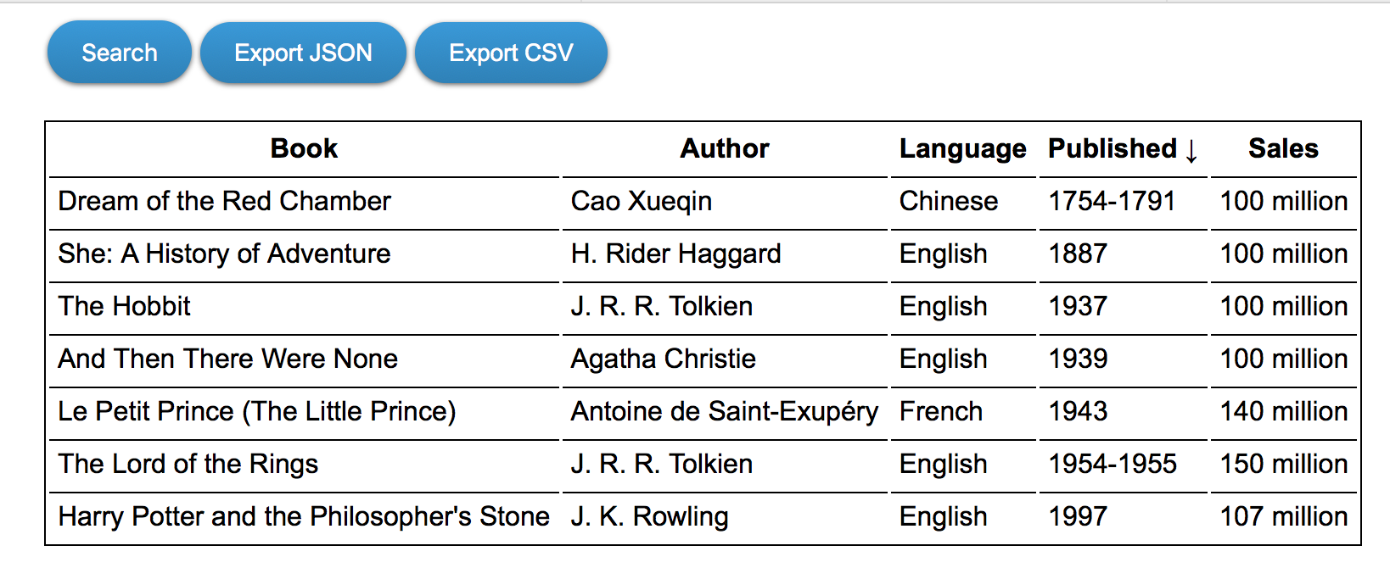
An Complex Example

Slide 4
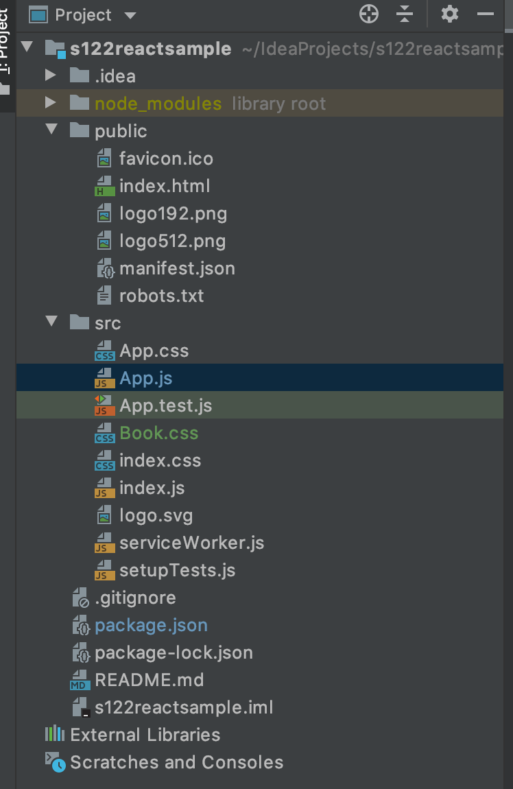
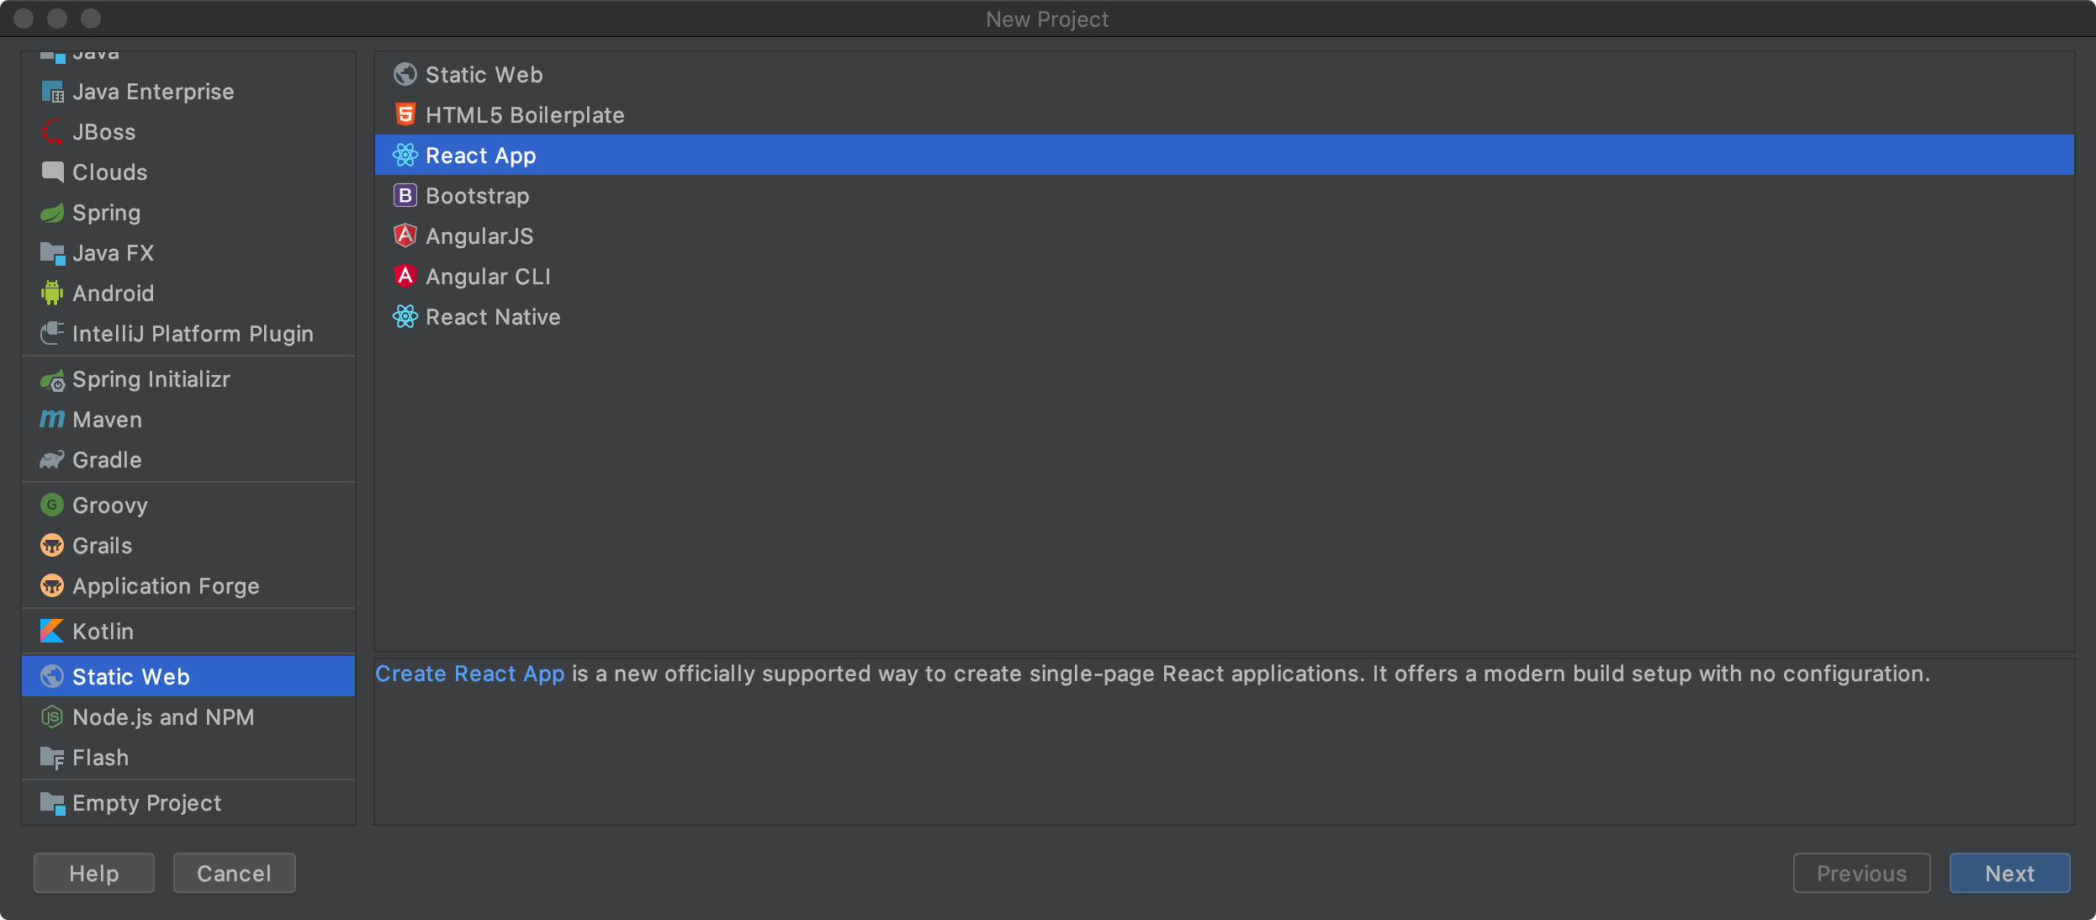
An Complex Example

Slide 5
An Complex Example
App.js
import React from 'react'; import ReactDOM from 'react-dom'; import PropTypes from 'prop-types'; import './Book.css';
const headers = ["Book", "Author", "Language", "Published", "Sales"];
const data = [
["The Lord of the Rings", "J. R. R. Tolkien", "English", "1954-1955", "150 million"],
["Le Petit Prince (The Little Prince)", "Antoine de Saint-Exupéry", "French", "1943", "140 million"],
["Harry Potter and the Philosopher's Stone", "J. K. Rowling", "English", "1997", "107 million"],
["And Then There Were None", "Agatha Christie", "English", "1939", "100 million"],
["Dream of the Red Chamber", "Cao Xueqin", "Chinese", "1754-1791", "100 million"],
["The Hobbit", "J. R. R. Tolkien", "English", "1937", "100 million"],
["She: A History of Adventure", "H. Rider Haggard", "English", "1887", "100 million"],
];

Slide 6
An Complex Example
class Excel extends React.Component { constructor(props) { super(props); this.state = { data: this.props.initialData, sortby: null, descending: false, edit: null, search: false, preSearchData: null, }; }
render = () => { return ( <div> {this.renderToolbar()} {this.renderTable()} </div> ); };

Slide 7
An Complex Example
renderToolbar = () => { return ( <div className="toolbar"> <button onClick={this.toggleSearch}>Search</button> <a onClick={this.download.bind(this, 'json')} href="data.json">Export JSON</a> <a onClick={this.download.bind(this, 'csv')} href="data.csv">Export CSV</a> </div> ); };
renderTable = () => { return ( <table> <thead onClick={this.sort}> <tr>{ this.props.headers.map(function (title, idx) { if (this.state.sortby === idx) { title += this.state.descending ? ' \u2191' : ' \u2193'; } return <th key={idx}>{title}</th>; }, this) }</tr> </thead> <tbody onDoubleClick={this.showEditor}> {this.renderSearch()}

Slide 8
An Complex Example
{this.state.data.map(function (row, rowidx) { return ( <tr key={rowidx}>{ row.map(function (cell, idx) { let content = cell; let edit = this.state.edit; if (edit && edit.row === rowidx && edit.cell === idx) { content = ( <form onSubmit={this.save}> <input type="text" defaultValue={cell}/> </form> ); } return <td key={idx} data-row={rowidx}>{content}</td>; }, this)} </tr> ); }, this)} </tbody> </table> ); }

Slide 9
An Complex Example
sort = (e) => { let column = e.target.cellIndex; let data = this.state.data.slice(); let descending = this.state.sortby === column
&& !this.state.descending; data.sort(function (a, b) { return descending ? (a[column] < b[column] ? 1 : -1) : (a[column] > b[column] ? 1 : -1); }); this.setState({ data: data, sortby: column, descending: descending, }); };

Slide 10
An Complex Example
showEditor = (e) => { this.setState({ edit: { row: parseInt(e.target.dataset.row, 10), cell: e.target.cellIndex, } }); }; save = (e) => { e.preventDefault(); let input = e.target.firstChild; let data = this.state.data.slice(); data[this.state.edit.row][this.state.edit.cell] = input.value; this.setState({ edit: null, data: data, }); };

Slide 11
An Complex Example
toggleSearch = () => { if (this.state.search) { this.setState({ data: this.preSearchData, search: false, }); this.preSearchData = null; } else { this.preSearchData = this.state.data; this.setState({ search: true, }); } };

Slide 12
An Complex Example
search = (e) => { let needle = e.target.value.toLowerCase(); if (!needle) { this.setState({data: this.preSearchData}); return; } let idx = e.target.dataset.idx; let searchdata = this.preSearchData.filter(function (row) { return row[idx].toString().toLowerCase().indexOf(needle) > -1; }); this.setState({data: searchdata}); };
renderSearch = () => { if (!this.state.search) { return null; } return ( <tr onChange={this.search}> {this.props.headers.map(function (ignore, idx) { return <td key={idx}><input type="text" data-idx={idx}/></td>; })} </tr> ); };

Slide 13
An Complex Example
download(format, ev) { let contents = format === 'json' ? JSON.stringify(this.state.data) : this.state.data.reduce(function (result, row) { return result + row.reduce(function (rowresult, cell, idx) { return rowresult + '"' + cell.replace(/"/g, '""') + '"' + (idx < row.length - 1 ? ',' : ''); }, '') + "\n"; }, ''); let URL = window.URL || window.webkitURL; let blob = new Blob([contents], {type: 'text/' + format}); ev.target.href = URL.createObjectURL(blob); ev.target.download = 'data.' + format; };

Slide 14
An Complex Example
Excel.propTypes = { headers: PropTypes.arrayOf( PropTypes.string ), initialData: PropTypes.arrayOf( PropTypes.arrayOf( PropTypes.string ) ), }; function App() { return ( ReactDOM.render( React.createElement(Excel, { headers: headers, initialData: data }), document.getElementById("root") ) ); }
export default App;

Slide 15

Web开发技术
Web Application Development
Thank You!

