Slide 1

第5课 Web前端-VUE简介
互联网应用开发技术
Web Application Development
Episode Five Vue Tutorials
陈昊鹏
chen-hp@sjtu.edu.cn

Slide 2
Vue
From
Vue Guide
https://vuejs.org/v2/guide/
Vue教程
https://cn.vuejs.org/v2/guide/
References
基于Idea从零搭建一个最简单的vue项目
https://www.jianshu.com/p/9c1d4f8ed068
electron-netease-cloud-music
https://github.com/Rocket1184/electron-netease-cloud-music
Vue.js Examples
https://vuejsexamples.com

Slide 3
Introduction
What is Vue.js?
Vue (pronounced /vjuː/, like view) is a progressive framework for building user interfaces.
Declarative Rendering
<div id="app">
{{ message }}
</div>
Vue.createApp({ data() { return { message: 'Hello Vue!' } } }).mount('#app')
Demo 1

Slide 4
Introduction
Declarative Rendering v-bind
<div id="app-2">
<span v-bind:title="message">
Hover your mouse over me for a few seconds
to see my dynamically bound title!
</span>
</div>
Vue.createApp({ data() { return { message: 'You loaded this page on ' + new Date().toLocaleString() } } }).mount('#app-2')
Demo 2

Slide 5
Introduction
Conditionals v-if
<div id="app-3">
<span v-if="seen">Now you see me</span>
</div>
Vue.createApp({ data() { return { seen: false } } }).mount('#app-3')
Demo 3

Slide 6
Introduction
Loops v-for
<div id="app-4">
<ol>
<li v-for="todo in todos">
{{ todo.text }}
</li>
</ol>
</div>
Vue.createApp({ data() { return { todos: [ { text: 'Learn JavaScript' }, { text: 'Learn Vue' }, { text: 'Build something awesome' } ] } }, methods: { addItem() { this.todos.push({text: 'Learn React'}) } } }).mount('#app-4')
Demo 4

Slide 7
Introduction
Handling User Input
<div id="app-5">
<p>{{ message }}</p>
<button v-on:click="reverseMessage">Reverse Message</button>
</div>
Vue.createApp({ data() { return { message: 'Hello Vue.js!' } }, methods: { reverseMessage() { this.message = this.message.split('').reverse().join('') } } }).mount('#app-5')
Demo 5

Slide 8
Introduction
Handling User Input
<div id="app-6">
<p>{{ message }}</p>
<input v-model:"message">
</div>
Vue.createApp({ data() { return { message: 'Hello Vue!' } } }).mount('#app-6')
Demo 6

Slide 9
Introduction
Composing with Components

Slide 10
Introduction
Composing with Components
<div id="app"> <ol> <!-- Now we provide each todo-item with the todo object it‘s representing, so that its content can be dynamic. We also need to provide each component with a “key”, which will be explained later. --> <todo-item v-for="item in groceryList" v-bind:todo="item" v-bind:key="item.id" ></todo-item> </ol> </div>
Demo 7

Slide 11
Introduction
Composing with Components
<script type="module"> import TodoItem from './TodoItem.js' Vue.createApp({ components: { TodoItem }, data() { return { groceryList: [ { id: 0, text: 'Vegetables' }, { id: 1, text: 'Cheese' }, { id: 2, text: 'Whatever else humans are supposed to eat' } ] } } }).mount('#app') </script>
Demo 7

Slide 12
Introduction
Composing with Components
TodoItem.js
export default { props: { todo: Object }, template: '<li>{{ todo.text }}</li>' }
Demo 7

Slide 13
The Vue Instance
Create a Vue Instance
Vue.createApp({ // options })
A Vue application consists of a root Vue instance created with Vue.createApp,
optionally organized into a tree of nested, reusable components.
Root Instance
└─ TodoList
├─ TodoItem
│ ├─ DeleteTodoButton
│ └─ EditTodoButton
└─ TodoListFooter
├─ ClearTodosButton
└─ TodoListStatistics

Slide 14
The Vue Instance
Data and Methods
Vue.createApp({ data() { return { foo: 'bar' } } }).mount('#app’)
<p>{{ foo }}</p> <!-- this will no longer update `foo`! --> <button v-on:click="foo = 'baz'">Change it</button>
Demo 8
Notes:
Object.freeze() 方法可以冻结一个对象。一个被冻结的对象再也不能被修改;

Slide 15
The Vue Instance
Instance Lifecycle Hooks
Vue.createApp({ data() { return{ a: 1 } }, created() { // `this` points to the vm instance console.log('a is: ' + this.a) } }).mount('#app') // => "a is: 1"
Demo 9

Slide 16
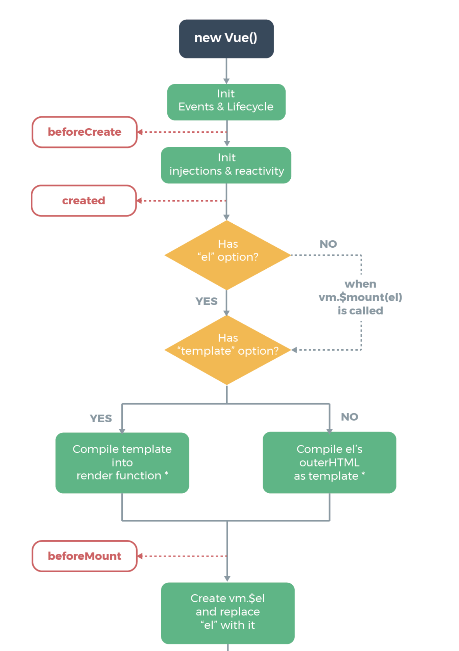

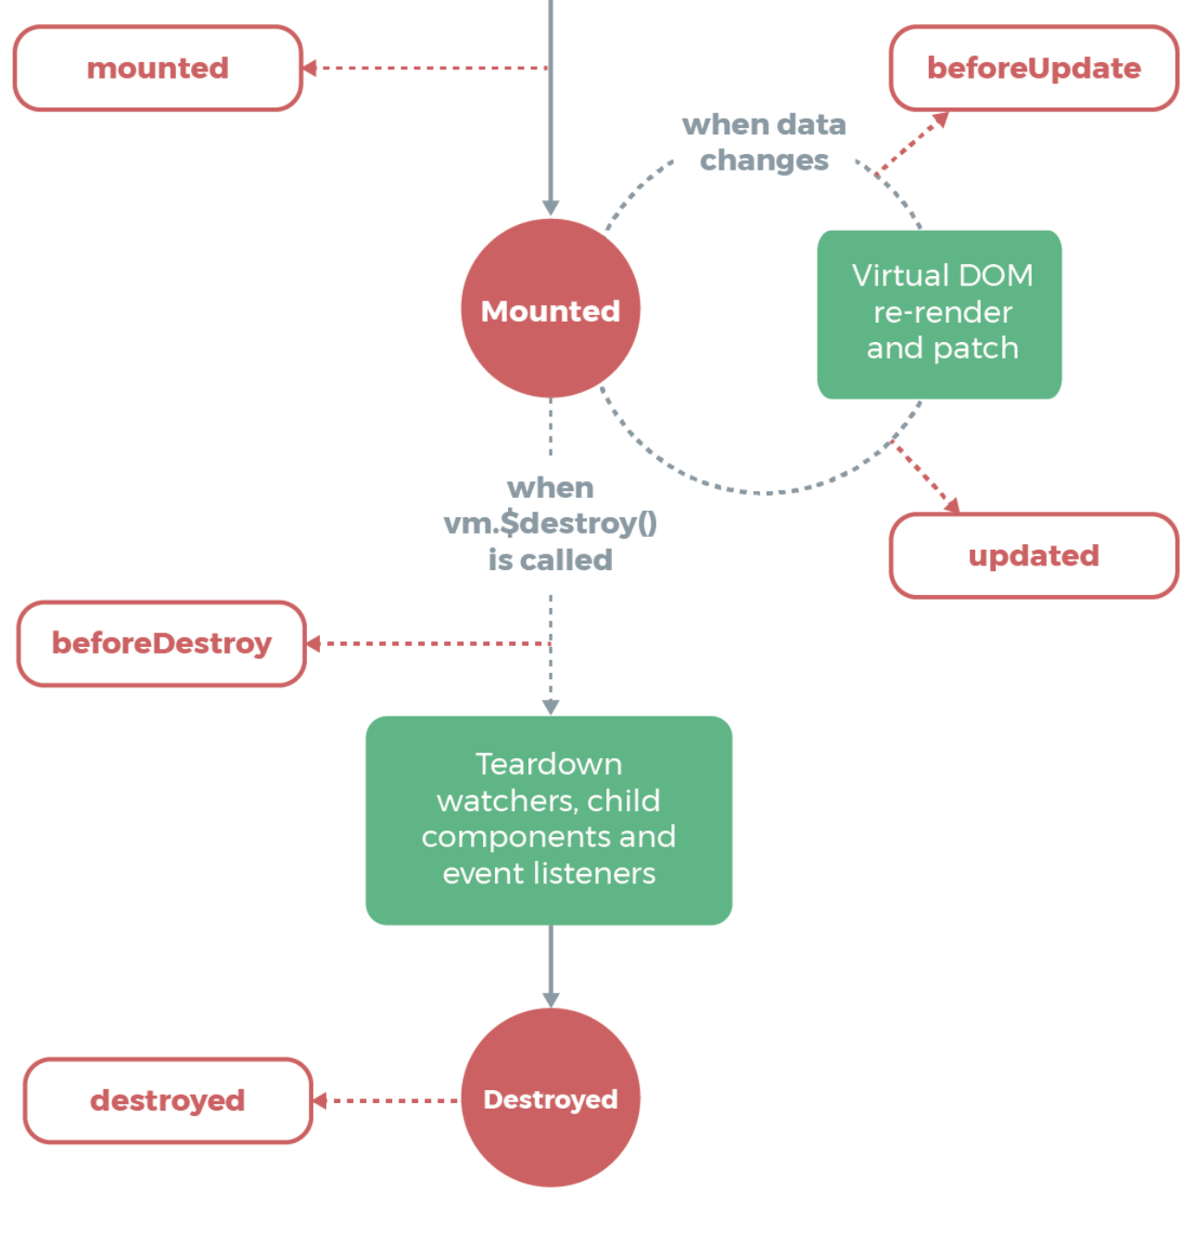
Lifecycle Diagram

Slide 17
Template Syntax
Vue.js uses an HTML-based template syntax
that allows you to declaratively bind the rendered DOM to the underlying Vue instance’s data.
All Vue.js templates are valid HTML
that can be parsed by spec-compliant browsers and HTML parsers.
Under the hood, Vue compiles the templates into Virtual DOM render functions.
Combined with the reactivity system, Vue is able to intelligently figure out the minimal number of components to re-render and apply the minimal amount of DOM manipulations when the app state changes.

Slide 18
Template Syntax - Interpolations
Text
<span>Message: {{ msg }}</span>
<span v-once>This will never change: {{ msg }}</span>
RawHTML
<p>Using mustaches: {{ rawHtml }}</p>
<p>Using v-html directive: <span v-html="rawHtml"></span></p>
Attribute
<div v-bind:id="dynamicId"></div>
<button v-bind:disabled="isButtonDisabled">Button</button>
Using JavaScript Expression
{{ number + 1 }}
{{ ok ? 'YES' : 'NO’ }}
{{ message.split('').reverse().join('') }}
<div v-bind:id="'list-' + id"></div>
Demo 10

Slide 19
Template Syntax - Directives
Arguments
<a v-bind:href="url"> ... </a>
<a v-on:click="doSomething"> ... </a>
Dynamic Arguments
<a v-bind:[attributeName]="url"> ... </a>
<a v-on:[eventName]="doSomething"> ... </a>
Modifier
<form v-on:submit.prevent="onSubmit"> ... </form>

Slide 20
Template Syntax - Shorthands
v-bind Shorthand
<!-- full syntax -->
<a v-bind:href="url"> ... </a>
<!-- shorthand -->
<a :href="url"> ... </a>
<!-- shorthand with dynamic argument (2.6.0+) -->
<a :[key]="url"> ... </a>
v-on Shorthand
<!-- full syntax -->
<a v-on:click="doSomething"> ... </a>
<!-- shorthand -->
<a @click="doSomething"> ... </a>
<!-- shorthand with dynamic argument (2.6.0+) -->
<a @[event]="doSomething"> ... </a>

Slide 21
Computed Properties
Basic Example
<div id="example">
<p>Original message: "{{ message }}"</p>
<p>Computed reversed message: "{{ reversedMessage }}"</p>
</div>
Vue.createApp({ data(){ return{ message: 'Hello' } }, computed: { // a computed getter reversedMessage () { // `this` points to the vm instance return this.message.split('').reverse().join('') } } }).mount('#example')
Demo 11

Slide 22
Computed Properties
Computed Caching vs Methods
You may have noticed we can achieve the same result by invoking a method in the expression:
<p>Reversed message: "{{ reverseMessage() }}"</p>
// in component
methods: {
reverseMessage() {
return this.message.split('').reverse().join(’’)
}
}
This also means the following computed property will never update, because Date.now() is not a reactive dependency:
computed: {
now() { return Date.now() }
}
Demo 12

Slide 23
Computed Properties
Computed Setter
// ...
computed: {
Vue.createApp({ data() { return { firstName: 'Foo', lastName: 'Bar', } }, computed: { fullName: { // getter get() { return this.firstName + ' ' + this.lastName }, // setter set(newValue) { // Note: we are using destructuring assignment syntax here. [this.firstName, this.lastName] = newValue.split(' ') } } } }).mount('#demo')
Demo 13
Notes:
Computed properties are by default getter-only, but you can also provide a setter when you need it:

Slide 24
Computed Properties
Watcher
Vue.createApp({ data() { return{ question: ‘’, answer: ‘I cannot give you an answer until you ask a question!’ } }, watch: { question(newQuestion, oldQuestion) { this.answer = 'Waiting for you to stop typing...' this.debouncedGetAnswer() } }, created() { this.debouncedGetAnswer = _.debounce(this.getAnswer, 500) },
Demo 14
Notes:
While computed properties are more appropriate in most cases, there are times when a custom watcher is necessary. That’s why Vue provides a more generic way to react to data changes through the watch option. This is most useful when you want to perform asynchronous or expensive operations in response to changing data.

Slide 25
Computed Properties
Watcher
methods: { getAnswer() { if (this.question.indexOf(‘?’) === -1) { this.answer = ‘Questions usually contain a question mark. ;-)’ return } this.answer = ‘Thinking...’ var vm = this axios.get(‘https://yesno.wtf/api’) .then(function (response) { vm.answer = _.capitalize(response.data.answer) }) .catch(function (error) { vm.answer = ‘Error! Could not reach the API. ’ + error }) } } })
Demo 14
Notes:
While computed properties are more appropriate in most cases, there are times when a custom watcher is necessary. That’s why Vue provides a more generic way to react to data changes through the watch option. This is most useful when you want to perform asynchronous or expensive operations in response to changing data.

Slide 26
Class and Style Bindings
A common need for data binding is manipulating an element’s class list and its inline styles.
Since they are both attributes, we can use v-bind to handle them:
we only need to calculate a final string with our expressions.
However, meddling with string concatenation is annoying and error-prone.
For this reason, Vue provides special enhancements when v-bind is used with class and style.
In addition to strings, the expressions can also evaluate to objects or arrays.

Slide 27
Binding HTML Classes
Object Syntax
<div v-bind:class="{ active: isActive }"></div>
<div
class="static"
v-bind:class="{ active: isActive, 'text-danger': hasError }" >
</div>
data() {
return { isActive: true, hasError: false }
}
=>
<div class="static active"></div>
Notes:
The above syntax means the presence of the active class will be determined by the truthiness of the data property isActive.
You can have multiple classes toggled by having more fields in the object. In addition, the v-bind:class directive can also co-exist with the plain class attribute. So given the following template:

Slide 28
Binding HTML Classes
Object Syntax
<div v-bind:class="classObject"></div>
data() {
return {
classObject: {
active: true,
'text-danger': false
}
}
}
=>
<div class="static active"></div>
Notes:
The bound object doesn’t have to be inline:
This will render the same result.

Slide 29
Binding HTML Classes
Object Syntax
<div v-bind:class="classObject"></div>
data() {
return {
isActive: true,
error: null
}
},
computed: {
classObject() {
return {
active: this.isActive && !this.error,
'text-danger': this.error && this.error.type === 'fatal'
}
}
}
Notes:
The bound object doesn’t have to be inline:
This will render the same result.

Slide 30
Binding HTML Classes
Array Syntax
<div :class="[activeClass, errorClass]"></div>
data() {
return{
activeClass: 'active',
errorClass: 'text-danger'
}
}
=>
<div class="active text-danger"></div>
<div v-bind:class="[isActive ? activeClass : '', errorClass]"></div>
<div v-bind:class="[{ active: isActive }, errorClass]"></div>
Notes:
We can pass an array to v-bind:class to apply a list of classes:
If you would like to also toggle a class in the list conditionally, you can do it with a ternary expression:
This will always apply errorClass, but will only apply activeClass when isActive is truthy.

Slide 31
Binding HTML Classes
With Components
Vue.component('my-component', {
template: '<p class="foo bar">Hi</p>'
})
<my-component class="baz boo"></my-component>
=>
<p class=“foo bar baz boo”>Hi</p>
<my-component v-bind:class="{ active: isActive }"></my-component>
=>
<p class=“foo bar active” >Hi</p>

Slide 32
Binding Inline Styles
Object Syntax
<div
v-bind:style="{ color: activeColor, fontSize: fontSize + 'px' }">
</div>
data() {
return { activeColor: 'red', fontSize: 30 }
}
<div v-bind:style="styleObject"></div>
data () {
return {
styleObject: {color: 'red', fontSize: '13px' }
}
}
Notes:
The object syntax for v-bind:style is pretty straightforward - it looks almost like CSS, except it’s a JavaScript object. You can use either camelCase or kebab-case (use quotes with kebab-case) for the CSS property names:
It is often a good idea to bind to a style object directly so that the template is cleaner:

Slide 33
Binding Inline Styles
Array Syntax
<div v-bind:style="[baseStyles, overridingStyles]"></div>
Auto-prefixing
Vue will automatically detect and add appropriate prefixes to the applied styles
Multiple Values
<div
v-bind:style="{ display: ['-webkit-box', '-ms-flexbox', 'flex'] }">
</div>
Notes:
The array syntax for v-bind:style allows you to apply multiple style objects to the same element:
This will only render the last value in the array which the browser supports. In this example, it will render display: flex for browsers that support the unprefixed version of flexbox.

Slide 34
Conditional Rendering
v-if
<h1 v-if="awesome">Vue is awesome!</h1>
<h1 v-if="awesome">Vue is awesome!</h1>
<h1 v-else>Oh no 😢</h1>
Conditional Groups with v-if on <template>
<template v-if="ok">
<h1>Title</h1>
<p>Paragraph 1</p>
<p>Paragraph 2</p>
</template>
Notes:
The directive v-if is used to conditionally render a block. The block will only be rendered if the directive’s expression returns a truthy value.
Because v-if is a directive, it has to be attached to a single element. But what if we want to toggle more than one element? In this case we can use v-if on a <template> element, which serves as an invisible wrapper. The final rendered result will not include the <template> element.

Slide 35
Conditional Rendering
v-else
<div v-if="Math.random() > 0.5">
Now you see me
</div>
<div v-else>
Now you don’t
</div>
v-else-if
<div v-if="type === 'A'"> A </div>
<div v-else-if="type === 'B'"> B </div>
<div v-else-if="type === 'C'"> C </div>
<div v-else> Not A/B/C </div>
Notes:
You can use the v-else directive to indicate an “else block” for v-if:
The v-else-if, as the name suggests, serves as an “else if block” for v-if. It can also be chained multiple times:
Similar to v-else, a v-else-if element must immediately follow a v-if or a v-else-if element.

Slide 36


Conditional Rendering
Controlling Resusable Elements with key
<template v-if="loginType === 'username'">
<label>Username</label>
<input placeholder="Enter your username">
</template>
<template v-else>
<label>Email</label>
<input placeholder="Enter your email address">
</template>
Demo 15
Notes:
Vue tries to render elements as efficiently as possible, often re-using them instead of rendering from scratch. Beyond helping make Vue very fast, this can have some useful advantages. For example, if you allow users to toggle between multiple login types:
Then switching the loginType in the code above will not erase what the user has already entered. Since both templates use the same elements, the <input> is not replaced - just its placeholder.

Slide 37

Conditional Rendering
Controlling Resusable Elements with key
<template v-if="loginType === 'username'">
<label>Username</label>
<input placeholder="Enter your username" key= "username-input" >
</template>
<template v-else>
<label>Email</label>
<input placeholder="Enter your email address" key= "email-input" >
</template>
Notes:
Note that the <label> elements are still efficiently re-used, because they don’t have key attributes

Slide 38
Conditional Rendering
v-show
<h1 v-show="ok">Hello!</h1>
v-if vs. v-show
v-if is “real” conditional rendering because it ensures that event listeners and child components inside the conditional block are properly destroyed and re-created during toggles.
v-if is also lazy: if the condition is false on initial render, it will not do anything - the conditional block won’t be rendered until the condition becomes true for the first time.
v-if with v-for
Using v-if and v-for together is not recommended.
Notes:
Another option for conditionally displaying an element is the v-show directive. The usage is largely the same:
The difference is that an element with v-show will always be rendered and remain in the DOM; v-show only toggles the display CSS property of the element.
v-if is “real” conditional rendering because it ensures that event listeners and child components inside the conditional block are properly destroyed and re-created during toggles.
v-if is also lazy: if the condition is false on initial render, it will not do anything - the conditional block won’t be rendered until the condition becomes true for the first time.
In comparison, v-show is much simpler - the element is always rendered regardless of initial condition, with CSS-based toggling.
Generally speaking, v-if has higher toggle costs while v-show has higher initial render costs. So prefer v-show if you need to toggle something very often, and prefer v-if if the condition is unlikely to change at runtime.

Slide 39
List Rendering
Mapping an Array to Elements with v-for
<ul id="example-1">
<li v-for="item in items">
{{ item.message }}
</li>
</ul>
Vue.createApp({
data() {
return{
items: [
{ message: 'Foo' },
{ message: 'Bar' }
]
}
}
}).mount('#example-1')
Notes:
We can use the v-for directive to render a list of items based on an array. The v-for directive requires a special syntax in the form of item in items, where items is the source data array and item is an alias for the array element being iterated on:

Slide 40
List Rendering
Mapping an Array to Elements with v-for
<ul id="example-1">
<li v-for="item in items">
{{ parentMessage }} - {{ index }} - {{ item.message }}
</li>
</ul>
Vue.createApp({ data() { return{ parentMessage: 'Parent', items: [ { message: 'Foo' }, { message: 'Bar' } ] } } }).mount('#example-1')
Demo 16
Notes:
We can use the v-for directive to render a list of items based on an array. The v-for directive requires a special syntax in the form of item in items, where items is the source data array and item is an alias for the array element being iterated on:

Slide 41
List Rendering
v-for with an Object
<ul id="example">
<li v-for= "(value, name, index) in object"> {{ index }} . {{ name }} : {{ value }}
</li>
</ul>
Vue.createApp({ data() { return{ object: { title: 'How to do lists in Vue', author: 'Jane Doe', publishedAt: '2016-04-10' } } } }).mount('#v-for-object')
Demo 17
Notes:
When iterating over an object, the order is based on the enumeration order of Object.keys(), which is not guaranteed to be consistent across JavaScript engine implementations.

Slide 42
Array Change Detection
Mutation Methods
Vue wraps an observed array’s mutation methods so they will also trigger view updates. The wrapped methods are:
push()
pop()
shift()
unshift()
splice()
sort()
reverse()
Demo 4: app4.todos.push({text: 'Learn React'})

Slide 43
Array Change Detection
Replacing an Array
example1.items = example1.items.filter(function (item) {
return item.message.match(/Foo/)
})
Demo 4:
app4.todos = app4.todos.filter(function (item) {
return item.text.match('Learn Vue')
})
Notes:
Mutation methods, as the name suggests, mutate the original array they are called on. In comparison, there are also non-mutating methods, e.g. filter(), concat() and slice(), which do not mutate the original array but always return a new array. When working with non-mutating methods, you can replace the old array with the new one:
You might think this will cause Vue to throw away the existing DOM and re-render the entire list - luckily, that is not the case. Vue implements some smart heuristics to maximize DOM element reuse, so replacing an array with another array containing overlapping objects is a very efficient operation.

Slide 44
Array Change Detection
Caveats
Due to limitations in JavaScript, Vue cannot detect the following changes to an array:
When you directly set an item with the index, e.g.
vm.items[indexOfItem] = newValue
When you modify the length of the array, e.g.
vm.items.length = newLength
var vm = new Vue({
data: {
items: ['a', 'b', 'c'] }
})
vm.items[1] = 'x' // is NOT reactive
vm.items.length = 2 // is NOT reactive

Slide 45
Array Change Detection
Caveats
var vm = new Vue({
data: {
items: ['a', 'b', 'c'] }
})
vm.items[1] = 'x' // is NOT reactive
=>
// Vue.set
Vue.set(vm.items, indexOfItem, newValue)
// Array.prototype.splice
vm.items.splice(indexOfItem, 1, newValue)
// instance.set
vm.$set(vm.items, indexOfItem, newValue)

Slide 46
Array Change Detection
Caveats
var vm = new Vue({
data: {
items: ['a', 'b', 'c'] }
})
vm.items.length = 2 // is NOT reactive
=>
vm.items.splice(newLength)

Slide 47
Array Change Detection
Object Change Detection Caveats
Vue cannot detect property addition or deletion.
var vm = new Vue({
data: {
a: 1
}
}) // `vm.a` is now reactive
vm.b = 2 // `vm.b` is NOT reactive
Vue does not allow dynamically adding new root-level reactive properties to an already created instance.
Notes:
Again due to limitations of modern JavaScript, Vue cannot detect property addition or deletion. For example:

Slide 48
Array Change Detection
Object Change Detection Caveats
However, it’s possible to add reactive properties to a nested object.
var vm = new Vue({
data: {
userProfile: {
name: 'Anika'
}
})
Vue.set(vm.userProfile, 'age', 27)
vm.$set(vm.userProfile, 'age', 27)
Object.assign(vm.userProfile, {
age: 27,
favoriteColor: 'Vue Green’
})
vm.userProfile = Object.assign({}, vm.userProfile, {
age: 27,
favoriteColor: 'Vue Green’
})
Notes:
Again due to limitations of modern JavaScript, Vue cannot detect property addition or deletion. For example:

Slide 49
Array Change Detection
Displaying Filtered/Sorted Results
<li v-for="n in evenNumbers">{{ n }}</li>
data() { return{ numbers: [ 1, 2, 3, 4, 5 ] } }, computed: { evenNumbers: function () { return this.numbers.filter(function (number) { return number % 2 === 0 }) } }
Demo 18
Notes:
Sometimes we want to display a filtered or sorted version of an array without actually mutating or resetting the original data. In this case, you can create a computed property that returns the filtered or sorted array.

Slide 50
Array Change Detection
Displaying Filtered/Sorted Results
<ul v-for="set in sets">
<li v-for="n in even(set)">{{ n }}</li>
</ul>
Vue.createApp({ data() { return{ sets: [[ 1, 2, 3, 4, 5 ], [6, 7, 8, 9, 10]] } }, methods: { even: function (numbers) { return numbers.filter(function (number) { return number % 2 === 0 }) } } }).mount('#object')
Demo 19
Notes:
Sometimes we want to display a filtered or sorted version of an array without actually mutating or resetting the original data. In this case, you can create a computed property that returns the filtered or sorted array.

Slide 51
Array Change Detection
v-for with a Range
<div> <span v-for="n in 10">{{ n }} </span> </div>
Notes:
Sometimes we want to display a filtered or sorted version of an array without actually mutating or resetting the original data. In this case, you can create a computed property that returns the filtered or sorted array.

Slide 52
Array Change Detection
v-for with a Component
<div id="todo-list-example">
<form v-on:submit.prevent="addNewTodo">
<label for="new-todo">Add a todo</label>
<input
v-model="newTodoText"
id="new-todo"
placeholder="E.g. Feed the cat"
>
<button>Add</button>
</form>
<ul>
<todo-item
is="todo-item"
v-for="(todo, index) in todos"
v-bind:key="todo.id"
v-bind:title="todo.title"
v-on:remove="todos.splice(index, 1)" >
</todo-item>
</ul>
</div>
Notes:
Sometimes we want to display a filtered or sorted version of an array without actually mutating or resetting the original data. In this case, you can create a computed property that returns the filtered or sorted array.

Slide 53
Array Change Detection
v-for with a Component
todoitemx.js
export default { props: ['title'], template: '\ <li>\ {{ title }}\ <button v-on:click="$emit(\'remove\')">Remove</button>\ </li>\ ' }

Slide 54
Array Change Detection
v-for with a Component
import TodoItem from “./todoitemx.js”; Vue.createApp({ components: { TodoItem }, data(){ return{ newTodoText: '',
todos: [
{ id: 1, title: 'Do the dishes', },
{ id: 2, title: 'Take out the trash', },
{ id: 3, title: 'Mow the lawn' } ],
nextTodoId: 4 } }, methods: { addNewTodo() { this.todos.push({ id: this.nextTodoId++, title: this.newTodoText }) this.newTodoText = '' } } }).mount('#todo-list-example')
Demo 20

Slide 55
Event Handling
Listening to Events
<div id="example-1">
<button v-on:click="counter += 1">Add 1</button>
<p>The button above has been clicked {{ counter }} times.</p>
</div>
Vue.createApp({
data() {
return{
counter: 0
}
}
}).mount('#example-1')

Slide 56
Event Handling
Method Event Handlers
<div id="example-3">
<button v-on:click="say('hi')">Say hi</button>
<button v-on:click="say('what')">Say what</button>
</div>
Vue.createApp({
methods: {
say(message) {
alert(message)
}
}
}).mount('#example-3')

Slide 57
Event Handling
Method Event Handlers
<button v-on:click=
"warn('Form cannot be submitted yet.', $event)">
Submit
</button>
methods: {
warn (message, event) {
// now we have access to the native event
if (event) {
event.preventDefault()
}
alert(message)
}
}

Slide 58
Event Handling
Event Modifiers
<!-- the click event's propagation will be stopped -->
<a v-on:click.stop="doThis"></a>
<!-- the submit event will no longer reload the page -->
<form v-on:submit.prevent="onSubmit"></form>
<!-- modifiers can be chained -->
<a v-on:click.stop.prevent="doThat"></a>
<!-- just the modifier -->
<form v-on:submit.prevent></form>
<!-- use capture mode when adding the event listener -->
<!-- i.e. an event targeting an inner element is handled here -->
<!-- before being handled by that element -->
<div v-on:click.capture="doThis">...</div>
Notes:
It is a very common need to call event.preventDefault() or event.stopPropagation() inside event handlers. Although we can do this easily inside methods, it would be better if the methods can be purely about data logic rather than having to deal with DOM event details.
To address this problem, Vue provides event modifiers for v-on. Recall that modifiers are directive postfixes denoted by a dot.

Slide 59
Event Handling
Event Modifiers
<!-- only trigger handler if event.target is the element itself -->
<!-- i.e. not from a child element -->
<div v-on:click.self="doThat">...</div>
<!-- the click event will be triggered at most once -->
<a v-on:click.once="doThis"></a>
<!-- the scroll event's default behavior (scrolling) will happen -->
<!-- immediately, instead of waiting for `onScroll` to complete -->
<!-- in case it contains `event.preventDefault()` -->
<div v-on:scroll.passive="onScroll">...</div>
Notes:
It is a very common need to call event.preventDefault() or event.stopPropagation() inside event handlers. Although we can do this easily inside methods, it would be better if the methods can be purely about data logic rather than having to deal with DOM event details.
To address this problem, Vue provides event modifiers for v-on. Recall that modifiers are directive postfixes denoted by a dot.

Slide 60
Event Handling
Key Modifiers
<!-- only call `vm.submit()` when the `key` is `Enter` -->
<input v-on:keyup.enter="submit">
<input v-on:keyup.page-down="onPageDown">
Key Code
.enter, .tab, .delete (captures both “Delete” and “Backspace” keys)
.esc, .space, .up, .down, .left, .right
<input v-on:keyup.13="submit">
Notes:
When listening for keyboard events, we often need to check for specific keys. Vue allows adding key modifiers for v-on when listening for key events:

Slide 61
Event Handling
System Modifier Keys
.ctrl, .alt, .shift, .meta
<!-- Alt + C -->
<input v-on:keyup.alt.67="clear">
<!-- Ctrl + Click -->
<div v-on:click.ctrl="doSomething">Do something</div>
.exact Modifer
<!-- this will fire even if Alt or Shift is also pressed -->
<button v-on:click.ctrl="onClick">A</button>
<!-- this will only fire when Ctrl and no other keys are pressed -->
<button v-on:click.ctrl.exact="onCtrlClick">A</button>
<!-- this will only fire when no system modifiers are pressed -->
<button v-on:click.exact="onClick">A</button>
Notes:
You can use the following modifiers to trigger mouse or keyboard event listeners only when the corresponding modifier key is pressed:
Why Listeners in HTML?
You might be concerned that this whole event listening approach violates the good old rules about “separation of concerns”. Rest assured - since all Vue handler functions and expressions are strictly bound to the ViewModel that’s handling the current view, it won’t cause any maintenance difficulty. In fact, there are several benefits in using v-on:
It’s easier to locate the handler function implementations within your JS code by skimming the HTML template.
Since you don’t have to manually attach event listeners in JS, your ViewModel code can be pure logic and DOM-free. This makes it easier to test.
When a ViewModel is destroyed, all event listeners are automatically removed. You don’t need to worry about cleaning it up yourself.

Slide 62
Form Input Bindings – Basic Usage
Text
<input v-model="message" placeholder="edit me">
<p>Message is: {{ message }}</p>
Multiline text
<span>Multiline message is:</span>
<p style="white-space: pre-line;">{{ message }}</p>
<br>
<textarea v-model="message" placeholder="add multiple lines">
</textarea>
Checkbox
<input type="checkbox" id ="checkbox" v-model ="checked" >
<label for ="checkbox">{{ checked }}</label>
Demo 21

Slide 63
Form Input Bindings – Basic Usage
Checkbox
<div id='example-3'>
<input type="checkbox" id="jack" value="Jack" v-model="checkedNames">
<label for="jack">Jack</label>
<input type="checkbox" id="john" value="John" v-model="checkedNames">
<label for="john">John</label>
<input type="checkbox" id="mike" value="Mike" v-model="checkedNames">
<label for="mike">Mike</label>
<br>
<span>Checked names: {{ checkedNames }}</span>
</div>
Vue.createApp({
data() {
return{
checkedNames: []
}
}
}).mount('#example-3')
Demo 21

Slide 64
Form Input Bindings – Basic Usage
Radio
<input type="radio" id="one" value="One" v-model="picked">
<label for="one">One</label>
<br>
<input type="radio" id="two" value="Two" v-model="picked">
<label for="two">Two</label>
<br>
<span>Picked: {{ picked }}</span>
Demo 21

Slide 65
Form Input Bindings – Basic Usage
Select – Single Select
<select v-model="selected">
<option disabled value="">Please select one</option>
<option>A</option>
<option>B</option>
<option>C</option>
</select>
<span>Selected: {{ selected }}</span>
Vue.createApp({
data: {
return{
selected: ''
}
}
}).mount('#example-3')
Demo 21

Slide 66
Form Input Bindings – Basic Usage
Select – Multiple Select
<select v-model="selected" multiple>
<option disabled value="">Please select one</option>
<option>A</option>
<option>B</option>
<option>C</option>
</select>
<span>Selected: {{ selected }}</span>
Vue.createApp({
data: {
return{
selected: ''
}
}
}).mount('#example-3')
Demo 21

Slide 67
Form Input Bindings – Basic Usage
Select – Dynamic options rendered with v-for
<select v-model="selected">
<option v-for="option in options" v-bind:value="option.value">
{{ option.text }}
</option>
</select>
<span>Selected: {{ selected }}</span>
Vue.createApp({
data() {
return{
selected: 'A',
options: [
{ text: 'One', value: 'A' },
{ text: 'Two', value: 'B' },
{ text: 'Three', value: 'C' } ]
}
}
}).mount('#example-3')
Demo 21

Slide 68
Form Input Bindings – Value Binding
Value Binding
For radio, checkbox and select options, the v-model binding values are usually static strings (or booleans for checkbox):
<!-- `picked` is a string "a" when checked -->
<input type="radio" v-model="picked" value="a">
<!-- `toggle` is either true or false -->
<input type="checkbox" v-model="toggle">
<!-- `selected` is a string "abc" when the first option is selected -->
<select v-model="selected">
<option value="abc">ABC</option>
</select>
But sometimes we may want to bind the value to a dynamic property on the Vue instance.
We can use v-bind to achieve that.
In addition, using v-bind allows us to bind the input value to non-string values.
Demo 22
Notes:
For radio, checkbox and select options, the v-model binding values are usually static strings (or booleans for checkbox):
But sometimes we may want to bind the value to a dynamic property on the Vue instance. We can use v-bind to achieve that. In addition, using v-bind allows us to bind the input value to non-string values.

Slide 69
Form Input Bindings – Value Binding
Checkbox
<input
type="checkbox"
v-model="toggle"
true-value="yes"
false-value="no"
>
// when checked:
vm.toggle === 'yes'
// when unchecked:
vm.toggle === 'no'
Demo 22

Slide 70
Form Input Bindings – Value Binding
Radio
<input
type="radio"
v-model="pick"
v-bind:value="a"
>
// when checked:
vm.pick === a
Demo 22

Slide 71
Form Input Bindings – Value Binding
Select options
<select v-model="selected">
<!-- inline object literal -->
<option v-bind:value="{ number: 123 }">123</option>
</select>
// when selected:
typeof vm.selected // => 'object’
vm.selected.number // => 123
Demo 22

Slide 72
Form Input Bindings – Modifier
.lazy
<!-- synced after "change" instead of "input" -->
<input v-model.lazy="msg">
.number
<input v-model.number="age" type="number">
.trim
<input v-model.trim="msg">
Demo 22

Slide 73
Component Basic
Base Example
<div id= " components-demo " > <button-counter></button-counter> </div> <script> // Define a new component called button-counter Vue.component(' button-counter ', { data: function () { return { count: 0 } }, template: ' <button v-on:click= " count++ " >
You clicked me {{ count }} times.</button> ' }) new Vue({ el: '#components-demo' }) </script>
Demo 23

Slide 74
Component Basic
Reusing Components
<div id= " components-demo " > <button-counter></button-counter>
<button-counter></button-counter> <button-counter></button-counter> </div>
data Must Be a Function
data: function () { return { count: 0 } },
Demo 23

Slide 75
Component Basic
Passing Data to Child Components with Props
Vue.component('blog-post', {
props: ['title'],
template: '<h3>{{ title }}</h3>‘
})
<div id="blog-demo">
<blog-post title="My journey with Vue"></blog-post>
<blog-post title="Blogging with Vue"></blog-post>
<blog-post title="Why Vue is so fun"></blog-post>
</div>
new Vue({el: '#blogs-demo'})
Demo 23
Notes:
Props are custom attributes you can register on a component.

Slide 76
Component Basic
Passing Data to Child Components with Props
Vue.component('blog-post', {
props: ['title'],
template: '<h3>{{ title }}</h3>‘
})
<div id="blog-post-demo"> <blog-post v-for="post in posts" v-bind:key="post.id" v-bind:title="post.title" ></blog-post> </div>
new Vue({ el: '#blog-post-demo', data: { posts: [ {id: 1, title: 'My journey with Vue'}, {id: 2, title: 'Blogging with Vue'}, {id: 3, title: 'Why Vue is so fun'} ] } })
Demo 23
Notes:
Props are custom attributes you can register on a component.

Slide 77
Component Basic
A Single Root Element
Every component must have a single root element.
<div class="blog-post">
<h3>{{ title }}</h3>
<div v-html="content"></div>
</div>
<blog-post // error-prone
v-for="post in posts"
v-bind:key="post.id"
v-bind:title="post.title"
v-bind:content="post.content"
v-bind:publishedAt="post.publishedAt"
v-bind:comments="post.comments"
></blog-post>
Notes:
Props are custom attributes you can register on a component.

Slide 78
Component Basic
A Single Root Element
Every component must have a single root element.
<blog-post
v-for="post in posts"
v-bind:key="post.id"
v-bind:post="post"
></blog-post>
Vue.component('blog-post', {
props: ['post'],
template: `
<div class="blog-post">
<h3>{{ post.title }}</h3>
<div v-html="post.content"></div>
</div> `
})
Notes:
Props are custom attributes you can register on a component.

Slide 79
Component Basic
Listening to Child Component Events
Vue.component('blog-post-event', { props: ['post'], template: '
<div class="blog-post">
<h3>{{ post.title }}</h3>
<button v-on:click="$emit(\'enlarge-text\')">
Enlarge text
</button>
<div v-html="post.content"></div>
</div>’ })
Demo 23
Notes:
As we develop our <blog-post> component, some features may require communicating back up to the parent. For example, we may decide to include an accessibility feature to enlarge the text of blog posts, while leaving the rest of the page its default size:

Slide 80
Component Basic
Listening to Child Component Events
<div id="blog-posts-events-demo"> <div :style="{ fontSize: postFontSize + 'em' }"> <blog-post-event v-for="post in posts" v-bind:key="post.id" v-bind:post="post" v-on:enlarge-text="postFontSize += 0.1" ></blog-post-event> </div> </div>
new Vue({ el: '#blog-posts-events-demo', data: { posts: [ {id: 1, title: 'My journey with Vue'}, {id: 2, title: 'Blogging with Vue'}, {id: 3, title: 'Why Vue is so fun'} ], postFontSize: 1 } })
Demo 23
Notes:
As we develop our <blog-post> component, some features may require communicating back up to the parent. For example, we may decide to include an accessibility feature to enlarge the text of blog posts, while leaving the rest of the page its default size:

Slide 81
Component Basic
Emitting a Value With an Event
Vue.component('blog-post-event', { props: ['post'], template: '
<div class="blog-post">
<h3>{{ post.title }}</h3>
<button v-on:click="$emit(\'enlarge-text\', 0.1)">
Enlarge text
</button>
<div v-html="post.content"></div>
</div>’ })

Slide 82
Component Basic
Then when we listen to the event in the parent, we can access the emitted event’s value with $event:
<blog-post ... v-on:enlarge-text="postFontSize += $event" >
</blog-post>
Or, if the event handler is a method:
<blog-post ... v-on:enlarge-text="onEnlargeText" ></blog-post>
Then the value will be passed as the first parameter of that method:
methods: {
onEnlargeText: function (enlargeAmount) {
this.postFontSize += enlargeAmount
}
}

Slide 83
Component Basic
Using v-model on Components
<input v-model="searchText">
=>
<input
v-bind:value="searchText"
v-on:input="searchText = $event.target.value"
>
Vue.component('custom-input’, {
props: ['value’],
template: `
<input
v-bind:value="value"
v-on:input="$emit('input', $event.target.value)" > `
})
<custom-input v-model="searchText"></custom-input>
Demo 23

Slide 84
Component Basic
Content Distribution with Slots
<alert-box> Something bad happened. </alert-box>
Vue.component('alert-box', {
template: `
<div class="demo-alert-box">
<strong>Error!</strong>
<slot></slot>
</div> `
})
Demo 23

Slide 85

Web开发技术
Web Application Development
Thank You!

