Slide 1
E5 Toolkit Tutorial
Musicminion/e5-toolkit (github.com)

Slide 2
版权声明
使用者可以将全部或部分本内容免费用于非商业用途
使用者在使用全部或部分本内容时请注明来源
对于不遵守此声明或者其他违法使用本内容者，将依法保留追究权
本内容的发布采用 Creative Commons Attribution 4.0 License
完整文本：https://creativecommons.org/licenses/by/4.0/legalcode

Slide 3
PREPRATION

Slide 4
What do you need?
To build a server with e5-renew(qyi), you need:
A Server (At least 2 core and 2G memory, Ubuntu 20 LTS)
A Domain(Also need matched SSL cert, Nginx type)
Configure Domain Name System(DNS) resolution to your server‘s IP address(check by ` ping your.domain.com`)
Deploying to your localhost is Not Recommended at all
E5-renew(qyi) run with 5 containers in total.
A waste of your computer resource.
Modify env file to add `:port` to related domain URI.

Slide 5
Introductions

Slide 6
Basic Concept
This is a tool for quick build qyi-e5 web. The original Author is qyi. if you want to support or check his original repository, refer to: luoye663/e5: e5-backend and luoye663/e5-html (GitHub)
E5 is a developer project for Microsoft office 365, only if you keep active in developing !
Official Website: Microsoft E5 Developer

Slide 7
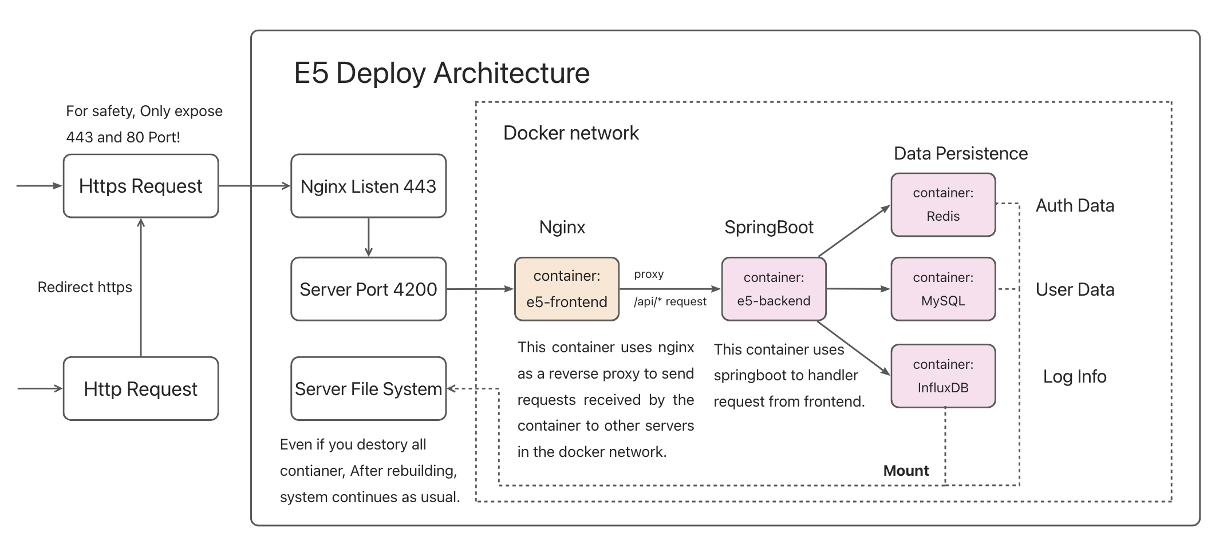
Project Architecture
Before you start, you'd better have a glimpse of the architecture of this project. Take a look of this!

Slide 8

Project Architecture(Nginx)
Nginx(on your host):
Redirect http:80 to https:443
Enable SSL to make your site more safe
Nginx(inside container):
Server frontend context
Proxy `/api/*` request to backend container

Slide 9
Project Architecture(Data)
All data related to your database will mount to your e5-toolkit directory, which named `data`
After you launch your containers, you will find three folders under data folder
MySQL
Influx DB
Redis

Slide 10
Project Architecture(Data)
dev@node-1:~/e5$ tree -L 2
├── config.env
├── data
│ ├── influxdb
│ ├── mysql
│ └── redis
├── doc
│ └── sql(for init db)
├── docker-compose.yml
├── Dockerfile
├── LICENSE
├── logs
│ └── log
Want to move to another server?
Just backup `data` folder
Want to clear all data?
Just remove `data` folder

Slide 11
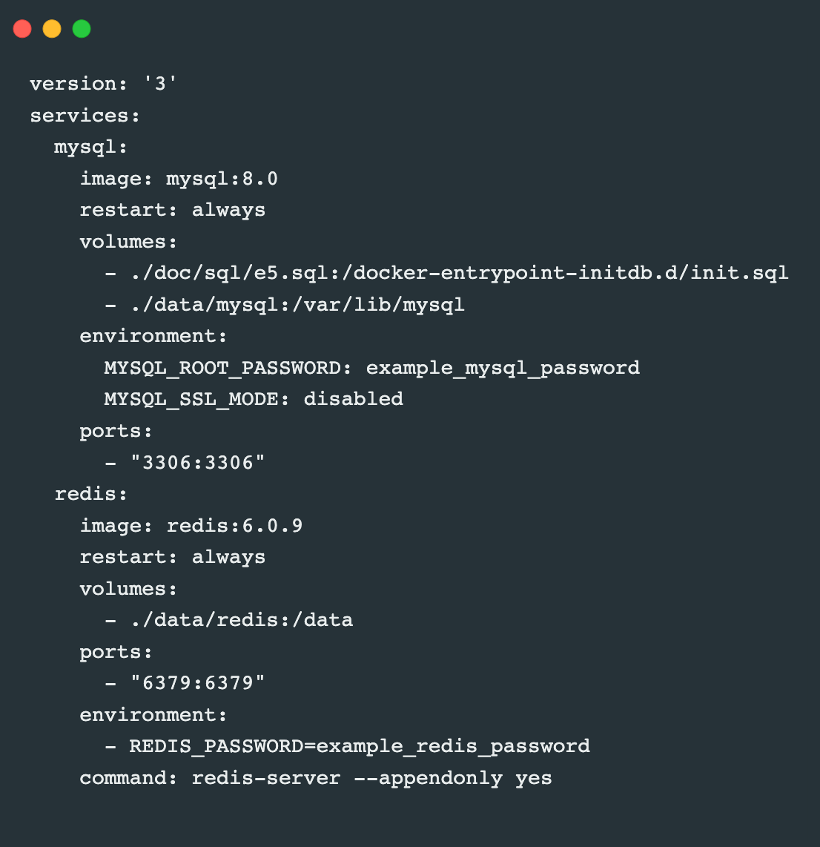
Safety is important !
However, In docker-compose file, I also opened database related ports for debug (Like SQL 3389)
So, If you want to make your SQL or Influx data safer, you need to restrict Safety Groups Or Open Only 443 Port For your data safety. Or you can modify related Password and token, and env file.
The Only needed Ports are :
TCP/443 (https)
TCP/80 (http)

Slide 12
Change Default Password
All password related starts with example_
Like: example_redis_password
Like: example_influxdb_token
How to modify password of token?
Use searching feature of vscode
modify both config.env and docker-compose.yaml

Slide 13
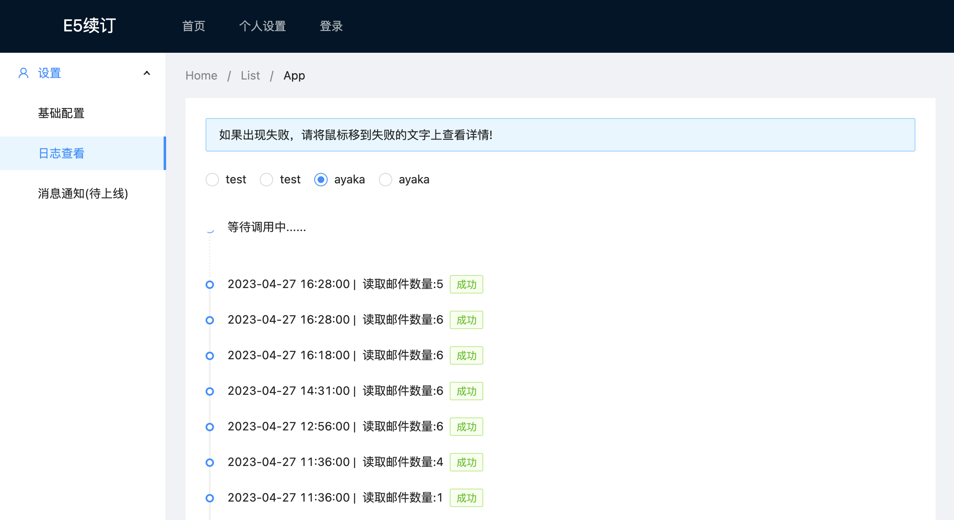
Effect display

Slide 14
Deployment

Slide 15

DEPLOYMENT
Setup Docker And Docker-Compose

Slide 16
Setup Docker
Refer to docker official website
following the instruction from docker official Install Docker Engine on Ubuntu | Docker Documentation
https://docs.docker.com/engine/install/ubuntu/
Commands are attached in following ppts
Run them one by one.

Slide 17
Setup Docker
sudo apt-get remove docker docker-engine docker.io containerd runc
sudo apt-get install ca-certificates curl gnupg
sudo install -m 0755 -d /etc/apt/keyrings curl -fsSL https://download.docker.com/linux/ubuntu/gpg |
sudo gpg --dearmor -o /etc/apt/keyrings/docker.gpg
sudo chmod a+r /etc/apt/keyrings/docker.gpg

Slide 18
Setup Docker
echo \ "deb [arch="$(dpkg --print-architecture)" signed-by=/etc/apt/keyrings/docker.gpg] https://download.docker.com/linux/ubuntu \ "$(. /etc/os-release && echo "$VERSION_CODENAME")" stable" | \
sudo tee /etc/apt/sources.list.d/docker.list > /dev/null
sudo apt-get update
sudo docker run hello-world

Slide 19
Add user to DockerGroup
sudo groupadd docker
sudo usermod -aG docker $USER
newgrp docker
Reboot Your System
docker run hello-world

Slide 20

DEPLOYMENT
Setup Git And Repository

Slide 21
Setup Git and Pull Repo
sudo apt-get update
sudo apt-get install git
git clone https://github.com/Musicminion/e5-toolkit.git ~/e5-toolkit
cd ~/e5-toolkit

Slide 22
DEPLOYMENT
Setup Nginx

Slide 23
Setup nginx
sudo apt-get update
sudo apt-get install nginx-full
sudo service nginx status # check if running
sudo service nginx start # if not running

Slide 24
Modify Nginx Conf
Reposiroty Example config file: e5-toolkit/nginx.conf at main · Musicminion/e5-toolkit (github.com)
Nginx default config file is under /etc/nginx/
You need to put ssl cert under: /etc/nginx/cert
Then Replace All `your.domain.com` to your actual domain name(in example nginx config file)
Finally, copy example nginx.cont to /etc/nginx/nginx.cont
Restart Nginx by running `sudo service nginx restart`

Slide 25
DEPLOYMENT
Setup Env Var

Slide 26
Env var is important!
First, modify config.env file you clone from my repo just now
Running cmd: nano ~/e5-toolkit/config.env
Search for [[[!!!changeIt!!!]]], you will find four in total
Go to New OAuth Application (github.com), following next slide and change your.domain.com to your own domain name.

Slide 27
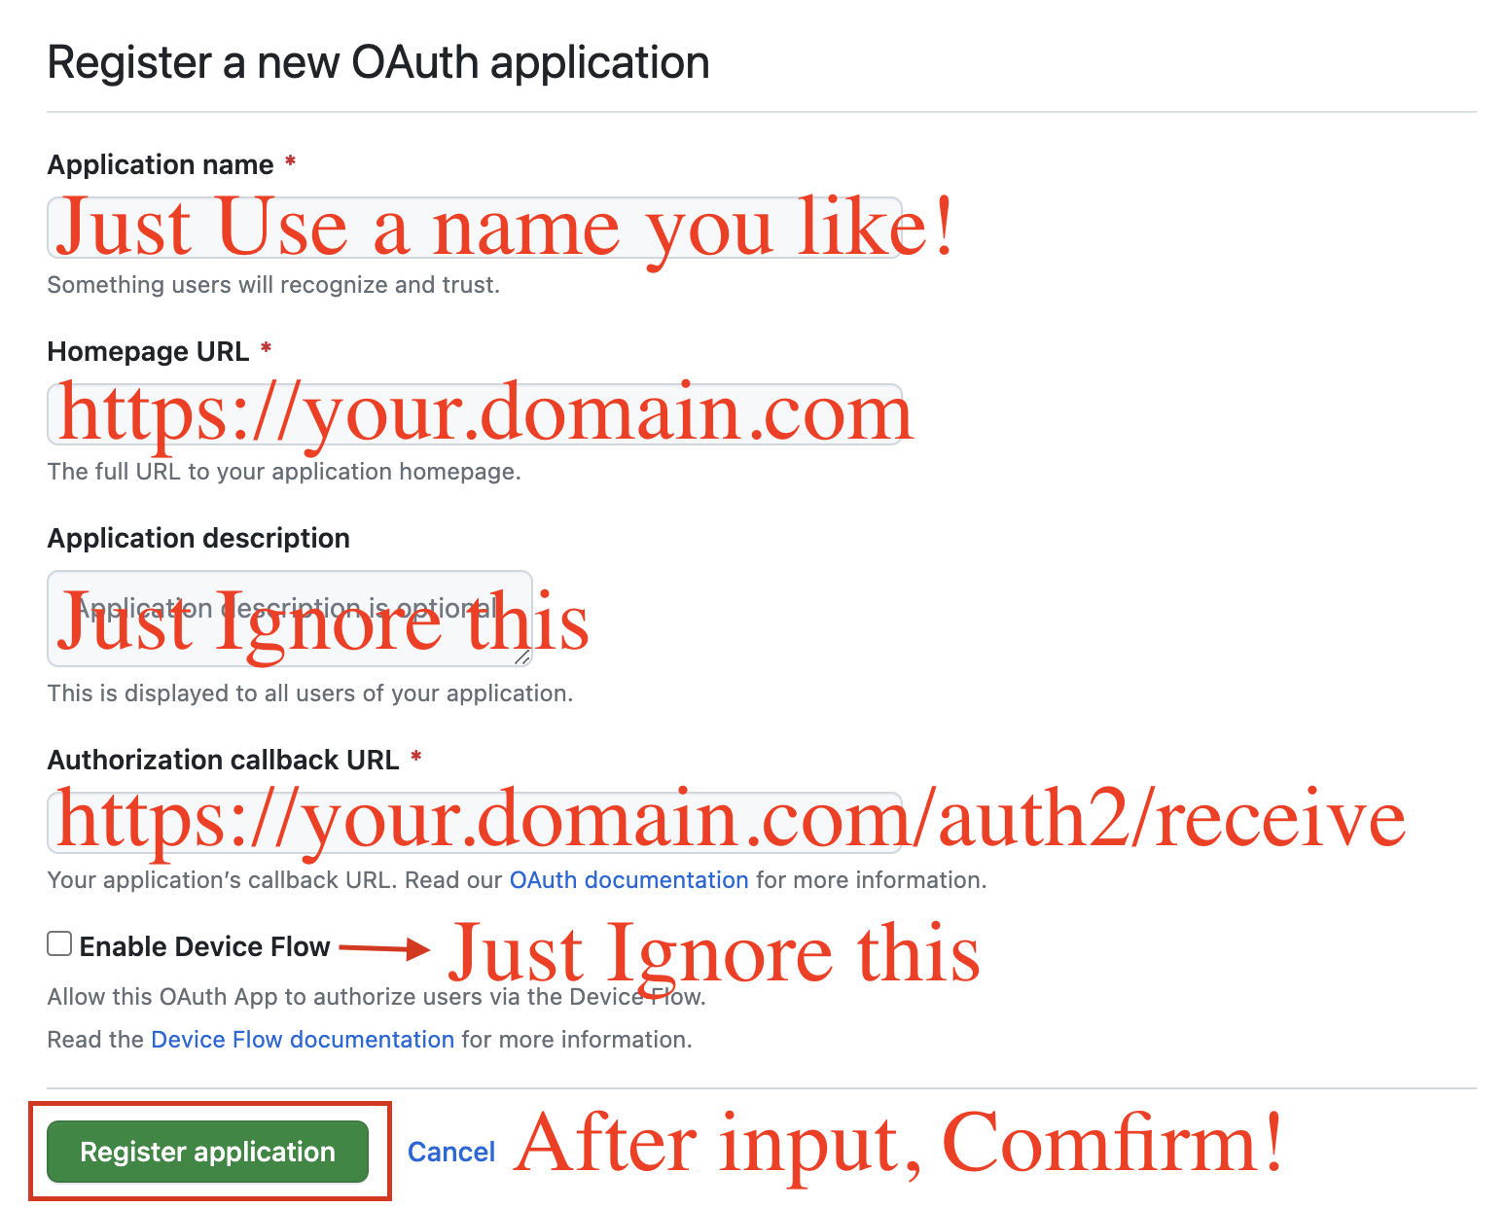
Config Github Oauth
Follow this:

Slide 28
Env Description
After create your OAuth App, you can get its ClientID, and then create your Client secrets
Copy your Client secrets Immediately, since you will never see it any more in latter time
GITHUB_CLIENT_ID: apply from New OAuth Application (github.com)
GITHUB_CLIENT_SECRET: create your OAuth APP and create your secrets
GITHUB_REPLYURL: the same as your input in upper table(Authorization callback url), like https://your.domain.com/auth2/receive
OUTLOOK_REPLYURL: https://your.domain.com/outlook/auth2/%s/receive
Launch and enjoy yourself.

Slide 29
Launch APP
cd ~/e5-toolkit
sudo docker-compose up –d
Wait for a moment, and check your website.

