Slide 1
INDIVIDUAL PROJECT · MUSKAAN MAHADIK · 2026
LightRAG (arXiv 2410.05779) · 16 pages
DocChat
In the ablation study, what is the Overall win rate of the ‑High variant on the CS dataset?
The Overall win rate of the ‑High variant on the CS dataset is 56.0% [S4].
Ask a long research paper anything, through an LLM that can see only 10,000 tokens.
Source: Table 2, ablation
Number found in source ✓
— Parsed on this machine; the LLM gets text only
— Answers cite the page, table or section they came from
— Every model call is measured against the 10K limit
Token ledger
plan 192 prompt + 62 output tokens
answer 5,120 prompt + 145 output tokens
limit 10,000 per call
Notes:
Open with the live demo if the machine is ready: upload the LightRAG PDF and ask this exact question. The answer reads one cell from a table that PDF extraction usually breaks, cites it, and the ledger shows the whole exchange used about half of one 10K window. Then: 'Here is how it got there.'

Slide 2
THE PROBLEM
Two hard limits and one test paper drove the design
The LLM may not parse the document
PDFs are parsed locally with PyMuPDF: reading order, headings, and tables rebuilt from word positions. The LLM only ever receives and returns text.
1
The LLM sees at most 10K tokens per call
One budget gate checks every call before it is sent; real token counts are logged per call and shown under every answer.
2
Test case: a 16-page paper, 1.5× the window
LightRAG (arXiv 2410.05779): summarise it, compare it with GraphRAG, and read its ablation table, every answer cited to the page.
3
How documents longer than the window, and summaries, are handled: slides 5 and 6.
2
Notes:
Each limit maps to one mechanism I can point to in the code and in the UI.

Slide 3
HOW IT WORKS
Parse once, retrieve narrowly, answer inside the budget
Once per
document
Upload
PDF · TXT · MD
Parse locally
no LLM
Document card
title · authors · abstract
Chunks
by section; tables kept whole
Index
keywords + embeddings
Summary notes
map-reduce, when first asked
Every
question
Question
any language
Planner
intent + search queries
Route
question · list · summary · ask back
Evidence
search · rerank · lookup · counts
Budget gate
≤ 10,000 tokens
Answer
streamed, with citations
Amber LLM call (text in, text out) Teal local code or small local models
After every answer, three checks run in code: every cited source must exist, every number must appear in the evidence, and every table number must sit under the row and column it came from. They flag problems under the answer for the reader; they do not rewrite it.
3
Notes:
A normal question costs two LLM calls: a ~200-token planner and the answer. Parsing, embeddings (nomic-embed-text), reranking (bge-reranker-base), lookups, counting and the checks are all local.

Slide 4
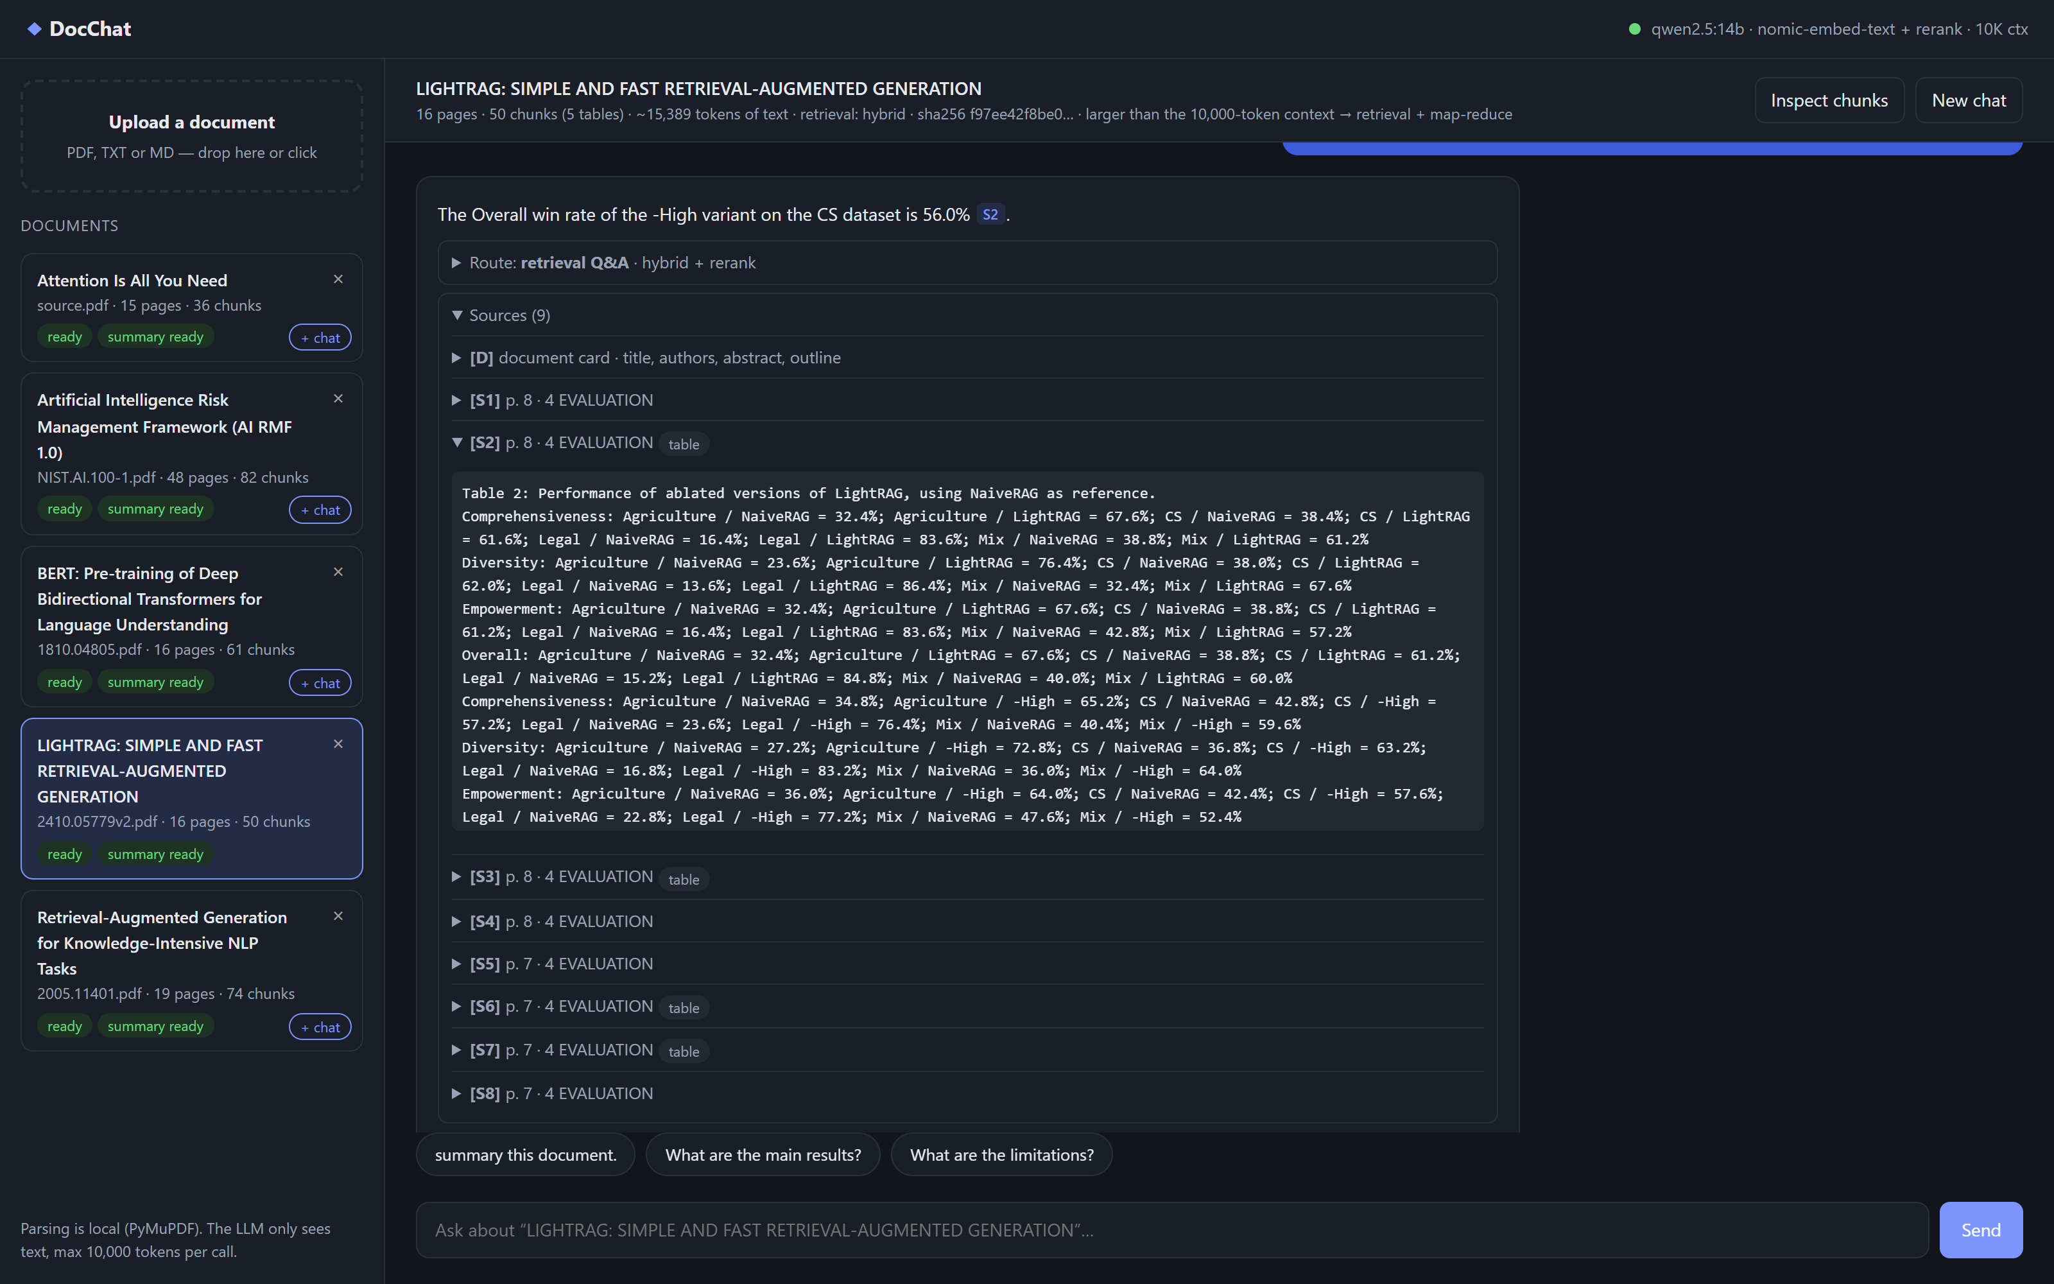
THE PRODUCT
What it looks like: every answer shows its work
1
The answer, with its citation
56.0% [S2]: one cell of the ablation table.
2
Click a citation, see the source
[S2] opens the exact text the model read: Table 2, page 8, rebuilt as "row · column = value".
3
The document's numbers
16 pages, ~15,389 tokens: larger than the 10K window, so it is retrieved, not pasted.
4
Checks and ledger
Under each answer: cited sources exist, numbers found under the right row and column, tokens per call.
Live capture of the local app, qwen2.5:14b
4
Notes:
This is the real app, captured while answering. The left list is the document library; the header shows the paper is bigger than the context, so it goes through retrieval and map-reduce.

Slide 5
DOCUMENTS LONGER THAN THE CONTEXT
A 15K-token paper never meets the 10K window whole
15,389
tokens of text in the LightRAG paper
10,000
• Budget first. 10,000 minus the answer reserve, with a 15% safety margin. A call that would not fit is stopped, never silently cut.
• Retrieve narrowly. Section-aware chunks, keyword + meaning search over several planner queries, then a cross-encoder keeps only clearly relevant passages.
• Tables as compact text. A whole results table fits, and every number keeps its row and column.
• Whole-document questions (summaries, "list all…") read every page in parts: next slide.
tokens the LLM may see in one call
5
Notes:
Median evidence over the 35 benchmark questions is 3,114 tokens including the document card, about a third of the window. The remaining headroom is why answers never need truncation.

Slide 6
HOW THE SUMMARY IS HANDLED
Summaries read every page, in parts that fit
Part 1
≤ 4,000 tokens
Part 2
≤ 4,000 tokens
Part 3
≤ 4,000 tokens
Part 4
≤ 4,000 tokens
• Why: search returns fragments; a summary needs every page.
• Any length: if the notes exceed 5,000 tokens they are condensed again, as many levels as needed.
• Built when asked: on the first summary request, then cached; every later summary is one call.
• Reusable: "key results only" or "用中文總結" reuse the same notes.
Map call → notes
≤ 600 tokens out
Map call → notes
≤ 600 tokens out
Map call → notes
≤ 600 tokens out
Map call → notes
≤ 600 tokens out
Answer call
document card + all notes + your request
LightRAG: 4 map calls of 3,363–4,202 prompt tokens each (17,883 tokens, once); each summary after that is one call of 4,496 tokens (qwen/qwen3.8-27b, final run).
6
Notes:
References are left out of the map step. Each note keeps its page range, so the summary cites [N1] to [N4] and the user can see which part of the paper a sentence came from.

Slide 7
HOW IT GOT BETTER
Release notes: each layer had to earn its place
same coverage, half the reading
34/35
35/35
33/35
33/35
27/35
v0.1 Keyword search
v0.2 + Meaning search
v0.3 + Reranker
v0.4 + Document card
v1.0 + Lookup
BM25
embeddings, fused
local cross-encoder
title, authors, abstract
Table/page lookup, counters
4,808 tokens of evidence
4,979 tokens of evidence
2,363 tokens of evidence
2,998 tokens of evidence
3,114 tokens of evidence
Facts that reached the model's evidence, 35 questions on 4 papers, with each layer switched on in turn (no answer model involved).
7
Notes:
This is the retrieval ablation from the report. Meaning search fixed questions phrased differently from the paper; the reranker halved what the model has to read with no loss; the document card fixed 'who wrote this'; direct lookup fixed 'what is on page 13'. Every layer is a measured step, not a guess.

Slide 8
WHAT IT CAN DO · 1/4
It reads the tables, and it knows the document
T
Reads the right cell
D
Knows what it is reading
Why it's hard a PDF table is just positioned words; one shifted column changes the number.
Why it's hard the author line answers no topic, so search never retrieves it.
In the ablation study, what is the Overall win rate of the ‑High variant on the CS dataset?
Who are the authors?
The Overall win rate of the ‑High variant on the CS dataset is 56.0% [S4].
Zirui Guo, Lianghao Xia, Yanhua Yu, Tu Ao, Chao Huang [D]
How tables are rebuilt from word coordinates and written as "row · column = value", so every number keeps its labels.
How a document card (title, authors, abstract, outline) is built from the layout without an LLM and goes into every call.
Answer from qwen/qwen3.8-27b
Answer from qwen2.5:14b
8
Notes:
Two failures most document chats have: wrong numbers from tables and 'I don't know who wrote this'. [D] in the answer means the fact came from the document card.

Slide 9
WHAT IT CAN DO · 2/4
It counts, and it goes straight to page 13
#
Counts instead of guessing
↗
Goes straight to the place
Why it's hard an LLM cannot count citations across pages it never sees.
Why it's hard "page 13" or "Table 4" means nothing to a search engine.
Which paper is cited the most in this paper?
What is on page 13?
"From local to global: A graph rag approach to query-focused summarization" by Darren Edge et al., which is cited 5 times [R].
Experimental settings, the statistics of the datasets (Table 4), and the prompts used for graph generation (Figure 4) [S1][S2][S4].
How citations are matched to the reference list and terms are counted in code ("GraphRAG": 37 times); the model only reports the result.
How references to a table, figure, section, page, appendix or reference number are resolved directly, in English and Chinese.
Answer from qwen2.5:14b
Answer from qwen2.5:14b, shortened
9
Notes:
Counting and direct lookup are deterministic: code does the part LLMs are bad at, the model writes the sentence.

Slide 10
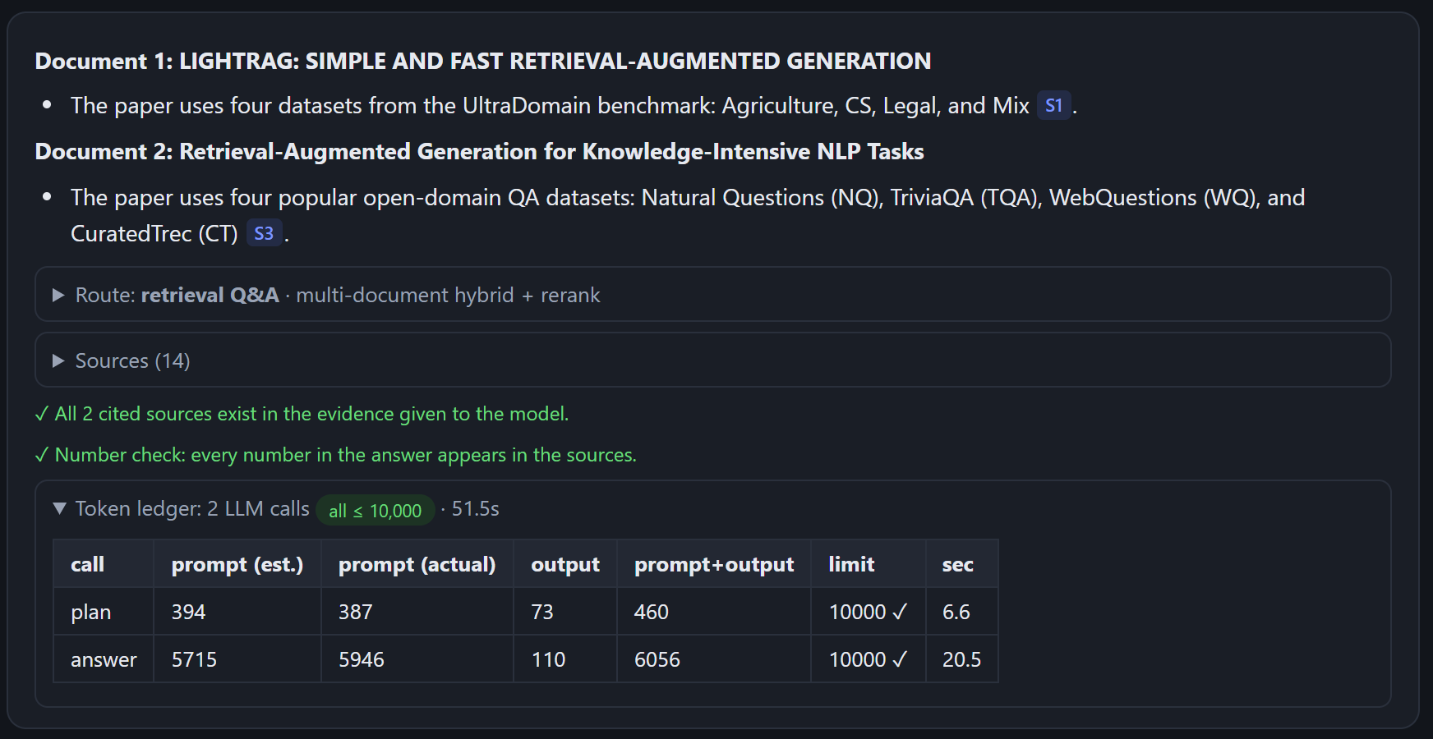
WHAT IT CAN DO · 3/4
It reads across the paper, and across papers
L
Finds every item, not the top five
+
Several papers in one chat
Why it's hard "list all…" needs every page; search returns only the best few passages.
Why it's hard one long paper can crowd the other out of the window.
List all baseline methods LightRAG is compared with.
NaiveRAG · GraphRAG · RQ-RAG · HyDE [L1]–[L4]
How the question is mapped over every part of the paper, each part reports what it contains, and the lists are merged.
How each paper is searched and reranked on its own.
Answer from qwen2.5:14b
Live capture, qwen2.5:14b
10
Notes:
Live demo option: tick '+ chat' on a second paper and ask 'Which datasets does each paper use in its experiments?'. The answer is split by document and each part cites its own source.

Slide 11
WHAT IT CAN DO · 4/4
It holds a conversation, and it pushes back
↩
Follows up
?
Asks back when unclear
And against GraphRAG?
What is its score?
LightRAG outperforms GraphRAG, particularly in larger datasets with complex language contexts… [S4]
The question is ambiguous… The closest related information is the win rates against the baselines in Table 1.
turn 8 of a 12-turn conversation; "it" and "against" are resolved first
it names what it could mean instead of picking one
!
Corrects false premises
中
Answers in your language
Why does LightRAG use reinforcement learning to build its graph?
這篇論文的作者是誰？
The sources do not mention that LightRAG uses reinforcement learning… not supported by the document.
這篇論文的作者是 Zirui Guo, Lianghao Xia, Yanhua Yu, Tu Ao, 和 Chao Huang [S4].
every question is checked against the document before it is answered
search splits Chinese and Japanese text into characters and pairs, so it works without spaces
Answers from qwen2.5:14b (robustness set), shortened with …
11
Notes:
Earlier answers are not fed back into the answer prompt, only earlier questions; that keeps one wrong answer from spreading through a long conversation. Document text is treated as data, so instructions inside a PDF are ignored.

Slide 12
WHAT HAPPENS BEHIND THE ANSWER
One question, peeled back
1
Plan
A small LLM call picks the intent and writes search queries
Token ledger (shown in the UI)
intent: question
“ablation study Overall win rate -High variant CS dataset”
“LightRAG ablation results table CS dataset win rate”
“comparison -High variant performance CS dataset”
Call | Estimated | Actual prompt | Output | Seconds
plan | 189 | 192 | 62 | 0.3
answer | 4,773 | 5,120 | 145 | 21.2
2
Gather
Search every query, rerank, pack within the budget
Table 2 chunk + its caption + the rest of the table · the document card, always
• Largest call: 5,120 of 10,000 tokens
• Estimate vs. provider count: within 8%, covered by the 15% margin
• Same view for every call: plan, map, reduce, answer
3
Answer
Answers from those sources only, with citations
“…the Overall win rate of the ‑High variant on the CS dataset is 56.0% [S4].”
4
Check
Code verifies the answer before it is marked as checked
cited sources exist ✓ · 56.0 appears in the evidence ✓
12
Notes:
This is the exact trace of the opening question. Nothing is hidden: the sources panel shows the text the model saw, the ledger shows what it cost, and the checks run without trusting the model.

Slide 13
RESULTS
Three test questions on the LightRAG paper
Q1
“summary this document.”
Q2
“compare lightRAG with GraphRAG”
Q3
“Performance of ablated versions of LightRAG”
• Structured: gist, problem, method, key results, limitations
• Gist: graph-based text indexing + dual-level retrieval for faster, cheaper, more context-aware RAG [D][N1]
• Exact numbers, e.g. Legal: 84.8% overall win rate vs. NaiveRAG
• Built from 4 map-reduce notes that cover all 16 pages
• Quality: LightRAG wins, most clearly on the large datasets [S4]
• Retrieval cost on Legal: GraphRAG ~610,000 tokens over hundreds of calls; LightRAG < 100 tokens, one call
• Updates: GraphRAG rebuilds its communities; LightRAG merges new graph nodes in
• Method: dual-level (specific + broad) retrieval vs. community reports
Overall win rate vs. NaiveRAG
 | Full | ‑High | ‑Low | ‑Origin
Agri | 67.6 | 64.8 | 65.2 | 74.4
CS | 61.2 | 56.0 | 56.4 | 60.8
Legal | 84.8 | 78.0 | 81.2 | 84.4
Mix | 60.0 | 57.6 | 64.8 | 55.6
Full Table 2 per dataset and dimension for every variant, each value cited and table-checked.
answer call 4,496 · 1 call (+4 map calls once)
answer call 4,785 · 2 calls, 5,310 in all
answer call 6,407 · 2 calls, 6,882 in all
Final run, qwen/qwen3.8-27b (open weights, via Groq; the default). Repeated from fresh uploads: Q3 complete 3/3 (0/3 on the offline qwen2.5:14b). Tokens per call out of 10,000; excerpts.
13
Notes:
Q1 goes through the summary route (map-reduce notes), Q2 and Q3 through retrieval. Q3 needs a whole results table, which is why tables are kept whole with their caption and continuation.

Slide 14
EVALUATION
Measured, not demoed once
35/35
16/18
26/27
questions whose facts reached the evidence
correct answers on an unseen paper
correct answers with qwen/qwen3.8-27b
4 papers, retrieval benchmark
qwen2.5:14b; questions frozen before the run
stricter Q3 check (27/27 as first scored)
7/7
11/12
196/196
confusing questions handled
turns right in a 12-turn conversation
LLM calls within 10,000 tokens
qwen2.5:14b; false premises, injection, off-topic
qwen2.5:14b; follow-ups depend on earlier turns
all qwen2.5:14b runs; largest 6,917
Open models: qwen2.5:14b and qwen/qwen3.8-27b. 0 answers cited a source that does not exist. Questions, expected facts and every run are in evaluation/.
14
Notes:
Development questions were written on four papers; a fifth paper (the original RAG paper) was held out and its questions frozen before the first run. Every number on this slide is read from the result files.

Slide 15
AI-NATIVE PROCESS
How I worked with AI: a loop with guardrails
Guardrails I set so speed did not cost trust
Spec
I wrote the spec and the
binding limits first
• Bias guard as a test. The build fails if a paper-specific name or number appears in the application code.
• Held-out paper. Its questions were frozen before the first run, so tuning could not leak in.
• Every design choice cited. Each feature in the report names the paper and finding behind it.
• Numbers from files. This deck is generated from the evaluation results, not typed in.
• Tests with a fake LLM. 58 offline tests run in CI on every push.
Fix
Build
AI diagnoses first;
I decide the direction
thin slices,
one layer at a time
Measure
Test
benchmark + ablation
after every change
on real papers of new
layouts, not one sample
15
Notes:
Built with Claude Code. My role: decide what to build and in what order, set the guardrails, and judge results against real documents. The AI wrote most of the code and ran the measurements. The collaboration log is in docs/AI_COLLABORATION.md.

Slide 16
INSIGHTS
What I learned working with AI
1
Verification is the real work
2
Measure the cost, not only the score
AI writes plausible code and plausible answers fast. So I built checks that do not trust it: the token ledger, and citation, number and table checks. The table check caught an answer my own string-match scoring had passed.
Reading the token ledgers showed plain questions taking the read-everything route (16–27K tokens). One guard brought them back to about 4K. A per-call limit is not a cost limit.
3
Give the AI a spec and a test, not only a prompt
4
A second opinion is input, not an answer
The 10K rule became a gate and a test; "don't tune to the test paper" became a test that fails the build. Spec first, tests as guardrails, a commit at every checkpoint.
I had other AI models review the project. Each suggestion was checked against the paper, the tests and the rules first; one parser tweak would have fitted this one paper, so I declined it.
5
Honest numbers are part of the product
Scores are reported per model and as first scored; the unseen paper's questions were frozen before the first run. Knowing where it fails is what makes the rest believable.
16
Notes:
These are lessons from this project, each with the evidence behind it. Lesson 3 is spec-driven and test-driven development with checkpoints, applied to AI-assisted coding.

Slide 17
What's next
• Per-passage evidence extraction before answering (PaperQA-style)
• Optional layout model for unusual tables
• Multi-user deployment: auth, job queue, Kubernetes
• More open models on the same benchmark
Good to know
• Text PDFs only: scanned pages would need OCR
• Figures are understood through captions and text
• Free API tier: about 7K input tokens per minute
• Instructions planted in a document are removed or fenced off; new phrasings rely on the model (27B resisted 9/9)
Full ranges and limits: docs/REPORT.md, section 11
Thank you
Demo: run.bat or docker compose up → http://localhost:8000
Notes:
Close on the opening idea: the 10K limit turned out to be a question of choosing what the model reads. Offer to open the token ledger, the sources panel or the evaluation report live.

Slide 18
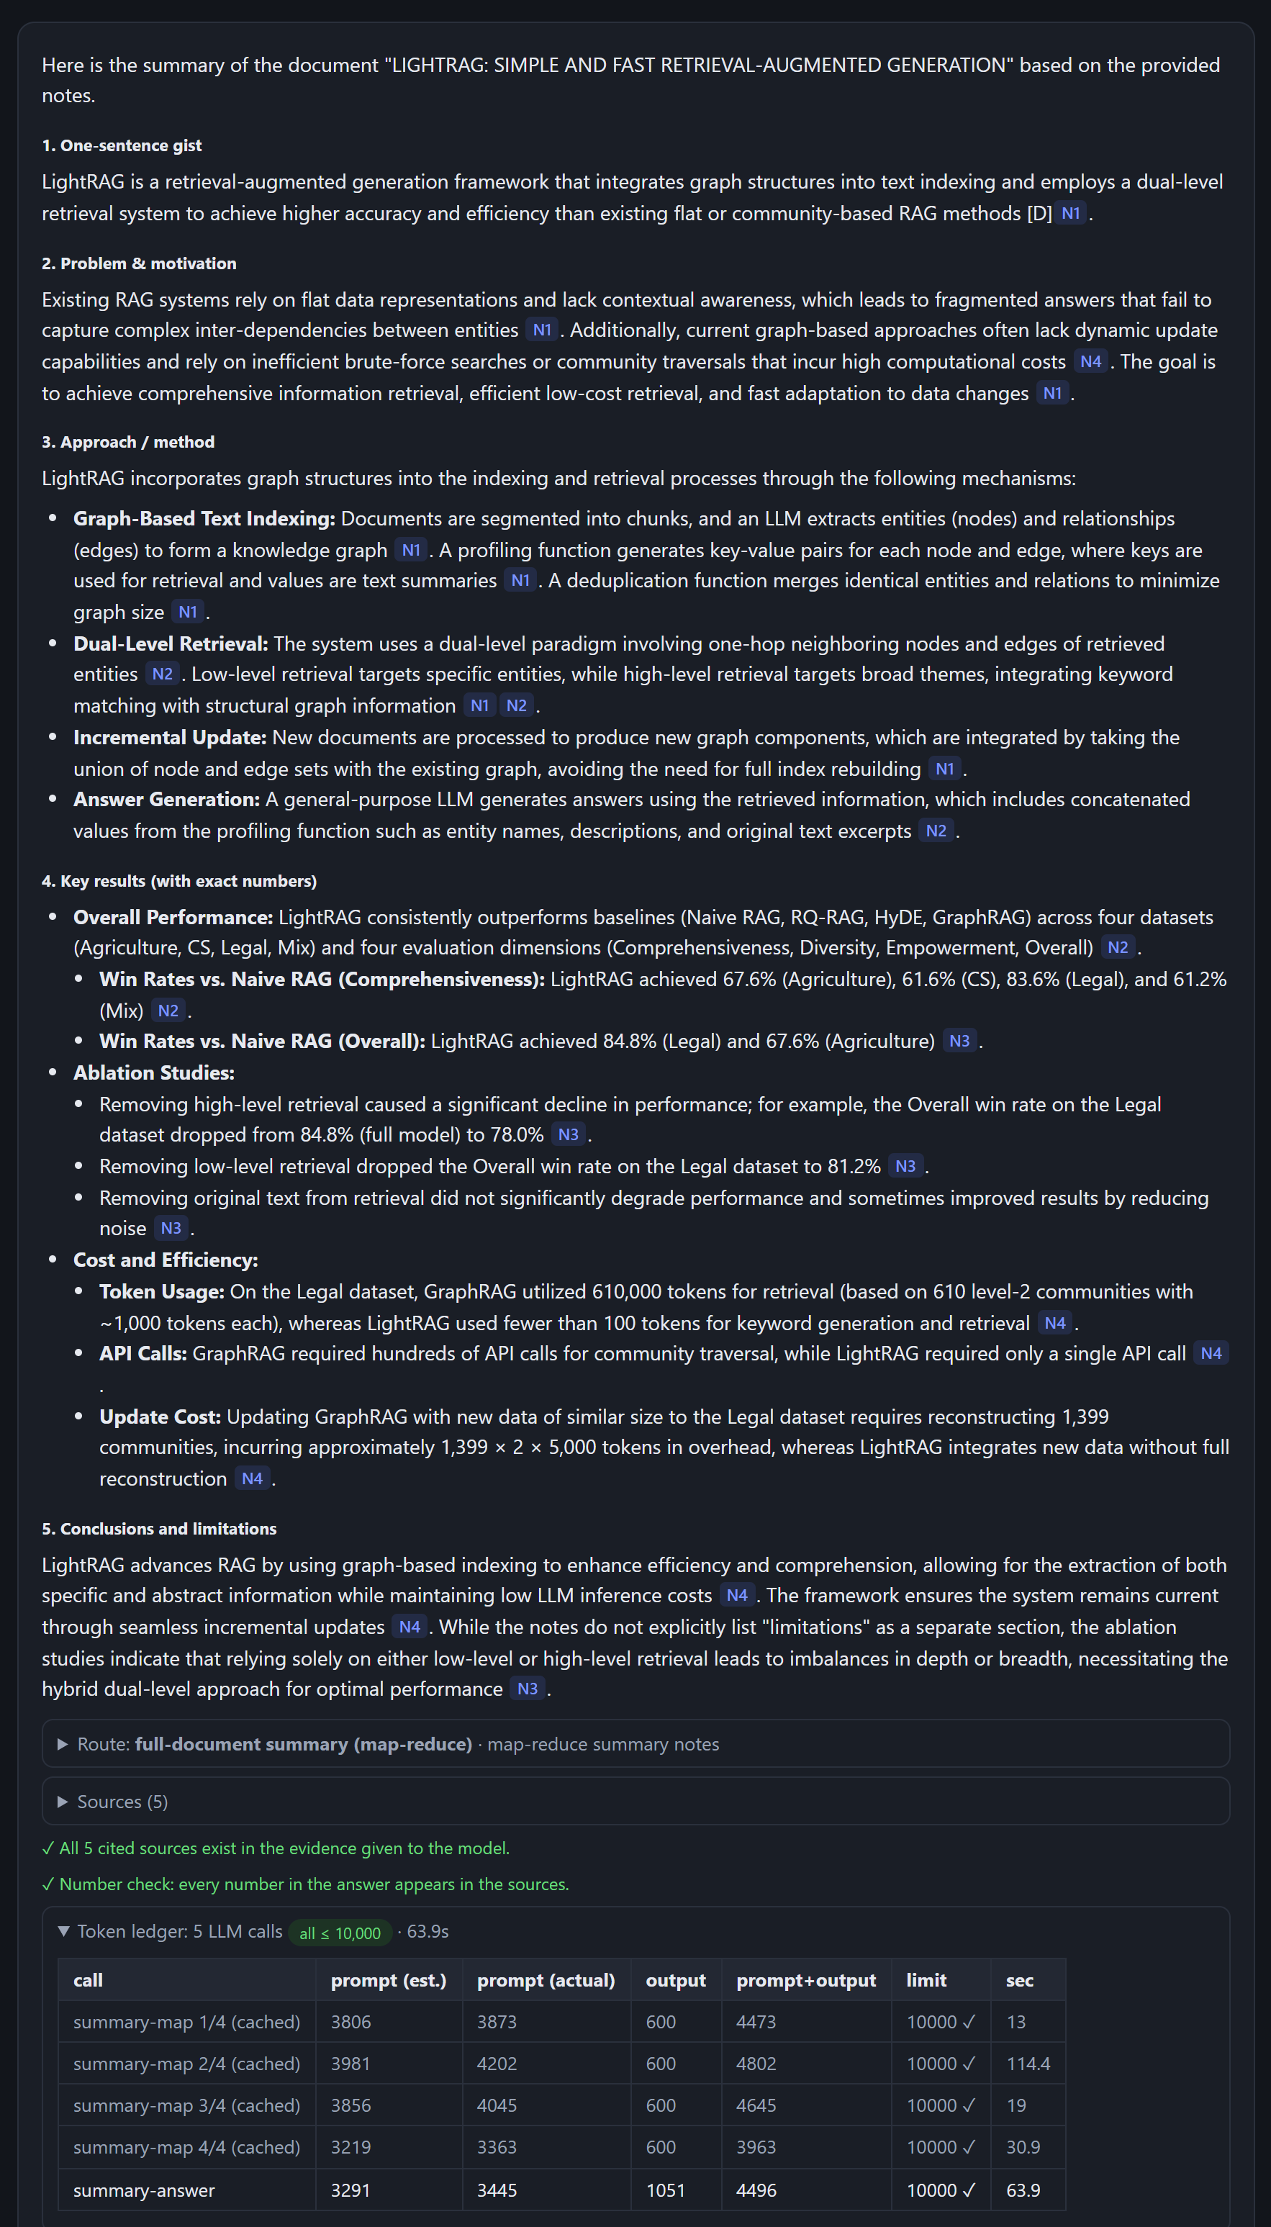
APPENDIX · LIVE ANSWER
Q1 · “summary this document.”
What happened
• Route: full-document summary (map-reduce)
• Calls: 4 map calls (built once, then cached) + 1 answer call; largest 4,802 tokens
• Reads: notes [N1]–[N4] that together cover all 16 pages
• Checks: 5 cited sources exist; every number found in the notes
Live capture of the local app, qwen/qwen3.8-27b via Groq, final code
18
Notes:
Backup slide: the full answer as it appeared in the app, with its checks and token ledger.

Slide 19
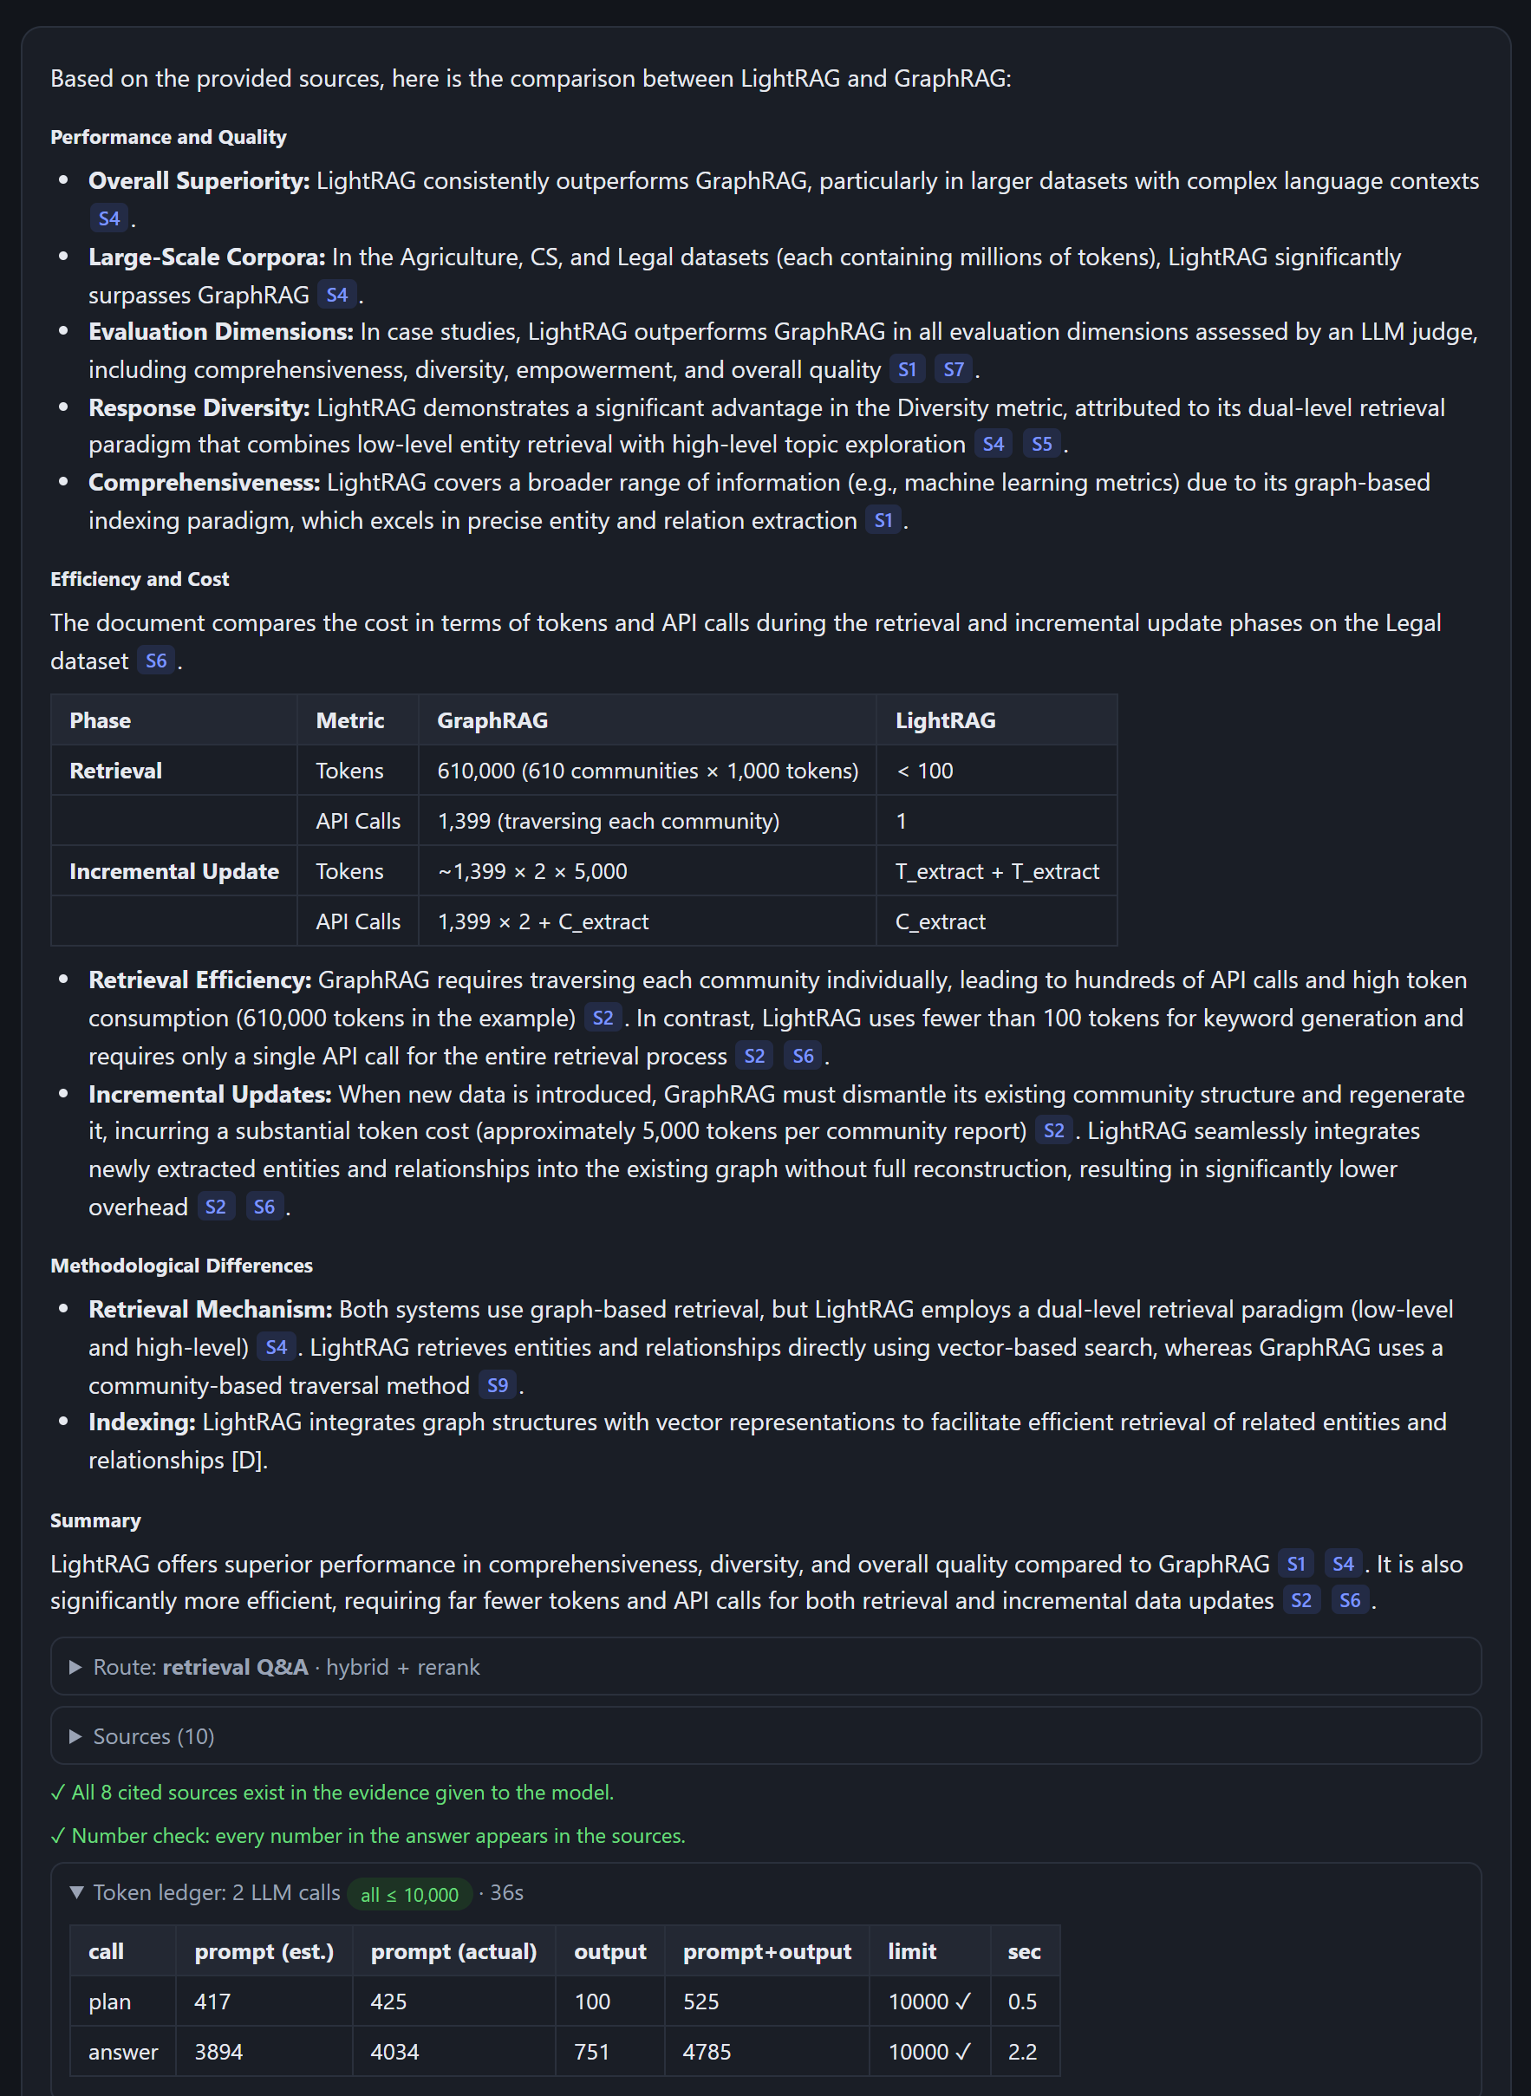
APPENDIX · LIVE ANSWER
Q2 · “compare lightRAG with GraphRAG”
What happened
• Route: retrieval Q&A, hybrid search + rerank
• Calls: planner + answer: 5,310 tokens in total; answer call 4,785
• Covers: quality on large datasets, retrieval and update cost (610,000 vs. < 100 tokens), method differences
• Checks: 8 cited sources exist; every number found
Live capture of the local app, qwen/qwen3.8-27b via Groq, final code
19
Notes:
Backup slide: the full answer as it appeared in the app, with its checks and token ledger.

Slide 20
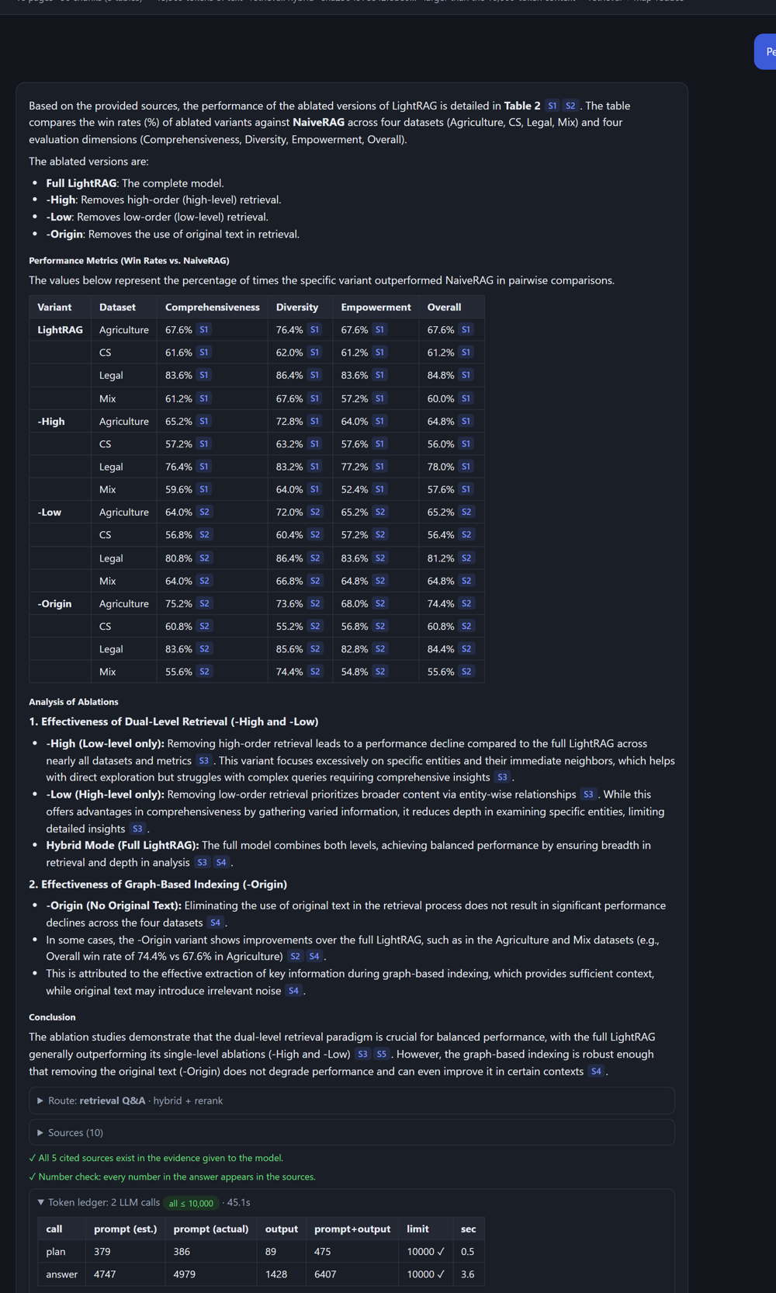
APPENDIX · LIVE ANSWER
Q3 · “Performance of ablated versions of LightRAG”
What happened
• Route: retrieval Q&A; Table 2 retrieved whole with its caption
• Calls: planner + answer: 6,882 tokens in total; answer call 6,407
• Covers: full model, ‑High, ‑Low and ‑Origin × 4 datasets × 4 dimensions, every value cited
• Checks: cited sources exist; every number found; no number under a wrong row/column (table check)
Live capture of the local app, qwen/qwen3.8-27b via Groq, final code
20
Notes:
Backup slide: the full answer as it appeared in the app, with its checks and token ledger.

